Slide 1
Chapter 5 End-To-End Protocols II
Computer Networks: A Systems Approach, Release Version 6.1
Peterson and Davie
November 2019

Slide 2
Sliding Window Protocol
In a sliding window protocol, the window size sets the amount of data that can be sent without waiting for acknowledgment from the receiver
Thus, the receiver throttles the sender by advertising a window (indicates the no. of frame space left in the receiver buffer) no more significant than the amount of data it can buffer.
For example, a 1.5-Mbps BW link with a 45-ms round-trip time (RTT).
Frame size is 1 KB; the sending rate is Bits-Per-Frame / Time-Per-Frame (RTT) = 1024 x 8 / 45ms (0.045) = 182 kbps or about one-eighth of the link’s capacity.
The window size (no. of sending frames) = BW/sending rate
= 1.5x2²⁰/182x2¹⁰ ≈ 8 frames
To use the link fully, the sender should transmit up to eight frames before waiting for an ACK.
Delay x BW product = 45 x 10⁻³ x 1.5 x 10⁶ = 67.5 Kbps = 8.4KB (indicates how many bits can fill on a network link)

Slide 3
Sliding Window Protocol
In TCP’s sliding window protocol, the receiver side must keep (LastByteRcvd – LastByteRead) <= MaxRcvBuffer to avoid overflowing the buffer.
Therefore, the receiver advertises a window size (indicates remaining receiver buffer space):
AdvertisedWindow =
MaxRcvBuffer - ((NextByteExpected - 1) - LastByteRead)
This represents the amount of free space in the receiver’s buffer.
Consider the receiver buffer structure depicted on the next sides; if MaxRcvBuffer = 8, then the AdvertisedWindow = 5
As data arrives, the receiver acknowledges it as long as all the preceding bytes have also arrived.

Slide 4
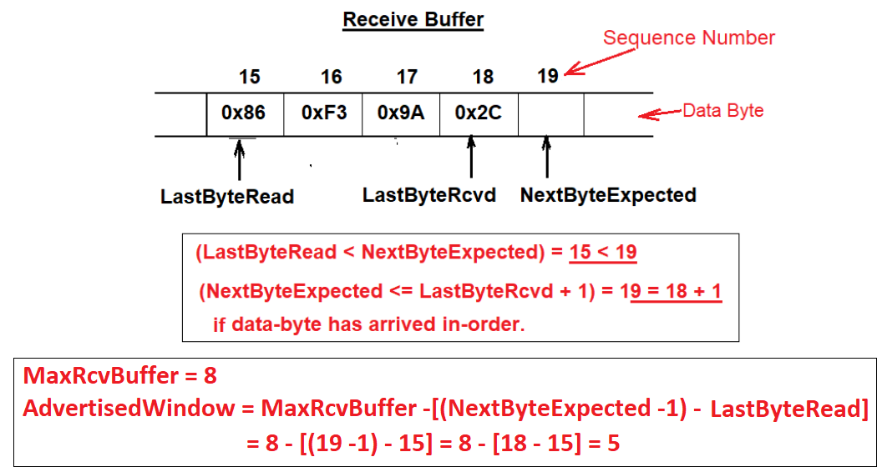
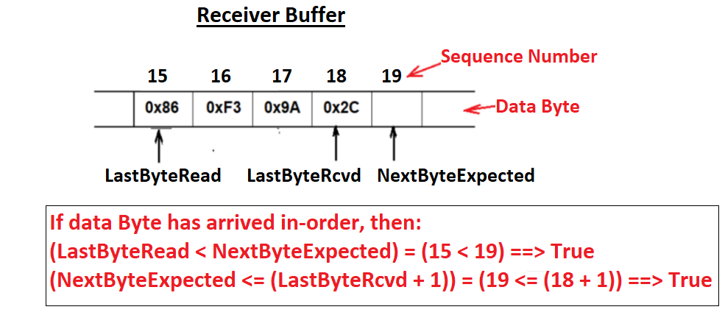
Sliding Window Protocol

Slide 5
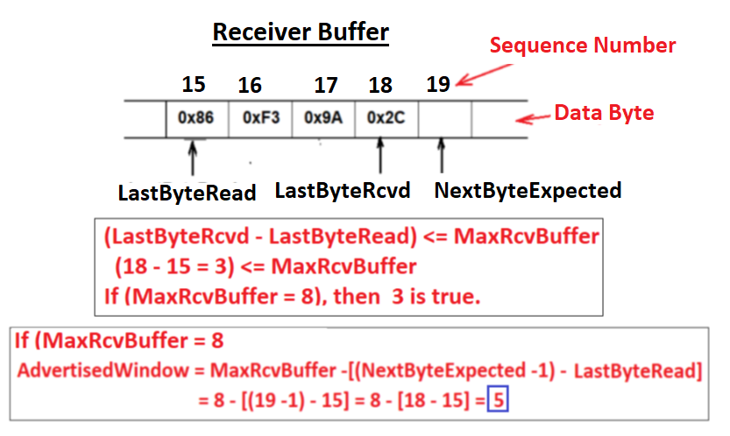
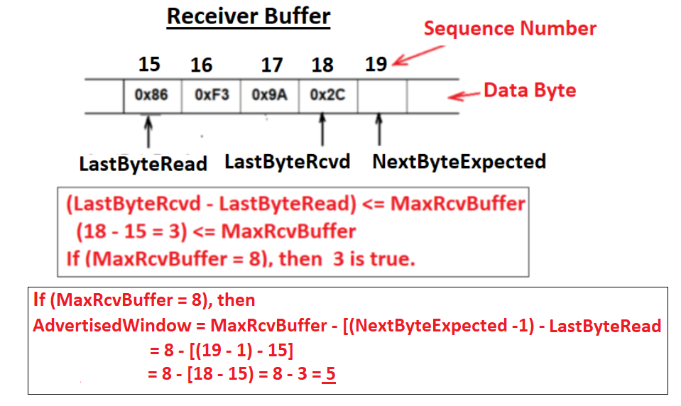
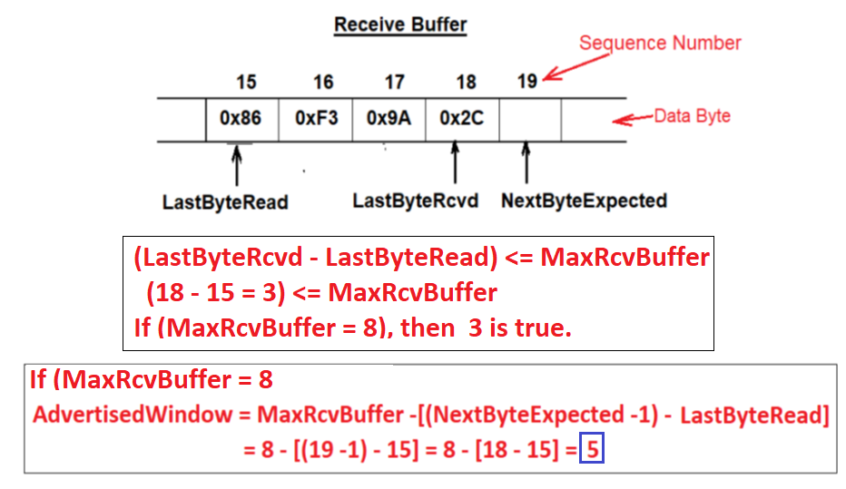
Sliding Window Protocol

Slide 6
Sliding Window Protocol
LastByteRcvd moves to the right (is incremented), meaning that the size of the advertised window shrinks (reduced).
If the local process reads all data from the receive buffer just as fast as it arrives, the advertised window stays open (i.e., AdvertisedWindow = MaxRcvBuffer).
TCP on the sending side must then adhere to the advertised window it gets from the receiver.
On the sending side, at any given time, TCP must ensure that (LastByteSent – LastByteAcked) <= AdvertisedWindow

Slide 7
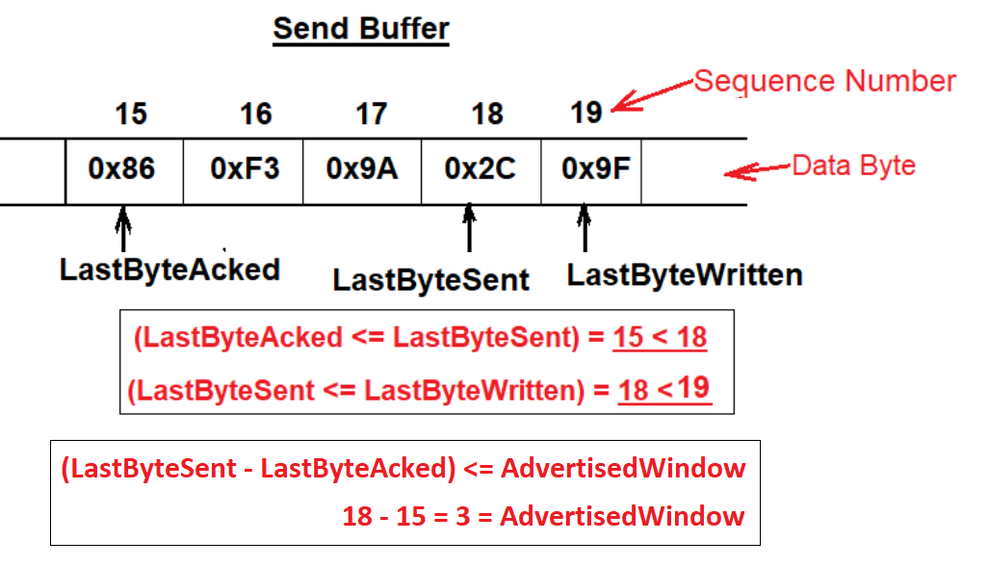
Sliding Window Protocol

Slide 8
Sliding Window Protocol
The sender computes an effective window that limits how much data it can send further to the receiver based on its send buffer:
The size of the EffectiveWindow must be greater than 0 before the sender can send more data.
Assume that the last acknowledge arrived for x bytes, allowing the sender to increment LastByteAcked by x; because the receiving process was not reading any data from its buffer, the advertised window is now x bytes smaller than the time before.
In such a situation, the sender would be able to free buffer space but not send any more data
EffectiveWindow = AdvertisedWindow - (LastByteSent - LastByteAcked)

Slide 9
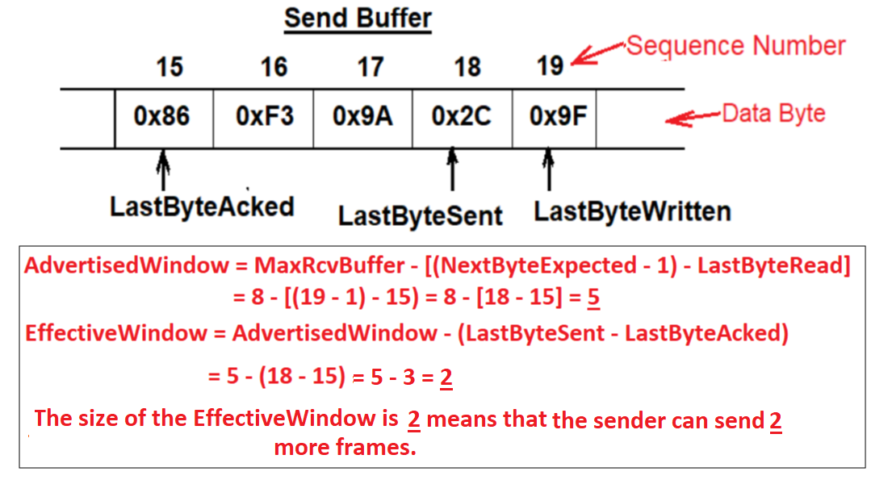

Slide 10
Sliding Window Protocol
The send side also ensures that its local application does not overflow the send buffer:
Assume that the sending process tries to write y bytes to TCP.
If (LastByteWritten - LastByteAcked) + y > MaxSendBuffer, then the TCP blocks the sending process and does not allow it to generate more data.
For example, LastByteWritten = 19, LastByteAcked = 15, y = 5, MaxSendBuffer = 8
It is now possible to understand how a slow receiving process stops a fast sending process.
First, the receive buffer is full, which means the advertised window is 0.
LastByteWritten - LastByteAcked <= MaxSendBuffer

Slide 11
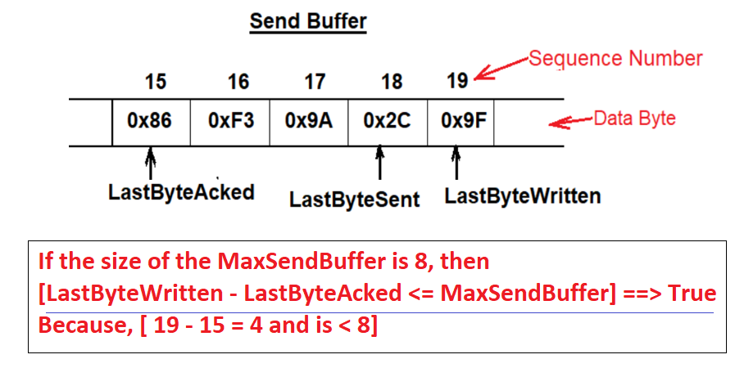
Sliding Window Protocol

Slide 12
Sliding Window Protocol
Receiver Advertised window of size 0 means that the sender cannot transmit any more frames, even though frames it has sent previously been successfully acknowledged.
Not being able to transmit any frames further means that the send buffer is full, which causes TCP to block the sending process.
As soon as the receiving process starts to read data from its buffer, the receive-side TCP can open its window back up, which allows the send-side TCP to transmit the frame out of its filled buffer.
When this frame is acknowledged, LastByteAcked is incremented, the buffer space holding this acknowledged data becomes free, and the sending process is unblocked and allowed to proceed.

Slide 13
Sliding Window Protocol
How does the sending side know that the value of the advertised window is no longer 0?
TCP sends an ACK segment in response to a received data segment.
This response contains the latest values for the Acknowledge and AdvertisedWindow fields, even if they have not changed since the last time they were sent.
The problem is that once the receive side has advertised a window size of 0, the sender is not permitted to send any more data segment/frame;
It has no way to discover that the advertised window is no longer 0 at some time in the future (it must be from the receiver).
TCP on the receive side only sends them in response to an arriving data segment/frame.

Slide 14
Sliding Window Protocol
TCP deals with this situation as follows:
Whenever the receiving side advertises a window size of 0, the sending side keeps sending a segment with 1-byte data.
It knows that this data will probably not be accepted, but it tries because each of these 1-byte segments triggers a response that contains the current advertised window.
Eventually, one of these 1-byte probes triggers a response that reports a non-zero advertised window.
Note that these 1-byte messages are called Zero Window Probes; in practice, they are sent every 5 to 60 seconds.

Slide 15
Sliding Window Protocol
The relevance of the 16-bit AdvertisedWindow field is that it must be big enough to allow the sender to keep the pipe full.
The receiver is free not to open the window as large as the AdvertisedWindow field allows;
We are interested in the situation where the receiver has enough buffer space to handle as much data as the largest possible AdvertisedWindow allows.
In this case, the delay x bandwidth product that dictates how big the AdvertisedWindow field needs to be
The window must be opened far enough to allow a total delay × bandwidth product’s worth of data to be transmitted.
Assuming an RTT of 100 ms, Table 5.2 gives the delay × bandwidth product for several network technologies.

Slide 16
Sliding Window Protocol

Slide 17
Control Flow
How does TCP decide to transmit a segment/frame?
TCP supports a byte-stream abstraction; application programs write bytes into the stream, and it is up to TCP to decide enough bytes to send in a segment.
What factors govern this byte-size decision?
Assume the window is open with a large size when a connection starts first.
TCP has three mechanisms to trigger the transmission of a segment/frame:
First, TCP maintains the maximum segment size (MSS) variable and sends a segment once it has collected MSS bytes from the application process.
MSS is usually set to the size of the largest segment, and TCP can send it without causing local IP data fragmentation.

Slide 18
Control Flow
MSS (maximum Segment size) is set to the network's maximum transmission unit (MTU) minus the size of the TCP and IP headers.
The second thing that triggers TCP to transmit a segment is that:
The sending process has explicitly asked it to do so.
TCP supports a push operation, and the sending process invokes this operation to flush the buffer of unsent bytes effectively.
The final trigger for transmitting a segment is a timer fire;
The resulting segment contains as many bytes currently buffered for transmission.

Slide 19
Silly Window Syndrome
If the sender has to send MSS bytes of data and the sending window is open at least that much, then the sender transmits a whole segment (MSS bytes) to the receiver side.
Suppose the sender accumulates MSS bytes to send, but the receiver window is currently closed for MSS bytes
Suppose an ACK arrives from the receiver enough for the sender to transmit MSS/2 bytes.
Should the sender transmit an MSS/2 segment or wait for the receiver window to open to a full MSS?
Early implementations of TCP decided to transmit a half-full segment (MSS/2) before the receiver window opens for a full MSS bytes reception.
This situation is known as the silly window syndrome.
The silly window syndrome is only a problem when the sender transmits a small segment, or the receiver opens the small window.

Slide 20
Silly Window Syndrome
Figure 5.9 describes a silly window syndrome:
As long as the sender sends MSS segments and the receiver ACKs at least one MSS of data at a time, everything is good (Figure 5.9(a)).
If the receiver reduces the window size, the sender can’t send a full MSS of data.
If the sender sends a smaller MSS segment (called a small container), the receiver will ACK that smaller number of container bytes, and hence, the small container is introduced into the system indefinitely.
This small container is filled and emptied at each end and is never combined with adjacent containers to create larger containers, as in Figure 5.9(b).
This scenario was discovered with early implementations of TCP.

Slide 21
Silly Window Syndrome

Slide 22
Adaptive Retransmission
TCP guarantees reliable data delivery; it retransmits each segment if an ACK is not received in a certain period (called timeout).
TCP sets this timeout as a function of the RTT it expects between the two ends of the connection.
Choosing an appropriate timeout value is not that easy
Especially in the case of RTTs between any pair of hosts on the Internet, as well as the variation in RTT between the same two hosts over time
To address this problem, TCP uses an adaptive retransmission mechanism.

Slide 23
A Simple Timeout Algorithm for TCP
The simple TCP algorithm for timeout estimation:
The idea is to keep an average of the RTT and then compute the timeout as a function of this average RTT.
Every time TCP sends a data segment, it records the sending time.
When an ACK for that segment arrives, TCP reads the time again and then takes the difference between these two times as a SampleRTT.
SampleRTT = (segment sending time - segment ACK arriving time)
TCP then computes an Estimated-RTT as a weighted average between the previous SampleRTT and new SampleRTT:
Estimated-RTT = alpha x SampleRTT_{prev} + (1 - alpha) x SampleRTT_{new}
The parameter alpha smooths the Estimated-RTT and its value between 0.8 and 0.9.
TCP then uses EstimatedRTT to compute the timeout:
TimeOut = 2 x EstimatedRTT

Slide 24
Karn/Partridge Algorithm
The problem with the mentioned simple algorithm was that an ACK does not acknowledge a transmission, but it only acknowledges the receipt of data.
Whenever a data segment is retransmitted, an ACK arrives at the sender; it is impossible to determine if this ACK should be associated with the first or the second transmission of the segment to measure the sampleRTT:
It is necessary to know which transmission to associate with to compute an accurate SampleRTT.
As illustrated in Figure 5.10:
If you assume that the ACK is for the original transmission, but it was really for the retransmission, then the SampleRTT is too large (a);
If you assume that the ACK is for the second transmission, but it was actually for the first, then the SampleRTT is too small (b).

Slide 25
Karn/Partridge Algorithm

Slide 26
Karn/Partridge Algorithm
The solution to this, was proposed in 1987:
Whenever TCP retransmits a segment, it stops taking samples of the RTT; it only measures SampleRTT for segments that have been sent only once.
This solution is known as the Karn/Partridge algorithm after its inventors.
Each time TCP retransmits, it sets the next timeout to be twice the last timeout.
That is, Karn and Partridge proposed that TCP use exponential backoff, similar to the Ethernet.
The motivation for using exponential backoff is simple:
Congestion is the most likely cause of lost segments, meaning that the TCP source should not react too aggressively to a timeout.

Slide 27
Remote Procedure Call (RPC)
A common pattern of communication used by application programs structured as a client/server pair is the request/reply message transaction:
A client sends a request message to a server, and the server responds with a reply message, with the client blocking (suspending execution) to wait for the reply.
Figure 5.13 illustrates the basic interaction between the client and server in such an exchange.

Slide 28
Remote Procedure Call (RPC)

Slide 29
Remote Procedure Call (RPC)
One of the request/reply paradigms of the transport protocol, called Remote Procedure Call (RPC), more closely matches the needs of an application involved in a request/reply message exchange.
RPC is not technically a protocol
It is better considered a general mechanism for structuring distributed systems.
RPC is popular because it is based on the semantics of a local procedure call
The application program makes a call into a procedure without regard for whether it is local or remote and blocks it until the call returns.
When the procedures being called are methods of remote objects in an object-oriented language, RPC is known as remote method invocation (RMI).

Slide 30
Remote Procedure Call (RPC)
While the RPC concept is simple, two main problems make it more complicated than local procedure calls:
The network between the calling process and the called process has much more complex properties than the backplane of a computer.
For example, it is likely to limit message sizes and tends to lose and reorder messages.
The computers on which the calling and called processes run may have different architectures and data representation formats.

Slide 31
Remote Procedure Call (RPC)
A complete RPC mechanism involves two major components:
A protocol that manages the messages sent between the client and the server processes and that deals with the properties of the underlying network.
Programming language and compiler support to package the arguments into a request message on the client machine and then translate this message back into the arguments on the server machine, and likewise with the return value (this piece of the RPC mechanism is called a stub compiler).
Figure 5.14 depicts what happens when a client invokes a remote procedure.
First, the client calls a local stub for the procedure, passing it the arguments required.
This stub hides the fact that the procedure is remote by translating the arguments into a request message and then invoking an RPC protocol to send the request message to the server machine.

Slide 32
Remote Procedure Call (RPC)

Slide 33
Remote Procedure Call (RPC)
At the server, the RPC protocol delivers the request message to the server stub, which translates it into the arguments to the procedure and then calls the local procedure.
After the server procedure completes, it returns in a reply message that it hands off to the RPC protocol for transmission back to the client.
The RPC protocol on the client passes this message up to the client stub, which translates it into a return value that it returns to the client program.

Slide 34
Remote Procedure Call (RPC)
Two functions that any RPC protocol must perform are:
Provide a namespace for uniquely identifying the procedure to be called.
Match each reply message to the corresponding request message.
RPC protocols often perform two additional functions to deal with networks:
Provide reliable message delivery
Support large message sizes through fragmentation and reassembly
An RPC protocol might “define this problem away” by choosing to run on top of a reliable protocol like TCP
The RCP protocol implements its reliable message delivery layer on top of an unreliable substrate (e.g., UDP/IP).
Such an RPC protocol would likely implement reliability using acknowledgments and timeouts, similar to TCP.

Slide 35
Remote Procedure Call (RPC)
The primary RPC transaction is illustrated by its timeline in Figure 5.15.
The client sends a request message, and the server acknowledges it.
Then, after executing the procedure, the server sends a reply message, and the client acknowledges the reply.

Slide 36
Remote Procedure Call (RPC)
To account for the possibility of losing either request or reply messages or ACK messages, both client and server save a copy of each message they send in a buffer until an ACK has arrived.
Each side also sets a RETRANSMIT timer and resends the message should this timer expire.
Both sides reset this timer and try again the agreed-upon number of times before giving up and freeing the message.
If an RPC client receives a reply message, the server must receive the corresponding request message.
Similarly, a request message could implicitly acknowledge the preceding reply message
Assuming the protocol makes request-reply transactions sequential, one transaction must be complete before the next begins.

Slide 37
Synchronous vs. Asynchronous Protocols
One way to characterize a protocol is by whether it is synchronous or asynchronous.
At the transport layer, it is most accurate to think of them as defining the extremes of a spectrum rather than as two mutually exclusive alternatives.
The key attribute of any point along the spectrum is how much the sending process knows after the operation to send a message.
In other words, if we assume that an application program invokes a send operation on a transport protocol, how does the application know about the operation’s success when the send operation returns?

Slide 38
Synchronous vs. Asynchronous Protocols
At the asynchronous end of the spectrum, the application knows nothing when sending returns.
Not only does it not know if the message was received by its peer, but it doesn’t even know that the message has successfully left the local machine.
At the synchronous end of the spectrum, the send operation typically returns a reply message.
That is, the application not only knows that the message it sent was received by its peer but also that the peer has returned an answer.
Thus, synchronous protocols implement the request/reply abstraction,
Asynchronous protocols are used if the sender wants to be able to transmit many messages without having to wait for a response.
Using this definition, RPC protocols are usually synchronous protocols.

Slide 39
Transport for Real-Time (RTP)
Voice over IP (VoIP) is a classic example of a real-time application
because you can’t easily carry on a conversation with someone if it takes more than a second to get a response.
Multimedia applications, including those that involve video, audio, and data, are sometimes divided into two classes:
interactive applications and streaming applications.
Figure 5.23 shows the authors using an example conferencing tool typical of the interactive class.
Along with VoIP, these applications have the most stringent (strongest) real-time requirements.

Slide 40
Transport for Real-Time (RTP)

Slide 41
Transport for Real-Time (RTP)
Streaming applications typically deliver audio or video streams from a server to a client and are typified by such commercial products as Spotify.
Streaming video, typified by YouTube and Netflix, has become one of the dominant forms of traffic on the Internet.
Because streaming applications lack human-to-human interaction, they place somewhat less stringent real-time requirements on the underlying protocols.
Timeliness is important, for example, you want a video to start playing soon after pushing “play,” and once it starts to play, late packets will either cause it to stall or create some sort of visual degradation.

Slide 42
Transport for Real-Time (RTP)
It should be apparent that designers of a transport protocol for real-time and multimedia applications face a real challenge in broadly defining the requirements to meet the needs of very different applications.
They must also pay attention to the interactions among different applications, such as the synchronization of audio and video streams.
The real-time transport protocol used today is the Real-time Transport Protocol (RTP).

Slide 43
Transport for Real-Time (RTP)
Much of RTP derives from protocol functionality originally embedded in the application.
RTP can run over many lower-layer protocols but still commonly runs over UDP.
That leads to the protocol stack shown in Figure 5.24.
Figure shows running a transport protocol (RTP) over another (UDP) protocol.
There is no rule against that, and it makes a lot of sense since UDP provides such a minimal level of functionality, and the basic demultiplexing based on port numbers is just what RTP needs as a starting point.
So, rather than recreate port numbers in RTP, RTP outsources the demultiplexing function to UDP.

Slide 44
Transport for Real-Time (RTP)

