Slide 1
Business Data Communications
Fourteenth Edition
Jerry FitzGerald, Alan Dennis, and Alexandra Durcikova
Chapter 11
Network Security

Slide 2
Learning Objectives
Be familiar with the major threats to network security
Be familiar with how to conduct a risk assessment
Understand how to ensure business continuity

Slide 3
Introduction
Businesses and the government have always been concerned with information security.
With the Internet, companies face global threats to their networks and, more importantly, to their data
Malware has long been a problem
Malware such as viruses and ransomware has long been a problem
Ransomware is a widespread problem in which criminals gain access to computer servers, lock them out, and demand payment in exchange for access
Credit card theft and identity theft are fast-growing
Computer security has become increasingly important with the Sarbanes-Oxley Act (SOX) and the Health Insurance Portability and Accountability Act (HIPAA)
A company of any size can be the target of a cyberattack
These incidents included malware such as viruses, industrial espionage, fraud, extortion (ransomware), and identity theft.

Slide 4
Introduction
Many private and public organizations focus on helping individuals, organizations, and governments protect themselves from criminals operating on the Internet (cyber criminals).
These attacks are called targeted attacks, in which cybercriminals try to exploit technical vulnerabilities and “hack the human” via social engineering or phishing emails.
Hacktivism (hacking techniques to bring attention to a larger political or social goal) has become more common
usually targets large organizations and governments by sabotaging or defacing their public websites to bring attention to the hackers’ social or political cause.
For example, the Anonymous group has taken down websites owned by Visa and MasterCard to protest their denial of payments to WikiLeaks.

Slide 5
Three Main Reasons for an Increase in Computer Security
In the past, hacking into somebody’s computer was considered to be a hobby, but today, being a cybercriminal is a profession
Hacktivism (the use of hacking techniques to bring attention to a larger political or social goal) has become more common
The increase in mobile devices offers a very fertile environment for exploitation
Protecting customer privacy and the risk of identity theft also drive the need for increased network security

Slide 6
Why Networks Need Security
Most organizations today have become increasingly dependent on data communication networks for their daily business communications, database information retrieval, distributed data processing, and the internetworking of LANs.
The rise of the Internet has significantly increased the potential vulnerability of the organization’s assets.
Emphasis on network security also has increased due to well-publicized security break-ins and as government regulatory agencies have issued security-related pronouncements.
The losses associated with security failures can be huge.
As organizations have come to depend on computer systems, computer networks have become “mission-critical.”
Bank of America, one of the largest banks in the United States, estimates that it would cost the bank $50 million if its computer networks were unavailable for 24 hours.

Slide 7
Types of Security Threats
There are three primary goals in providing computer security:
Confidentiality: The protection of organizational data from unauthorized disclosure of customer and data
Integrity: The assurance that data have not been altered or destroyed
Availability: Providing continuous operation of the organization’s hardware and software
Security Threats can be classified into two broad categories:
Ensuring business continuity refers primarily to ensuring availability, with some aspects of data integrity
Three main threats are the loss of or reduction in network services are disruptions, destruction, and disaster
Preventing unauthorized access (intrusion) refers primarily to confidentiality but also integrity, as an intruder may change important data
Intrusion is viewed as external attackers gaining access to organizational data files and resources across the Internet.

Slide 8
Network Controls
Developing a secure network means developing network controls:
Network Controls are software, hardware, rules, or procedures that reduce/eliminate the threats to network security
Three types of network controls:
Preventive controls mitigate or stop a person from acting or an event from occurring
For example, a password can prevent illegal entry into the system, or a set of second circuits can prevent the network from crashing.
Detective controls reveal or discover unwanted events
For example, software that looks for illegal network entry can detect these problems.
Corrective controls remedy an unwanted event or an intrusion
For example, the software can recover and restart the communication circuits automatically when a data communication fails.
Network Controls must be reviewed periodically

Slide 9
Risk Assessment
The first step in developing a secure network is to conduct a risk assessment
Commonly used risk assessment frameworks that provide strategies for analyzing and prioritizing security risks to computer networks are:
Operationally Critical Threat, Asset, and Vulnerability Evaluation (OCTAVE)
Control Objectives for Information and Related Technology (COBIT)
Risk Management Guide for Information Technology Systems (NIST guide)
The five standard steps to risk assessment are:
Develop risk measurement criteria
Inventory IT assets
Identify threats
Document existing controls
Identify improvements

Slide 10
Develop Risk Measurement Criteria
Risk measurement criteria are the measures used to evaluate the way a security threat could affect the organization
Each organization needs to develop the following set of potential business impacts:
Financial (revenues and expenses)
Productivity
Reputation
Safety
Legal
Figure 11-1 has sample risk measurement criteria for a Web-based bookstore.
As you can see, only four of the impact areas apply to this company because information systems and network security problems would not harm the safety of employees or customers.

Slide 11
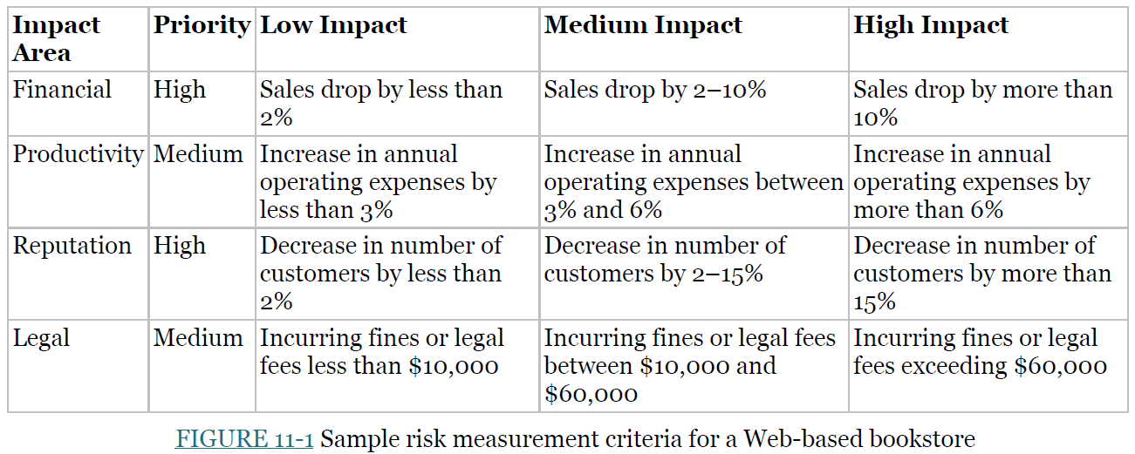
Develop Risk Measurement Criteria

Slide 12
Inventory IT Assets
An asset is something of value and can be either hardware, software, data, or applications
Figure 11-2 defines six common categories of IT assets.
The first essential type of asset is the mission-critical application
It is an application that cannot be permitted to fail, and if it fails, the network staff drops everything else to fix it.
For example, the website is a mission-critical application for an Internet bank with no brick-and-mortar branches (Brick-and-mortar or B&M is an organization or business with a physical presence in a building or other structure).
The next most important type of asset is the organization’s data
Suppose someone were to destroy all the student records at your university so that no one would know what courses anyone had taken or their grades.
Once all assets are identified, they need to be rated for importance
Figure 11-3 summarizes some typical assets found in most organizations.

Slide 13
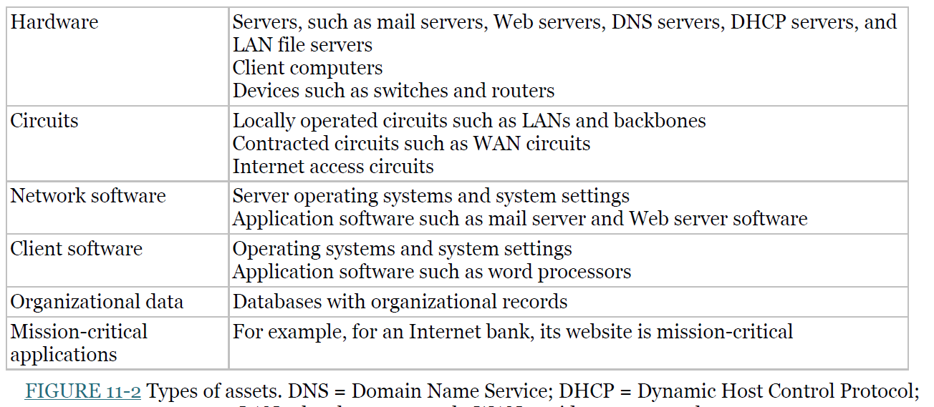
Inventory IT Assets

Slide 14
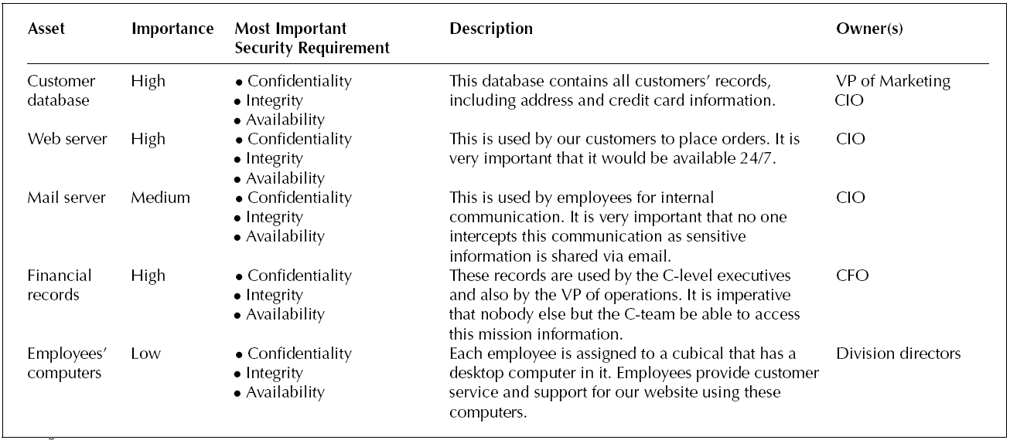
Inventory IT Assets
Figure 11-3 summarizes some typical assets found in most organizations

Slide 15
Identify Threats
A threat is any occurrence that can harm or interrupt the systems using the network or cause a potential loss to an organization
Figure 11-4 summarizes the most common types of threats and their likelihood of occurring based on several surveys in recent years.
For example, 100% of companies reported experiencing one or more malware attacks, such as viruses or ransomware, but their antivirus software prevented any problems in most cases.
Another common threat is information theft, whether by phishing (the attacker sends an email to trick employees into revealing their passwords) or other means, such as via a security hole or social engineering.
The actual probability of a threat to your organization depends on the nature of your business
The next step is to create threat scenarios

Slide 16
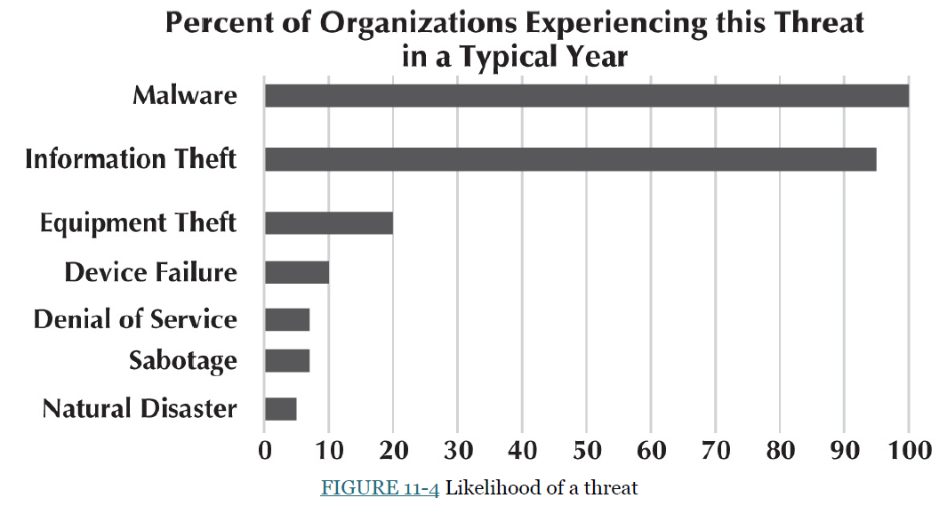

Slide 17
Threats Scenarios
A threat scenario describes how an asset can be compromised by one specific threat.
Multiple threats can compromise an asset, so having more than one threat scenario for each asset is common
For example, the confidentiality, integrity, and availability of the client data database in Figure 11-3 can be compromised by an attacker stealing information (affect confidentiality), an attacker changing information (affect integrity), or destroying information (affect availability).
When preparing a threat scenario, we name the asset, describe the threat, explain the consequence (violation of confidentiality, integrity, or availability), and estimate the likelihood of this threat happening (high, medium, or low).

Slide 18
Document Existing Controls
The risk control strategy is the way an organization intends to address a risk
There are four ways an organization can address its risks:
If an organization decides to accept a risk, it means the organization will be taking no action to address it and accept the consequences
These risks have a very low impact on the organization.
Risk mitigation involves the implementation of some control to counter the threat or to minimize the risk impact
An organization can implement antivirus software, state-of-the-art firewalls, or provide employee security training.
An organization can share the risk, typically by buying insurance.
The organization can defer (block) the risk, which usually happens when there is a need to collect additional information about the threat and the risk
These risks are usually not imminent (serious) and would not significantly impact the organization if they were to occur.

Slide 19
Identify Improvements
The first step in risk assessment is to identify what improvements are needed
Most organizations face so many threats that they cannot afford to mitigate all of them
They need to focus first on the highest risks: The threat with the highest risk scores is carefully examined to ensure at least a medium level of control adequacy.
The most important assets’ security requirements (labeled as high in Figure 11-3) are adequately protected.
The second focus is on threat scenarios whose mitigation controls have low adequacy
These will all be low-risk threats, but they are examined to ensure the expenditure level matches the risk level.

Slide 20
Ensuring Business Continuity
Business continuity means that the organization’s data and applications will continue to operate even in the face of disruption, destruction, or disaster
A business continuity plan has two major parts:
The development of controls that will prevent these malicious events from significantly impacting the organization.
A disaster recovery plan that will enable the organization to recover if a disaster occurs

Slide 21
Five Major Threats to Business Continuity
The five major network threats to business continuity are:
Viruses
Theft
Denial of service (DoS) attacks
Device failure
Disaster

Slide 22
Virus Threat
Special attention must be paid to preventing malware such as computer viruses and ransomware
Most malware attaches itself to other programs or USB drives
As those files execute or the USB is accessed, the malware spreads.
Ransomware can cause widespread destruction (it is a widespread problem in which criminals gain access to computer servers, lock them out, and demand payment in exchange for access)
Macro viruses can spread when an infected file is opened
Viruses that are contained in documents, emails, or spreadsheet files
A worm is a particular type of virus that spreads itself without human intervention
A worm copies itself from computer to computer.
Worms spread when they install themselves on a computer and then send copies of themselves to other computers, sometimes by email or via software security holes.
Malware is often spread by downloading files from the Internet
, e.g., music, videos, screen savers
Installing antivirus software prevents the spread of viruses.

Slide 23
Denial-of-Service Attack
With a denial-of-service (DoS) or distributed DoS (DDoS) attack, an attacker attempts to disrupt the target by flooding it with messages
To flood a Web server, DNS server, mail server, and so on with incoming messages.
Some DDoS attacks have sent more than one billion packets per second to the target machine
It is possible to filter out all the messages from the source IP before they reach the targeted machine.
But most attackers use tools that enable them to put false source IP addresses on the incoming messages, making it difficult to recognize a message as a real or a DoS message.
With a DDoS attack, the attacker breaks into and takes control of thousands of computers or smart devices and plants software on them called a DDoS agent
The attacker then uses a DDoS handler to control the DDoS agent. The DDoS handler issues instructions to the computers under the attacker’s control (see Figure 11-7).

Slide 24
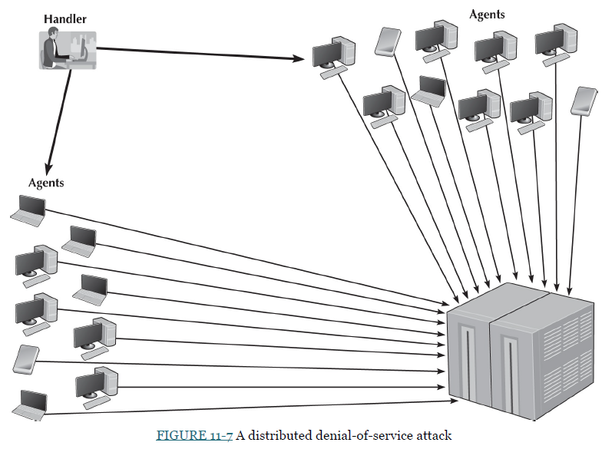

Slide 25
Preventing DoS and DDoS Attacks
The following three approaches are preventing DoS and DDoS attacks:
The first is to configure the main router that connects your network to the Internet to verify that the source address of all incoming messages is in a valid address range for that connection, called traffic filtering
For example, if an incoming message has a source address inside your network, it is false. This ensures that only messages with valid addresses are permitted into the network
The second approach is to configure the main router (or firewall) to limit the number of incoming packets that could be DoS/DDoS attack packets that it allows to enter the network, Called traffic limiting
Even though some packets are legitimate packets, a flood of such packets indicates a DoS/DDoS attack.
So discarding packets over a certain number that arrive each second can reduce the DoS/DDoS attack’s impact.
The disadvantage is that some valid packets from regular customers will be discarded during the traffic limiting.

Slide 26
Denial-of-Service Protection
The third and more sophisticated approach is installing a special-purpose security device, called a traffic anomaly detector, in front of the main router (or firewall) to perform traffic analysis (see Figure 11-8).
The traffic anomaly detector monitors standard traffic patterns and learns what regular traffic looks like.
Most DoS/DDoS attacks target a specific server or device.
So, when the anomaly detector recognizes a sudden burst of abnormally high message traffic destined for a particular server or device, it quarantines those incoming packets/messages but allows regular traffic to flow through the network.
The anomaly detector reroutes the quarantined packets to a traffic anomaly analyzer
The anomaly analyzer examines to recognize valid source addresses and “normal” packets and release them into the network.

Slide 27
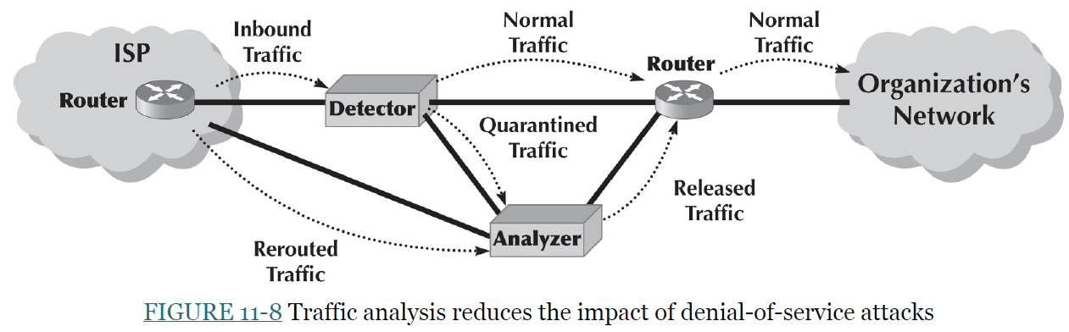
Denial-of-Service Protection

Slide 28
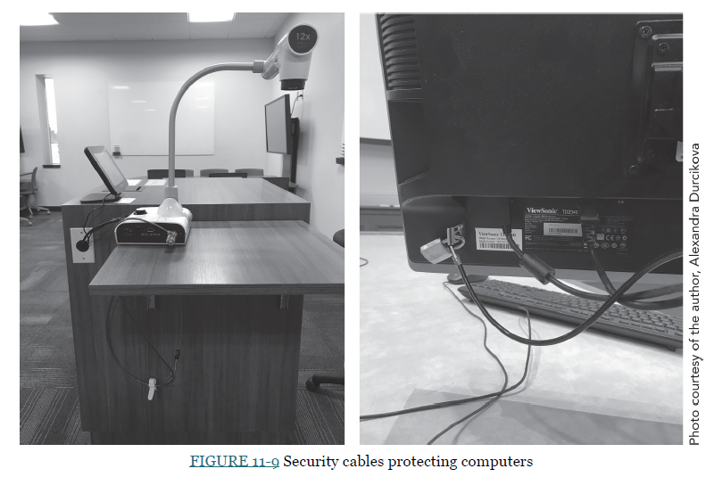
Theft Attack
One often overlooked security risk is theft
Physical security is a key component of theft protection
One of the most common targets for theft is laptop computers

Slide 29
Device Failure Protection
Eventually, every computerized device will fail.
The best way to prevent a failure from impacting business continuity is to build redundancy into the network
Internet connection
Core backbone
Each access layer LAN
Redundancy can be expensive
Redundancy also applies to servers
Some organizations use fault-tolerant servers
An uninterruptible power supply (UPS) is a device that detects power failures and permits the devices attached to it to continue to operate

Slide 30
Disaster Threat
A disaster is an event that destroys a large part of the network and computing infrastructure in a part of the organization
Disasters are usually caused by natural forces (e.g., hurricanes, floods, earthquakes, fires), but some can be human-made (e.g., arson, bombs, terrorism).
Want to avoid a disaster if possible
Via Redundancy
Other steps depend on the disaster to be avoided
A critical element in correcting problems from a disaster is the disaster recovery plan
Should address various levels of response to several possible disasters and should provide for partial or complete recovery

Slide 31
Intrusion Prevention
Intrusion is the second primary type of network security problem and the one that tends to receive the most attention
Four types of intruders may attempt to gain unauthorized access to networks:
The first is casual intruders who have only a limited knowledge of computer security (they may use various hacking tools such as script kiddies)
The second type of intruders are experts in security, but their motivation is the thrill of the hunt
They break into computer networks because they enjoy the challenge and showing off friends or network owners.
These intruders are called hackers, and hackers who cause damage are often called crackers.
The third type of intruders are dangerous professional hackers who break into corporate or government computers for specific purposes, such as espionage, fraud, or destruction
The fourth type of intruders is the most dangerous organization of employees who have legitimate access to the network but who gain access to information they are not authorized to use
This information could be used for their gain, extra income

Slide 32
Perimeter Security and Firewalls
You want to stop external intruders at the perimeter of your network so that they cannot reach the servers
Most networks have three essential access points:
Internet
LANs
WLANs
The most common access point for intrusion is the Internet connection:
Recent surveys suggest that the most common access point for intrusion is the Internet connection (70% of organizations experienced an attack from the Internet), followed by LANs and WLANs (30%).
External intruders are most likely to use the Internet connection because the Internet is the most common source of intrusions
Internal intruders are most likely to use the LAN or WLAN.

Slide 33
Using a Firewall to Protect Networks
A firewall is commonly used to secure an organization’s Internet connection.
The firewall is an intelligent router or special-purpose device that examines packets/message flow into and out of a network and restricts access to the organization’s network
The network is designed so that a firewall is placed on every network connection between an organization and the Internet (see Figure 11-12)
Some firewalls can detect and prevent denial-of-service (DoS) attacks and unauthorized access attempts
Three types of firewalls:
Packet-level firewalls,
Application-level firewalls, and
Network Address Translation (NAT) firewalls.

Slide 34
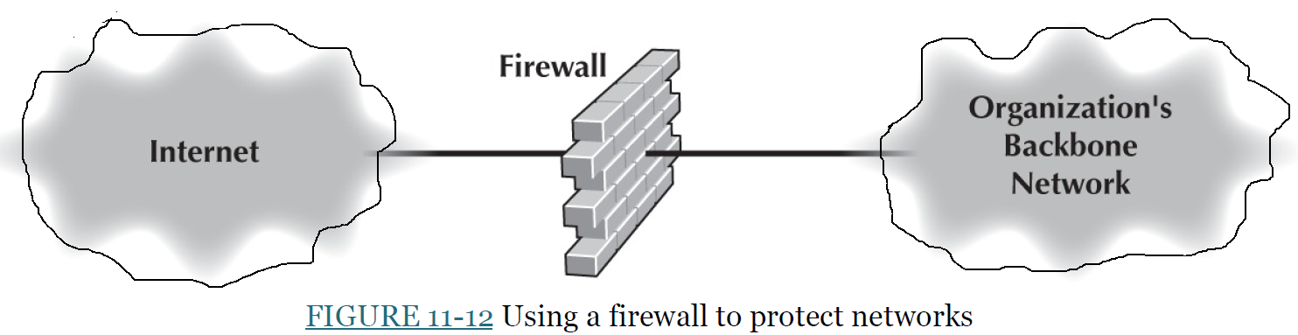
Perimeter Security and Firewalls

Slide 35
Packet-Level Firewall
A packet-level firewall examines the source and destination addresses of every network packet that passes. It only allows packets into or out of the organization’s networks that have acceptable or valid source and destination addresses
The function of the packet-level firewall is based on the network manager's set of rules (called access control list (ACL)) (see Figure 11-13).

Slide 36
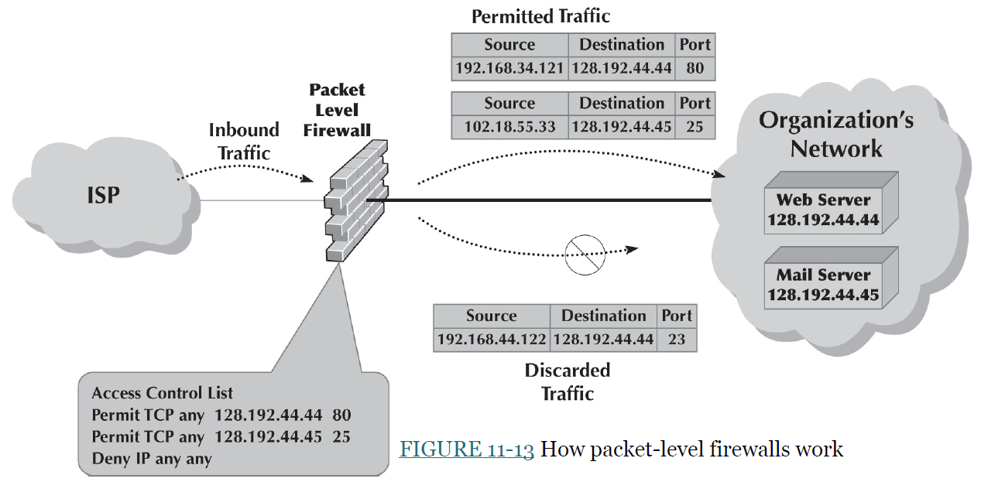

Slide 37
Packet-Level Firewalls
Suppose the organization had a Public Web server with an IP address of 128.192.44.44 and an email server with an IP address of 128.192.44.45 (see Figure 11-13).
The ACL could include a rule permitting the Web server to receive HTTP packets from the Internet (but other packets would be discarded).
For example, the rule would say if the source address is anything, the destination IP address is 128.192.44.44, and the destination TCP port is 80, then permit the packet into the network; see Figure 11-13.
We could add a rule to the ACL that would permit SMTP packets to reach the email server: If the source address is anything, the destination is 128.192.44.45, and the destination TCP port is 25, then permit the packet through (see Figure 11-13).
The ACL usually says to deny entry to all other packets that have not been specifically permitted.
With this ACL, if an external intruder attempted to use telnet (port 23) to reach the Web server, the firewall would deny entry to the packet and discard it (see Figure 11-13).

Slide 38
Packet-Level Firewalls
Although source IP addresses can be used in the ACL, they are often unimportant.
Using the source IP address in security rules is not usually worthwhile; most hackers have software that can change the source IP address on the data packets (IP spoofing).
Some network managers include a rule in the ACL that denies entry to all packets coming from the Internet that have a source IP address of a subnet inside the organization
Because any such packets must have a spoofed address and are considered an intrusion attempt.

Slide 39
Application-Level Firewalls
An application-level firewall is more expensive and more complicated to install and manage than a packet-level firewall
Because the application-level firewall examines the contents of the application-level packet and searches for known attacks
For example, most application-level firewalls can check Web packets (HTTP), email packets (SMTP), and other standard protocols.
They have rules for each application they process
Application-level firewalls can be used for stateful inspection
This means that they monitor and record the status of each connection and can use this information in making decisions about what packets to discard as security threats
Many application-level firewalls prohibit external users from uploading executable (.exe) files
This way, intruders (or authorized users) cannot modify any software without physical access to the firewall.

Slide 40
Network Address Translation (NAT) Firewalls
Network address translation (NAT) is the process of converting between one set of public IP addresses that are viewable from the Internet and a second set of private IP addresses that are hidden from people outside of the organization
NAT is transparent in that no computer knows it is happening.
If external intruders on the Internet can not see the private IP addresses inside your organization, they can’t attack/access your computer
The NAT firewall uses an address table to translate the private IP addresses of the organization into public IP addresses
When a computer inside the organization accesses a computer on the Internet, the firewall changes the source IP address in the outgoing IP packet to its original address.
Most routers and firewalls today have NAT built into them

Slide 41
Firewall Architecture
Many organizations use NAT, packet-level, and application-level firewall layers (Figure 11-14).
Packet-level firewalls are used as an initial screen from the Internet into a network devoted to servers intended to provide public access (e.g., Web servers, public DNS servers).
The network with initial Packet-level firewalls is called the DMZ (demilitarized zone).
The primary purpose of the DMZ is to provide an extra layer of security to the LAN.
The packet-level firewall in front of the DMZ will permit Web requests and access to the DMZ network servers but will deny the FTP access
because the internal users of the network have the right to use the FTP servers, which may cause the intruder to access the network.
The organization’s internal networks have their own NAT firewall to grant (or deny) access based on rules established by that part of the organization (Figure 11-14).

Slide 42
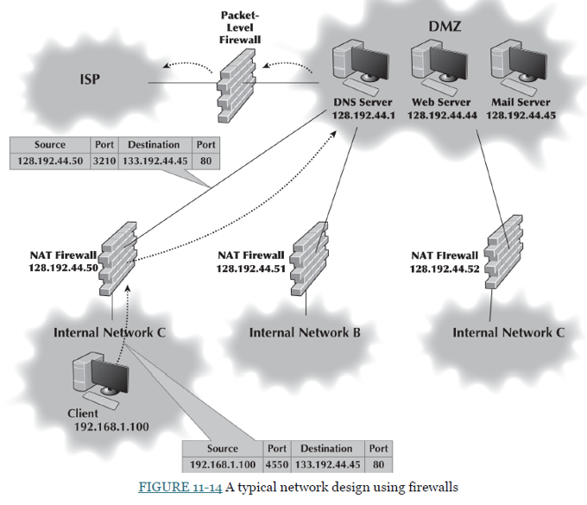

Slide 43
Firewall Architecture
Figure 11-14 shows how a packet is sent by a client computer inside one of the internal networks protected by a NAT firewall.
The packet created by the client has the client’s source address and the source port number of the process on the client that generated the packet (an HTTP packet going to a Web server from the destination port address of 80).
When the packet reaches the NAT firewall, it changes the source address on the IP packet to its address and changes the source port number to an index to identify the client computer’s address and port number.
The destination address and port number are unchanged.
The NAT firewall then sends the packet to the destination.
When the destination Web server responds to this packet, it will use the firewall’s address and port number.
When the firewall receives the incoming packets, it will use the destination port number to identify the destination's IP address and port number, change the packet’s destination and port number, and send it into the internal network so it reaches the client’s computer.

Slide 44
Security Holes
The servers and client computers on a network may not be safe because of the security holes
A security hole is simply a bug that permits unauthorized access
A software developer with a security hole usually works to fix the security hole and produces a patch that corrects/fixes the hole.
Once a security hole is discovered, it is quickly circulated through the Internet
Attacks that take advantage of a newly discovered security hole before a patch is developed are called zero-day attacks
One problem is that many network managers do not routinely respond to such security threats and immediately download and install the patch.
Many security holes are highly technical; the attacker sends a message that lists the server’s address as both the sender and the destination, so the server repeatedly sends messages to itself until it crashes.

Slide 45
Trojan Horses
A critical tool for gaining unauthorized computer access is a Trojan horse.
Trojans Horses are remote access management consoles (sometimes called rootkits) enabling users to access and manage a computer from afar.
Trojans are often concealed in other software that unsuspecting users download over the Internet
Music and video files shared on Internet music sites are common carriers of Trojans.
The attached Trojan software silently installs as a small program that enables the attacker to control the user’s computer completely.
The user is unaware that anything terrible has happened.
The attacker then connects to the user’s computer and access and controls it as its user.
Many Trojans are entirely undetectable by the very best antivirus software.
Spyware, adware, and DDoS agents are three types of Trojans

Slide 46
Encryption
One of the best ways to prevent intrusion is Encryption
Encryption is the process of disguising information
Encryption can encrypt files stored on a computer or data in transit between computers.
Most websites use encryption on data in transit via VPNs or encrypted Web protocols such as HTTPS.
Decryption is the process of restoring encrypted data to its readable form
When information is in readable form, it is called plaintext
When information is in encrypted form, it is called ciphertext
There are two fundamental types of encryption: symmetric and asymmetric
With symmetric encryption, the key used to encrypt a message is the same as the one used to decrypt it
With asymmetric encryption, the key used to decrypt a message is different from the key used to encrypt it

Slide 47
Symmetric (Single Key) Encryption
Symmetric encryption (single-key encryption) has two parts: the algorithm and the key.
Two identical pieces of information encrypted with the same algorithm but with different keys produce different ciphertexts.
With symmetric encryption, the communicating parties must share one key.
If the algorithm is adequate and the key is kept secret, acquisition of the ciphertext by unauthorized personnel is of no consequence to the communicating parties.
Good encryption systems do not depend on keeping the algorithm secret. Only the keys must be kept secret.
The key is a small numeric value
The more significant the key, the more secure the encryption because the large “keyspace” protects the ciphertext against those who try to break it.
Because the same key is used to encrypt and decrypt, symmetric encryption can cause problems with key management

Slide 48
Public Key Encryption
The Public key encryption is asymmetric, so there are two different keys:
The public key is used to encrypt the message
The private key is used to decrypt the message
Keys are often 512 bits, 1,024 bits, or 2,048 bits in length.
Public key systems are based on one-way functions
Once the public key encryption encrypts your message, the message cannot be decrypted without a separate private key.
Public key encryption is one of the most secure encryption techniques available, excluding special encryption techniques developed by national security agencies.
Public key encryption greatly reduces the key management problem
Each user has a public key to encrypt messages sent to it. In addition, each user has a private key that decrypts only the messages encrypted by its public key.

Slide 49
Public Key Encryption
If two parties wish to communicate via a network, there is no need to exchange keys beforehand.
Each knows the other’s public key from the listing in a public directory and can communicate encrypted information immediately.
The key management problem is reduced to the on-site protection of the private key.
Figure 11-16 illustrates how this process works.
All public keys are published in a directory.
When Organization A wants to send an encrypted message to Organization B, it looks through the directory to find its public key.
It then encrypts the message using B’s public key.
This encrypted message is sent through the network to Organization B, which decrypts the message using its private key.

Slide 50
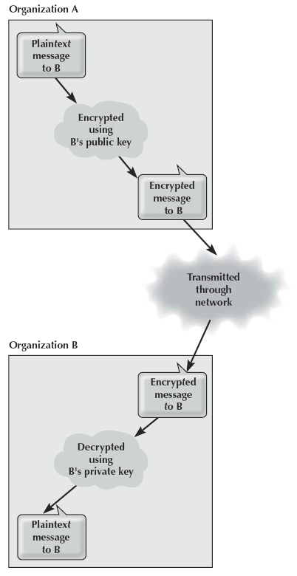
FIGURE 11-16 Secure transmission with public key encryption

Slide 51
Public Key Encryption: Authentication
Public key encryption also permits the use of digital signatures through authentication.
Figure 11-17 illustrates how authentication can be combined with public encryption to provide a secure and authenticated transmission with a digital signature.
Normally, we encrypt with the public key and decrypt with the private key:
However, it is possible to do the inverse: encrypt with the private key and decrypt with the public key.
Because the private key is secret, only the real user can encrypt a message.
Thus, many financial transactions use a digital signature as a legal signature.
The sender encrypts this signature using the private key.
The receiver uses the sender’s public key to decrypt the signature block
Compares the result to the name and other key contents in the rest of the message to ensure a match.

Slide 52
Public Key Encryption: Authentication
Encrypted message to B from A using Organization A’s private key (Figure 11-17).
Then, Authenticate (via digital signature) the encrypted message using Organization B’s public key.
The encrypted and authenticated message is then transmitted to Organization B.
Organization B first decrypts the message using its private key, indicating it is an authenticated message.
Organization B then decrypts the message using A’s public key to produce the original plaintext message.
Since only Organization A has the private key that matches A’s public key, B can safely assume that A sent the message.
It would be possible for someone to create a website and claim to be “Organization A” when the person is someone else.

Slide 53
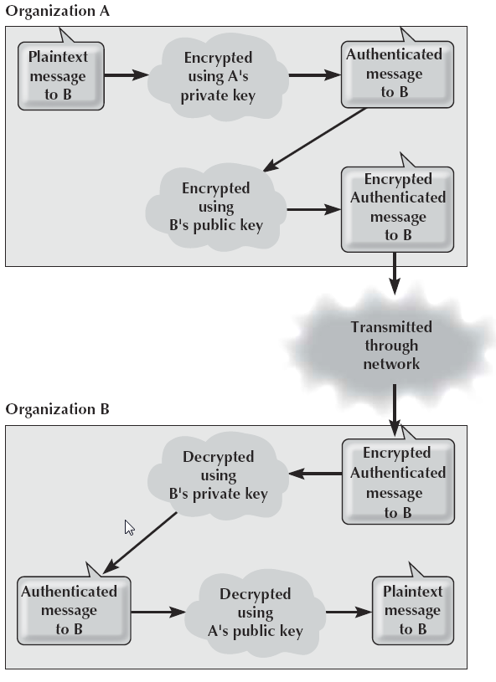
FIGURE 11-17 Authenticated and secure transmission
with public key encryption

Slide 54
Public Key Infrastructure (PKI)
Verifying identity is where the Internet’s Public Key Infrastructure (PKI) becomes important
The PKI is a set of hardware, software, organizations, and policies designed to make public key encryption work on the Internet
PKI begins with a certificate authority (CA), which is a trusted organization that can vouch (prove) for the authenticity of the person or organization using authentication
The CA issues a digital certificate that is the requestor’s public key encrypted using the CA’s private key as proof of identity

Slide 55
User Authentication
Once the network perimeter and the network interior have been secured, the next step is to ensure that only authorized users are permitted into the network
This is called user authentication
The basis of user authentication is the user profile for each user’s account
One security problem is the removal of user accounts when someone leaves an organization
Often, network managers are not informed of the departure
If the network staff members are not friendly, there is a risk that they may attempt to access data and resources and use them for personal gain or destroy them to get back at the organization

Slide 56
User Authentication
Gaining access to a network account can be based on something you know, something you have, or something you are
The most common approach is something you know, usually a password
Some organizations have moved to passphrases
Password managers are becoming more common
Entering a password in conjunction with something you have is called two-factor authentication
Two-factor authentication commonly employs the user’s mobile phone (via OTP)
Another approach is one-time passwords
Biometric systems scan the user (fingerprint, or retina) to ensure that the user is the sole individual authorized to access the network account

Slide 57
Preventing Social Engineering
One of the most common ways for attackers to break into a system is through social engineering
Social engineering refers to breaking security simply by asking
Phishing is a very common type of social engineering
The attacker emails millions of users that their bank account has been shut down due to an unauthorized access attempt and that they need to reactivate it by logging in to an attacker-provided site(by providing the account number, ATM password, etc..)
After the user logs into the fake site provided by the attacker, the attacker can use the user’s user ID and password to break into their bank account and other valuable areas of the system at will

