Slide 1
Project Tracking System
Group 7
101820308 蔡易儒
101820331 陳亮宇
101820340 鄒令業
101820329 林家文
101820302 施帛辰
Software Engineering Project

Slide 2
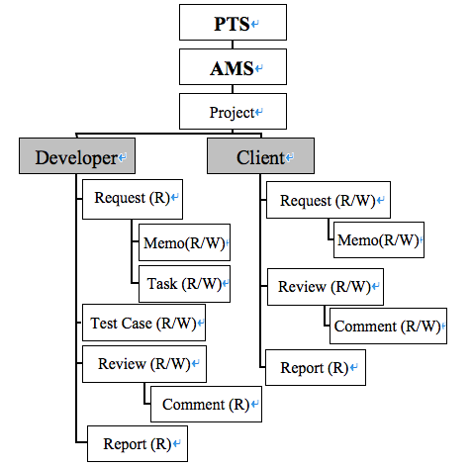
System Block Diagram
Project Tracking System

Slide 3
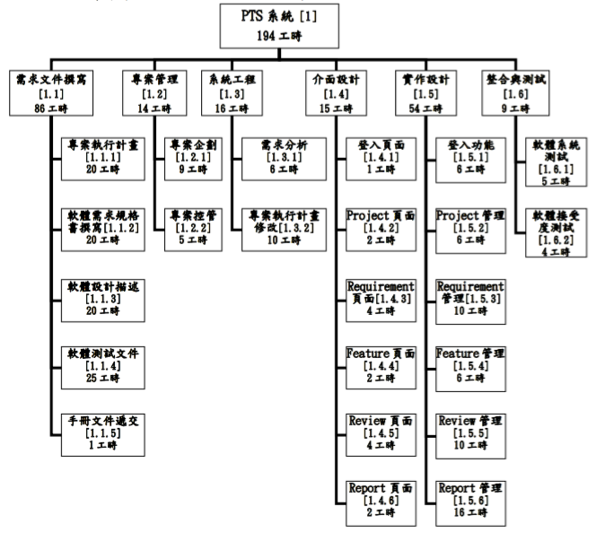
WBS
Project Tracking System

Slide 4
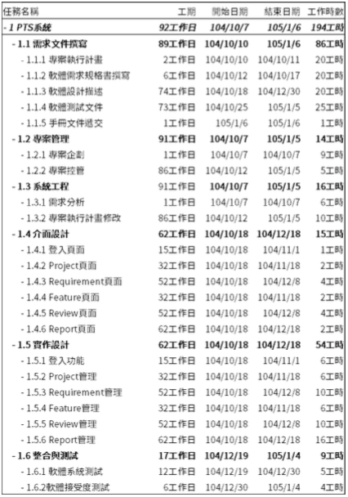
Task Assignments
Project Tracking System

Slide 5
Team Meeting
Weekly Meeting - Tuesday 10:00 ~ 12:00
Daily Scrum – noon or 22:30(SKYPE)
Meeting Documents
Hackpad & Document on GitHub
Date | Subject | Type
2015/10/07 | SCRUM | Temporary
2015/10/08 | PEP Planning | Temporary
2015/10/15 | SRS Planning | Temporary
2015/11/03 | Discuss last iteration problem Plan how to execute project Plan next iteration tasks | Weekly Meeting
2015/11/10 |  | Weekly Meeting
2015/11/17 |  | Weekly Meeting
Project Tracking System

Slide 6
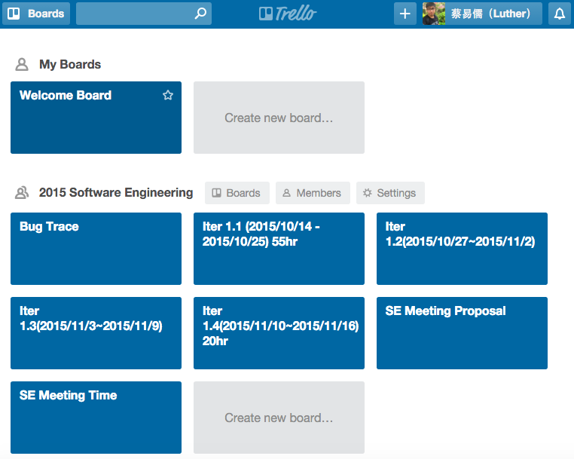
Project Tracking System

Slide 7
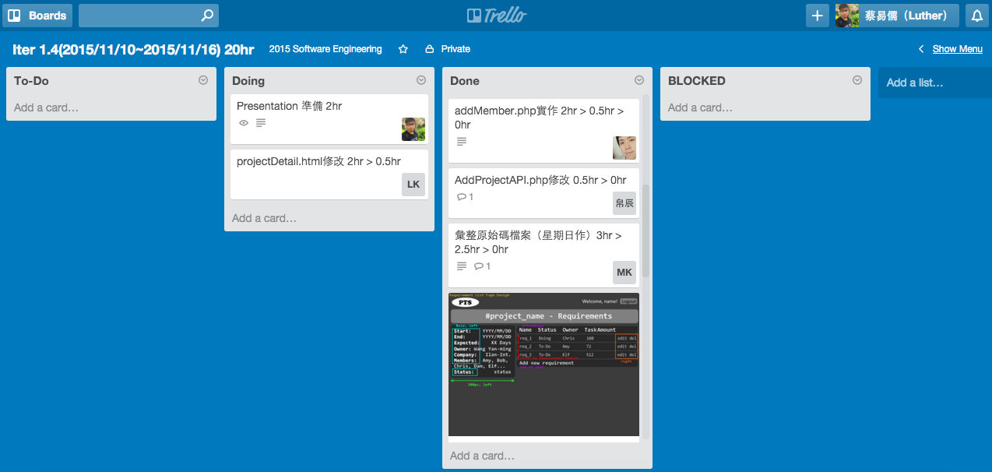
Task Scheduling
Project Tracking System

Slide 8
SCRUM Burn Time

Slide 9
DEMO
Project Tracking System

