Slide 2
jLM (Python)
SWIG Interface
SBML/CMD Line
Lower-Level
Lattice Microbes (C++)

Slide 3
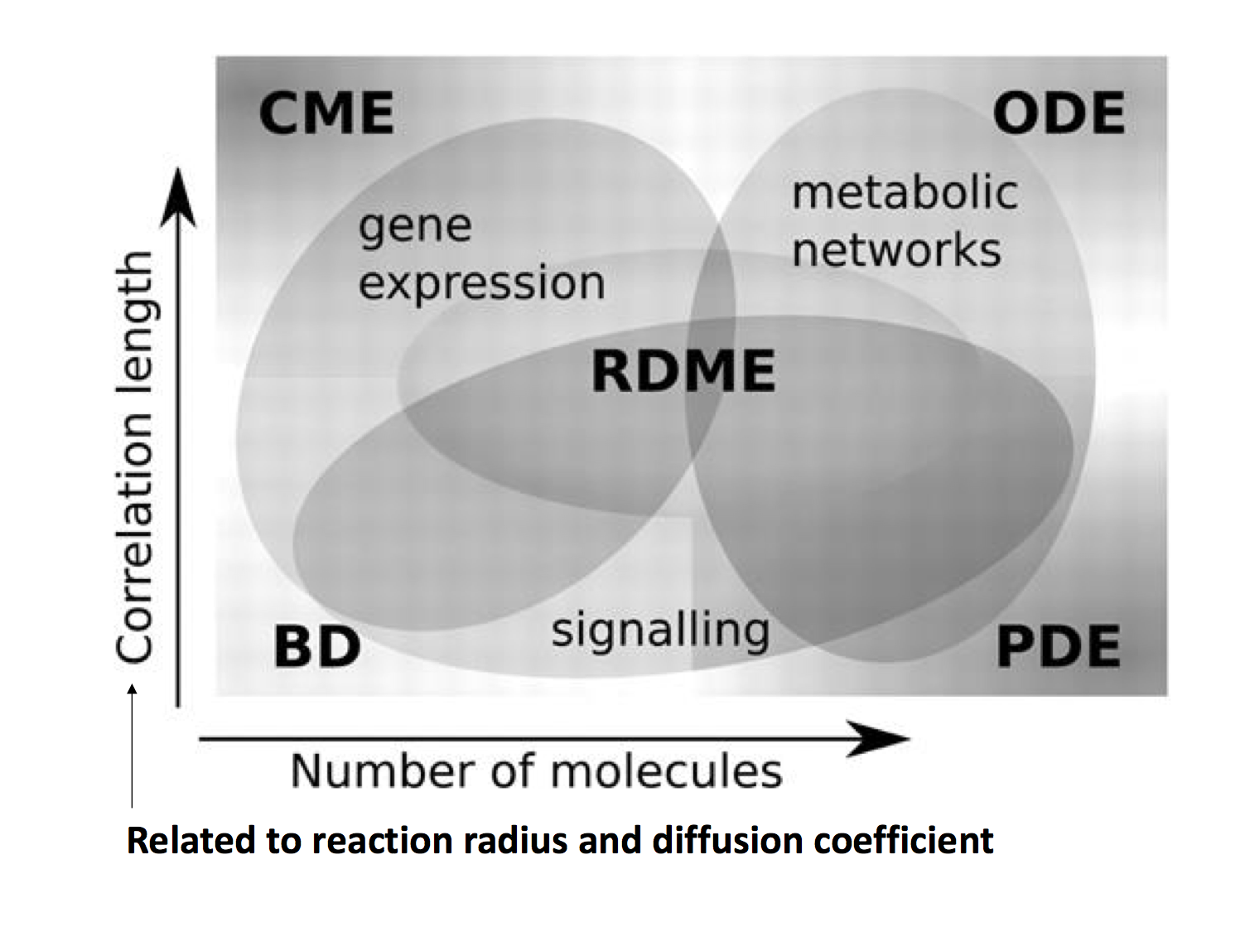
Homogeneous
Heterogeneous
Stochastic
Deterministic

Slide 4
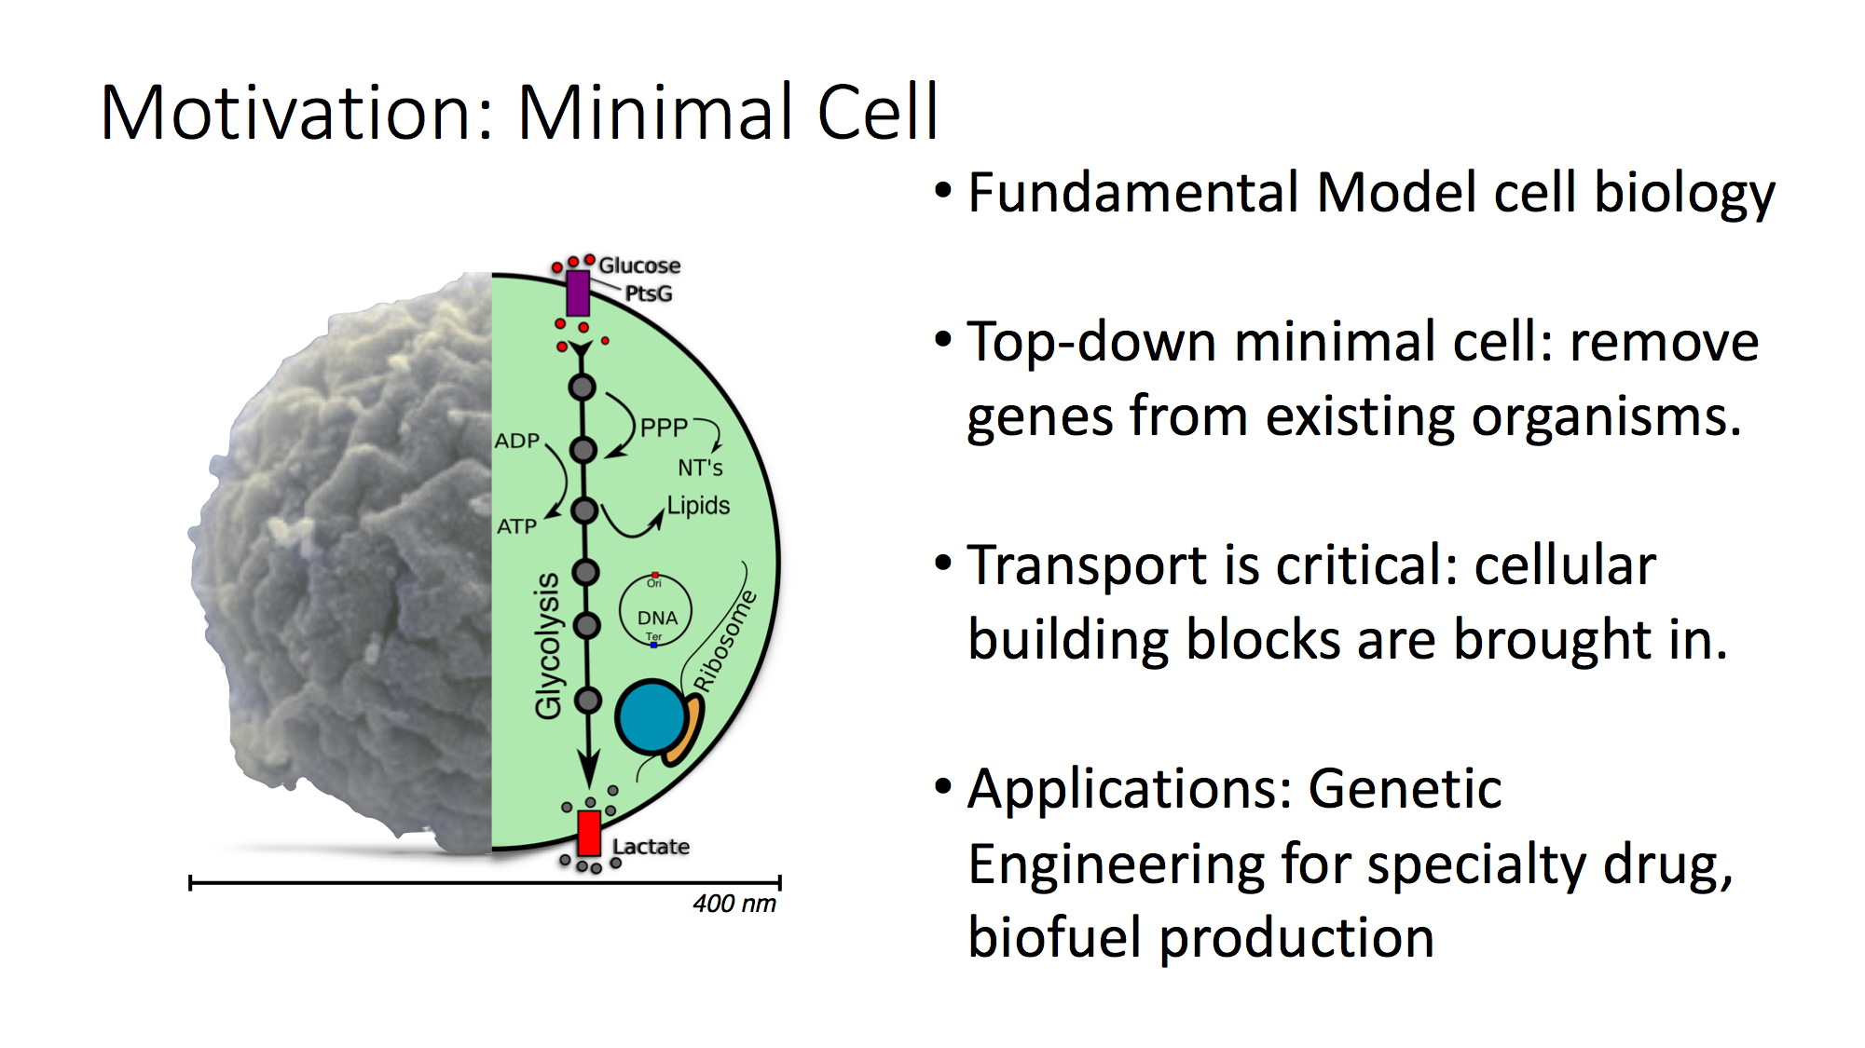
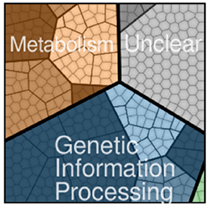
Nucleoside
Fatty Acid
155
<90
200
Amino Acid

Slide 5
Nucleoside
Fatty Acid
Amino Acid

Slide 6
Nucleoside
Transporters
rRNAs
Fatty Acid
Proteins
Complex
Assembly
Ribosome, RNAP, Degradosome
Amino Acid

Slide 7
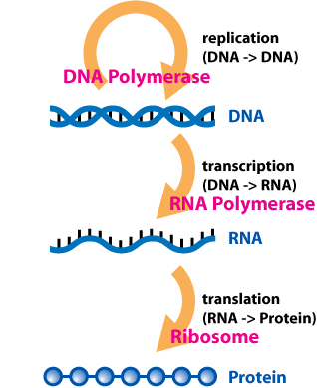
Enzyme
Template
Initiation
Name | Biological Function
Replication | Copy genetic Information
Replication Initiation | Regulate replication
Transcription | Copying DNA into RNA
Translation | Convert mRNA into functional proteins
Degradation | Regulation of translation and recycle NMPs
Ribosome Biogenesis | Assembly ribosomes
tRNA Charging | Carry AA for translation
tRNA charging
(tRNA -> tRNA:AA)
tRNA ligase
Ribosome biogenesis
(rRNAs -> ribosome)
Degradation
(mRNA -> NMPs)
Degradosome

Slide 8
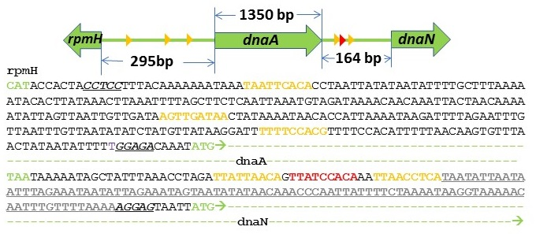
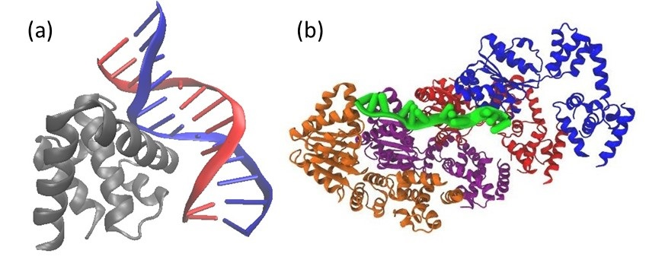
Domain IV binds
to 9 NT on dsDNA
Domain III binds
to 3 NT on ssDNA
oriC sequence of JCVISYN3A

Slide 9
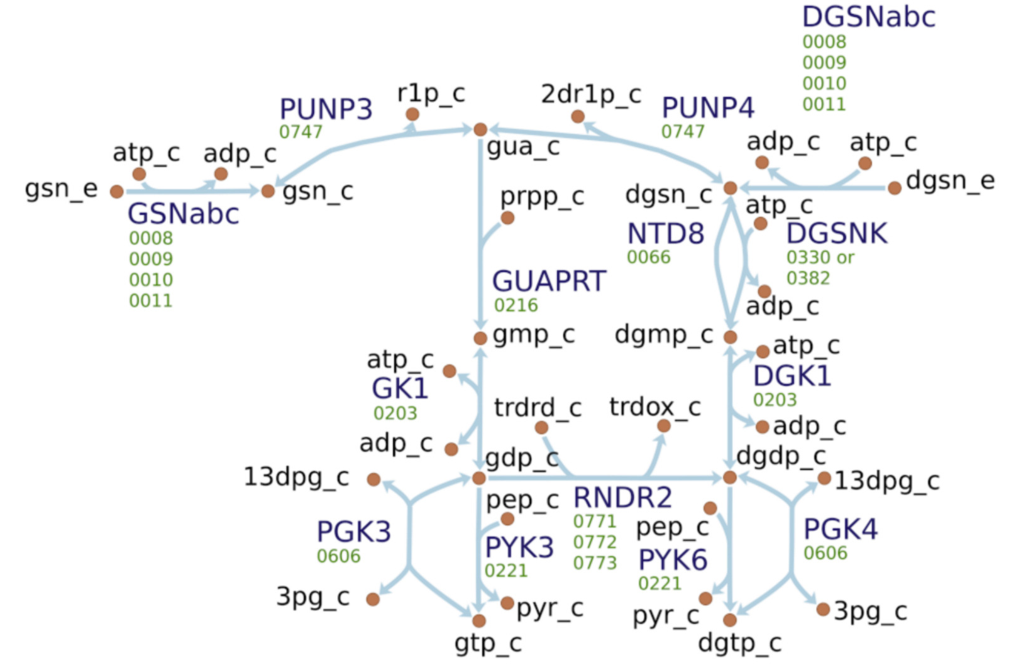
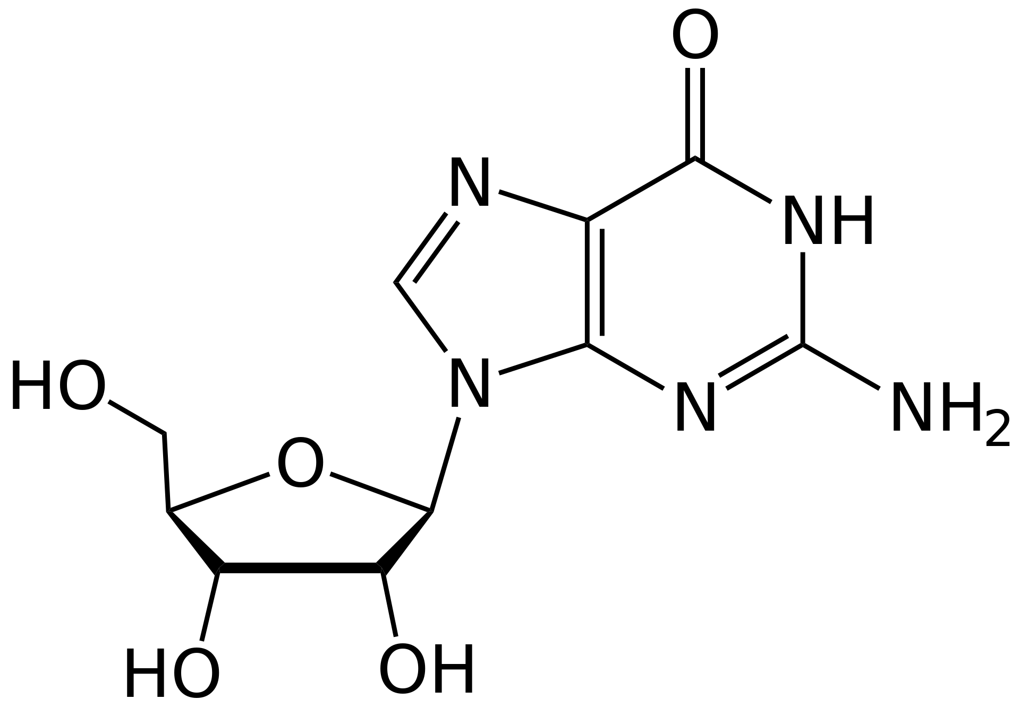

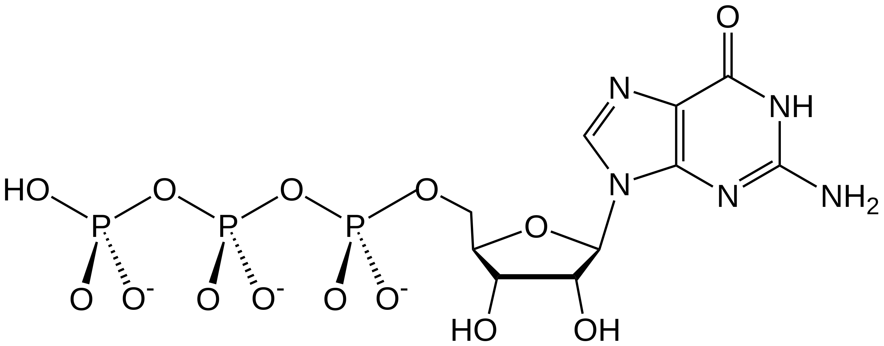
Nucleoside
Supply from Medium
deoxyNucleoside
Supply from Medium
Guanosine gsn
NMP recycling of mRNA
rRNA, mRNA Demands
ATP
UTP
GTP
CTP
DNA Demands
dATP
dTTP
dGTP
dCTP
Guanosine Triphosphate GTP

Slide 10
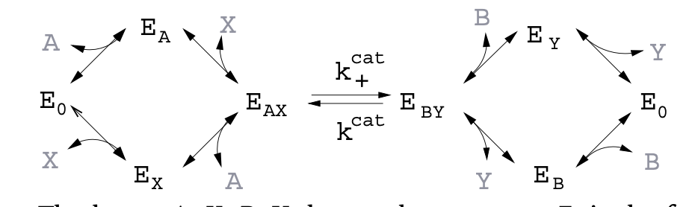

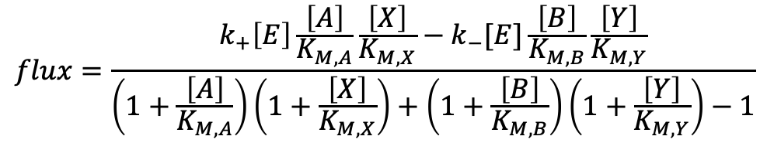
$$A+X \underset{⇔}{k_{+}, k_{−}}B+Y$$
$$flux=\frac{k_{+}\left[E\right]\frac{\left[A\right]}{K_{M,A}}\frac{\left[X\right]}{K_{M,X}}−k_{−}[E]\frac{\left[B\right]}{K_{M,B}}\frac{\left[Y\right]}{K_{M,Y}}}{\left(1+\frac{\left[A\right]}{K_{M,A}}\right)\left(1+\frac{\left[X\right]}{K_{M,X}}\right)+\left(1+\frac{\left[B\right]}{K_{M,B}}\right)\left(1+\frac{\left[Y\right]}{K_{M,Y}}\right)−1}$$
$K_{A}$ dissociation constant, $k_{+}$ and $k_{−}$forward and backward rate

Slide 11
