Slide 1
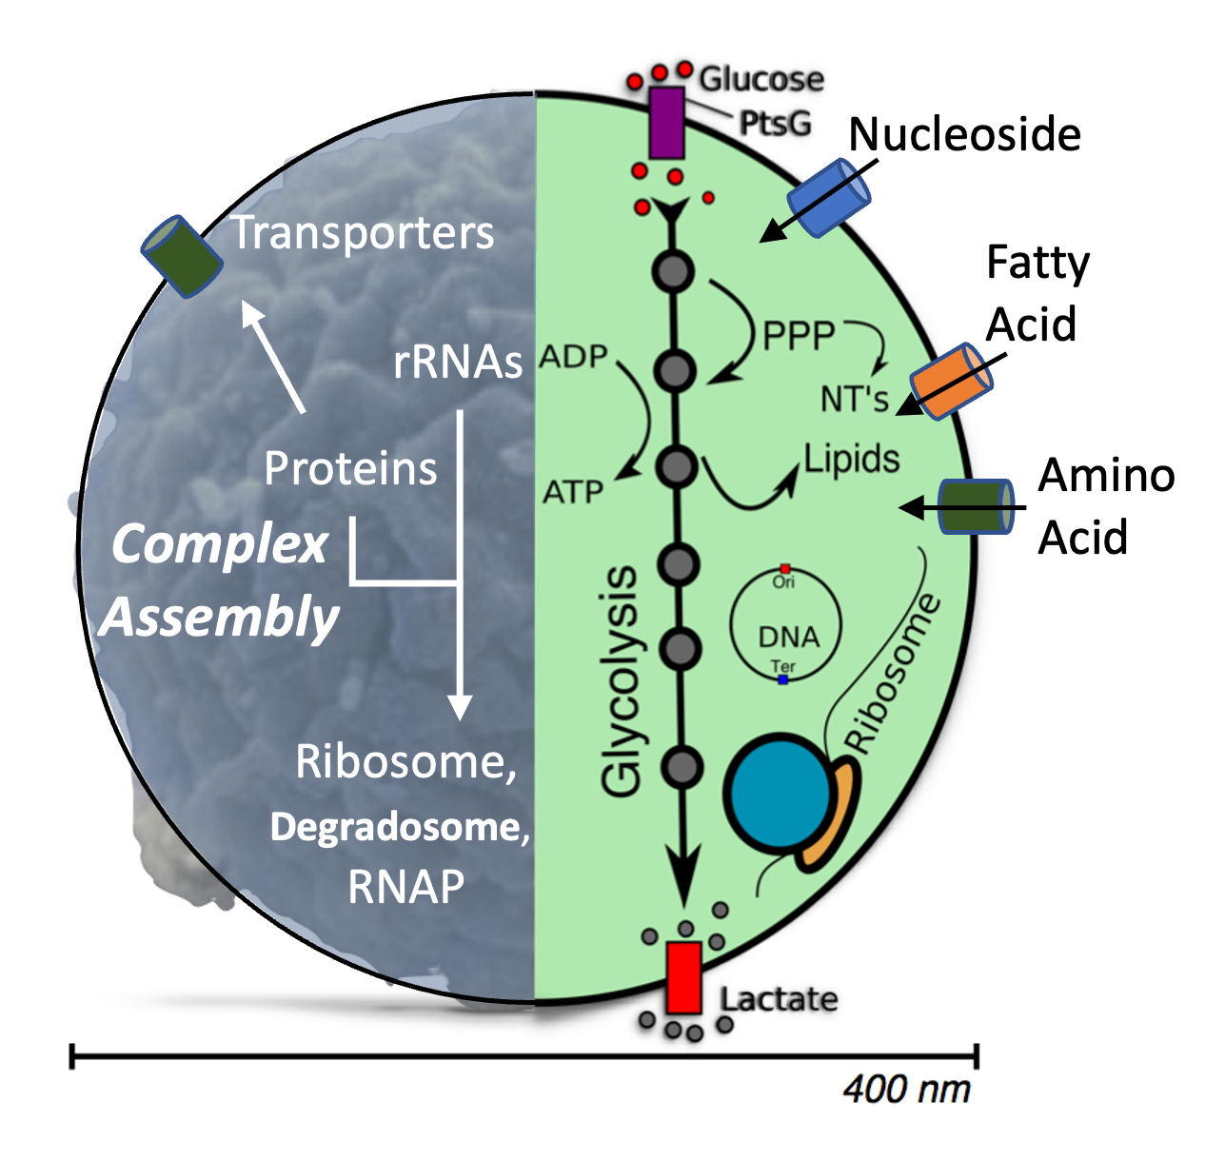
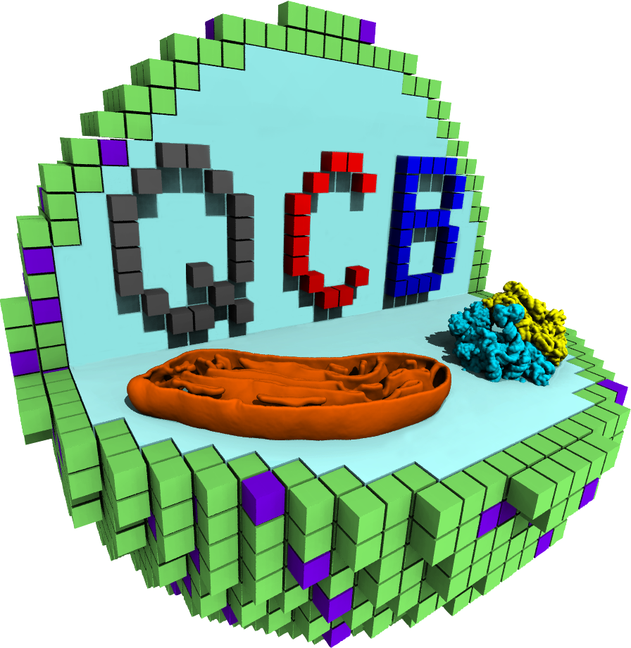
Introduce CME-ODE WCM of the Minimal Cell
Enguang Fu – Prof. Zan Luthey-Schulten Lab
QCB Summer School 2026
NSF Science and Technology Center for Quantitative Cell Biology (QCB)
4D WCM and Experiments
Notes:
Good afternoon, professors. Thank you and welcome you for attending my preliminary examination, titled Assembly of Macromolecular Complexes in the Whole-Cell Model of a Minimal Cell. I am in Physical Chemistry area, and my advisor is Prof. Zan Luthey-Schulten. My current work is funded by NSF Science and Technology Center for Quantitative Cell Biology, located at Beckman Institute.

Slide 2
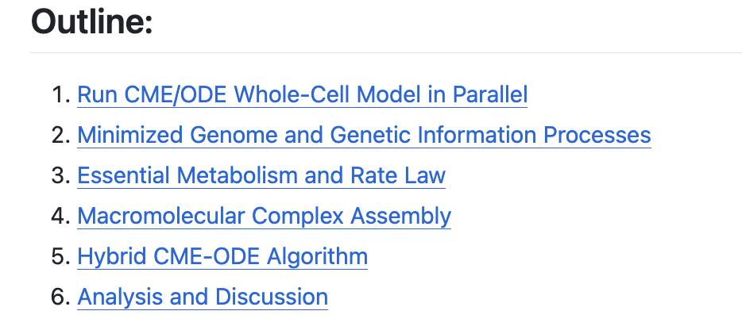
CME-ODE WCM Tutorial Outline
1. Launched and finished on Wed, and 50 trajs compiled for 6.
5. Hybriding two algorithms; More algorithms for 4DWCM.
Notes:
A complete solution to a cell, the fundamental unit of life has been suggested by Francis Crick back in 1973. There, he stated that the structural, functional and mechanical studies of cellular molecules and processes would significantly contribute to this pursuit. Within the last decades, substantial developments have been made in cell biology. Cryo-electron microscopy and tomography disclose the structures of proteins and cellular compartments. The high throughput omics provide genome-scale measurements of DNAs, RNAs, proteins, and metabolites. Super resolution imaging and accumulated biochemical functional studies, such as enzymatics in BRENDA database allows us to depict the kinetics of cellular processes. Don’t even to mention the invention of bioinformatics, especially with the machine-learning approach, such as AlphaFold.
Whole-cell Modeling (WCM) integrates the experiment data and theory via simulation to connect the entire cell by mechanical processes, including gene expression, metabolism, and others, thus providing a complete solution to the cell. To simulate the entire cell, even for the small bacterial for hours to days to cover biologically significant events, coarse-graining of the cell is necessary because of its rich content. Thousands of gens, RNAs, proteins, adding up to billions of atoms in one cell. In our current implementation, each gene, RNA, and protein is represented as a single particle. Also, hybrid algorithms are used to efficiently simulate the stochastic gene expression and deterministic metabolism that simultaneously occur.

Slide 3
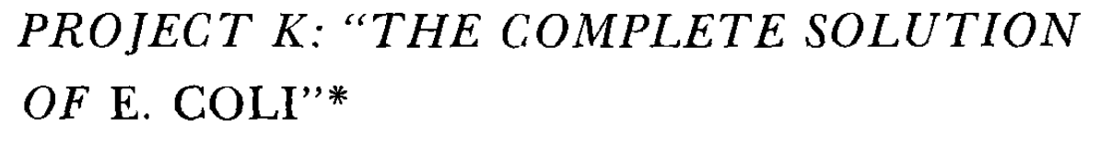
Integrative Whole-Cell Modeling (WCM)
Whole-Cell Model
Integrate experiment and theory via simulation.
Connect the entire cell by mechanical processes.
Francis Crick, 1973
Coarse-grained simulation:
In one single bacterial cell:
Hundreds of genes, RNAs
Thousands of proteins
Millions of small metabolites
Billions of atoms¹
Substantial Developments in Cell Biology:
Structures: Cryo-EM, Cryo-ET, …
High throughput Omics: Illumina, PacBio, ONT, …
Functional Study: BRENDA database, …
Spectroscopies: smFRET, MINFLUX, …
Machine Learning: AlphaFold, …
Hybrid algorithms²:
Stochastic gene expression
Deterministic metabolism
Stevens, J. A. et al. Molecular dynamics simulation of an entire cell. Front. Chem. 11, 1106495 (2023).
Bianchi, D. M., et al., …, Luthey‐Schulten, Z. IET syst. biol. 12, 170–176 (2018).
Notes:
A complete solution to a cell, the fundamental unit of life has been suggested by Francis Crick back in 1973. There, he stated that the structural, functional and mechanical studies of cellular molecules and processes would significantly contribute to this pursuit. Within the last decades, substantial developments have been made in cell biology. Cryo-electron microscopy and tomography disclose the structures of proteins and cellular compartments. The high throughput omics provide genome-scale measurements of DNAs, RNAs, proteins, and metabolites. Super resolution imaging and accumulated biochemical functional studies, such as enzymatics in BRENDA database allows us to depict the kinetics of cellular processes. Don’t even to mention the invention of bioinformatics, especially with the machine-learning approach, such as AlphaFold.
Whole-cell Modeling (WCM) integrates the experiment data and theory via simulation to connect the entire cell by mechanical processes, including gene expression, metabolism, and others, thus providing a complete solution to the cell. To simulate the entire cell, even for the small bacterial for hours to days to cover biologically significant events, coarse-graining of the cell is necessary because of its rich content. Thousands of gens, RNAs, proteins, adding up to billions of atoms in one cell. In our current implementation, each gene, RNA, and protein is represented as a single particle. Also, hybrid algorithms are used to efficiently simulate the stochastic gene expression and deterministic metabolism that simultaneously occur.

Slide 4
Synthetic Minimal Cell – JCVI-Syn3A as Model Organism
Minimized circular genome of 543 kbp (half a million):
Reduced genome from Mycoplasma mycoides subsp. Capri.
Encoding 452 proteins and 38 RNAs.
Only 90 of the 452 proteins unknown (lowest).
Two rRNA operons.
Smallest autonomously replicating organism:
Doubling time of ~ 2 hours in lab condition.
Spherical morphology with radius of 200 nm.
Perfect organism for WCM:
E. coli: 10 times bigger, with ~ 1,800 unclear proteins.
Published by J. Craig Venter Institute in 2016¹
Fundamental Rule of Life
1. Hutchison, C. A. et al. Design and synthesis of a minimal bacterial genome. Science 351, aad6253 (2016).
Notes:
JCVI-syn3A, the minimal cell is the product of the synthetic biology. Its minimal genome was reduced from parent organism Mycoplasma mycoides, which now encodes 452 proteins. Only roughly 90 out of these proteins remains unknown, the lowest percentage compared to other model organisms, including E. coli and B. subtilis.
Syn3A has a doubling time of ~2 hr in rich lab growth condition and consistently forms spherical cells of approximately 200 nm in radius. In the summer school organized in Beckman by STC-QCB, the students can even grow the minimal cell and measure the approximate doubling time by themselves.
In 1970s, Francis Crick proposed E Coli as the target organism due to its smaller size, and the fact that many labs working on it. Under the same reasoning, we believe that Syn3A is an excellent organism to model to study the fundamental rules of life.

Slide 5
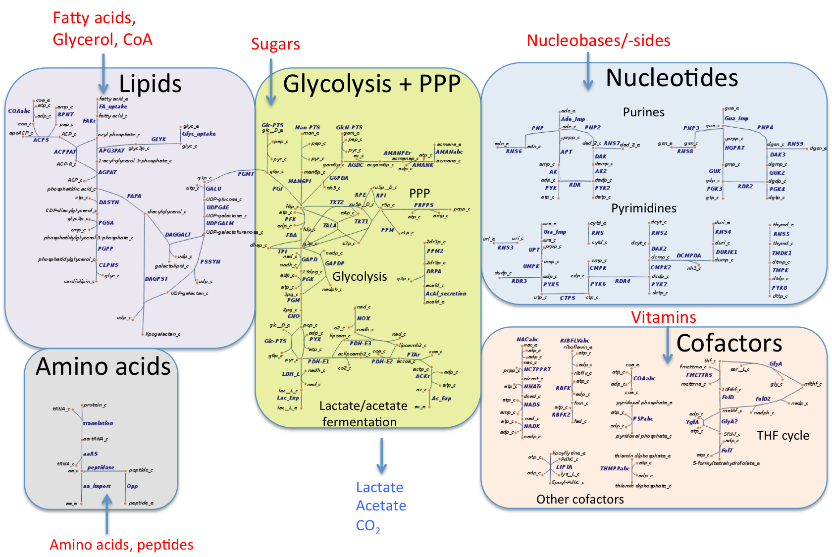
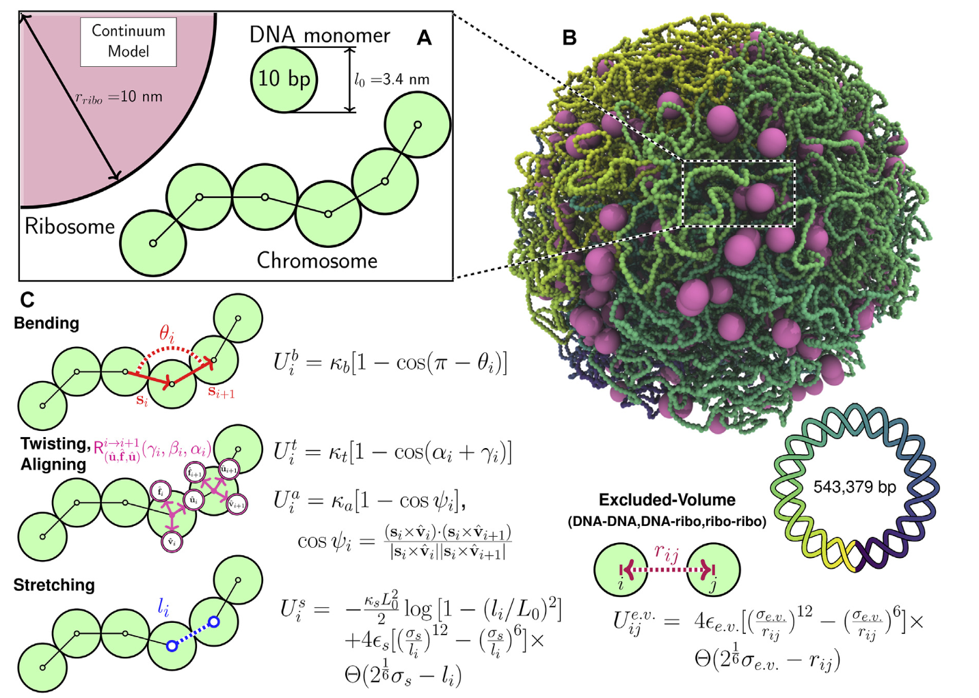
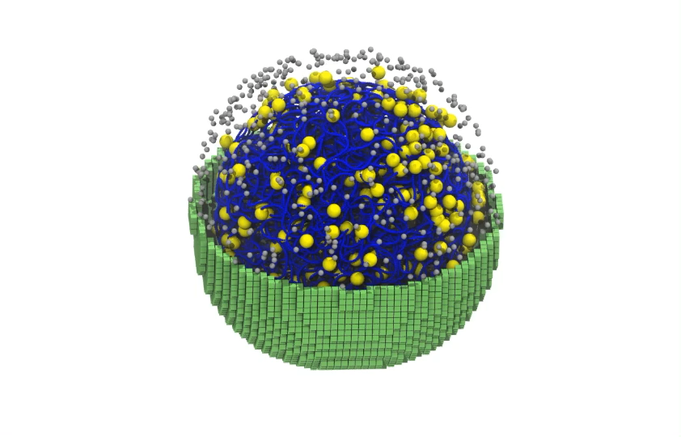
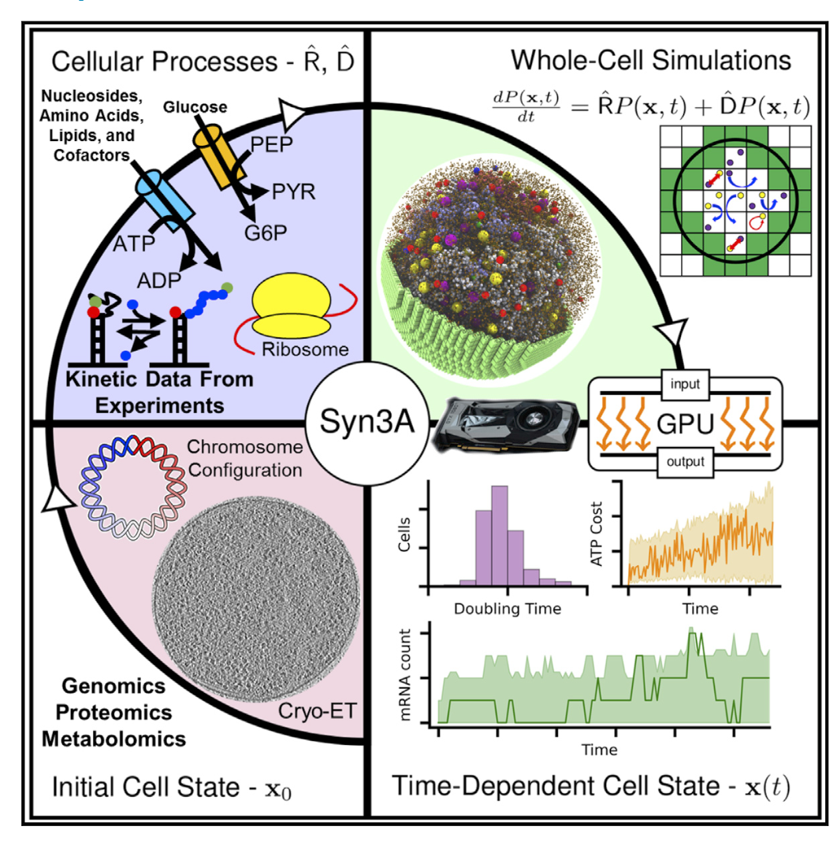
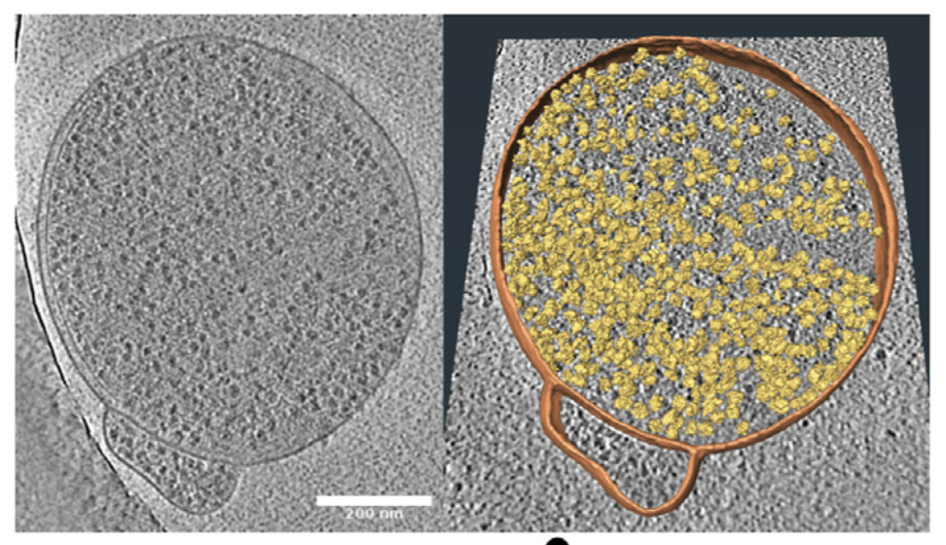
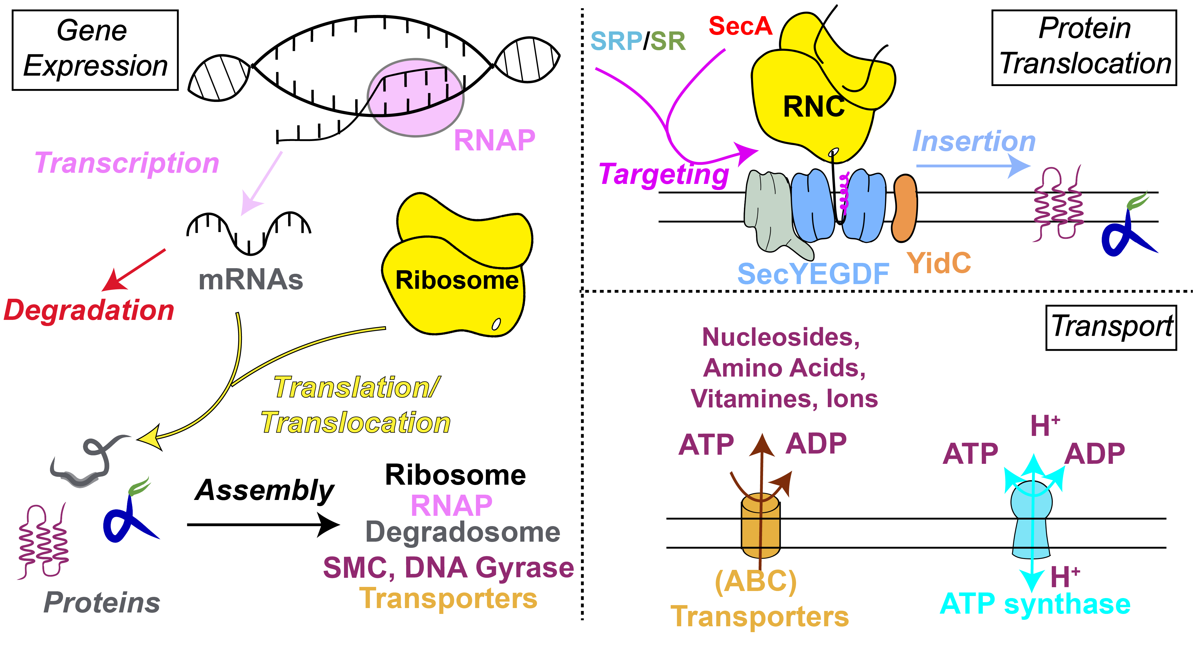
Whole-Cell Model of a Minimal Cell, JCVI-Syn3A
Proteomics
3C Contact Map
Chromosome Dynamics⁵
Imaging
Metabolism¹
4D WCM⁶
Genomics
Reported by JCVI
2016
2019
2023
2019
2021
2022
2025
Gene Expression²
3D Structure³
Complex Formation⁷
smFRET
Cryo-ET
First WCM⁴
1. Breuer, M. et al. eLife 8, e36842 (2019); 2. Thornburg, Z. R. et al. Front. Mol. Biosci. 6, 130 (2019); 3. Gilbert, B. R. et al. Front. Mol. Biosci. 8, 644133 (2021); 4. Thornburg, Z. R. et al. Cell 185, 345-360.e28 (2022); 5. Gilbert, B. R. et al. Front. Cell Dev. Biol. 11, (2023); 6. Thornburg, Maytin, et al. (2026) Cell,. 7. Fu, E. et al. J. Phys. Chem. B 10.1021/acs.jpcb.5c04532 (2025).
Notes:
With the collaboration with JCVI, our lab paced the voyage of modeling this synthetic minimized bacteria, JCVI-Syn3A back in 2016, starting from two important subsystems, stochastic gene expression and deterministic metabolism. Together with 3D spatial information, we simulated the minimal cell at a whole-cell scale for the first 20 mins in 2022 using hybrid stochastic-deterministic algorithms.
Now in 2025, we can simulate the entire cell cycle in 4D, 3D space and time to cover the entire cell cycle to demonstrate the full dynamics and partitioning of chromosomes during cell division.
Today, I want to focus on another important subsystem, which is the macromolecular complex formation.

Slide 6
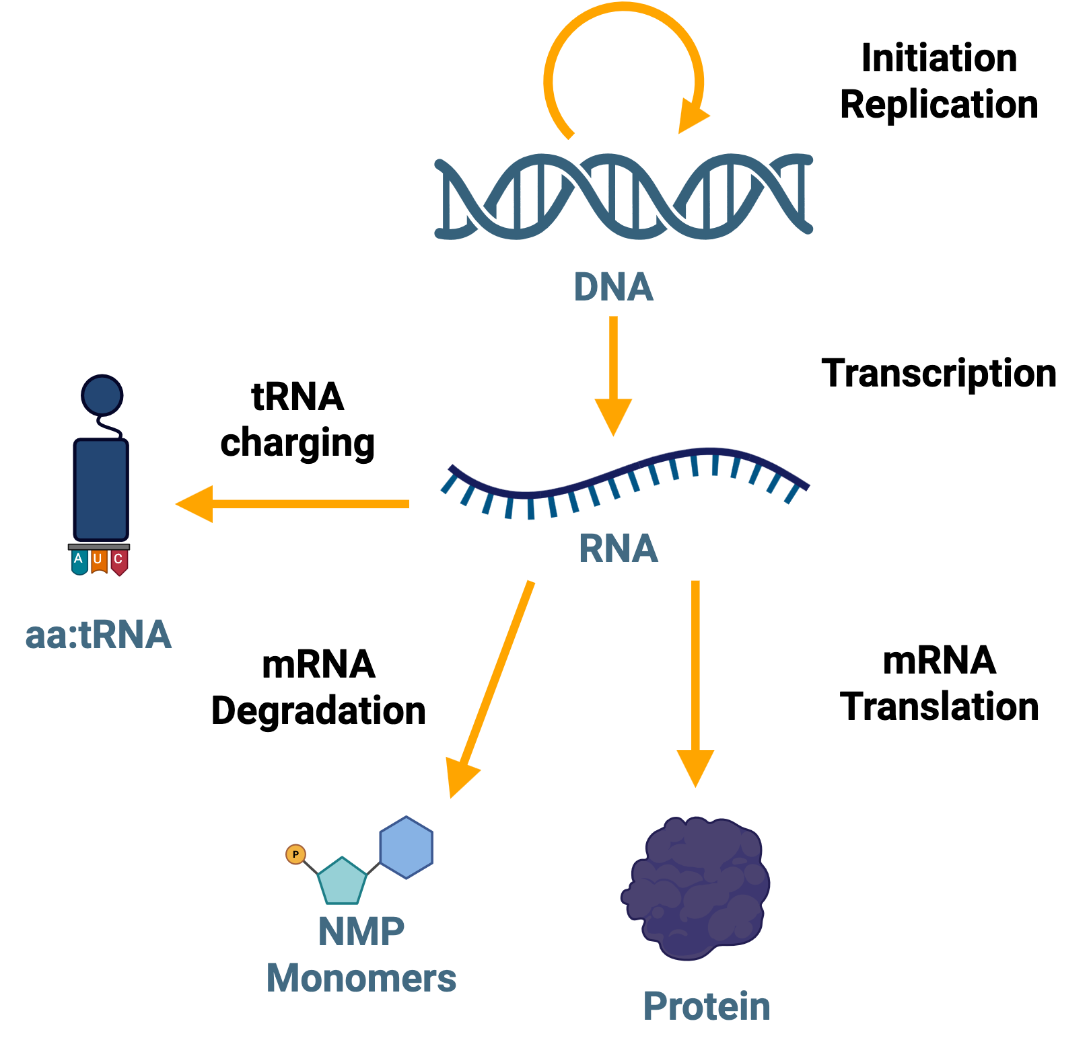
Cellular Processes in the WCM of Syn3A
Gene Expression
Essential Metabolism
Cell growth: Biogenesis of membrane proteins and lipids.
Spatial structure (cryo-ET): Size, cellular compartment, ribosome distribution.
Motion in 4D WCM: Particle diffusion, Brownian dynamics of chromosomes.
Notes:
Here is a summary of the cellular processes included in the WCM of Syn3A. The gene expression subsystem include chromosome replication initiation and replication, the transcription into RNAs, the translation from mRNAs into proteins, tRNA charging, and mRNA degradation.
Since Syn3A’s parent organism Mycoplasma mycoides is parasitic and the genome reduction, Syn3A relies heavily on the import of metabolic precursors from the growth media. Glucose is imported via Phosphotransferase System into the glycolysis to produce ATPs. Nucleotide synthesis starts from the import of nucleosides by membrane transporters. Incorporation of lipids from media accounts for a large fraction of membrane lipids. (phosphatidylglycerol PG and cardiolipin CLPN are synthesized from imported fatty acid and glycerol. Cholesterol and sphingomyelin are imported from the media to the membrane.)
The cell expands as the surface area increases with the biogenesis of membrane proteins and lipids. In the 4D WCM, we further incorporate the diffusion of particles and Brownian dynamics of chromosomes.

Slide 7
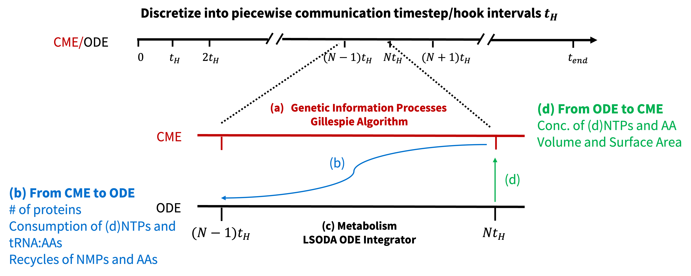
Hybrid Stochastic-Deterministic CME-ODE Algorithm
Communicate¹
Stochastic CME:
Gene Expression
Complex Formation
Deterministic ODE:
Metabolism
Well-stirred
Software: Lattice Microbe
Communicate 1 second out of total 2 hours
Code available at Github
Simulated 100 cells by efficient parallelization within one day
1. Bianchi, D. M., Peterson, J. R., Earnest, T. M., Hallock, M. J. & Luthey‐Schulten, Z. IET syst. biol. 12, 170–176 (2018).
Notes:
To simulate the co-evolution of stochastic gene expression, complex formation and deterministic metabolism, we perform communication between these two algorithms to depict the interactions. We then proposed to use a hybrid CME-ODE simulation back in 2018. We first discretize the entire simulation length of 2 hours into piecewise time steps (hook intervals, $t_{H})$of 1 second. During each time step,
(a) Run a CME simulation of 1seoncd to describe the kinetics in gene expression and complex formation.
(b) Communicate from CME to ODE by passing the protein counts, the consumption of monomers (dNTP, NTP, and amino acid charged tRNAs) in synthesis, and the recycling of nucleoside monophosphates (NMP) in the degradation of mRNA and recycling of amino acids in the degradation of membrane protein.
(c) Then run ODE simulation of metabolism for the same 1 second with the updated counts/concentrations of proteins and metabolites.
(d) At last, we update the concentrations of metabolites after ODE to CME to re-evaluate the rates of synthesis of DNAs, RNAs, and proteins using Hofmeyr rate law.
Numerically, we use Gillespie or more broadly kinetic Monte Carlo to sample the CME system and LSODA for ODE.
The simulation is conducted with GPU-based stochastic simulation software Lattice Microbe. We need to sample large cell population to get meaningful statistics of the stochastic cellular dynamics. Since only two algorithm hybridized, the computation can be efficiently parallelized to simulate 100 cells within one day, allowing fast testing the parameters for the computationally expensive 4D WCM.

Slide 8
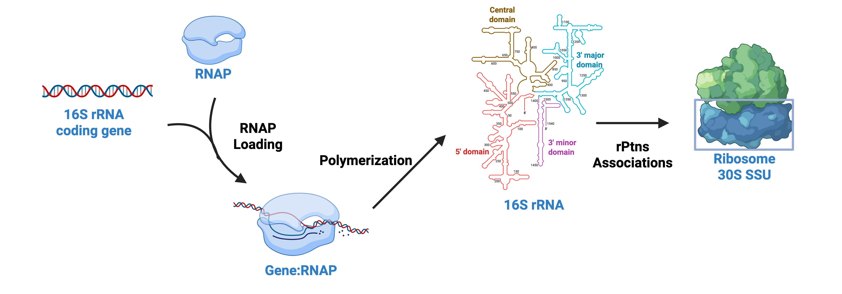
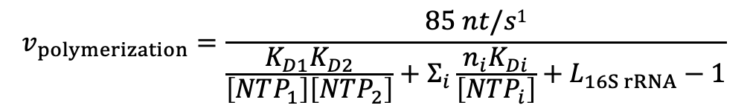

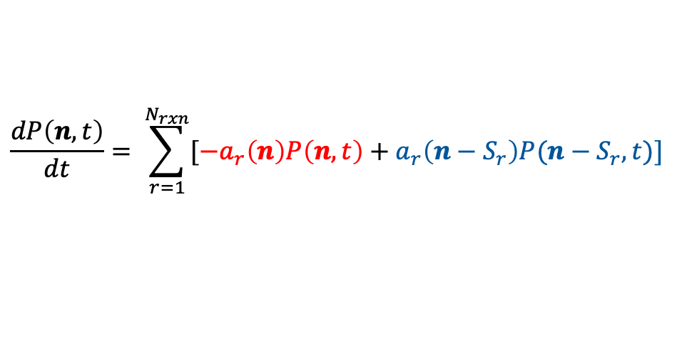
Chemical Master Equation (CME) for Gene Expression and Complex Formation
CME: Stochastic gene expression and complex formation with few particle numbers.
State transition as reaction r with stoichiometry $S_{r}$ fire:
Propensity $a_{r}\left(n\right)$ is the per unit time probability that reaction r will fire in state $n$.
Out-flow
In-flow
$$\frac{dP\left(n,t\right)}{dt}= \sum_{r=1}^{N_{rxn}}{[−a_{r}\left(n\right)P\left(n,t\right)+a_{r}\left(n−S_{r}\right)P(n−S_{r},t)]}$$
Transcription of 16S rRNA:
Hofmeyr Rate Law²
Proxy promoter strength to enhance expression
$$v_{polymerization}=\frac{85 nt/s1}{\frac{K_{D1}K_{D2}}{\left[NTP_{1}\right]\left[NTP_{2}\right]}+Σ_{i}\frac{n_{i}K_{Di}}{\left[NTP_{i}\right]}+L_{16S rRNA}−1}$$
$$K_{D}=1μM$$
1. Bremer, H. & Dennis, P. P. EcoSal Plus 3, 10.1128/ecosal.5.2.3 (2008).
2. Hofmeyr, J.-H. S., Gqwaka, O. P. C. & Rohwer, J. M. FEBS Letters 587, 2868–2875 (2013).
Notes:
Gene expression and macromolecular complex formation in cells are intrinsically stochastic because of the low numbers of genetic particles, including genes, RNAs, and proteins. Therefore, the stochastic chemical master equation (CME) is used. In CME, the state of the system n is the counts of particles, and the transition from one state to another occurs via chemical reaction r with stoichiometry Sr. And the whole equation depicts that the time derivatives of probability in one state is the summation of out-flows from this state and in-flows from other states.
The bottom part is how we simulate biochemical reactions in CME, transcription of 16S rRNA as an example. The loading of RNAP into the promoter region of 16S rRNA coding-gene is a bimolecular reaction, with rate tuned by the introduced proxy promoter strength. Upon the formation of the transcription complex, we use Hofmeyr rate law to calculate the overall rate of polymerization to synthesize a complete 16S rRNA, which will then bind to form 30S SSU. The overall rate of polymerization dominantly depends on the length of the polymers when the pool of monomers is rich. Upon depletion of monomers, this rate will decrease to halt the synthesis.

Slide 9
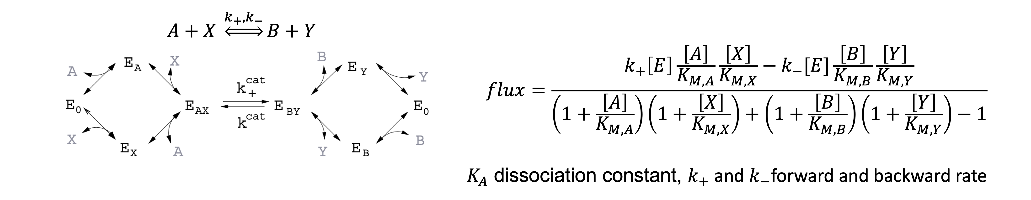
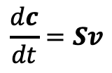
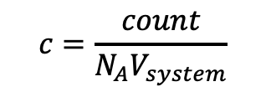

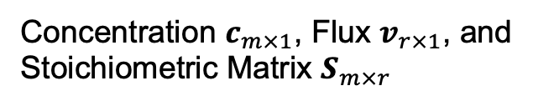
Ordinary Differential Equation (ODE) for Metabolism
ODE: Deterministic metabolism with high particle abundances in mM.
$$\frac{dc}{dt}=Sv$$
Time evolution of concentrations
Concentration $c_{m×1}$, Flux $v_{r×1}$, and Stoichiometric Matrix $S_{m×r}$
Convenience rate law¹ Kinetic parameters in BRENDA²
Gibbs free energy analysis³
$$v_{i}=f_{i}(c,K_{i})$$
$$c=\frac{count}{N_{A}V_{system}}$$
Convenience Rate Law:
Arbitrary binding order of substrates and products.
Conversion step is rate-limiting.
1. Liebermeister, W. & Klipp, E.Theoretical Biology and Medical Modelling 3, 41 (2006).
2. Chang, A. et al. Nucleic Acids Research 49, D498–D508 (2021). 3. Thornburg, Z. R. et al. Cell 185, 345-360.e28 (2022);
Notes:
Metabolism involves small metabolites of concentrations of milimolars, counts of millions, and is much less subject to randomness. We use deterministic ordinary differential equation for the time evolution of metabolic concentrations. For enzymatic reactions, convenience rate law is used, which assumes random binding of reactants and products to the enzymes. We parameterized the metabolism network with values reported in BRENDA database and tested the Gibbs free energy to assure the thermodynamic consistency of the parameterized network.

Slide 10
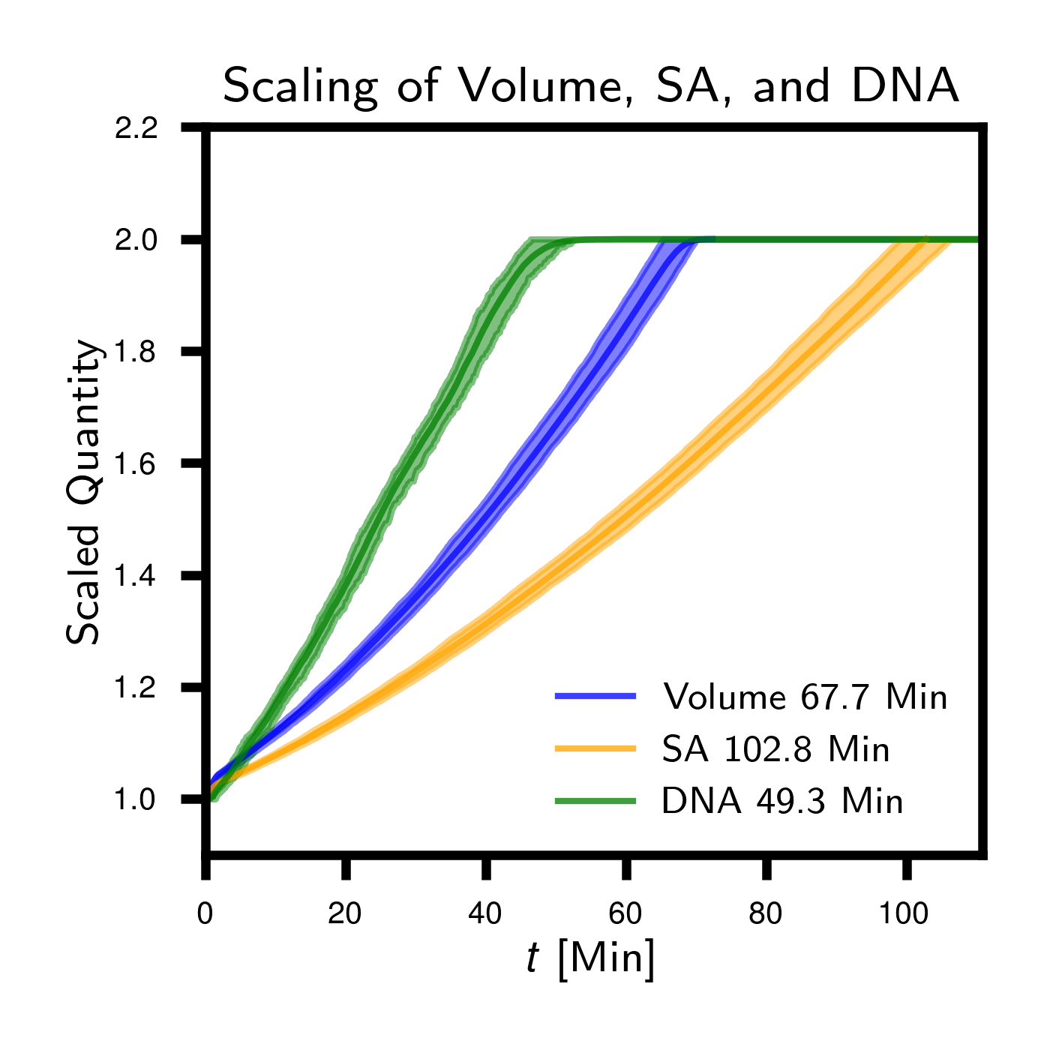
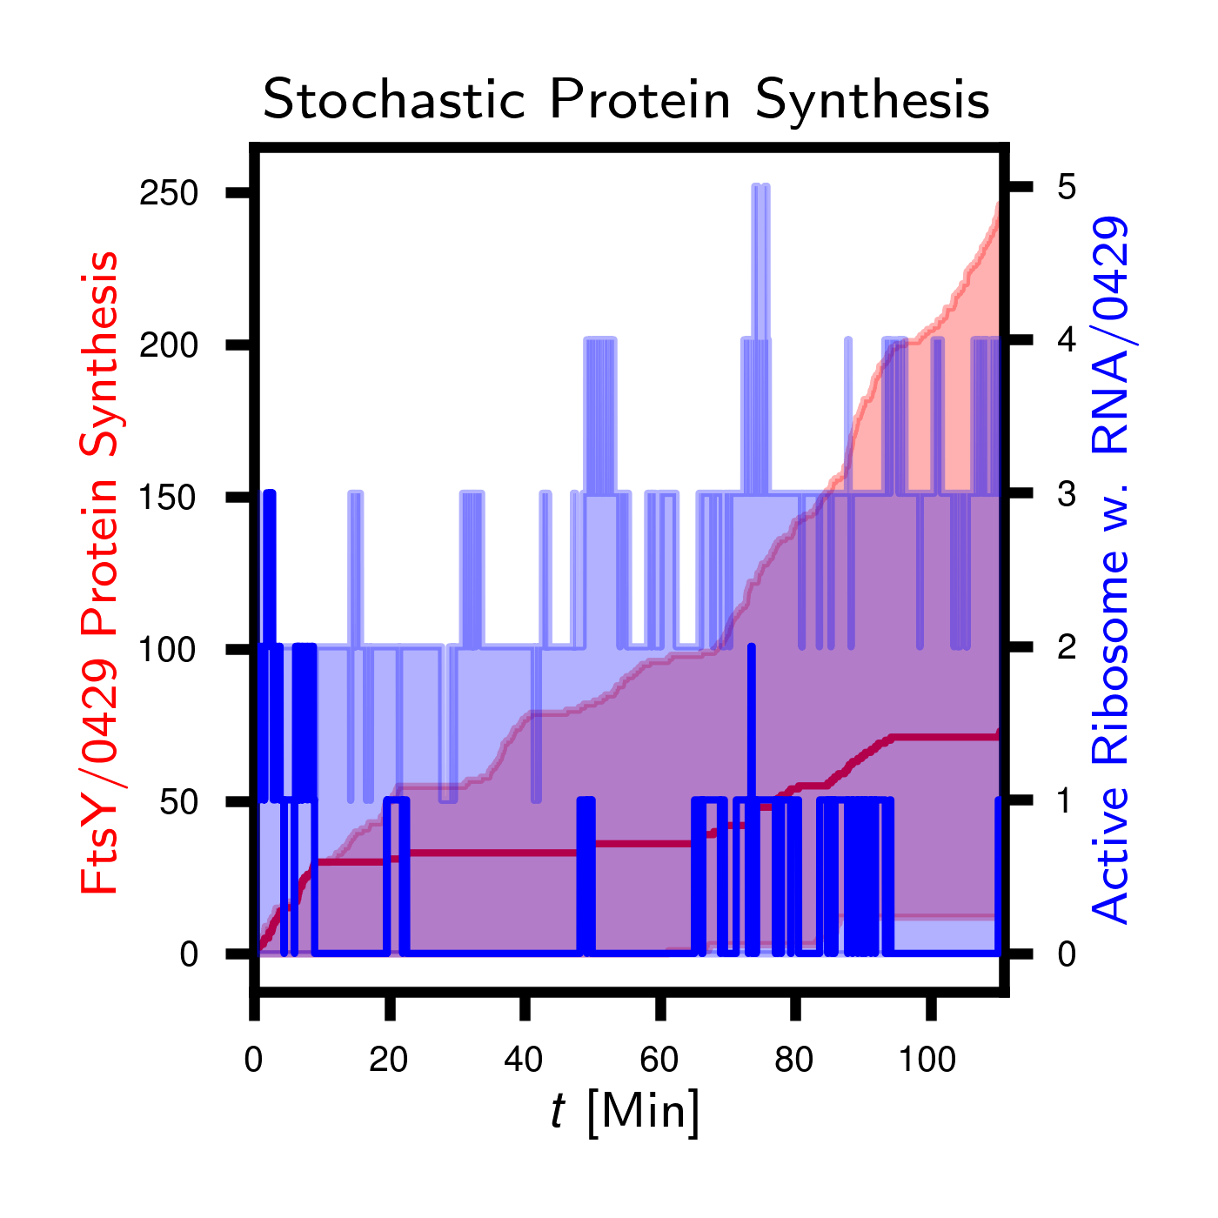
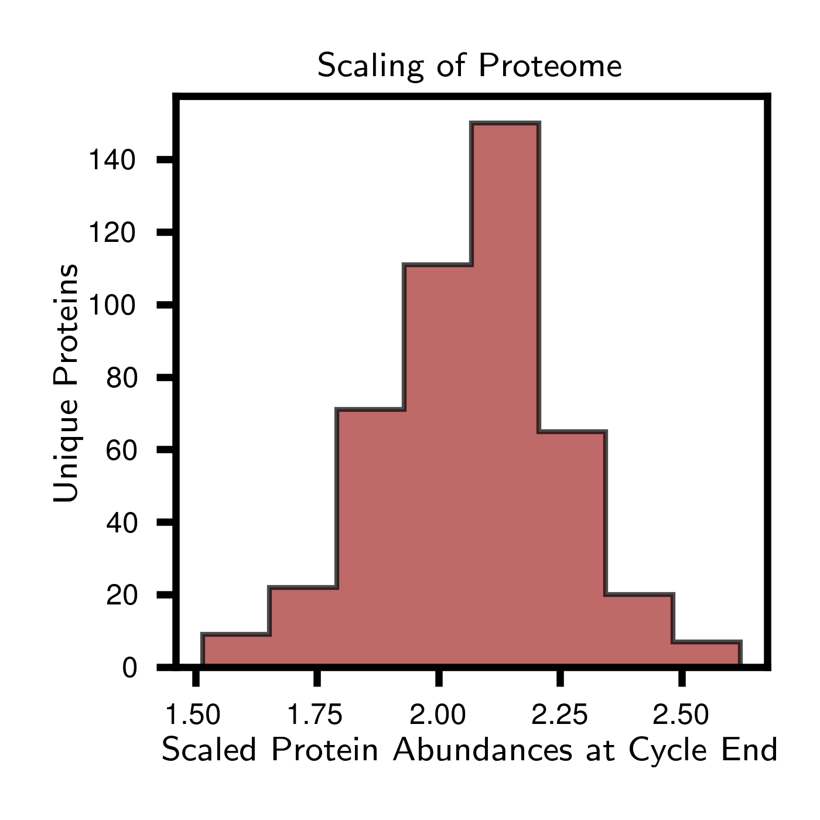
Cell Growth and Gene Expression
Cell Growth
Protein Synthesis
Doubling Proteome
(a)
(b)
(c)
V
V
2V
V
Sphere to dumbbell to two spheres.
Cell cycle of 102 min.
mRNA birth and degradation.
One mRNA translated into 6 proteins.
Crucial for cell division.
Constrained complex formation.
Notes:
Before discussing the complex assembly subsystem, we first examined whole-cell dynamics to provide the context. Our model predicted the cell cycle of 102 min, defined as surface area doubled the initial value from the membrane protein biogenesis and lipid metabolism, which is consistent with experiments. The gene expression is intrinsically stochastic, and actively translated mRNA transcript in one cell shown by the blue curve is subject to birth from transcription and death from degradation. At the end of the cell cycle, the initial proteome doubled to prepare for halving in cell division. Also, the synthesis of subunits ultimately constrained the formation of corresponding complexes.

