Slide 1
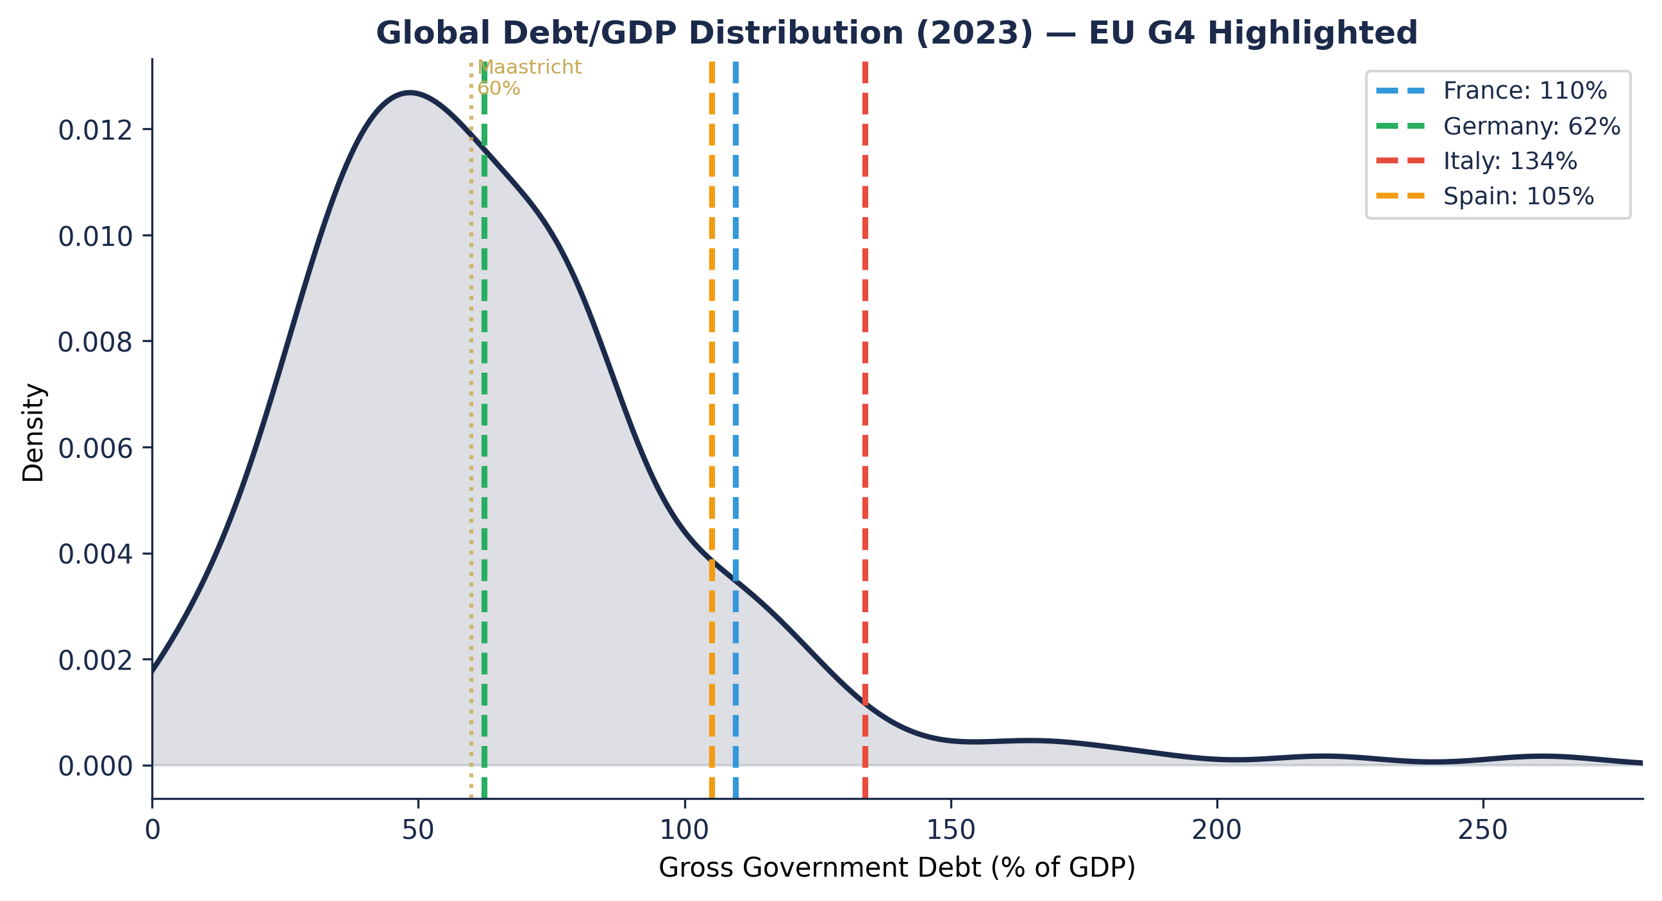
EU G4 Debt-at-Risk — Board Presentation
April 2026
Based on IMF Working Paper WP/25/86 · Furceri, Giannone, Kisat, Lam & Li (May 2025)
IMF WP/25/86 Methodology | Confidential

Slide 2
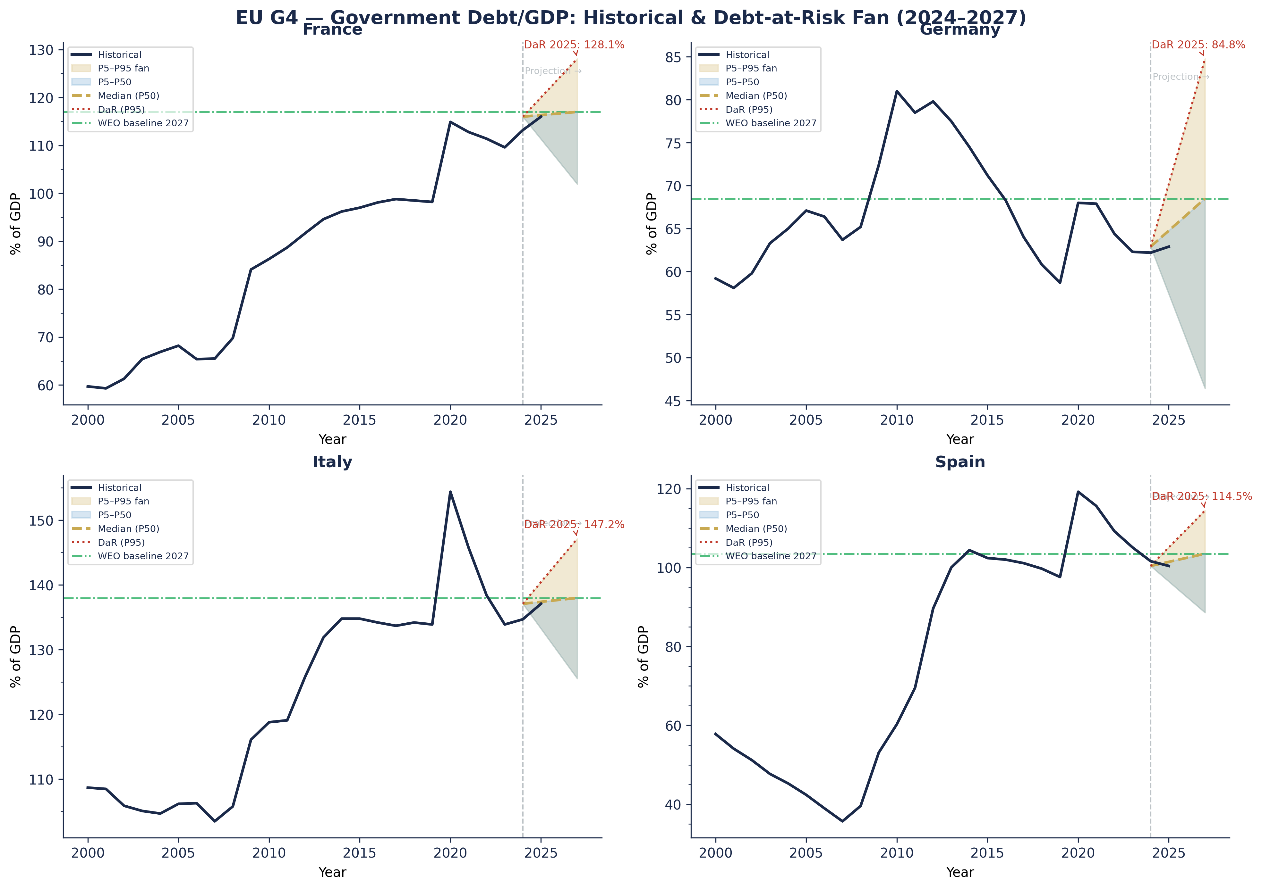
Debt-at-Risk Fan Charts — EU G4 (2024–2027 Horizon)
April 2026
Shaded bands: P5–P95 distribution conditional on current macro-financial environment
IMF WP/25/86 Methodology | Confidential

Slide 3
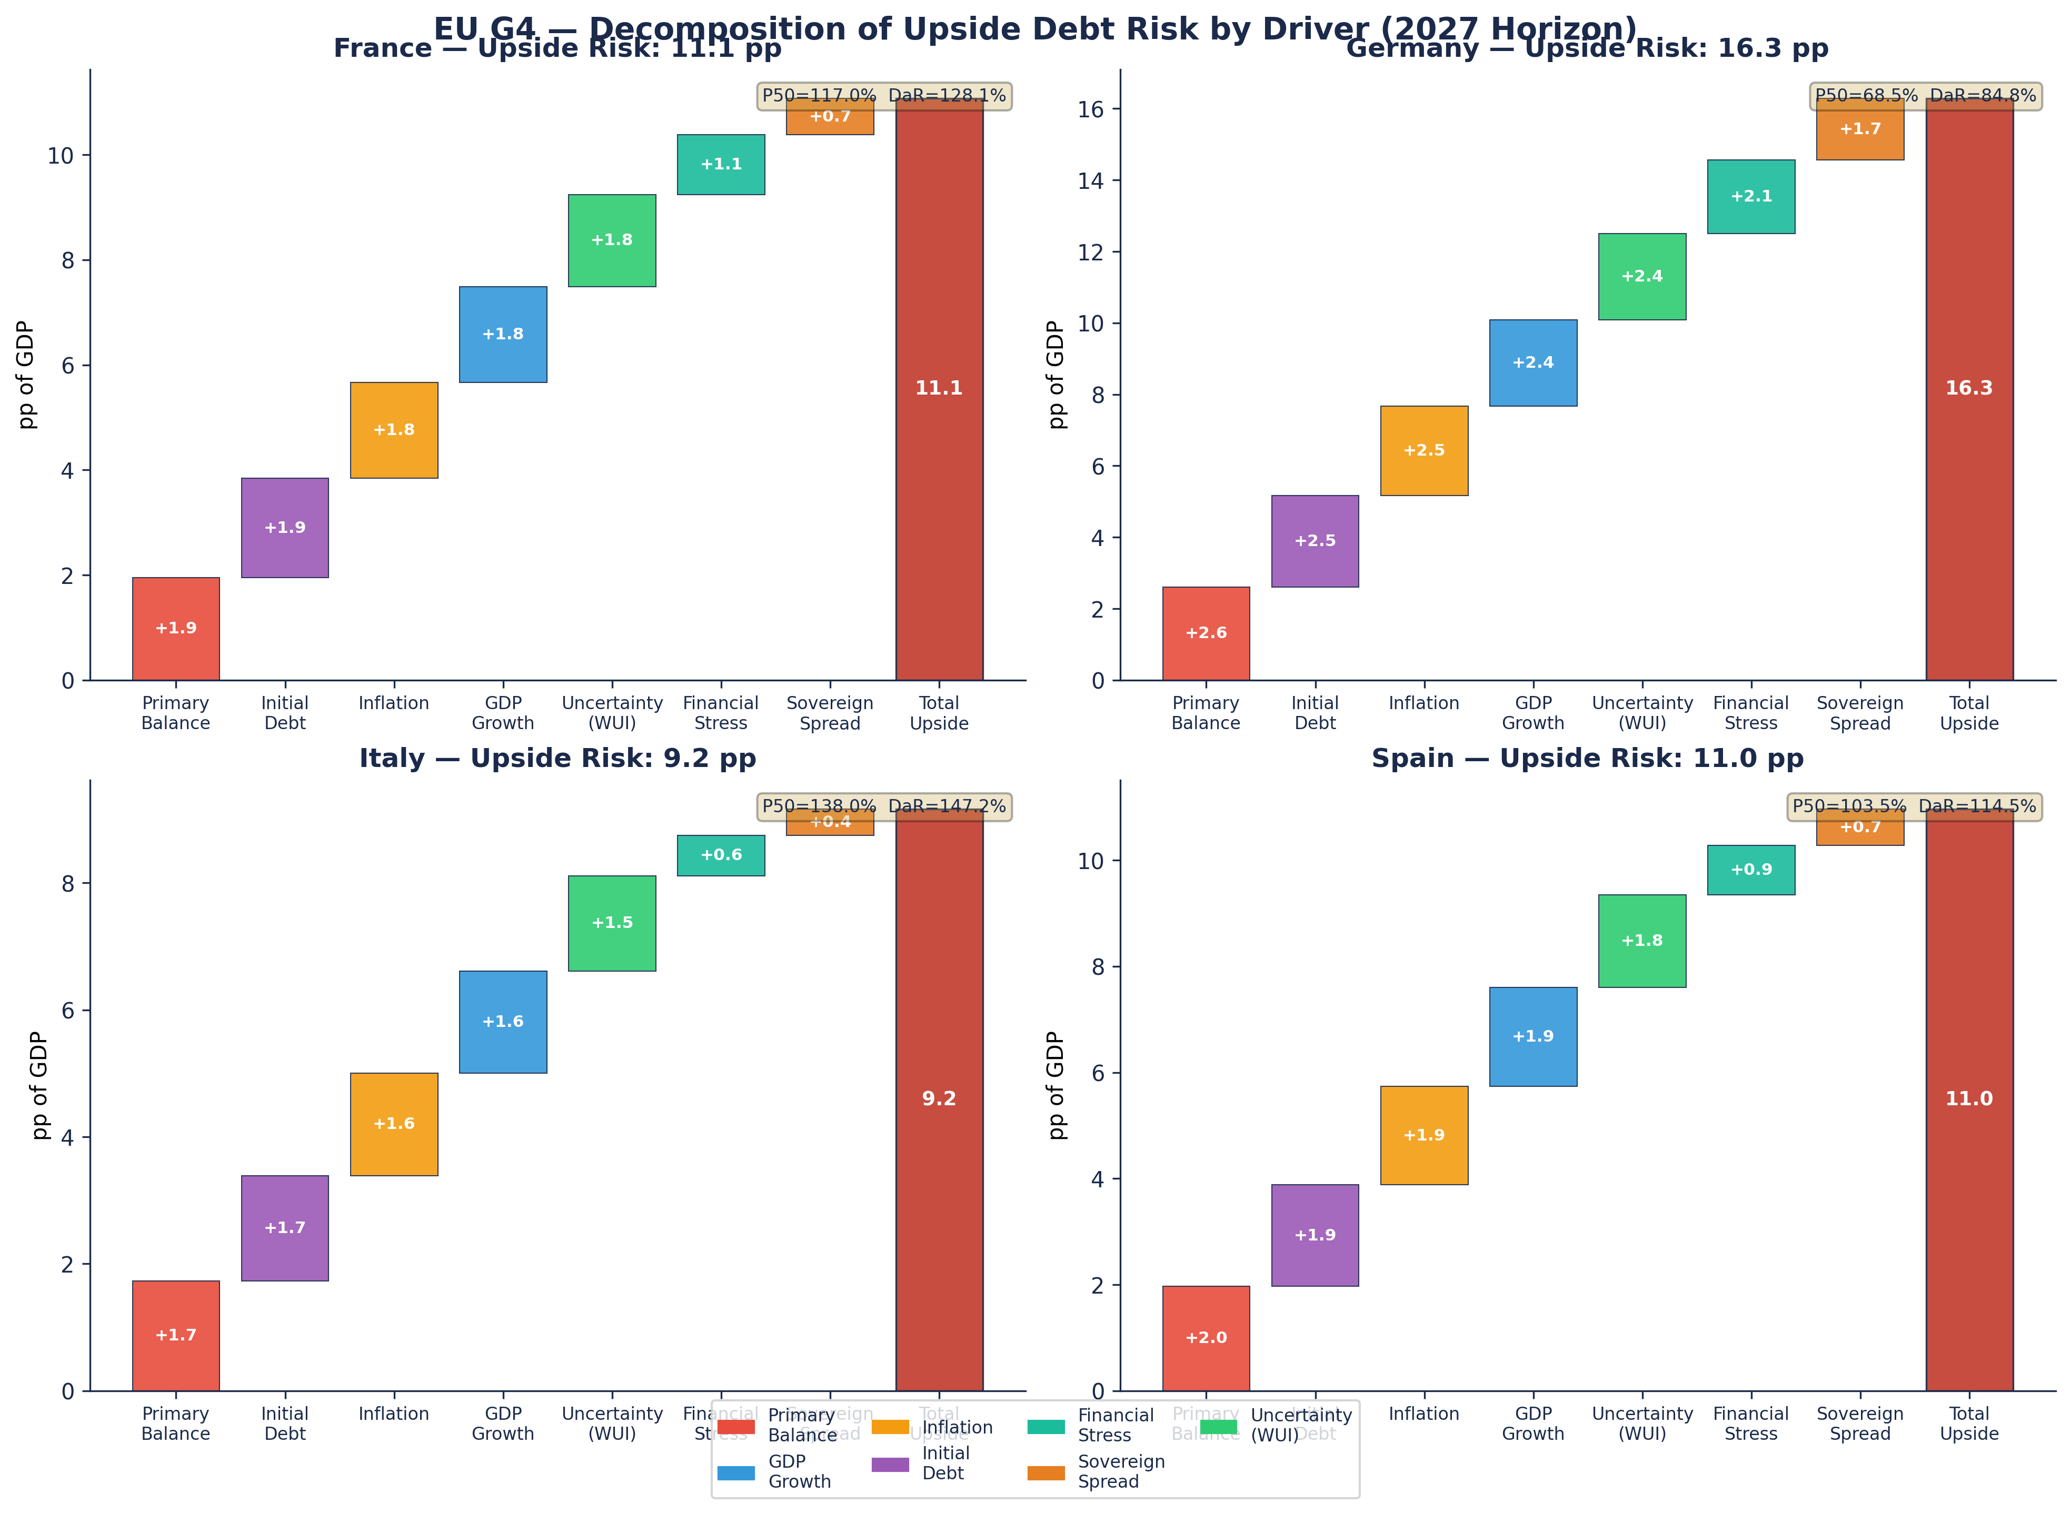
Upside Risk Decomposition by Driver
April 2026
Contribution of macro-financial drivers to DaR (P95 − P50) — 3-year horizon
IMF WP/25/86 Methodology | Confidential

Slide 4
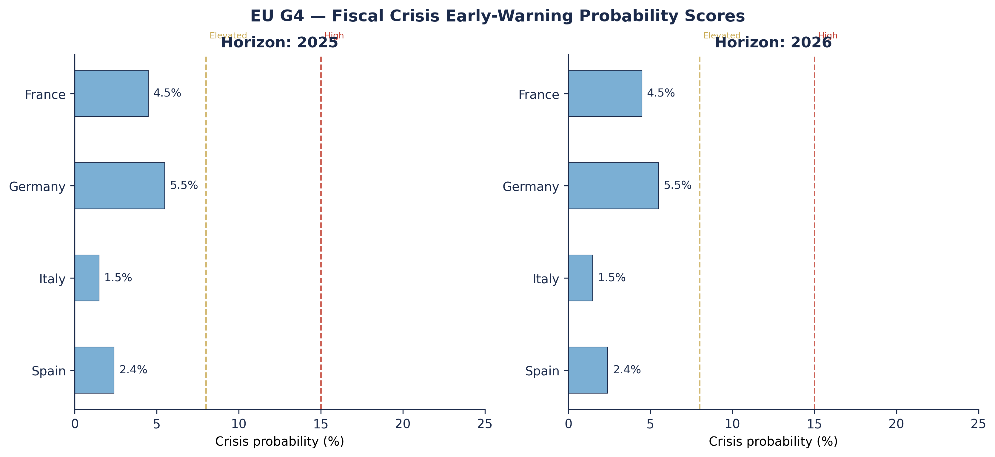
Fiscal Crisis Early-Warning Signals — EU G4 (2025–2026)
April 2026
Logit model: crisis probability ~ upside debt risk (P95 − P50) | Laeven-Valencia crisis episodes
Crisis Probability Summary
France 2025: 4.5% ●
France 2026: 4.5% ●
Germany 2025: 5.5% ●
Germany 2026: 5.5% ●
Italy 2025: 1.5% ●
Italy 2026: 1.5% ●
Spain 2025: 2.4% ●
Spain 2026: 2.4% ●
IMF WP/25/86 Methodology | Confidential

Slide 5
Policy Implications & Key Takeaways
April 2026
Edit this slide with current policy conclusions
Debt-at-Risk Summary (2027 Horizon)
France WEO Baseline: 117.0% │ Median: 117.0% │ DaR (P95): 128.1% │ Upside: +11.1 pp
Germany WEO Baseline: 68.5% │ Median: 68.5% │ DaR (P95): 84.8% │ Upside: +16.3 pp
Italy WEO Baseline: 138.0% │ Median: 138.0% │ DaR (P95): 147.2% │ Upside: +9.2 pp
Spain WEO Baseline: 103.5% │ Median: 103.5% │ DaR (P95): 114.5% │ Upside: +11.0 pp
1. Italy and France face the highest Debt-at-Risk: model-implied P95 paths exceed 130–145% of GDP by 2027 under adverse macro-financial scenarios.
2. Primary balance consolidation remains the dominant driver of upside risk across all G4 economies, followed by sovereign spread widening for periphery sovereigns.
3. Fiscal crisis early-warning scores are elevated for Spain and Italy (2025–2026), warranting contingency planning.
4. Germany's lower DaR reflects fiscal space; however, uncertainty-driven tail risks have risen post-2022.
5. [EDIT] Recommended policy action: Commit to credible medium-term fiscal frameworks to anchor debt expectations and narrow the DaR-to-baseline gap.
Methodology: Machado-Santos Silva (2019) location-scale quantile regression · Log-score density pooling (Crump et al. 2022) · IMF WP/25/86
IMF WP/25/86 Methodology | Confidential

