Slide 1


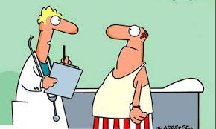

PROBLEM?
WHO ARE YOU ??
ASK YOURSELF -
DO YOU FACE IT???

Slide 2




We present - GetMed
OUR VISION- TO PROVIDE RELIABLE INFORMATION ON PHARMACEUTICAL AVAILABILITY TO
THE NEEDY.
OUR MISSION- TO BE THE PRE-EMINENT PROVIDER OF CHOICE FOR PHARMACY
TO THE PEOPLE OF INDIA
GetMed

Slide 3
Where’s the money?
INFLOW
TRANSACTIONAL
SUBSCRIPTIONAL
DATA RESOURCES
OUTFLOW
IT INFRASTRUCTURE
FEET ON THE GROUND
EMPLOYEES
OVERHEADS
EXPECTED MARGIN

Slide 4




MARKET SIZE
US$ 50 Bn -- 80%+20%
TARGET CUSTOMER
COMPETITORS

Slide 5
HOW WE ARE DIFFERENT?
COMMUNITY - UNORGANISED SEGMENT
OMNI CHANNEL
HYPER SEARCH
DELIVERY
MULTIPLE MODES OF RECEIPT.
REMINDER SERVICE
OUR USP
HYPER LOCAL AGGREGATOR SERVICE WHICH FACILITATES DELIVERY

Slide 6
WHAT CUSTOMERS THOUGHT ABOUT THIS IDEA?
WHAT PHARMACIES THOUGHT ABOUT THIS IDEA?

Slide 7
HOW WE PLAN TO ENTER THE MARKET ?
GROWTH STRATEGY
Geographical
APARTMENTS-LOCALITY-REGION-CITY
Revenue
TRANSACTIONAL-SUBSCRIPTION-ADS-DATA RESOURCES
Technological
Display results based on Price, Discount, Distance.
Display Substitute and offer to buy
Real Time Updation of the Inventory

Slide 8
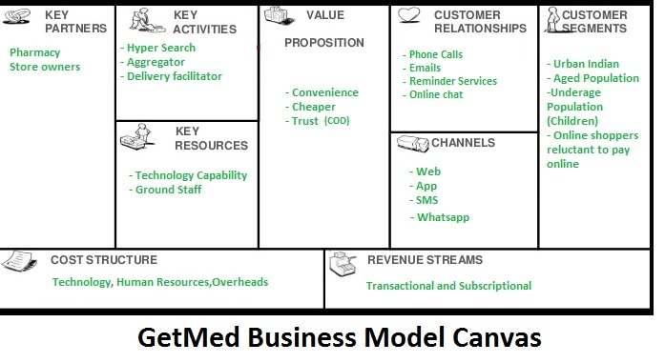

Slide 9
OUR TEAM
Hirak Business Development
Abhishek Marketing
Anirudh Business Development
Ravi Marketing Research
Ritul Web Dev
Rachit App Dev
Amit Web Dev
Shaijil Marketing
Research
GetMed
Get Medicines Hassle Free

