Slide 1


School Facilities and Equipment Management System - SFEMS
SEP490_G123
Supervisor: Đinh Thị Xuân

Slide 2
I. Project introduction
II. Project Management Plan
III. Software Requirement Speciﬁcation
TABLE OF CONTENT
Page 2

Slide 3






TEAM MEMBERS
Lưu Văn Đông
HE181461
Trần Ngọc Tú
HE181526
Phạm Nguyễn Duy Hoàng
HE186613
Nguyễn Vũ Nghĩa
HE170095
Trần Duy Quang
HE176369
Page 4

Slide 4
SEP490_G123
School Facilities and Equipment Management System
I. PROJECT INTRODUCTION
SFEMS
Page 5

Slide 5
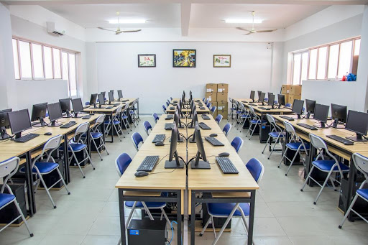
PROJECT BACKGROUND
Governance & Roles: Equipment is provided according to MOET minimum lists; DOET directs procurement, while individual schools manage tracking records and annual inventory.
Existing IT Setup: DOET already operates student and teacher management systems, but facility and equipment data remains isolated and unsynchronized.
Large Data Scale: Over 1,670 schools from merged administrative regions bring disparate equipment codes, naming conventions, and record templates.
Centralized System Need: DOET is investing in a unified data system to manage the entire equipment lifecycle (procurement planning, asset registration, and inventory).
SFEMS
Page 6

Slide 6
PROBLEMS
Fragmented Data: Inconsistent coding, naming, and record templates make city-wide data consolidation across over 1,670 schools impossible.
Manual Processes: Only ~50% IT usage; heavy reliance on local spreadsheets creates high administrative workload and data silos.
Delayed Reporting: Complex, manual review cycles across 1,300+ units result in missed deadlines and urgent reminder notices.
Equipment Loss: Absence of centralized, real-time tracking leads to untracked asset loss and budgeting inefficiencies.
SFEMS
Page 7

Slide 7
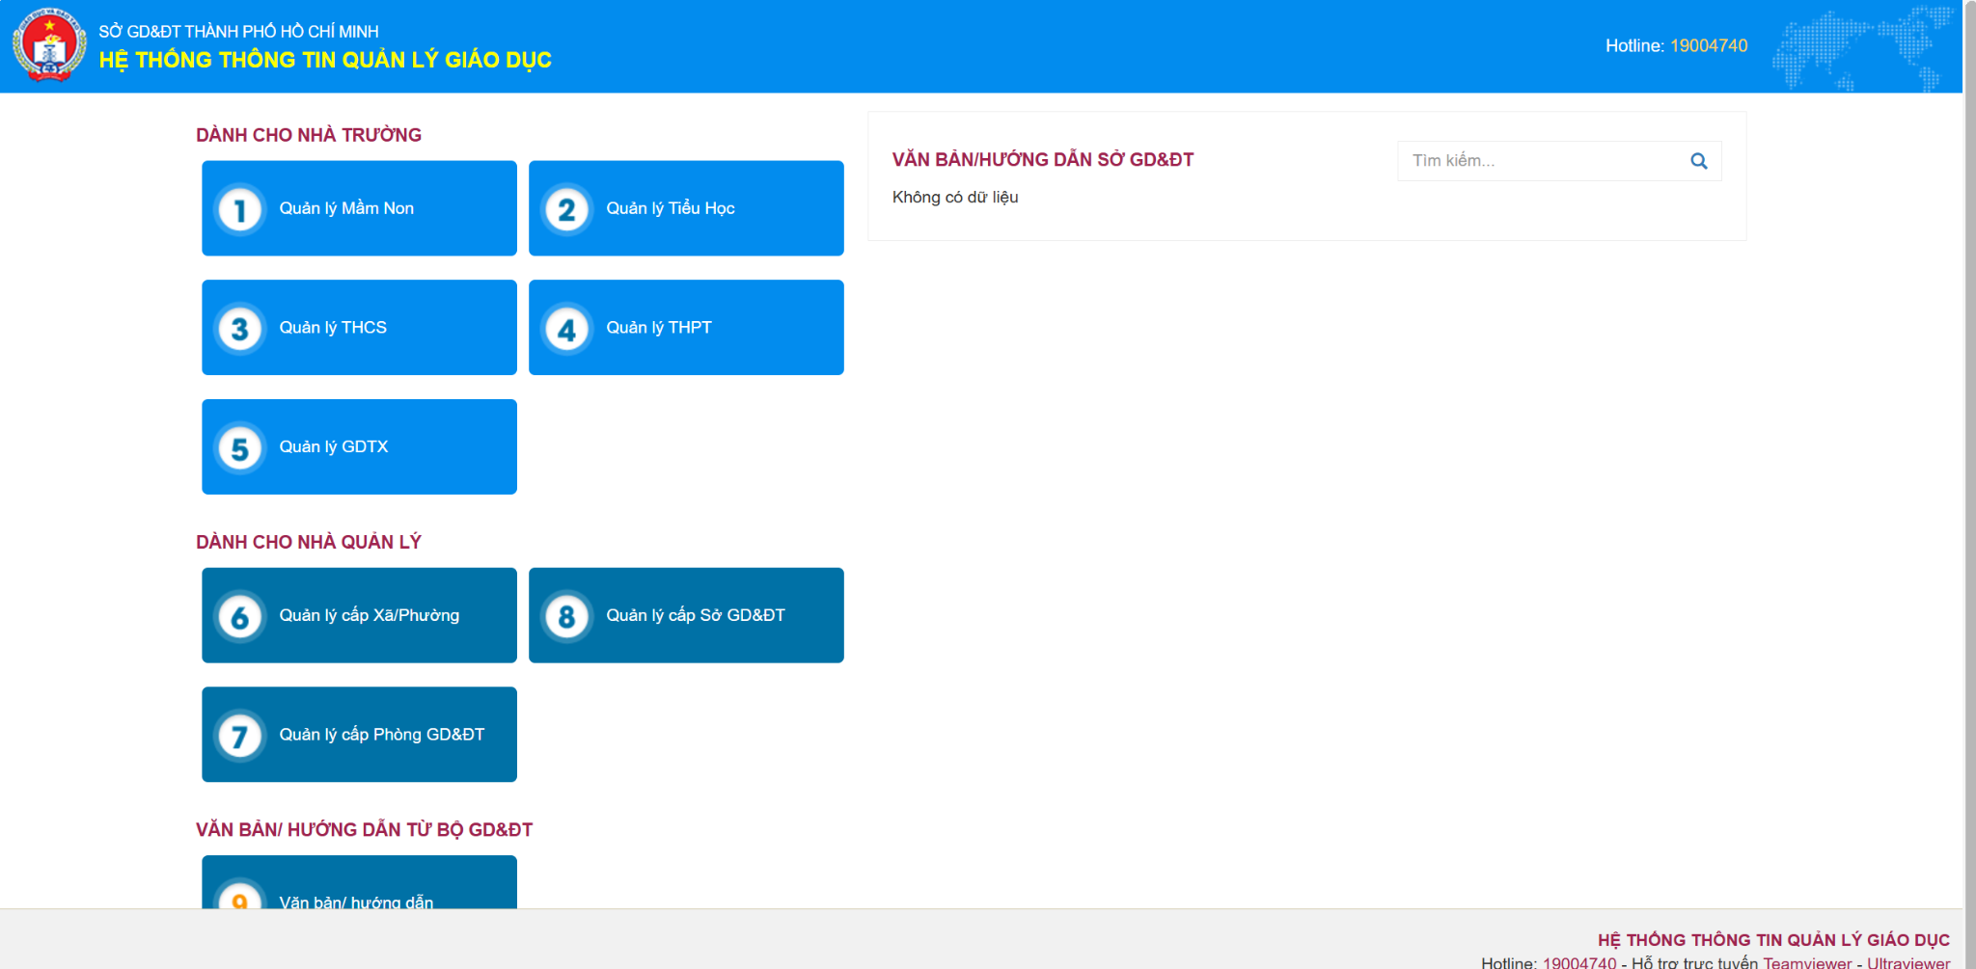
EXISTING SOLOTIONS
https://csdl.hcm.edu.vn
SFEMS
Page 8

Slide 8
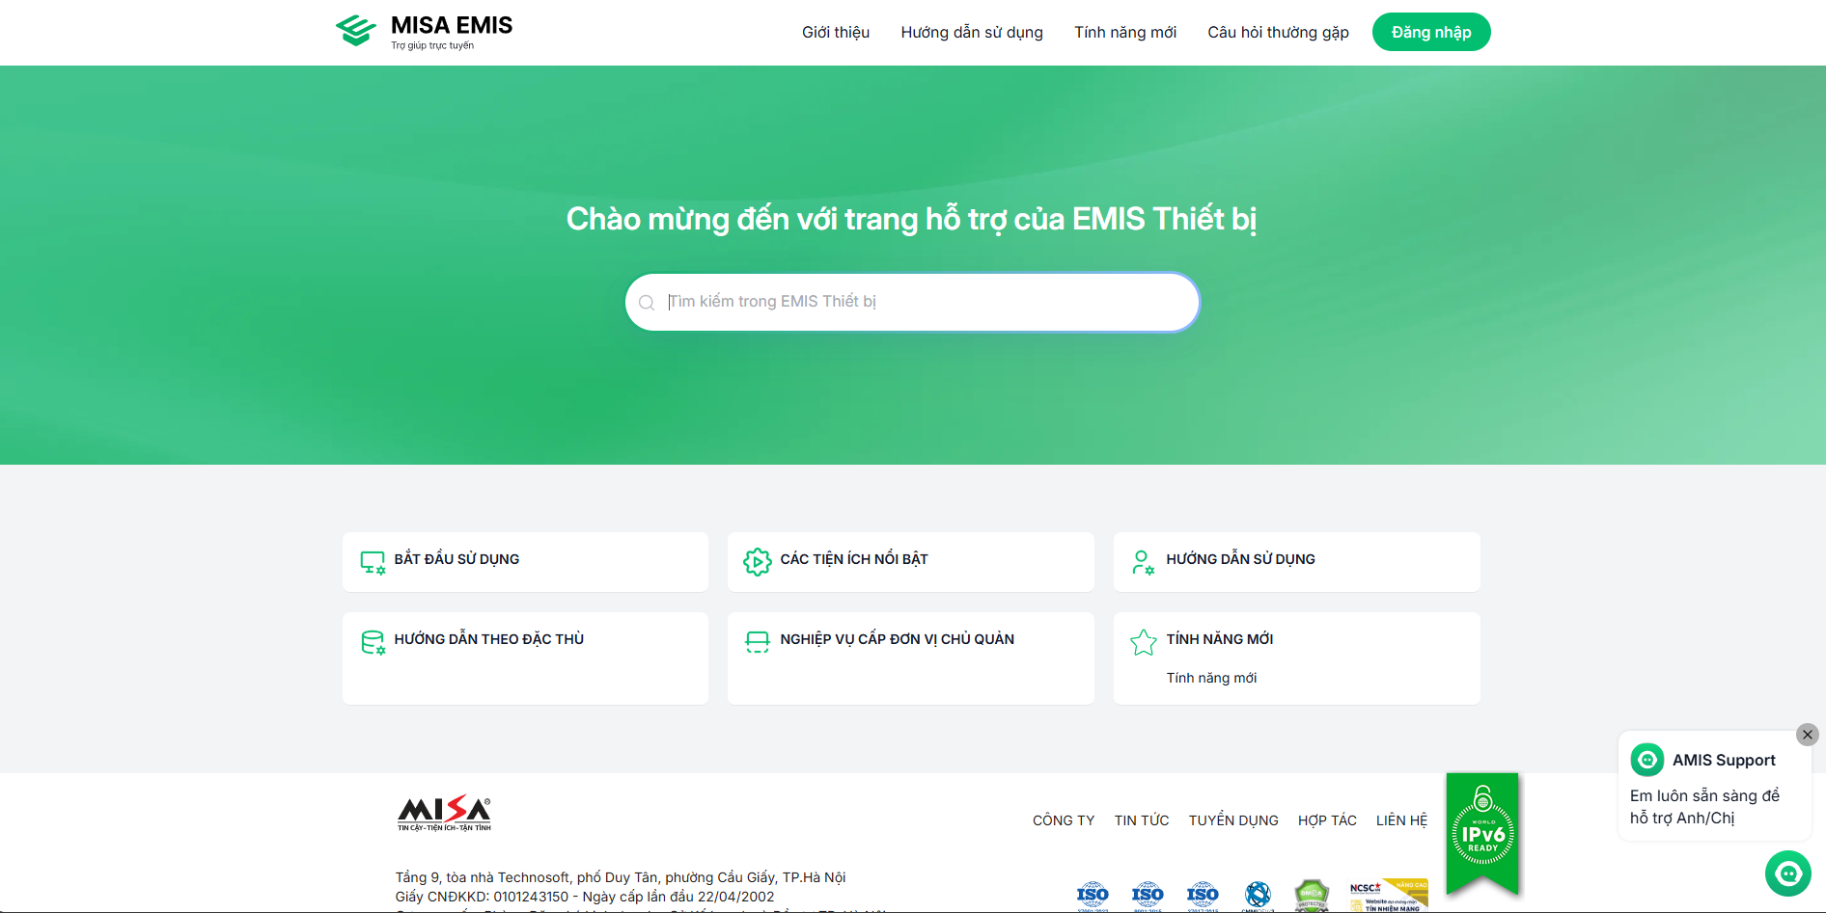
EXISTING SOLOTIONS
https://helpemis.misa.vn/
SFEMS
Page 9

Slide 9
PROJECT PURPOSE
Centralized Lifecycle Management : Implements a web-based system (SFEMS) to manage the entire equipment lifecycle directly from daily school operations, eliminating manual reporting rounds.
Standardized Coding & Rules : Classifies equipment using MOET minimum lists and enforces unified coding rules, allowing seamless data consolidation across all schools.
Automated Core Flows : Streamlines 3 key operational flows: procurement planning (GAP-07), asset registration & code generation (GAP-02), and digital inventory rounds (GAP-06).
Single Source & Secure Access : Provides a single shared database with strict Role-Based Access Control (RBAC)—schools manage local assets, while DOET maintains city-wide oversight.
SFEMS
Page 10

Slide 10
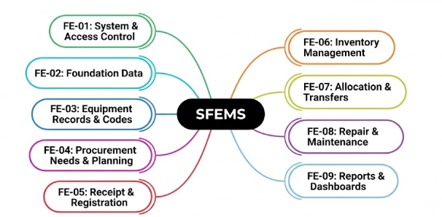
MAIN FEATURE
SFEMS
Page 11

Slide 11
LIMITATION & EXCLUSIONS
1. Limitation:
Waiting for the DOET to provide access to the City's shared identity system.The system uses its own accounts and passwords.
Teachers do not sign into the system;the school equipment officer records borrowing,returns and fault reports on their behalf.
2. Exclusions:
These Schools Belong To A different management level and need their own roles,data scope and approval steps.
The project covers only the upper-secondary schools managed directly by the DOET, with two levels: the DOET and the school
SFEMS
Page 12

Slide 12
SEP490_G123
School Facilities and Equipment Management System
II. PROJECT MANAGEMENT PLAN
SFEMS
Page 13

Slide 13
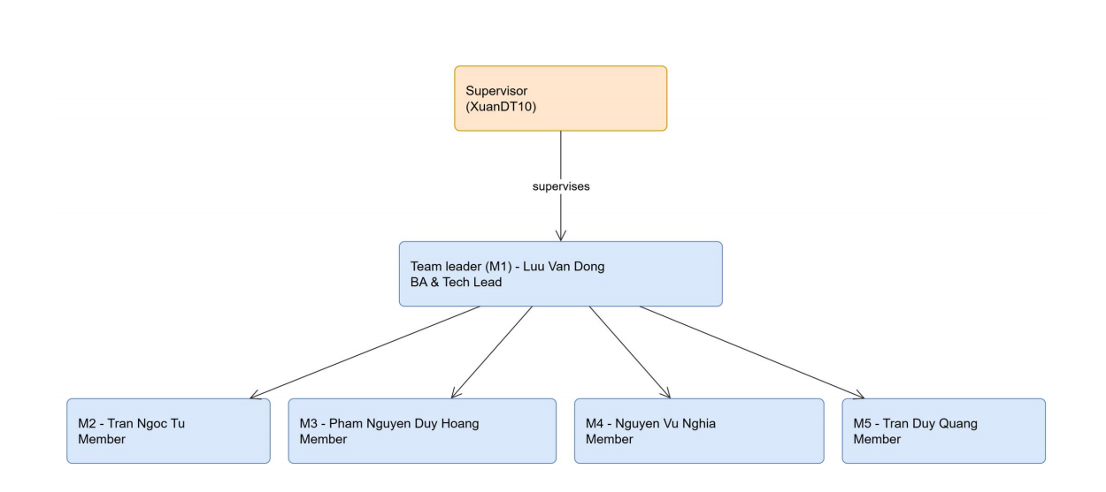
PROJECT ORGANIZATION
SFEMS
Page 14

Slide 14
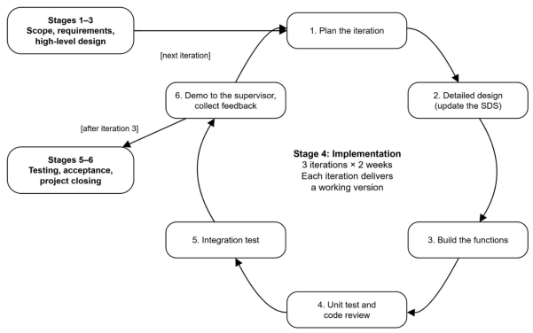
PROJECT PROCCESS
SFEMS
Page 15

Slide 15
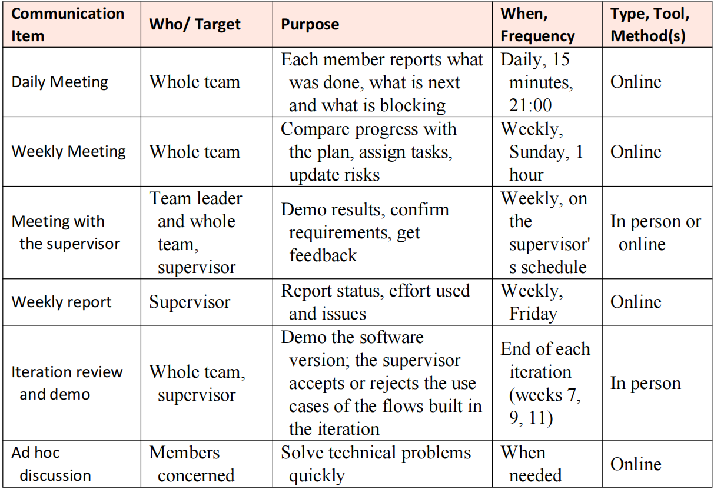
COMMUNICATION PLANT
SFEMS
Page 16

Slide 16

QUALITY MANAGEMENT
Defect prevention
Database safety
Testing
Review
Metrics tracking
SFEMS
Page 17

Slide 17


















PROJECT TOOLS
Technologies
Version Control
Database
Communication
IDEs/Editors
Deployment server
Document & Diagramming
SFEMS
Page 18
Election System

Slide 18
SEP490_G123
School Facilities and Equipment Management System
III. REQUIRMENT SPECIFICATION
SFEMS
Page 20

Slide 19
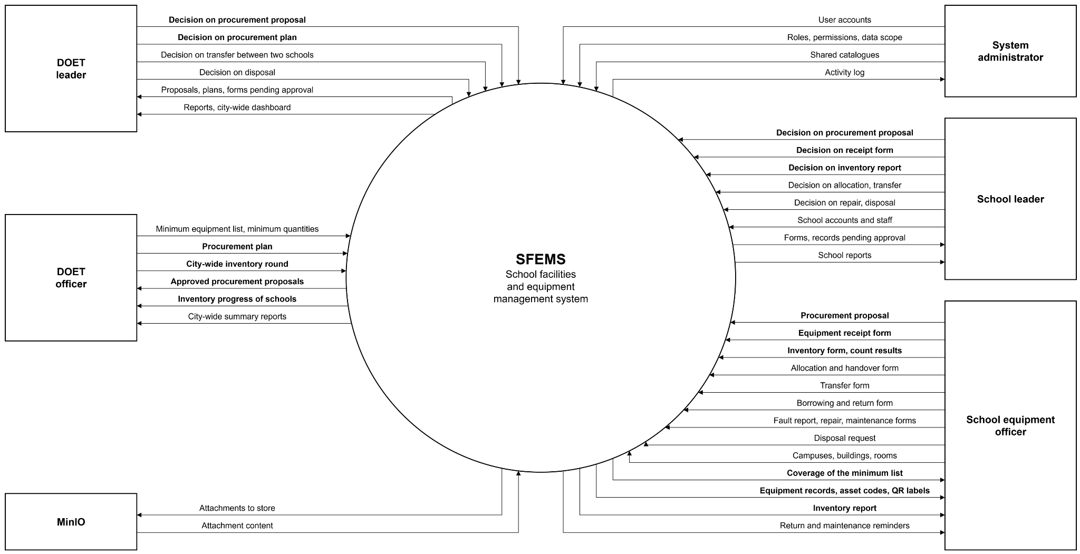
Context Diagram
SFEMS
Page 21

Slide 20
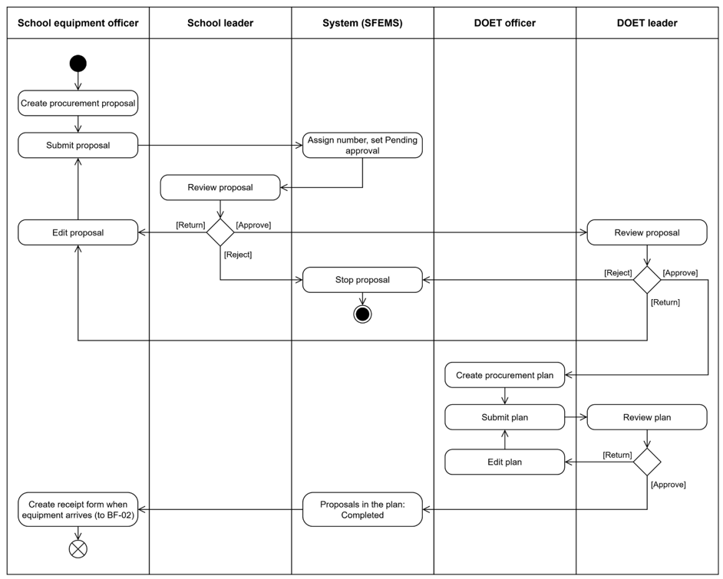
Main Workflow
Procurement needs and planning Workflow
SFEMS
Page 22

Slide 21
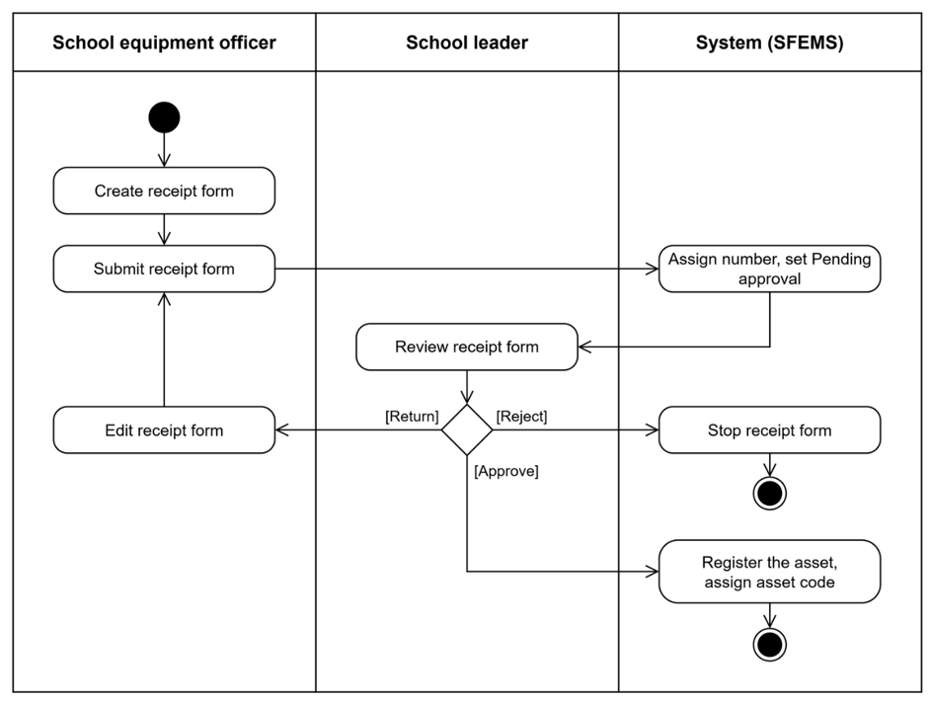
Main Workflow
Equipment receipt and asset registration workflow
SFEMS
Page 23

Slide 22
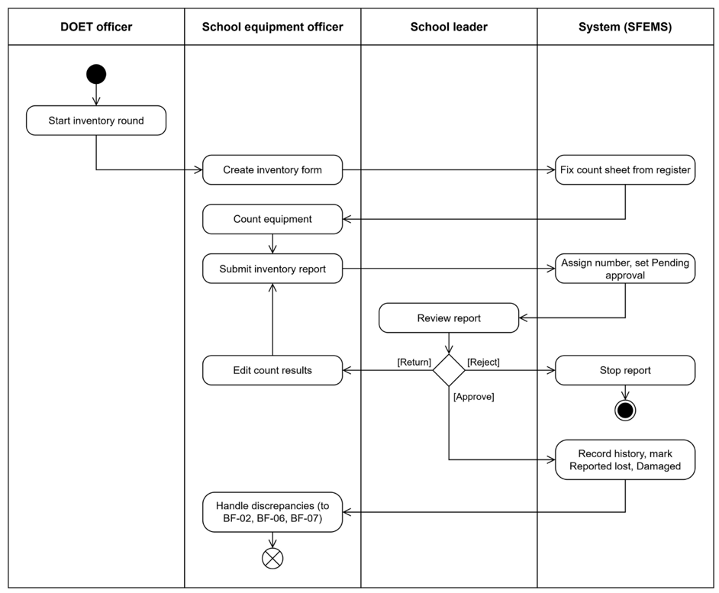
Main Workflow
Inventory Workflow
SFEMS
Page 24

Slide 23
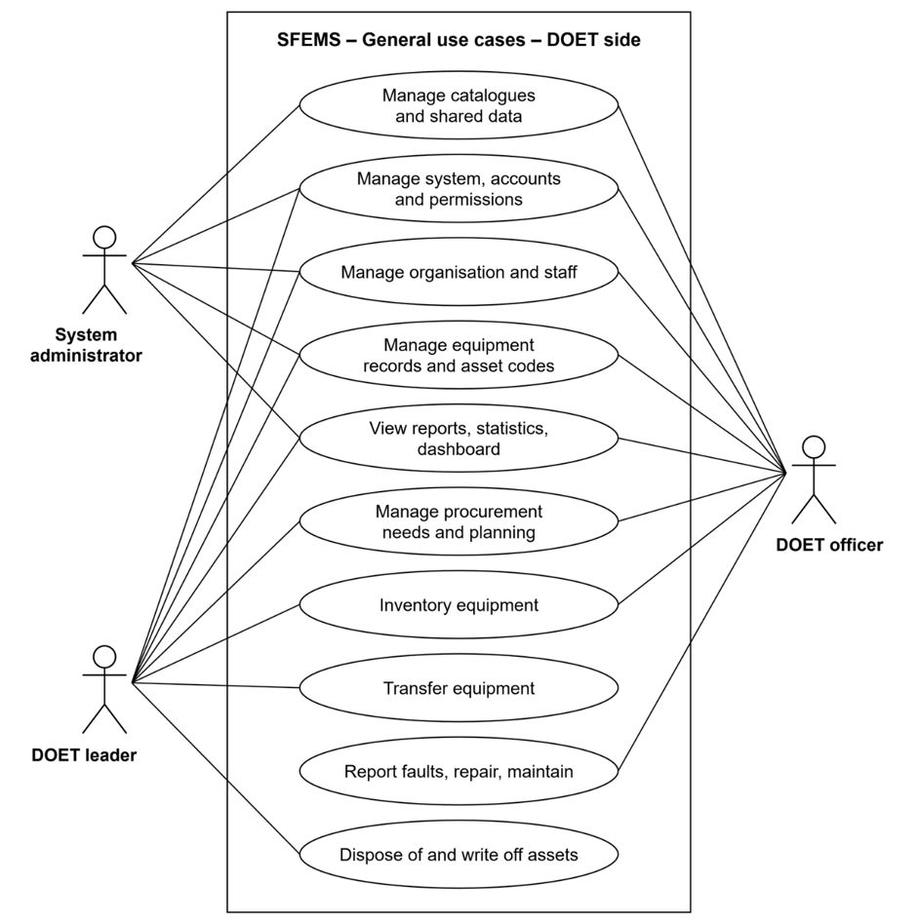
USE CASE
DIAGRAM
Overall Use Case: DOET Side
SFEMS
Page 27

Slide 24
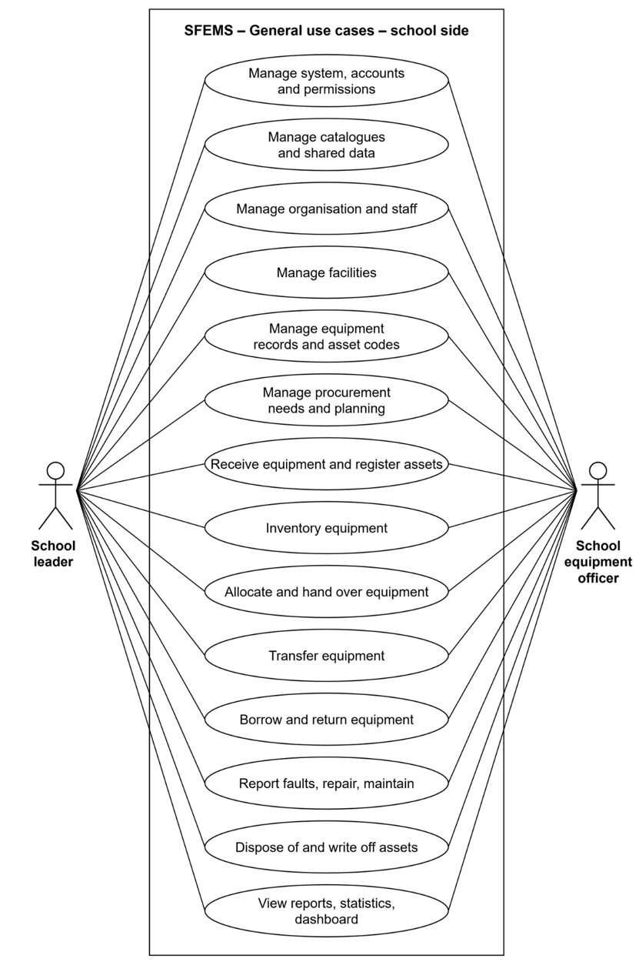
USE CASE
DIAGRAM
Overall Use Case:
School Side
SFEMS
Page 27

Slide 25
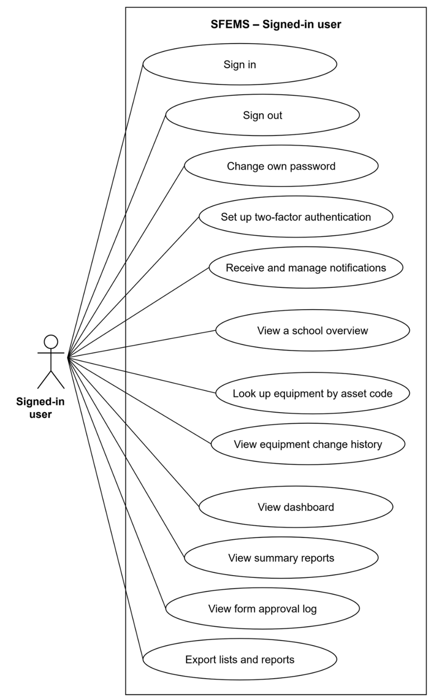
USE CASE
DIAGRAM
Use Cases For Signed-in User
SFEMS
Page 27

Slide 26
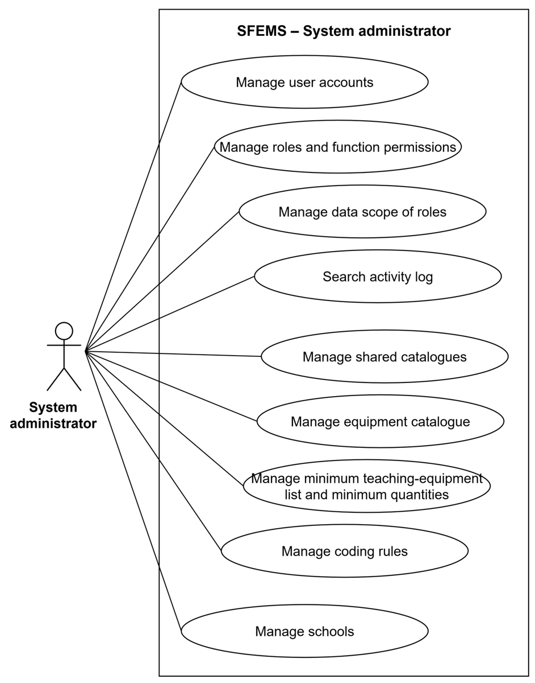
USE CASE
DIAGRAM
Use Case For
System Administrator
SFEMS
Page 28

Slide 27
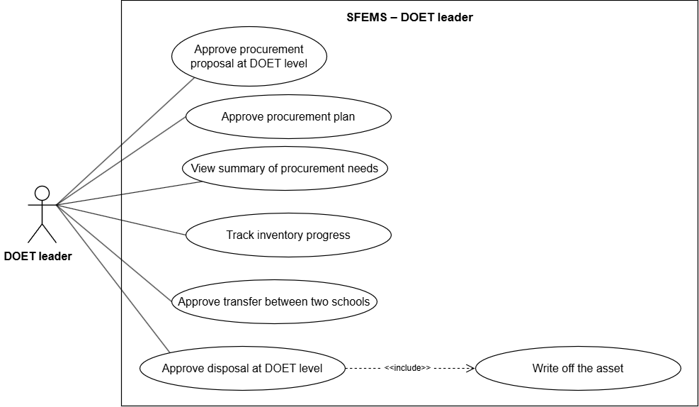
USE CASE
DIAGRAM
Use Case For DOET Leader
SFEMS
Page 29

Slide 28
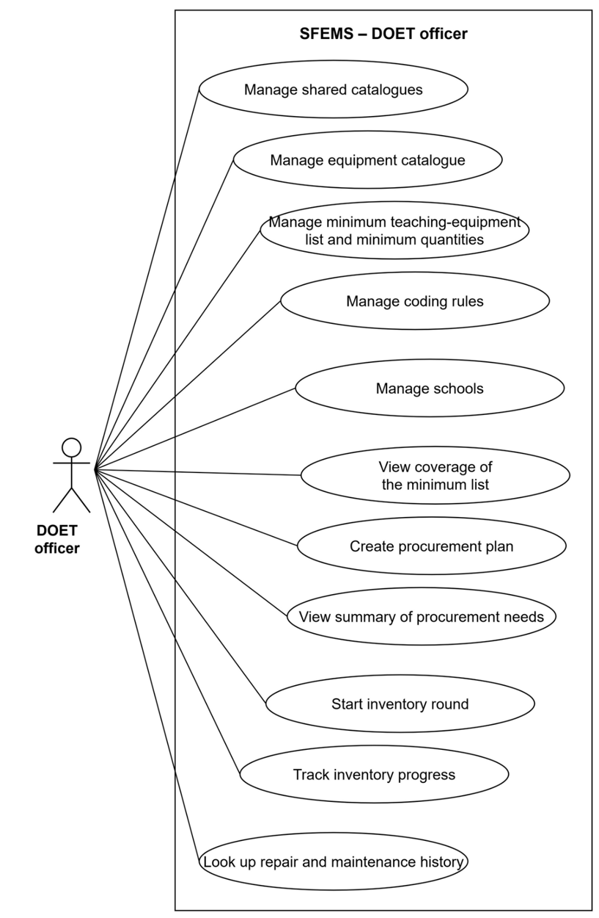
USE CASE
DIAGRAM
Use Case For DOET Officer
SFEMS
Page 30

Slide 29
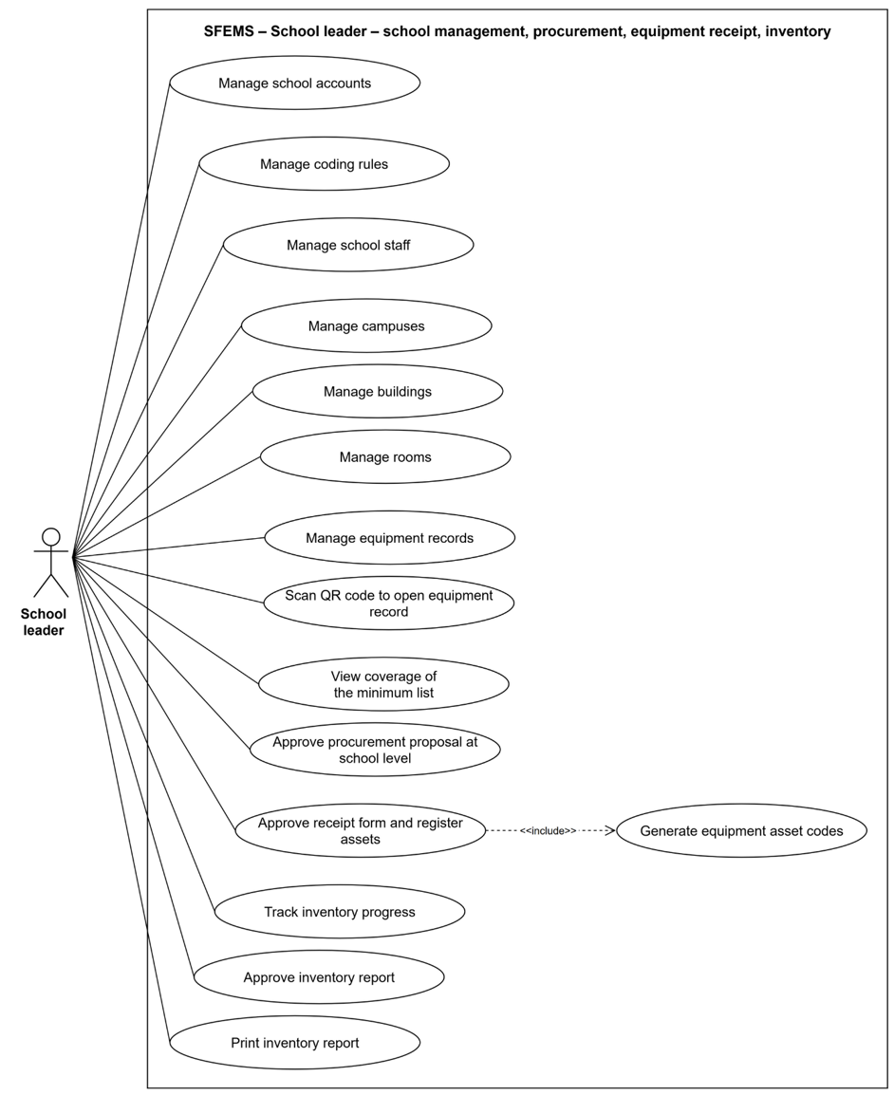
USE CASE
DIAGRAM
Use Case For School Leader
SFEMS
Page 31

Slide 30
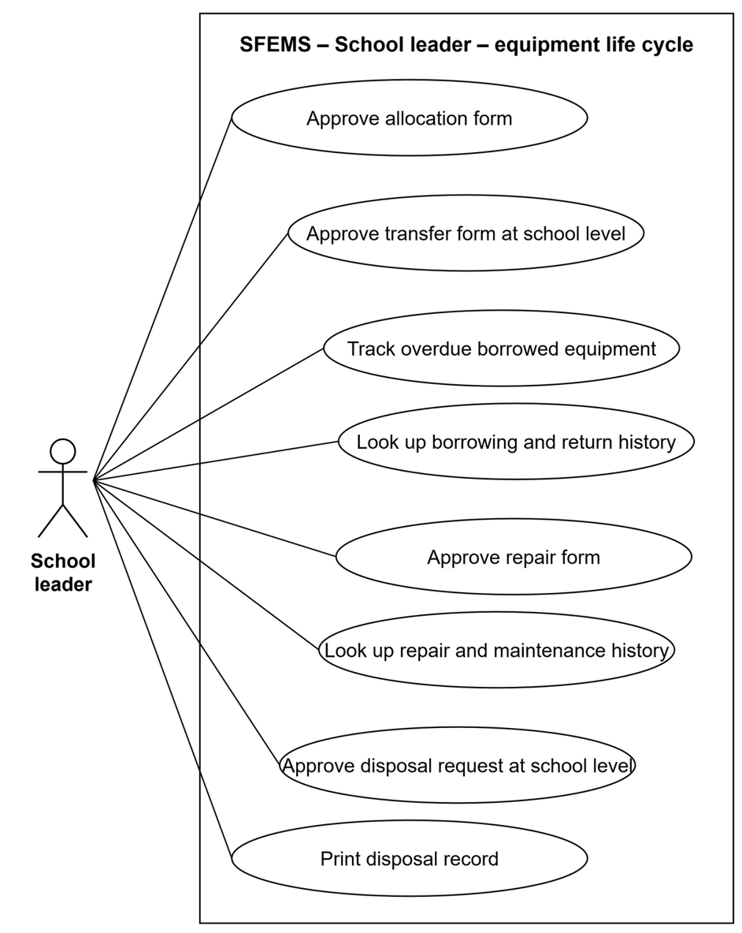
USE CASE
DIAGRAM
Use Case For School Leader
SFEMS
Page 32

Slide 31
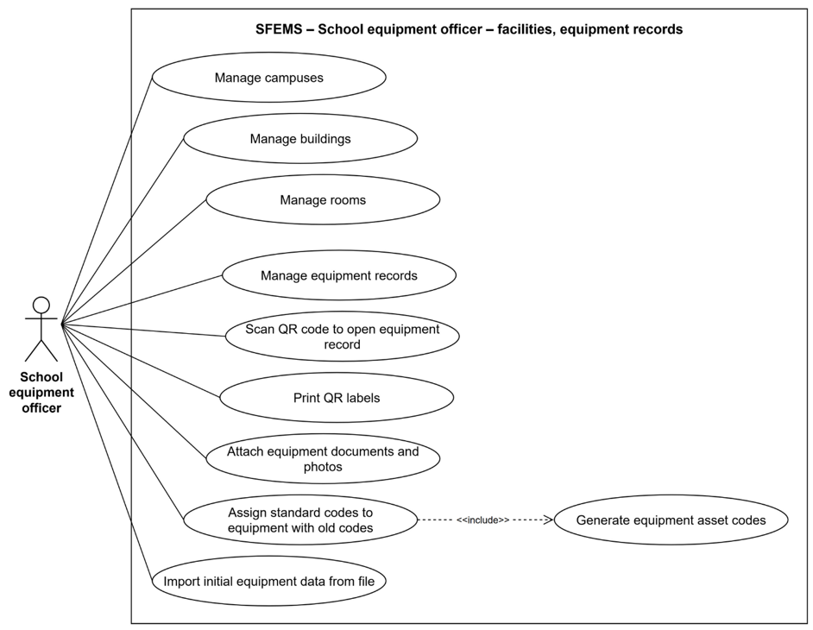
USE CASE
DIAGRAM
Use Case For
School Equipment Officer
SFEMS
Page 32

Slide 32
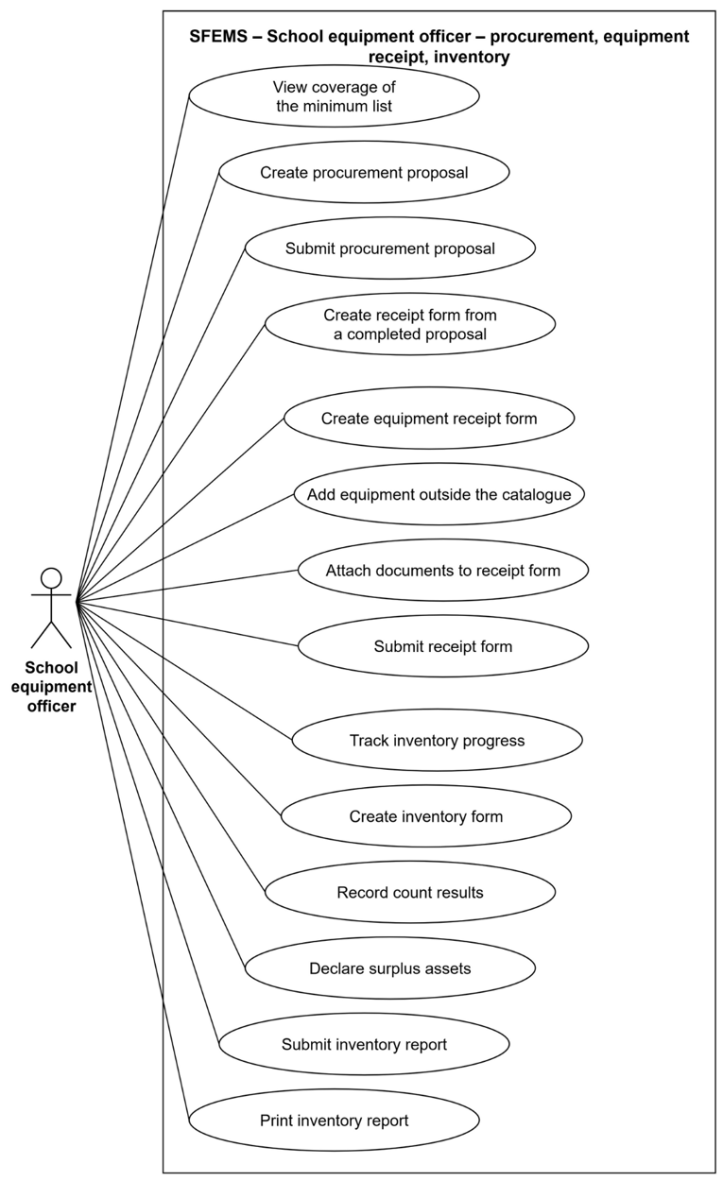
USE CASE
DIAGRAM
Use Case For
School Equipment Officer
SFEMS
Page 32

Slide 33
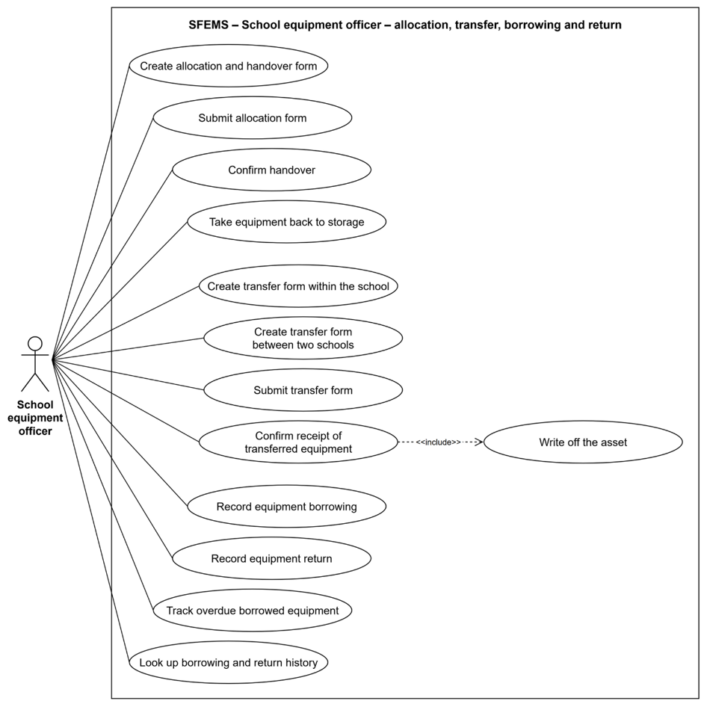
USE CASE
DIAGRAM
Use Case For
School Equipment Officer
SFEMS
Page 32

Slide 34
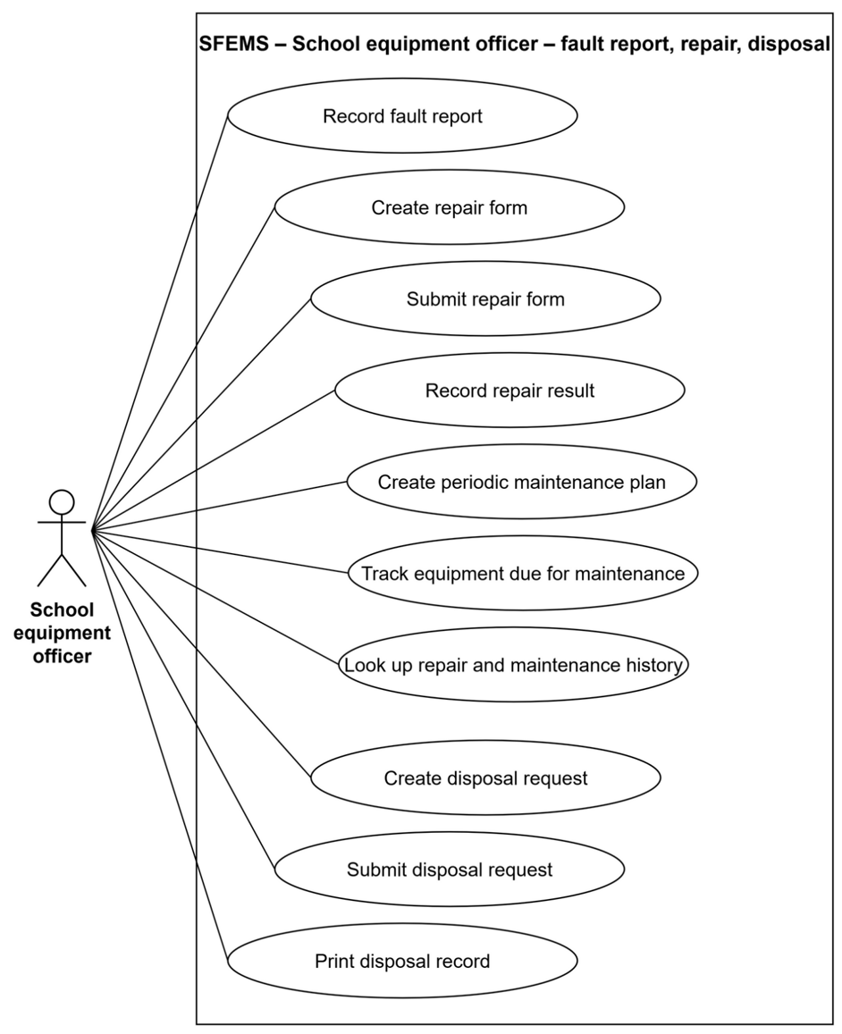
USE CASE
DIAGRAM
Use Case For
School Equipment Officer
SFEMS
Page 32

Slide 35




THANK YOU

