Slide 1
LIbRARY PROJECT
GROUP 1
Eman Mohammed 986642 Thi Quynh Mai Tran 986609 Thi Kim Hoa Luu 986647

Slide 2
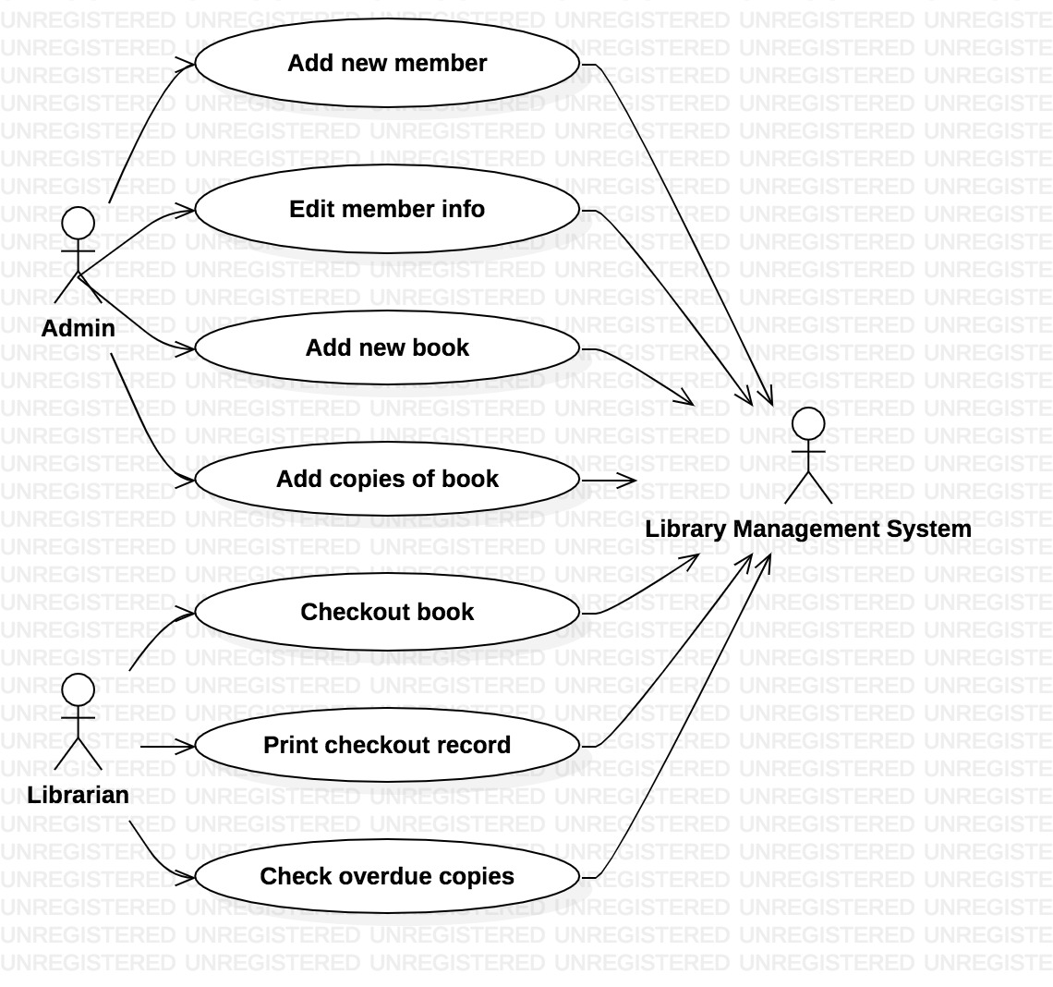
UseCase Model

Slide 3
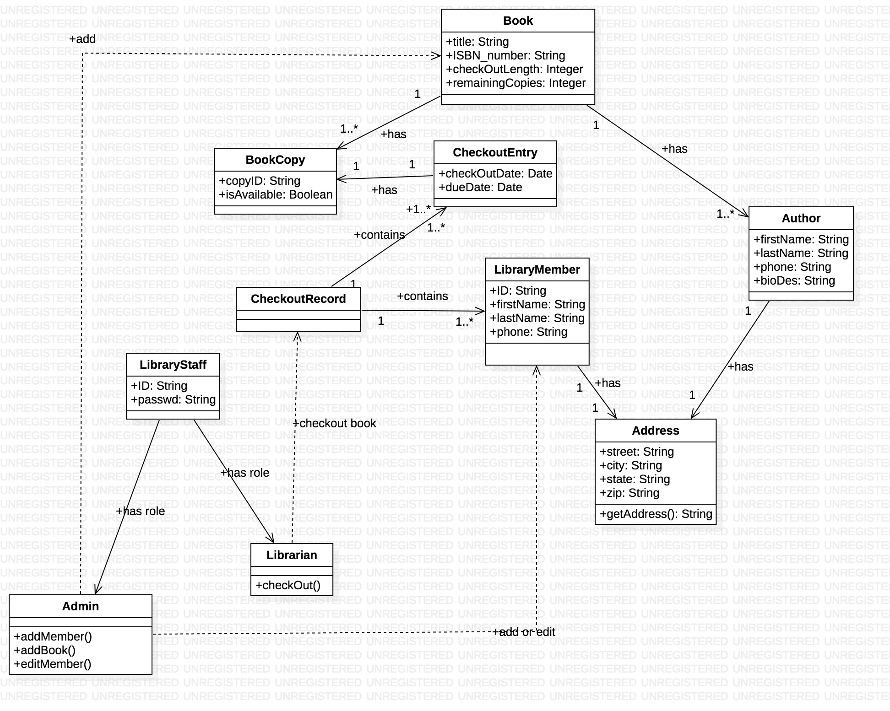
Class Diagram

Slide 4
Sequence Diagram
Add New Book
Checkout Book

Slide 5
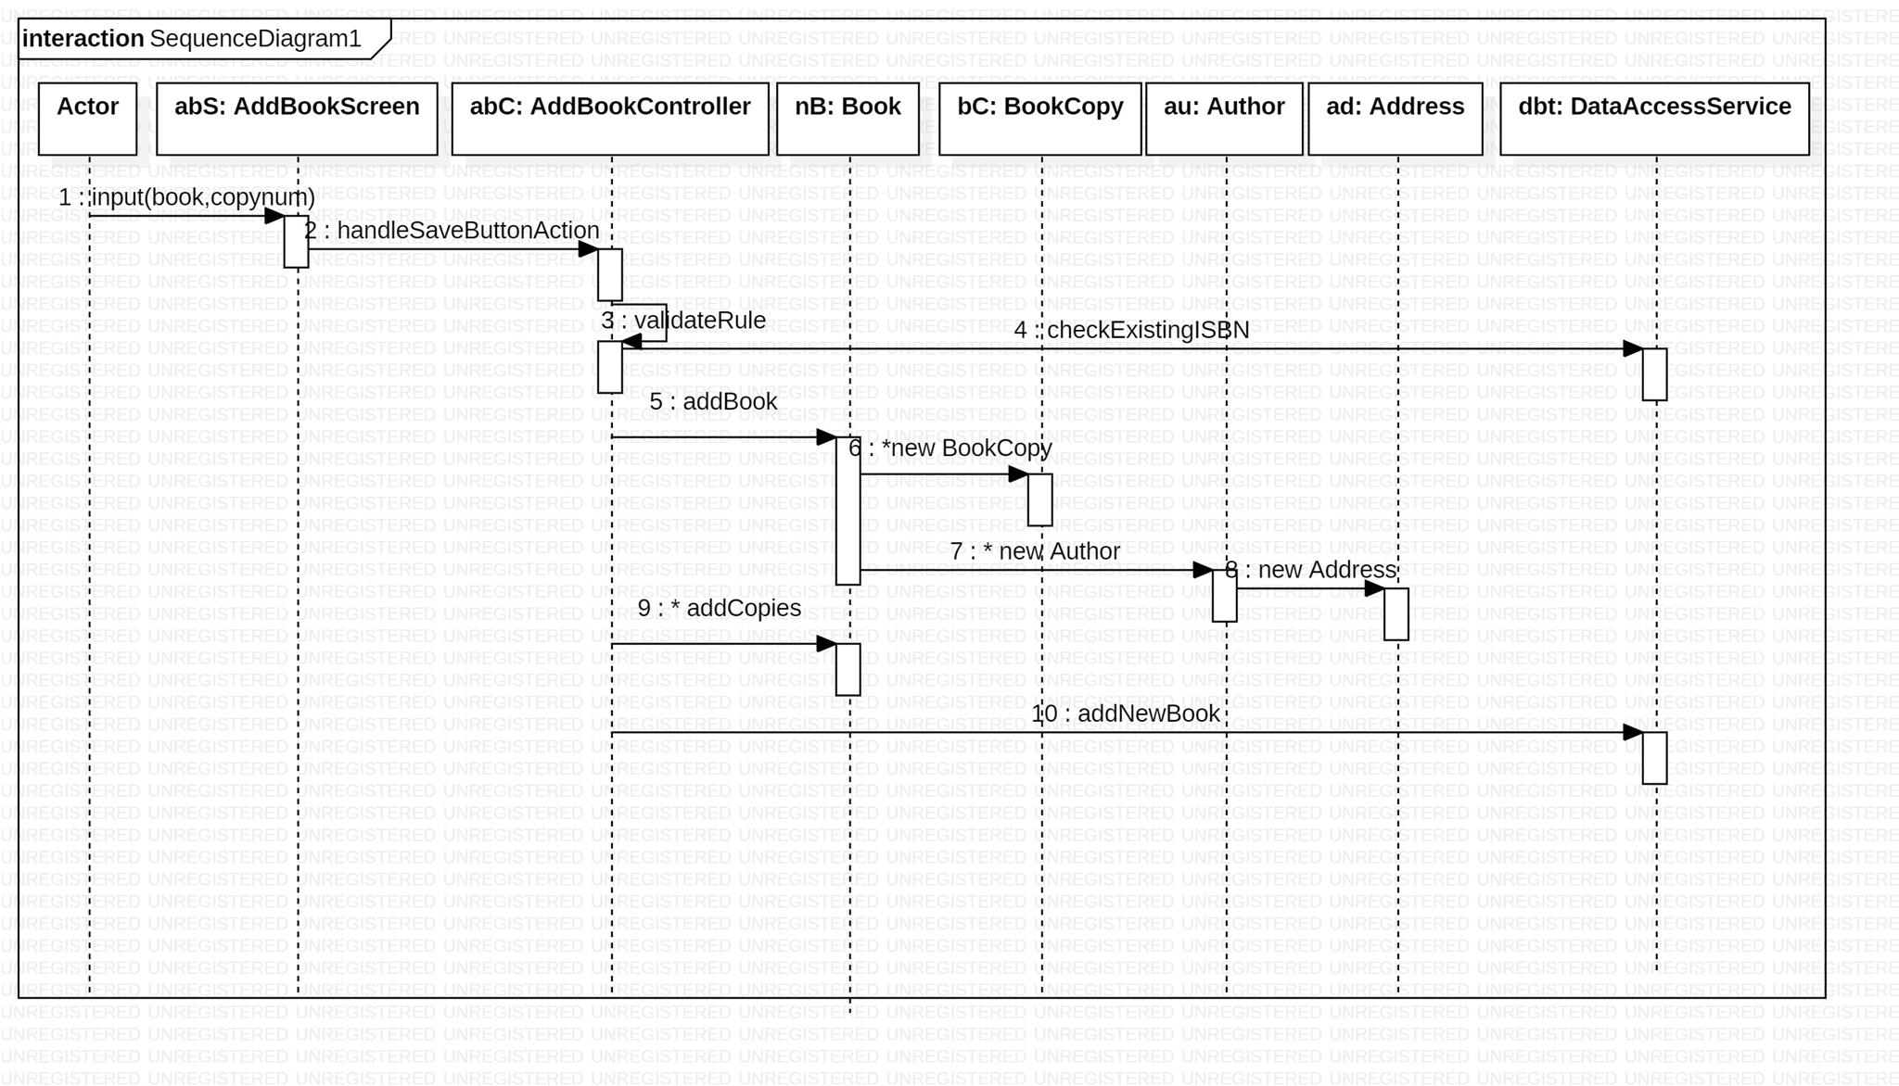

Slide 6
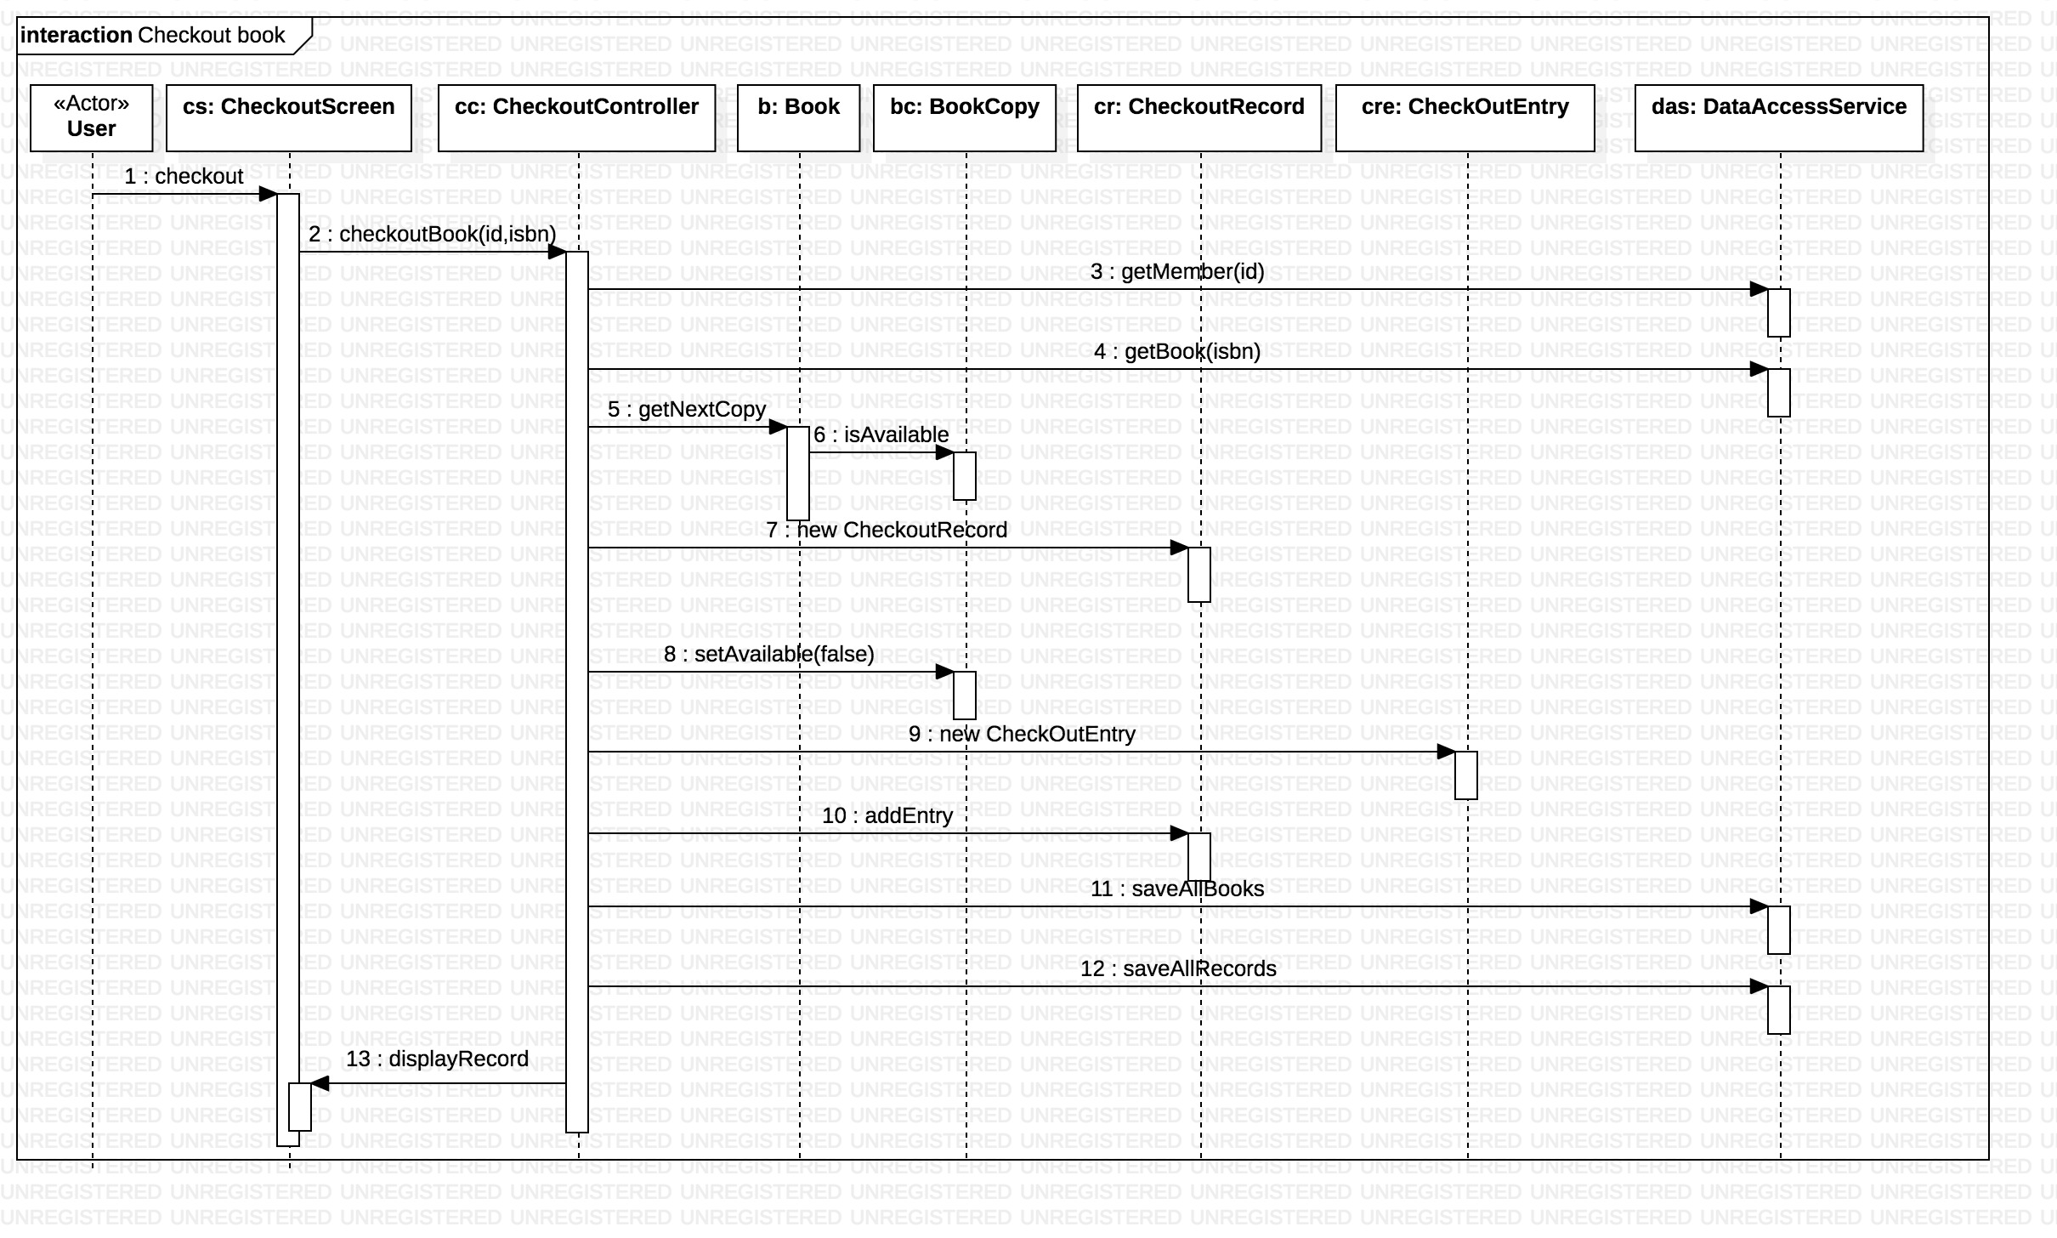
Sequence Diagram

Slide 7
Extra Credits
Add books to the library collection
Get checkout history of Library Members
Check Overdue rental book

Slide 8
SCI Principle

Slide 9
Demo

