Slide 1
Relation between Machine Learning and CNN
I’m here！
Machine Learning
CNN
Unsupervise learning
Supervise learning
Deep Learning
Reinforcement
learning

Slide 2
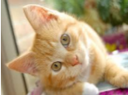
Machine Learning ≈ Looking for a Function
Convolution Neural Network(CNN for short) is just like:

Slide 3
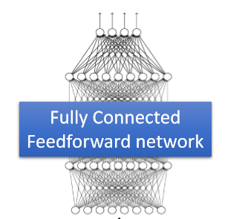

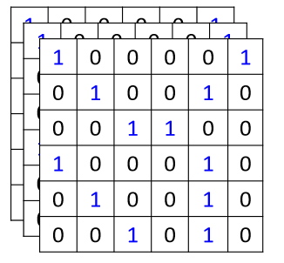
Think we have the model to recognize the picture
To train model, We feed the picture to Model.
However, what computer see is …

Slide 4
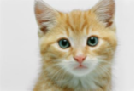
You could simply do this:
Cat detector
But, there are few Property
Some patterns are much smaller than the whole image.
A neuron does not have to see the whole image to discover the pattern.
Connecting to small region with less parameters
The same patterns appear in
Different regions.
Do almost the same thing but can’t use the same set of parameters.
Subsampling the pixels
will not change
the object
Noise
=
Subsampling
cat

Slide 5
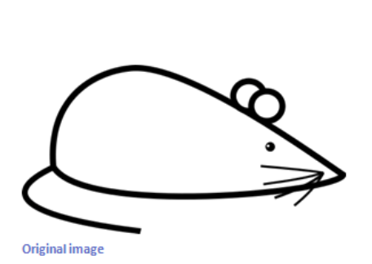
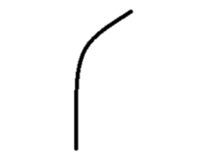
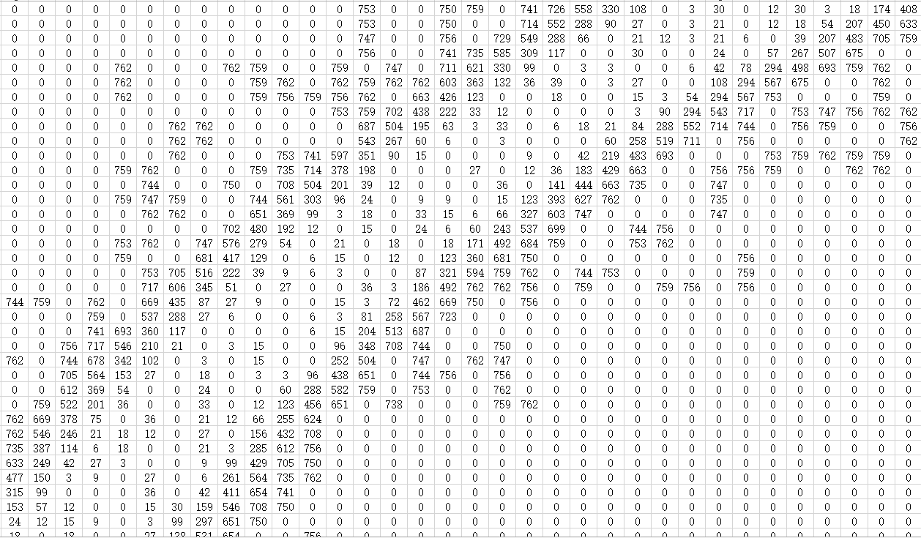
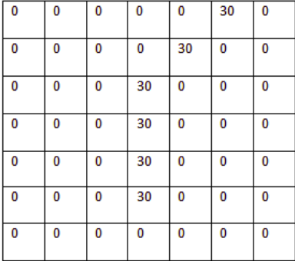
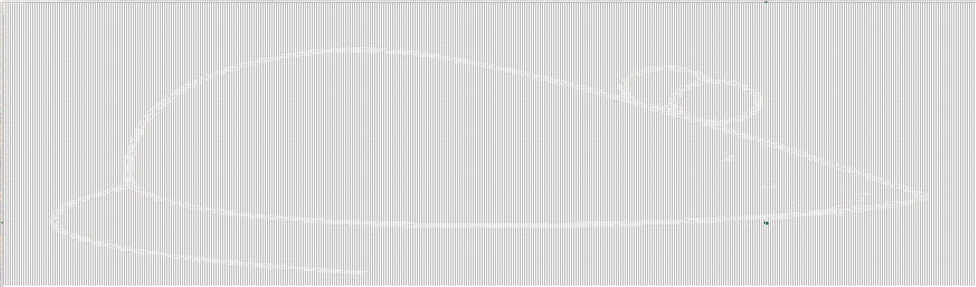
To solve this problem. someone invented CNN, let’s see how it work.
in this image
We want detect
Both of them represented like this:

Slide 6
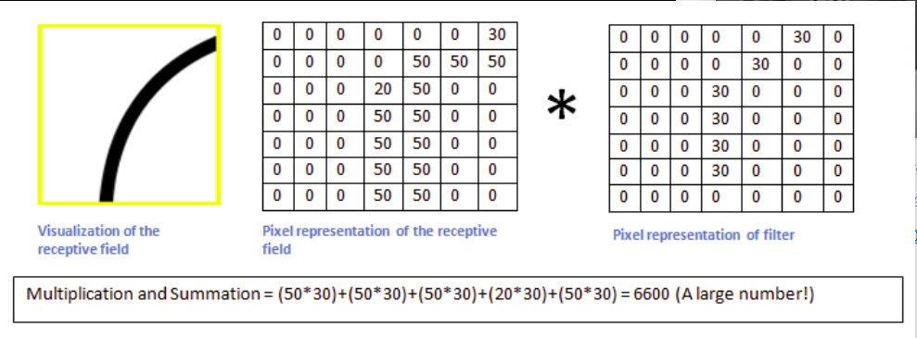
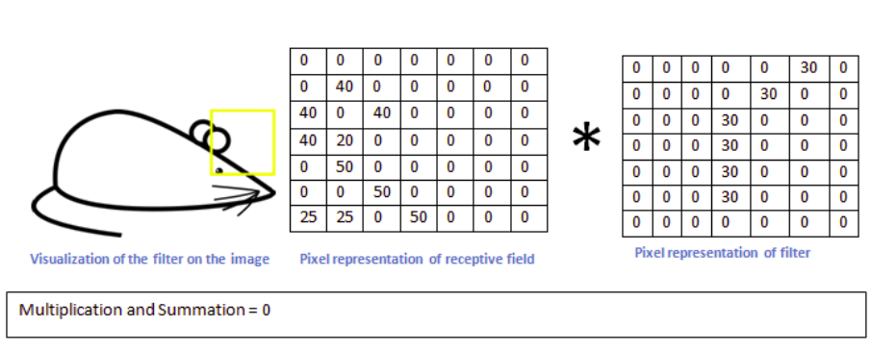
If we convolute two matrix
You will find, the more two picture alike, the more value you will get.

Slide 7
So, by simply convoluted two matrix, we could filter the noise and get what we want detect. In previous example, we call the left matrix as “kernel” or “filter”
Highlight the area contained
what we want to detect
*
kernel
Original image

Slide 8
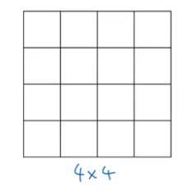
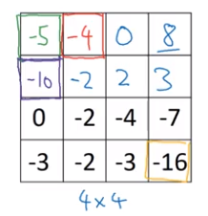
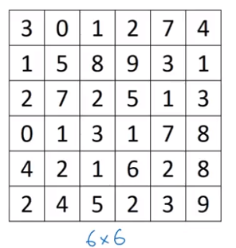
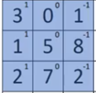
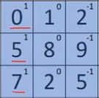
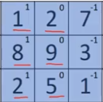
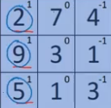
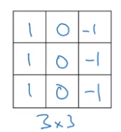
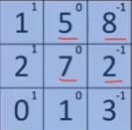
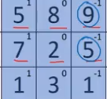
Let’s drive into Convolution Operation:
*
=

Slide 9
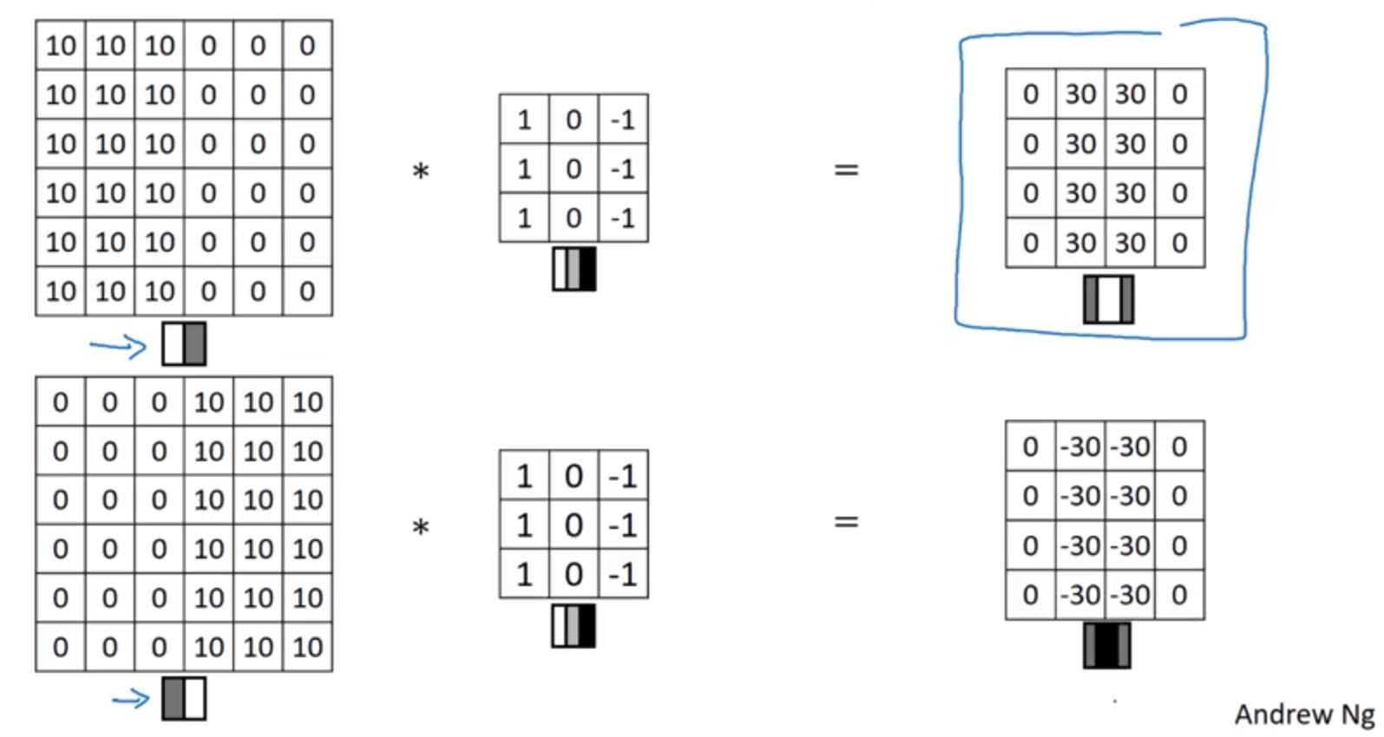
More example (Andrew Ng’s Course):

Slide 10
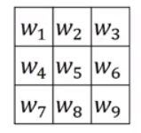
Use filter is nice, but when you really want to detect object in some complicated image, actually you don’t need to design filter. What you need to do is just learn from data, just treat filter as parameter:

Slide 11
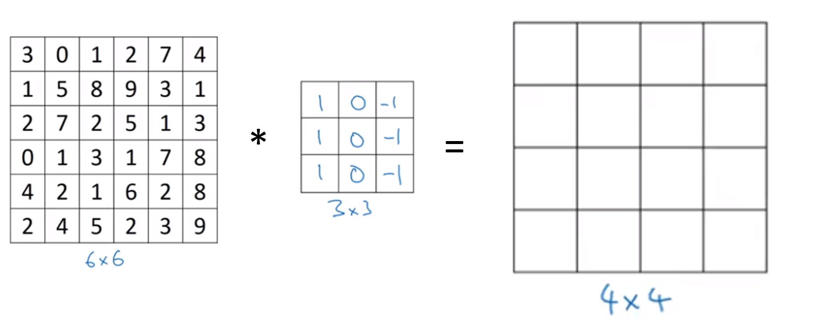
Shrinking output
Every time we Convolution two matrix, your image will shrinks:
After few times convolution, the image will down to 1 by 1.

Slide 12
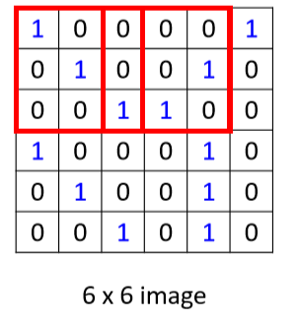
Also, the pixels at corners uses less than middle:
Throw away a lot of information from edge
Uses only ones
To solve those problem, someone introduce Padding, let’s see how it works:

Slide 13
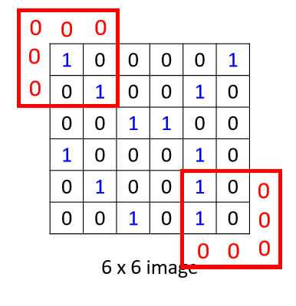
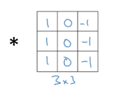
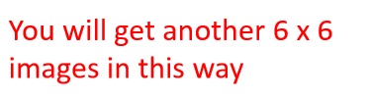
So simply, just padding with zero:

Slide 14
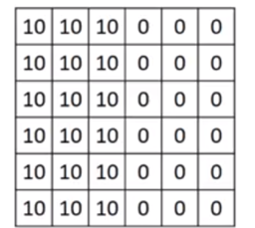
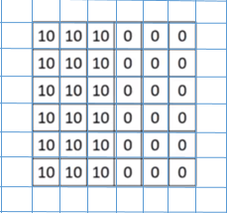
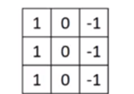
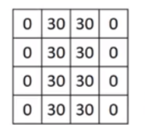
If we use padding, it called “Same convolution”
If we don’t use padding, it called “Valid convolution”
p
*
N by N
f by f
N-f+1 by N-f+1
When p= (f-1)/2 ,
We get same size of original image

Slide 15
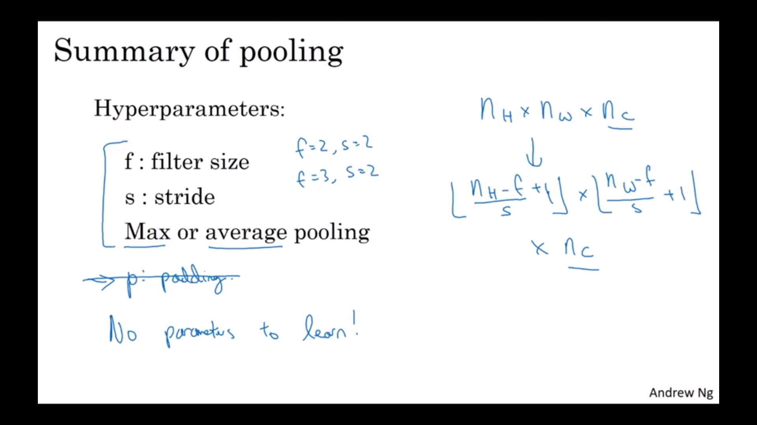
To reduce the size of image’s representation and speed up computation, let’s introduce pooling

