Slide 1
How COVID-19 affects the economic in Indonesia
Luu Duc Quy| Nguyen Tan Luu Tung | Pham Quy Hung
Prof. Rafik Hamza’s Python for Data Science and AI

Slide 2
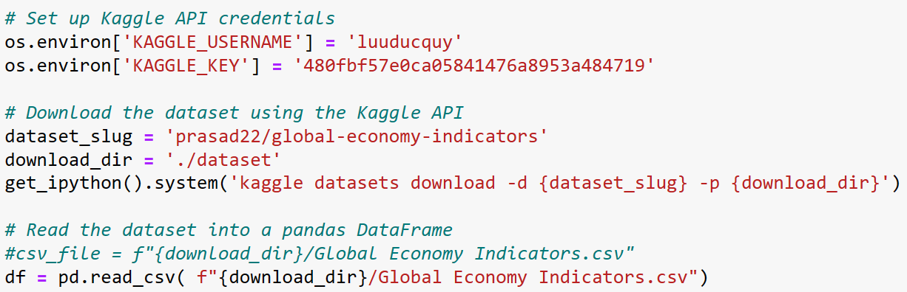
Acquiring the data from Kaggle
Note: The data is reference only, it does not assume any major occurrence of any countries.
Notes:
Insert a map of your country.

Slide 3
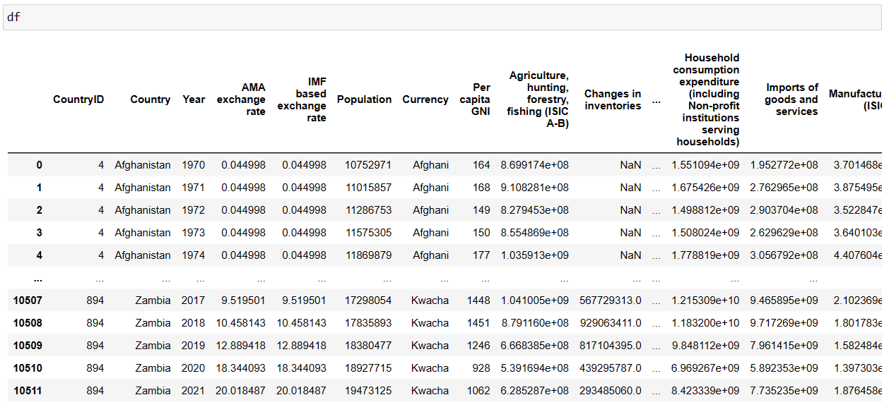
Acquiring the data from Kaggle
Notes:
Insert a map of your country.

Slide 4
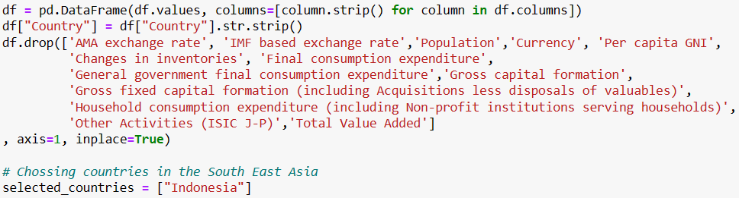
Data cleaning

Slide 5
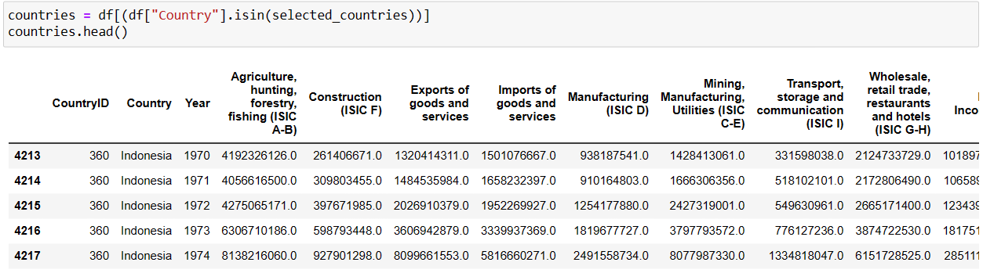
Getting the data for indonesia

Slide 6
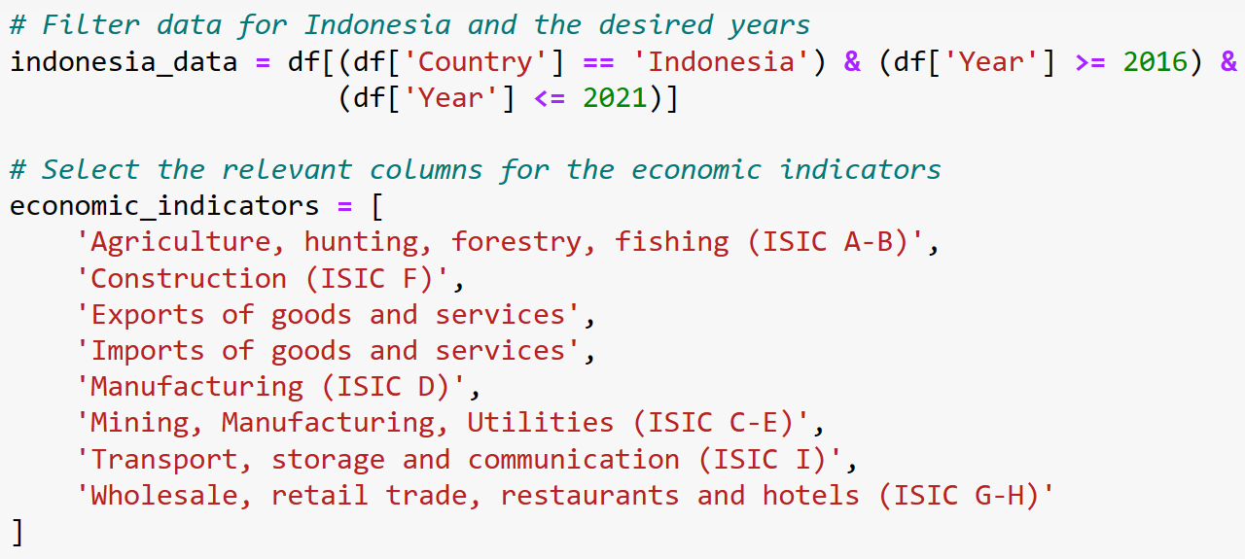
Data filtering

Slide 7
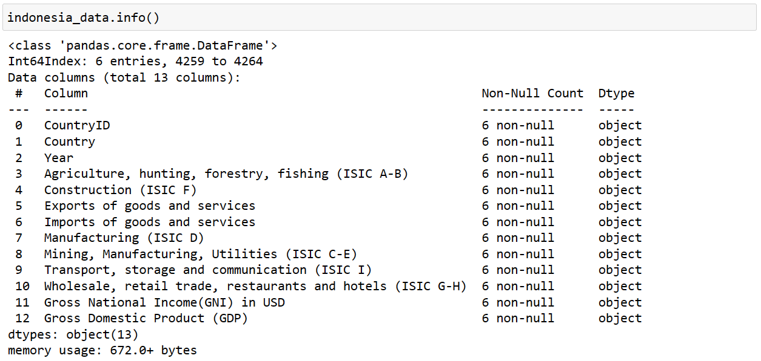
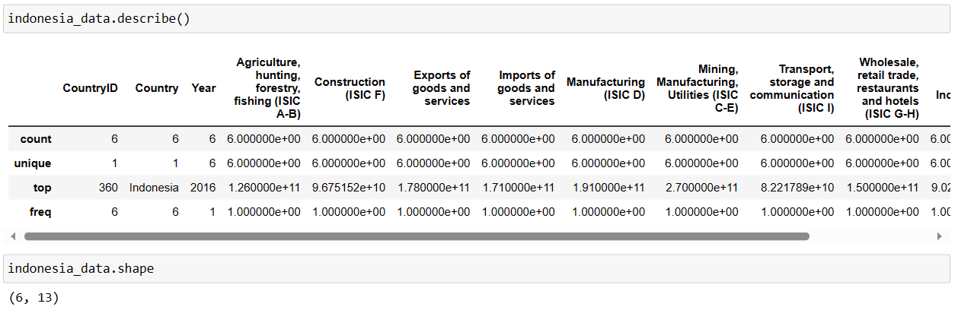
Understanding the data

Slide 8
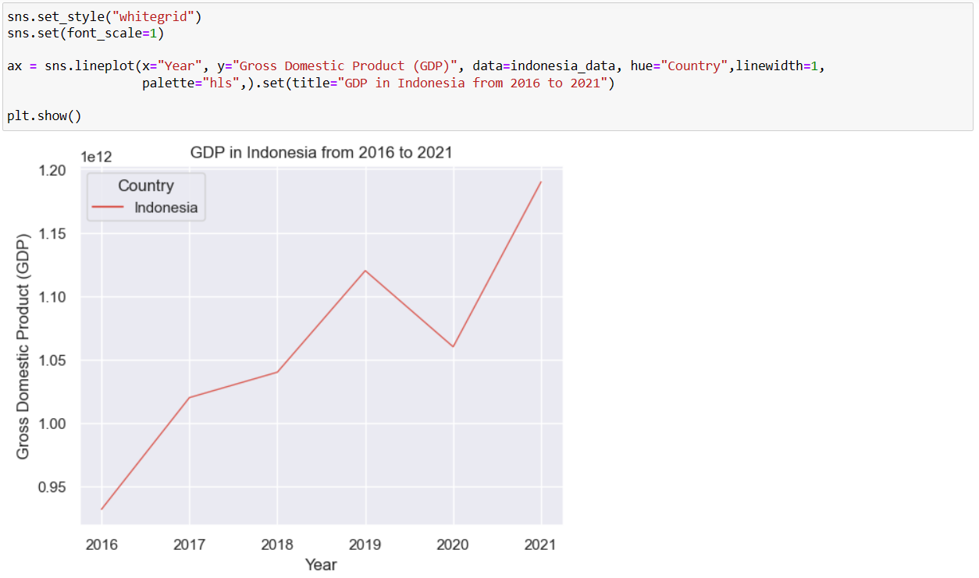
Gdp in Indonesia from 2016 to 2021
2016-2017: The economy increased significantly until
2017-2018: Slowing down
2018-2019: Come back
2019-2020: Economic downturn
2020-2021: Rocket again
*COVID-19 occurred in March 2020
*The vaccination started in January 2021.

Slide 9
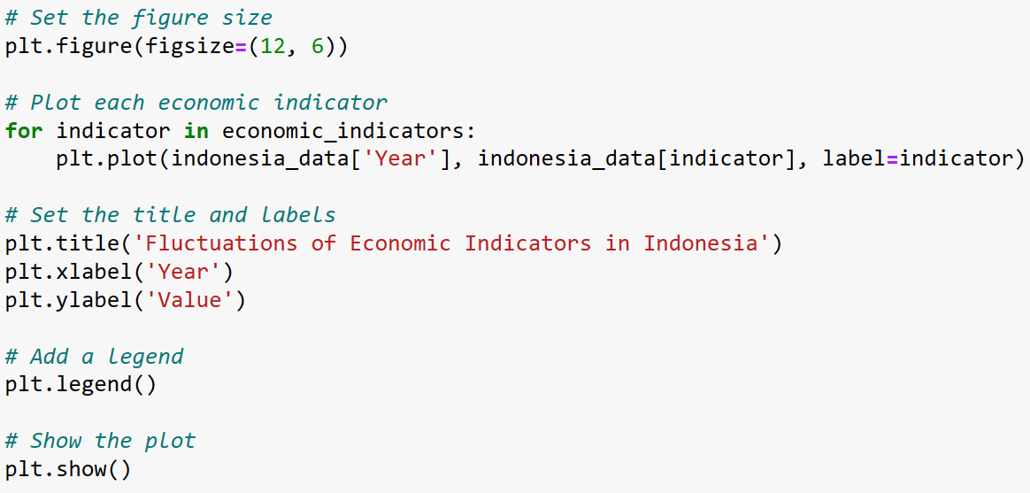
Deeper analysis into Indonesia’s economy

Slide 10
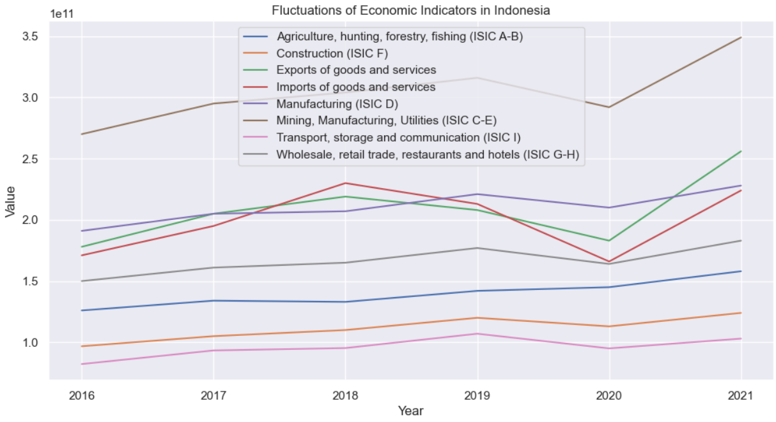
Deeper analysis into Indonesia’s economy
Most GDP contribution: Mining, manufacturing, utilities, and exports of goods and services
2018-2019: The significant development of imports to GDP
2020:
COVID-19 hit a hard one on the import activities.
Most of the economic indicators declined due to the pandemic.
2021: The comeback of the whole economy.

Slide 11
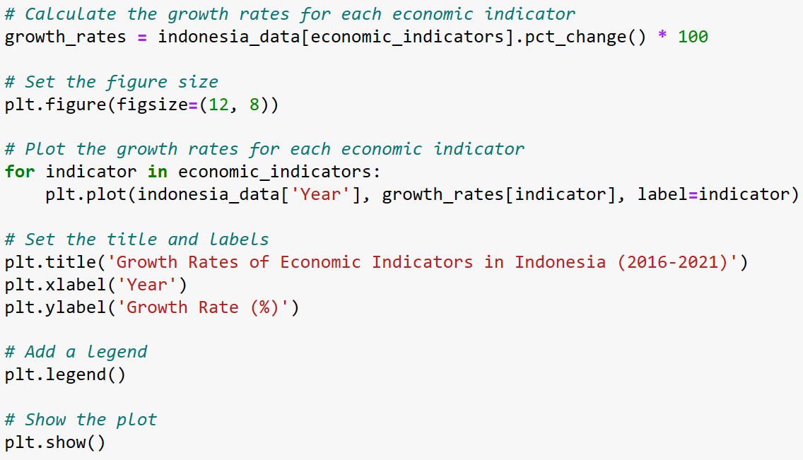
How serious is the decline of Indonesia’s economy?

Slide 12
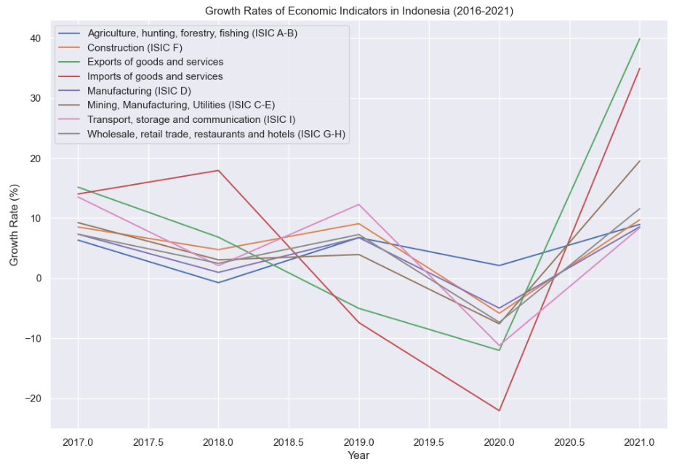
How serious is the decline of Indonesia’s economy?
“Import” rocketed when the whole economy started to slow down
Since 2018, imports started to drop, and more disastrously through the pandemic. (COVID-19 stopped the process of commerce between states)
COVID-19 did not affect agriculture, hunting, forestry, and fishing => self-sufficiency.

Slide 13
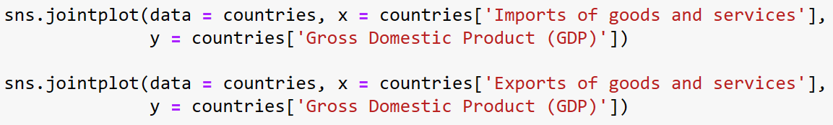
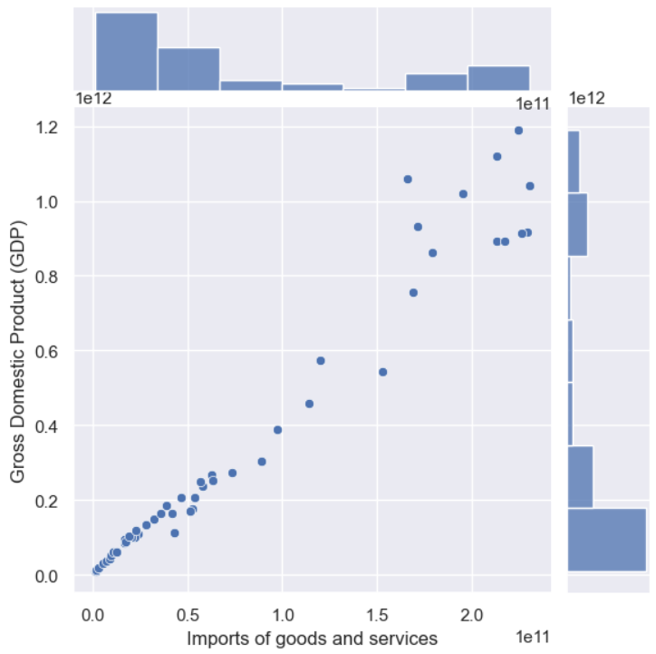
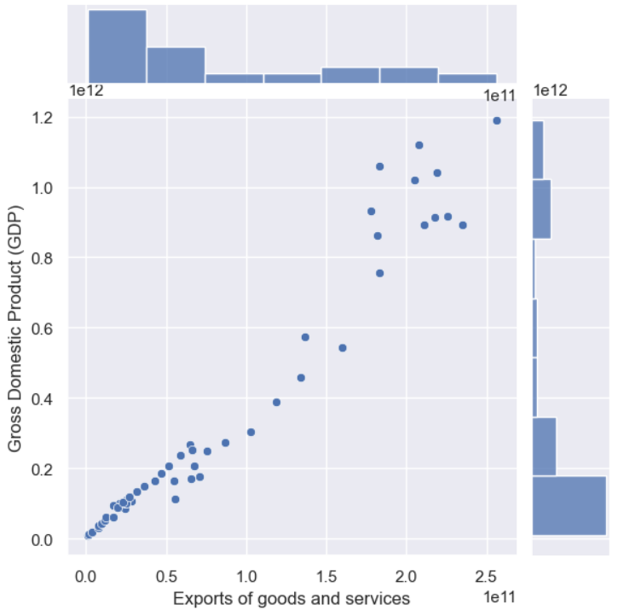
Analysis of main indicators

Slide 14
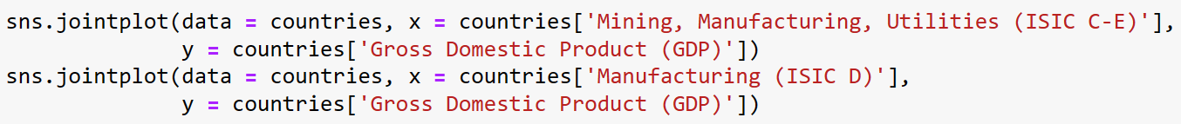
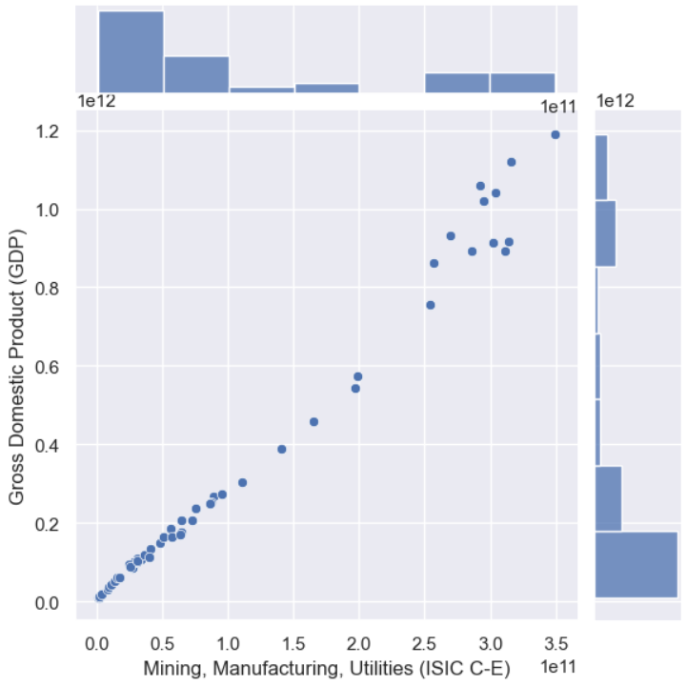
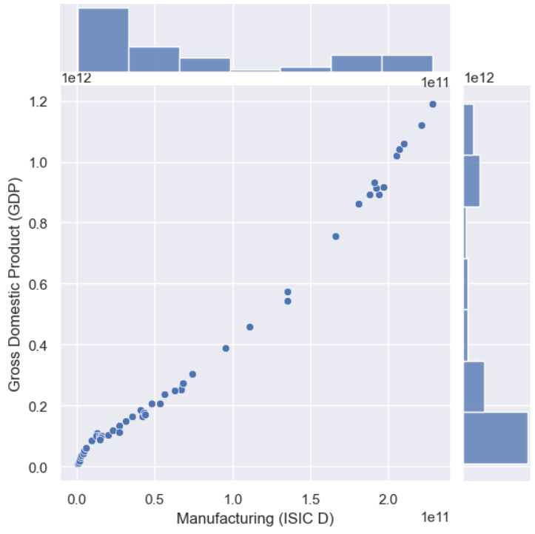
Analysis of main indicators

Slide 15
conclusion
COVID-19 has had severe consequences on Indonesia’s economy
As the border is closed, import and export activities were unsurprisingly affected and declined significantly. => The same situation for any countries in the pandemic.
In contrast, self-sufficiency activities (agriculture, hunting, forestry and fishing) had almost no harm to them. => COVID-19 did not hit too hard with indicators that performed inside the nation.

Slide 16
Thank you!
Any questions?

