Slide 1
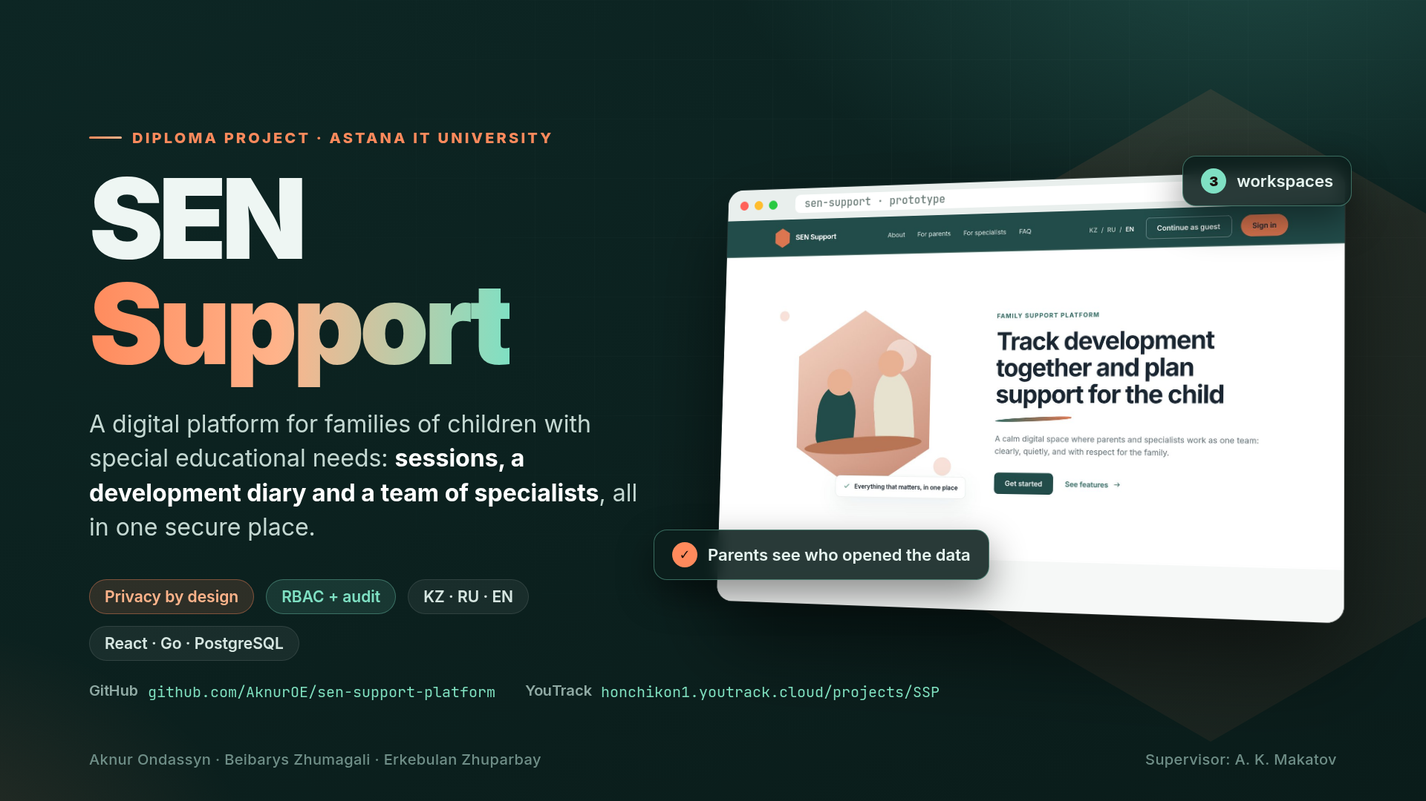
Notes:
Good afternoon! We are the SEN Support team. Imagine a family whose child has special educational needs: a speech therapist, a special education teacher, a tutor and the parents all work with the same child, but they have no shared space. Our project is a digital platform that brings them together as one team while carefully protecting the child's data.

Slide 2
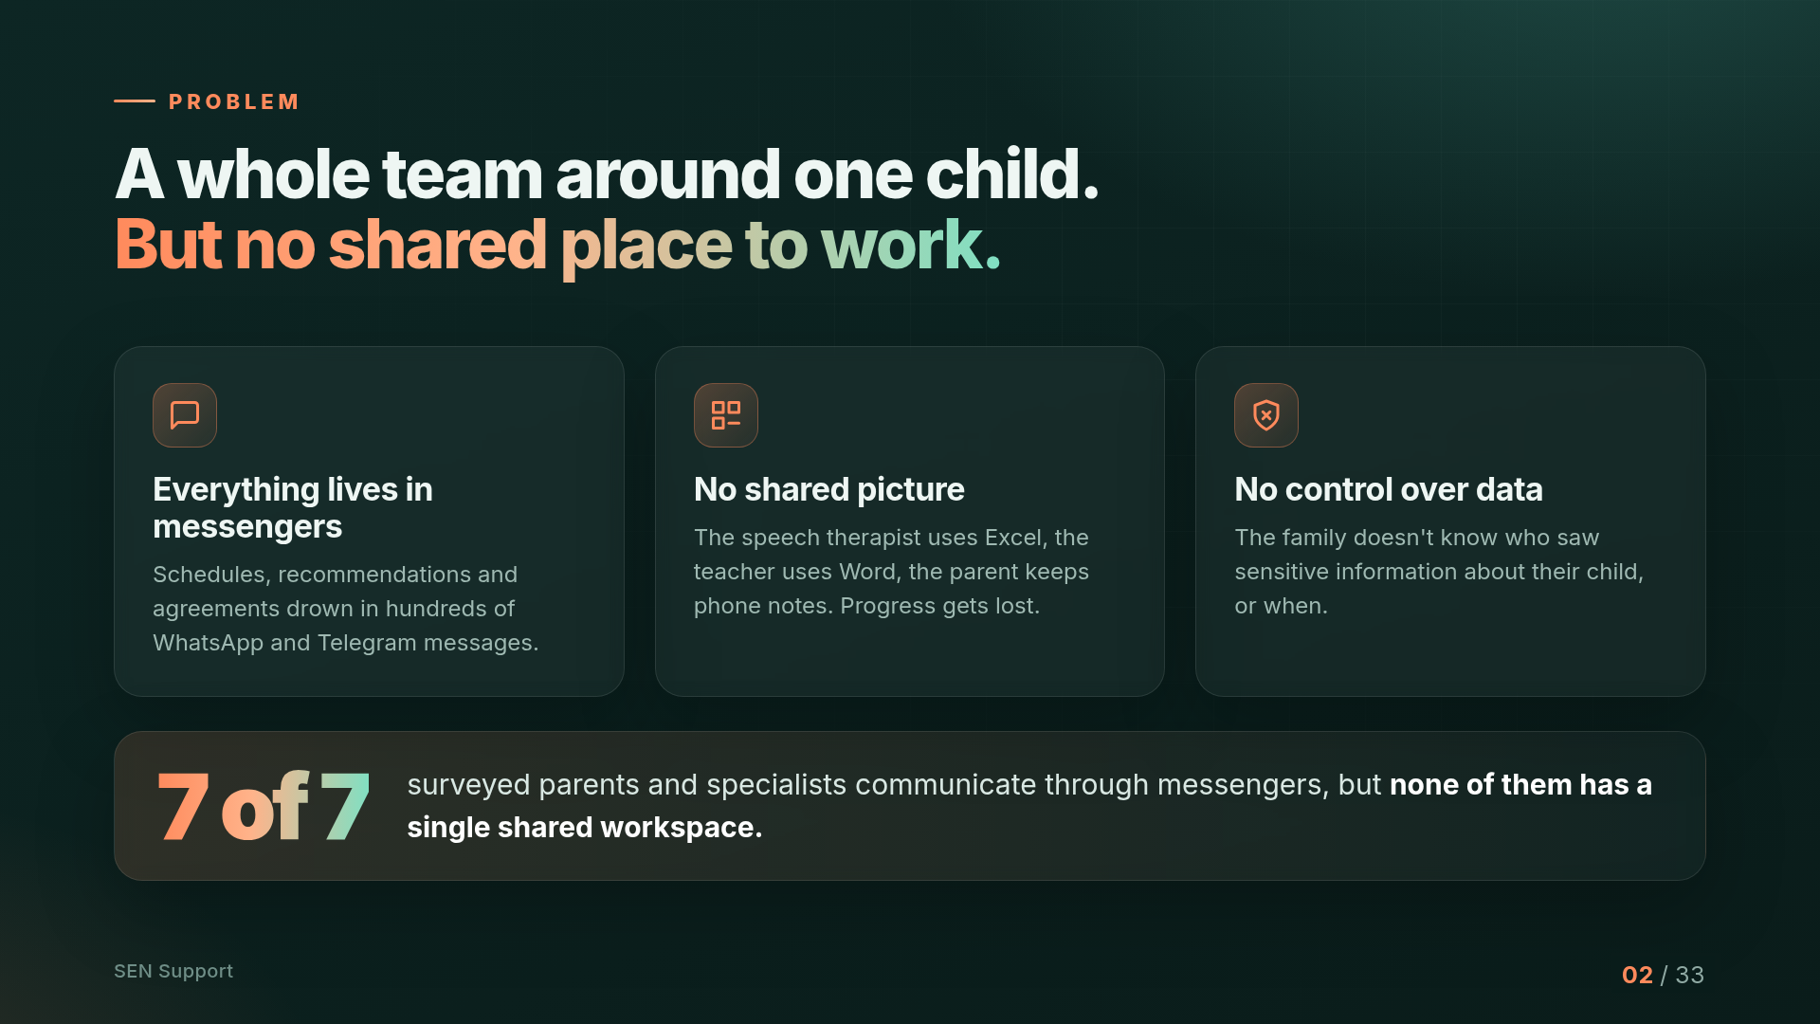
Notes:
Today, information about the child is scattered: the schedule lives in WhatsApp, specialists keep notes in Excel and Word, and parents keep notes on their phones. There is no shared picture of the child's progress, and the family doesn't know who has seen sensitive data. Our survey confirmed this: all 7 respondents communicate through messengers.

Slide 3
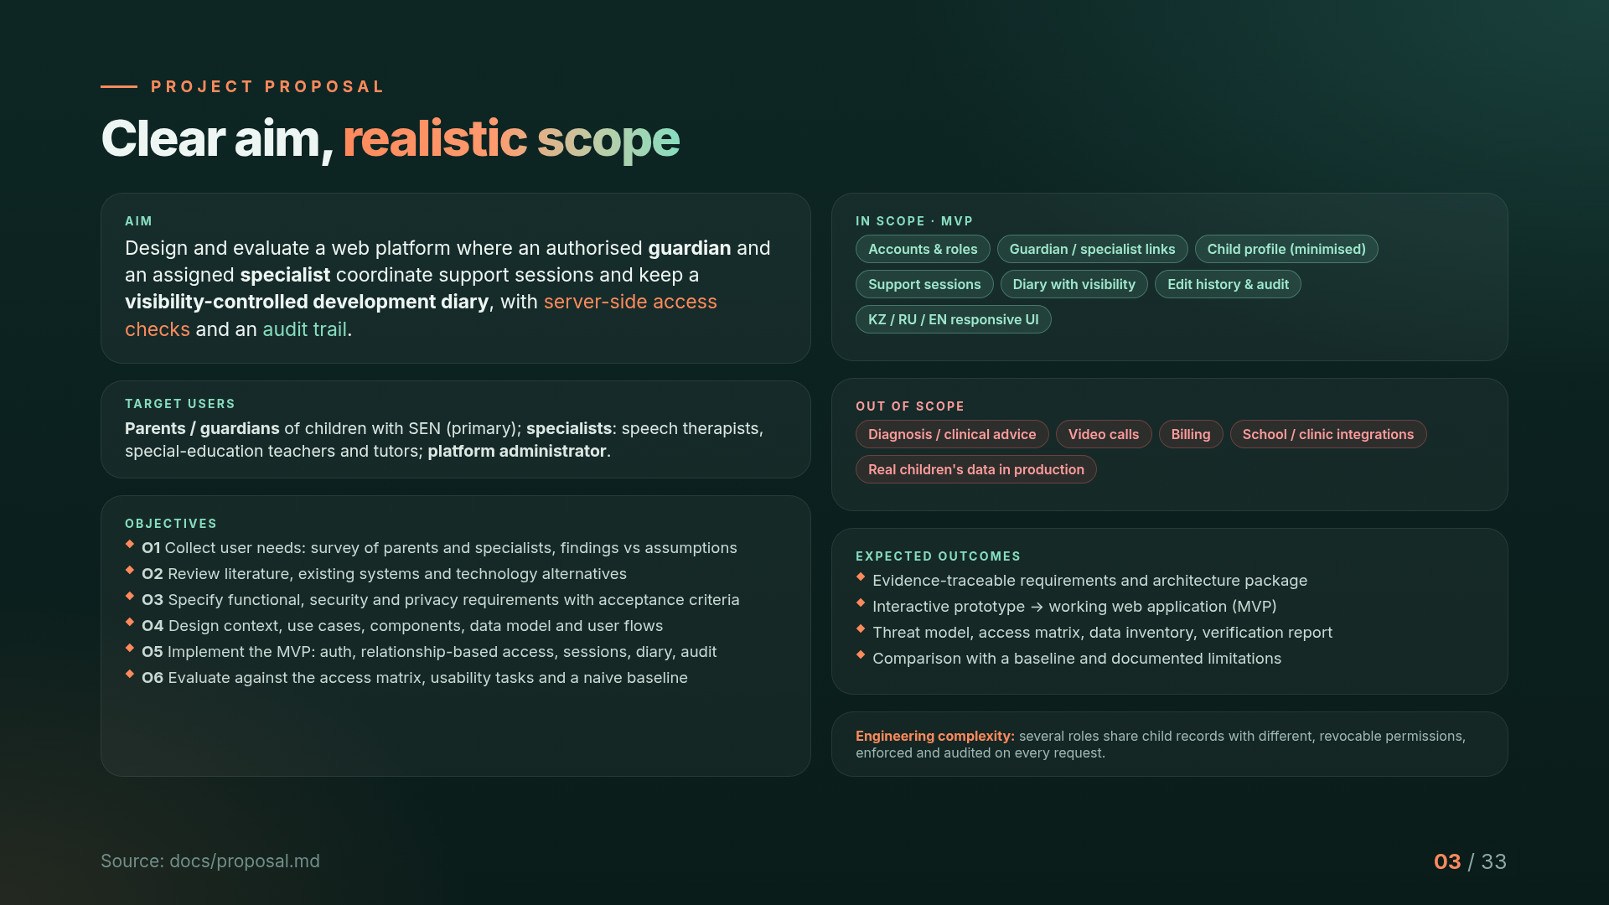
Notes:
Our target users are parents and guardians of children with SEN as the primary users, specialists such as speech therapists, special-education teachers and tutors, and a platform administrator. Our aim is to design and evaluate a web platform where a guardian and an assigned specialist coordinate sessions and keep a development diary with visibility control, enforced on the server and audited. Six objectives lead from user research to evaluation. The scope is deliberately limited: accounts, links, profiles, sessions, diary and audit are in; diagnosis, video calls, billing and integrations are out. The engineering complexity is several roles sharing child data with different, revocable permissions.

Slide 4
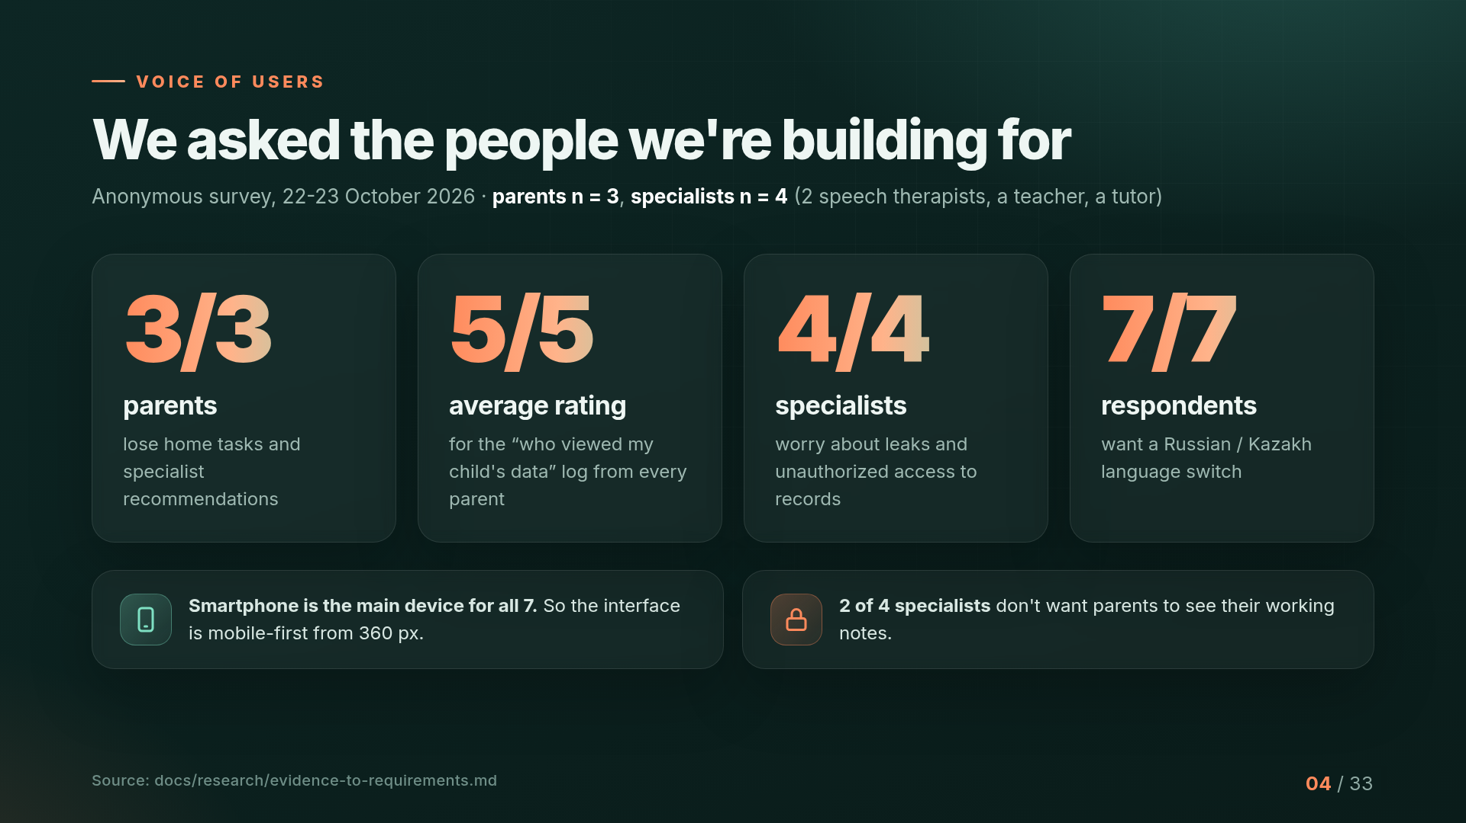
Notes:
We didn't build the product on guesses. We ran an anonymous survey with 3 parents and 4 specialists. Key numbers: all parents lose home recommendations; every parent rated the 'who viewed the data' log 5 out of 5; all specialists worry about leaks; all 7 want Kazakh and Russian. The sample is small, and we say so openly. The next stage will include interviews.

Slide 5
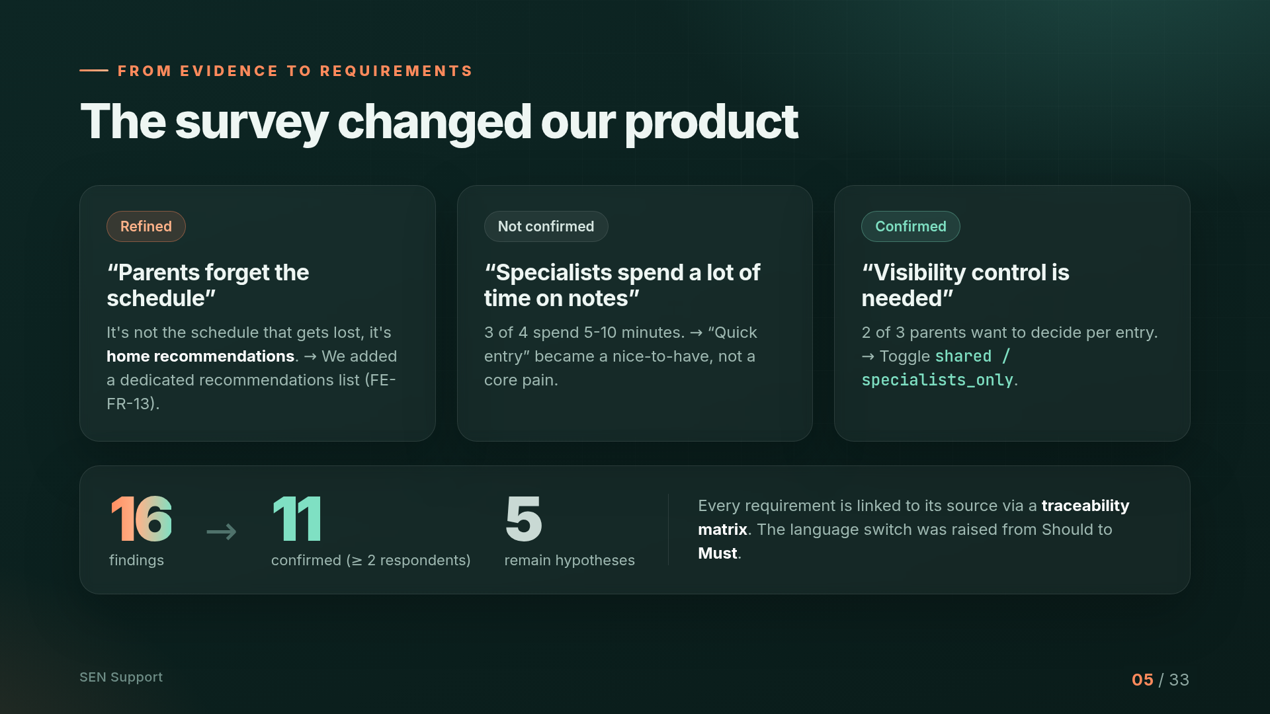
Notes:
The survey changed the product. The hypothesis 'parents forget the schedule' was refined: what actually gets lost is the recommendations, so we added a dedicated recommendations list. The hypothesis about time-consuming notes was not confirmed. Visibility control was confirmed. 11 of 16 findings are confirmed by at least two respondents, and every requirement is linked to its source through a traceability matrix.

Slide 6
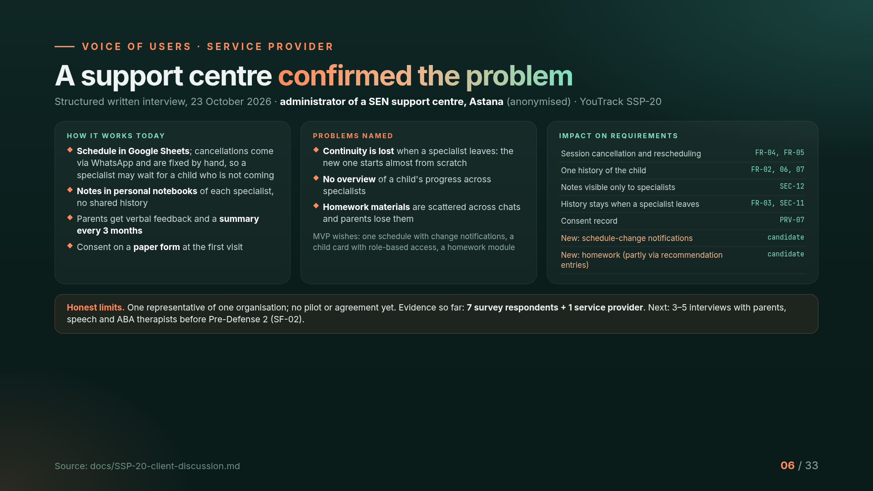
Notes:
Besides the survey, we spoke with the administrator of a support centre for children with SEN in Astana. Today the schedule lives in Google Sheets, cancellations come through WhatsApp, and each specialist keeps notes in a personal notebook. The main problem she named is continuity: when a specialist leaves, the next one starts from scratch. This confirmed six of our requirements and added two candidates: schedule-change notifications and a homework module. To be honest, this is one organisation and no pilot is agreed, so we plan three to five interviews before pre-defense 2.

Slide 7
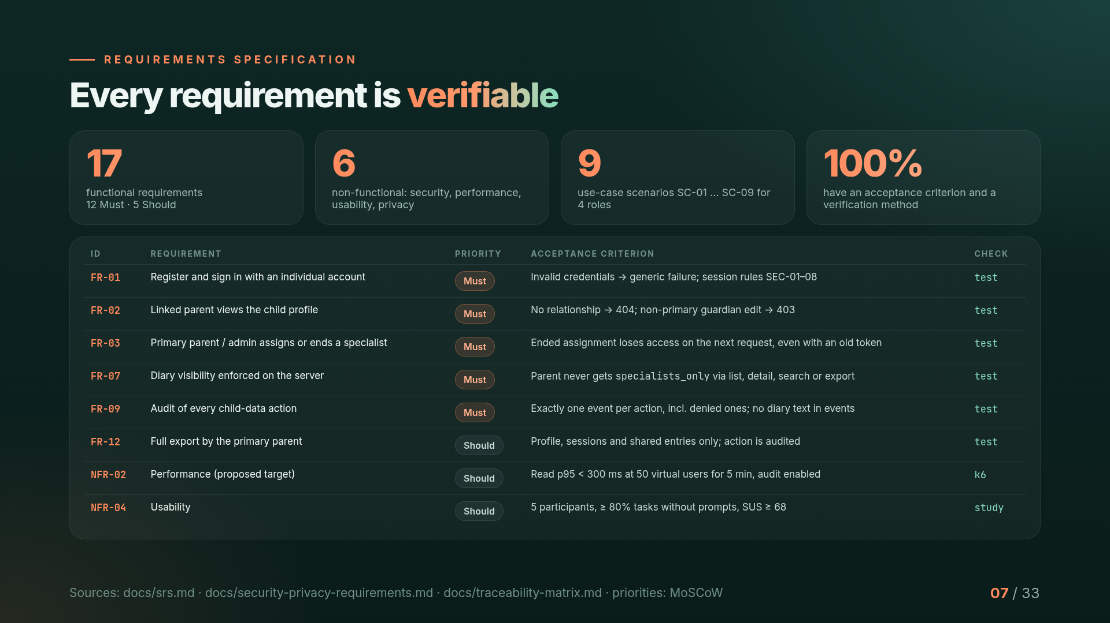
Notes:
From the survey and the literature we derived 17 functional and 6 non-functional requirements, prioritised with MoSCoW. Every requirement has an acceptance criterion and a verification method, and the traceability matrix links each one to a test. For example, FR-03: when an assignment ends, the specialist loses access on the very next request, even with an old token.

Slide 8
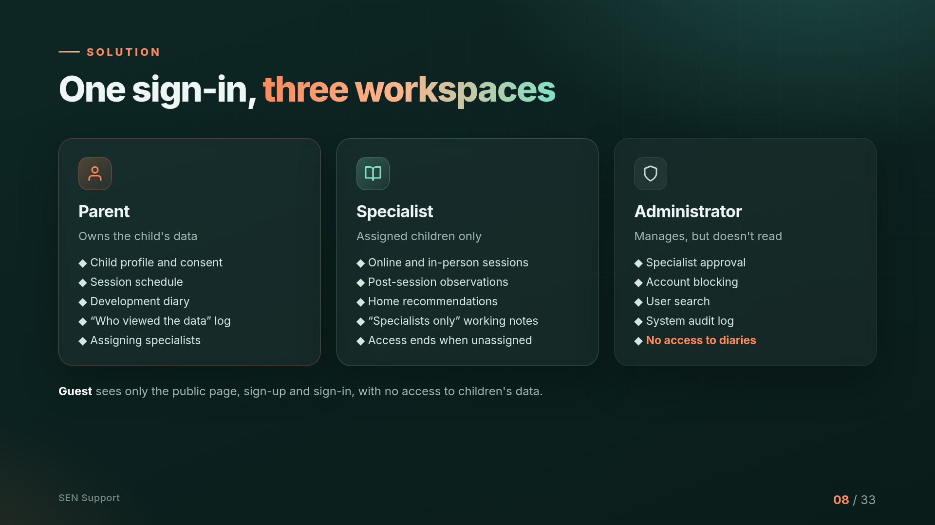
Notes:
The solution is one sign-in and three workspaces. The parent owns the data: profile, schedule, diary and access log. A specialist sees only assigned children and loses access as soon as the assignment ends. The administrator manages accounts but, by design, does not read diaries.

Slide 9
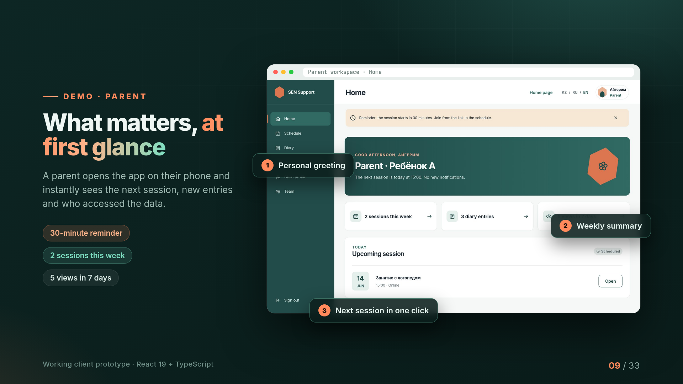
Notes:
This is a working client prototype built with React and TypeScript. The parent opens the workspace and immediately sees what matters: the next session, a weekly summary, a 30-minute reminder and how many times the child's data was viewed.

Slide 10
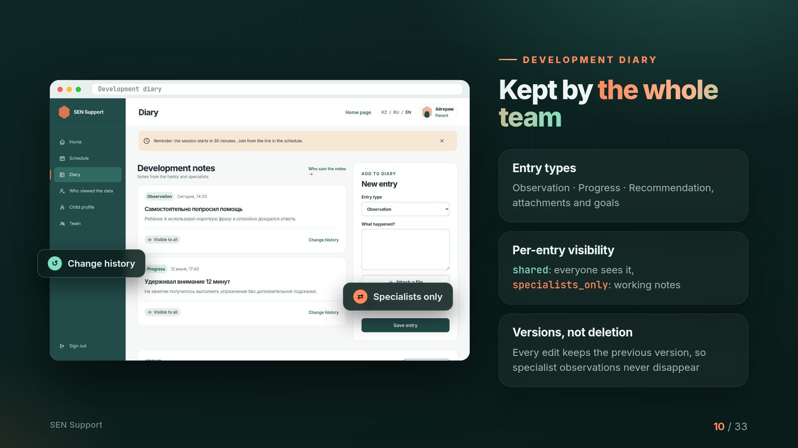
Notes:
The development diary is kept by the whole team. Entries have types: observation, progress and recommendation. Each entry has a visibility setting: shared means everyone sees it, specialists_only is for specialists' working notes. Edits keep previous versions, so observations are never lost.

Slide 11
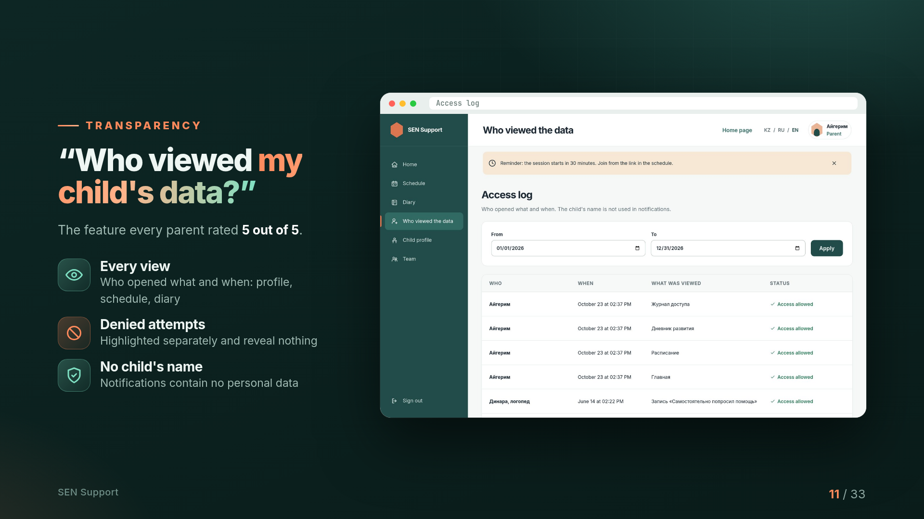
Notes:
The most requested feature is the access log. Parents see who opened what and when. Denied attempts are highlighted separately, and notifications never contain the child's name.

Slide 12
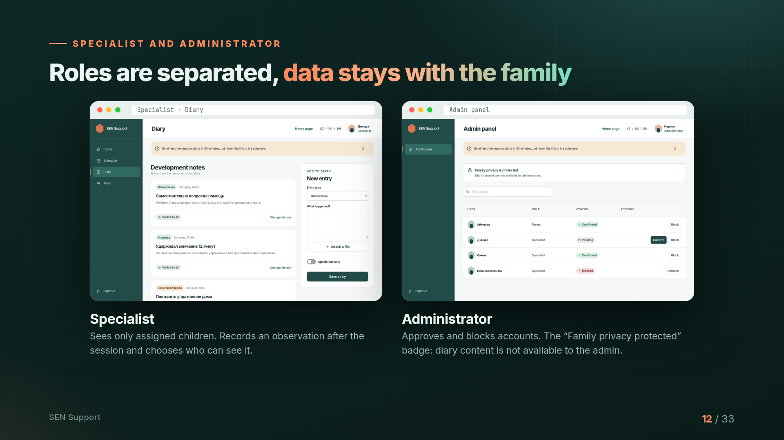
Notes:
A specialist works only with assigned children and chooses the visibility of each entry. The administrator approves and blocks accounts, but diary content is not available to them, and the interface makes this visible.

Slide 13
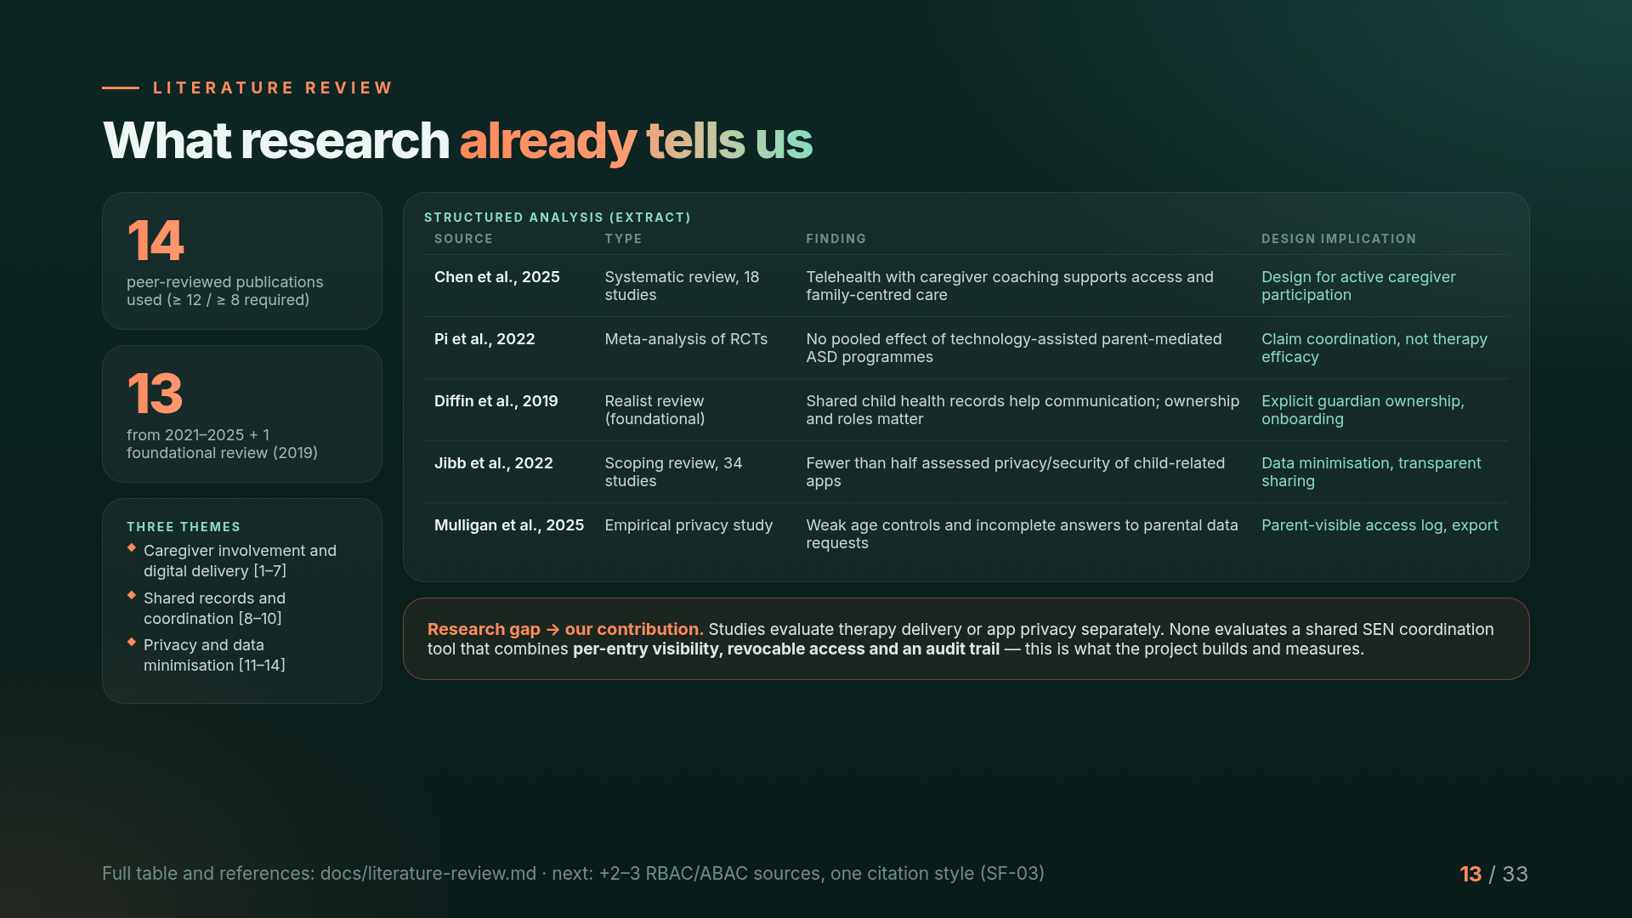
Notes:
We used 14 peer-reviewed publications, 13 of them from the last five years. Research shows caregivers must stay active participants, that technology alone does not prove therapy efficacy, and that child apps often neglect privacy. No study evaluates a shared SEN coordination tool with per-entry visibility, revocable access and audit, and that is our contribution.

Slide 14
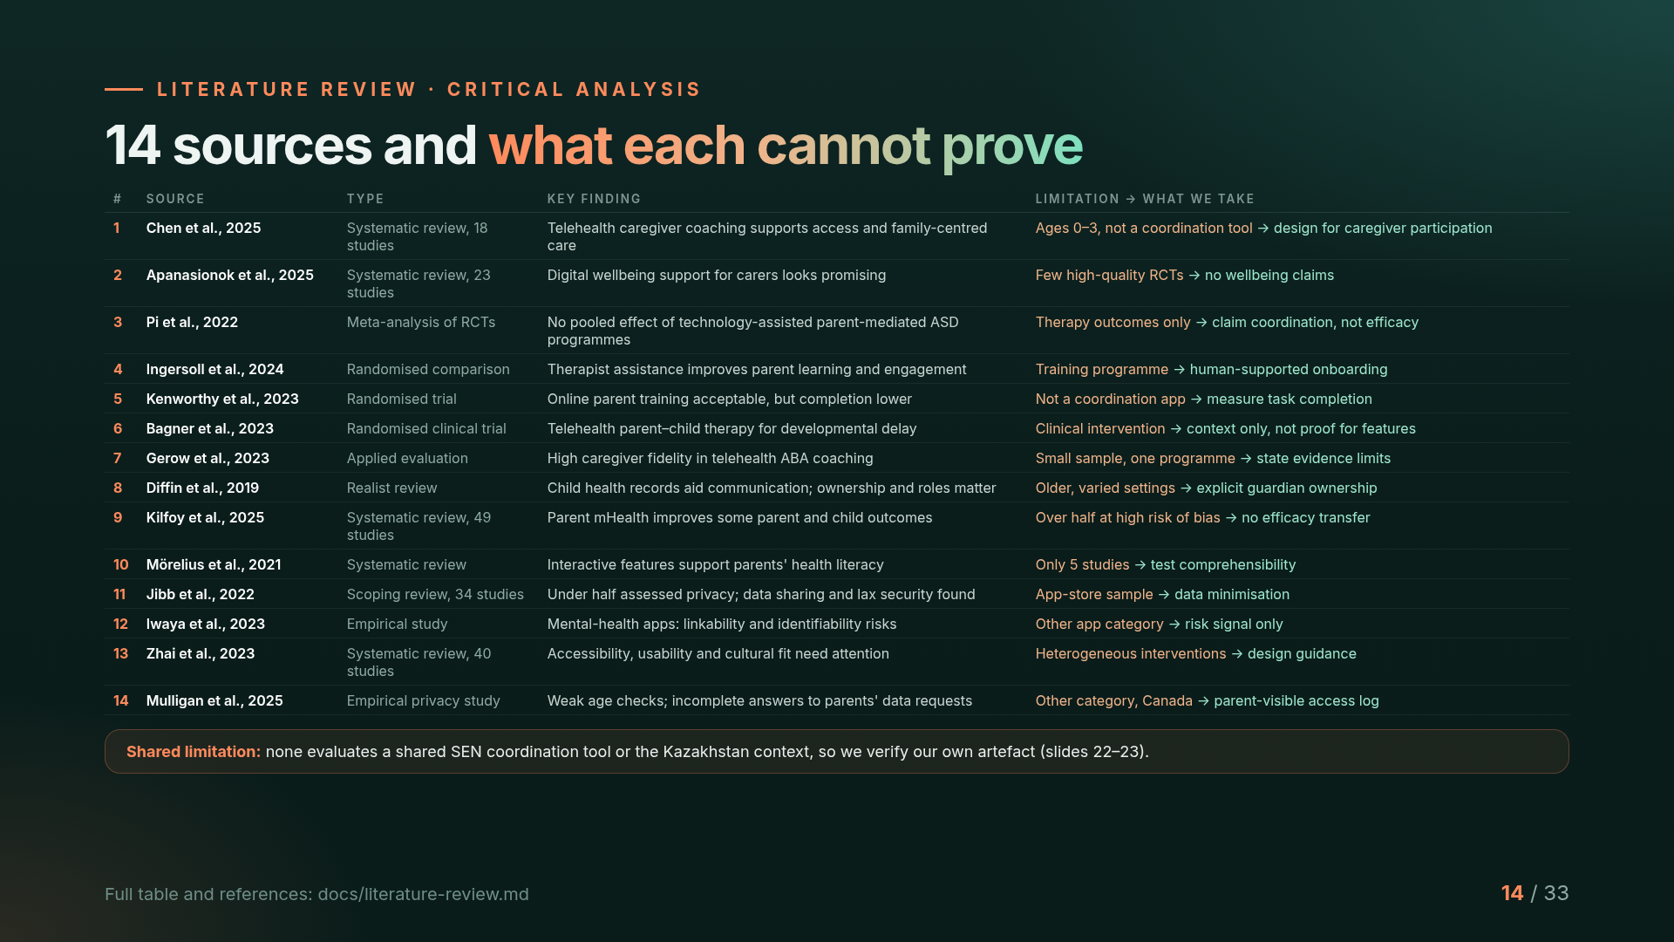
Notes:
Here is the full critical table. For each of the 14 sources we show not only the finding but also what it cannot prove. Most studies evaluate therapy delivery or app privacy, often with small or heterogeneous samples, and none evaluates a shared SEN coordination tool or the Kazakhstan context. That is why we do not claim therapy efficacy and instead verify our own artefact, which is the next part of the talk.

Slide 15
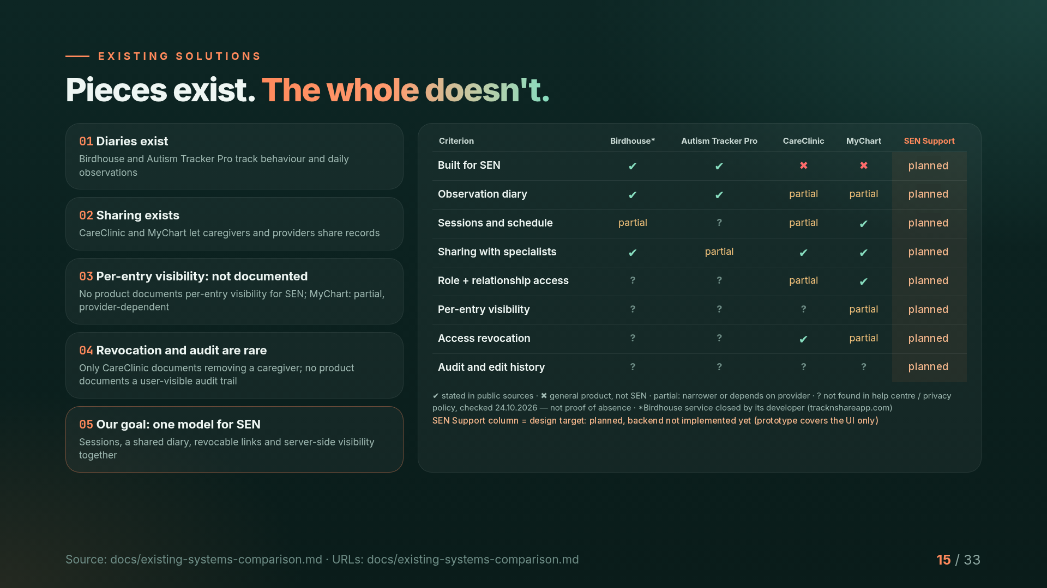
Notes:
We compared four existing solutions across eight criteria. Individual features exist: diaries, scheduling, sharing with doctors. On 24 October we re-checked every question mark in the four security rows against each product's help centre and privacy policy. CareClinic documents removing a caregiver and per-person permissions; MyChart proxy access is governed by the provider. No product documents per-entry visibility for SEN or a user-visible audit trail, and Birdhouse has been closed by its developer. A question mark means not found in public sources, not proof that the feature is absent. All URLs with dates are in the repository. Our own column is marked as planned: it is the design target, not a finished product.

Slide 16
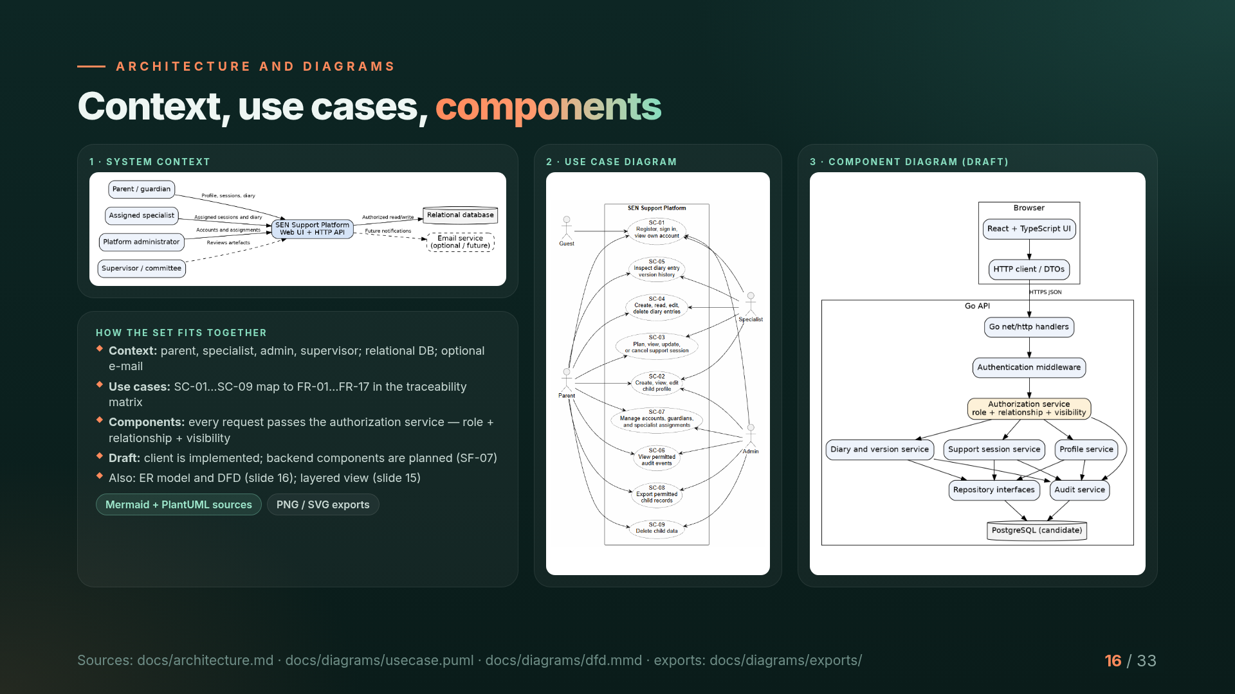
Notes:
Here is the required set of diagrams. The system context shows four actor types, the database and an optional e-mail service. The use case diagram covers scenarios SC-01 to SC-09, which map to our requirements. The component diagram is a draft: every request passes the authorization service that checks role, relationship and visibility. All sources are editable Mermaid and PlantUML files in the repository.

Slide 17
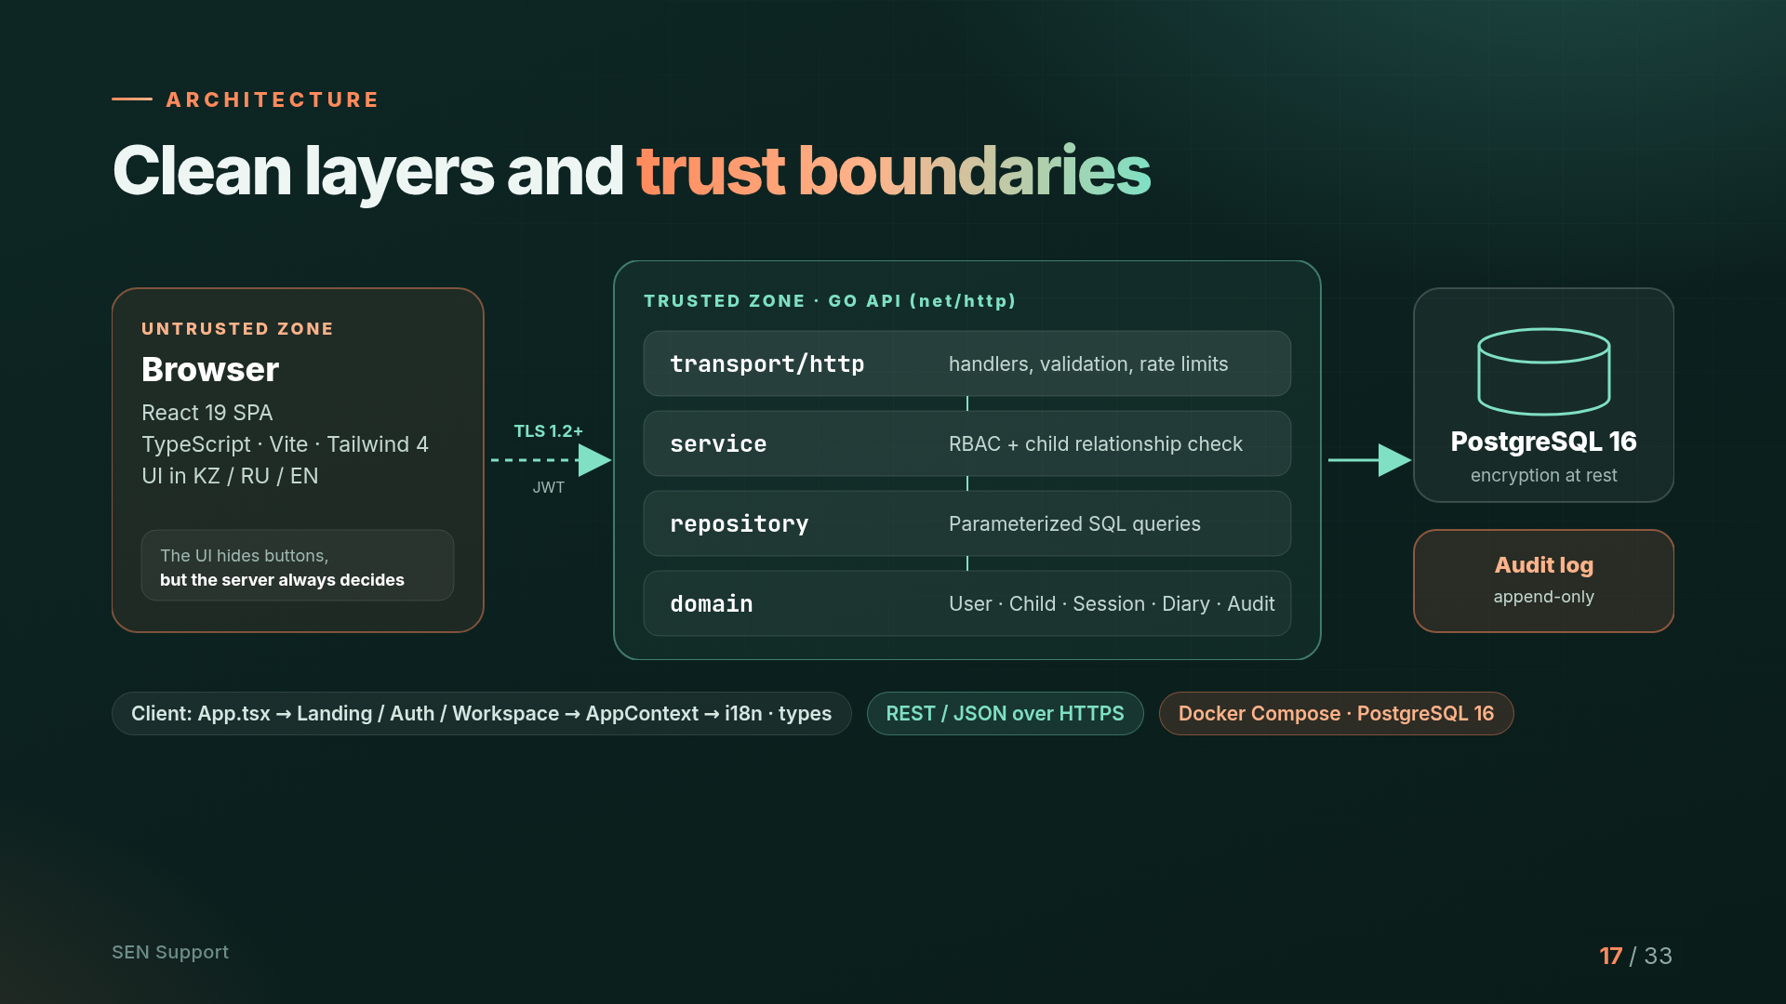
Notes:
Architecture: the browser is an untrusted zone. The interface may hide buttons, but the server always makes the decision. The Go API is built on the standard library and split into layers: transport, a service layer that checks roles and relationships, a repository with parameterized queries, and the domain. Data lives in PostgreSQL, with a separate append-only audit log.

Slide 18
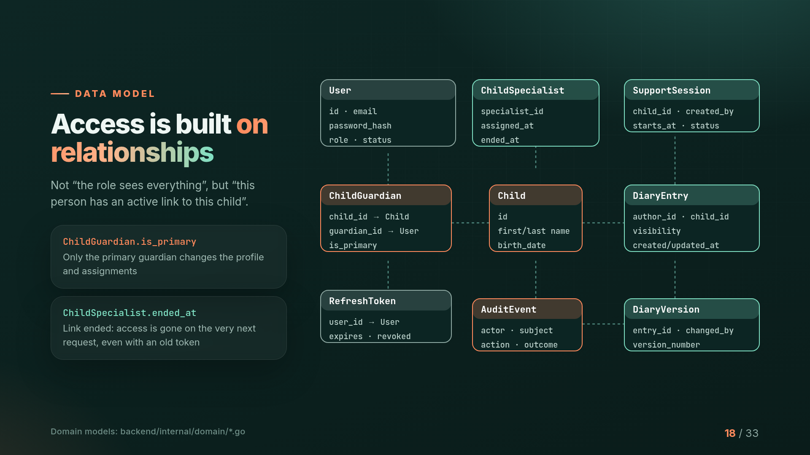
Notes:
The key idea of the data model is that access is built on relationships. Not 'a specialist sees everything', but 'this specialist has an active link to this child'. The is_primary field marks the primary guardian, and ended_at marks the end of an assignment: access disappears on the very next request, even with an old token.

Slide 19
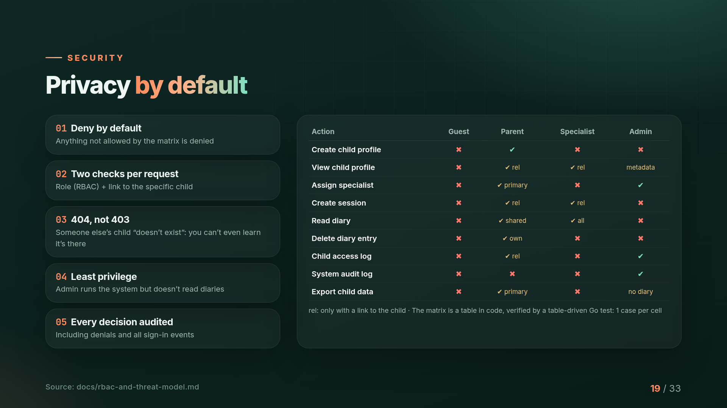
Notes:
Five security principles: deny by default, two checks on every request, 404 instead of 403 for other people's children, least privilege, and an audit of every decision. The access matrix is a table in code, verified by a test for every cell.

Slide 20
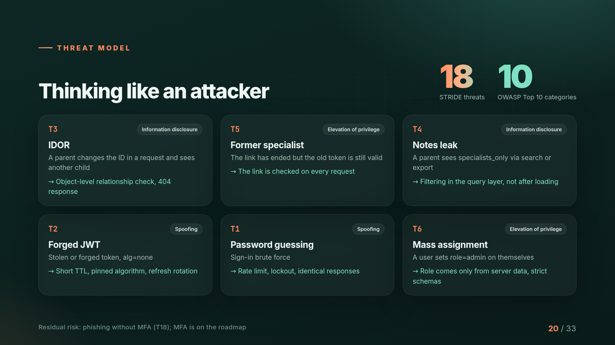
Notes:
We modeled 18 threats using STRIDE and mapped them to the OWASP Top 10. The main ones are IDOR, access by a former specialist, leakage of working notes, forged JWTs, password brute force and mass assignment. Each has a mitigation and a test. The residual risk is phishing without MFA, which is on the roadmap.

Slide 21
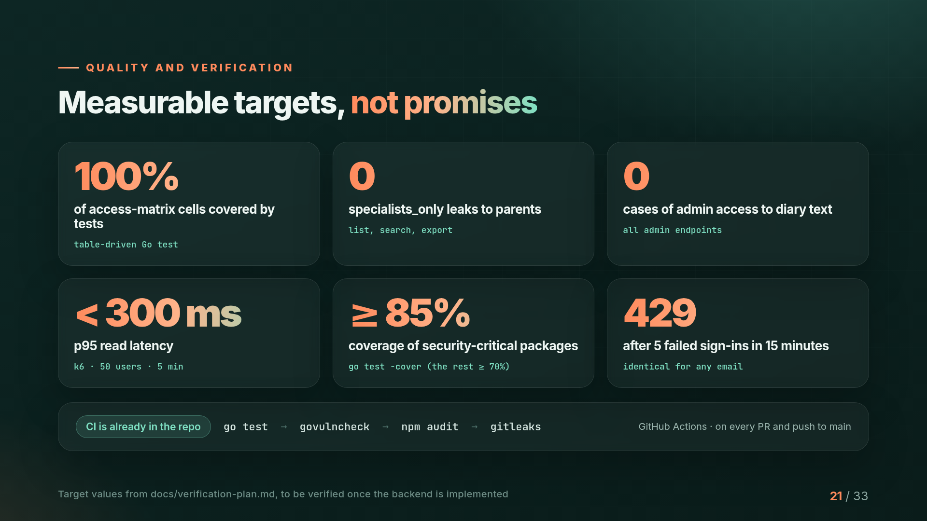
Notes:
We have measurable targets: 100% of matrix cells covered by tests, zero leaks of notes, zero admin access to diaries, and p95 under 300 ms under load. These are target values that we will verify once the backend is implemented. CI is already running go test, govulncheck, npm audit and gitleaks on every PR.

Slide 22
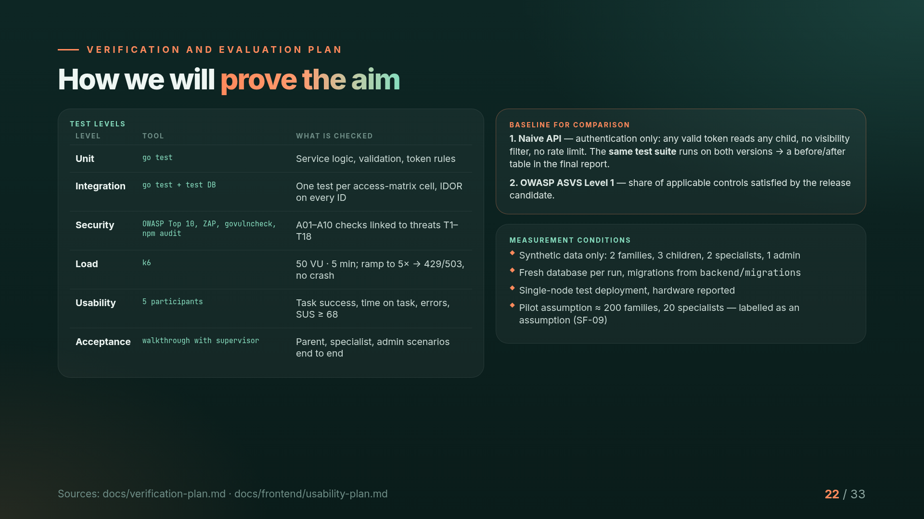
Notes:
To prove the aim we combine unit, integration, security, load, usability and acceptance testing. The key idea is a baseline: a naive version of the API with authentication only. We run the same test suite on both versions and show which tests the naive one fails. We also report the share of OWASP ASVS Level 1 controls satisfied. All tests use synthetic data under documented conditions.

Slide 23
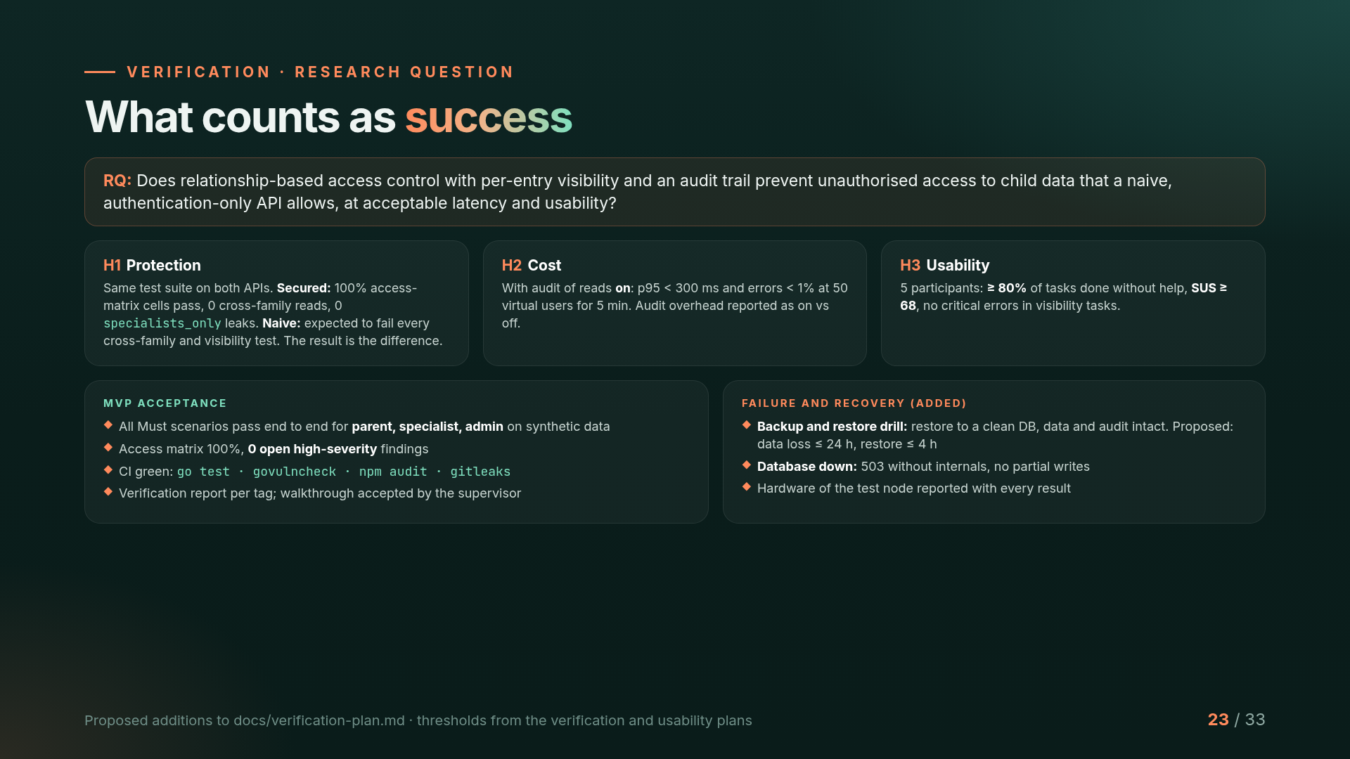
Notes:
Our research question: does relationship-based access control with per-entry visibility and an audit trail prevent unauthorised access that a naive authentication-only API allows, at acceptable latency and usability? Three hypotheses: protection, measured by running the same test suite on both APIs; cost, p95 under 300 milliseconds with auditing on; and usability, at least 80 percent task success and SUS of 68 or higher. The MVP is accepted when all Must scenarios pass for the three roles, the access matrix is 100 percent and there are no open high-severity findings. We also added backup-and-restore and database-failure checks.

Slide 24
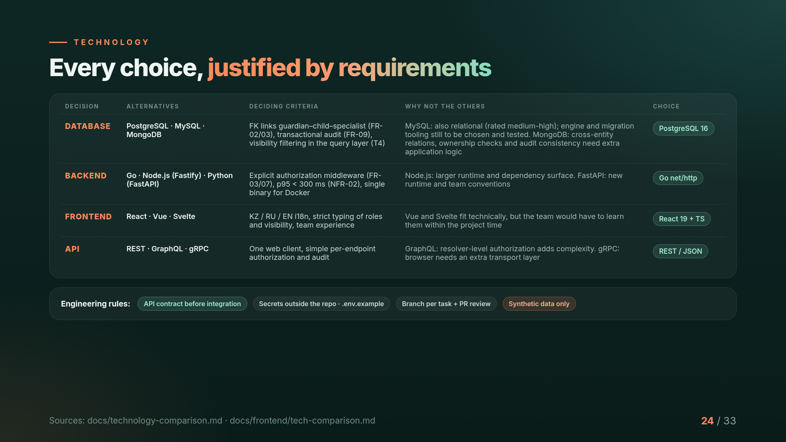
Notes:
Each decision is driven by requirements. The database must enforce guardian-child-specialist links, keep audit writes transactional and filter visibility in the query layer, so we chose PostgreSQL over MySQL and MongoDB. The backend needs explicit authorization middleware and p95 under 300 milliseconds, so Go net/http. The frontend needs three languages and strict typing of roles, so React with TypeScript. With one web client and per-endpoint authorization, REST is simpler than GraphQL or gRPC.

Slide 25
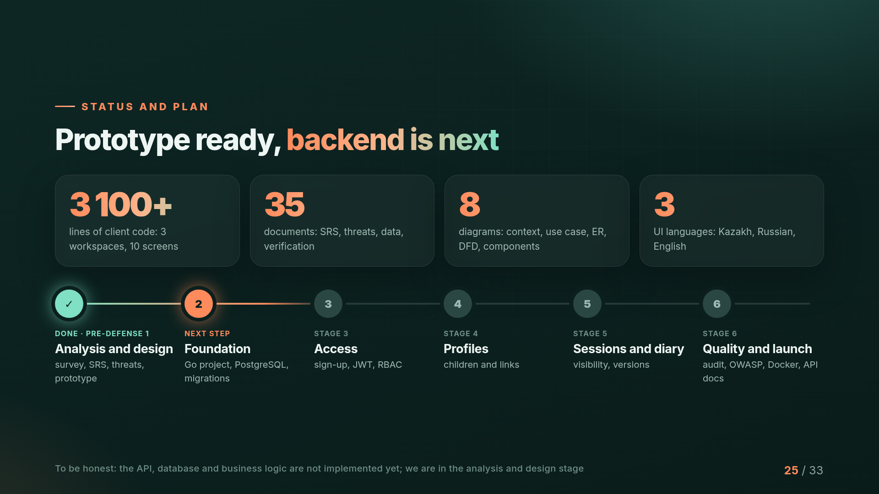
Notes:
Status: the analysis and design stage is complete, with a survey, SRS, threat model, 35 documents, 8 diagrams and a clickable prototype in three languages. To be honest, the API, database and business logic are not implemented yet. Next: foundation, access, profiles, sessions and the diary, and finally auditing, OWASP testing and Docker.

Slide 26
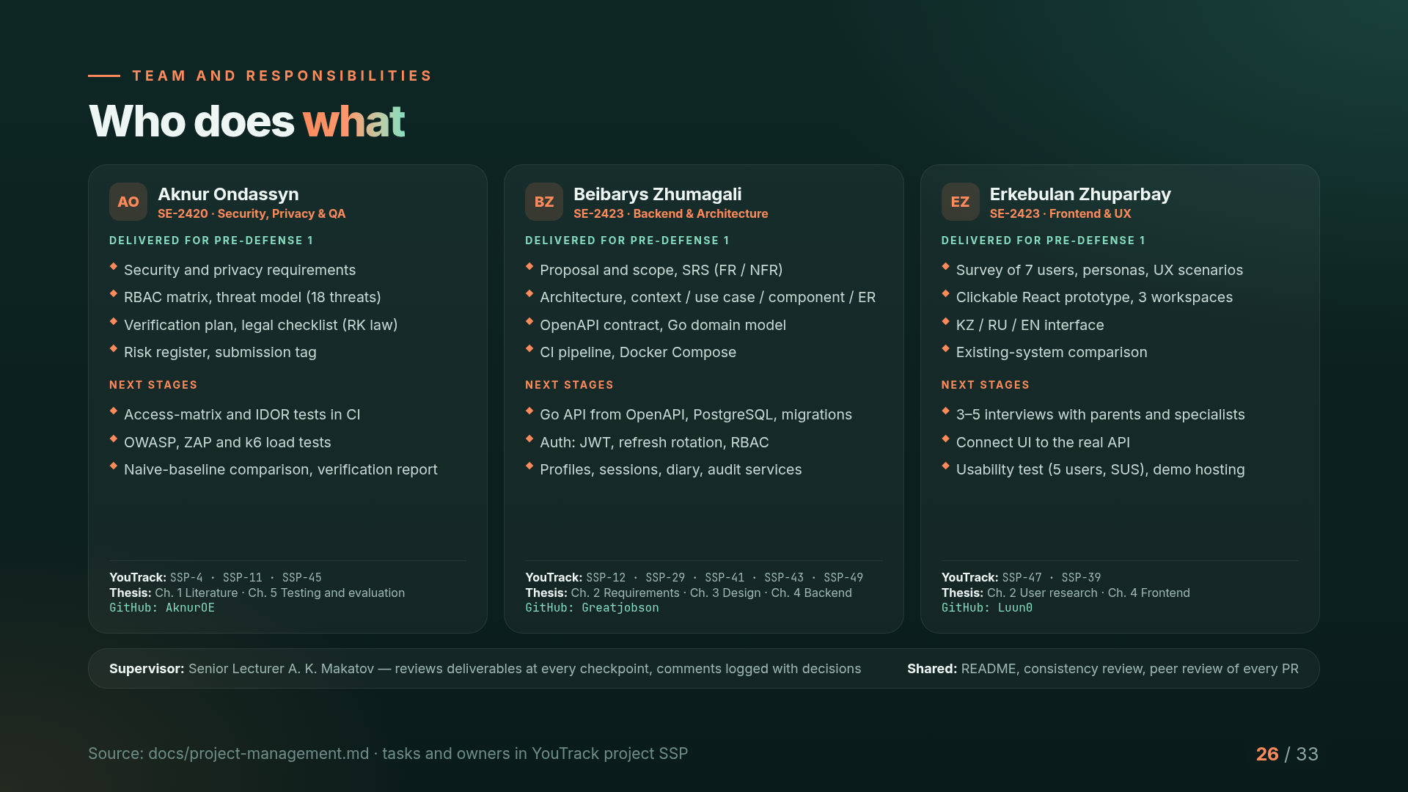
Notes:
Responsibilities are split by area. Aknur leads security, privacy and quality. Beibarys leads the backend and architecture. Erkebulan leads frontend and UX. Each of us also owns chapters of the thesis and tasks in YouTrack, and every pull request is reviewed by another member. Our supervisor reviews the deliverables at each checkpoint.

Slide 27
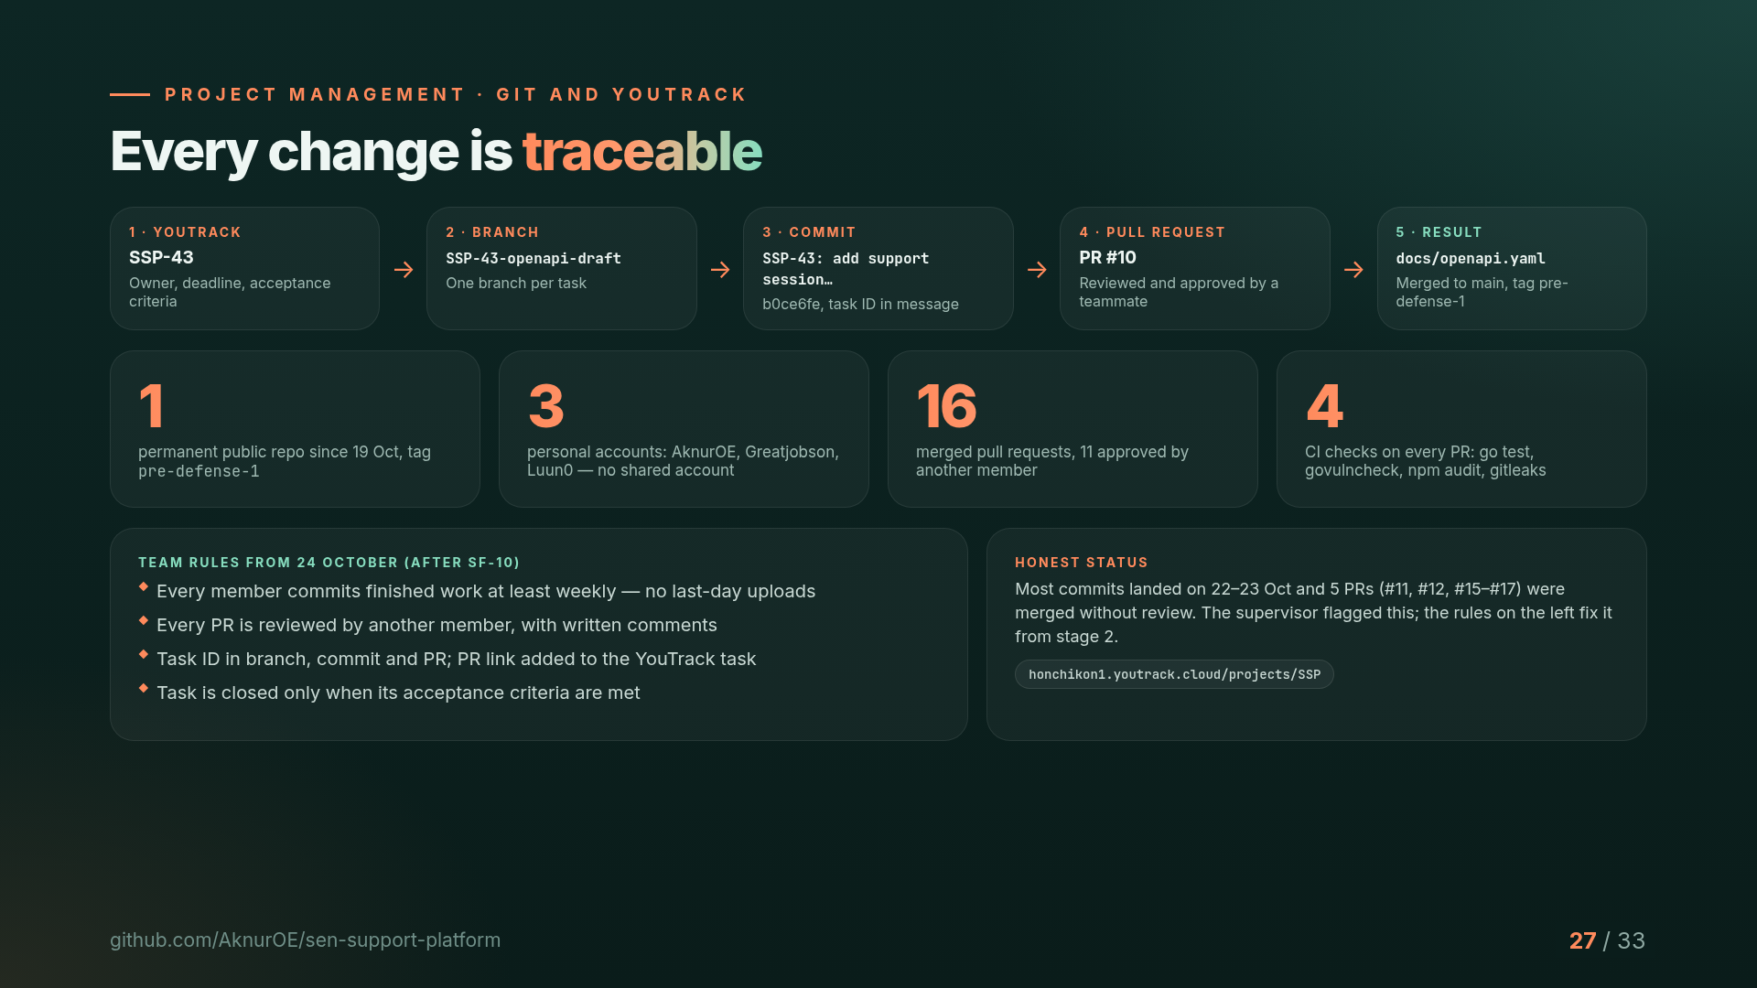
Notes:
Every change can be traced. Example: task SSP-43 in YouTrack, branch SSP-43-openapi-draft, a commit with the task ID, pull request number 10 reviewed by a teammate, and the result is the OpenAPI contract on main, fixed by the tag pre-defense-1. We are honest that most commits came in the last days and some PRs were merged without review; the supervisor pointed this out and we adopted strict rules from today.

Slide 28
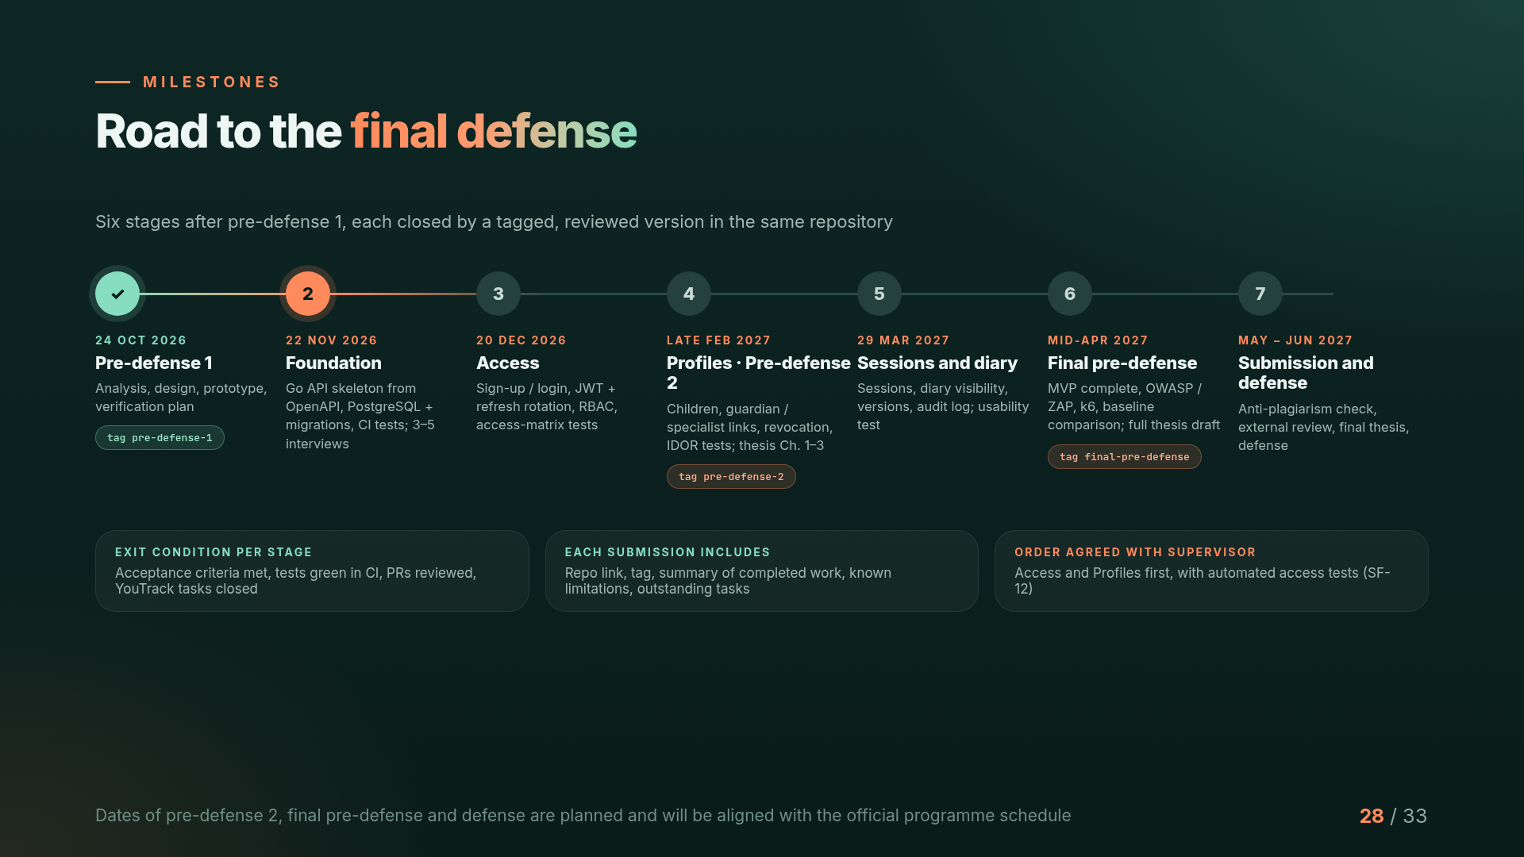
Notes:
After pre-defense 1 we have six stages. Foundation by 22 November, Access by 20 December, Profiles and pre-defense 2 in late February, Sessions and diary by the end of March, the final pre-defense in mid-April, then thesis submission and the defense in May and June. Each stage ends with reviewed code, green tests and a tag.

Slide 29
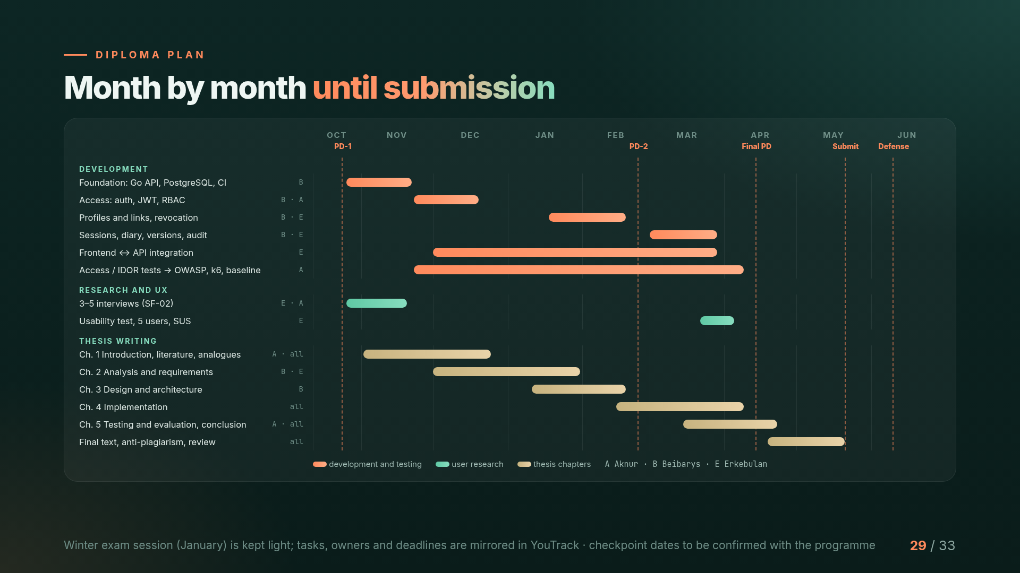
Notes:
This is our month-by-month plan until submission. Development follows the order agreed with the supervisor: access first, then profiles, then sessions and the diary. Testing runs in parallel from the start. Thesis chapters are written alongside development, so that the full draft is ready before the final pre-defense, followed by the anti-plagiarism check and review.

Slide 30
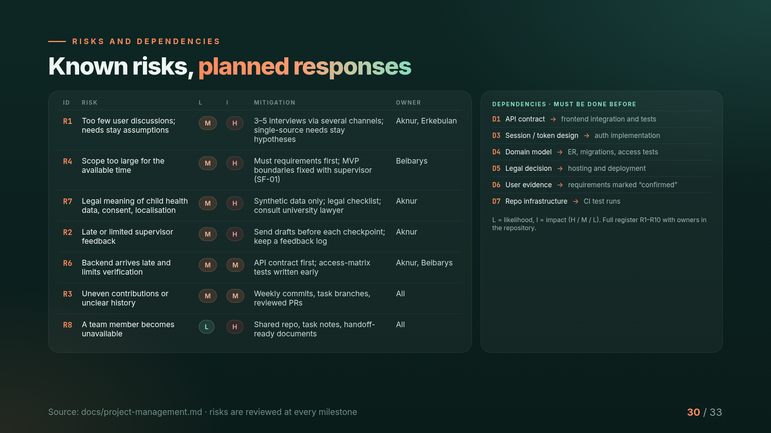
Notes:
The main risks are too little user evidence, scope that is too large, and legal questions about child data. For each risk we have a mitigation and an owner. We also track dependencies, for example the API contract must be ready before frontend integration and tests.

Slide 31
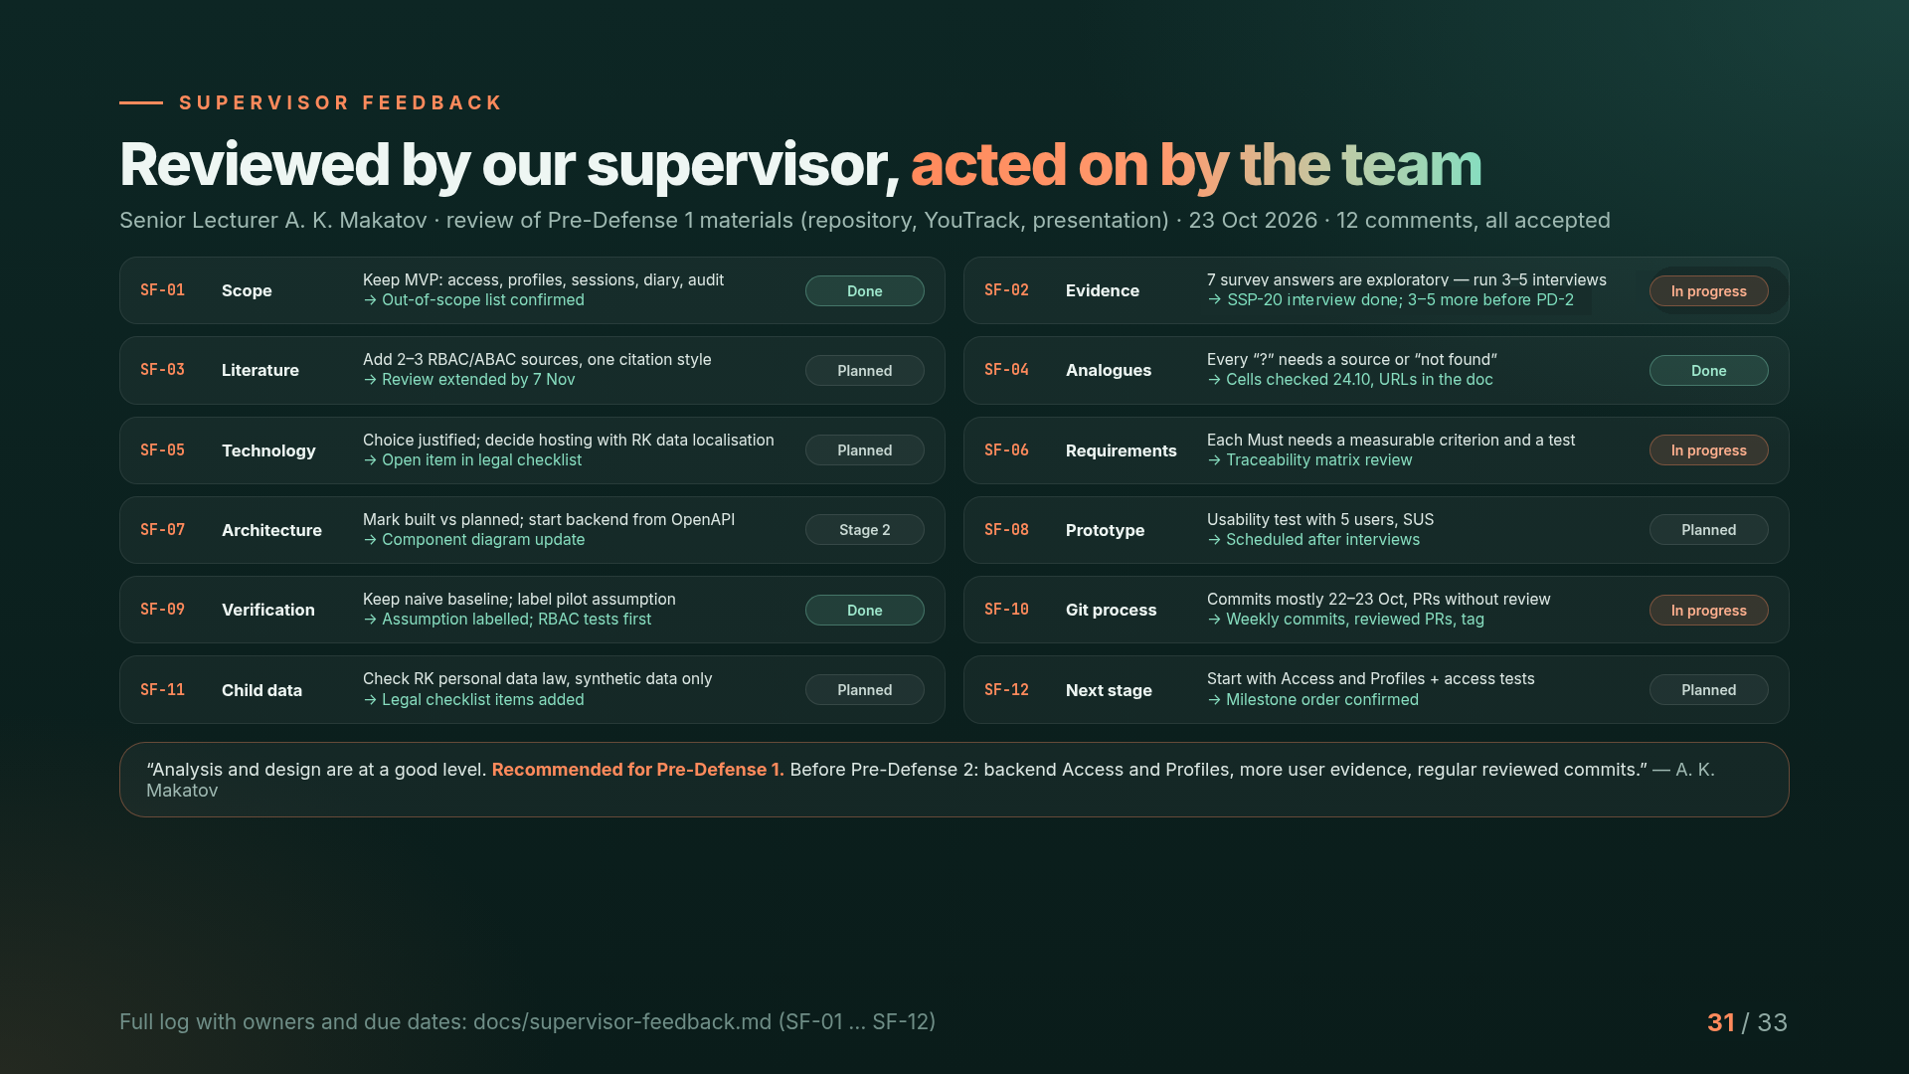
Notes:
Our supervisor reviewed the repository, YouTrack and the presentation and gave twelve comments. We accepted all of them; each has a decision, an owner and a deadline in the feedback log. The main changes: interviews before pre-defense 2, stricter Git rules, legal checks for child data, and starting development with access and profiles. The supervisor recommended the project for pre-defense 1.

Slide 32
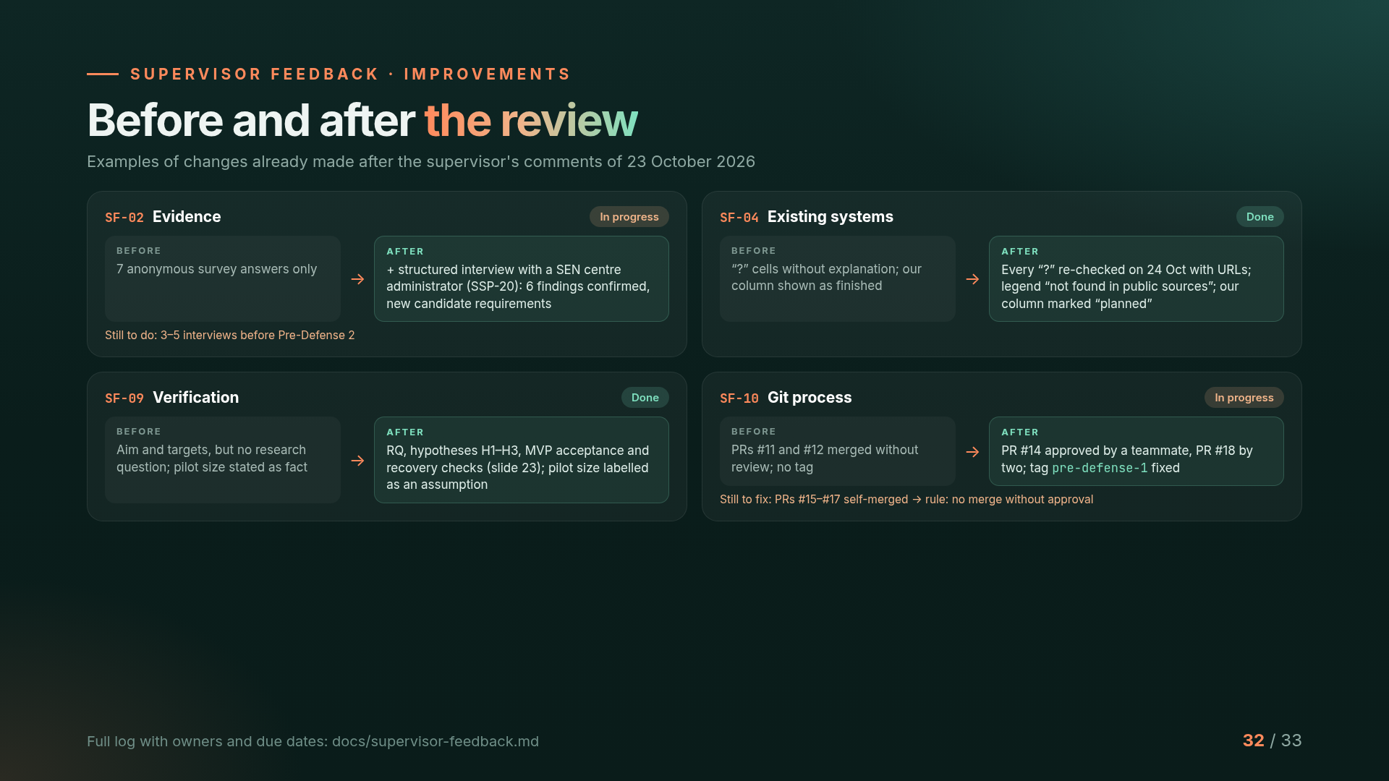
Notes:
Here is what changed after the review. Evidence: besides the survey we now have an interview with a support centre, and three to five more interviews are planned. Existing systems: every question mark was re-checked with sources, and our own column is now honestly marked as planned. Verification: we added a research question, hypotheses and MVP acceptance. Git: PRs are now reviewed by teammates and the pre-defense-1 tag is fixed, but three PRs were still self-merged, so the rule now is no merge without approval.

Slide 33
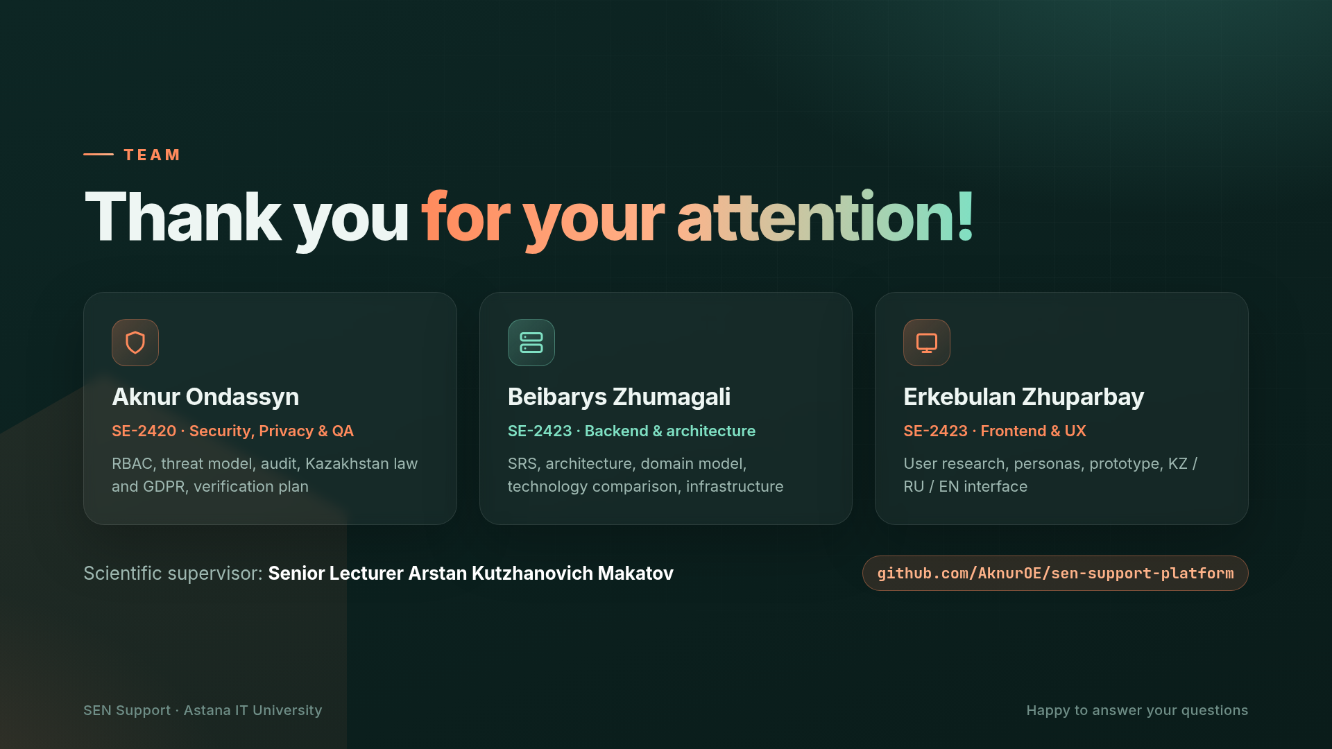
Notes:
Thank you for your attention! Aknur is responsible for security, privacy and quality, Beibarys for the backend and architecture, and Erkebulan for the frontend and UX. We are happy to answer your questions.

