Slide 1
Sound Recognition using Temporal Convolutional Networks
Eric Schölzel
Chair of Media Design
TU Dresden

Slide 2
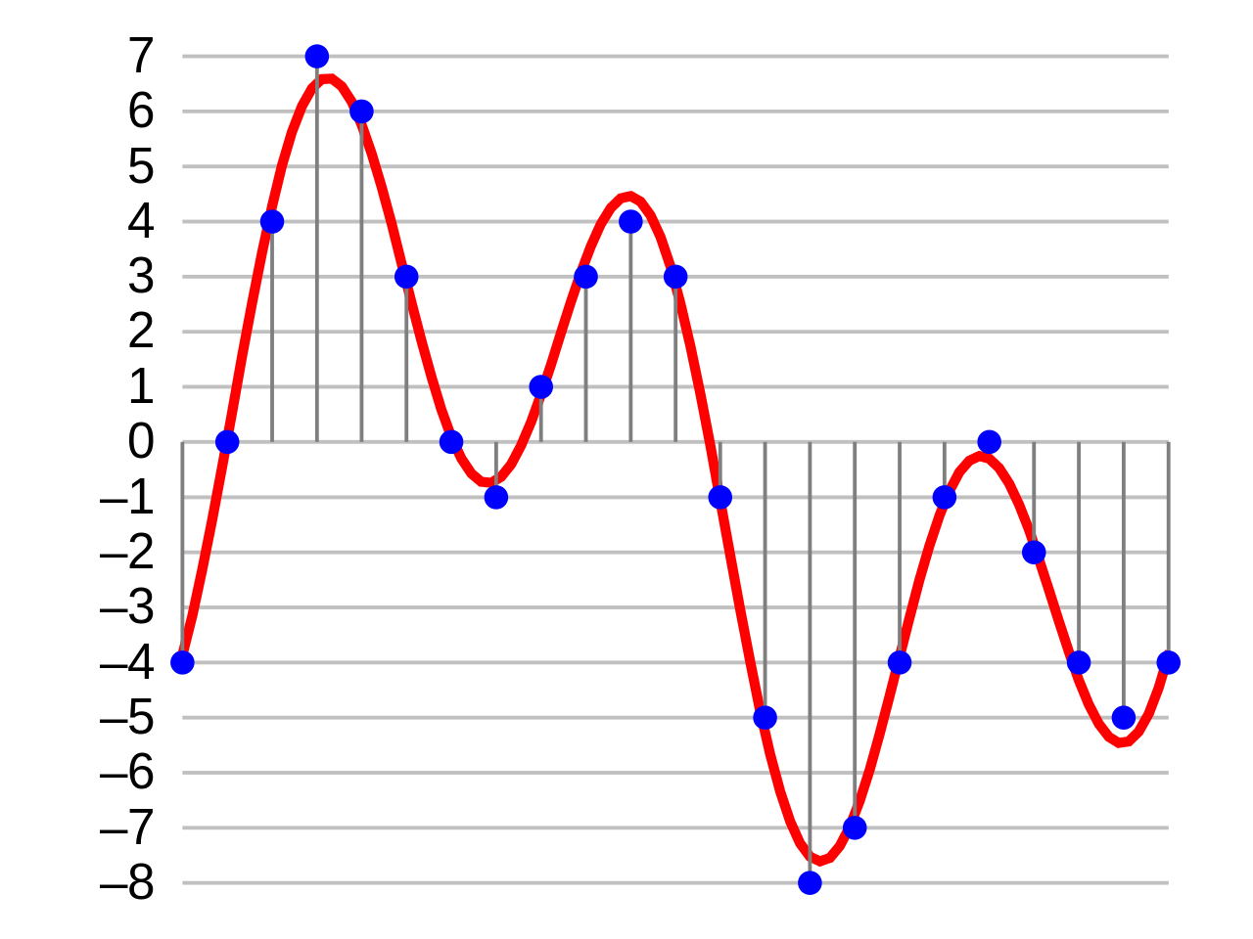
An extensible, simple Sound Recognition Pipeline
as simple and extensible as possible
state-of-the-art techniques (data augmentation, modern neural network architectures)
lightweight
Audio
Preprocessing
Input Features
ML-Algorithm
Output
[i1]

Slide 3
Sound Recognition using Machine Learning
1D signal over
(sample rate * duration)
time steps
fixed input and output dimensions:
samples have fixed length
(„bell“, „children‘s cry“, …)
[i1]
variable input size, output size dependend on input
Speech Recognition
Segmentation
...
Normalizing input length can (only) help to some extend.

Slide 4
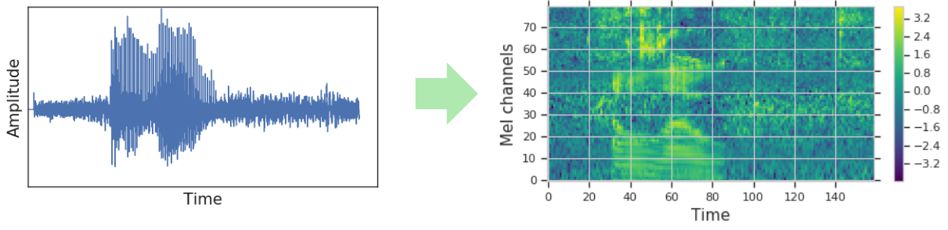
Preprocessing: Mel Spectrograms
mel spectrograms are used as input features
used by most state-of-the-art approaches [Hendrik Purwins et al. 2019]
audio recognition as image recognition problem
use raw audio as input for neural network?
works to some extend [Wei Dai et al. 2017]
intuition: network has to learn own preprocessing first
[i2]

Slide 5
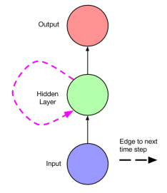
Network Architectures
Why Neural Network?
state-of-the-art image recognition (see mel spectrograms) [Hendrik Purwins et al. 2019]
time series, variable input- and output sizes, … ([Hendrik Purwins et al. 2019], [Wei Dai et al. 2017], …)
extremely flexible
Recurrent Neural Network / Long Short-Term Memory? [LSTM1997][Lipton et al. 2015]
slow…
unknown length of history
[i4]
[i5]

Slide 6
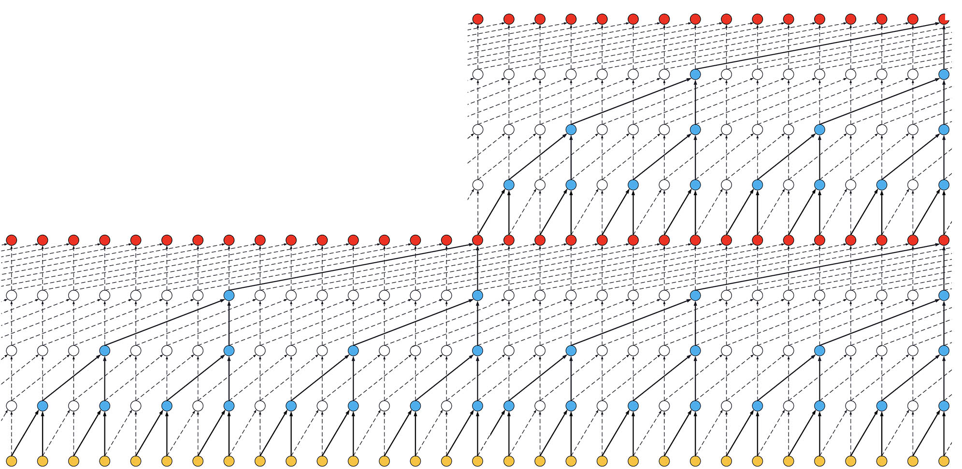
Temporal Convolutional Networks [Wavenet2016][Shaojie Bai et al. 2018]
dilated + causal* convolutions
residual connections
exponentially growing receptive field
fully parallelizable
better results, faster convergence
additional feature extraction through conv. layers possible
adopted from [CNN-LSTM2015]
*(can be made non-causal optionally)
[i6]
[i7]

Slide 7
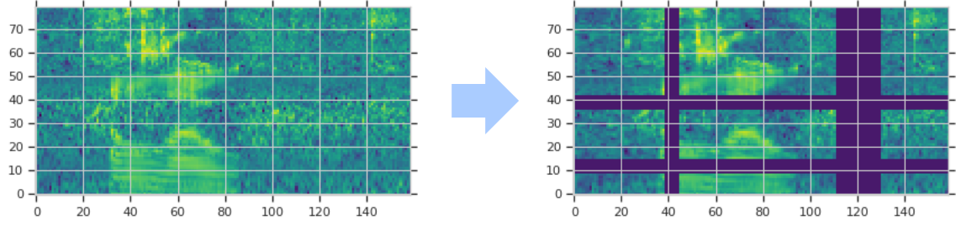
Training Data Augmentation [SpecAugment2019]
Sound Training Data Augmentation
add noise, change speed, …
prior to SpecAugment: done on audio signal itself
spectrograms have to be calculated again… (slow!)
SpecAugment (Google AI)
data augmentation directly on spectrograms
3 main components:
Time Warping
Frequency Masking
Time Masking
[i3]

Slide 8
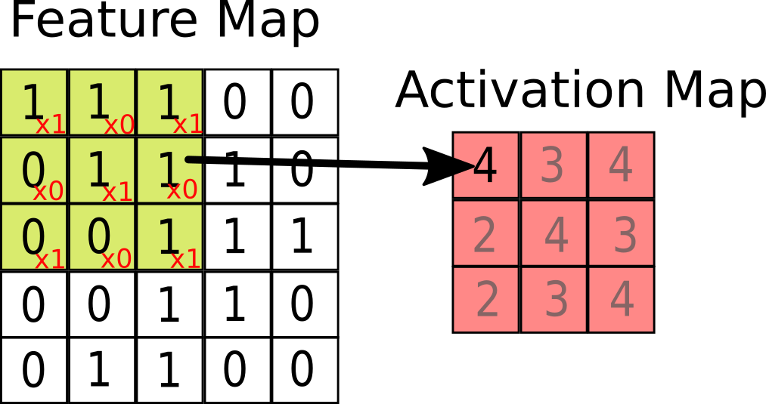
Pipeline Overview
[i2/i3]
raw audio
mel spectrogram
SpecAugment
(only during training!)
CNN-TCN
[i7]
Output

Slide 9
Testing
Test on UrbanSound8K Dataset [UrbanSound2014]
8732 samples, 10 classes, length per sample: <= 4s
air conditioner, car horn, children playing, dog bark, …
Does it work?
Yes*. (model + weight Size < 7mb!)
Code available (no download/personal setup/GPU needed!): https://colab.research.google.com/drive/1wflMtZzj3wXiXYrH7Y3vR1m4fdf5TJyD
*Disclaimer:
no full implementation of SpecAugment used (Time Warping is missing)
no 10-fold cross-validation

Slide 10
Sources
[Hendrik Purwins et al. 2019] “Deep Learning for Audio Signal Processing”. In: IEEE Journal of Selected Topics in Signal Processing (2019)
[Wei Dai et al. 2017] “Very deep convolutional neural networks for raw waveforms”. In: 2017 IEEE International Conference on Acoustics, Speech and Signal Processing (ICASSP) (2017)
[SpecAugment2019] Daniel S Park et al. “SpecAugment: A Simple Data Augmentation Method for Automatic Speech Recognition” (2019)
[LSTM1997] Sepp Hochreiter and Jürgen Schmidhuber. “Long Short-Term Memory”. In: Neural Comput. 9.8., pp. 1735-1780 (1997)
[Lipton et al. 2015] Zachary C. Lipton, John Berkowitz, and Charles Elkan. A Critical Review of Recurrent Neural Networks for Sequence Learning (2015)
[Wavenet2016] Aaron van den Oord et al. “WaveNet: A Generative Model for Raw Audio” (2016)
[Shaojie Bai et al. 2018] Shaojie Bai, J. Zico Kolter, and Vladlen Koltun. “An Empirical Evaluation of Generic Convolutional and Recurrent Networks for Sequence Modeling” (2018)
[CNN-LSTM2015] T. N. Sainath et al. “Convolutional, Long Short-Term Memory, fully connected Deep Neural Networks” (2015)
[UrbanSound2014] Justin Salamon, Christopher Jacoby, and Juan Pablo Bello. A Dataset and Taxonomy for Urban Sound Research. In Proceedings of the 22nd ACM international conference on Multimedia (MM '14). ACM, New York, NY, USA (2014)

Slide 11
Image Sources
[i1] https://commons.wikimedia.org/wiki/File:4-bit-linear-PCM.svg (November 13, 2013)
[i2][i3] https://ai.googleblog.com/2019/04/specaugment-new-data-augmentation.html, Daniel S. Park, AI Resident and William Chan, April 22, 2019
[i4][i5] siehe [Lipton et al. 2015]
[i6] siehe [Shaojie Bai et al. 2018]
[i7] Philippe Rémy. Keras-TCN (TCN-Implementation für Keras) https://github.com/philipperemy/keras-tcn (besucht am 10.07.2019)

