Slide 1


FINANCELY
YOUR PERSONAL FINANCE MANAGER

Slide 2
WHAT THIS PROJECT IS ABOUT
WHY FINANCELY?
In today's fast-paced world, keeping track of daily expenses can be challenging. Whether you're managing a household budget or tracking personal finances, Financely simplifies the process by offering a user-friendly way to log, categorize, and analyze your financial transactions.
Financely, your reliable companion for managing and tracking your personal finances efficiently. Our platform empowers users to take control of their spending habits, allowing for better financial planning and organization through an easy-to-use interface.

Slide 3
KEY FEATURES
SECURE LOGIN
EASY-TO-USE INTERFACE
EASY RETRIEVAL
SUMMARIZED RESULTS
SPENDING RECOMMENDATIONS AND WARNINGS
Our system uses secure password storing as to maintain user privacy
Transactions stored can be retrieved with just a click with additional filters you can apply
Monthly and categorical summaries with pie charts and bar graphs are provided to get an overview of your spending
The user interface is beginner friendly with everything organized and labelled
The system warns you in case of an overspending as per your budget set

Slide 4
TECHNOLOGY STACK
FRONTEND
BACKEND
Dynamic User Interface build with HTML, CSS And JavaScript with ExpressJS used to connect the frontend to backend
C++ Core Engine with custom data structures and file based storage system

Slide 5

1. DOUBLY LINKED LIST
A doubly linked list is used to store the transactions and used to further add new transactions as well as for the retrieval of transactions as per the user filter
DATA STRUCTURES AND ALGORITHMS USED
2. PRIORITY QUEUE
A priority queue is used to keep track of overspending in a sorted order so as to warn the user as per the amount overspend
3. HASH MAPS
Unordered maps are used to store data categorically so as for efficient retrieval in the case of categorical data retrieval
4. KMP ALGORITHM
KMP Algorithm is used for string matching as to find a particular key in the whole transaction string stored

Slide 6
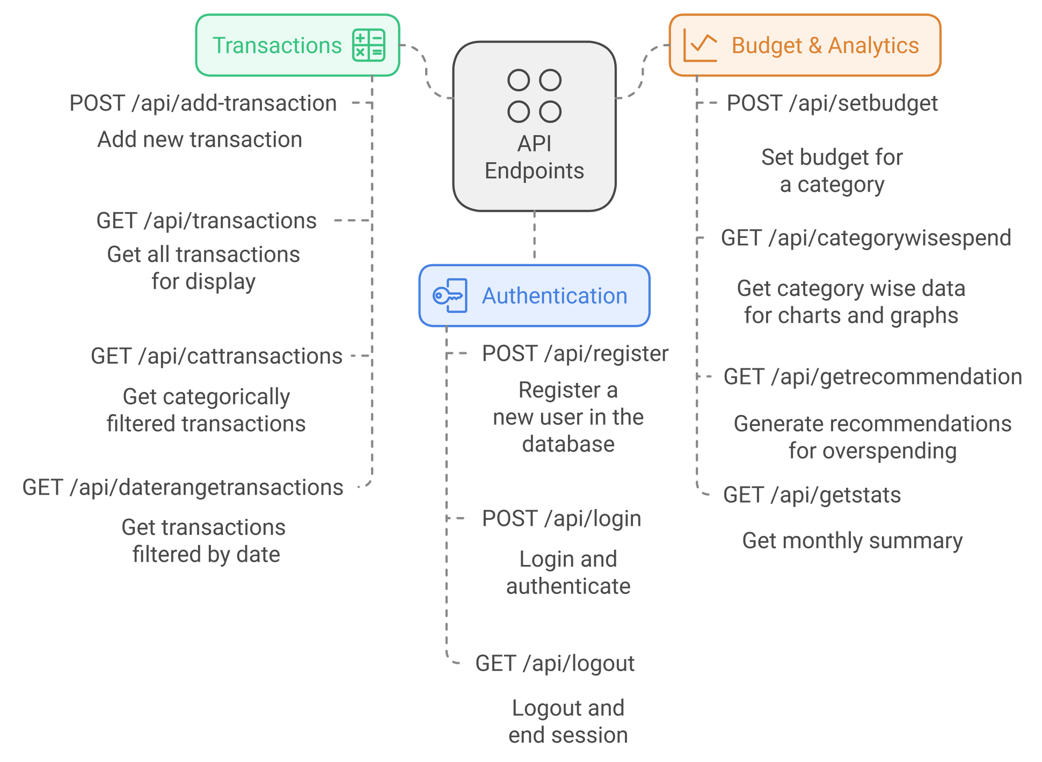

Slide 7
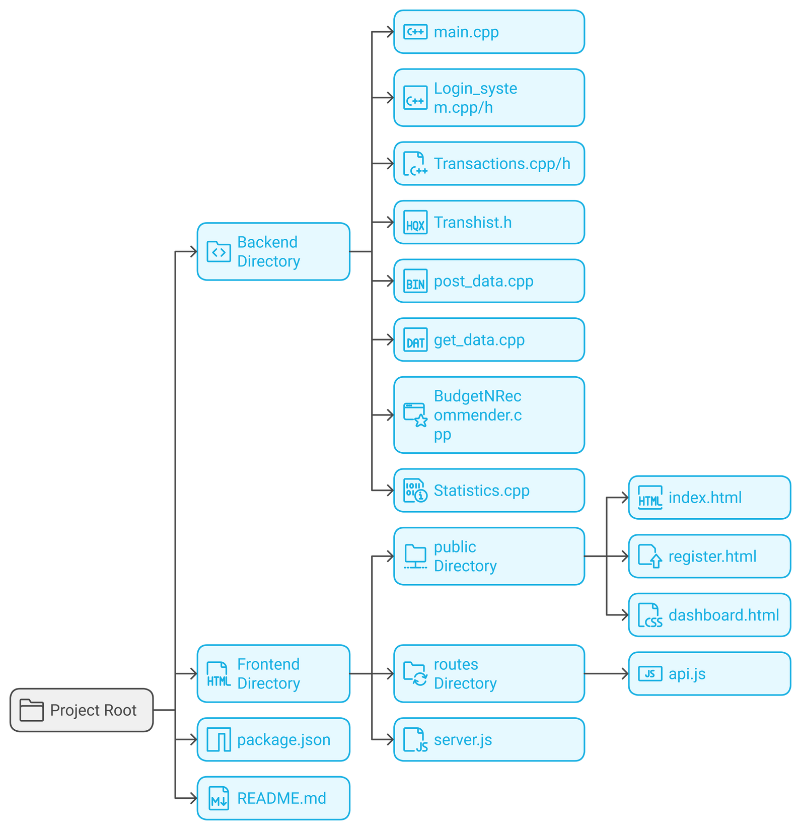
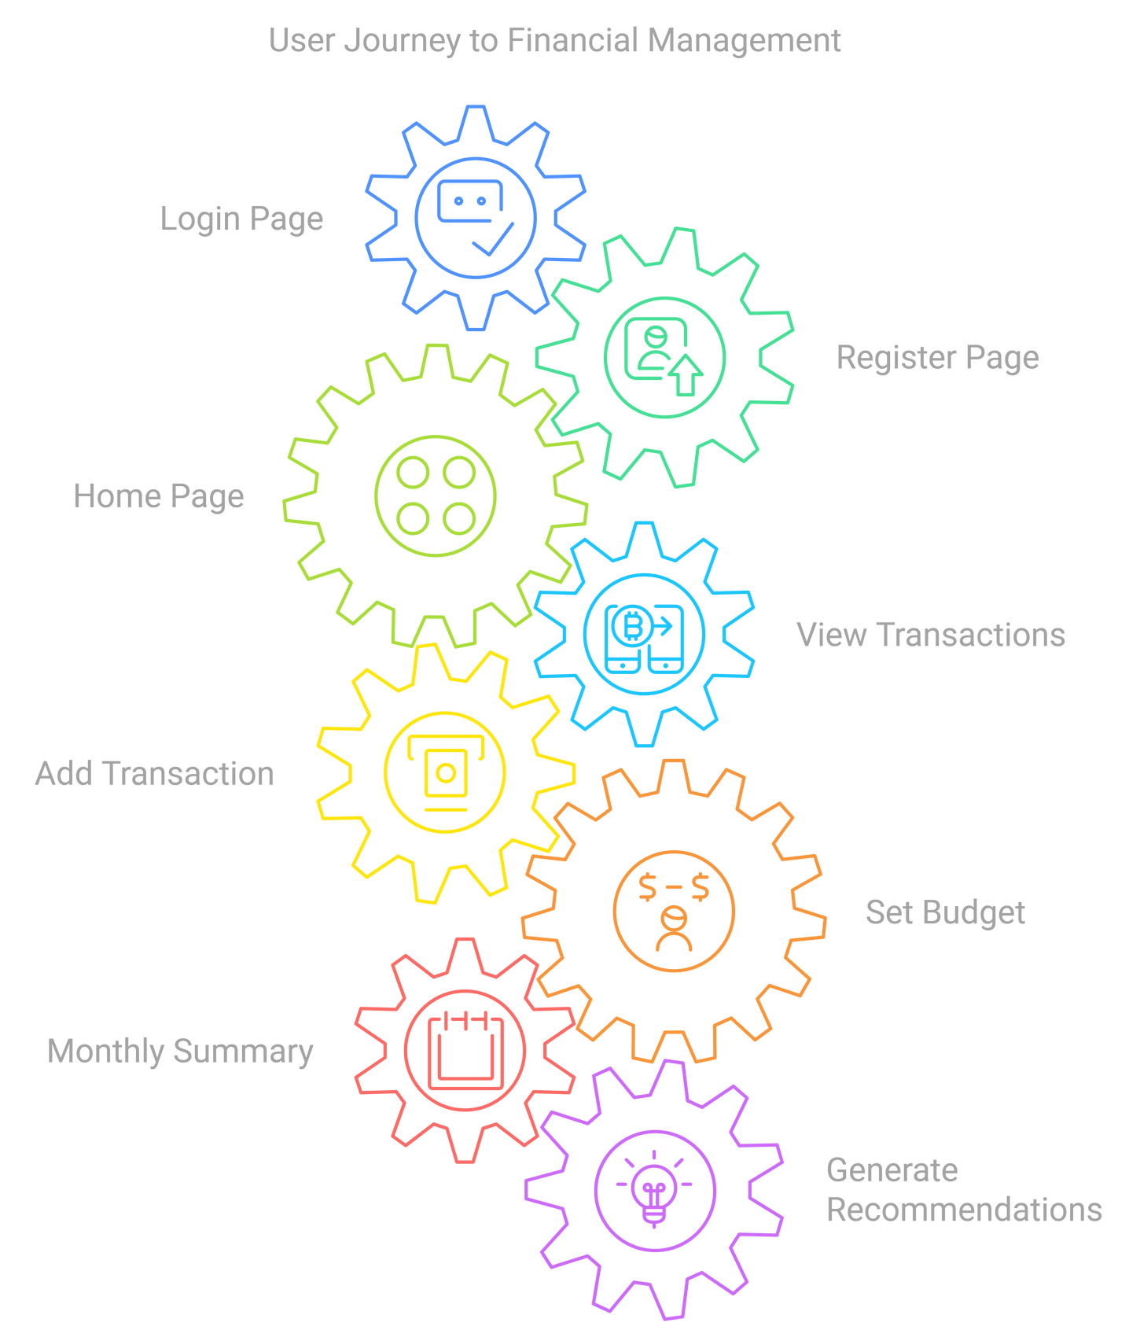

Slide 8

THANK YOU
TEAM MEMBERS
LUV VALECHA B23CS1093
KRISH TECKCHANDANI B23CS1092
ANSHIT AGARWAL B23CS1087
GITHUB

