Slide 1
Adv. Topic in cloud computing
Term Assignment
one-on-one meeting
Professor :
Lu Yang
DALHOUSIE UNIVERSITY
HALIFAX

Slide 2
oVERVIEW
OneStore
It is a cloud-based application, allowing users to securely store their files. The application provides a seamless and secure way for users to manage their files using a combination of AWS services.
Features:
Create account using just their email address.
Upload Photos to cloud with just one click.
View all the photo files under “MyFiles”
Delete a item if no longer needed

Slide 3
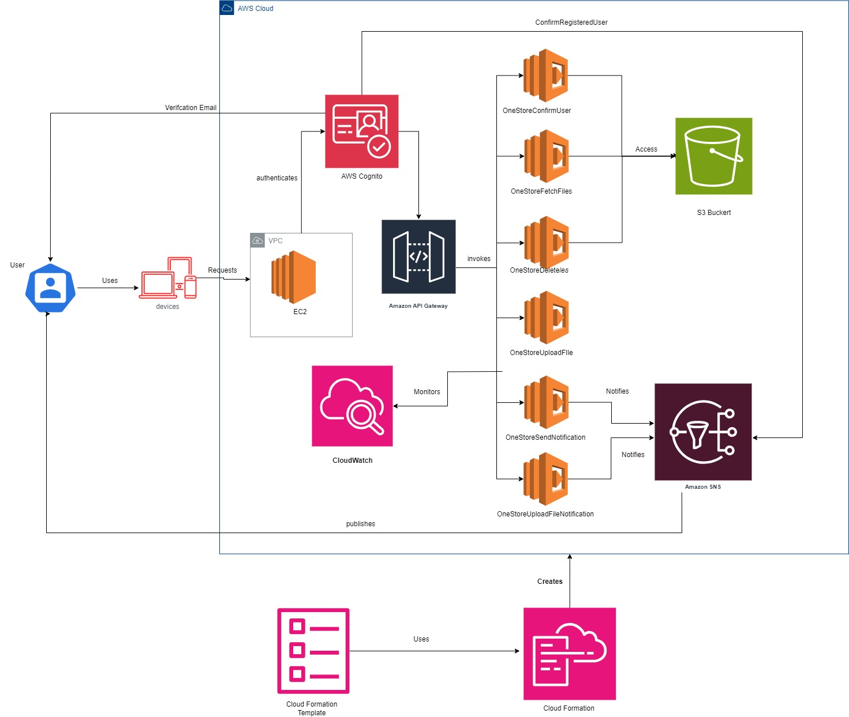
Architecture Diagram

Slide 4
Thank you

