Slide 1


SIWES DEFENCE PRESENTAION
NAME: Arinde David
Matric: Run/cpe/21/10327
Firm: emmakulate system solutions

Slide 2
TABLE OF CONTENT
Introduction
Networking
Computer Hardware
Operating System
Web Development
Thank You

Slide 3
INTRODUCTION
OVERVIEW
During this program I had the opportunity to get trained in the following fields of Computer Engineering which included:
Hardware and OS
Networking Fundamentals
Web Development Fundamentals

Slide 4
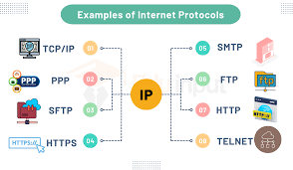
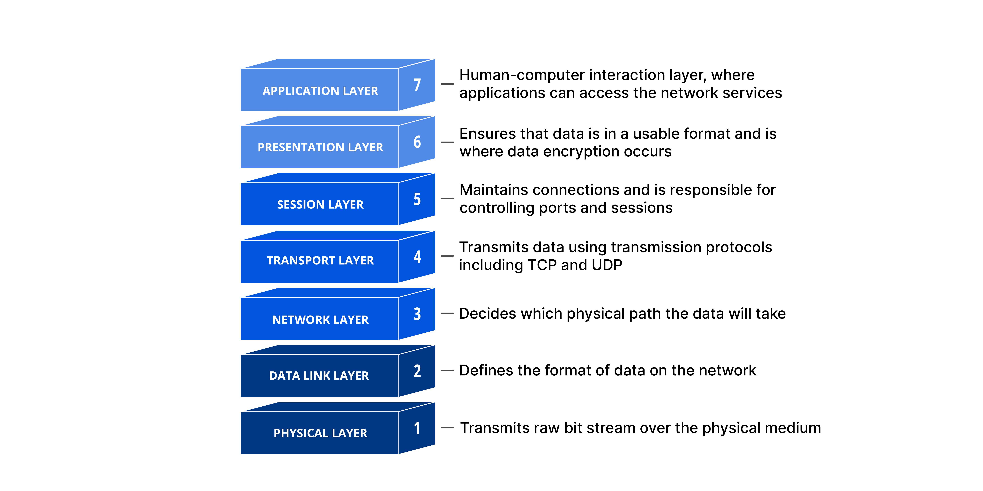
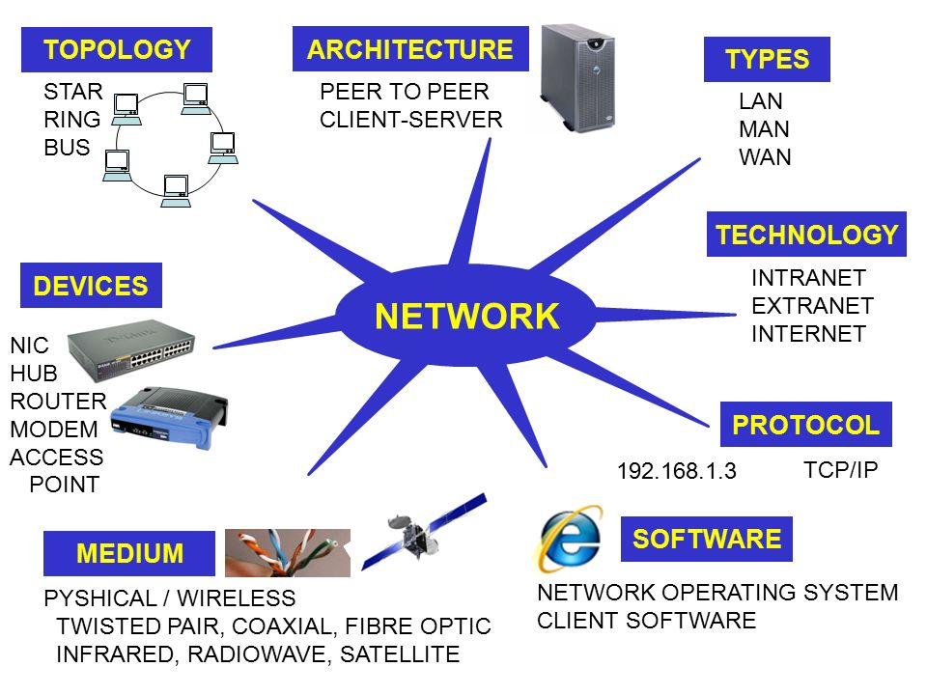
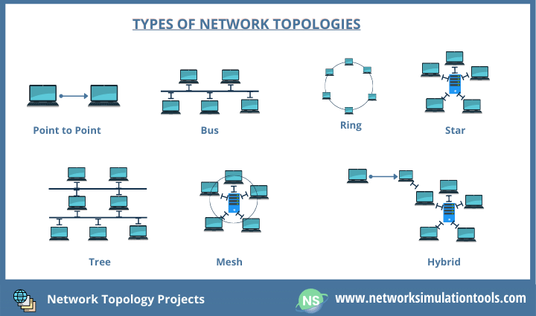
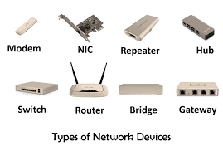
NETWORKING
Networking is the process of connecting several devices together to exchange resources and data.
Network Protocols.
Network Devices.
Network Topologies.
Network Architecture.
OSI Model
Network Medium.
Network Types.

Slide 5
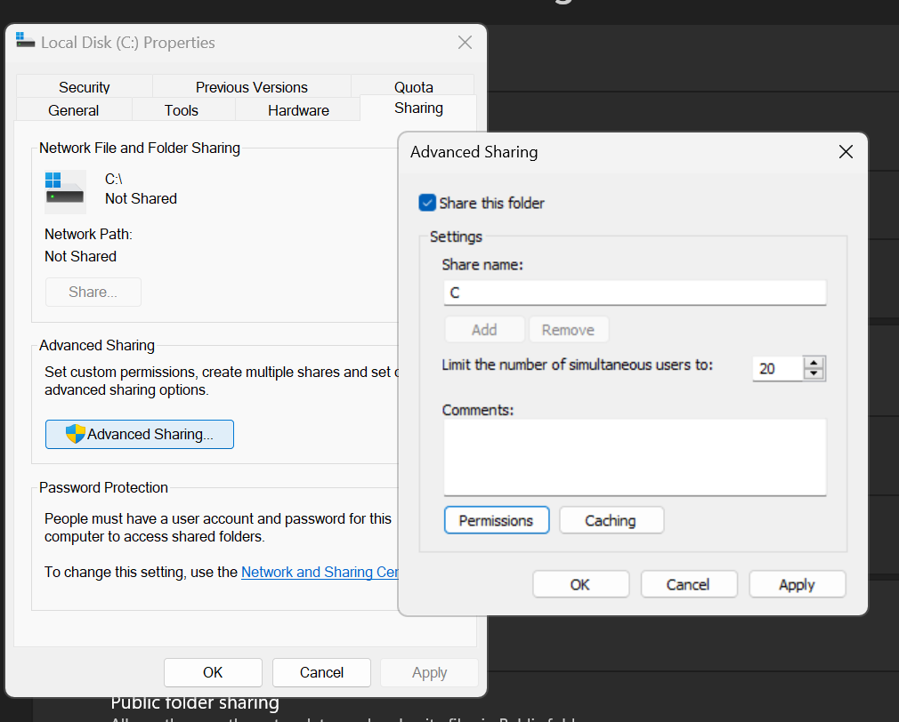
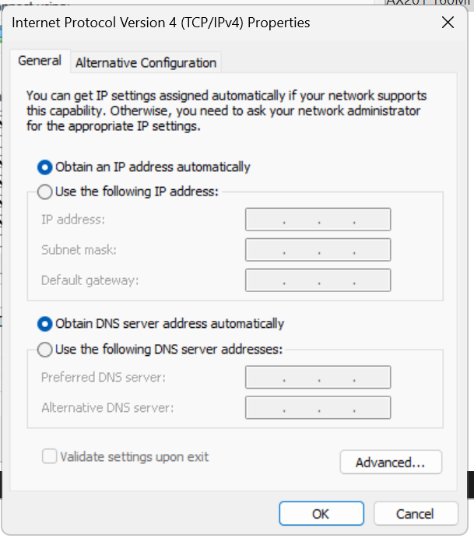
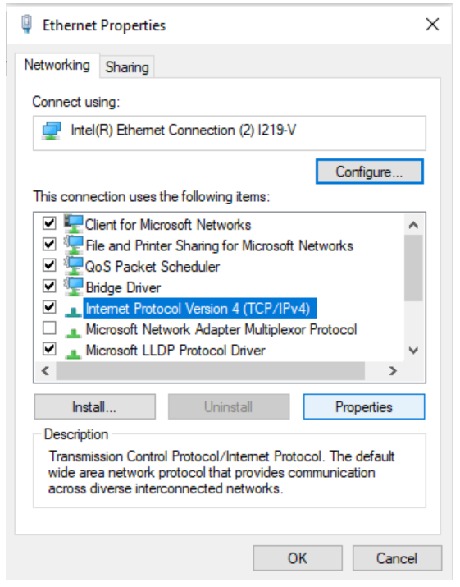
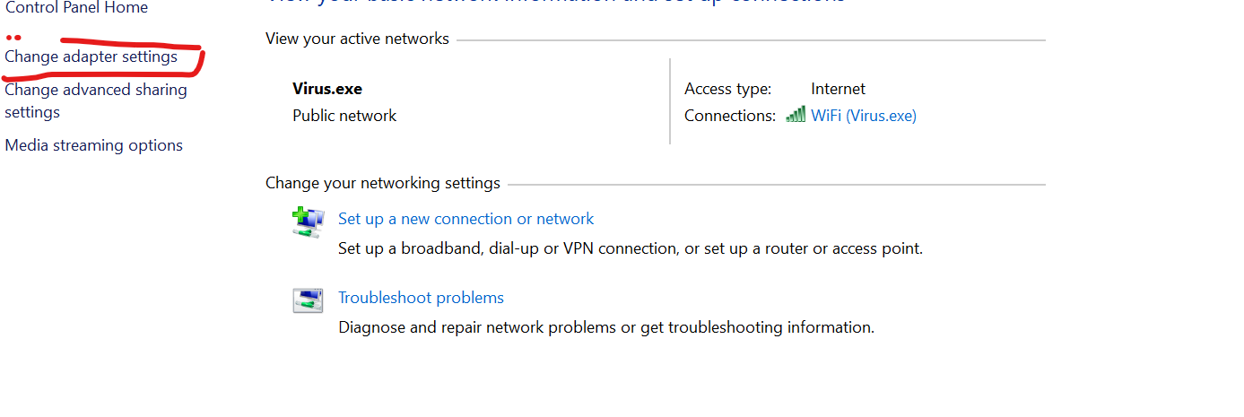
PROJECT
A Simple Local Area Network.
Steps
Problems
Observation

Slide 6
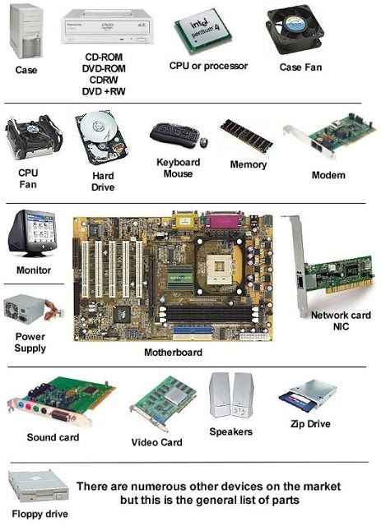
COMPUTER HARDWARE
Introduction.
Computer Hardware Components.
Peripherals.
System Unit.
Memory.
Expansion Slot.
Drivers.

Slide 7
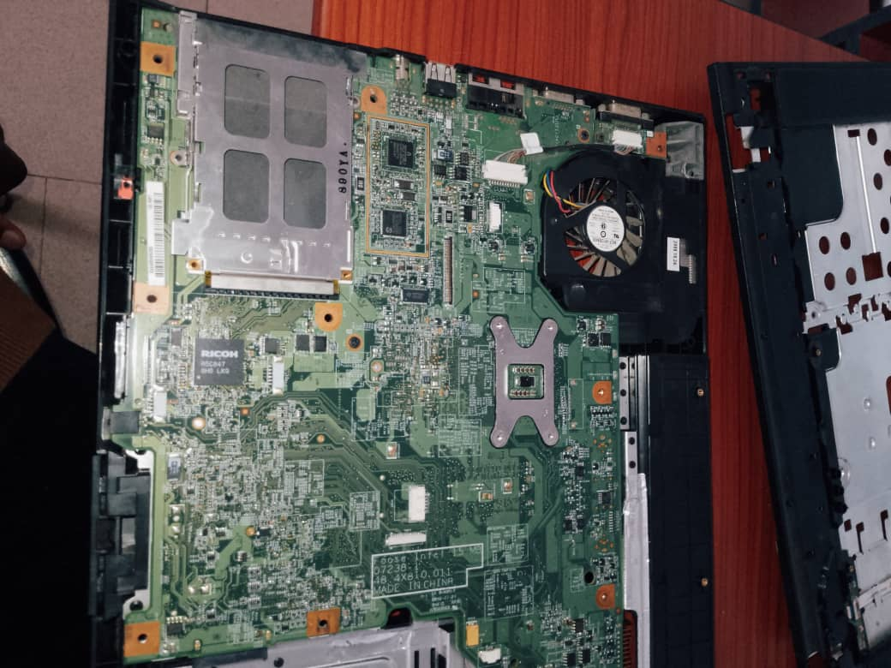
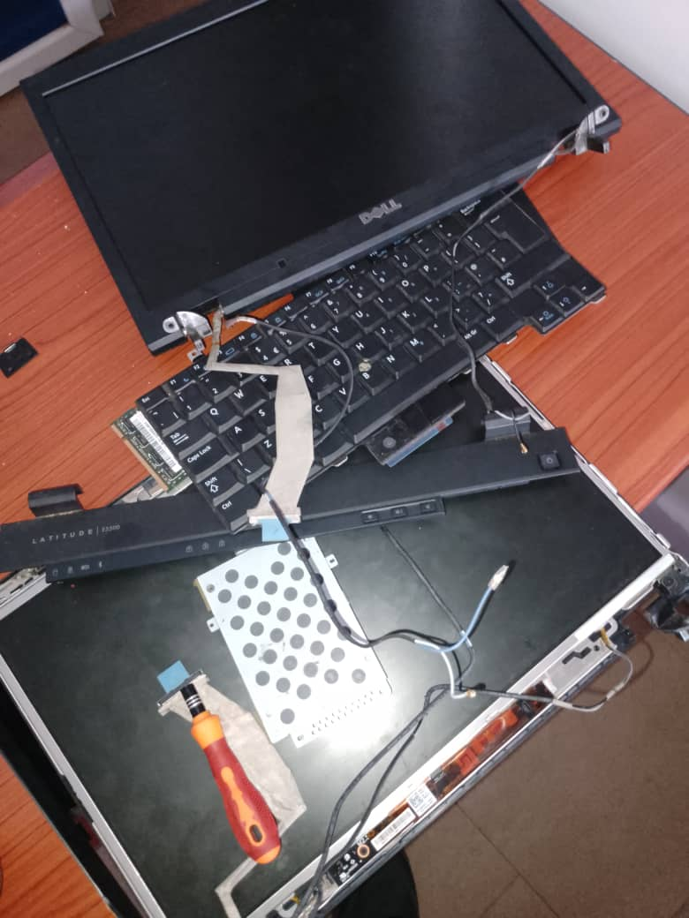
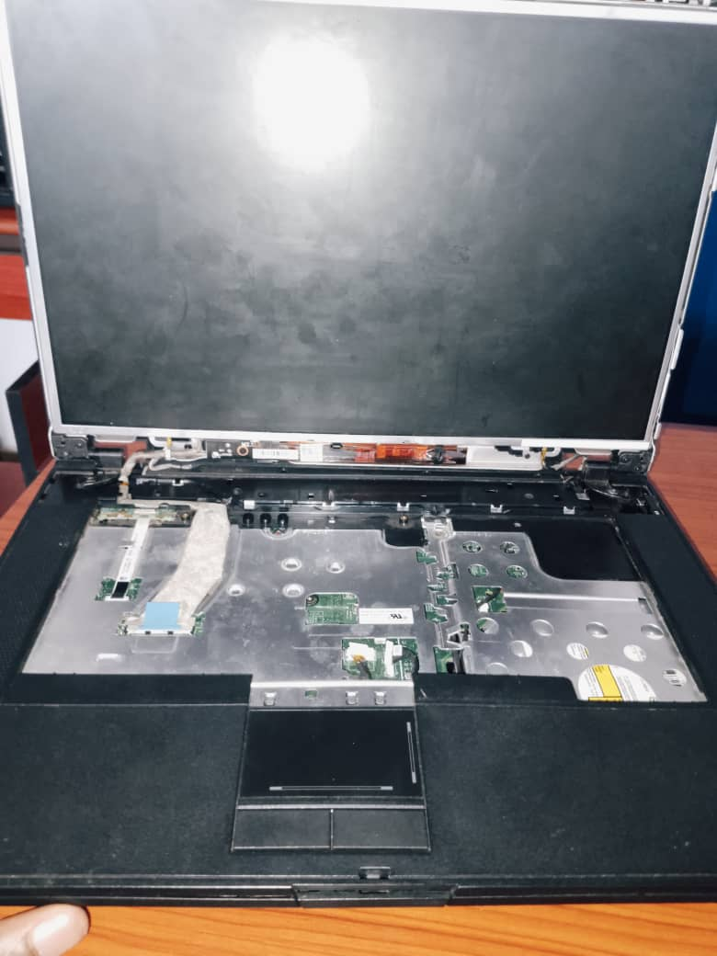
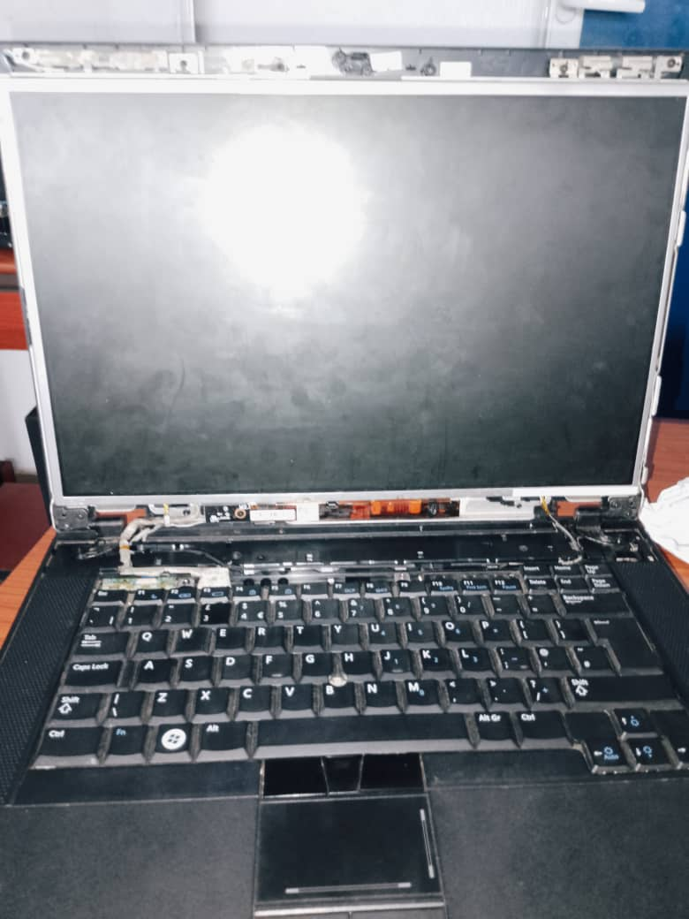
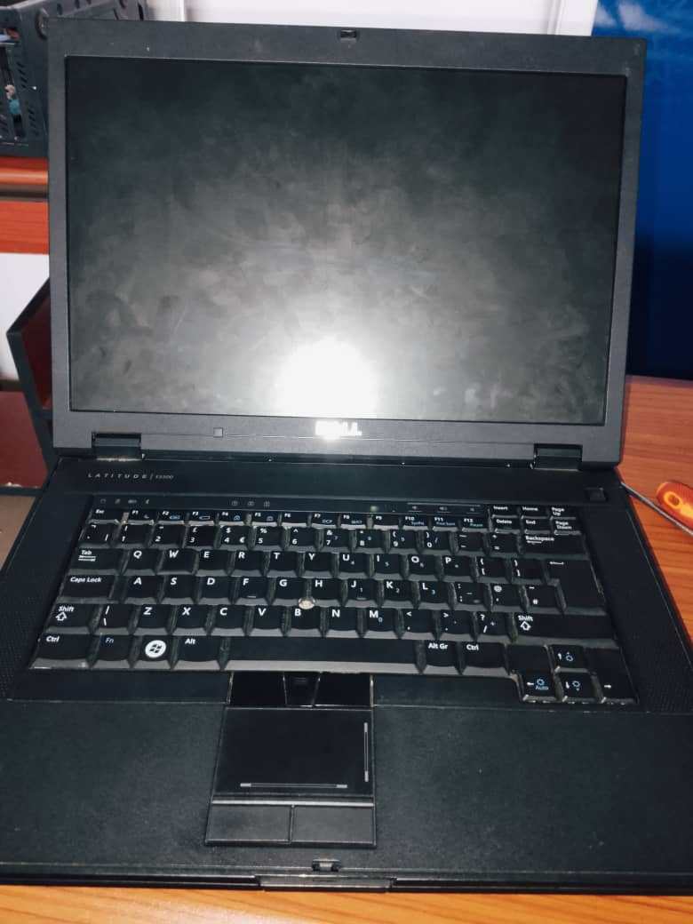
PROJECT
Disassembling and reassembling a Laptop
Steps
Problems
Observations

Slide 8
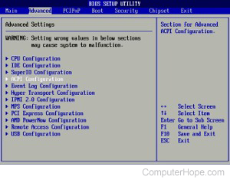
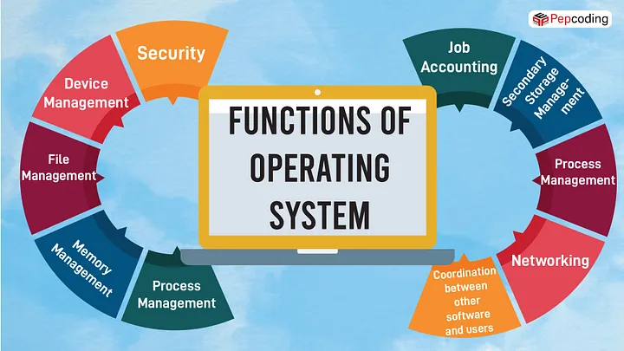
OPERATING SYSTEM PRINCIPLES
Introduction
Functions
Booting Process
BIOS (Basic Input and Output System)
Drivers
Utilities Programs
Interrupts
Kernel

Slide 9
OPERATING SYSTEM
Interfaces
Command Prompts
Introduction
Functions.
Commands. Eg ren, cd, mkdir, chkdsk, shutdown, ipconfig etc
How to use.
GUI (Graphics User Interface)

Slide 10
PROJECTS
Operating System Installation and Configuration.
Steps.
Problems.
Observation.

Slide 11

Web Development
Introduction
Types
Front-end Development
Back-end Development
Full-stack Development
Tools and Frameworks used

Slide 12
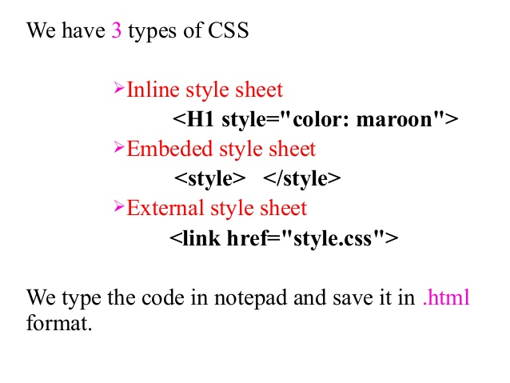
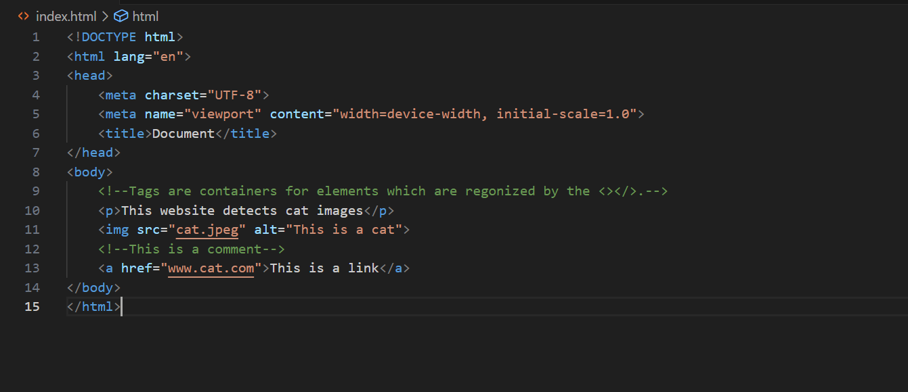
WEB DEVELOPMENT
Tools and Development.
HTML
Basic Structure
Elements
Attributes
Tags
Links
Comments
CSS
JavaScript
SQL

Slide 13
Conclusion
Thank you

