Slide 1
SentinelScan
One URL. Complete Security Insight.
Automated Website Vulnerability & OWASP Top 10 Scanner
Problem Statement
Posted by
Team
Website Scanning tool
Uplers
Luv Rawal,
Divyanshu Rawat

Slide 2
Nobody is checking. Attackers already are.
Security teams and site owners have no fast, on-demand way to check whether a website is running outdated software or exposing OWASP Top 10-class weaknesses.
Manual security audits are slow, expensive, and need specialist skills — so most small and mid-sized teams skip them.
~6%
of websites run fully up-to-date software
6.29B
attacks targeting website vulnerabilities in 2025 (↑ 56% YoY)
$4.44M
average cost of a data breach in 2025
THE GAP
Organizations lack rapid vulnerability visibility until a breach occurs.
Most
breaches traced to unpatched components

Slide 3
What Makes Us Different — and Responsible
DIFFERENTIATORS
One Unified Report
RESPONSIBLE BY DESIGN
1
Outdated-component detection AND OWASP Top 10 in a single scan. Most tools do only one.
✓
Authorization gate before every scan
2
Fixes, Not a CVE Dump
✓
Non-destructive checks only (read-only probes, zero exploitation)
Plain-language remediation that developers can act on without security background.
✓
Rate-limited requests (scan never degrades target availability)
3
Prioritization That Means Something
CVSS severity scoring + business context. Know what to fix first.
✓
Full scope disclosure (report states exactly what was and wasn’t tested)
4
Minutes, Not Weeks
Full scan and shareable report in minutes — no security expertise required.
A scanner that could damage the site it audits is not a security tool. Restraint is a feature.

Slide 4
Our Solution & Approach
Reading the brief, then answering it exactly
OUR SOLUTION
WHAT WE DO
A web portal where a user submits a URL, confirms authorization, and gets an automated, prioritized security report within minutes.
INPUT
A single website URL submitted through the portal
Delivered two ways:
OUTPUT
Interactive dashboard for triage
Downloadable PDF for audits, compliance, or client hand-off
Outdated software & version detection
OWASP Top 10 (2025) risks
SOAR-enabled remediation — automated action playbook per finding
Clear remediation guidance
THREE-STAGE PIPELINE
01
Reconnaissance & Fingerprinting
DNS, HTTP headers, server detection, robots.txt/sitemap parsing
CONSTRAINTS
Black-box only (real attacker’s view)
Non-destructive, read-only checks
Readable by developers and non-technical stakeholders
02
Vulnerability & OWASP Top 10 Analysis
Version matching, CVE cross-reference, OWASP risk checks
03
SOAR-Integrated Remediation Report
Findings aggregated, severity-prioritized, remediation playbooks attached

Slide 5
Key Capabilities
What it does, end to end
01
02
03
04
One-Click URL Scan
Technology & CMS Fingerprinting
Outdated-Component Detection
Automated OWASP Top 10 Checks
Submit a URL and watch live progress as each module reports back
Server, CMS, JS libraries, frameworks — with version numbers (signature-based, Wappalyzer-style)
Every detected version cross-referenced against the NVD/CVE database
The full 2025 category set, run automatically on every scan
05
06
07
08
CVSS-Based Severity Scoring
SOAR-Enabled Remediation Playbooks
Scan History Dashboard
Exportable PDF Report
Critical, High, Medium, Low, Info — triage order is never a guess
Every finding includes an automated action playbook — developers execute fixes without manual research
Track a site’s security posture over time, scan after scan
Ready for audits, compliance evidence, or client delivery

Slide 6
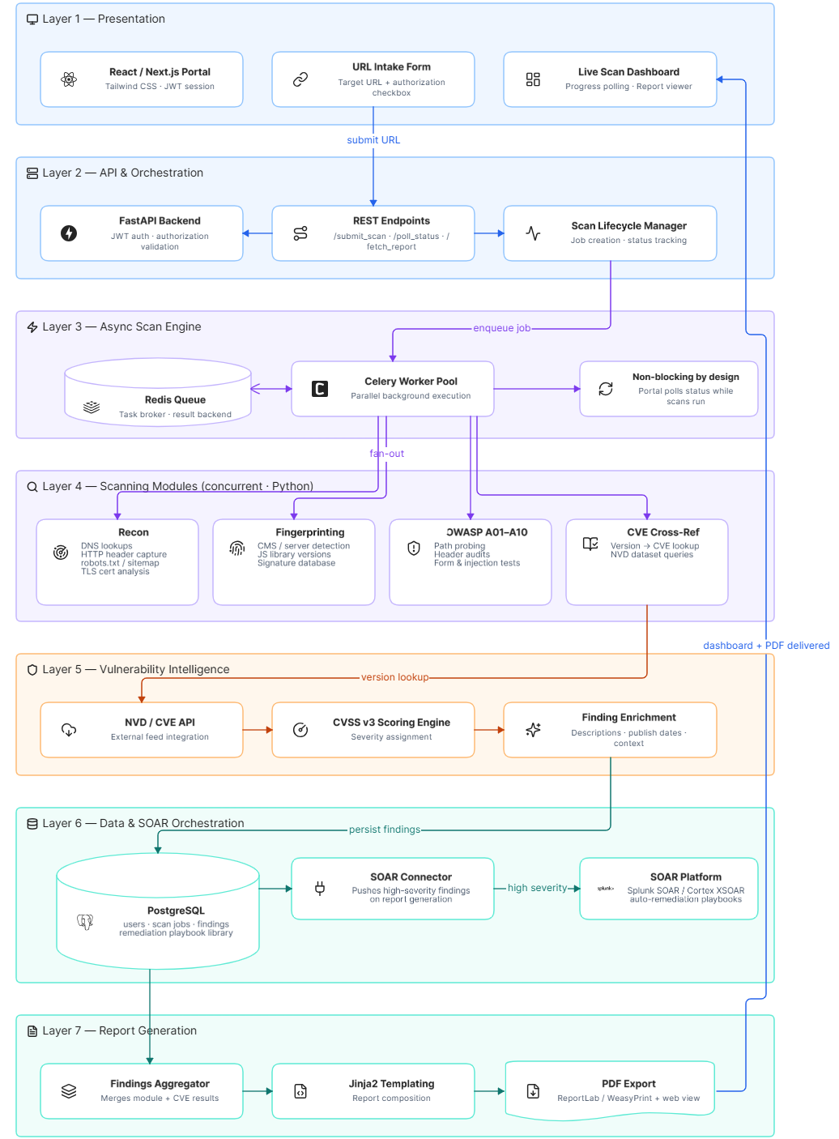
System Architecture
Seven-layer stack, one request path
1
Presentation
React/Next.js + Tailwind — URL intake, auth checkbox, live dashboard, report viewer
2
API & Orchestration
FastAPI + JWT — /submit_scan, /poll_status, /fetch_report
3
Async Scan Engine
Celery workers + Redis queue — non-blocking parallel scans
4
Scanning Modules
SYSTEM ARCHITECTURE DIAGRAM
Recon · Fingerprinting · OWASP Checks · CVE Cross-Ref (concurrent)
5
Vulnerability Intelligence
7-layer vertical stack — diagram to be inserted here
NVD/CVE API + CVSS v3 scoring engine
6
Data & SOAR Orchestration
PostgreSQL + SOAR connector — auto-triggers remediation playbooks
7
Report Generation
Jinja2 + ReportLab/WeasyPrint — web dashboard + downloadable PDF

Slide 7
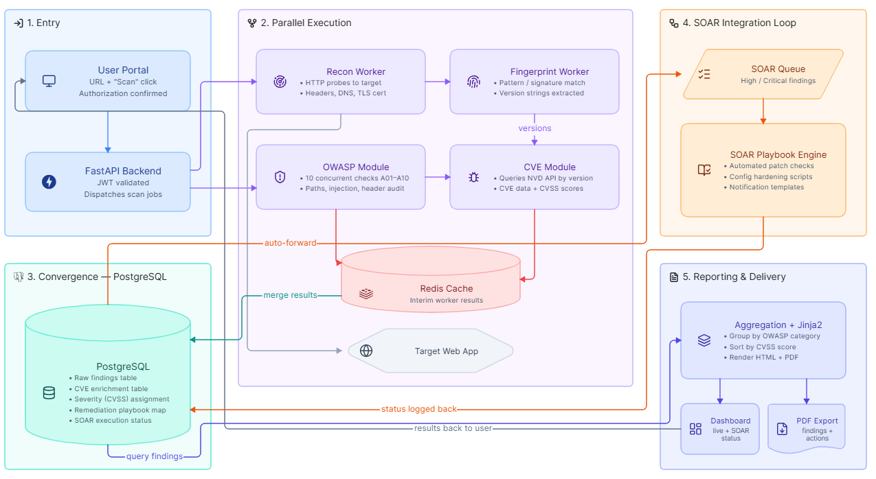
Data Flow
How a single scan moves through the system
START: USER PORTAL
User enters URL + clicks Scan (with authorization confirmation) → Request sent to FastAPI backend (JWT validated)
PARALLEL EXECUTION
Recon Worker (headers/DNS/TLS) · Fingerprint Worker (signature match) · OWASP Module (A01–A10 checks) · CVE Module (NVD lookup) — all write results to Redis
CONVERGENCE POINT
DATA FLOW DIAGRAM
All worker results merge in PostgreSQL: raw findings, CVE enrichment, CVSS severity, remediation playbook mapping
Circular/flow diagram — diagram to be inserted here
SOAR INTEGRATION LOOP
High/Critical findings auto-forwarded to SOAR queue → matching playbook retrieved → execution status logged back to PostgreSQL
REPORT GENERATION & DELIVERY
Findings grouped by OWASP category, sorted by CVSS → Jinja2 populates HTML + PDF → dashboard & PDF show SOAR action status

Slide 8
Sample Output & Impact
SentinelScan · Report — https://example-target.com
Scan date: 2026-08-21 · Duration: 3m 42s · COMPLETE
OVERALL RISK SCORE
FINDINGS (SORTED BY SEVERITY)
62 / 100
Severity | OWASP | Finding | Affected Component | CVE
CRITICAL 9.8 | A03 | Known RCE in detected CMS version | WordPress 5.4.2 | CVE-XXXX-XXXXX
HIGH 7.5 | A04 | Deprecated TLS 1.0/1.1 accepted | TLS endpoint :443 | —
MEDIUM 5.3 | A02 | Content-Security-Policy header absent | HTTP response headers | —
Medium Risk
0 SECURE
100 CRITICAL
FINDINGS BY SEVERITY
Critical
2
High
5
Each row expands into a detailed finding card — description, evidence, CVSS vector, remediation steps — and rolls up into a prioritized remediation roadmap with SOAR playbook status for each finding (pending, automated, manual review required).
Medium
9
Low
6
TECHNOLOGY PROFILE
CMS: WordPress 5.4.2 [OUTDATED]
Server: nginx 1.18.0 [OUTDATED]
Runtime: PHP 7.2.24 [END OF LIFE]
Library: jQuery 1.12.4 [OUTDATED]
THE IMPACT
A URL goes in. A comprehensive report with remediation actions comes out — exactly the ask. Security teams get visibility in minutes. SOAR automation means fixes can start immediately.

