Slide 1
COMP3013 Tutorial02

Slide 2
Outlines
Lecture review
Lab review

Slide 3
LECTURE REVIEW

Slide 4
Relationship Constraints
Cardinality Constraints
Participation Constraints
For Ternary Relationship Sets
To express the answers, ER diagrams have constraints on relationship sets.
Constraints indicate some conditions under the context of the modeled problem.
Two types of constraints
Cardinality constraints （one-one/many-many/many-one, ….)
Participation constraints (for all/ for some)
“Cardinality” is a term from set theory. It is the number of items in a set.

Slide 5
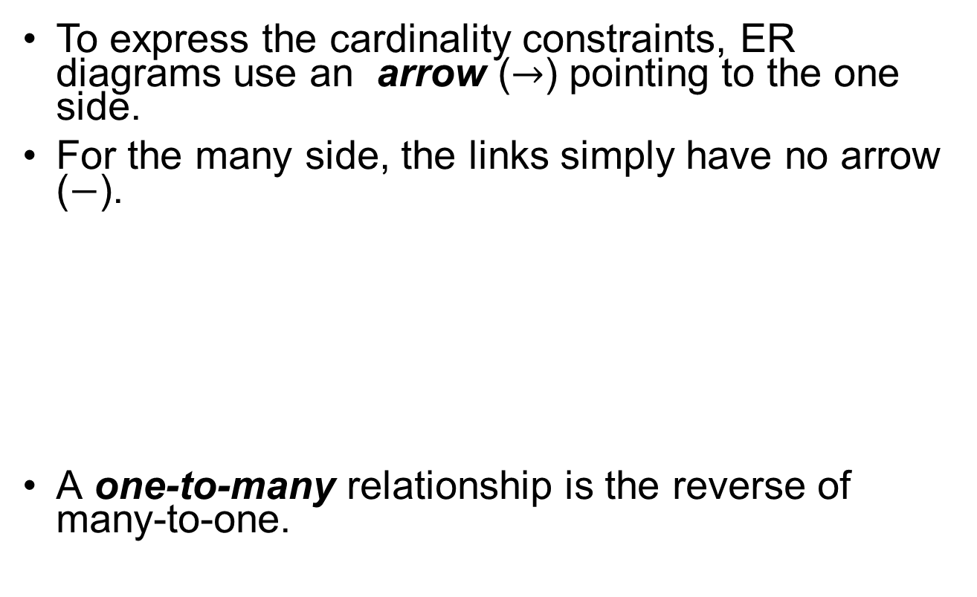
Cardinality Constraints
Cardinality Constraints
Participation Constraints
For Ternary Relationship Sets
To express the cardinality constraints, ER diagrams use an arrow ($→$) pointing to the one side.
For the many side, the links simply have no arrow ($−$).
A one-to-many relationship is the reverse of many-to-one.
student
major
program

Slide 6
Cardinality Constraints
Cardinality Constraints
Participation Constraints
For Ternary Relationship Sets
One-to-one relationship:
One entity from one entity set is associated with at most one entity from the other entity set and vice versa.
For example, one instructor can be the program director of at most one program, and one program has at most one program director.
instructor
program
director
program

Slide 7
Cardinality Constraints
Cardinality Constraints
Participation Constraints
For Ternary Relationship Sets
Many-to-many relationship:
One entity from one entity set can be associated with multiple entities from the other entity set and vice versa.
For example, one student can borrow multiple books, and one book can be borrowed by multiple students.
student
borrow
book

Slide 8
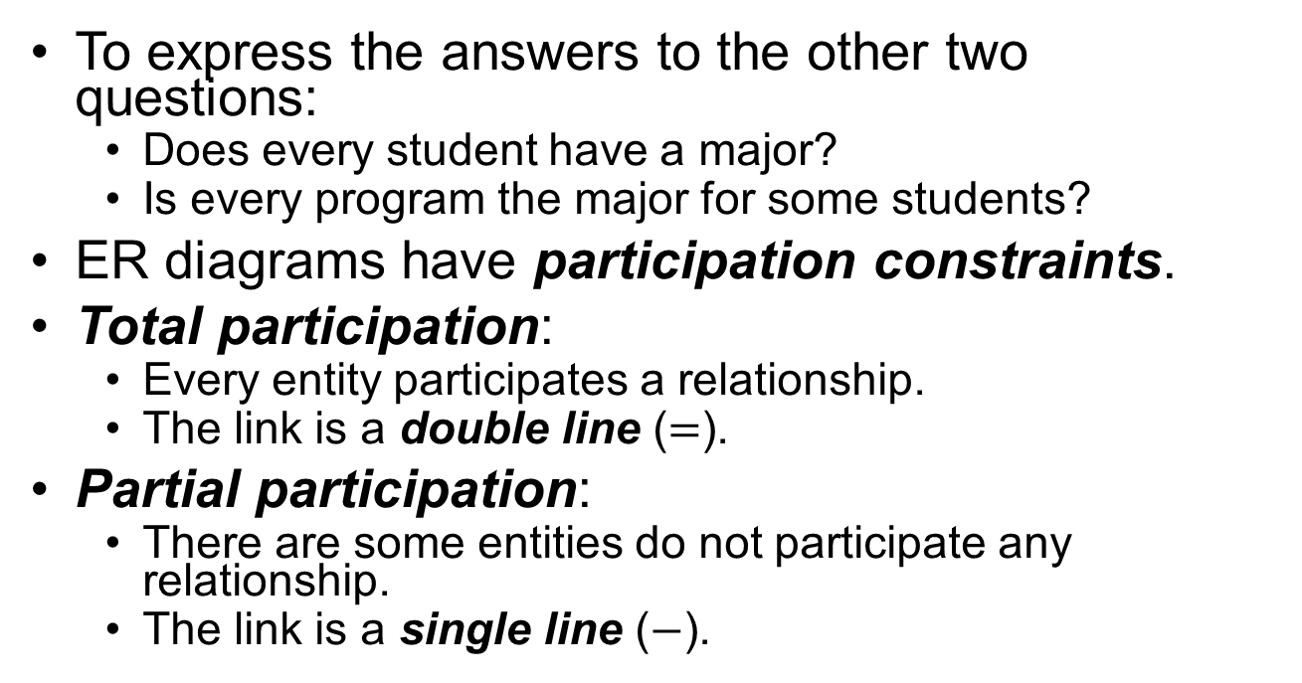
Participation Constraints
Cardinality Constraints
Participation Constraints
For Ternary Relationship Sets
To express the answers to the other two questions:
Does every student have a major?
Is every program the major for some students?
ER diagrams have participation constraints.
Total participation:
Every entity participates a relationship.
The link is a double line ($=$).
Partial participation:
There are some entities do not participate any relationship.
The link is a single line ($−$).

Slide 9
Participation Constraints
Cardinality Constraints
Participation Constraints
For Ternary Relationship Sets
Back to the example,
Every student has a major. (Students totally participate in the relationship set.)
Every program is the major for some students. (Programs also totally participate.)
Combining the cardinality constraints,
student
major
program

Slide 10
Participation Constraints
Cardinality Constraints
Participation Constraints
For Ternary Relationship Sets
Consider another example, the relationship set “program director”.
It’s possible that an instructors is not a program director for any program.
But every program has a program director.
Thus, “instructor” is on the partial side, while “program” is on the total side.
Combining the cardinality constraints,
instructor
program
director
program

Slide 11

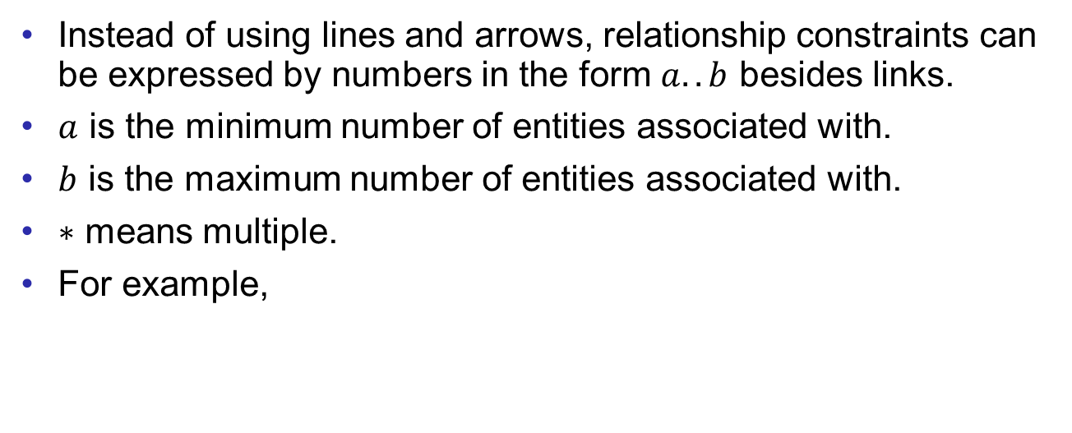


Alternative Notations
Cardinality Constraints
Participation Constraints
For Ternary Relationship Sets
Instead of using lines and arrows, relationship constraints can be expressed by numbers in the form $a..b$ besides links.
$a$ is the minimum number of entities associated with.
$b$ is the maximum number of entities associated with.
$∗$ means multiple.
For example,
$$1..1$$
$$1..∗$$
student
major
program
$$0..1$$
program
director
$$1..1$$
instructor
program

Slide 12
Non-binary relationships with constrains is complex.
Not suggested to use constrains on non-binary relationships(ambiguous)
See lecture: convert non-binary to binary

Slide 13
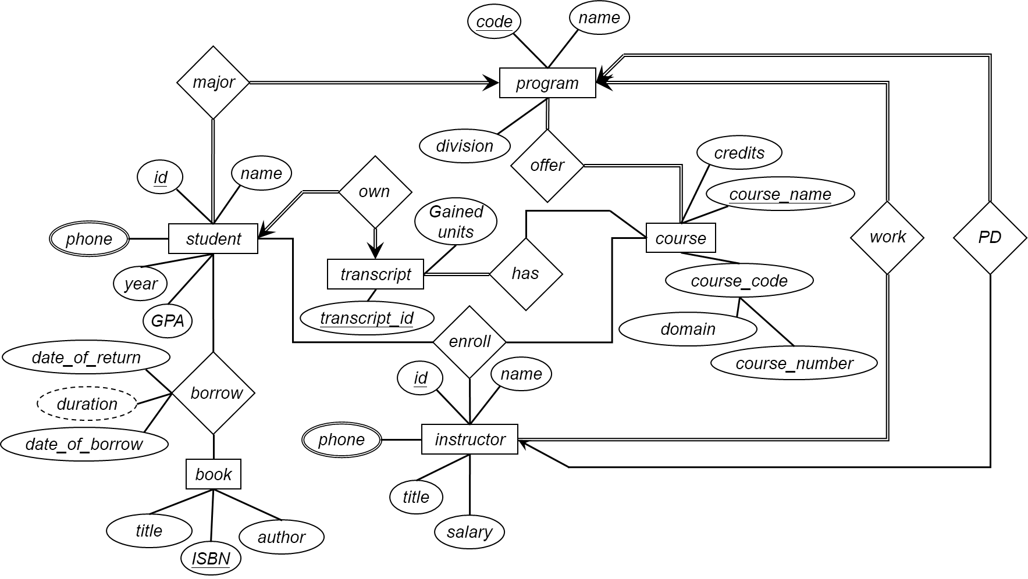
Lec 03 exercise answer is on lec 4 slides.

Slide 14
LAB REVIEW

Slide 15
Cross Table
The crossing of tables is the cartesian product of them

Slide 16
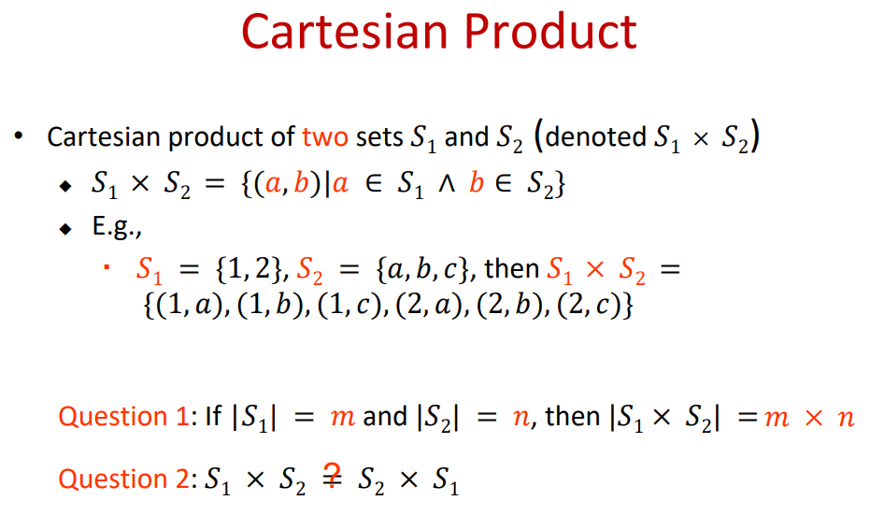


Cross Table
city
country
city_id | city | country_id
1 | Beijing | 1
2 | Tokyo | 2
country_id | country
1 | China
2 | Japan
$$×$$
city.
country.
city_id | city | country_id | country_id | country
1 | Beijing | 1 | 1 | China
2 | Tokyo | 2 | 1 | China
1 | Beijing | 1 | 2 | Japan
2 | Tokyo | 2 | 2 | Japan
$$=$$

Slide 17
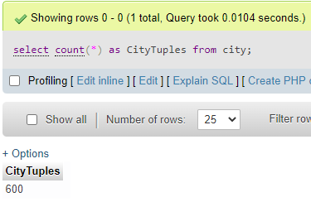
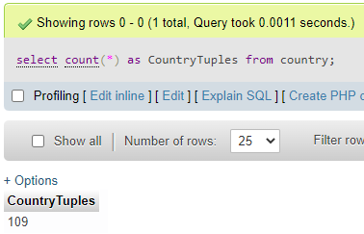
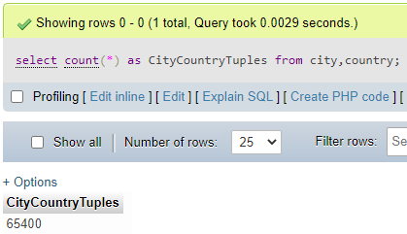
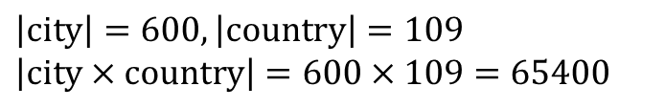
Cross Table
$$\left|city\right|=600, \left|country\right|=109$$
$$\left|city×country\right|=600×109=65400$$

Slide 18
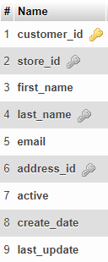
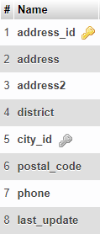
Cross Table
Find the phone number of the customer Lisa Anderson.
Table: customer, address
Predicate: first_name = “Lisa”
last_name = “Anderson”
customer.address_id = address.address_id
3. Attribute: phone
Table: customer
Table: address
“Lisa”
“Anderson”

Slide 19
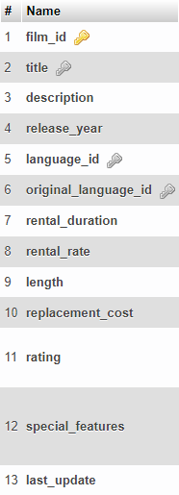
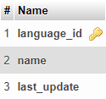
Cross Table
“Angles Life”
Table: film
Table: language
Find the language of the film “Angles Life”.
Table: film, language
Predicate: title = “Angles Life”
film.language_id = language.language_id
3. Attribute: name

Slide 20
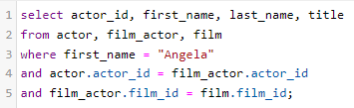
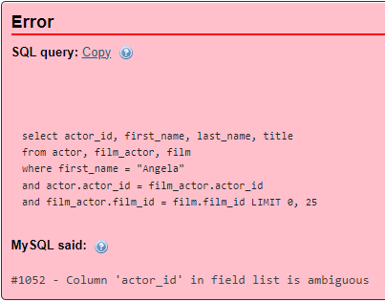
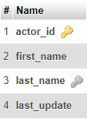
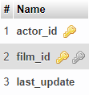
Cross Table
Table: actor
Table: film_actor
Table: film

Slide 21
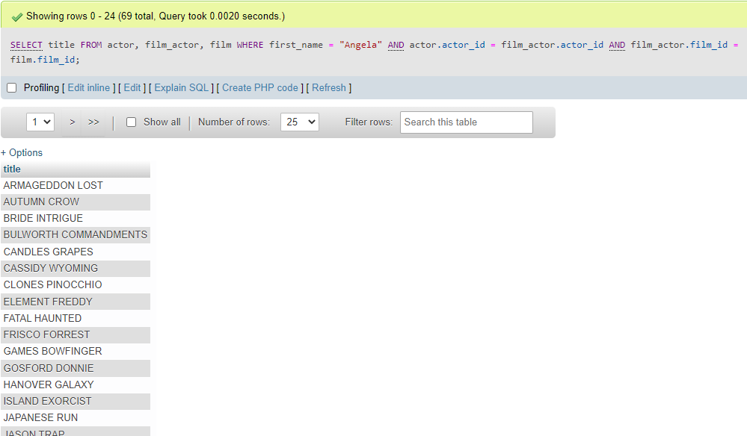
Cross Table
Table: actor
Table: film_actor
Table: film

Slide 22
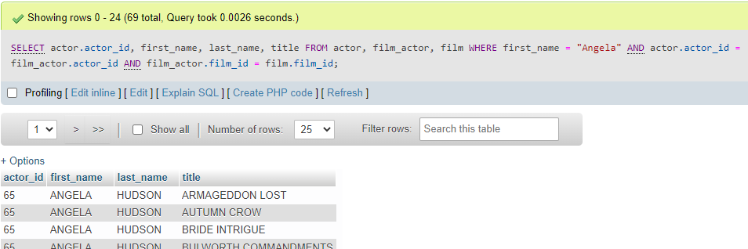
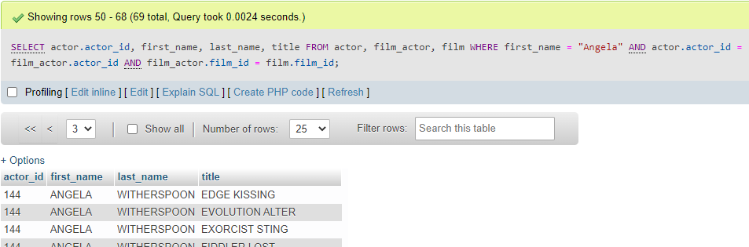
Cross Table
Table: actor
Table: film_actor
Table: film

Slide 23
Cross Table – self times
Table: address as a1
Table: address as a2
SELECT a1.city_id
FROM address AS a1, address AS a2
WHERE a1.city_id = a2.city_id AND
a1.address_id <> a2.address_id
The two tables are renamed by “AS”, to avoid ambiguous.
If two tuples agree on city_id but have different address_id, this city_id has multiple addresses.
<> is not equal.

Slide 24
Cross Table – self times
Find the name (first and last) of actors who have a same first name with other actors.
Table: actor as a1, actor as a2
Predicate: a1.first_name = a2.first_name
a1.actor_id <> a2.actor_id
Or a1.actor_id <> a2.actor_id
a1.first_name = a2.first_name
(Think about the order of predicate....)
3. Attribute: a1.actor_id, a1.first_name, a1.last_name, a2.actor_id
Table: actor as a1
Table: actor as a2

Slide 25
Cross Table - Exercise
Table: actor
Table: film_actor
Table: film
Find the films (name) played by Zero Cage.
Table: film, film_actor, actor
Predicate: film.film_id = film_actor.film_id
film_actor.actor_id = actor.actor_id
first_name = “Zero”
last_name = “Cage”
3. Attribute: title
SELECT title, first_name, last_name
FROM film, film_actor, actor
WHERE film.film_id = film_actor.film_id
AND film_actor.actor_id = actor.actor_id
AND first_name = “Zero”
AND last_name = “Cage”
“Zero”
“Cage”

Slide 26
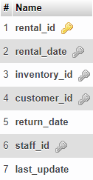
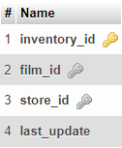
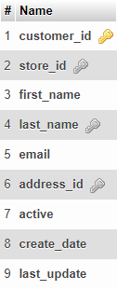
Cross Table - Exercise
Table: rental
Table: inventory
Table: film
2. Find the films (name) rented by George Linton.
Table: film, inventory, rental, customer
Predicate: film.film_id = inventory.film_id
inventory. inventory _id = rental.inventory_id
rental.customer_id = customer. Customer_id
first_name = “George”
last_name = “Linton”
3. Attribute: title
SELECT title, first_name, last_name
FROM film, inventory, rental, customer
WHERE film.film_id = inventory.film_id
AND inventory. inventory _id = rental.inventory_id
AND rental.customer_id = customer. Customer_id
AND first_name = “George”
AND last_name = “Linton”
Table: customer
“George”
“Linton”

Slide 27
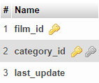
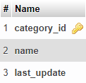
Cross Table - Exercise
Table: customer
Table: rental
Table: inventory
Table: film_category
Table: category
“action”
3. Find the customers (name) who have rented some action (category) films.

Slide 28
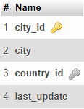
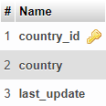
Table: rental
Table: inventory
Table: film
Cross Table - Exercise
Table: customer
Table: language
Table: address
“Japanese”
Table: city
4. Find the customers who live in China and have rented some Japanese films.
Find the customers who live in China
Find the customers who have rented some Japanese films.
Table: country
“China”

Slide 29
Table: inventory as i2
Table: customer as c2
Table: customer as c1
Table: inventory as i1
Table: rental as r2
Table: rental as r1
5. Find all pairs of customers (name) who have rented a same film.
1. Table: inventory as i1, rental as r1, customer as c1,
inventory as i2, rental as r2, customer as c2
2. Predicate: i1. inventory _id = r1.inventory_id, r1.customer_id = c1. customer_id
i2. inventory _id = r2.inventory_id, r2.customer_id = c2. customer_id
i1.film_id = i2.film_id
c1.customer_id <> c2.customer_id
3. Attribute: c1.first_name, c1.last_name, c2.first_name, c2.last_name

Slide 30
Cross Table - Exercise
Table: actor as a1
Table: film_actor as fa1
6. Find the actors who have played a same film with Bolger (the last name of an actor)
Table: actor as a1, film_actor as fa1
actor as a2, film_actor as fa2
Predicate: fa1.actor_id = a1.actor_id
fa2.actor_id = a2.actor_id
fa1.film_id = fa2.film_id
a2.last_name = “Bolger”
a1.last_name <> “Bolger”
3. Attribute: a1.first_name, a1.last_name
Table: actor as a2
Table: film_actor as fa2
“Bolger”

