Slide 1
Operating Systems
Introduction to Course
Julius Raphael
Room A 515
Raphael@ifm.ac.tz
Notes:
Intro to OS

Slide 2
Course Overview
Lectures → 2 Hours per week
Tutorial → 1 Hour per week
Assessment
  40% Continuous Assessment
  60% End of semester Exam
Operating Systems
Notes:
Intro to OS

Slide 3
Module Aims
Introduce principals of Operating Systems design
Provide knowledge of major components of an Operating System
Gain a working knowledge of modern Operating Systems
Operating Systems
Notes:
Intro to OS

Slide 4
Reference Material
Introduction to Operating Systems: Behind the Desktop
  John English, Palgrave MacMillan (2005)
Understanding Operating Systems (5th Ed)
  I.M. Flynn and A. Mclver-McHoes, Thompson Learning (2008)
Operating Systems: Internals and Design Principles (4th Ed)
  William Stallings, Prentice Hall (2001)
Operating Systems
Notes:
Intro to OS

Slide 5
What is an OS?
Many Definitions
  “A program that acts as an intermediary between a user of a computer and the computer hardware”
  “Part of the computing system that manages all of the hardware and all of the software”
  “Controls every file, device, section of main memory & every nanosecond of processing time”
Operating Systems
Notes:
Intro to OS

Slide 6
What is an OS?
Most important program that runs on any hardware
  Without an OS a computer device is useless
  Manages hardware and software and enables a PC to function
Allows for the usage of various applications
  Surf the Internet
  Play Games
  Write software code
Operating Systems
Notes:
Intro to OS

Slide 7
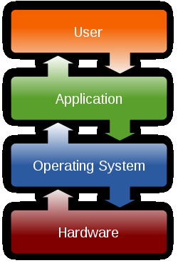
What is an OS?
Layer of software between the user & applications and the hardware
The OS is a Resource Allocator
  Allows the proper use of resources
The OS is a Control Program
  Controls the execution of programs to prevent errors
Operating Systems
Notes:
allows the proper use of resources (hardware,
software, data) in the operation of the computer
system
• provides an environment within which other programs
can do useful work
controls the execution of user programs to prevent
errors and improper use of the computer
• especially concerned with the operation and control of
I/O devices
Intro to OS

Slide 8
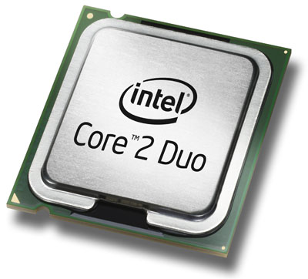
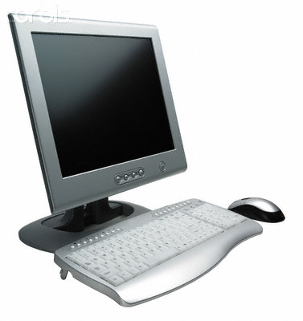
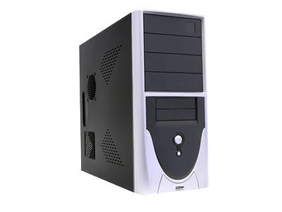
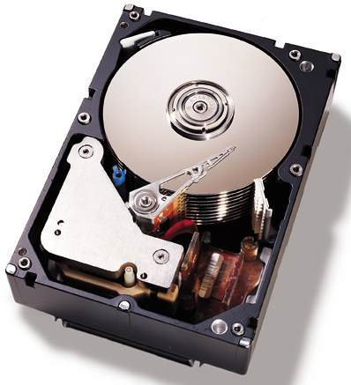
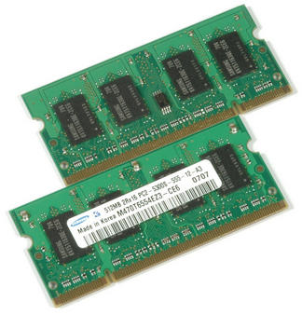
Operating System consists of...
Device Management
Process & Processor Management
Memory Management
File Management
Notes:
Sub systems to manage all these!
Intro to OS

Slide 9
Computer System Components
1. Hardware – provides basic computing resources (CPU, memory, I/O devices).
2. Operating system – controls and coordinates the use of the hardware among the various application programs for the various users.
3. Applications programs – define the ways in which the system resources are used to solve the computing problems of the users (compilers, database systems, video games, business programs).
4. Users - (people, machines, other computers).

Slide 10

Abstract View of System Components

Slide 11
Functions of OS
User Environment - OS layer transforms bare hardware machine into higher level abstractions
  Execution environment - process management, file manipulation, interrupt handling, I/O operations, language.
  Error detection and handling
  Protection and security
  Fault tolerance and failure recovery

Slide 12
Functions of OS
Resource Management
  Time management
    CPU and disk transfer scheduling
  Space management
    main and secondary storage allocation
  Synchronization and deadlock handling
    IPC, critical section, coordination
  Accounting and status information
    resource usage tracking

Slide 13
Key Concepts of OS
A CPU is “the component with the circuitry , ‘the chips’, to control the interpretation and execution of instructions”
Main Memory is “memory unit that works directly with the CPU, data and instructions must reside in order to be processed” also known as RAM
The kernel is “the primary part of the operating system that remains in RAM and performs the systems most essential tasks” e.g. managing RAM
Operating Systems
Notes:
Intro to OS

Slide 14
Key Concepts of OS
Main Memory (Random Access Memory)
  Random → processes can access data locations in any order
  Volatile → data stored vanishes when it looses power
  Accessed by electrical signals
Secondary Storage
  Permanently stores large amounts of data
  Persistent → preserves data in event of power loss
  Requires mechanical movement to read/write
Operating Systems
Notes:
Main Memory & Secondary Storage
Intro to OS

Slide 15
Key Concepts of OS
A program is “a static entity with the potential for execution”
A process is “a program in execution”
  An active entity
  Unit of work in a system
A thread (or light weight process) “is a portion of a program that can be run independently of other portions but not meant to exist alone”
Operating Systems
Notes:
Process Table stores data about each process
A process can create one or more child processes
unit smaller that a process which can be scheduled and executed
Intro to OS

Slide 16
Key Concepts of OS
A file is “anything that is held on secondary storage”
  programs (exe), text (doc), web (html) etc
A file system “presents a clear abstract model of device-independent files”
  Major complexities are hidden from user
Different OS utilise different file systems
Operating Systems
Notes:
Intro to OS

Slide 17
Key Concepts of OS
Input/Output Sub-system manages I/O devices
  Block devices → stores information in fixed sized blocks e.g. Hard Disk, CD-ROM etc
  Character devices → delivers or accepts streams of characters e.g. Printers, Network interfaces etc
  Each device has an associated hardware controller
Virtual Memory → provide processes with the illusion that they have more main memory available than is built in to the computer
  Addresses referenced by processes → Virtual Addresses
  Addresses in Main Memory → Real addresses
Operating Systems
Notes:
All Computers have devices for acquiring input and producing output called Input/Output Devices
Intro to OS

Slide 18
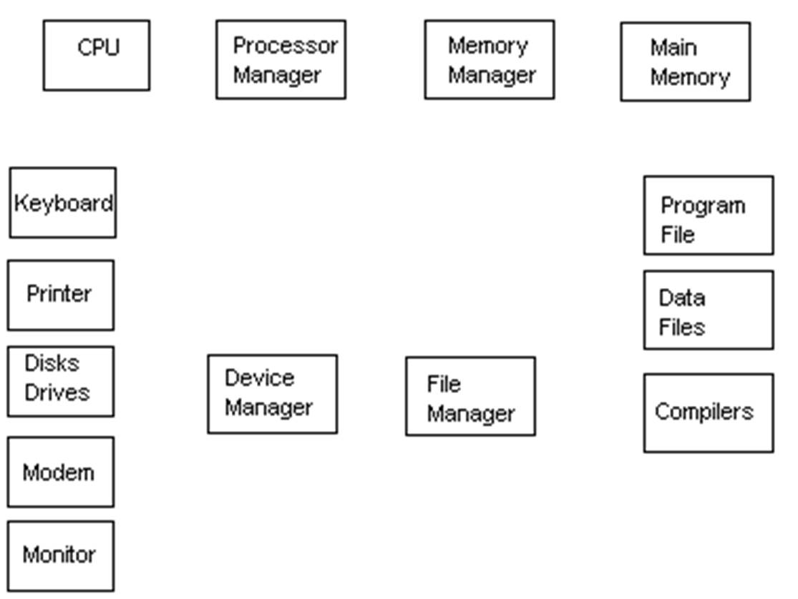
Operating Systems
Fig 1.1 – Sub-system Interaction
Notes:
Intro to OS

Slide 19
Sub-system Tasks
Monitor its resources continuously
Enforce the policies that determine who gets what, when and how much
Allocate the resource when appropriate
De-allocate the resource (reclaim it) when appropriate
Operating Systems
Notes:
Intro to OS

Slide 20
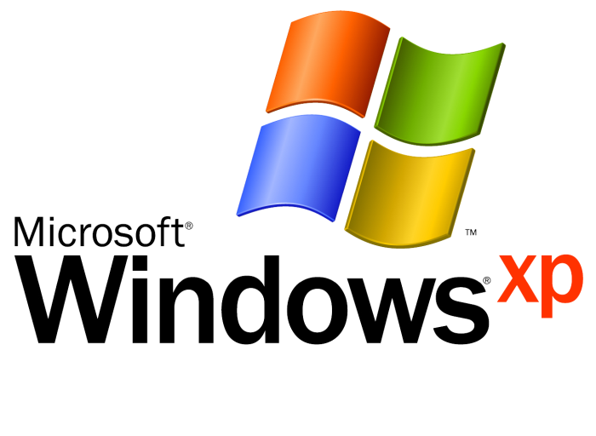
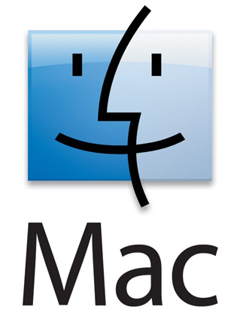
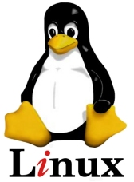


Examples of OS
Operating Systems
Notes:
Intro to OS

Slide 21
Categories of OS
Mainframe
Server
Multiprocessor
Person
Handheld
Embedded
Real-Time
Sensor node
Smart Card
Operating Systems
Notes:
Intro to OS

Slide 22
Mainframe OS
Operate at High end
  Major corporate data centres
High capacity of disks & data
Oriented toward processing many jobs at the same time
Requires large amounts of Input/Output (I/O) capability
IBMs OS/360, OS/390 & z/OS
Operating Systems
Notes:
Intro to OS

Slide 23
Mainframe OS
Batch Systems
  “A system in which jobs are bundled together with the instructions necessary to allow them to be processed without intervention”
  Jobs entered as a group & processed serially
  Simple - No user interaction (mid 50s → 60s)
  Multi – Spooling utilized (mid 60s → late 70s)
  Performance measured in through-put
Operating Systems
Notes:
Financial transaction processing
Census data
Spooling batch systems were the first and are the simplest of the multiprogramming systems
Simultaneous Peripheral Operation OnLine
Intro to OS

Slide 24
Mainframe OS
Time Sharing & Interactive Systems
  Multiple terminals connected to mainframe
  Time Sharing – development of ‘time sharing’ software allocating idle time to different jobs
  Interactive - allowed user to interact with the computer (eg per job basis)
  Developed to satisfy demand of immediate feedback to the user (eg debugging)
  Mid 1970s → Present
  CTSS, TSS & Multics
Operating Systems
Notes:
TOPS VAX/VMX
One type is represented by computers like our VAX/VMS computers and UNIX workstations. In these computers entire processes are in memory (albeit virtual memory) and the computer switches between executing code in each of them. In other types of systems, such as airline reservation systems, a single application may actually do much of the timesharing between terminals.
Introduced concept of ‘Virtual Memory’ TSS Multics and CP/CMS
Intro to OS

Slide 25
Server OS
Server Operating Systems
  Run on Servers
  Workstations, Hi Spec PC or Mainframes
  Serve multiple users at once
  Offer services to clients over network
    Print
    File
    Web servers
  Windows Server 200x, Solaris
Operating Systems
Notes:
Intro to OS

Slide 26
Multiprocessor OS
Shared memory multiprocessors
  Multiple CPU - all with access to the same memory
  Communication between the processors is easy to implement
  Memory accesses must be synchronised.
Distributed memory multiprocessors
  Each CPU has it's own associated memory
  Memory access synchronization is not a problem
  Communication between the processors is often slow and complicated.
Operating Systems
Notes:
Connect multiple CPUs into a single system
Intro to OS

Slide 27
Personal Computer OS
Personal Computer Systems
  Due to advancement in microprocessors, lowering cost of hardware and GUIs
  Move to ‘multiprocessing’
    Having more than one processor
  Enabled parallel processing – executing of more than one program at a time
  Primary goal to service a single user
Operating Systems
Notes:
Circuit board cheap, Technology cost decline, OS functions now made part of the hardware – concept of firmware developed (program permanently held in ROM
Finally computers became small enough and inexpensive enough that an individual could own one, and hence have complete access to it
Apple II in late 70s, IBM PC in 1981 – Macintosh PC in 1984
PARC – Palo Alto Research Centre – Mouse...
Windows Icons & Menus
Intro to OS

Slide 28
Handheld OS
PDA, Smartphones, Tablet PCs
  Sophisticated OS to handle
    Telephony
    Photography
    Networking (WLAN, Bluetooth)
  Capable of running 3rd party applications
  Operate in protected mode
  Symbian OS, Android, OSX
Operating Systems
Notes:
Intro to OS

Slide 29
Embedded OS
Embedded Systems
  Computer placed inside other products
  Do not accept user-installed software
  Adds features & capabilities
  Found in
      Household appliances
      Digital music players
      Elevators
Operating Systems
Notes:
Software located in ROM – no need for protection between applications
Intro to OS

Slide 30
Real Time OS
Real Time Systems
  “A real-time computer is one that executes programs that are guaranteed to have an upper time limit on tasks that they carry out”
  Developed for time critical environments
  ...and Reliability
  Hard – total system failure if deadline is missed
  Soft – Partial failure, eg performance
Operating Systems
Notes:
Dedicated computers are special purpose computers that are used to perform only one or more tasks. Often these are real-time computers and include applications such as the guided missile mentioned above and the computer in modern cars that controls the fuel injection system.
Intro to OS

Slide 31
Others
Sensor Node OS
  Network of sensors with a small & simple OS
  Event driven OS, responds to external events
  TinyOS
Smart Card
  Credit card devices containing a CPU chip
  Severe processing, power & memory limits
  Mostly proprietary systems
Operating Systems
Notes:
Detect fires, security systems etc
Often only undertake one function - Validate a user
Intro to OS

Slide 32
Second Generation
Job scheduling, JCL, faster I/O, spooling, batch, files
Modern Developments
Distributed computing, personal computers, high-speed communication, multi-media
1940 1955 1965 1980 1990
Third Generation
Shared processing, multiprogramming, virtual memory, DBMS
First Generation
Vacuum tube, single user, early operating systems
Fig 1.2 – OS Timeline
Notes:
Intro to OS

