Slide 1
Operating Systems
Hardware Overview

Slide 2
Introduction to Hardware
A computers hardware consists of its physical devices and its electronic components
The ‘real’ resources an Operating System manages
The OS takes the burden off applications to manage individual hardware devices
Operating Systems

Slide 3
Mainboards & PCB
Computers need interactions between many independent hardware devices
A printed circuit board (PCB) provides electrical connections between devices
Mainboard or motherboard is the central PCB in a system
Provides slots into which other components are inserted
  e.g. Processors, Main Memory
Operating Systems

Slide 4
Traces & BUS
Traditional wires are too large to establish electrical connections between components
Traces are “extremely thin layers of silicone containing microscopic electrical connections”
Serves as communication channels and provide connectivity on any PCB
A large set of traces forms a high speed communication channel knows as a Bus
Operating Systems

Slide 5
BIOS and Bootstrapping
Mainboards normally contain several chips to perform low level operations e.g. BIOS chip
Basic Input/Output System “basic instructions for hardware initialisation & management”
Also responsible for loading the initial portion of the OS into memory → bootstrapping
After OS has been loaded it uses BIOS to communicate with the systems hardware
  i.e. low level, basic input & output
Operating Systems

Slide 6
Controllers & Chipsets
Mainboards hold chips called controllers that manage data transfer on the board busses
A mainboard’s chipset is “the collection of controllers, processors, buses (hardware etc) integrated onto the mainboard”
Traditionally ‘extras’ such as graphics, network cards were add-on’s to the mainboard but are now more commonly integrated onto the mainboard called on-board devices
Operating Systems

Slide 7

Clocks
Almost all modern computers are synchronous machines
The clock signal is a square electric pulse supplied to the processor
Computers operations are broken up into cycles
Cycle triggered by rising edge of clock pulse
Operating Systems
Notes:
s

Slide 8
Clocks
Computer time measured in cycles
A cycle refers to “a complete oscillation of an electrical signal provided by the systems clock generator” → A clocktick
Clock generator sets the cadence for a computer system
It determines the frequency at which busses transfer data
  Measured in cycles per second or Hertz's (Hz )
Operating Systems
Notes:
Clock generator / cadence (an orchestras conductor) tempo, pace, beat, pulse
An example:
Frontside Bus (FSB) connects processors to memory modules, typically operates at several hundred MHz
Desktop processors operate at GHz
Examples of derived speeds by multiplying or dividing the speed of the FSB

Slide 9
Processor
A processor is “a hardware component that executes a stream of machine language instructions”
Central Processing Unit (CPU) is the main processor that executes the instructions of a program
Registers are “high speed memories located on the processor that hold data for immediate use by the processor”
Operating Systems
Notes:
Can be many forms e.g. graphic processor
Registers are hard wired
Relocation registers (example)
32 bit processor can store 32 bits of data in each register
64 bit

Slide 10
CPU Components
Instructions are fetched, loaded in to the registers and decoded by Fetch/Decode unit
The ALU (Arithmetic and Logical Unit) is “the execution unit, which performs the basic arithmetic and logical operations”
  e.g. addition and logical comparisons
As processors operate at higher speeds than main memory, they contain high speed memory called cache that stores copies of data in main memory
Operating Systems

Slide 11
Memory
Size and speed of memory are limited by the laws of physics and economics
Almost all electronic devices transfer data using electrons passing through traces on PCBs
There is a limit to the speed at which electrons can travel → this delay is called latency
  The longer the wire/trace, the longer the transfer
Cost of memory with processor speed is prohibitive → a Cost v Performance trade off
Operating Systems
Notes:
Cost of memory with processor speed is prohibitive
Cost/performance trade off

Slide 12
Memory Hierarchy
Main Memory
  Also called 'Real' or 'Physical' memory
  Main Memory a separate topic further on
Secondary Storage
Storage systems organized in hierarchy.
  Speed
  Cost
  Volatility
Operating Systems
Notes:
Main memory - operates at a fraction of processor speed
Hard Disks, CD & DVD are the least expensive and slowest data storage units in a computer system
Require mechanical movement (Block Device)

Slide 13
Memory Hierarchy
OS Overview (Chapter 1)
Caching
More Expensive
Faster & Smaller
Registers
Cache
Main Memory
Disk Cache
Bigger
Slower
Magnetic Disk
Magnetic Tape
Optical Disk
BYU CS 345
Notes:
Alex Milenkovich

Slide 14
System Bus
A Bus is “a collection of traces that transport information between hardware devices”
The System Bus connects various components
  Data Bus → transports data
  Address Bus → determines the recipient or sources of that data
  Control Bus → transmits timing & control signals between components
Operating Systems
Notes:
(or other electrical connections)
Port → a bus that connects two devices
I/O Channel → a bus shared by several I/O devices to perform I/O operations

Slide 15
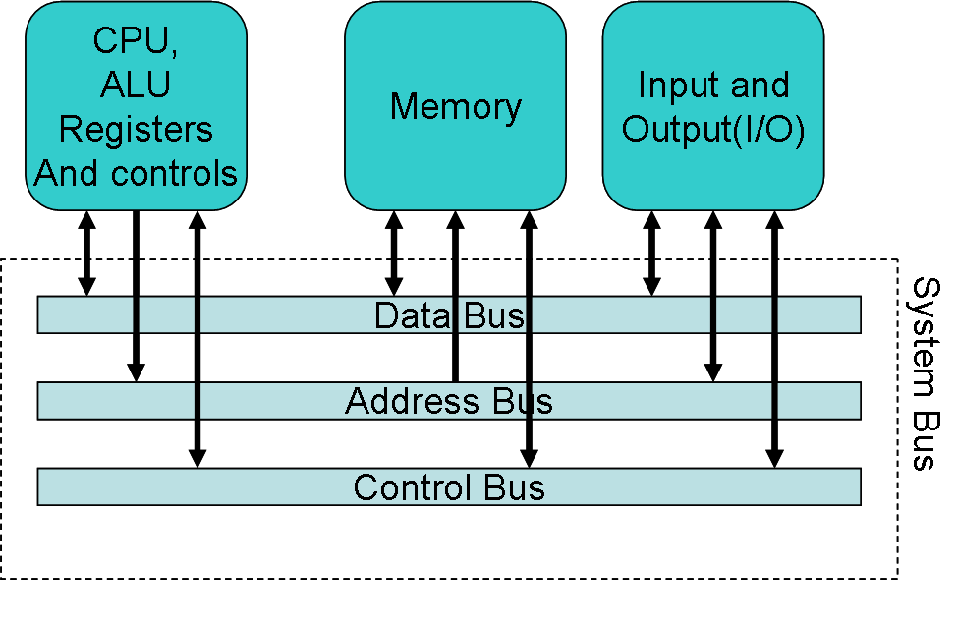
System Bus
Operating Systems
Fig 2.2 – System Bus
Notes:
Other Bus forms
Port → a bus that connects two devices
I/O Channel → a bus shared by several I/O devices to perform I/O operations

Slide 16
Other Buses
The frontside bus (FSB) connects a processor to main memory
Port → a bus that connects two devices
I/O Channel → a bus shared by several I/O devices to perform I/O operations
Peripheral Component Interconnect (PCI)
  Connects peripheral devices to the system
  e.g. Sound Cards, Network Cards
Operating Systems

Slide 17
Peripheral Devices
“Any device not required for a computer to execute software instructions”
  I/O devices → printers, scanners, mice
  Network devices → modems, n/w cards
  Storage devices → CD, DVD, disk drives
Connected via ports or other Busses
  Serial → data transfer one bit at a time (mice)
  Parallel → several bits at a time (printers)
  USB & IEEE 1394 (FireWire) → High speed Serial
Internal devices are referred to as integrated peripheral devices
Operating Systems
Notes:
Internal devices are referred to as integrated peripheral devices → Network interface cards, modems, sound cards
Block devices → stores information in fixed sized blocks e.g. Hard Disk, CD-ROM etc
Character devices → delivers or accepts streams of characters e.g. mice, keyboards
Can be attached to a computer via ports and other buses
Serial ports, parallel ports, USB, IEEE 1394 ports and SCSI

Slide 18
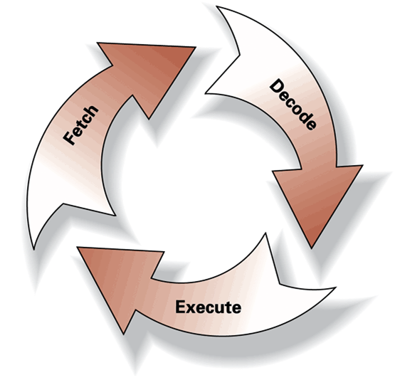
Fetch-Decode-Execute
Also called Instruction Cycle
Fetch Instructions
  Data and Code
Decode Instructions
  Increment Counter
Execute Instruction
  End - Yes/No?
Based on Von Newman Architecture
Operating Systems
Notes:
Abstract View

Slide 19
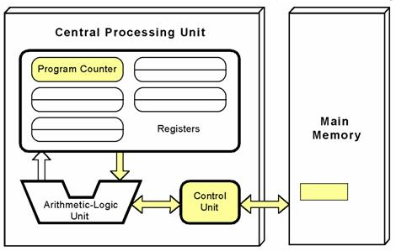
CPU Interaction
Operating Systems
The Control Unit fetches next instruction from main memory using the Program Counter to determine where the instruction is located
Notes:
an instruction register is the part of a CPU's control unit that stores the instruction currently being executed

Slide 20
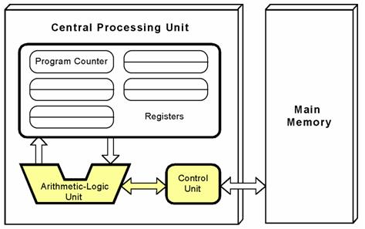
CPU Interaction
Operating Systems
The instructions are decoded into a language that the AUL can understand
Notes:
The control unit fetches the next instruction from main memory using the program counter to determine where the instruction is located.
2. The instruction is decoded into a language that the ALU can understand.
3. Any data operands required to execute the instruction are fetched from memory and placed into registers within the CPU.
4. The ALU executes the instruction and places results in registers or memory.

Slide 21
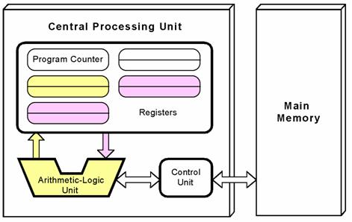
CPU Interaction
Operating Systems
The ALU executes the instructions and places the results in registers or memory
Notes:
Any data operands required to execute the instruction are fetched from memory and placed into registers within the CPU
vAn operand is one of the inputs (arguments) of an operator in mathematics. The following arithmetic expression shows an example of operators and operands:
3 + 6 = 9
Here '+' is the operator and '3' and '6' are the operands.

Slide 22
Interrupts – Meaning
This is a signal to a processor indicating that an asynchronous event has occurred. Here the current sequence of instructions is temporarily suspended, and a sequence appropriate to the interruption is started in its place. Its purpose is to alert the operating system when any special event occurs so that it can suspend its current activity and deal appropriately with the new situation
Asynchronous event is events that are not synchronized, or coordinated, in time. Starting the next operation before the current one is completed

Slide 23
Interrupts Continued
Interrupts enable software to respond to signals from hardware
  May be initiated by a running process
    Interrupt is called a trap – software generated caused by error or user request for an OS service
    Dividing by zero or referencing protected memory
  May be initiated by some event that may or may not be related to the running process
    Key is pressed on a keyboard or a mouse is moved
  Low overhead
Polling is an alternative approach
  Processor repeatedly requests the status of each device
  Increases in overhead as the complexity of the system increases
Slide <number>

Slide 24
Handling Interrupts
After receiving an interrupt, the processor completes execution of the current instruction, then pauses the current process
The processor will then transfer to a fixed location and executes the service routine for the interrupt
The interrupt handler determines how the system should respond
Interrupt handlers are stored in an array of pointers called the interrupt vector
  To handle the interrupt quickly, a table of pointers is generally stored in low memory which hold the addresses of the ISR for the various devices
  This array, or interrupt vector, of addresses is then indexed by a unique device number to provide the address of the ISR for the interrupting device
After the interrupt handler completes, the interrupted process is restored and execution continues from the address of the interrupted instruction (stored on stack) or the next process is executed
Slide <number>

Slide 25
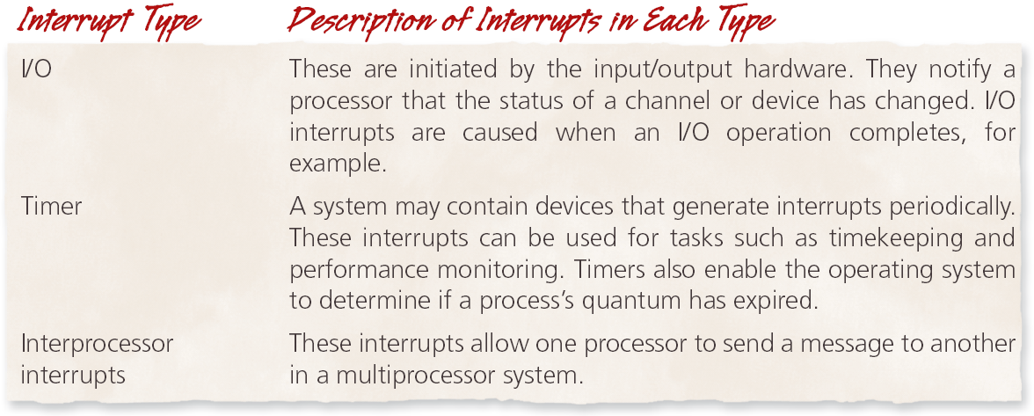
Interrupt Classes
Common interrupt types recognized in the Intel IA-32 architecture.
Slide <number>

Slide 26
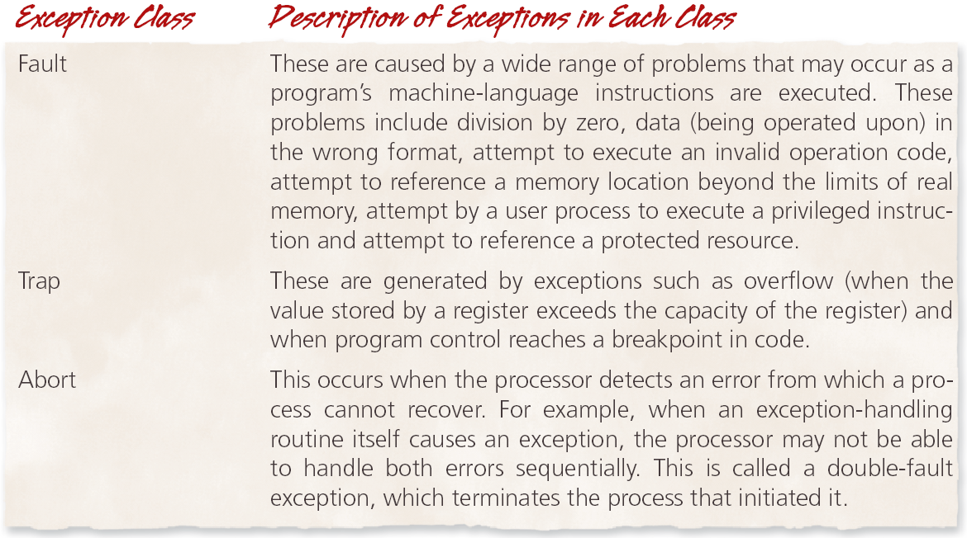
Interrupt Classes
Intel IA-32 exception classes.
Slide <number>

Slide 27
I/O Interrupts
To start an I/O operation, the CPU loads the appropriate registers within the device controller
The device controller examines the values and determines what action to take (e.g. read, write)
When the transfer is complete, the device controller informs the CPU via an interrupt
The device driver returns control to the OS
  Returns the data or pointer to the data if a read was done
  For other operations it returns status information
Slide <number>

Slide 28
I/O Interrupts
Synchronous:
  After I/O starts, control returns to user program only upon I/O completion.
  Wait instruction or tight loop (Loop: jmp Loop) idles the CPU until the next interrupt
  At most one I/O request is outstanding at a time, no simultaneous I/O processing.
Asynchronous:
  After I/O starts, control returns to user program without waiting for I/O completion.
  Increased system efficiency by increasing CPU utilization
Slide <number>

Slide 29
Direct Memory Access ..meaning
Direct memory access (DMA) is a feature of modern computers and microprocessors that allows certain hardware subsystems within the computer to access system memory for reading and/or writing independently of the central processing unit. Many hardware systems use DMA including disk drive controllers, graphics cards, network cards and sound cards

Slide 30
Direct Access Memory … meaning cont…
Direct memory access (DMA) is a means of having a peripheral device control a processor's memory bus directly. DMA permits the peripheral, such as a UART, to transfer data directly to or from memory without having each byte (or word) handled by the processor. Thus DMA enables more efficient use of interrupts, increases data throughput, and potentially reduces hardware costs by eliminating the need for peripheral-specific FIFO buffers

Slide 31
Direct Memory Access Structure
Slow devices (terminal) may transmit one character per millisecond (1000 microseconds). An ISR may require 2 microseconds per character leaving 998 for other computations
A high speed device may interrupt every 4 microseconds leaving little time for execution
Device controller transfers blocks of data from buffer storage directly to main memory without CPU intervention.
DMA for high-speed I/O devices able to transmit information at close to memory speeds.
Only one interrupt is generated per block, rather than the one interrupt per byte.
Processor sends information to DMA to start and doesn’t hear from DMA until transfer is completed at which time is receives an interrupt
While DMA is transferring, CPU is free to perform other tasks
  The DMA controller seizes the memory bus to transfer a word of data to memory, This is called “stealing” memory cycles from the CPU as the CPU can not access main memory at that time (though the primary and secondary cache are accessible). However, overall total system performance is improved.
Slide <number>

Slide 32

Direct Memory Access Structure
Slide <number>

Slide 33
Storage Structure
Main memory – only large storage media that the CPU can access directly.
  Too small to store all needed programs and data permanently
  Volatile storage – loses contents when power removed
  Registers built into the CPU are generally accessible within one cycle of the CPU clock
  Most CPUs can decode instructions and perform simple operations on register contents at the rate of one or more operations per clock tick
Slide <number>

Slide 34
Storage Structure
Secondary storage – extension of main memory that provides large nonvolatile storage capacity.
Magnetic disks – rigid metal or glass platters covered with magnetic recording material
  Disk surface is logically divided into tracks, which are subdivided into sectors.
  The disk controller determines the logical interaction between the device and the computer.
  Random access time = seek time + rotational latency
    Seek time – time to move disk arm to desired cylinder
    Rotational latency – time for desired sector to rotate to the disk head
Slide <number>

Slide 35
Storage Hierarchy
Caching – copying information into faster storage system; main memory can be viewed as a last cache for secondary storage.
Slide <number>

Slide 36
Caching
Use of high-speed memory to hold recently-accessed data.
Requires a cache management policy.
  Careful selection of the cache size and of a replacement policy can result in 80 to 99 percent of all accesses being in cache greatly improving performance
Caching introduces another level in storage hierarchy. This requires data that is simultaneously stored in more than one level to be consistent.
Slide <number>

Slide 37
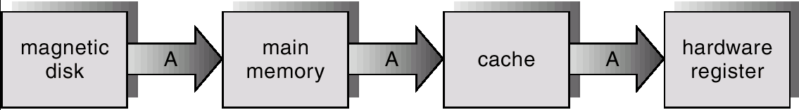

Migration of A From Disk to Register
The copy of A appears in several places – magnetic disk, main memory, cache and internal register
Once it is changed in the internal register, it is no longer consistent with the other locations until it is written back to magnetic disk
Gets more complicated as move to a multitasking environment, multiprocessor environment and distributed environment
Slide <number>

Slide 38
Hardware Protection
Dual-Mode Operation
I/O Protection
Memory Protection
CPU Protection
Slide <number>

Slide 39
Dual Mode operation
Dual mode of operation (Two modes of operation) is the distinction between execution of user mode and kernel mode (supervisor mode, system mode, and privileged mode). A mode bit is added to the hardware to indicate the current mode: Kernel(0) or user(1). Dual mode of operation provides us with more protection to the operating system. For example, if a kernel instruction is executed under user mode, the hardware does not execute it, although identifies it as an illegal execution and traps it to the operating system.

Slide 40
Dual-Mode Operation
Sharing system resources requires operating system to ensure that an incorrect program cannot cause other programs to execute incorrectly as well as to protect the OS from errant user programs
Provide hardware support to differentiate between at least two modes of operations.
  User mode – execution done on behalf of a user.
  Monitor mode (also kernel mode or system mode) – execution done on behalf of operating system.
  MS-DOS for the Intel 8088 had no mode bit
    User program can wipe out the OS
    Multiple programs can write to a device simultaneously
Slide <number>

Slide 41

Dual-Mode Operation (Cont.)
Mode bit added to computer hardware to indicate the current mode: monitor (0) or user (1).
When an interrupt or trap (program error) occurs hardware switches to monitor mode.
Slide <number>

Slide 42
CPU Protection
Timer – interrupts computer after specified period to ensure operating system maintains control.
  Timer is decremented every clock tick.
  When timer reaches the value 0, an interrupt occurs.
Timer commonly used to implement time sharing
  interrupt every N milliseconds (a time slice) at which time a context switch occurs
    Performs housekeeping on the program just stopped, saves registers, internal variables, buffers etc. and prepares for the next program to run
Load-timer is a privileged instruction.
Slide <number>

Slide 43
Protection and Security
Protection controls the access of processes or users to the resources of the computer system
  Distinguish between authorized and unauthorized use
Security defends a system from external and internal attacks
  Viruses, worms, denial of service attacks, identify theft
Slide <number>

Slide 44
Synchronization
To occur at the same time; be simultaneous.
To operate in unison.
To cause to occur or operate with exact coincidence in time or rate: We synchronized our watches.
To cause to occur or operate at the same time as something else: They synchronized their trip with the annual tulip festival. To arrange (historical events) in a synchronism so as to indicate parallel occurrence.

Slide 45
System Call
A System call is a mechanism used by an application for requesting a service from the operating system. Examples of the services provided by the operating system are allocation and deallocation of memory, reporting of current date and time etc. These services can be used by an application with the help of system calls. Many of the modern OSes have hundreds of system calls. For example Linux has 319 differenct system calls.
Example: open, close, read, write, kill, wait etc
A privileged instruction is the one which only operating system must execute

Slide 46
Dual mode operation
DT228/1 - Hardware Overview
Michael Gleeson
I/O protection, all I/O operations are privileged; so user programs can only access I/O by sending a request to the (controlling) OS.
Memory protection, base/limit registers (in early systems), memory management unit, (MMU, in modern systems); so user programs can only access the memory that the OS has allocated.
CPU control, timer (alarm clock), context switch; so user programs can only read the time of day, and can only have as much CPU time as the OS allocates.

