Slide 1
CS302 Operating System Lab 4 Concurrency: Mutual Exclusion and Synchronization
March 28th , 2018
Dongping Zhang
cadongllas@gmail.com

Slide 2
Race Condition
The outcome of an execution depends on a particular order in which the shared resource is accessed.
A simple example
a.c and b.c are two processes need to display their outputs on the standard error
Compile and run like this:
gcc a.c -o a
gcc b.c -o b
./a & ./b &

Slide 3
Mutual Exclusion
Mutual exclusion
It prevents multiple threads from entering
Critical resource:
Nonsharable resource
Example: only one process at a time is allowed to send command to the printer
critical section
the portion of the program that uses critical resource
Only one program at a time is allowed in its critical section
Lock
a mechanism for mutual exclusion

Slide 4
Semaphores
two or more processes can cooperate by means of simple signals, such that a process can be forced to stop at a specified place until it has received a specific signal.
For signaling, special variables called semaphores are used.
If a process is waiting for a signal, it is suspended until that signal is sent

Slide 5
Semaphores
Semaphore is a variable that has an integer value
Initialize: a nonnegative integer value
semWait (P): decreases the semaphore value. the value becomes negative, then the process executing the semWait is blocked.
semSignal (V): increases semaphore value. If the resulting value is less than or equal to zero, then a process is blocked by a semWait operation, if any, is unblocked.

Slide 6
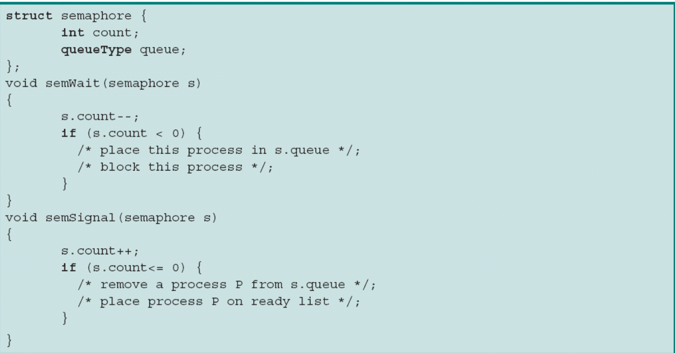
Semaphores

Slide 7
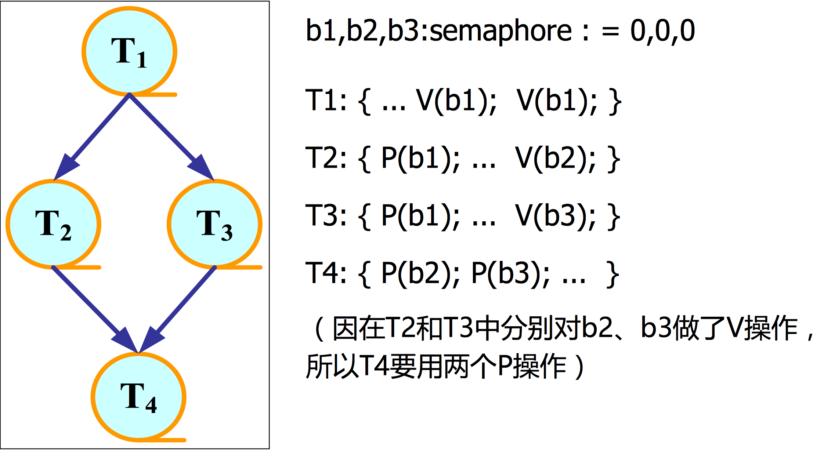
Semaphores

Slide 8
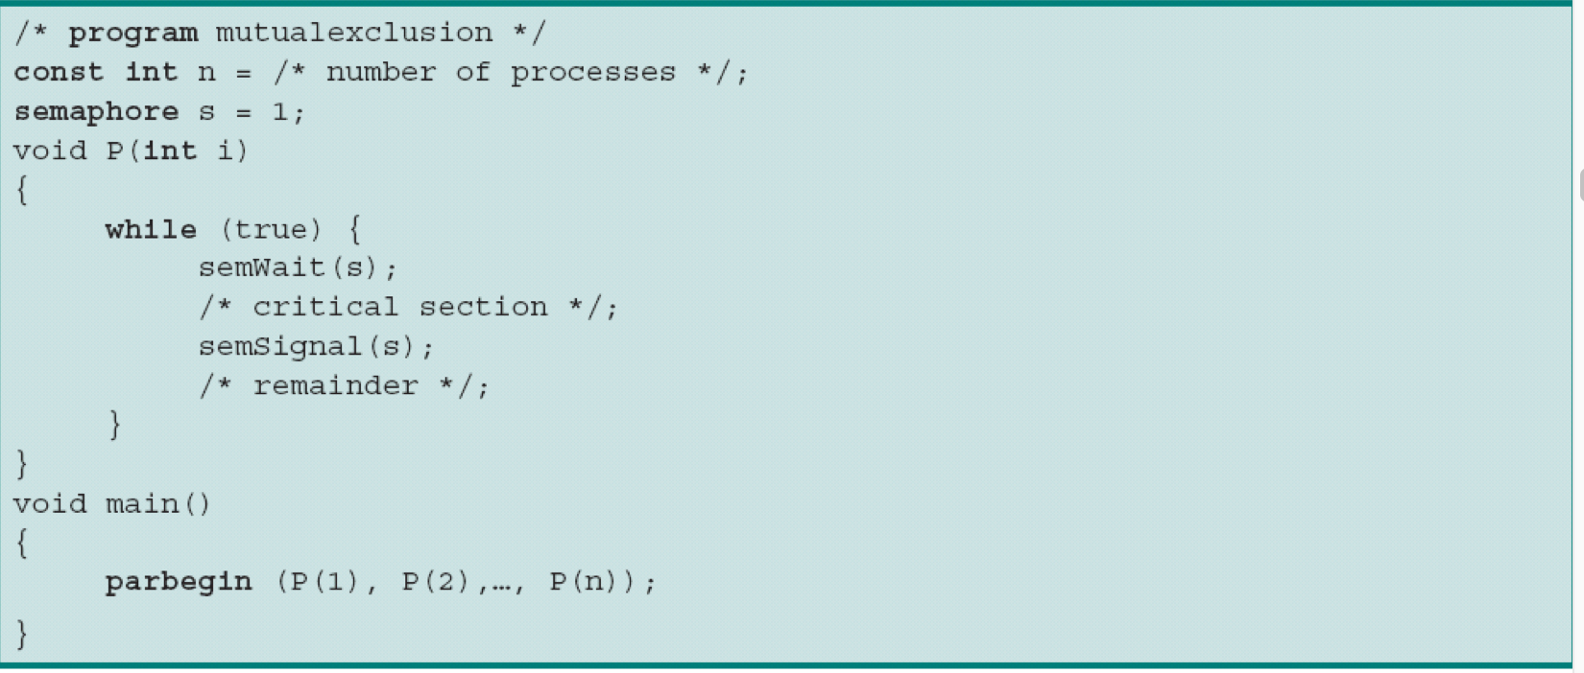
Mutual Exclusion using Semaphores
a

Slide 9
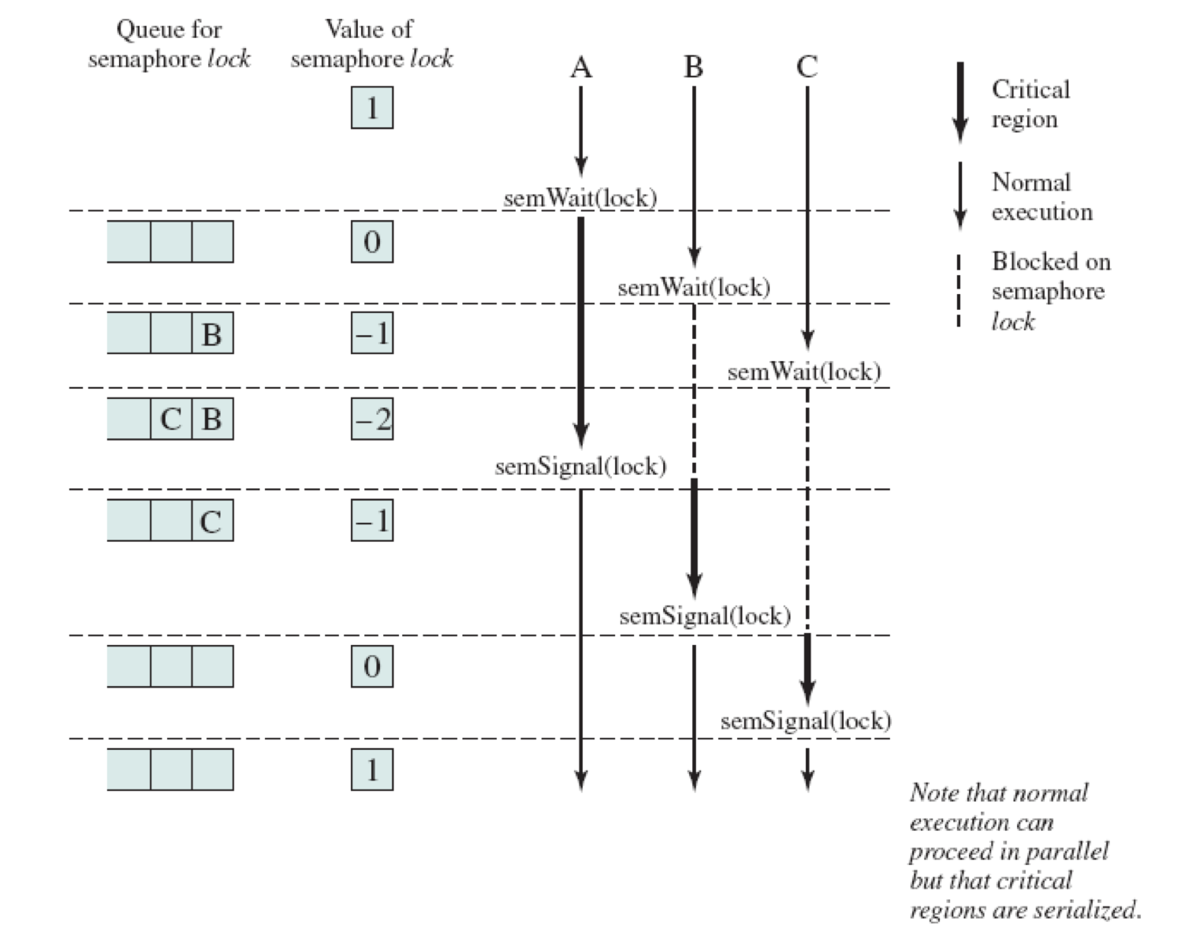
Mutual Exclusion using Semaphores

Slide 10
Semaphore in C
semaphore.c shows how to use these functions to create, operate and remove named semaphore.
compile semaphore.c like this: gcc semaphore.c -pthreaad -o semaphor
Function | Description
sem_open | Opens/creates a named semaphore for use by a process
sem_wait | lock a semaphore
sem_post | unlock a semaphore
sem_close | Deallocates the specified named semaphore
sem_unlink | Removes a specified named semaphore

Slide 11
Shared Output: Use semaphore
We use semaphore to provide mutual exclusion to the standard error. If the process is using, the another process will wait until the semaphore is unlocked.
Compile and run：
gcc a_sol.c -pthread -o a
gcc b_sol.c -pthread -o b
./a & ./b &

