Slide 1

Accessory Control Connectivity for Infotainment System (AXIS)
Luxoft Automotive R&D
V.110 – May 24,2011

Slide 2
Why AXIS?
Car OEMs & Aftermarket vendors need to integrate with the rapidly expanding world of “Apps” & corresponding connected iOS, Android devices
  Head-Units are becoming mainstream not only for high-end cars but also for mid-tier
  Consumers are looking to leverage their investment in apps & content on their personal devices with their cars
  Tablet PCs become a standard including in-car use
Car OEMs are looking to differentiate their cars and create branded experience around their Infotainment offerings by including “Apps” & external content integration
  but are constrained by safety requirements, cost and time of development as well as traditions and tendencies of the market

Slide 3
What is AXIS?
Multi-modal real time content exchange protocol for in-car mobile devices connectivity, also suitable for RSE and VIC connectivity to HU
SDK to create automotive and mobile applications
Supported in Linux, iOS and Android
Works over WiFi, Bluetooth, USB and in-vehicle links (only serial channel needed)
Designed for applications and multimedia transfer
Profile-oriented, updatable and fully controllable by OEM

Slide 4
What AXIS does?
AXIS solves the problem of two-way integration between car HeadUnit and consumer personal devices based on iOS and Android
AXIS is a portable middleware platform that provides secure, OEM controlled two-way connectivity & abstraction layers for:
  Screen/Controls access
  Audio / Video sharing
  Internet connectivity sharing
  Telephony services sharing
  Navigation functions sharing
  API access
HU Apps
API
Profiles
Profiles
API
Gadget Apps
Transport Independent Protocol
Drivers & Runtime
Drivers & Runtime
HU side
Tablet / Phone

Slide 5
Main Use Cases
Use smartphone as a source of applications for Head Unit
Share smartphone screen to the Head Unit
Synchronize head unit and smartphone/tablet contents
Use tablet as a display to head unit
Share media content to the multiple vehicle and consumer devices
Integrate navigation
Integrate cameras
Integrate aftermarket equipment

Slide 6



Technical Details: Architecture
L4
Applications
L3
Services
L2
Profiles
L1
AXIS Control
AXIS Streaming
Marshaller + Message Broker
Direct Media Access
L1 RPC
L1 Streaming
L0
HAL

Slide 7
Technical Details: Architecture
HMI and business logic
System-defined services being a supersets of profile APIs
L4
Applications
L3
Formatted data processing according to the subject oriented algorithms
IDL-based description of profile APIs
Services
Provides RPC-based API for atomic control transactions
L2
Provides interface for binary data streaming
Profiles
L1
AXIS Control
AXIS Streaming
Marshaller + Message Broker
Direct Media Access
Provides multiple serial sockets (for raw binary data) over single serial channel
L1 RPC
L1 Streaming
Encapsulates the carrier and provides single serial socket
L0
HAL

Slide 8
Technical Details: Architecture
User-specific
OEM or community provided
Third-party allowed
L4
Applications
L3
System defined
Activatable
Multi-profile
Services
L2
Profiles
Installable
Upgradable
OEM controlled
L1
AXIS Control
AXIS Streaming
Marshaller + Message Broker
Direct Media Access
L1 RPC
L1 Streaming
L0
HAL

Slide 9
Technical Details: Architecture
L4
Applications
Out of band data & service carriers under AXIS profiles control
L3
Services
L2
DLNA
Terminal Mode
Bluetooth
Profiles
L1
AXIS Control
AXIS Streaming
Marshaller + Message Broker
Direct Media Access
L1 RPC
L1 Streaming
L0
HAL

Slide 10
Initial Business model
AXIS middleware & SDK is provided by Luxoft for free
OpenSource framework + proprietary (OEM-specific) profiles with shared examples
Luxoft offers training, development and support services for Car OEMs /Tier1/ Aftermarket vendors
Phone side to be published in Android Market and AppStore.
Head unit side is a subject of customization for each car manufacturer

Slide 11
Competitive View
Existing standards & efforts
  VNC
  RDP
  Nokia Terminal Mode
  Bluetooth
  DLNA
Competition strategy
  Embed the competiting technologies
  Form Plug & Play user experience based on any data/service carrier
  Unified API & control mechanism

Slide 12
Assets
DashCore Head Unit
iOS-based gadgets
API contribution to GENIVI
Market-ready application
SDK
Market-ready OSS application
Reuse of gadget app + HMI rework
Android-based gadgets
DroidBUZZ RSE
Notes:
TODO: same as slide 17 = consider A-ha for iOS gadget

Slide 13
Roadmap
Basic approach architecting
Proof of concept
Demo available
SDK available
April – May
2011
June – July
2011
Aug – Sep
2011
Oct – Nov
2011
Dec – Jan
2011
Feb – Mar
2011
Notes:
TODO: revise and synchronize

Slide 14
Roadmap
Integrate to GENIVI & co-operate with CCC alliance
Identifying key partners & start establishing ecosystem
Publish in mobile stores
Publish open source part
April – May
2011
June – July
2011
Aug – Sep
2011
Oct – Nov
2011
Dec – Jan
2011
Feb – Mar
2011
Notes:
TODO: revise and synchronize

Slide 15
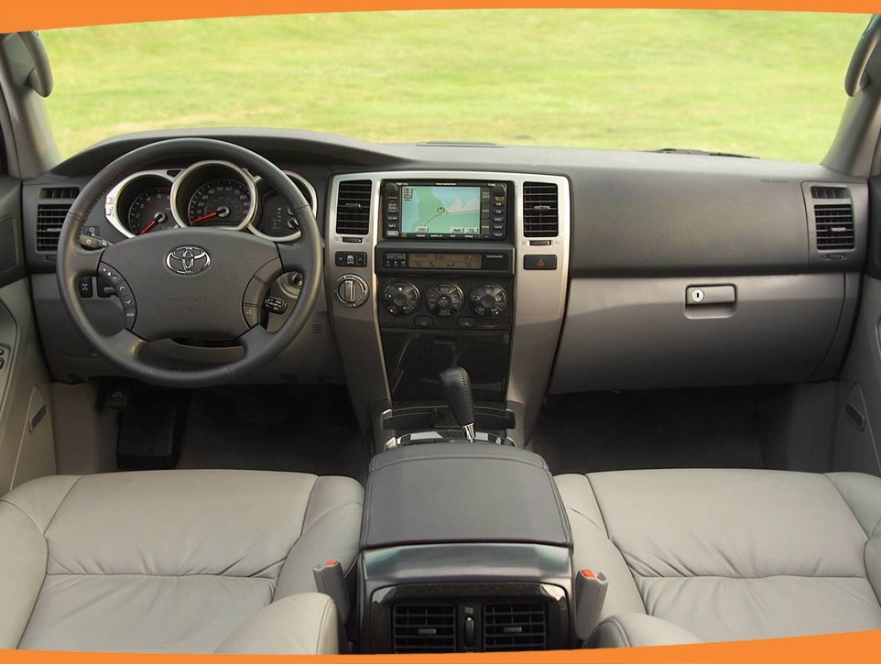
Thank you!

