Slide 1
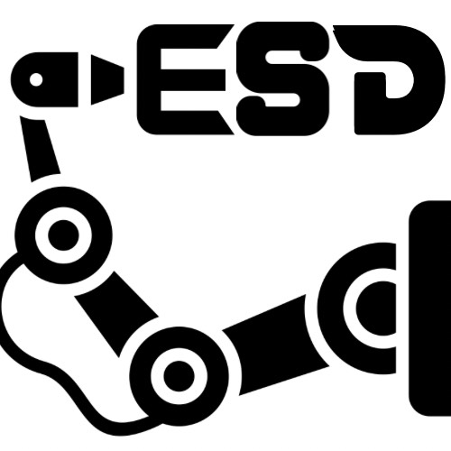
ESD Auto Inspection Robot
Software documentation details
Date: 17/10/2024

Slide 2

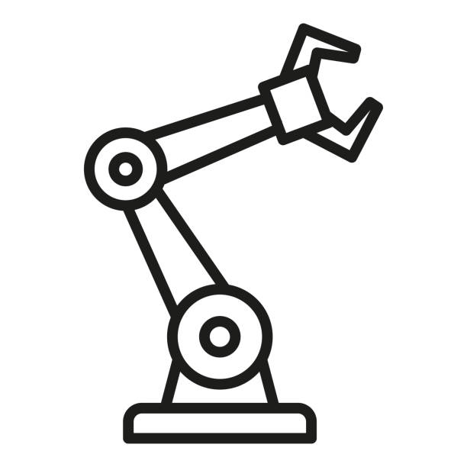
Software architecture
Pyqt5
- User Interface
- Control Test Flow
ROS 2: Humble
- Hardware Control
-Hardware Monitoring
Users
Hardware
All others folders outside of documentation and Interface_test_code
Code folder/files:
gui/
gui/RosNode/

Slide 3
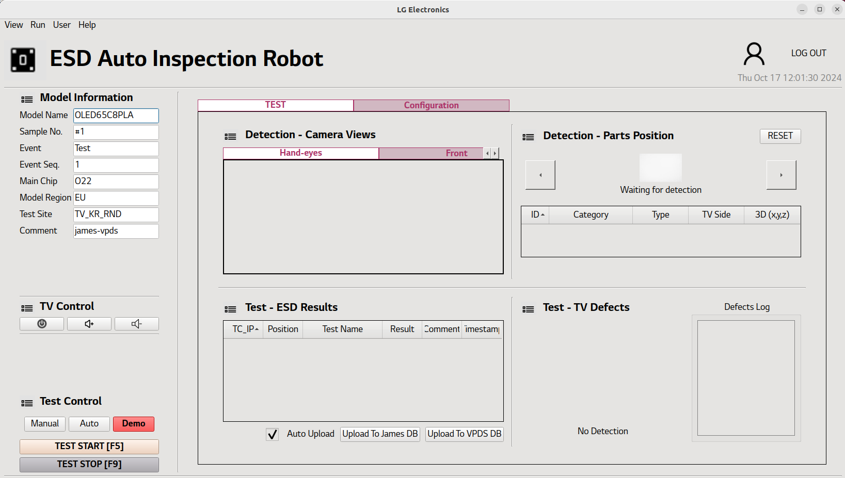
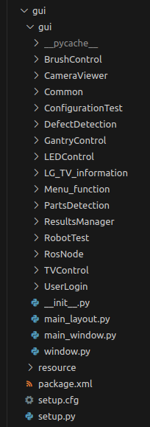
Pyqt5 architecture
It is a single window application, the menu can open additional control window but the main logic are all store in the main window.
1- window.py :
Event handling of the window movement, resizing or change
2- main_window.py:
- Initialize software with the function: setupSoftware()
- Controller logic in it (All button and signal handling)
3- main_layout.py:
- Initialize all graphical instance.
4- Others folders:
- RosNode/ contains interface for pyqt5 and ros2 system
- Others folders contains the layouts and widgets class separate by concern
ROS2 build needed files. Inside are information about the main file, licensing and dependency

Slide 4
Pyqt5 overall UI layout organization
Object name (Object type): code localization
MainWindowWidget (Qwidget): main_layout.py l.33
header_layout (QHBoxLayout): main_layout.py l.53
body_layout (QHBoxLayout): main_layout.py l.88
controller_layout (QverticalLayout): main_layout.py l.103
work_layout (QverticalLayout): main_layout.py l.148
Details of the controller and work layout are in slide 5/6/7

Slide 5
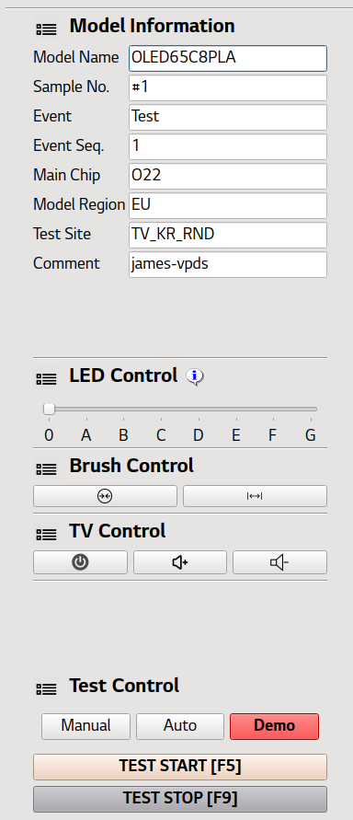
Pyqt5 Controller layout details
DESCRIPTION | CODE FILE
Fill information that can be query during test session for database upload | LG_TV_Information/layout/ModelInformationLayout.py
Control the brightness of LED system on the end effector. [Currently use LED is not recommended as it decreases AI detection and create reflection on TV] | LEDControl/layout/ControlLEDLayout.py
Control the brush actuator, with two possibility: unfold and fold at max and min value. | BrushControl/layout/BrushControlLayout.py
Control the TV with IR remoter command: turn on/off button, volume up, volume down | TVControl/layout/ControlTVLayout.py
Start test session. Currently 2 modes available: DEMO: cross-over/ test one preset connectics with air/ cross over AUTO: automatic scan of the TV/ sorting of the found value/ test with air/contact of all of them (+tooltip change) | RobotTest/layout/ControlButtonLayout.py

Slide 6
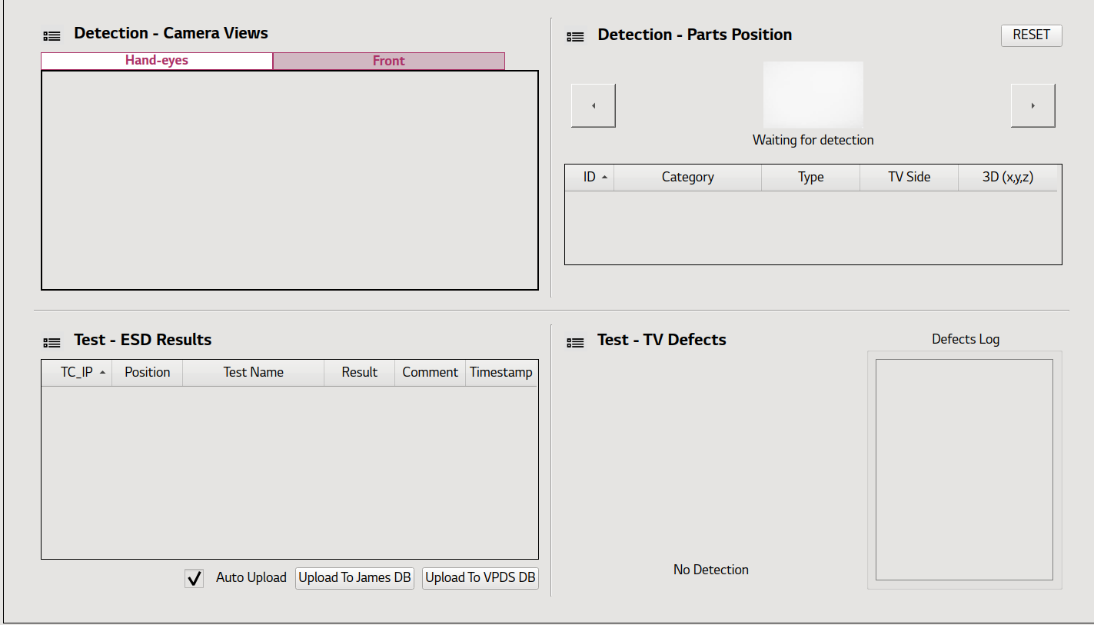
Pyqt5 work widget: test layout details
DESCRIPTION | CODE FILE
Hand-eyes camera with AI detection model apply in real-time & front camera image. Only monitoring, no interaction possible | CameraViewer/layout/FixCameraDetectionLayout.py
Information about the test points detected. Empty when start software. When we run a test sequence, the results of the detection part will show. The user can remove unwanted points from the table | PartsDetection/layout/PartsDetectionLayout.py
Information about the ESD test. Empty when software start. When we are in esd test part, the line are added in real-time when we are doing one test item. First with testing then with the results OK, NG | ResultsManager/layout/TestTableFullLayout.py
Monitoring of the defect detection camera with the screen state (black-screen or turn on) in real-time with AI model. The defectLog is extra details about the defect detected when testing parts | DefectDetection/layout/DefectCameraDetectionLayout.py

Slide 7
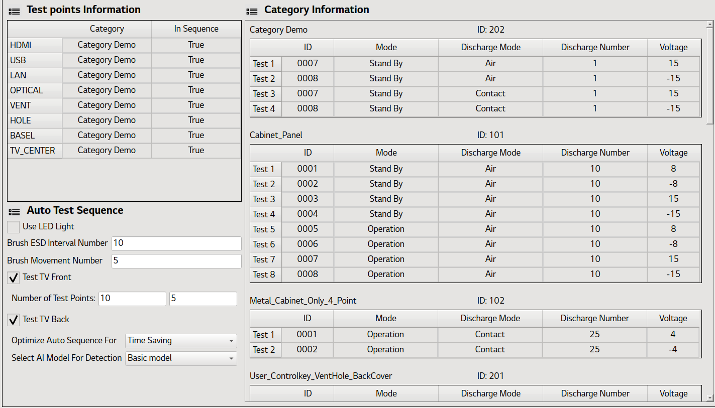
Pyqt5 work widget: configuration layout details
DESCRIPTION | CODE FILE
List of the Test Points to detect on the TV with the associate category to test on it. The in sequence column is not functional yet, but in future you can use it to enable/disable some points to test | ConfigurationTest/layout/ConfigurationLayout.py Line 31
Configuration for the auto sequence, LED light, brush movement, TV front number of points, tv back. | ConfigurationTest/layout/AutoSequenceLayout.py
List of the test to do for a category: ID is for database upload, Mode for defect detection, discharge number and voltage for the esd test. | ConfigurationTest/layout/ConfigurationLayout.py
These parameters can be change in administrator mode only. (Also if you save them, they will be apply as default value for next software run)

Slide 8
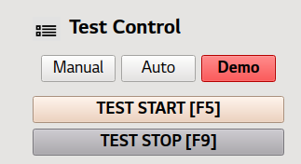
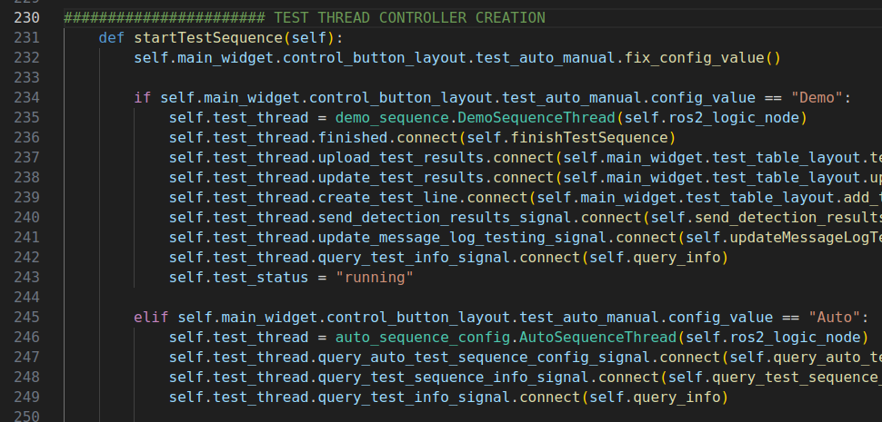
Software: Test main logic
When we click on the test start button, the selected test will be launch (I.e auto or demo test). Each test case is a Qthread so it can run parallel to the main window update
1- DemoSequenceThread
- Crossover of the TV
- Test 1 preset points in air with +15 / -15 Volt
- Return back home
2- AutoSequenceThread
- Detection of test parts on TV
- Automatic test of all the detected points
main_window.py

Slide 9
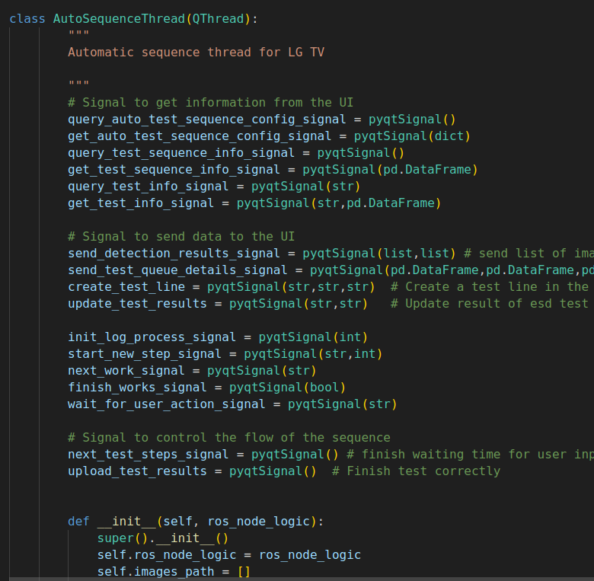
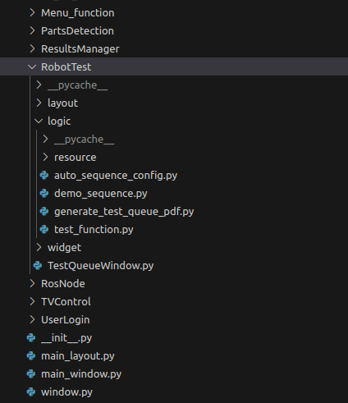
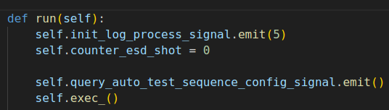

Test: Auto sequence initialization
The Qthread is an custom object name AutoSequenceThread. When create the object, the function __Init__() is run which initialize the variable. Then we connect all the necessary pyqt5 signal to communicate between the main window thread and the test thread safely. When we start the thread the run() function is executed.
The run function is execute in the Thread until the end of the function.
The self.exec_() function makes the thread pauses until a self.quit() function is called in the Thread.

Slide 10
Test: Auto sequence initialization
The Qthread is an custom object name AutoSequenceThread. When create the object, the function __Init__() is run which initialize the variable. Then we connect all the necessary pyqt5 signal to communicate between the main window thread and the test thread safely. When we start the thread the run() function is executed.
The run function is execute in the Thread until the end of the function.
The self.exec_() function makes the thread pauses until a self.quit() function is called in the Thread.

Slide 11
Pop Up window system
PopUpProtectionLED.py: when the admin is trying to put the maximum value for the LED system (G)
PopUpTesting.py: when we are running a test and the user try to change the robot/system setting or run another command
PopUpResetGantry.py: when we use the manual gantry command control, the collision with the TV is disable. So the pop up remind the user to check if the movement is possible before.

Slide 12
ROS2 architecture

Slide 13
Additional ressource
ROS2 tutorial start:
https://docs.ros.org/en/humble/Tutorials/Beginner-CLI-Tools/Understanding-ROS2-Nodes/Understanding-ROS2-Nodes.html

Slide 14
Path planning documentation
Currently there are three path planners being used:
    Open Motion Planning Library planner (OMPL). [Randomly creates a path to reach the goal avoiding obstacles]
    Cartesian motion planner. [Useful for achieving precise industrial movements, like welding. It is not user friendly]
    Pilz Industrial Motion Planner. [Useful for achieving precise industrial movements, like welding. It is user friendly]
ROS2 services used per planner
OMPL | Pilz | Cartesian Motion planner
/moveit_lux/move_linear /moveit_lux/move_preset | /moveit_lux/move_small_distance_updated /moveit_lux/rotation | /moveit_lux/move_small_distance
/move_linear_client/move_to_World_Point_back_restricted /move_linear_client/move_to_World_Point_back /move_linear_client/move_to_World_Point | /move_linear_client/make_Contact

Slide 15
Path planning documentation
Services beginning with /moveit_lux/ are the backbone of the /move_linear_client/ services. The planner to be used (OMPL or Pilz) and the computations for achieving the required movement, gets decided in these services through a cpp code.
ROS2 services used per planner
OMPL | Pilz | Cartesian Motion planner
/moveit_lux/move_linear /moveit_lux/move_preset | /moveit_lux/move_small_distance_updated /moveit_lux/rotation | /moveit_lux/move_small_distance
/move_linear_client/move_to_World_Point_back_restricted /move_linear_client/move_to_World_Point_back /move_linear_client/move_to_World_Point | /move_linear_client/make_Contact

Slide 16
Path planning documentation
The /move_linear_client/ services are written in python. They provide a more friendly user interface for using the /moveit_lux/ services.
ROS2 services used per planner
OMPL | Pilz | Cartesian Motion planner
/moveit_lux/move_linear /moveit_lux/move_preset | /moveit_lux/move_small_distance_updated /moveit_lux/rotation | /moveit_lux/move_small_distance
/move_linear_client/move_to_World_Point_back_restricted /move_linear_client/move_to_World_Point_back /move_linear_client/move_to_World_Point | /move_linear_client/make_Contact

Slide 17
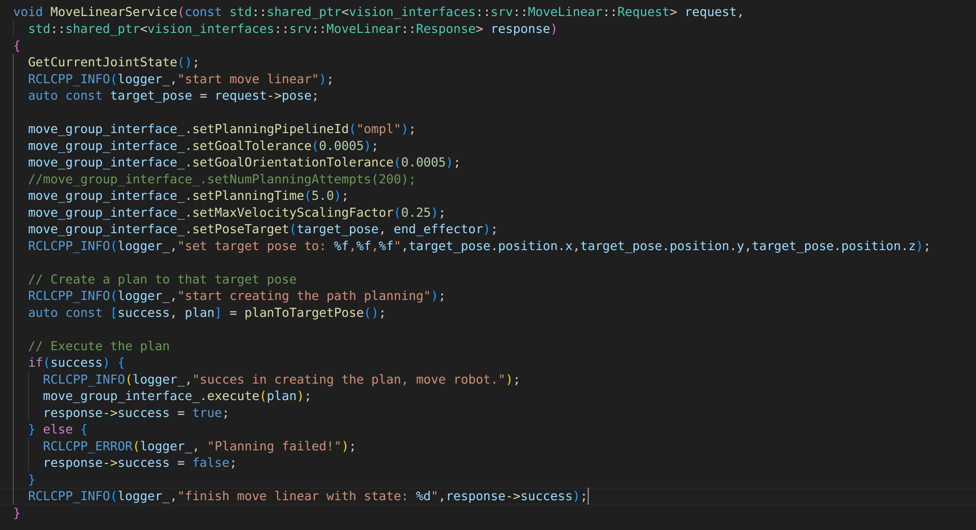
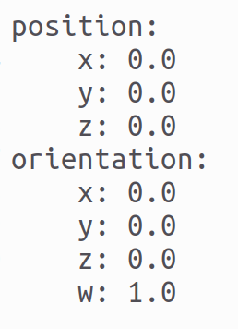
OMPL
Moves the robot to some position in the world system of reference (middle of the table) but requires also the orientation of the end-effector
/moveit_lux/move_linear
Some options of the planner, like goal tolerance and velocities can be changed in this section
/moveit_lux/move_linear callback

Slide 18
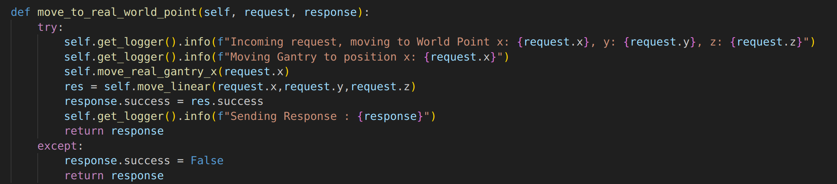
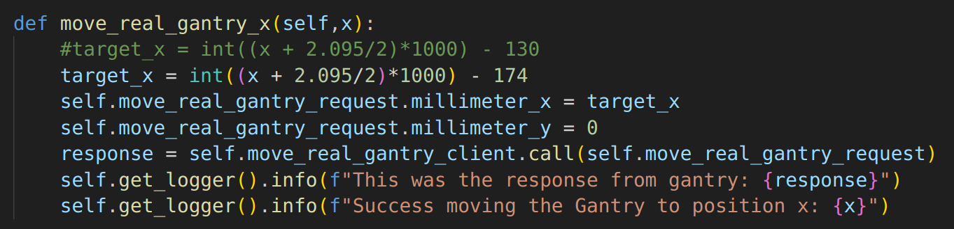
OMPL
/move_linear_client/move_to_World_point
The logic forces the gantry to always move first a certain distance in X direction, before commanding the ur10e robot to move
/move_linear_client/move_to_World_point callback
The gantry always moves in X direction and always stops 174mm before the x coordinate of the target
Step1 of move_to_World_point

Slide 19
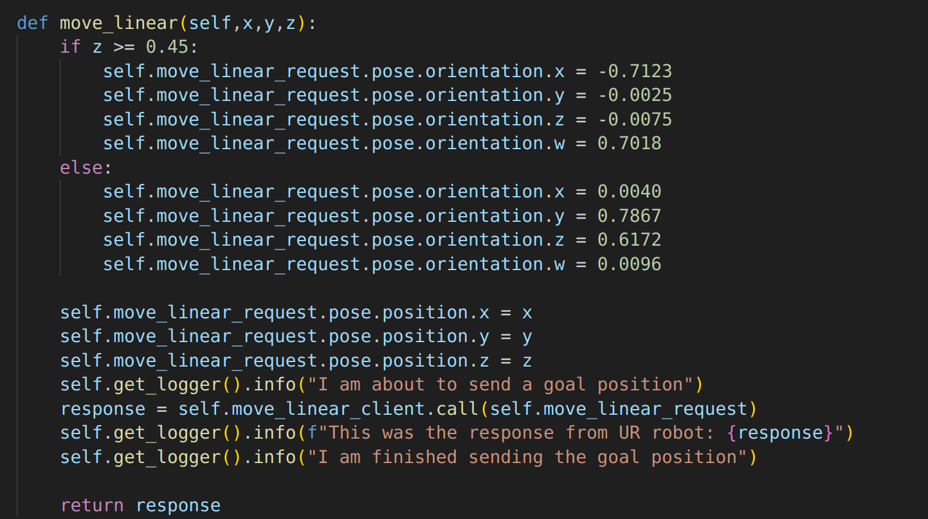
OMPL
/move_linear_client/move_to_World_point
For now, we are always fixing two orientations depending on the height of the target. This is needed since with only one orientation it is impossible to reach all the points.
Step2 of move_to_World_point

Slide 20
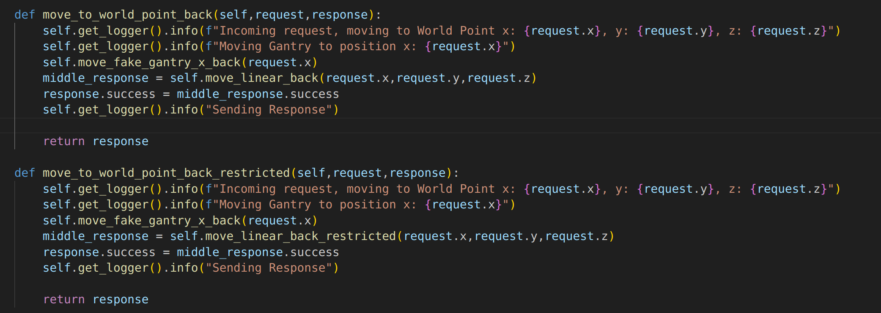
OMPL
The move_to_World_point_back service should only be used when the ur10e robot is located at the back of the tv. The only difference from the previous service is the gantry movement.
At the moment we only move the gantry varying X, by fixing its Y = 0 (front) or Y = 390 mm (back).
To be able to reach all the lower points (near the level of the table), the orientation is not perfectly horizontal but tilted.
/move_linear_client/move_to_World_point_back
/move_linear_client/move_to_World_point_back callback

