Slide 1

League of Legends Gameplay Analysis
By Steven Jasper
Notes:
Good morning. My name is Steven Jasper and I will be presenting the results of my analysis of League of Legends Gameplay

Slide 2
Problem Statement
How can we take a data driven approach to improving League of Legends gameplay?
Notes:
The problem we are facing is how can we take a data driven approach to improving game play? Especially, in a dynamic environment like a Multiplayer Online Battle Arena, a 5v5 brawl where the objective is to defeat the opponents Nexus.

Slide 3
Business Value
Provide a tool for players to use to increase their competitive edge in the game
Minimize the guessing of what to do in the game, provides a direct data driven guide to what is more important
Notes:
The business value here is to provide a tool for players to increase their competitive advantage while minimizing the guessing part of increasing game play by using a data driven approach to analyze what objectives and goals are more important.

Slide 4
Methodology
OSEMN data science workflow, which involves:
Obtain (import the data)
Scrub (clean the data, deal with missing values and data types)
Explore (answer descriptive questions using EDA)
Model (build our predictive model)
iNterpret (comment on our model and findings)
Notes:
I utilized the OSEMN data science work flow for this analysis. I began by obtaining the data, once the data was obtained I scrubbed, explored and began modeling our data. Finally we took outcomes from our model and interpreted these to produce our findings.

Slide 5
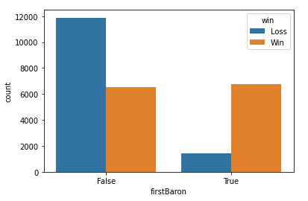
First Baron vs Win/Loss
Notes:
This graph is interesting, it seems that you have an equal chance of winning the game whether you get the first baron or not, however the data shows that more games are lost if they do not get the first baron.

Slide 6
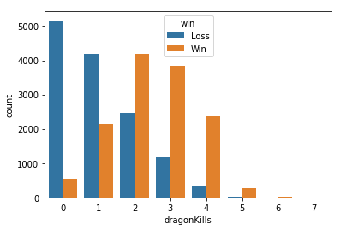
Dragon Kills vs Win/Loss
Notes:
This graph shows us the breakdown of wins and losses for each game based on number of dragon kills. We can gather some interesting information from this graph. It sees that dragon kills are highly important, as if you have 0 you have a higher chance to lose, however dragon kills have diminishing returns when it comes to the competitive advantage gained from kills.

Slide 7
Data
The data was collected from the Riot Games API. We took all match data from all players within the Diamond 1 rank, which can be considered a higher level of play. Over 30,000 games were used to train this model.
Notes:
Our data was obtained from the Riot API, we utilized over 30,000 matches from Diamond 1 players who can be regarded as high level players to train our model.

Slide 8
Model Performance
Utilizing a Decision Tree, we managed to obtain an F1-Score of 87. This is great and legitimizes our recommendation process. Since our F1 score was so good it allows us to recommend strategies based on the data with a higher degree of comfort.
Notes:
Utilizing a Decision Tree with Grid Search Cross Validation we managed to obtain a F1-Score of .87 This is a great score which legitimizes our analysis power. With such a good score we are able to confidently determine the outcome of a match with a high degree of certainty, the model does not need to be right every single time based on target values, however it needs to understand the data to a point where it can tell what the outcome of the game ‘should’ be based on the team’s performance.

Slide 9
Demo
Notes:
Now we will go through a short Demo. We will use my personal account name, as well as 2 other professional players to demonstrate functionality.

Slide 10
Future Work
Utilize a larger sample size for training
Create separate model framework that will allow us to explore player specific performance rather than team performance
Provide additional insight by assigning player, and team performance
Notes:
Some future work topics include utilizing a larger sample size, more data always increases model performance. I would also like to implement pretrained networks in order to increase layer performance of our CNN. In order to increase computational power in training our model we would want to explore distributed computation options. I also would like to take a look at some research on the topic of the medical field to find the best metric of success for our model.

Slide 11
Questions?

