Slide 1
Online Food Ordering System

Slide 2
Table Of Contents
General Information
Objective
Scope and Limitation
Literature Review
Methodology
ER-Diagram
Data Flow Diagram (DFD)
Gannt Chart
Tools Used
Output
References

Slide 3
General Information
Online Food Ordering System is a tool which is used by small, medium, and large coffee or café shops to provide services such as delivery, online order and billings.
It is also designed to provide better and quick services to the customers.
This system helps to save your time and attract the new and existing customers.

Slide 4
Objective
Remove the human error as well as miscalculations.
Remove the Paper based record keeping.
Easy to use for both Customer(ordering) as well as Café Administrator (visible flow of data).
Also, will be helpful in regard to the Marketing, since everyone these days do have internet access on their fingertips.
Trustworthy delivery system for the customers as it uses its own delivery system.

Slide 5
Scope
Easier system to use for any age group.
Easy select and order with simplicity.
No use of third party application for delivering.
Reliable for customers since, we are owning our own ordering as well as delivery system.
Many methods for payment (Cash on Delivery, E-sewa, Khalti).

Slide 6
Limitation
Tracking of food delivery is not available.
This system can not specify the time consumed during delivery.
User cannot update or edit profile.
User cannot change password.
Food category is not made yet.

Slide 7
Literature Review
Although there are lots of third-party delivery system, it is much more viable to have own ordering as well as delivery system for the customers.
For this cafe customers satisfaction is the prior thing, that’s the reason why this cafe owner came up with an idea of developing its own system.
It also protects the customers information being handed to third-party.

Slide 8
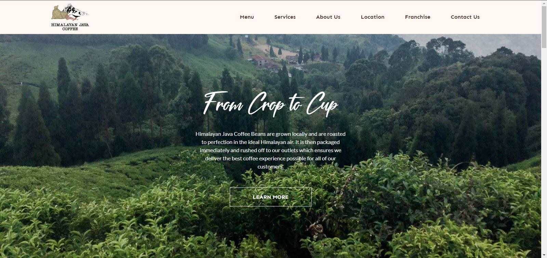
Himalayan Java home page

Slide 9
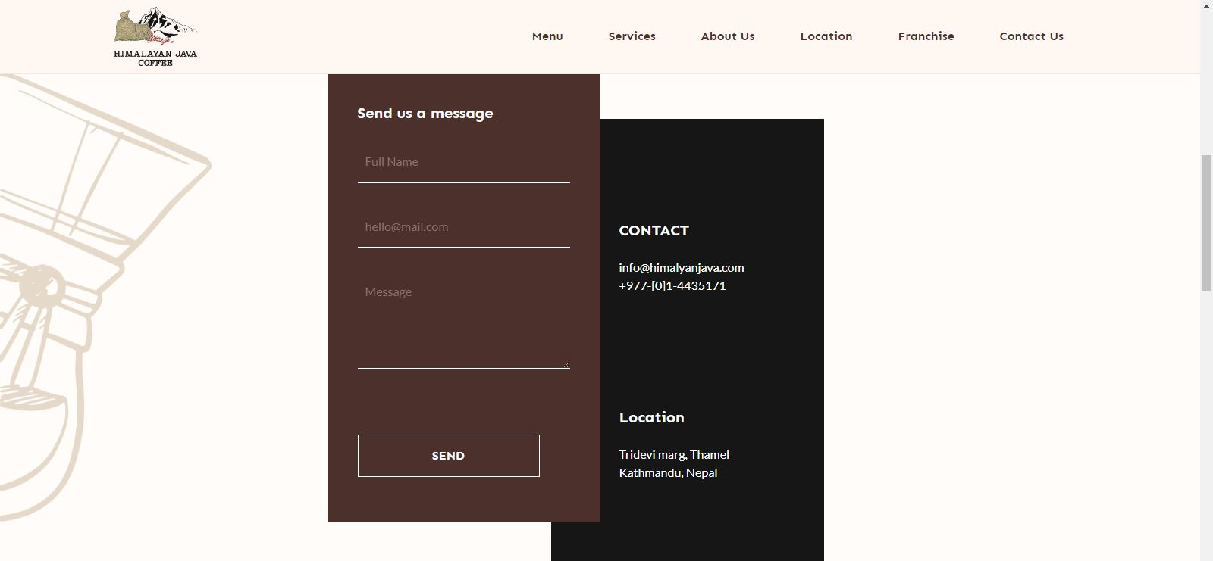
Himalayan Java Contact page

Slide 10
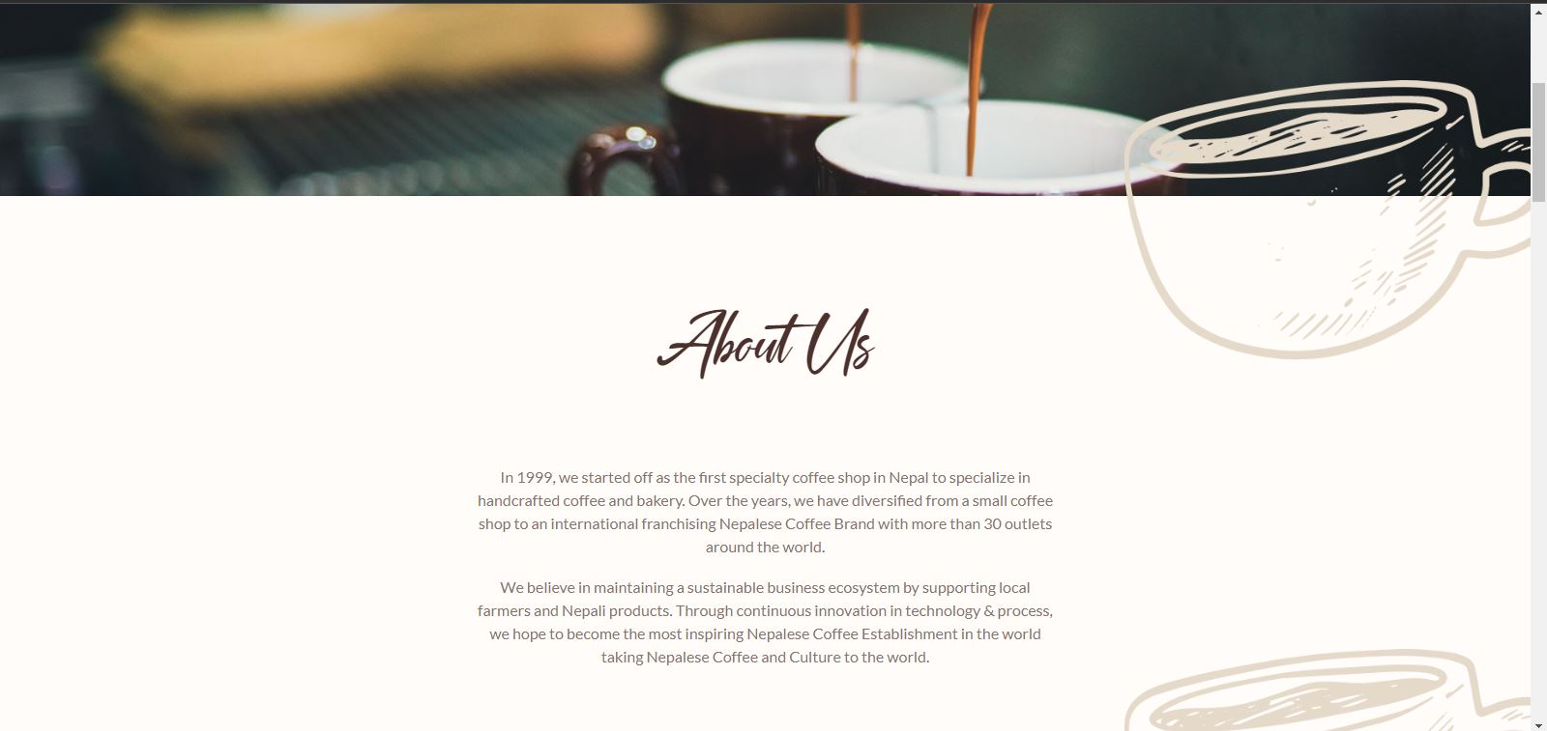
Himalayan Java About page

Slide 11
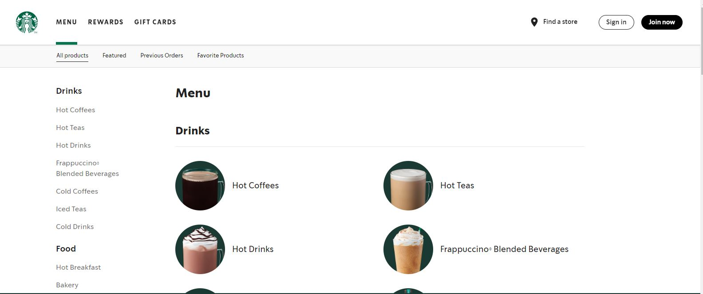
Starbucks Menu page

Slide 12
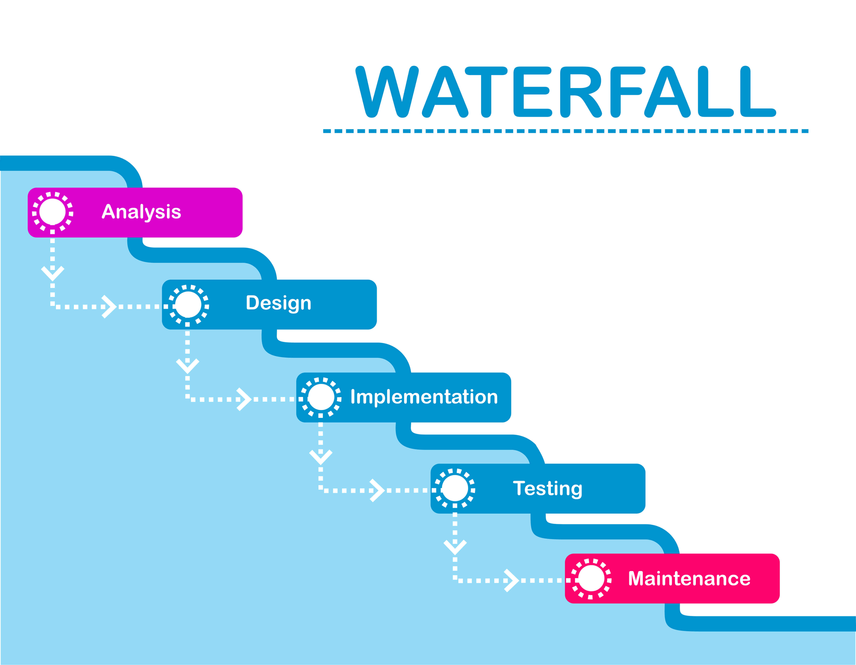
Methodology

Slide 13
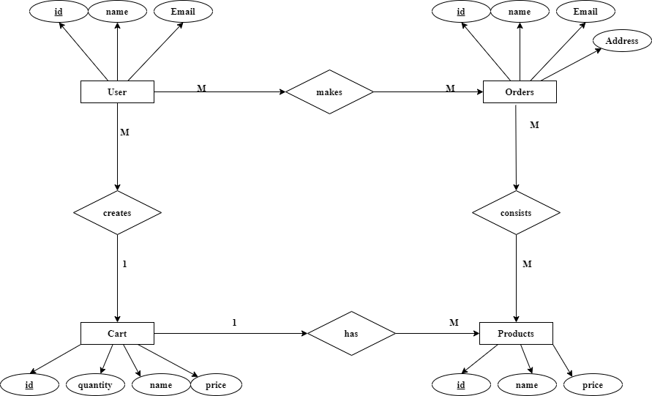
ER-Diagram

Slide 14
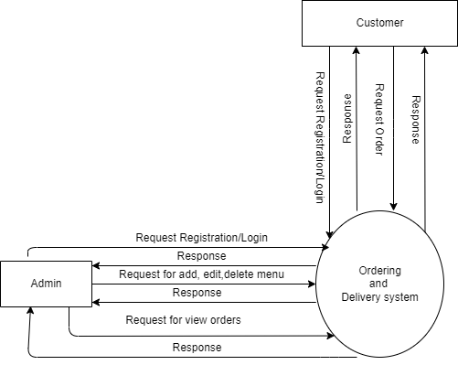
Context level DFD

Slide 15
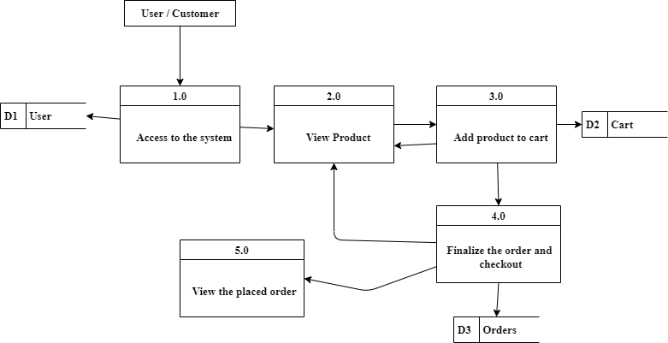
DFD level 1

Slide 16
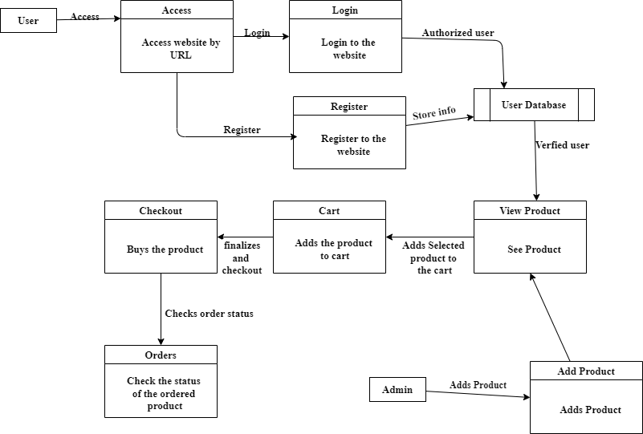
Physical level DFD

Slide 17
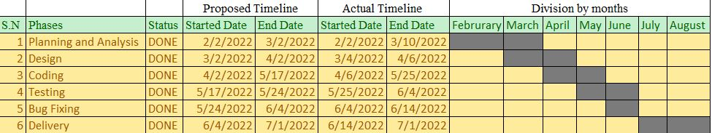
Gannt Chart

Slide 18
Tools Used
Frontend HTML (Hypertext Markup Language) . CSS (Cascading Style Sheets). Javascript. Font awesome
Backend PHP (Hypertext Preprocessor). MySQL.
Editor Vscode.
Browsers Google Chrome.
Server Xammp.

Slide 19
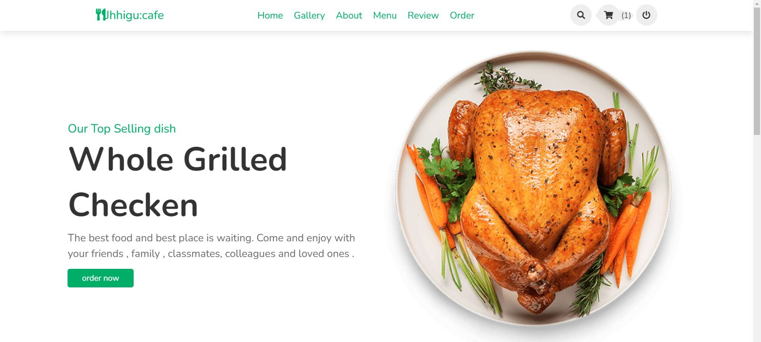
Output

Slide 20
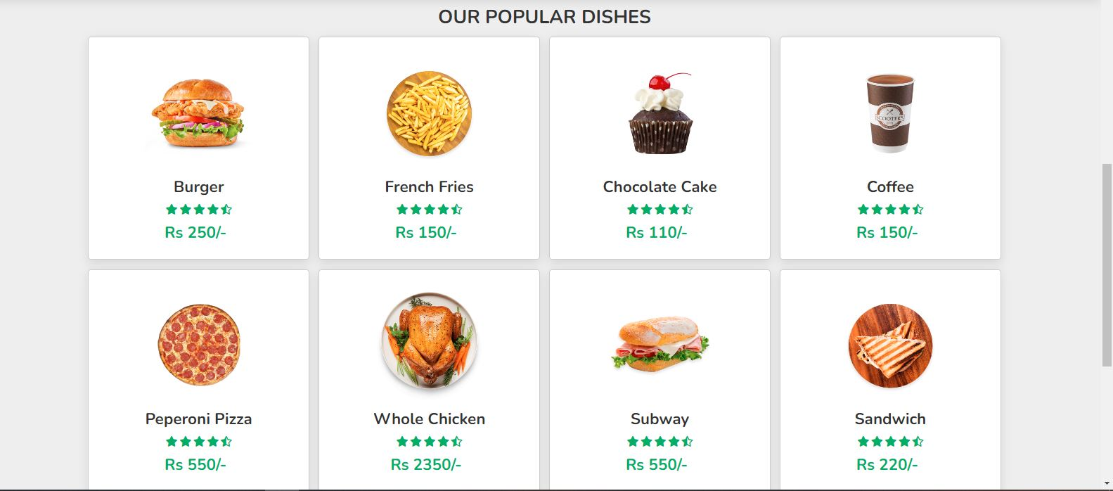

Slide 21
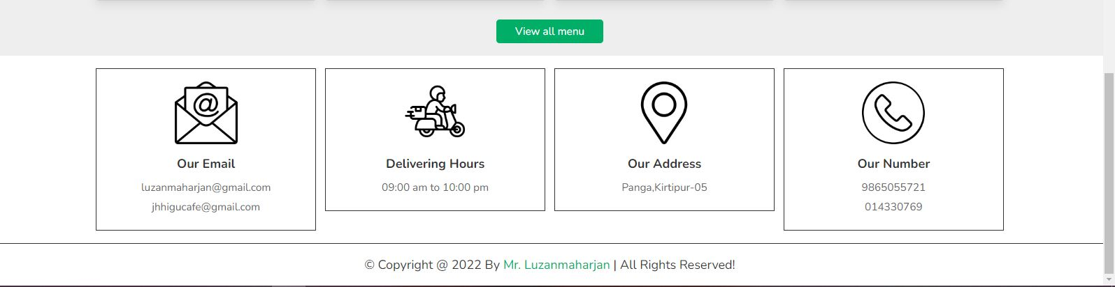

Slide 22
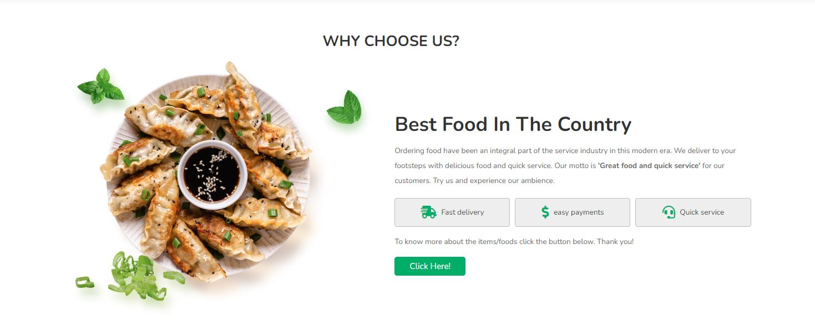

Slide 23
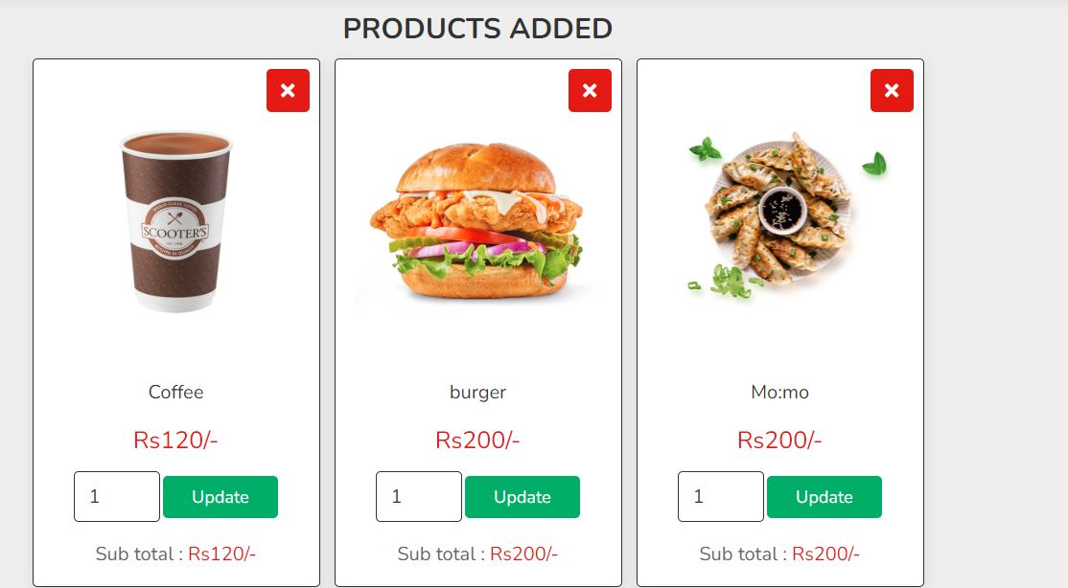

Slide 24
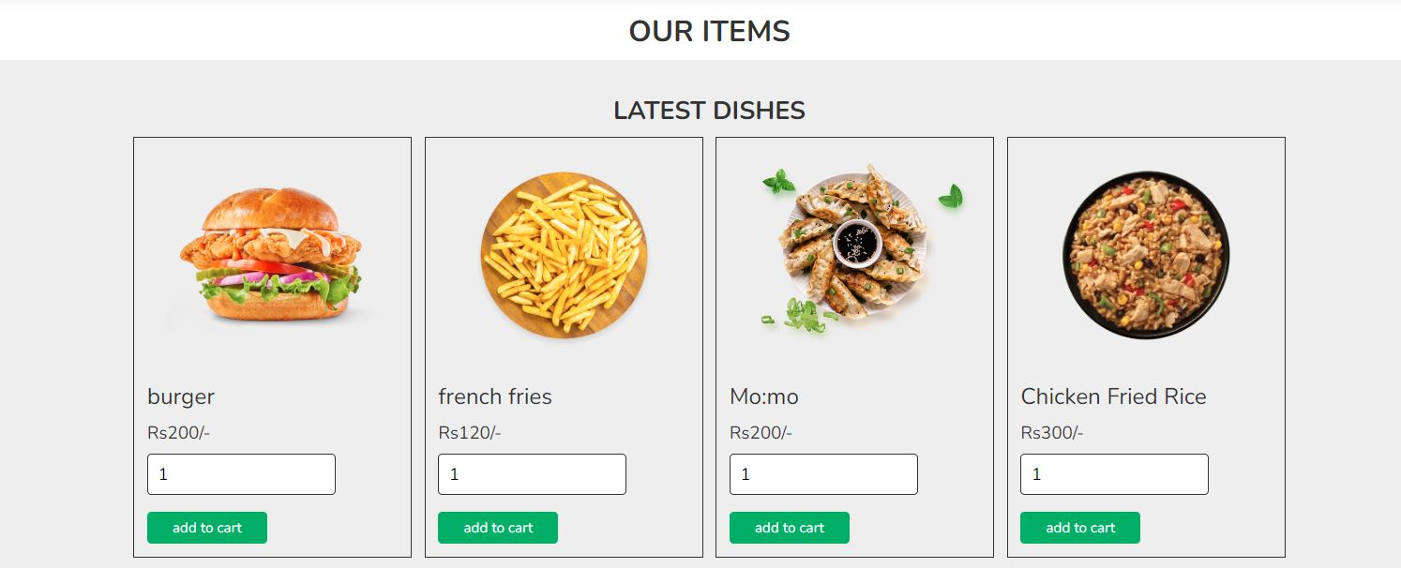

Slide 25
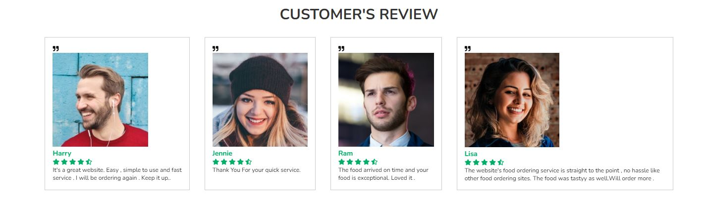

Slide 26
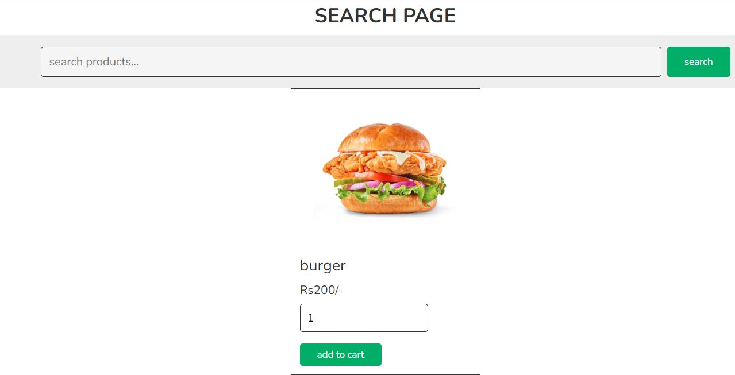

Slide 27
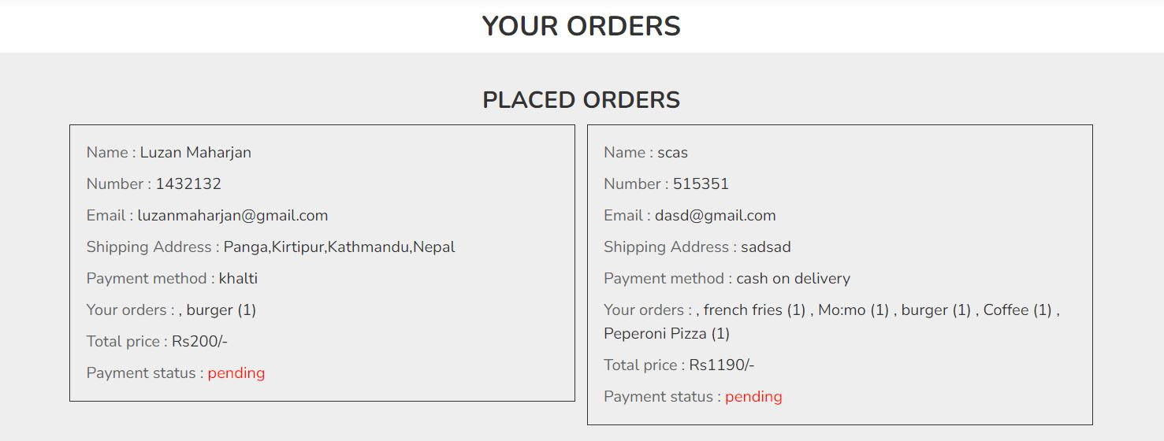

Slide 28
[7] Peterson, R. (2022, August 25). Entity Relationship (ER) Diagram Model with DBMS Example. Guru99. https://www.guru99.com/er-diagram-tutorial-dbms.html
[8] Barrier, T. (2003). System analysis. System Analysis, 1. https://www.sciencedirect.com/topics/computer-science/system-analysis#:~:text=Systems%20analysis%20is%20the%20process,problems%2C%20opportunities%2C%20and%20directives.
[9] GeeksforGeeks. (2021, November 15). System Design Tutorial. https://www.geeksforgeeks.org/system-design-tutorial/
[10] Brush, K. (2020, February 14). use case. SearchSoftwareQuality. https://www.techtarget.com/searchsoftwarequality/definition/use-case
[11] DBMS - Data Schemas. (n.d.). Tutorialspoint. https://www.tutorialspoint.com/dbms/dbms_data_schemas.htm

Slide 29
[12] System Development Lifecycle (SDLC) | Michigan Tech Information Technology. (n.d.). Michigan Technological University. https://www.mtu.edu/it/security/policies-procedures-guidelines/information-security-program/system-development-lifecycle/
[13] Wikipedia contributors. (2022, August 8). HTML. Wikipedia. https://en.wikipedia.org/wiki/HTML
[14] Wikipedia contributors. (2022b, August 20). CSS. Wikipedia. https://en.wikipedia.org/wiki/CSS
[15] Javascript Tutorial. (n.d.). Tutorialspoint. https://www.tutorialspoint.com/javascript/index.htm
[16] PHP Tutorial. (n.d.). Tutorialspoint. https://www.tutorialspoint.com/php/index.htm
[17] font awesome. (n.d.). Fontawesome. https://fontawesome.com/
[18] MySQL Tutorial. (n.d.). Tutorialspoint. https://www.tutorialspoint.com/mysql/index.htm

