Slide 1
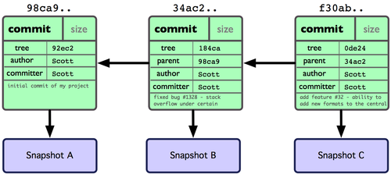

Slide 2
1011000000111001
1100001010111010
1010000110011100
1000100001011110
1000100111010000
1101101011000110
0010111110011111
1110100100010000
1101100001100001
1101111101011001
SHA-1
100001001……

Slide 3
1011000000111001
1100001010111010
1010000110011100
1000100001011110
1000100111010000
1101101011000110
0010111110011111
1110100100010000
1101100001100001
1101111101011001
SHA-1
100001001……
1011 0000 0011 1001 1100 0010 1011 1010 1010 0011….
B039C2BAA3….

