Slide 1


Slide 2
Wat is Git?
Distributed Version Control System
Open source
2005 by Linus Torvalds

Slide 3
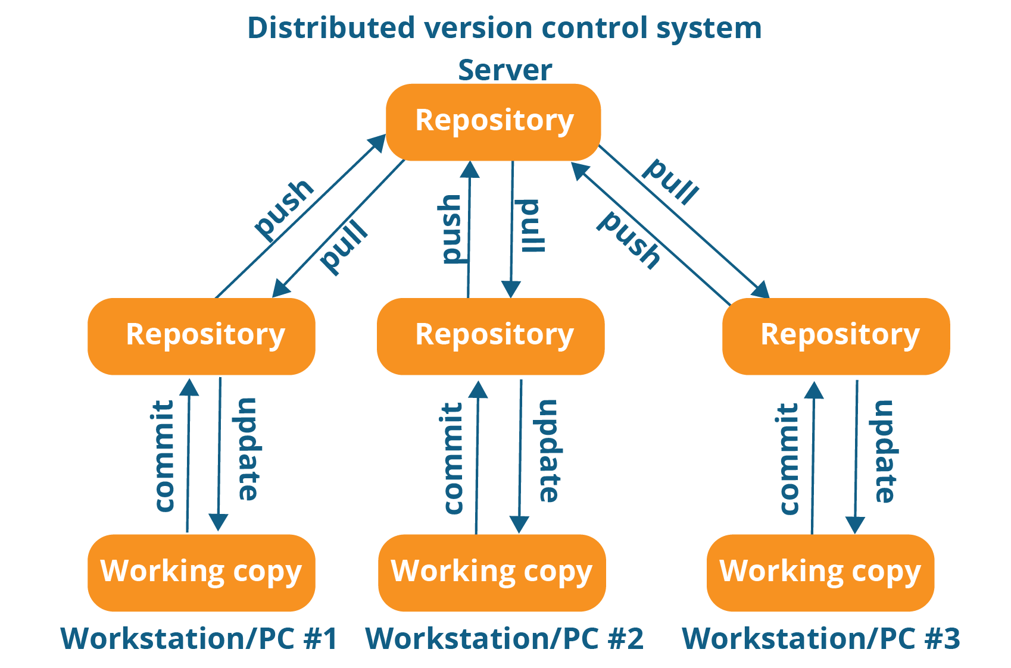

Slide 4
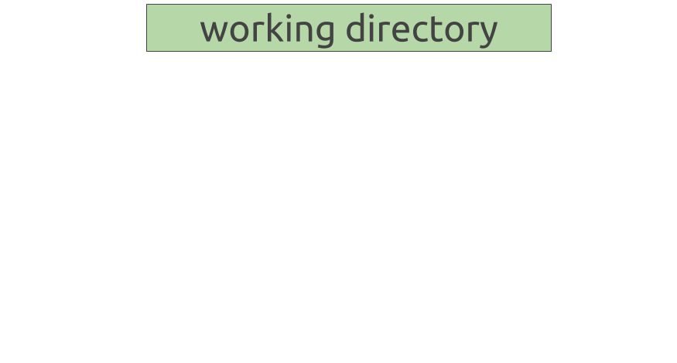

Slide 5
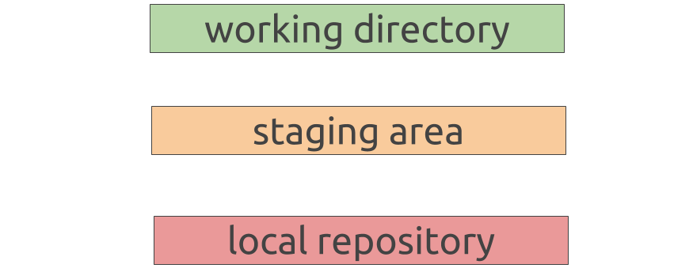

Slide 6
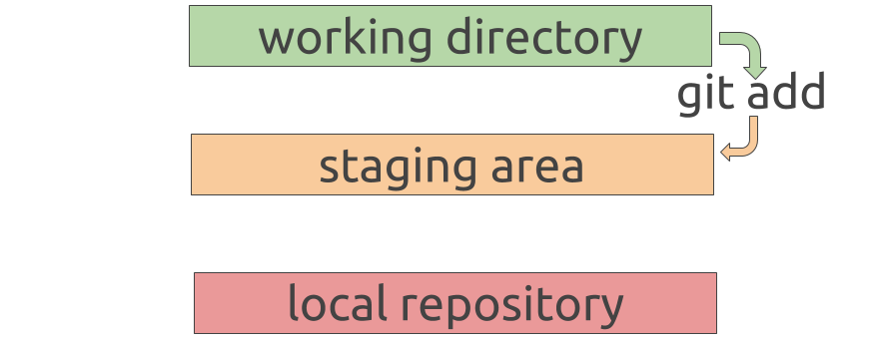

Slide 7
