Slide 1
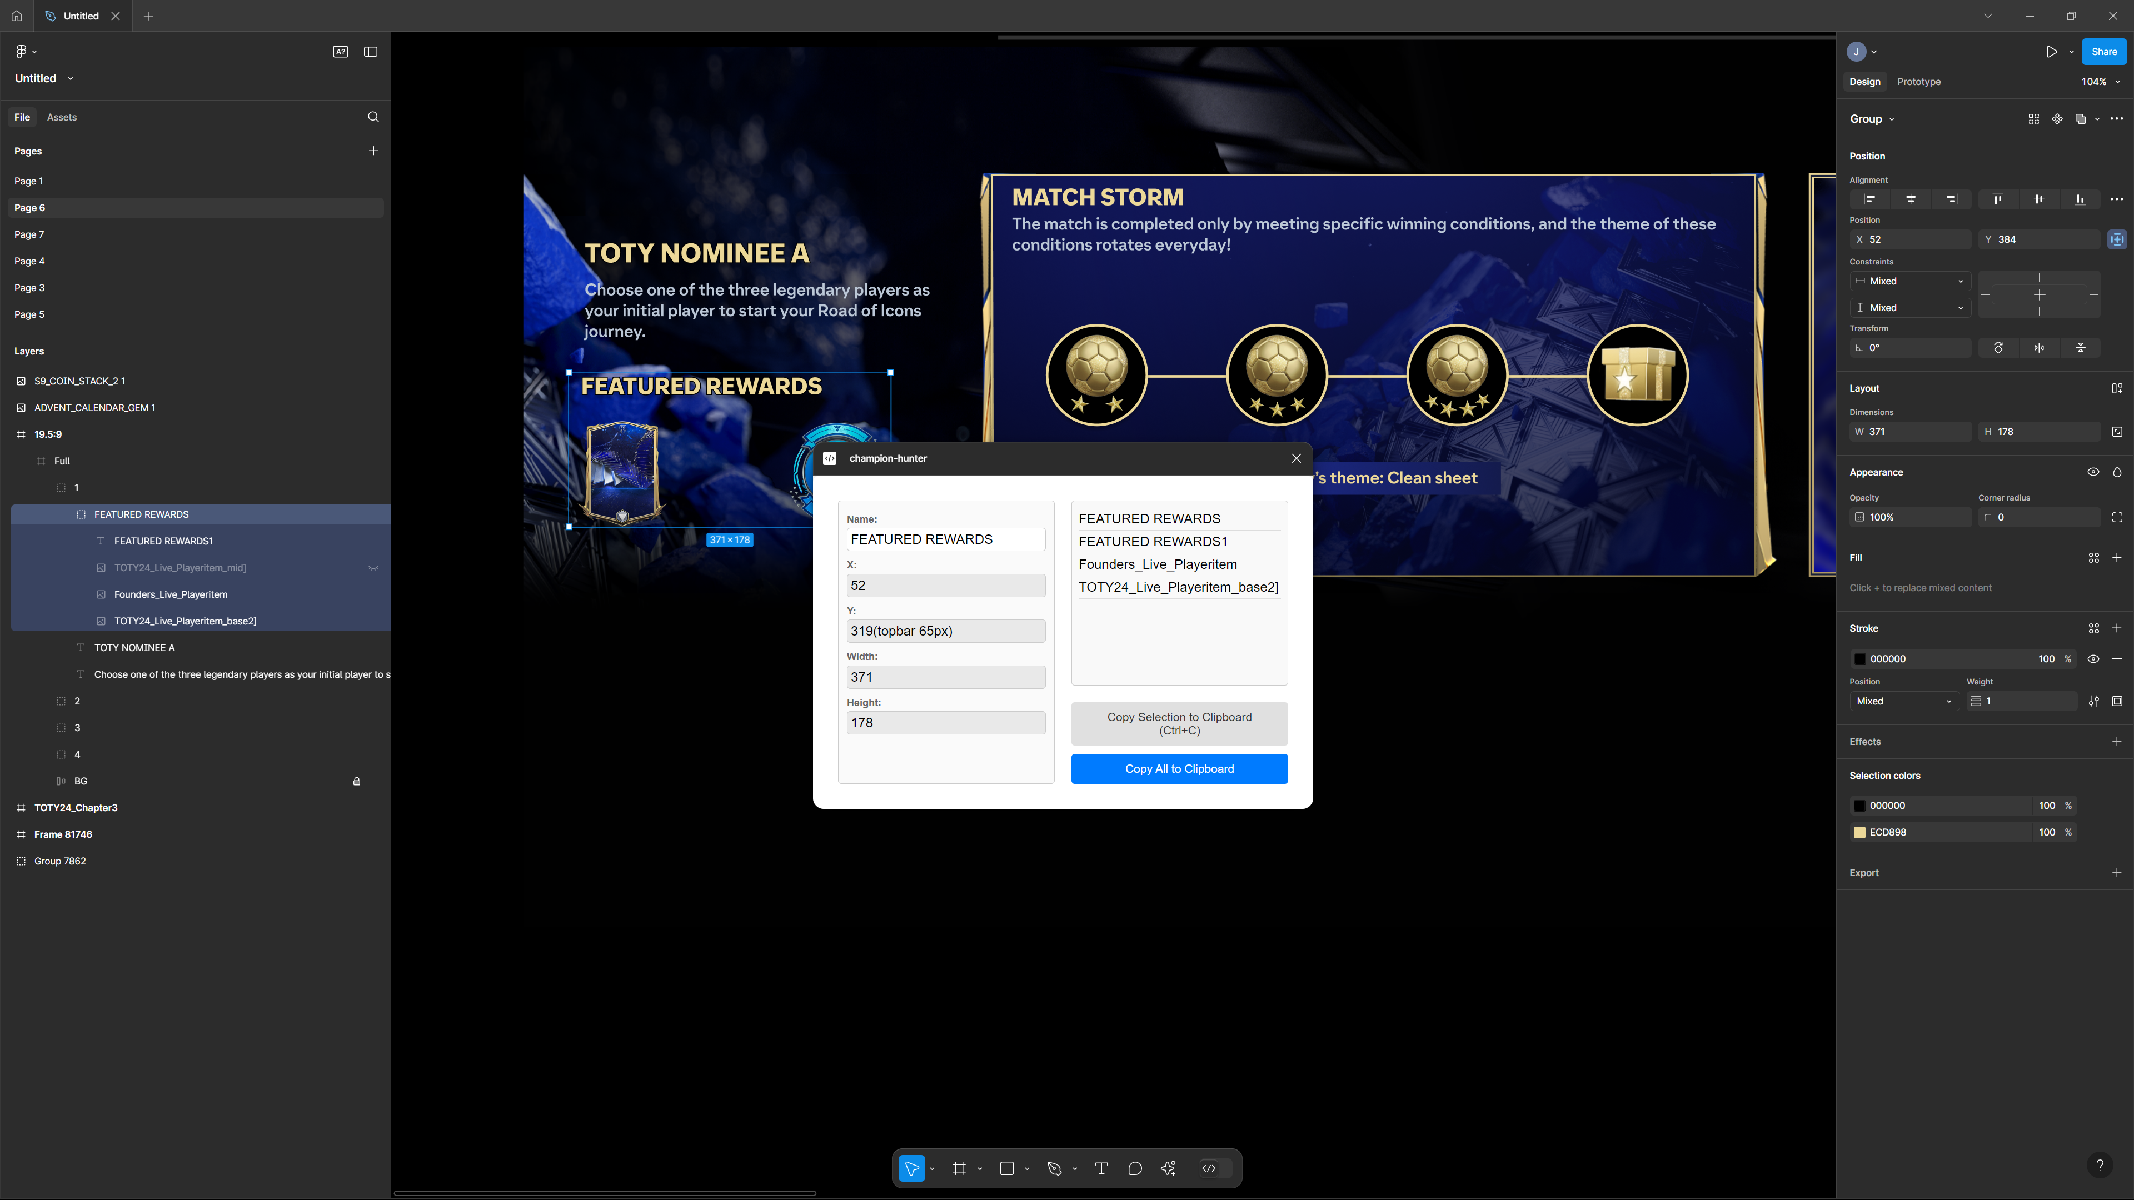

CH
Support By LviatStudio
dev.Lviat.com

Slide 2
CH

