Slide 1

From Incident to Insight: Using AI to Surface Cultural Risk
Kristen Foster
Can we turn the language in safety reports into measurable indicators of psychological safety and engagement — and use that to detect cultural risks before they escalate into real-world harm?

Slide 2

Culture risk and linguistic signals
Designing the model and prototyping phases
Demonstrating reporting - culture risk index
Post project reflection and insights
Feature engineering
Personas and exemplars
Developing the Assessment Model
Notes:
Introduction to Language Models Application in Safety Governance RoBERTa and Hugging Face Pipelines Analyzing Psychological Safety and Emotional Tone Detecting Linguistic Signals in WHS Reports Real-Time Insights into Safety Culture Actionable Governance Risks
Practical take-aways – what I tried to do…..
Position emotion metrics as leading indicators that complement (not replace) classical risk scores.
Emphasise the explainability of hybrid models—you can show which linguistic features (passive voice, hedging, blame terms) drive a low psychological-safety score.
Leverage personas to demonstrate how different communication styles map to different risk profiles; this makes the numbers relatable to non-data audiences.
Quantifying emotion doesn’t just add another metric—it brings the human dimension of risk into the same analytic frame as probability and impact, giving leaders a fuller, faster picture of where trouble may emerge next.

Slide 3
Culture risk and linguistic signals

Slide 4
Business value
Early warning signals TO IMPROVE COMPLIANCE AND MINIMISE ‘RISKY BEHAVIOURS’ AS CONTRIBUTORS OF INCIDENTS
Sharper models and forecasts
Explainability and storytelling
BENCHMARKING ACROSS BUSINESS UNITS AND TIME
TARGETED INVENTIONS
BRIDGING SOLOS BETWEEN SAFETY, AND OTHER DISCIPLINES
Notes:
1. Low Marginal Cost
“Once implemented, this solution has very low marginal cost, especially if integrated into existing safety or reporting systems like WHS portals or SharePoint. We're leveraging narratives that are already being written — there's no need to create new forms or surveys. It runs in the background and extracts insights without requiring extra effort from frontline teams.”
🟢 2. High Long-Term Benefit
“The long-term benefit is significant. By detecting early signals of disengagement, blame, or fear in how incidents are described, we can intervene earlier — before these cultural issues manifest as safety incidents. That means fewer injuries, stronger reporting behaviours, and better engagement with WHS processes over time. It turns everyday language into a continuous culture monitor.”
🔵 3. Scalable, Adaptable Framework
“Finally, the framework is scalable. While we started with safety reports, the same architecture can support related use cases — like safety leadership coaching, compliance tone monitoring, or even psychosocial risk detection under new regulatory frameworks. It gives organisations a flexible tool to track the human side of safety, risk, and culture.”

Slide 5
Language reveals culture
1. Psychological Safety & Engagement
Amy Edmondson’s work on psychological safety (Harvard) defines behaviors that signal voice, risk-taking, and trust — which informed terms like "Cautious" or "Proactive".
Engagement concepts from Kahn (1990) and Maslach & Leiter (1997) describe involvement, ownership, and burnout — leading to labels like “Concerned”, “Disengaged”, etc.
2. Sociolinguistics & Organisational Discourse
Workplace styles draw on sociolinguistic analysis of workplace communication (Holmes & Marra 2011, Gee 1999).
Terms like “Complier,” “Fixer,” “Champion” emerge from ethnographic descriptions of how people “talk safety” in different roles.
3. Practice-Driven Persona Modelling (UX design)
Similar to UX design, in this case I apply behavioral labels that capture motivations + communication style.
Used heavily in safety culture training, healthcare team simulations, and even nudge-based risk design (e.g. UK Behavioural Insights Team).
Notes:
My project draws on sociolinguistic theories of workplace discourse (Holmes & Marra 2011; Gee 1999), which frame language as a vehicle for power, identity, and cultural norms. The use of personas and linguistic features in my model reflects this — allowing us to quantify how reporting styles, tone, and emotional expression encode psychological safety and organisational risk. By applying these theories computationally, I bridge qualitative discourse analysis with NLP-based safety governance.
Behavioural insights:
In industries like construction, energy, and aviation, psychological safety is taught as a core concept — encouraging workers to speak up without fear of blame.
Programs often use roleplay, linguistic examples, and narrative walkthroughs to teach safer communication patterns (e.g., avoiding blame, encouraging ownership).
Your modelling of blame language, passive voice, and engagement cues directly aligns with these training goals — you're just quantifying them.
Healthcare Team Simulations:
In hospitals and emergency medicine, interprofessional simulations are used to train teams in safe communication under pressure (e.g., speaking up about a surgical error).
Tools like the SBAR (Situation, Background, Assessment, Recommendation) protocol rely on structured, clear, emotionally aware language — the same kind your emotion model is scoring.
Psychological safety scores and linguistic markers could be used to assess how safe or hesitant a team’s handover language sounds.
Nudge-Based Risk Design (e.g., UK Behavioural Insights Team):
This refers to using behavioral science and subtle cues (nudges) to change how people make decisions — especially in compliance, safety, or public health.
The UK Behavioural Insights Team pioneered this approach, showing how framing, language, and timing can reduce risk-taking or increase reporting.
Your approach could support these initiatives by identifying language patterns that indicate disengagement or reluctance, then tailoring nudges accordingly (e.g., how a prompt is phrased in a reporting system).
This project also on sociolinguistic theories of workplace discourse (Holmes & Marra 2011; Gee 1999), which frame language as a vehicle for power, identity, and cultural norms. The use of personas and linguistic features in my model reflects this — allowing us to quantify how reporting styles, tone, and emotional expression encode psychological safety and organisational risk. By applying these theories computationally, I bridge qualitative discourse analysis with NLP-based safety governance.
Holmes & Marra (2011): Key Ideas
In "Leadership, Discourse, and Ethnicity" and other works, Janet Holmes and Meredith Marra argue that:
Language in the workplace is not neutral — it encodes status, hierarchy, group norms, and cultural expectations.
People adopt different "interactional styles" depending on role, context, and identity — e.g., directive vs. collaborative, assertive vs. deferential.
These styles are shaped by sociolinguistic variables like gender, ethnicity, seniority, and occupational culture — and can be analysed systematically using discourse features (e.g., turn-taking, hedging, mitigated directives, modal verbs).
Workplace talk includes small talk, humour, emotional management, and indirectness — all of which serve important relational and power-balancing functions.
I attempted to compute their model: personas (e.g., Mia the Anxious Validator, Kavita the Avoidant Minimalist) mirror interactional styles described in Holmes & Marra's work.
By extracting features like passive voice, hedging, blame language, and emotion, you’re operationalising what sociolinguists do qualitatively.
Your model tries to quantify how people navigate authority, safety, and emotion through workplace narratives — which is exactly what Holmes & Marra study using discourse analysis.
Relation to Gee (1999)
James Paul Gee’s “Discourse analysis: What makes it critical?” and related work adds that:
Communication practices are part of broader “Discourses” with a capital D — ways of being, doing, and valuing in a social group.
Workplace reporting styles are shaped by these Discourses — e.g., construction vs. healthcare industries may differ in emotional expression, formality, or use of jargon.
Analysing text lets us uncover power, identity, and ideology, not just information.

Slide 6
Challenges
Formal tone masks emotional cues in corporate reports
Vagueness and avoidance is the norm
Low variance in language makes feature extraction tricky
Ambiguity between engagement and safety
Lack of labelled data
Generally, models and pipelines are pretrained on casual or news language
Industry-specific jargon requires custom glossaries
Notes:
High level notes based on outcome from second round of testing.
Formal tone masks emotional cues
Corporate reports are written to be objective, risk-neural and formal – even when psychological safety is low
This limits detectable sentiment and creates ambiguity:
“The issue was addressed” could mean proactive action or pressured silence.
Impact: Emotion/sentiment models often underperform or misclassify this type of language
Vagueness and avoidance is the norm
In WHS or compliance-heavy settings, people avoid blame or specificity. Likewise, it can also be attributable to corporate culture or industries.
So phrases such as “Procedures were followed” = no ownership, potential deflection when looking at linguistic signals
Impact: Classifiers must detect what’s omitted, not just what’s said – e.g absence of detail or agency becomes a feature
Low variance in language makes feature extraction tricky
Repetitive use of boilerplate (incident occurred, “hazard logged”, “discussed at toolbox” reduces signal diversity
The limits the usefulness of typical text frequency-based models (TF-IDF, bag-of-words).
Impact: Requires engineered features (eg passive voice, specificity, use of pronouns – which note vagueness issue to the left, is also not useful) and use of transformer-based model for richer context.
Ambiguity between engagement and safety
A person can write detailed, engaged reports but still feel psychologically unsafe.
Engagement does not equal trust.
Impact: Requires separating cognitive effort (task completion) from emotional tone (trust/fear).
Lack of labelled data
Nothing available that labelled for psychological safety and/or engagement
This required creation of synthetic personas and exemplars to build ‘truths’
Impact: Required development of hybrid KNN and and threshold driven classification.
Generally, models and pipelines are pretrained on casual or news language
Many NLP models (BERT, DistiBERT) are trained on Wikipedia or Reddit
These domains are very different from WHS reports and/or corporate reports/incident logs etc
Impact: The model can misinterpret linguistic signals from formal or procural text neutral or low risk.
Industry-specific jargon requires custom glossaries
Terms like SWIMS, JSEA, PEE, toolbox talk are highlighly domain specific
Impact: Model needed to align model with OHS glossaries (like from Safework Australia) to score engagement or procedural fluency properly
In case you are asked and you can’t remmber the terms. Model: SamLowe/roberta-base-go_emotions initially used for testing
Moved to j-hartmann/emotion-english-distilroberta-bas which is a single lab el emotion classifier that covers 6 emotion categories: (joy, sadness, anger, fear, surprise, neutral). But only assigns one dominant emotion. This was used to attempt to overcome high neutral assignment.
Also in case ydou are asked and you forgetBased on the GoEmotions dataset from Google. Fine-tuned on 28 emotion classes using RoBERTa base

Slide 7
Estimated benefits
Benefit Category | Description
Proactive Risk Detection | Flags cultural red flags (e.g. fear, blame, disengagement) before incidents escalate, supporting early intervention.
Enhanced Governance | Provides board- and executive-level insights into safety culture through explainable AI and cultural indicators.
Continuous Safety Intelligence | Moves beyond periodic surveys to real-time analysis of routine WHS reports, improving responsiveness and oversight.
Data-Driven Decision Making | Empowers safety leaders with evidence-based insights for coaching, training, or escalation.
Cultural Benchmarking | Enables comparison across teams, shifts, or sites to identify patterns of concern or improvement over time.
Compliance & Audit Readiness | Demonstrates alignment with psychological safety and safety culture principles in ISO, WHS regulations, or audit frameworks.

Slide 8
Estimated costs
Cost Area | Description
Development & Data Science Time | Initial setup required approximately 40–80 hours of skilled effort (data cleaning, modelling, validation).
Infrastructure | Minimal additional infrastructure; runs on existing Python/Jupyter environment or can be deployed via a secure dashboard.
Model Maintenance | Periodic retraining and calibration needed (~quarterly or biannually) to reflect new language and incident types.
Training & Change Management | Time to onboard safety staff and leaders in understanding model outputs and embedding insights into workflows.
Governance & Ethics Review | Internal review for fairness, transparency, and interpretability in line with responsible AI practices.

Slide 9
Overview of the model and prototyping phases

Slide 10
Key stages of development
Synthetic data design and creation
Modelling and evaluation
Refinement Loop
Feature Engineering

Slide 11
Synthetic data and exemplars (Stages 1 and 2)
Synthetic data design and creation
Why: To ground the model in real world reasoning needed a library of annotated exemplar texts.
Why: To overcome confidentiality and access limitations with real WHS data.
Result: 500 labelled records with embedded psychological safety, engagement, emotion and action quality traits.
Build and trained exemplars for training and allocation
Templates with WHS structure: incident description, corrective action, location/team and other data
Injected tone and variation using linguistic rules and TOOCS-aligned OHS terminology aligned language with behavioral science terminology (ie modal verbs etc)
Purpose: To act as semantic anchors for similarity-based scoring (LM and RoBERTa) Support ‘human-in-the-loop calibration’ and bias testing Served as ground truth for SHAP interpretation

Slide 12
Engineering, modelling and refinement (Stages 3 – 5)
Tools used: SHAP for exaplanatbility
Confusion matrices to surface misclassified edge cases
Feature Engineering
What: Engineered behavioural and linguistic signals drawing from safety and hazard models, psychology and sociolinguistics.
Core features: Linguistic features, emotional and sentiment features, personas and scoring features.
Models
Hartmann for dominant emotion tagging (single-label)
Modelling and evaluation
Tested multiple classification strategies to predict psychological safety and cultural indicaotrs from report text
Models used/tested: Random Forest, Logistic Regression (TF-IDF), RoBERTa GoEmotions, MiniLM-L6-v2 + KNN
Metrics: F1 score, class wise precision/recall, SHAP value impacts
Results: Random Forest model achieved 90% accuracy on synthetic data Logistic Regression performed lower (83%) but still offered a useful benchmark
Refinement Loop
Tested feature weights (ie hedging had more predictive power than initially assumed) Persona traits to better match real world variation Action quality scoring and emotion averaging
GoEmotions for top-3 average emotion scoring (multi-label)

Slide 13
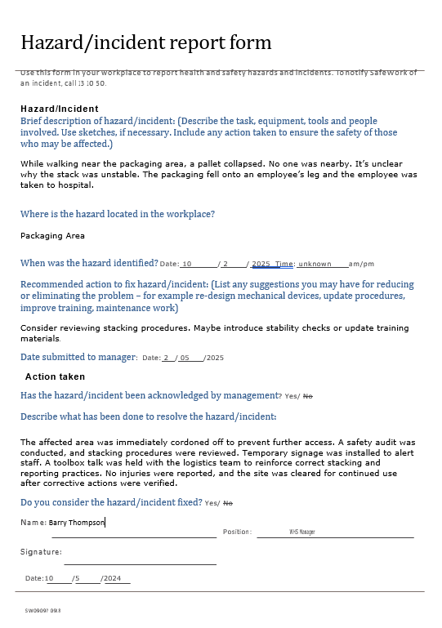
Model stages and feature engineering
Scores around fear, guilt, or gratitude help indicate whether the writer felt safe, hesitant, or empowered to speak up.
The emotion model adds depth to traditional linguistic analysis by identifying subtle affective cues.
Text input (WHS report)
Emotion model (RoBERTa GoEmotions)
Preprocessing (clean, tokenise)
Linguistic signal extraction and encoding
Extract emotion probabilities
Classify:
Psychological Safety Level
Engagement Level
Assign persona
Culture Indicator
Convert to emotion score or dominant ‘label’
These scores become part of the input used to classify psychological safety, improving the interpretability of neutral-seeming text.
Developing the hybrid model turning qualitative information and ‘unnoisy’ corporate language into quantitative features
Notes:
.

Slide 14
Feature engineering
Linguistic Features – Risk Culture, Tone, and Intent
Emotional & Sentiment Features
Persona and Scoring Features
Culture Risk Indicator
Examples of the hybrid scoring model
How the use of persona’s support this model.

Slide 15
Feature Engineering
Linguistic Features
Selection Strategy
Passive voice count – Indicators of deflected responsibility or reduced agency.
Modal verbs & hedging terms – Signals of uncertainty or fear (e.g., "might," "perhaps").
Corrective action word count & specificity – Proxies for engagement and diligence.
Average word length – A proxy for writing effort or sophistication.
Safety jargon frequency – Gauges procedural focus and compliance mindset.
Emotion & Tone Features - Used transformer-based models (GoEmotions, RoBERTa) to detect:
Dominant emotion (fear, guilt, trust, blame, gratitude).
Emotion intensity vector (multi-label probabilities for nuanced insight).
Top-3 emotion average score to measure affective richness.
Theoretical relevance from safety and organisational psychology literature.
Statistical contribution via SHAP value analysis.
Low multicollinearity and clear interpretability for governance use.
Features were retained based on:
Psychological safety and engagement effort scores derived using rule-based logic from combinations of the above features.
> Culture zone classification (Desirable,
Scored Cultural Traits

Slide 16
Linguistic Features – Risk Culture, Tone, and Intent
Meaning | Feature Name | Method Used | Purpose and Interpretive Value
Blame indicators | passive_voice_count, ‘you_count” | Regex match on was, were, been, being | High values may suggest blame avoidance or deflection, linked to low psych safety
Tentativeness and fear | modal_verb_count | Regex on modals: should, could, might, must, etc. | Suggests tentative or indecisive language, correlated with low engagement or fear
 | hedging_terms_count | Frequency of softeners like maybe, perhaps, I think, appears | Indicates uncertainty, anxiety, or low confidence, linked to Mia-style personas
Agency markers (not used in final model) | i_count, we_count, | Regex-based pronoun counting | Assesses agency or detachment (e.g., “we” = team inclusion; “you” may signal blame)
Effort/Engagement indicators | avg_word_length | Average word length across combined_text | A proxy for writing effort or technical sophistication
 | specificity_score | Count of WHS-specific terms (SOP, LOTO, gauge, checklist, etc.) | Indicates technical engagement or procedural compliance, common for Kavita persona
 | corrective_action_word_count | Word count from corrective_action_taken | Captures depth of response, used in engagement scoring

Slide 17
Emotion & Sentiment Features
Feature Name | Method Used | Purpose
dominant_emotion | Hugging Face model j-hartmann/emotion-english-distilroberta-base | Top emotion extracted from incident_description_paraphrased using classification
emotion_vector | JSON of all GoEmotions multi-label scores | Used for richer downstream emotion insights (optional for X features)
top3_emotion_avg | Averaged top 3 emotion scores | Used to estimate emotional richness or affective clarity
sentiment_score | Not used – too many ‘neutral’ results due to corporate writing | Can add polarity value (positive, neutral, negative) to support culture_zone mapping

Slide 18
Persona and Scoring Features
Feature Name | How It’s Derived | Notes,
persona | Derived from persona model | Maps reporter to one of the five synthetic personas
psychological_safety | Rule-based logic using modal verbs, hedging, passive voice etc. | 3-class label (Low/Medium/High)
engagement_score | Based on corrective action length and specificity score | Used to reflect effort/engagement levels
language_score | Combined avg_word_length + specificity_score | Optional feature representing linguistic sophistication and used to calculate engagement_score.
culture_zone | Derived from blend of: psych_safety, engagement_score, sentiment | 3-class label: Desirable / Transitional / Intolerable

Slide 19
Psychological safety calculations
Feature | Weight | Reasoning
Hedging terms | 0.2 | Key linguistic signal of uncertainty
Passive voice | 0.2 | Indicator of low ownership or defensiveness
Top-3 emotion avg | 0.3 | Measures affective presence and richness
Reverse fear score | 0.15 | Fear suppresses psychological safety
Reverse blame score | 0.15 | Blame shifts suppress safety culture

Slide 20
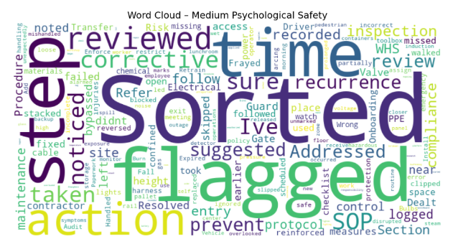
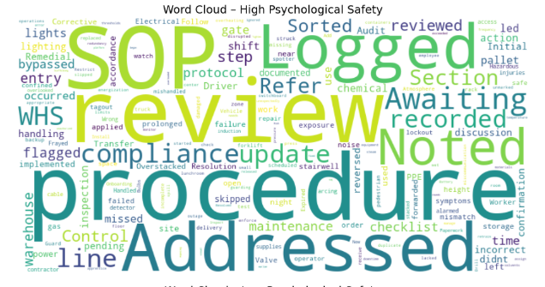
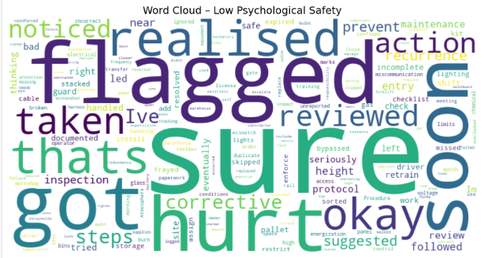
Do the categorising of language markers demonstrate variation in language?

Slide 21
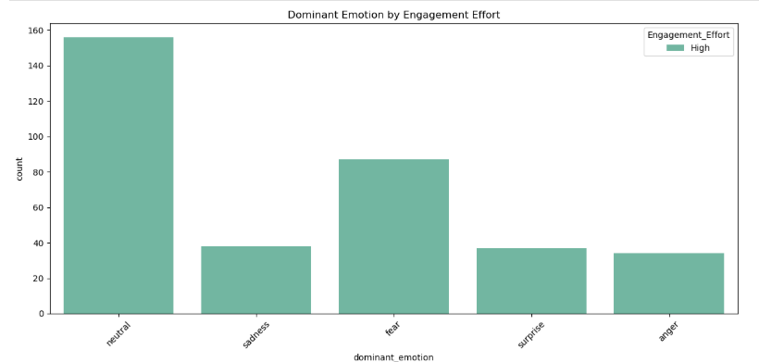
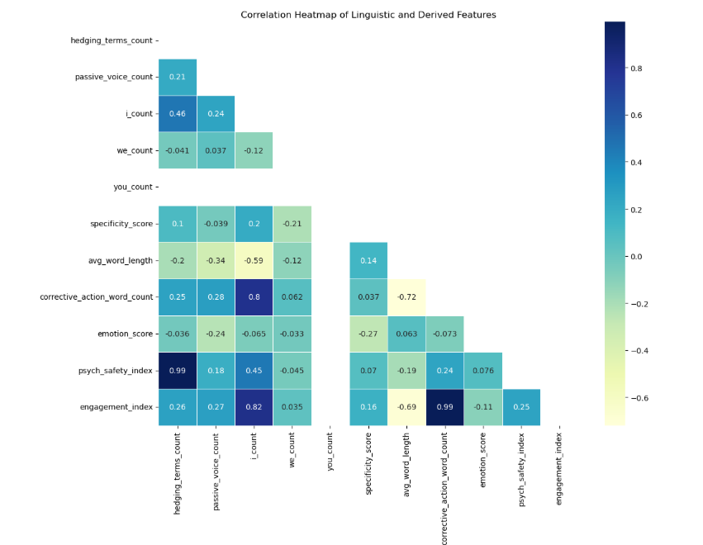
Overview of key metrics

Slide 22
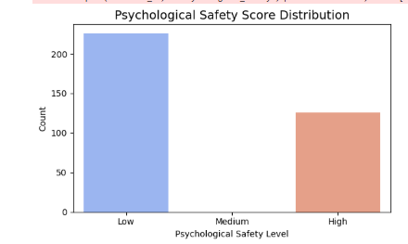
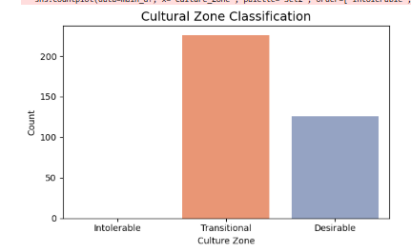
Demonstrating reporting - psychological risk index features
Feature | Weight | Reasoning
Hedging terms | 0.2 | Key linguistic signal of uncertainty
Passive voice | 0.2 | Indicator of low ownership or defensiveness
Top-3 emotion avg | 0.3 | Measures affective presence and richness
Reverse fear score | 0.15 | Fear suppresses psychological safety
Reverse blame score | 0.15 | Blame shifts suppress safety culture

Slide 23
Why use personas?
Predict class labels directly for key indicators
Model:
Pros:
Assign Persona Based on Threshold Patterns
Model:
Clean, explainable ML pipeline
Avoids confusion between style and outcome
Use:
Classifies incident reports into engagement level, psych safety level and culture zone
Post-event interpretation or visualisation only
Pros:
Makes personas an interpretive output (like an archetype)
Helps human users contextualize results (e.g. “This sounds like Mia”)
Great for training, benchmarking, and cultural coaching
Requires:
Persona definitions (e.g., thresholds for each trait)
Clustering or scoring logic to match input to closest persona
Use: Allows analysis on team dynamics and individual work styles
“ This employee’s style of report (medium for psych safety, high effort) most likely aligns with a persona like Anxious Validator”. Therefore they exhibit behaviours x and y”.
Very useful for operations and monitoring dashboards –
“This report is LOW STAFF PSYCH SAFETY + HIGH ENGAGEMENT”
Extracts psych safety + engagement features first then uses thresholds or KNN to assign persona-style label
Persona use
Notes:
Developing and using personas in modelling
Broadly, Option 1 is used for classification and Option 2 for interpretation. This meaning the model training is different
Approach adopted was to predict the indicators based on text.
Then personas were assigned as interpretive tags by comparing report outputs (in source data) to persona thresholds (pre-defined)
Option 1 example: The system assigns this report as Low Psych Safety, High Engagement — matching typical patterns seen in Kavita Rao (Avoidant Minimalist).
Option 2 example: “The style of this report (medium psych, high effort, high emotion) most closely aligns with Mia Chen (Anxious Validator).

Slide 24
Sidenote: We think about labels differently in the workplace
Industrial/Construction/Critical Infrastructure
General persona | Industry-Aligned Name | Why It Fits
Cautious Deflector | Low-Profile Operator | Reflects someone avoiding blame or visibility in a high-risk setting
Concerned Reporter | Conscientious Crew Member | Signals care, safety diligence, and a “check twice” attitude
Task-Focused Resolver | Field Fixer | Suits boots-on-ground, “get it done” technician or trade role
Procedural Communicator | Compliance-Focused Coordinator | Matches safety advisor or engineer sticking to systems
Proactive Safety Leader | Site Safety Champion | Encourages culture-building, procedural vigilance, peer leadership
Healthcare/Aged Care/Hospitals/Allied Health etc
General Persona | Industry-Aligned Name | Why It Fits
Cautious Deflector | Guarded Carer | May document for policy but hesitate to speak up
Concerned Reporter | Diligent Clinician | Someone who worries about patient outcomes, overcommunicates
Task-Focused Resolver | Practical Nurse | Does what’s needed fast, but doesn’t narrate the whole situation
Procedural Communicator | Policy-Aligned Administrator | Strong on policy, avoids judgement or interpretation
Proactive Safety Leader | Clinical Safety Champion | Leads culture of care, reporting, and reflective practice
Notes:
Human personality traits are not a fixed class
What is the science behind this?
Different industries use different terms and so the use of personas would be tailored for your organisation and culture. While there isn’t a validated list, the approach used has attempted to be:
Aligned with evidence from existing organisational and behaviour theories such as Edmonson, Kahn, Hofstede’s culture dimensions
The are language aware - and look to analyse tone, blame, hedging (I/we/our), specificity , industry phrase-alignment or structure.
Are able to be functionality useful (support dashboarding, allow for analysis of inputs into he model and training and feedback narratives in workplaces.

Slide 25
Personas are not a fixed class – they exhibit multiple combinations.
Persona name | Psychological Safety level | Work engagement level | Common linguistic traits | Example of incident writing
Cautious Reflector | Low | Low / Medium | Vague, procedural, passive voice, minimal detail, deflective, formal but non-committal | The incident was recorded in the hazard log. No further actions were deemed necessary.
Concerned Reporter | Medium | Medium / High | Verbose, uncertain tone, self-doubt, emotionally cautious, hedging, grateful, apologetic | The worker noticed a possible equipment fault and submitted a near-miss report using the digital incident platform. They're unsure if it had already been flagged but followed up to confirm.
Task-focussed Resolver | Low / Medium | Low / Medium | Terse, direct, action-focused, avoids elaboration, few emotional cues, 'just fix it' language | Found the loose panel. Reattached it with locknuts. Logged in system as maintenance complete.
Procedural Communicator | Medium | Medium | Balanced tone, procedural, policy-referencing, neutral, passive structure | During a scheduled walkthrough, a slip hazard was identified and logged in accordance with standard HIRAC procedures. Remedial work was scheduled through asset control.
Proactive Safety Leader | High | High | Confident, proactive, inclusive language ('we'), procedural precision, safety leadership cues | The team identified a pinch point on the conveyor during pre-start checks. The hazard was logged through the digital HIRAC system, immediate controls were implemented, and it was raised at the next toolbox talk.
Label vs stylistic templates that:
Express different combinations of psychological safety and engagement
Reveal how tone, effort, and risk communication can vary across roles and personalities
Are useful for showing within-person variability and testing model sensitivity.
Notes:
Human personality traits are not a fixed class
What is the science behind this?
This means that persona’s cannot (or should not) be used as static labels for indicators that provide a qualitative outcome, such as psych_safety or engagement level, and used as stylistic templates that:
Express different combinations of psychological safety and engagement
Reveal how tone, effort, and risk communication can vary across roles and personalities
Are useful for showing within-person variability and testing model sensitivity.
What is the science behind this?
Different industries use different terms and so the use of personas would be tailored for your organisation and culture. While there isn’t a validated list, the approach used has attempted to be:
Aligned with evidence from existing organisational and behaviour theories such as Edmonson, Kahn, Hofstede’s culture dimensions

Slide 26
Cultural Risk indicator
Feature Name | How It’s Derived | Notes,
persona | Derived from persona model | Maps reporter to one of the five synthetic personas
psychological_safety | Rule-based logic using modal verbs, hedging, passive voice etc. | 3-class label (Low/Medium/High)
engagement_score | Based on corrective action length and specificity score | Used to reflect effort/engagement levels
language_score | Combined avg_word_length + specificity_score | Optional feature representing linguistic sophistication and used to calculate engagement_score.
culture_zone | Derived from blend of: psych_safety, engagement_score, sentiment | 3-class label: Desirable / Transitional / Intolerable

Slide 27
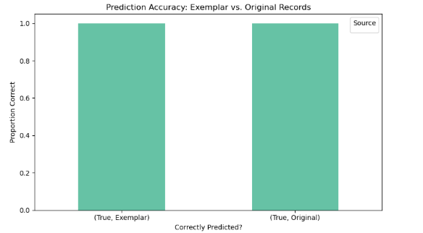
Prediction accuracy of model
Notes:
Note: I think there is an issue where possibly I didn’t concancenate “main_df["source"] = "Original“. Ran out of time ☺
I would need to rerun some cells to to visually compare performance across both datasets and see both correct and incorrect predictions:
Ensure main_df["source"] = "Original" is applied before concatenating.
Ensure model predictions are generated for both main_df and exemplar_df.
Plot the Psychological_Safety vs predicted_psych_safety using .value_counts() per group.
Only True under “Exemplar” appears:
The model correctly predicted 100% of the exemplar records.
That's a strong signal that your exemplars are:
Internally consistent
Well-aligned with the model’s logic
Potentially overfitting (i.e., too easy to predict due to strong patterns

Slide 28
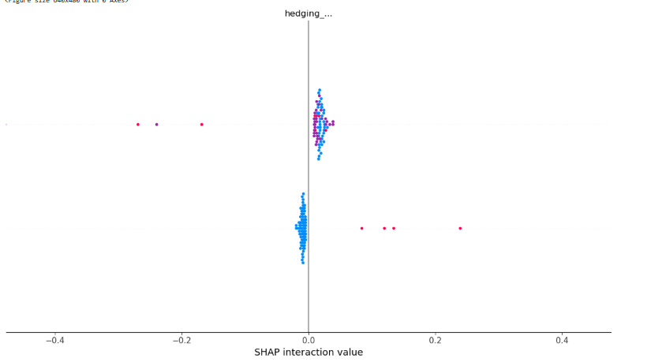
SHAP value – overall feature impact
Notes:
Don’t show this. You pulled out the wrong SHAP with only one feature.

Slide 29
Overview of the ‘hybrid’ model – simple example
“The worker submitted a report and hoped someone would review it soon.”
Hybrid scoring breakdown
Feature | Detected Signal | Score / Impact
Hedging terms | "hoped" is a hedging/emotional softener | 1 (positive for uncertainty)
Passive voice | Passive structure implied ("would review it") | 1
Specificity score | Low — no detail on the incident, only outcome hope | 0.2
Corrective action present? | None present | 0
Average word length (average of 3 fields – incident, proposed corrective action, corrective action taken) | Moderate (formal tone, neutral indicator) | Neutral
Feature | Detected Signal | Score / Impact
Dominant emotion | Matches surface tone detects hope, uncertainty, maybe anxiety, possibly emotional trust | Moderate
Average of top 3 emotions | Moderate (Hope, Curiosity, Optimism) | 0.45
Sentiment Score | No strong polarity | Neutral
Emotion model
Classification Result
Dimension | Predicted Class | Rationale
Psychological Safety | Medium | Expresses concern about being heard; not fearful, but not confident
Engagement | Medium / High | The worker followed procedure, used system, and demonstrated emotional follow-up effort
Persona Match | Concerned Reporter | Verbose, polite, emotionally tentative

Slide 30
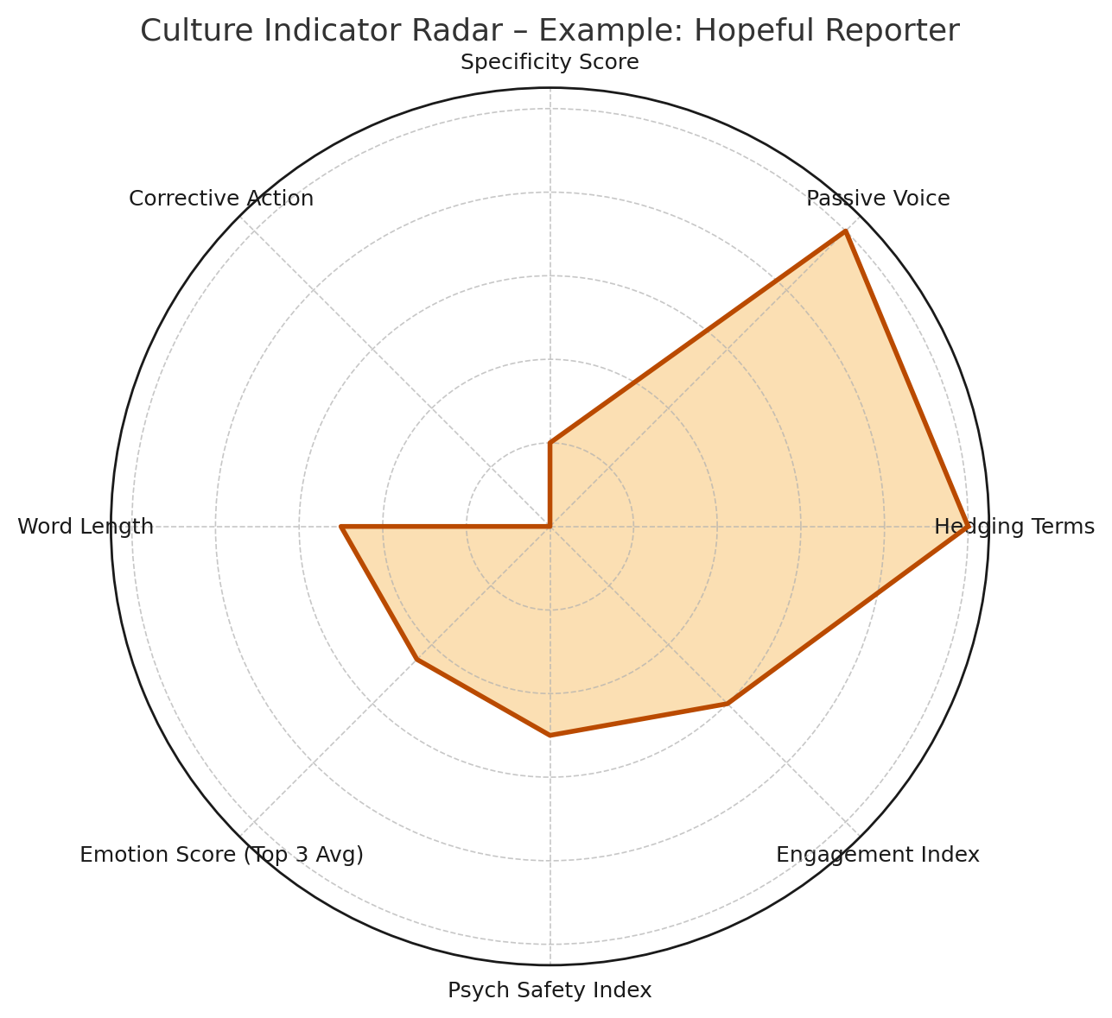
Overview of the ‘hybrid’ model – simple example (cont’d)
“The worker submitted a report and hoped someone would review it soon.”
Incident:
Date:
Concerned Reporter
Analysis of incident report and strengths and gaps across the key cultural features:
High on: Passive voice, hedging terms (signals uncertainty)
Low on: Corrective action and specificity (signals lack of procedural detail)
Mid-range: Emotion, psychological safety, and engagement scores
This balanced, slightly hesitant profile aligns with a "Medium Psychological Safety" and "Concerned Reporter" persona.
Feature | Score / Value
Hedging Terms | 1
Passive Voice | 1
Specificity Score | 0.2
Corrective Action | 0
Word Length | 0.5
Emotion Score (Top 3 Avg) | 0.45
Psych Safety Index | 0.5
Engagement Index | 0.6

Slide 31
Overview of the ‘hybrid’ model– not so-simple example
“The equipment was inspected following the incident, and corrective measures were taken. The worker noted that similar issues had been raised before but were not escalated.”
Feature | Detected Signal | Score / Impact
Hedging terms | None directly (but implied concern) | 0
Passive voice | Indicates low agency (“were taken:, “were not escalated” | 2
Specific action | Moderate – provides action detail | ~ 0.5
Corrective action present | Suggests procedural diligence – (corrective measures were taken) | ~ 6
Average word length (average of 3 fields – incident, proposed corrective action, corrective action taken) – proxy for engagement level | formal tone, neutral indicator | ~ 5.4
Hybrid scoring breakdown
Emotion model (RoBERTa-
GoEmotions)
Feature | Detected Signal | Score / Impact
Dominant emotion | Matches surface tone detects hope, uncertainty, maybe anxiety, possibly emotional trust | Disappointment
Average of top 3 emotions | Emotionally rich (affectively clear) – High (Concern, disappointment, fear) | 0.72
Sentiment Score | Weak signal – model ignored | Neutral/slightly negative
Classification Result
Dimension | Predicted Class | Rationale
Psychological Safety | Medium | Trust has been eroded by not withdrawn; historical issues raised/written in report suggests damaged trust
Engagement | High | The worker followed process, reported issue again
Persona Match | Proactive Safety Leader | Shows initiative despite cultural barriers

Slide 32
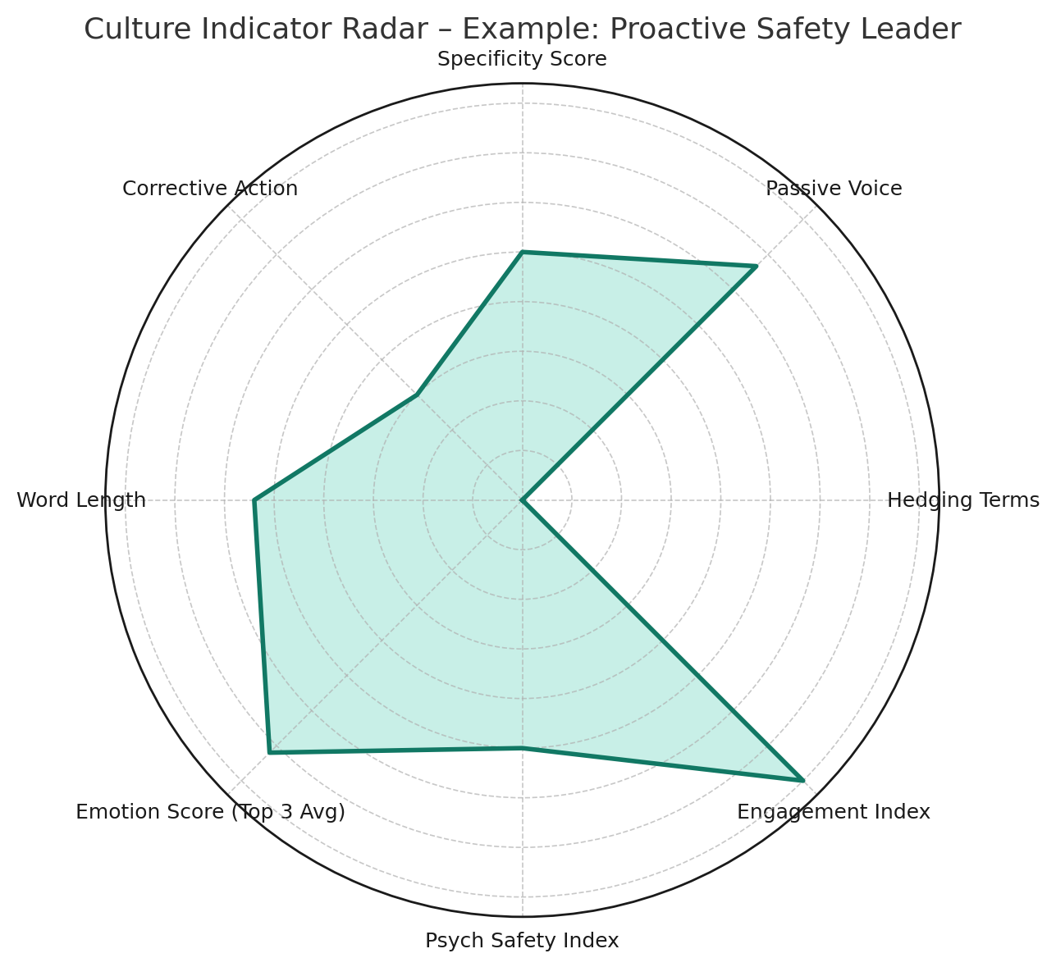
Overview of the ‘hybrid’ model– not so-simple example (cont’d)
“The equipment was inspected following the incident, and corrective measures were taken. The worker noted that similar issues had been raised before but were not escalated.”
Incident:
Date:
Proactive Safety Leader
This report reflects a clear, confident reporting style with procedural detail and emotional clarity.
Analysis of incident report and strengths and gaps across the key cultural features:
High on:
Engagement Index (0.6) – strong procedural follow-through
Corrective Action – multiple steps taken to resolve the issue
Emotion Score (Top 3 Avg) – affective clarity with concern, disappointment, and fear
Word Length – longer entries suggesting care and professionalism
Feature | Score / Value
Hedging Terms | 1
Passive Voice | 1
Specificity Score | 0.2
Corrective Action | 0
Word Length | 0.5
Emotion Score (Top 3 Avg) | 0.45
Psych Safety Index | 0.5
Engagement Index | 0.6
Moderate to Low on:
Passive Voice – slight use (“were taken”), signals some detachment or reporting habit
Specificity Score – moderate (0.5), provides some action detail but not highly granular
Hedging Terms – none used, indicating strong conviction or confidence
Psychological Safety – scored Medium, suggesting lingering trust concerns due to unresolved prior issues
This balanced, slightly hesitant profile aligns with a "Medium Psychological Safety" and "Concerned Reporter" persona.

Slide 33
Post project reflection
Lessons learnt
Unexpected insights

Slide 34
Lessons learned
Language is rich but ambiguous
Feature engineering matters more than model complexity
Explainability is essential for trust
Synthetic data can support rigorous prototyping
Handcrafted features such as passive voice, hedging, and pronoun usage proved effective in predicting psychological safety, but only when carefully contextualised.
The Random Forest model significantly outperformed, TF-IDF logistic regression, not because of algorithmic superiority, but due to (I’d like think) thoughtful, theory-driven feature design. This confirmed the value of domain expertise in AI applications – of which I probably need a lot more
SHAP and visual tools like word clouds provided transparency into model behaviour.
With privacy constraints in real WHS reporting, the use of well-designed personas and generated incident narratives enabled full pipeline development without compromising ethics.
Corporate language is domain specific but not noisy. Which made sentiment style analysis difficult and therefore needed a more novel approach.
This was essential is assessing prototype design.
Potentially however, these visuals are essential in these types of analysis to make the insights accessible and meaningful to non-technical stakeholders—a critical factor for projects looking to improve and uplift governance and ensuring ethical and safe AI use.
Not all tentative language reflects low safety—sometimes it's simply cautious professionalism.
Notes:
Practical take-aways project
Position emotion metrics as leading indicators that complement (not replace) classical risk scores.
Emphasise the explainability of hybrid models—you can show which linguistic features (passive voice, hedging, blame terms) drive a low psychological-safety score.
Leverage personas to demonstrate how different communication styles map to different risk profiles; this makes the numbers relatable to non-data audiences.

Slide 35
Unexpected insights
Medium safety reports were the most revealing
Emotion signals often contradicted tone
High effort doesn't always mean high safety
Surprisingly, some longer reports (noting that the test data was not ‘long’ by definition) were associated with lower psychological safety, especially when filled with procedural language and hedging—suggesting a “cover-your-back” writing style rather than genuine engagement.
Some reports that appeared “neutral” on the surface contained hidden emotional signals (e.g., fear or guilt) when modelled with RoBERTa. This highlighted the limitations of sentiment analysis and the importance of multi-dimensional emotion detection.
Reports classified as “Medium” consistently exhibited subtle forms of defensive or self-protective behaviour—not overt fear or disengagement, but a careful balance of compliance, caution, and hopefulness. This “grey zone” appears to hold key signals of emerging cultural risk.

Slide 36

References
Blei, D. M., Ng, A. Y., & Jordan, M. I. (2003). Latent Dirichlet Allocation. Journal of Machine Learning Research, 3, 993–1022.
Demszky, D et al. GoEmotions: A Dataset of Fine-Grained Emotions. Computer Science submission, submitted 1 May 2020. arXiv:2005.00547 https://doi.org/10.48550/arXiv.2005.00547
Doshi-Velez, F., & Kim, B. (2017). Towards a rigorous science of interpretable machine learning. arXiv preprint arXiv:1702.08608.
Edmondson, A. C. (1999). Psychological safety and learning behavior in work teams. Administrative Science Quarterly, 44(2), 350–383. https://doi.org/10.2307/2666999
Frazier, M. L., Fainshmidt, S., Klinger, R. L., Pezeshkan, A., & Vracheva, V. (2017). Psychological safety: A meta-analytic review and extension. Personnel Psychology, 70(1), 113–165. https://doi.org/10.1111/peps.12183
Hutto, C. J., & Gilbert, E. (2014). VADER: A Parsimonious Rule-based Model for Sentiment Analysis of Social Media Text. Proceedings of the 8th International AAAI Conference on Weblogs and Social Media (ICWSM-14).
Filho, AP (November 2012). Safety Culture Maturity and Risk Management Maturity in Industrial Organisations. Proceedings of the Conference: International Conference on Industrial Engineering and Operations Management Portugal
Safework Australia Welcome | Safe Work Australia. Accessed 3 April 2025.
Work health and safety data reporting. Work health and safety data reporting | dataswa. Accessed 15 April 2025.
Notes:
Key references

Slide 37
Questions
Thank you!

