Slide 1
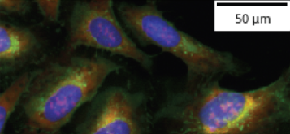
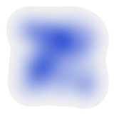
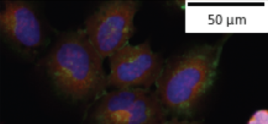






A
Microscopy images
B
Causal relations
C
Representation
learning
D
Batch correction
E
Phenotype
estimation
Control cells
Intervention:
Treatment
Outcome:
Phenotype
T
Y
T
50 μm
CNN
C
Y
Treated cells
50 μm
C
O
O
Confounders:
e.g. batch effects
Observation:
Images
F
Cell Painting CNN
G
Evaluation of the biological matching task
Query treatment
List of top results
?
Folds of enrichment
Mean Average Precision
Cell Painting channels
EfficientNet
Single-cell features
Adapted from Moshkov et al., Nature Communications 15, 1594 (2024), Fig. 1. DOI: 10.1038/s41467-024-45999-1. CC BY 4.0.
Editable reconstruction; source microscopy, density and feature-vector crops retained. https://creativecommons.org/licenses/by/4.0/
Notes:
Source: Moshkov, N., Bornholdt, M., Benoit, S. et al. Learning representations for image-based profiling of perturbations. Nature Communications 15, 1594 (2024). Figure 1: Framework for analyzing image-based profiling experiments. https://doi.org/10.1038/s41467-024-45999-1
Original figure: https://media.springernature.com/full/springer-static/image/art%3A10.1038%2Fs41467-024-45999-1/MediaObjects/41467_2024_45999_Fig1_HTML.png
Licence: Creative Commons Attribution 4.0 International, https://creativecommons.org/licenses/by/4.0/ .
Changes: labels, nodes, arrows, qualitative contours, CNN blocks and matching symbols reconstructed as native editable PowerPoint objects; source microscopy images, density field and feature vector retained as ten independent image crops. No new scientific measurements or model results generated. Typography and schematic geometry have minor differences from the original. The original panels A-G are retained in full; attribution occupies an added footer.

