Slide 1
Project #2: Visualize Me Captain!
Week 18
The Data Bootcamp |
2018

Slide 2
Requirements
Notes:
It’s important to keep in mind why you joined this class. Let’s talk about your goals.

Slide 3
Project Description
For this second project, your task will be to "tell a story" through data visualizations.
Unlike the first project, where you focused on using the "Analytics Paradigm" to explore relationships in "report form", this project should be more focused on providing users an interactive means to explore data themselves.
Just as with the first project, you will be asked to conduct a 10 minute presentation that lays out your theme, coding approach, data munging techniques, and final visualization.
You may choose a project of any theme, but we encourage you to think broadly. The universe is wide and expansive. Don't limit yourself to what you know.
You will have two weeks to complete this project.

Slide 4
Specific Requirements
Your visualization must include a Python Flask powered RESTful API, HTML/CSS, JavaScript, and at least one database (MySQL, MongoDB, SQLite, etc.)
Your project should fall into one of the below four tracks:
A custom "creative" D3.js project (i.e. non-standard graph or chart)
A combination of Web Scraping and Leaflet or Plotly
A dashboard page with multiple charts all updating from the same data
A "thick" server that performs multiple manipulations on data in a database prior to visualization (must be approved)
Your project should include at least one JS library that we did not cover.
Your project must be powered by a dataset with at least 100 records.
Your project must include some level of user-driven interaction (e.g. menus, dropdowns, textboxes, etc.)
Your final visualization should ideally include at least three views

Slide 5
Groups
There will be 4 groups of 5 or 6 students each.

Slide 6
Schedule
Notes:
It’s important to keep in mind why you joined this class. Let’s talk about your goals.

Slide 7
Weekly Schedule
Today, Thursday May 17: Between now and Saturday, you will need to start brainstorming topics with your group and researching potential datasets. Your focus should specifically center around:
Selecting a Topic
Finding a Dataset
Finding Inspiration
"Sketching" your ideal visuals
Creating a 1-Page Proposal
End-of-Class Next class session (Saturday May 19): You will need to create a 1 page proposal. The proposal should include:
A brief articulation of your chosen topic and rationale
A link to your dataset(s) and a screenshot of the metadata if it exists.
3-4 screenshots of relevant "inspiring" visualizations that frame your creative fodder
A sketch of the final design
A link to the primary GitHub repository you'll be housing your work in
Next week: project work and short intros to machine learning.

Slide 8
Schedule continued
Week of May 22 Tues, May 24 Thurs: project work.
May 26 Saturday and May 29 Tuesday there is a holiday (no class!).
May 31 Thurs project work
June 2 Saturday no class again!
Project presentations June 5 Tues.

Slide 9
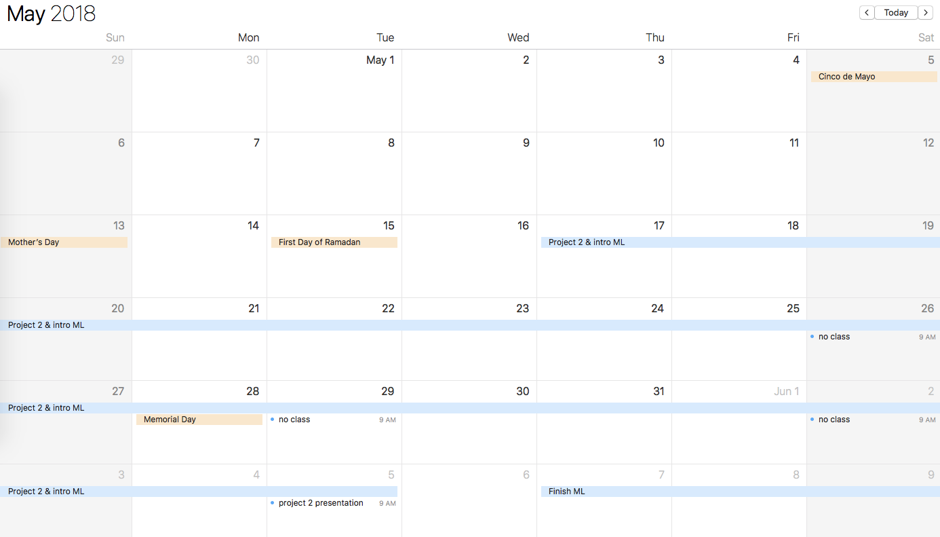
Calendar

