Slide 1
Data Science to Market a Backlisted Book on Social Media.
Laura Waggaman

Slide 2

Tiktok. Opportunity
“Crying on tiktok sells books.”
The New York Times
“Tiktok’s reading renaissance is making is making old books best bessels.”
Business Insider
“Tiktok is taking the book industry by storm”
NBC News
“BookTok has passion - and enormous marketing power”
The Economist
“Booktok is a new force driving book sales and publishing deals”
NPR

Slide 3
On The Jellicoe Road. Problem
Melina Marchetta
Predict Influencers’ Opinions
“Man, the author is lucky that books don't have hotlines where you can phone in to complain about your lack of customer satisfaction, because I'd be on the line right now, saying, "Dafuque-ce que c'est? Comme ça.”
-★
“It frustrates me so much to know that I can never do this book justice. That so many readers out there have yet to read this beauty.”
- ★★★★★

Slide 4

Data
Design
Reviews of target book.
Past reviews of the reviewers.
Data of books featured in past reviews.
Classification Model
Observations:
Each reviewer.
Target:
1 - Did like the book (4-5★)
0 - Did not like the book (1-3 ★)

Slide 5
Features
Reviewer
Rating Bias (tend to rate low/high).
Rating vs book’s avg rating.
Avg # books read
Avg length books read
Avg # ratings in books read (popularity)

Slide 6


Features
Granularity / Subgenres
Nr Books read
Difference from avg rating
Difference from median rating
Percentile location of their rating within rating distribution
Each book has 10
subgenres
Very different Books:
Young Adult - Romance
Romance / Historical Fiction
Historical Fiction - Horror.

Slide 7
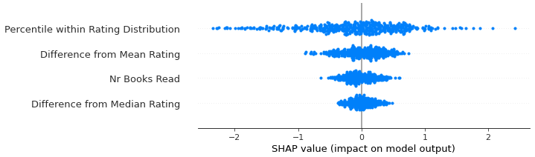
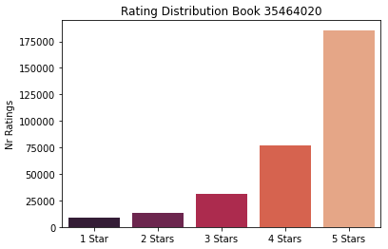
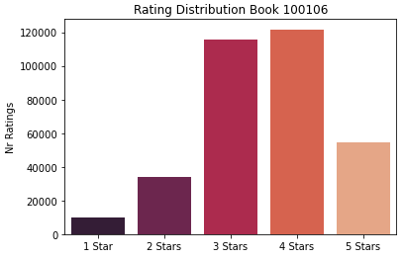
Books’ Rating Distribution
Percentile - .71
Popular opinion
Percentile - .92
Not popular opinion.
5 Stars
Same Rating

Slide 8
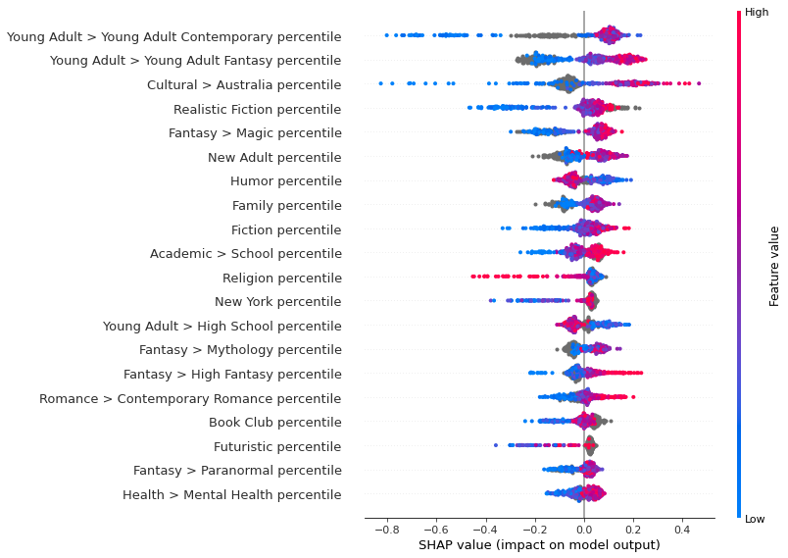
Insights

Slide 9
Metrics
Test Set - .64 F1
Adjust Threshold 80%:
Precision: .81
Recall: .23
Validation Set - .65 F1
Adjust Threshold 80%:
Precision: .85
Recall: .07

Slide 10
The following slides were added after the presentation.

Slide 11
Performance. Solution
85% of readers assigned to the positive class liked the book*. Author can start mailing hardcopies with confidence that the initial impression of content in the app will be +.
*With adjusted threshold

Slide 12
Potential Applications
Model can be converted into a pipeline, where given a book’s ID, it can scrape its data and train a model on its readers’ characteristics.
Users can get important insights about who their target readers are and deduce whether or not to send a hardcopy to a particular Booktoker given their Goodreads ID (GR profile link is usually linked in their bios).

Slide 13
Future Work
Model Performance can be improved, and there is more exploration to be done. There is a lot of potential in the data and field. Different scales, further filtering of the genres, some of the features dropped due to lack of separability to be tested in ‘buckets’. Unsupervised learning. NLP on the reviews’ text.

