Slide 1
Project 1
Lauren Greenwood

Slide 2
Which Property Types receive the most positive reviews?
Prompt 2

Slide 3
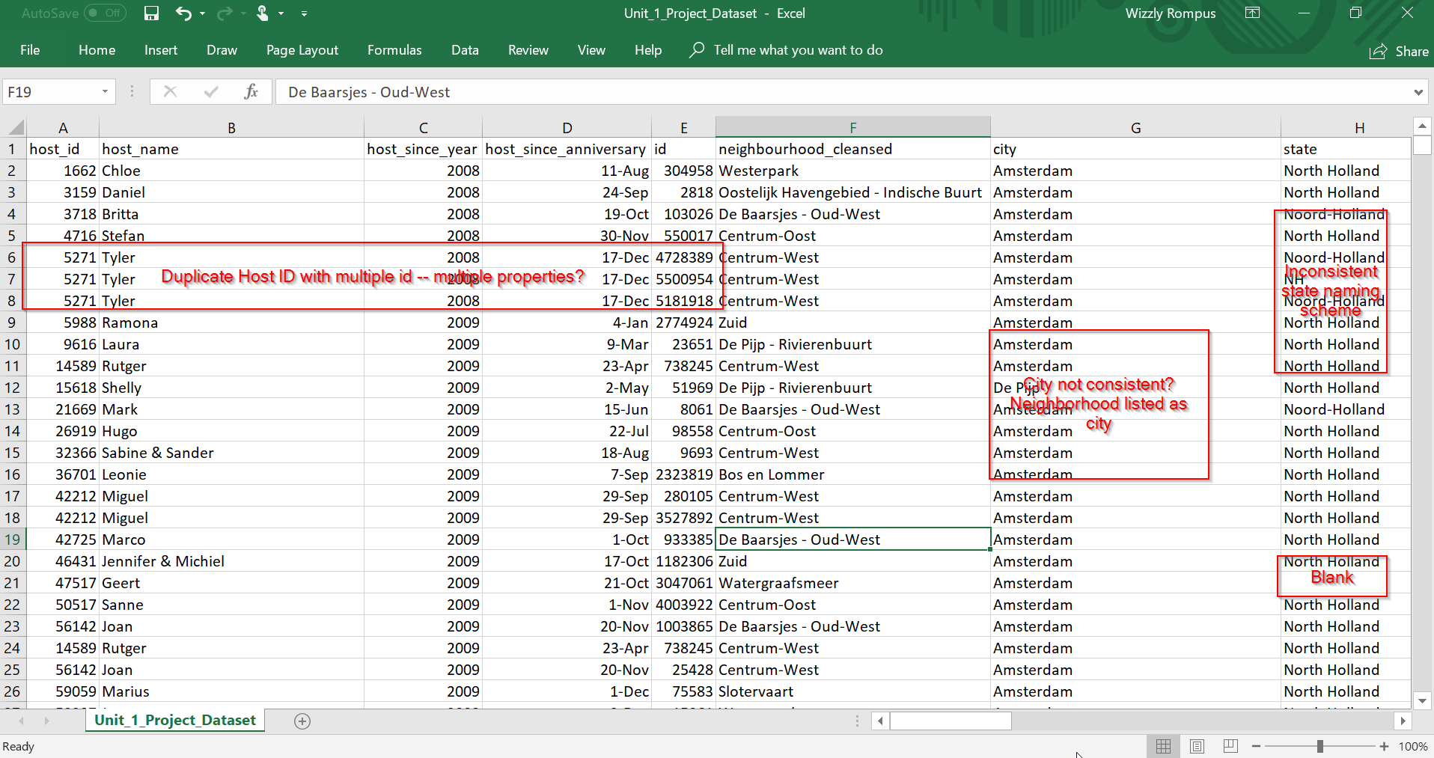
First impressions (Initial EDA)
Inconsistencies
Column relationships
Unnecessary columns

Slide 4
Understanding the Data
Identified 4 main groupings of columns (and used Freeze Panes to freeze top row!)
Host information
Location Information
Rental information
Rating information
KEY NOTE: At no point does it say how many total bookings are represented per row

Slide 5
Understanding the Data
Questions
Does ID correspond to property Id?
Is ID unique?
Is neighborhood_cleansed actually clean? Can it be used for validating non “Amsterdam” names in City field?
City is not just “Amsterdam” – how many represent properties actually IN ADam (i.e. listing has Neighborhood as City as in line 12)
Above is also true for State – which of these constitute a valid listing?
How do Dutch zip codes work? How well do zips correlate to neighborhood? Is this an important data point? Should the data be presented by Zip first and Neighborhood second, despite the original request?
Do all neighborhoods have both houses and apartments?
What defines accommodates? Does beds mean beds per room or beds total? How do 6 people fit in 2 beds (line 6)?
If a property accommodates more guests than are included in the base rate, does that affect booking rates? Should cost per be based on accommodation rate or base guests?
If Extra People = 0 does that mean they are additional people are free, or that no additional people are allowed? Does it matter?
How does response rate correlate to other factors, particularly overall score?
Number of reviews is difficult to read as total stays is unknown, but what would it matter if the number of stays were known?
What about the effect of squeezing more beds in the rooms (dependent)
Notes
Total bookings data point is missing
There are duplicate host_ids
Hostname is probably not a useful column
Host since year and anniversary should be combined into a single date
Country column is cleanly Netherlands with no blanks
Latitude and Longitude are probably irrelevant, but could help in validating location city/state and maybe zip data
Lat/long probably do not need ~20 sig figs
Effect of property type (and room type) on $$
Number of reviews can help determine weight of review scores, i.e. 1 5-star review should weigh less than 100 5-star reviews
Need to understand fully what the review categories are pointing to. Comparing value to per night may point to what is considered a “good value” per neighborhood

Slide 6
Key Questions
Does id correspond to property Id? If so, is it supposed to be unique?
Does beds mean beds per room or beds total? How do 6 people fit in 2 beds (line 6)? (Ignore?)
If a property accommodates more guests than are included in the base rate, should cost per night be based on accommodation rate or base guests?

Slide 7
Need metadata sheet
Descriptive stats
Anomalies
Possibly data dictionary

Slide 8
Planned Steps
Step 1: Clean Data
Step 2: Analyze Data
Step 3: Gather Insight
Step 4: Present Data

Slide 9
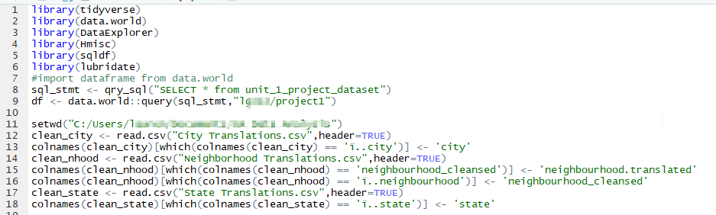
Importing Data
Libraries:
Also set working directory and imported cleaned CSVs of city,etc. data
Renamed some columns to make Match easier later (all done in R)

Slide 10
Cleaning Data
Duplicates
NA/NaN values
dupes <- df[duplicated(df$id)|duplicated(df$id, fromLast = TRUE),] %>% arrange(desc(id))
confirmed duplication; removed from data set
Per instructions, remove all rows with zero reviews
Removed all 14 rows with NaN (in Ratings)
Removed rows where Bathrooms or Bedrooms was NA due to time constraint (49 rows)

Slide 11
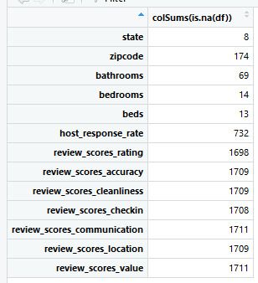
Dealing with NA values
Subset list to only include columns with NA values for easier analysis
State handled with FE
Zip handled with FE
Bathrooms/Bedrooms/Beds ignored
Host response rate imputed to 0
NA/NaN reviews ignored per scope of project

Slide 12
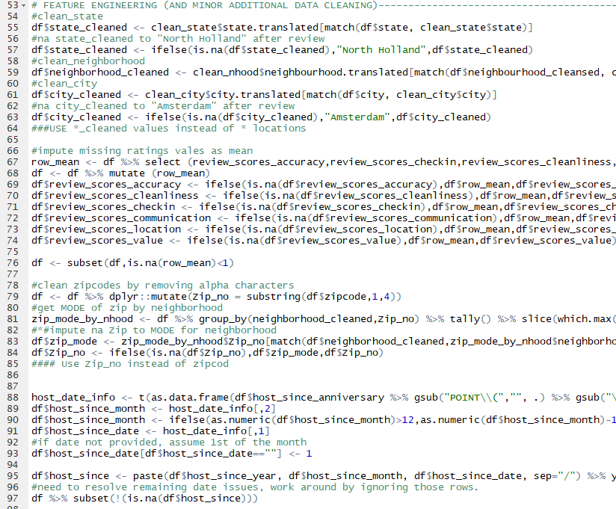
Feature Engineering
R “VLOOKUP” via Match : Clean city/state/nhood data
FE new ZIP column (digits only) -imputed NA as Mode of ZIP wrt Neighborhood
Tally/slice
Host date POINT nightmare
Calculating Revenue

Slide 13
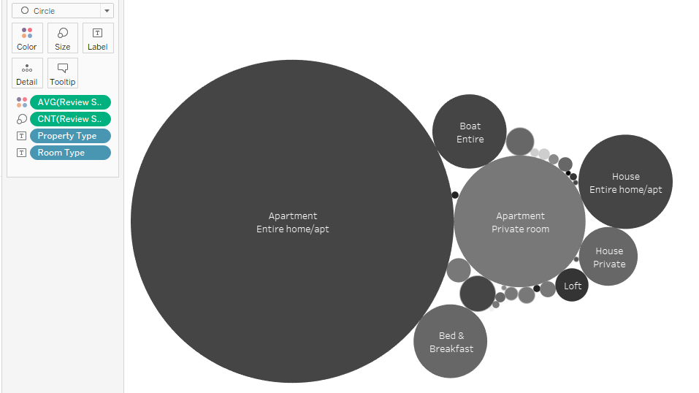

So what is the answer?

Slide 14
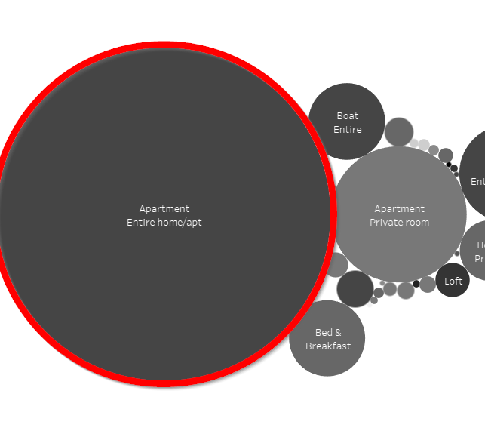
Which property types get the most positive reviews?
Size: Larger = more reviews
Color: Darker = better review
Darker && Larger = most positive review
https://public.tableau.com/profile/lg1798#!/vizhome/Project1_672/HMAVGREVPTRT2?publish=yes

Slide 15
What’s next ?
Time Constraints
More charts!
Better NA cleaning in R
Include zero reviews at 50% weight
Include Geodata on Public Transport stops and Revenue as a function of proximity
Scrape A-dam house price data per zip/neighborhood for full recommendation on where to purchase a house for use as an AirBnB – considering the fact that the house needs to be purchased first!

