Slide 1
Strategic data analytics in telecom companies Data Science in Context presentation
Presented by Lwin Shwe

Slide 2
Overview
Introduction
Network Optimization
Churn Prediction
Price Optimization
Targeted Marketing
Fraud Detection and Prevention
Product and Service Innovation
Preventive diagnostics
Recommendation Engines
Business Growth
Conclusions

Slide 3
Introduction
Data science is becoming a more integral part of the business world in all aspects.
With the increasing use of Internet of Things (IoT) devices, there has been a surge in the amount of data flowing through the networks of telecom operators.
We need to rapidly store, process and extract useful insights from the available data.
Data Strategies can help telecom companies increase profitability by helping optimize network usage and services, enhance customer experience, and improve security.
With the right data analytics approach, telecommunication companies can dramatically improve their services and retain more loyal customers

Slide 4
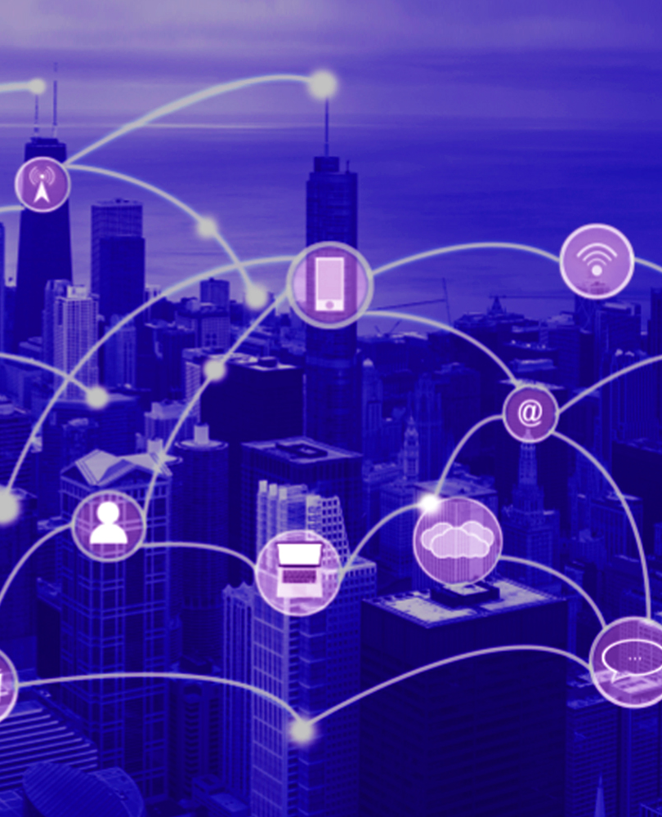
Network Optimization
Backbone of business, connecting to customers, partners, and employees across the globe
Refers to the tools, techniques, and best practices used to monitor and improve network performance
With real-time data analytics, telecom providers can determine
highly congested areas
Provide premium network bandwidth
Faster data communication through networks

Slide 5
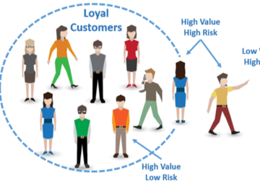
Churn Prediction
Based on user behavior and usage in customer data base
Identify at-risk customers
Identify pain points and friction across the customer journey
Identify strategies to lower churn and increase retention rates.
Monitor and manage any drop in service performance
Build a better network behavior

Slide 6
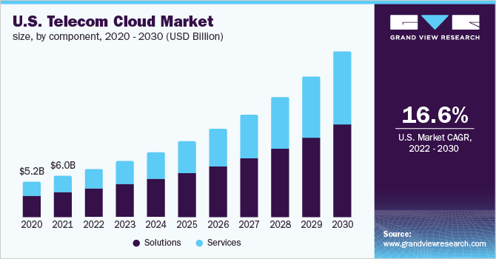
Price Optimization
Create optimal pricing strategies
Accurate data insights
Analyze customers’ reactions
Purchase history
Competitor pricing
Retain loyal customers

Slide 7
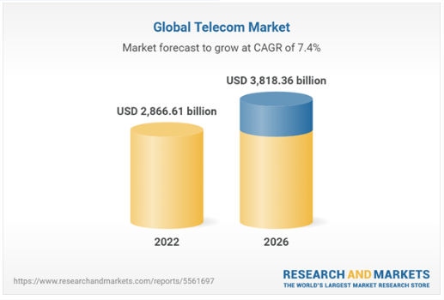
Targeted Marketing
Analytical data outcomes understand customer behavior
Review how they use the services offered by the telecom
Analysis of purchase history, service preferences, and customer feedback
Enables customized product offering to target the right audience at the right time

Slide 8
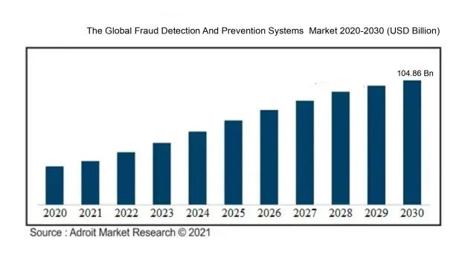
Fraud Detection and Prevention
Telcos annually lose approximately 2.8% of their revenues to leakage and fraud
Cost the industry approximately US $40 billion every year
Protect the telecommunication industry against such fraud
Prevent from cybercriminals and intercept spam mailings and calls

Slide 9

Product and Service Innovation
Ensure the product’s high-quality performance according to the customer’s requirement
Create data-driven product innovative process, internal feedback, and marketing intelligence
Analyze customer usage to develop new and innovative products
Serve users’ needs, cost effective and save money

Slide 10
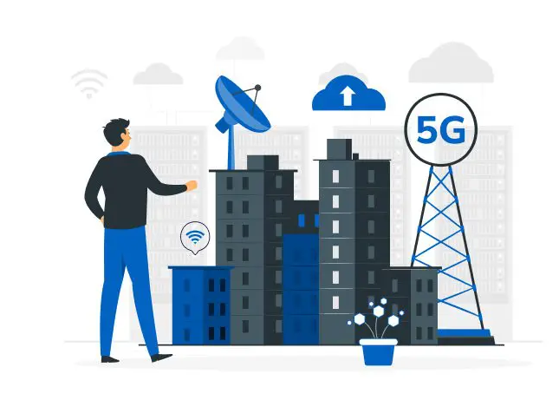
Preventive Diagnostics
Identify patterns of system behavior
Sense the occurrence of failures
Determine the causes of such failures
Early diagnosis plan preventive maintenance
Replace and repair network equipment

Slide 11
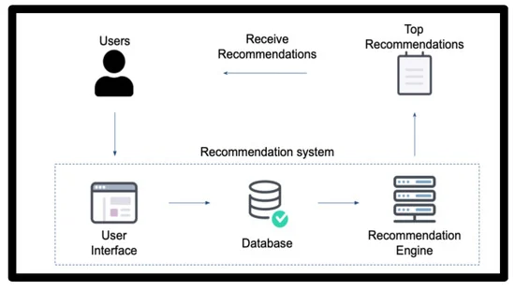
Recommendation Engines
A set of smart algorithms that indicates the customer’s behavior
It predicts the future needs of customers and market demand
Content-based filtering shows the relationship between the customer profile and the product or service of customer choice
Collaborative filtering analyze data according to the user’s preferences and behavior

Slide 12
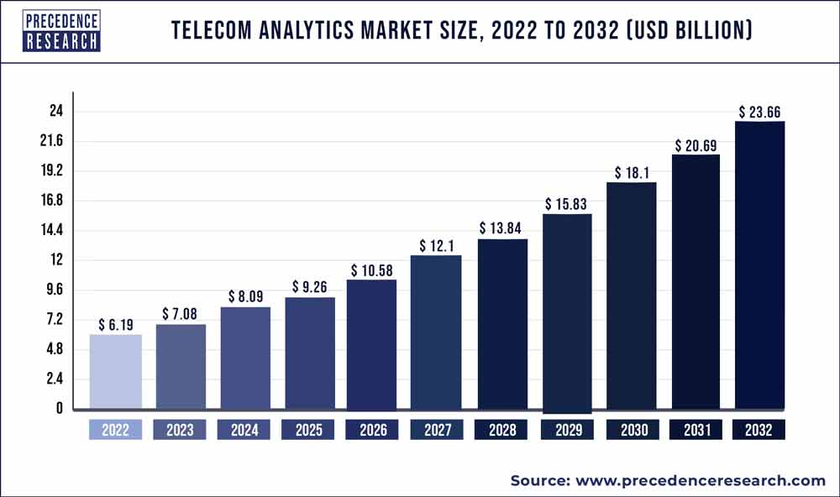
Business Growth
Widespread adoption of 5G technology, enabling faster speeds, lower latency, and increased network capacity
Analytics to optimize network performance, personalize services, and create new revenue streams
Improving customer experience by gaining deep insights into customer behavior and preferences
Identify potential upselling and cross-selling opportunities by understanding customer preferences and usage patterns
Personalized recommendations, providers can increase revenue streams and drive customer loyalty

Slide 13
Conclusions
The strategic data analytics in telecom sector is the process of collecting, analyzing, and interpreting vast amounts of data generated within the telecommunications industry.
This data may come from various sources, such as network equipment, customer interactions, billing systems, and other operational processes.
The ultimate outcome of telecom analytics is to derive valuable insights and actionable intelligence from the data to improve operational efficiency, enhance customer experience, and drive business decision-making for all stakeholders.

Slide 14


