Slide 1
Project Tracking & Requirement Gathering and Analysis
Subject Name: Applications Development Project Subject Code: APDP201
Lecturer Name : Freedom Khubisa
Department : Information Technology

Slide 2
Objectives
Explain and compare Gantt Charts and Kanban Boards for effective project tracking and task management.
Create and interpret a Gantt Chart and a Kanban Board using appropriate project scenarios.
Apply Design Thinking to gather user-centered functional and non-functional requirements.
Differentiate and document functional vs non-functional requirements with real-world examples. (Use UML Diagrams)
Lesson Outline

Slide 3
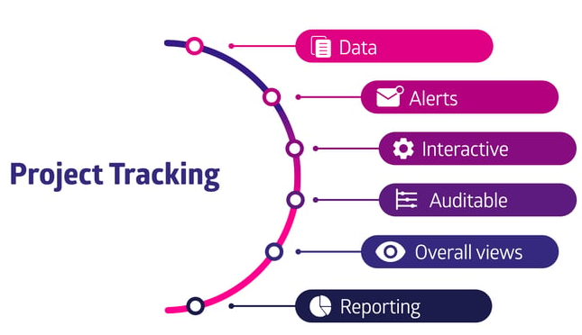
Project tracking
Project tracking ensures that a project progresses on schedule, within budget, and aligned with goals.
It involves monitoring tasks, timelines, responsibilities, and milestones.

Slide 4
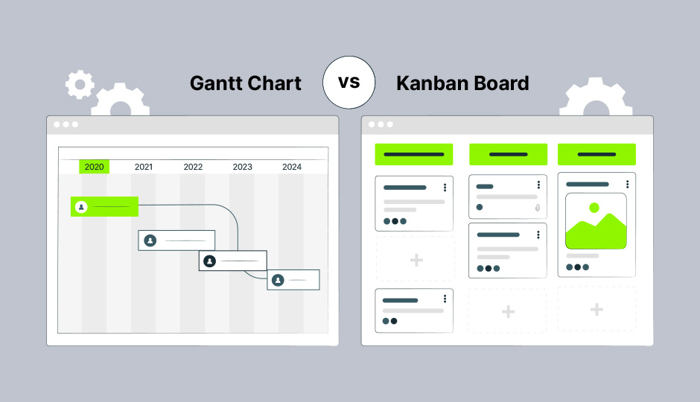
Gantt Chart & Kanban Board
A timeline-based visual representation of project tasks.
Shows start/end dates, duration, and dependencies.
A visual workflow tool divided into columns such as: To Do, In Progress, and Done
Great for Agile teams
Promotes flexibility and real-time updates

Slide 5
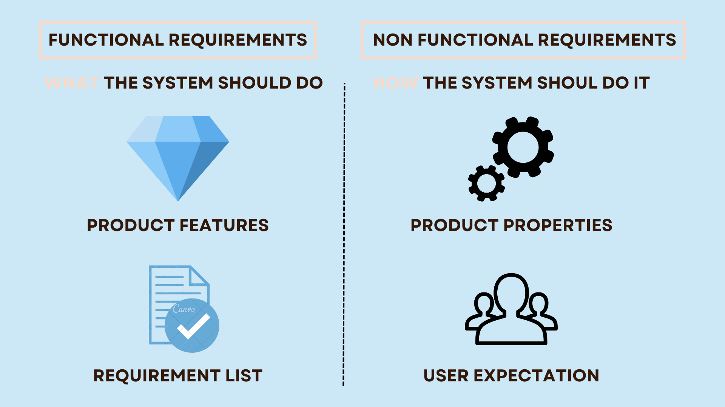
Requirements gathering basics
First step in the software development lifecycle
Focuses on identifying what users need and expect
Divided into:
  Functional Requirements (What the system must do)
  Non-Functional Requirements (Performance, usability, security)

Slide 6
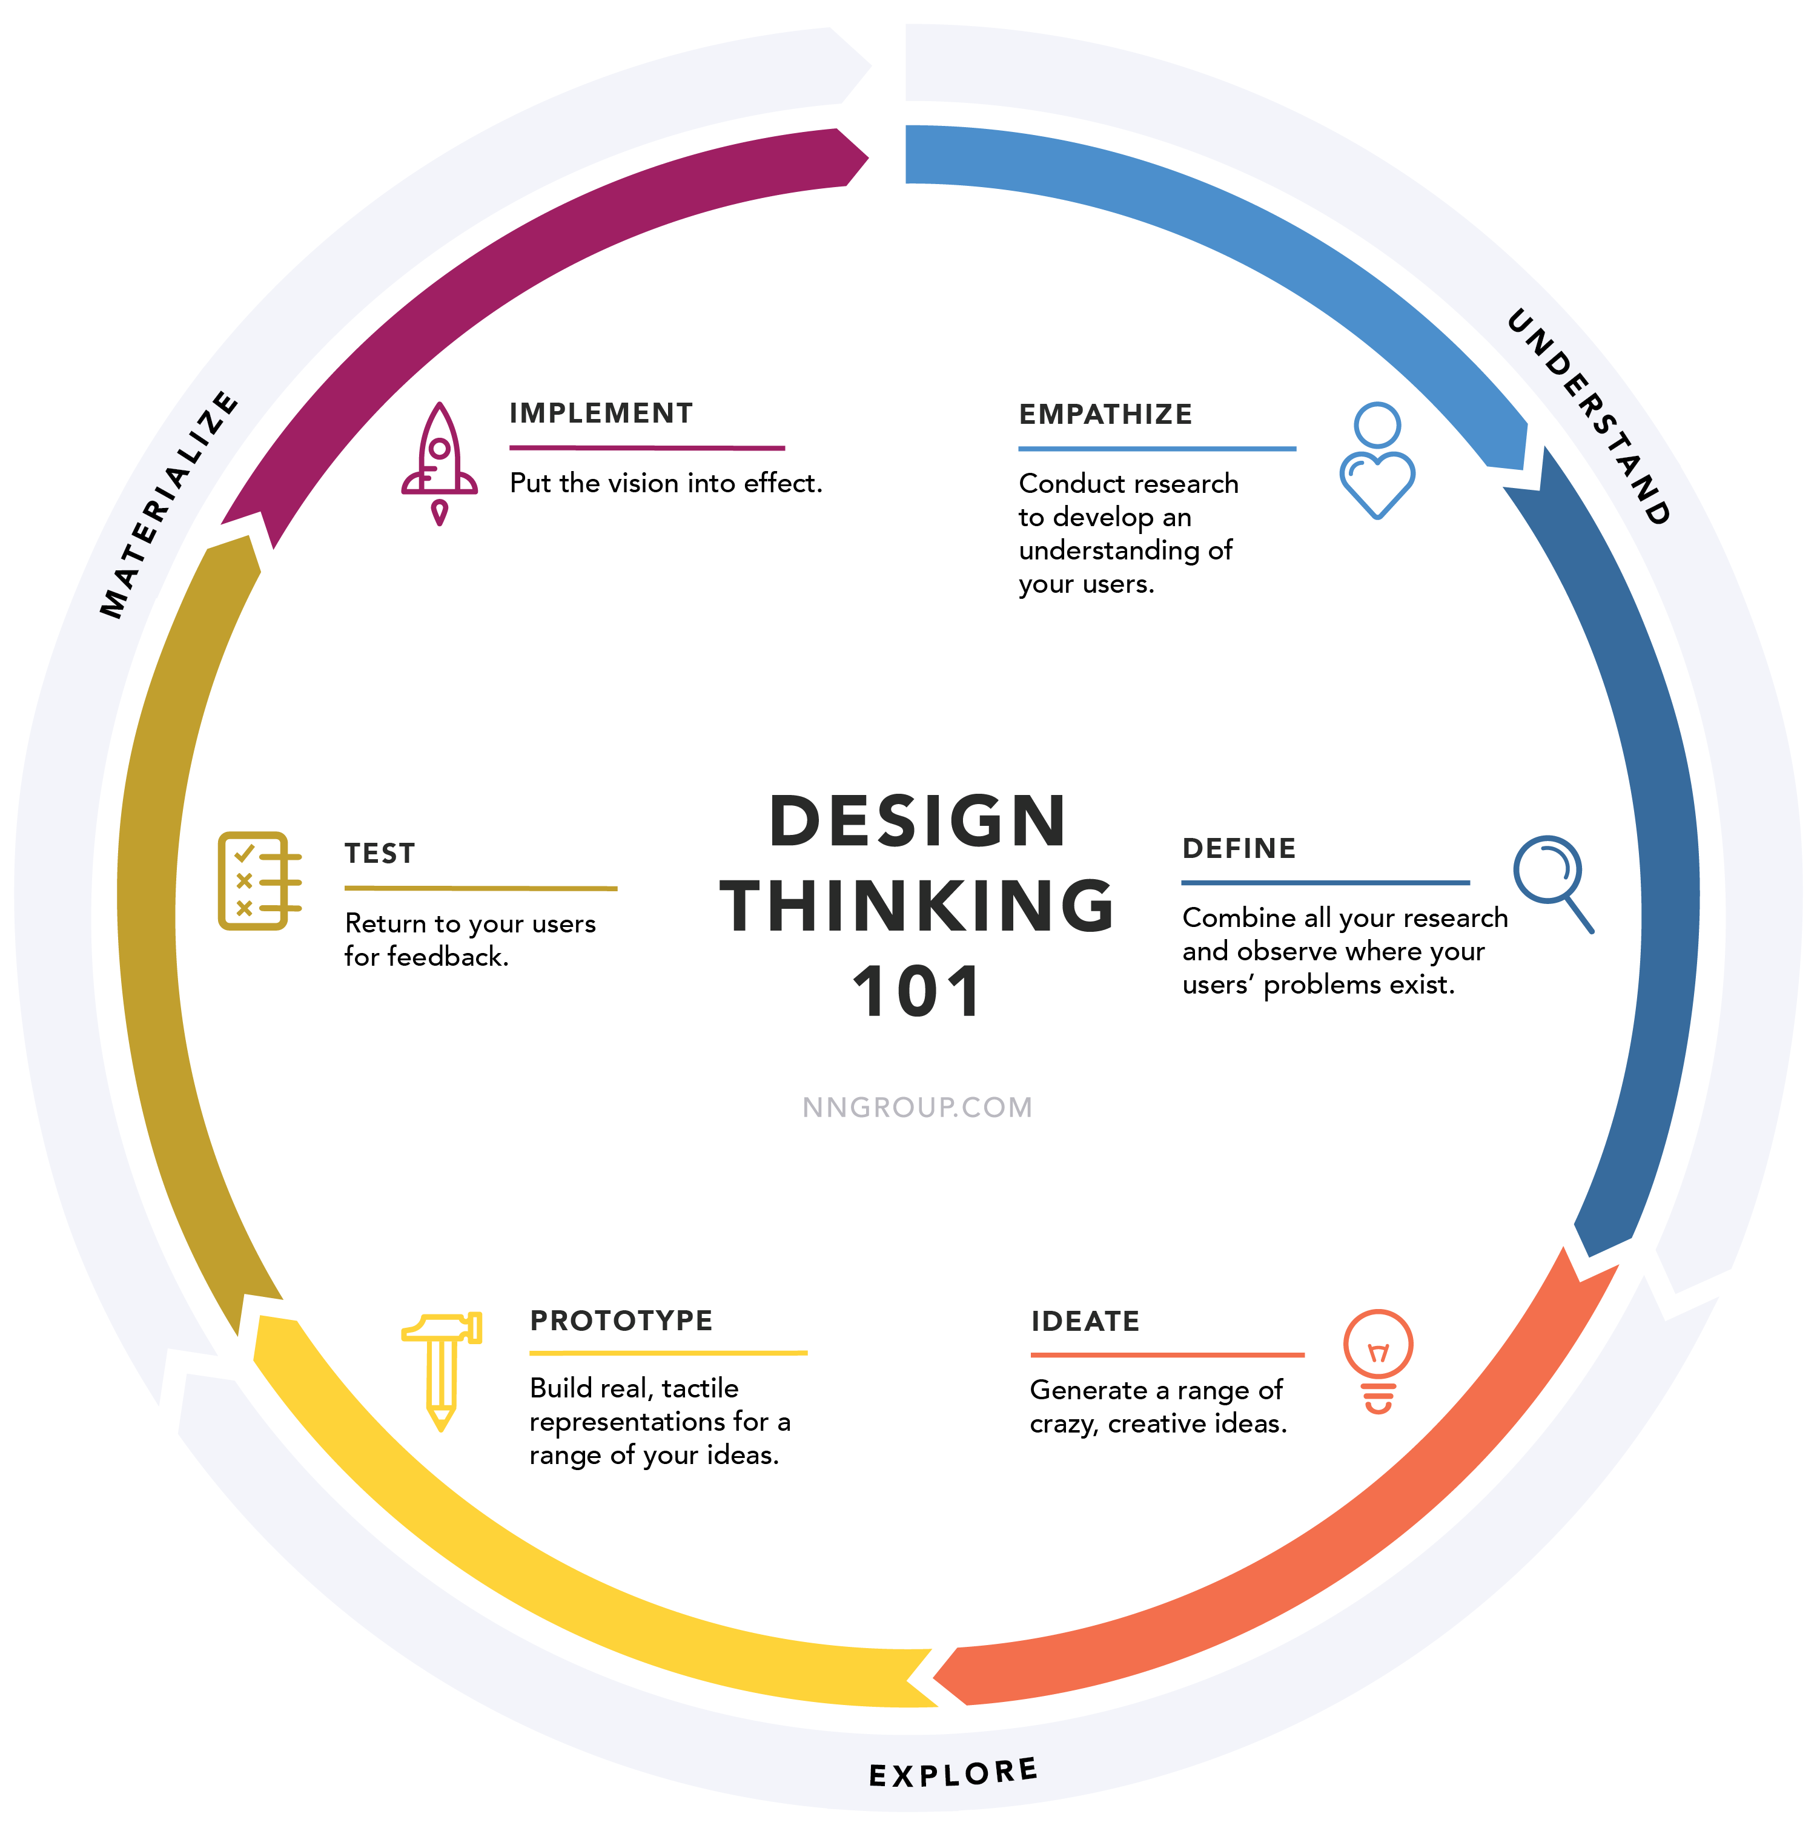
Design thinking for requirement gathering
Phases of Design Thinking:
  Empathize – Observe user behavior
  Define – Frame the user’s need
  Ideate – Brainstorm possible solutions
  Prototype – Create mockups
  Test – Validate with real users

Slide 7
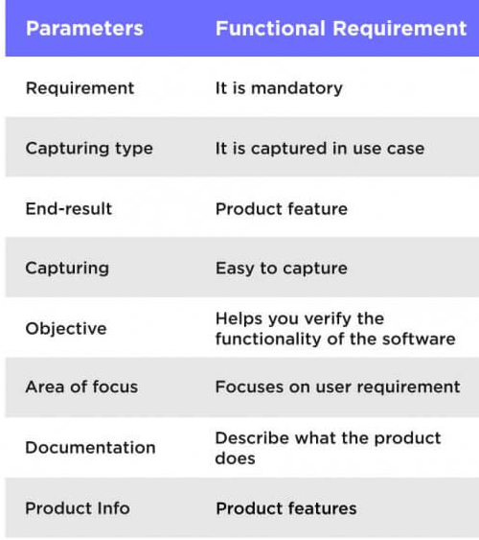
Functional requirements
These describe specific behaviors or functions a system must perform.
Includes user actions, system responses, and business rules.

Slide 8
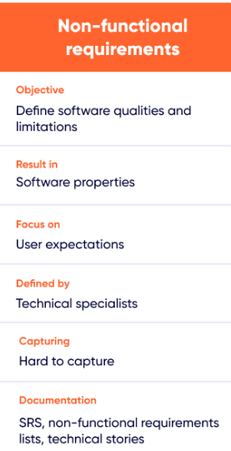
Non-functional requirements
Defines system quality attributes, such as:
  Performance
  Usability
  Reliability
  Security
  Scalability

Slide 9
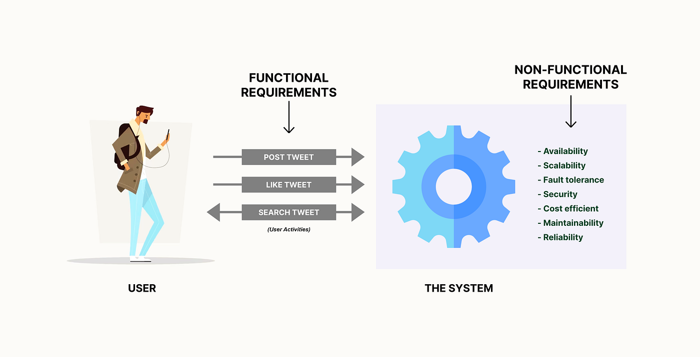

Slide 10
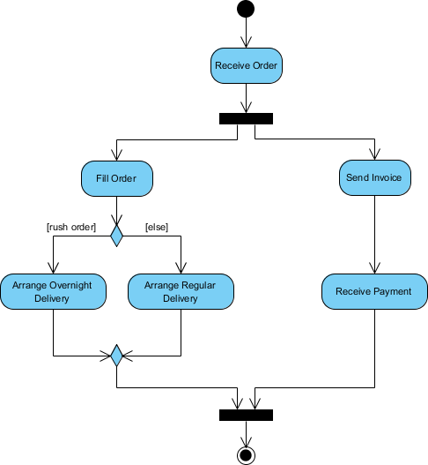
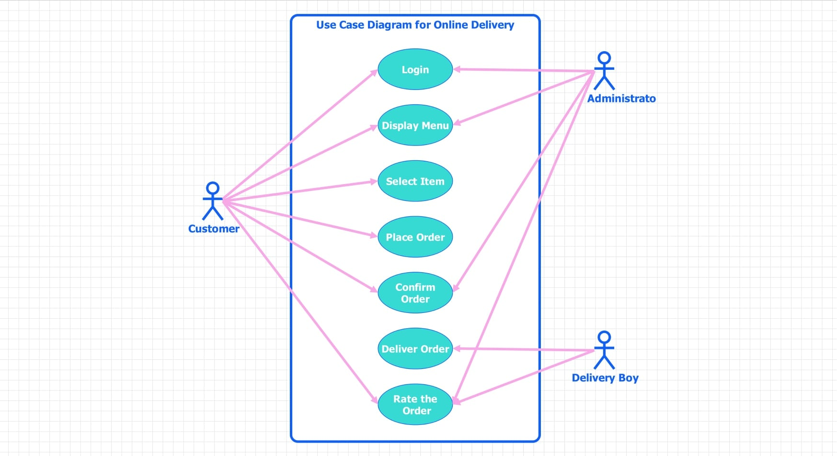
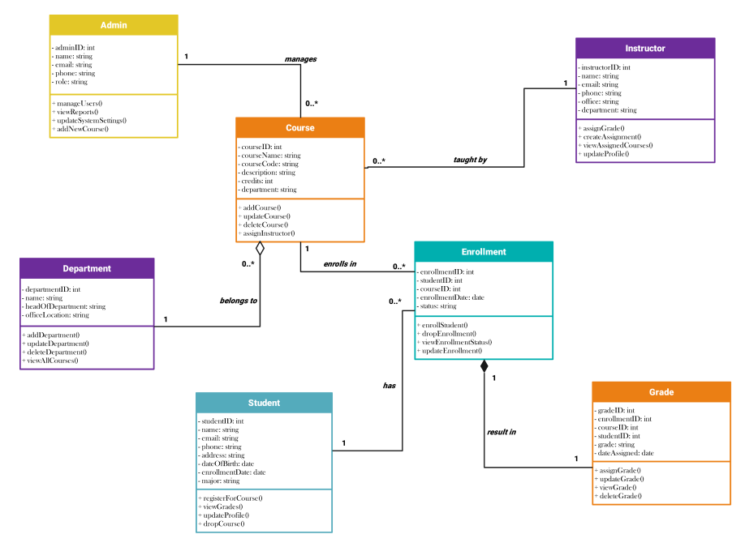
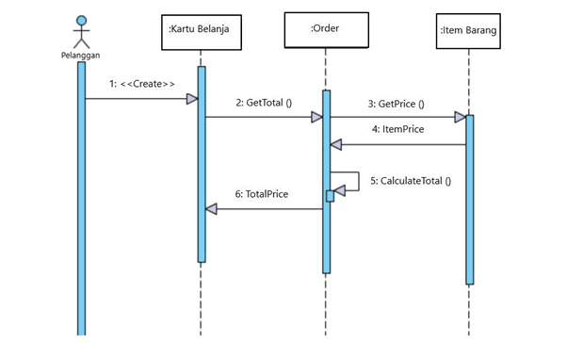
UML for VISUALIZING requirements
UML = Unified Modeling Language
Helps visualize system structure and behavior
Common UML diagrams:
  Use Case Diagram
  Activity Diagram
  Sequence Diagram
  Class Diagram

Slide 11
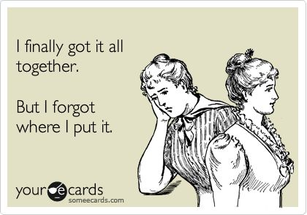
Summary
Use Gantt for high-level planning
Use Kanban for agile execution
Apply Design Thinking for user-focused requirements
Use UML for clarity and alignment across the team

Slide 12
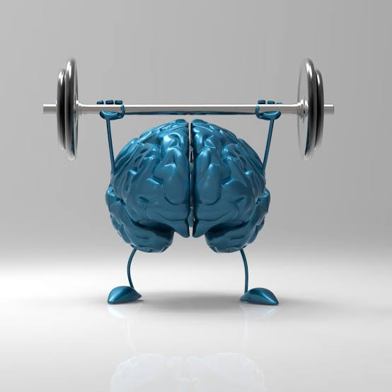
Class exercise – 27/07/2026
Quick Activity (15 Minutes)
For your own project, write:
6 Functional Requirements (begin with "The system shall...")
6 Non-Functional Requirements (choose (3) from Performance, Security, Usability, Reliability, Maintainability, Compatibility and make them specific).
Project: Online Library System
Functional
The system shall allow students to search for books.
The system shall allow librarians to add new books.
The system shall allow users to reserve books online.
Non-Functional
The system shall load pages within 3 seconds.
The system shall require users to log in before borrowing books.
The system shall be responsive on desktop and mobile devices

