Slide 1
Testing and Debugging
Subject Name: Applications Development Project Subject Code: APDP201
Lecturer Name : Freedom Khubisa
Department : Information Technology

Slide 2
Objectives
Identify and explain different types of software testing and their purposes (e.g., unit, integration, system, acceptance, regression, performance).
Differentiate between manual and automated testing approaches, including appropriate tools and use cases.
Apply debugging techniques using suitable tools to locate, analyze, and resolve errors in software applications.
Evaluate and implement best practices for ensuring software quality through systematic testing and effective debugging
Lesson Outline

Slide 3

introduction
Software Testing- Process of evaluating a system or its components with the intent to find whether it satisfies requirements.
Debugging- Process of identifying, analyzing, and removing errors (bugs) from the software.
Importance:
Ensures quality and reliability.
Saves cost and time in later stages.
Increases user satisfaction.

Slide 4
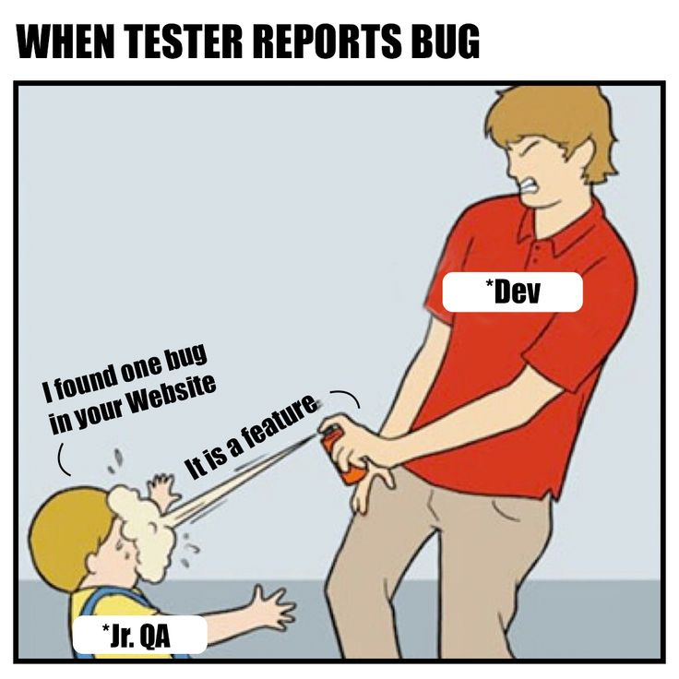
introduction
Detect defects early.
Ensure the software meets functional & non-functional requirements.
Validate performance under various conditions.
Reduce risk of failure.
Example: Testing an e-commerce app to ensure smooth checkout process.

Slide 5
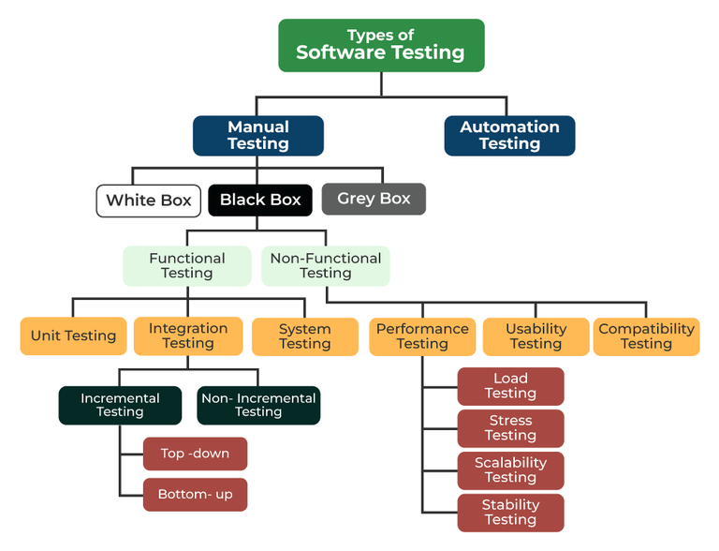
Types of testing
Manual Testing
Automation Testing
Black Box Testing
White Box Testing
Unit Testing
Integration Testing
System Testing
Acceptance Testing
Regression Testing
Performance/Load Testing

Slide 6
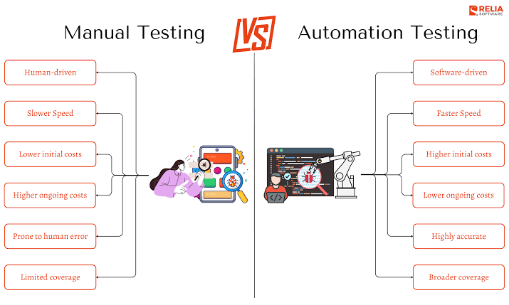
Manual vs. automation testing
Manual Testing
Human executes test cases without tools.
  Example: Checking a Login, Registration and CRUD functionality of an ASP.NET MVC app.
  Tools: TestRail for test case management and browser developer tools.
Automation Testing
Scripts & tools perform tests.
  Example: Selenium running automated login tests.
  Tools: Selenium, WebDriver, xUnit, MSTest, Cypress, Cypress.

Slide 7
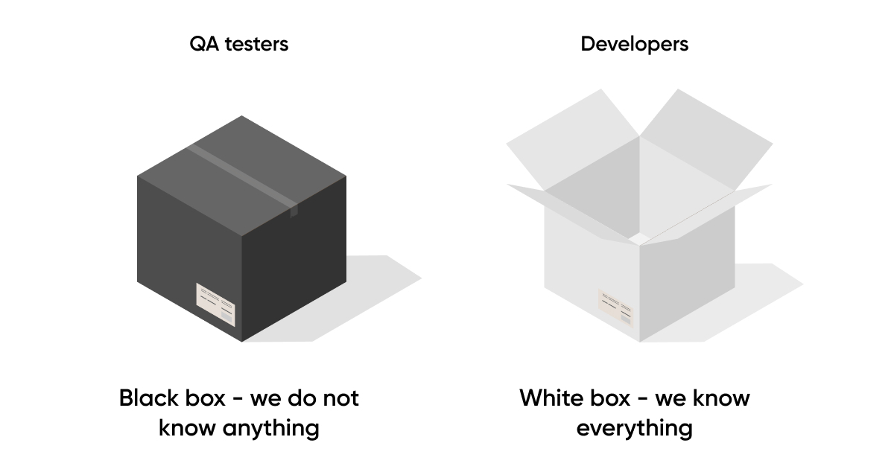
Black box vs. white box testing
Black Box Testing
Focus on inputs & outputs.
Internal logic not considered.
Testing an ATM withdrawal process (example).
Tools: Selenium, QTP.
White Box Testing
Focus on internal code structure.
Verifying loop conditions (example)

Slide 8
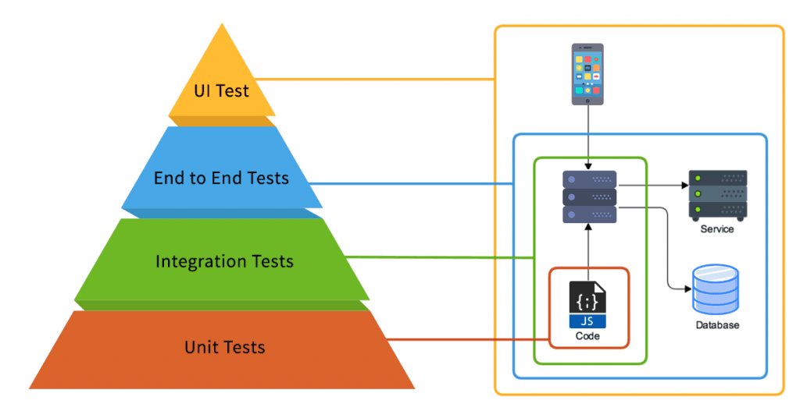
Unit, Integration & System Testing
Unit Testing
Test individual modules/components/features
E.g. Testing a payment calculator function
Integration Testing
Verify modules working together
E.g. Payment feature with order DB
Tools – Postman (API)
System (End-to-End) Testing
Test system as a whole
Complete e-commerce app workflow

Slide 9
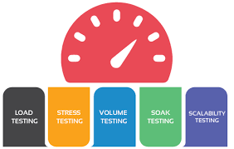
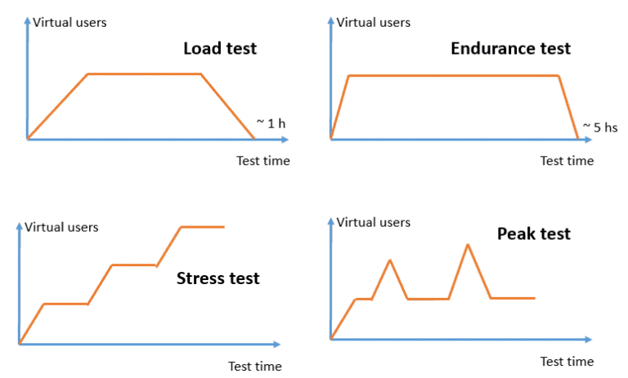
Performance, Load and Security Testing
Performance Testing
Check responsiveness and stability
Web app page load speed under heavy traffic
Tools (Jmeter, LoadRunner)
Load Testing
Check system behaviour under expected load
500k users logging in simultaneously
Security Testing
Test system as a whole
Complete e-commerce app workflow

Slide 10

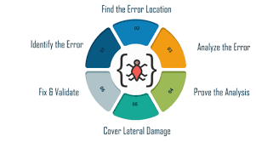
Debugging – Process & Tools
Reproduce the bug.
Isolate the source of error.
Analyze cause.
Fix the issue.
Test the fix.
Debugging Tools
IDE Debuggers (Eclipse, VS Code).
Chrome DevTools (for web).
GDB (for C/C++).

Slide 11
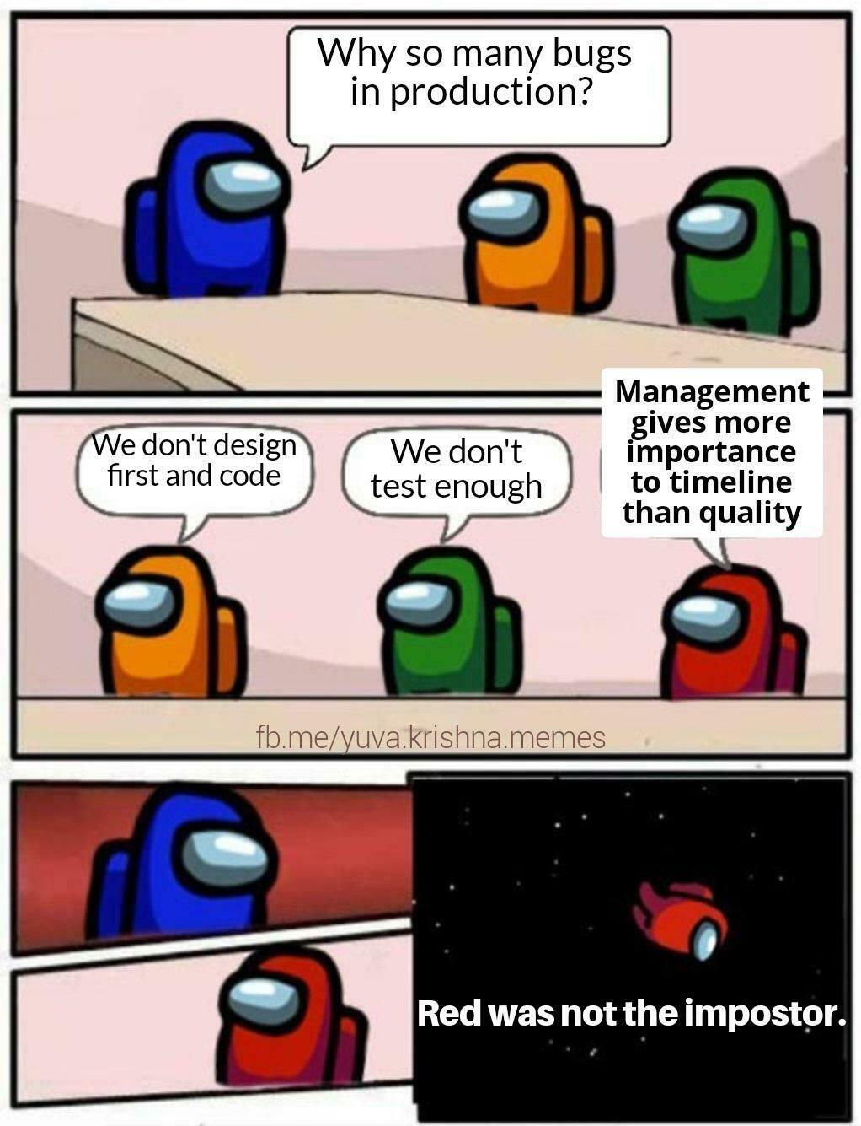

Summary
Testing ensures correctness, reliability, and performance.
Debugging helps trace and fix errors.
Best Practices
Test early, test often (shift-left approach).
Automate repetitive tasks.
Document bugs clearly.
Use CI/CD pipelines for continuous testing.
Key Takeaway
Quality software = Systematic Testing + Effective Debugging.

