Slide 1
INFORMATION SYSTEMS 3A
Requirements Engineering Concepts

Slide 2

Contents
1. Requirement Engineering
2. Introduce the Concept of User Requirements and System Requirements
3. Establishing Groundwork
4. Functional and Non-Functional Requirements
5. Requirement engineering process.

Slide 3
What is a Requirement
The software requirements are description of features and functionalities of the target system.
Requirements convey the expectations of users from the software product. The requirements can be obvious or hidden, known or unknown, expected or unexpected from the client's point of view.

Slide 4
Requirement Engineering
Requirements engineering (RE) is the process of defining, documenting, and maintaining requirements in the engineering design process.
The system requirements are the descriptions of the system services and constraints that are generated during the requirements engineering process.

Slide 5
Types of Requirements
User requirements
User requirements are defined using natural language, tables, and diagrams as these can be understood by all users.
Should describe functional and non-functional requirements in such a way that they are understandable by system users who don't have detailed technical knowledge.
System requirements
More detailed specifications of system functions, services, and constraints than user requirements.
They are intended to be a basis for designing the system.

Slide 7
Readers of different types of requirements specification

Slide 8
Establishing Groundwork
Identifying the stakeholders:
• Any person who benefits directly or indirectly from the system being developed is a stakeholder.
• Examples: Business operations managers, product managers, marketing people, internal and external customers, end-users, consultants, product engineers, software engineers, developers, testers and support/maintenance engineers are the usual stakeholders.
• Each stakeholder sees the system differently, gains different benefits when the system is successfully developed.
•They also faces different risks if the development effort fails.

Slide 9
Establishing Groundwork….
Recognizing Multiple Viewpoints:
• Because there are so many different stakeholders, the system's requirements will be examined from various perspectives.
• Each of these stakeholders will contribute data to the requirements engineering process.
• As information is gathered from multiple viewpoints, collecting requirements may be inconsistent or contradictory.
• You should categories all stakeholder information so that decision-makers can select a consistent set of system requirements for the system.

Slide 10
Establishing Groundwork….
Working toward Collaboration:
• If there are five stakeholders involved in a software project, there may be five different opinions on the set of requirements.
• Customers must work together with software development team to create a successful system.
• A requirements engineer's job is to identify areas of commonality requirement as well as areas of conflict requirements.
• At the end project head & requirement engineer may decide on which requirements are accepted.

Slide 11
Functional and
Non-functional requirements
Functional requirements
In software development, functional requirements describe what a system should do, defining its features and functionalities.
Functional requirements define "what" a system does.
Non-functional requirements
Non-functional requirements specify how the system should behave, focusing on qualities like performance, security, usability, and reliability, essentially defining the system's quality attributes rather than its specific actions.
Non-functional requirements define "how well" it does it.

Slide 12
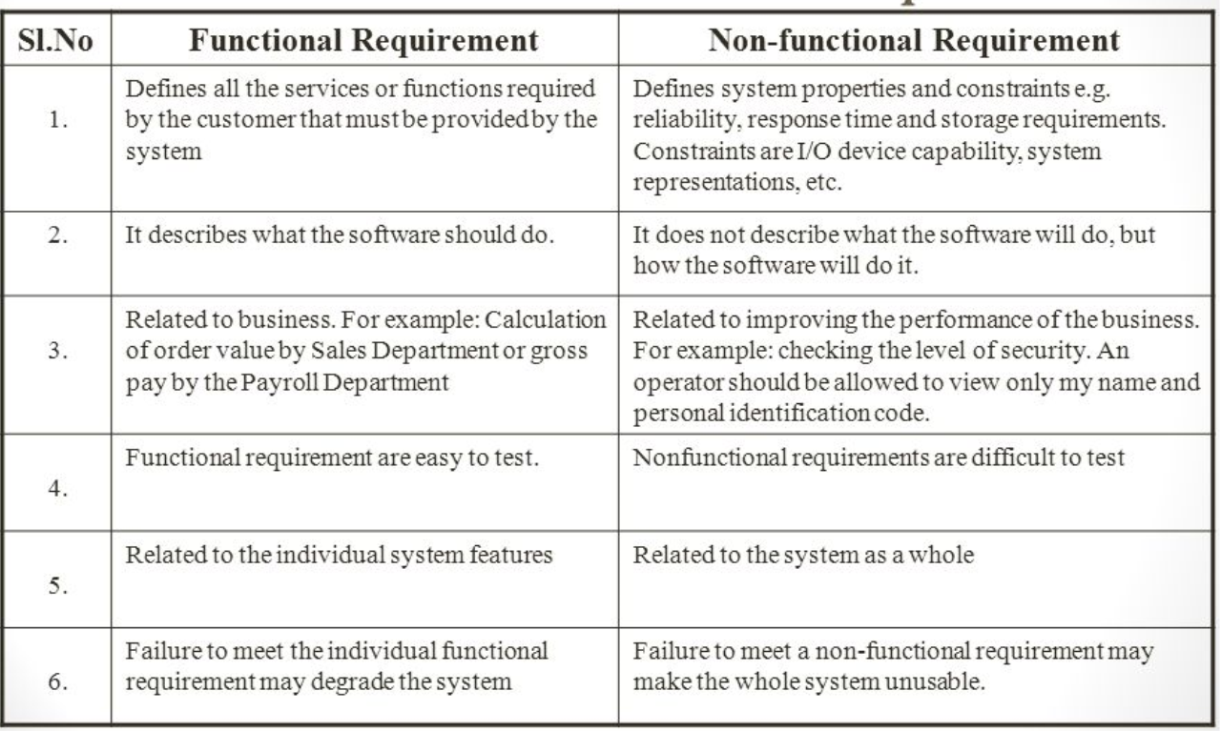

Slide 13
Types of nonfunctional requirement

Slide 14
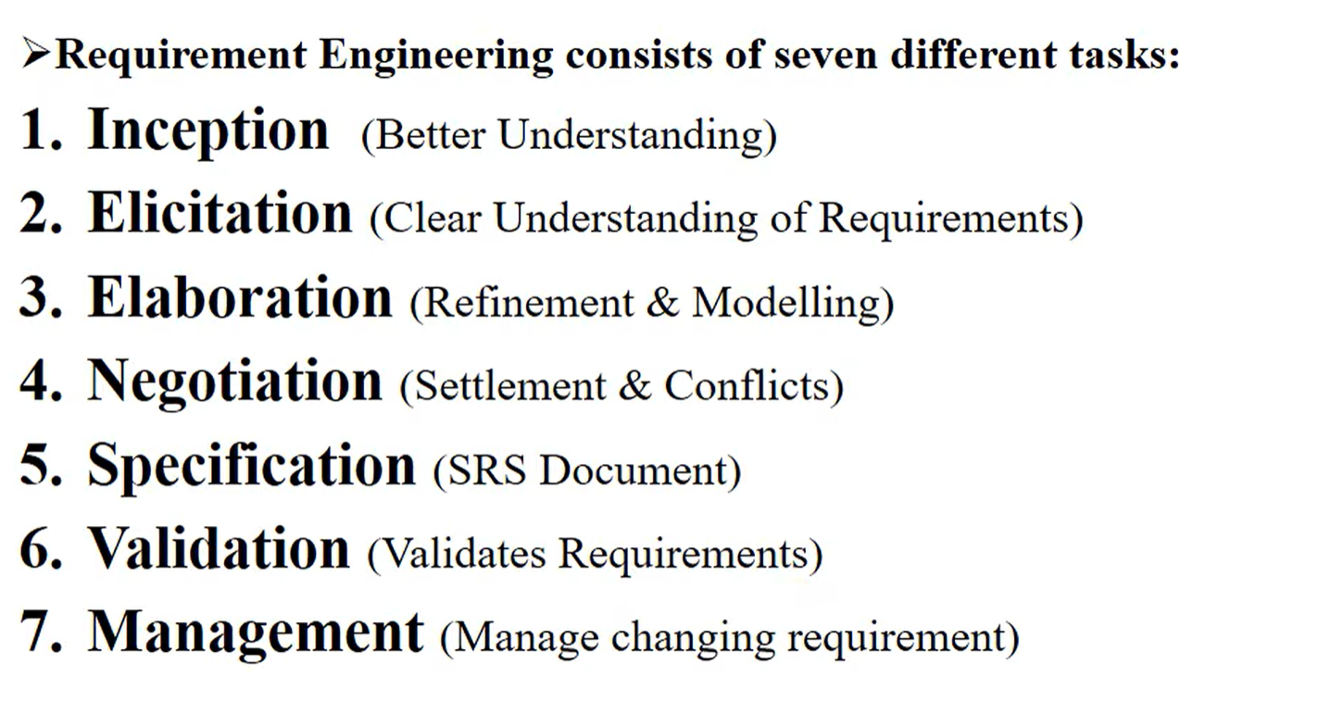
Tasks in requirements engineering
Key tasks in requirements engineering involve systematically identifying, analyzing, documenting, and managing system requirements to ensure stakeholders' needs are met.

Slide 15
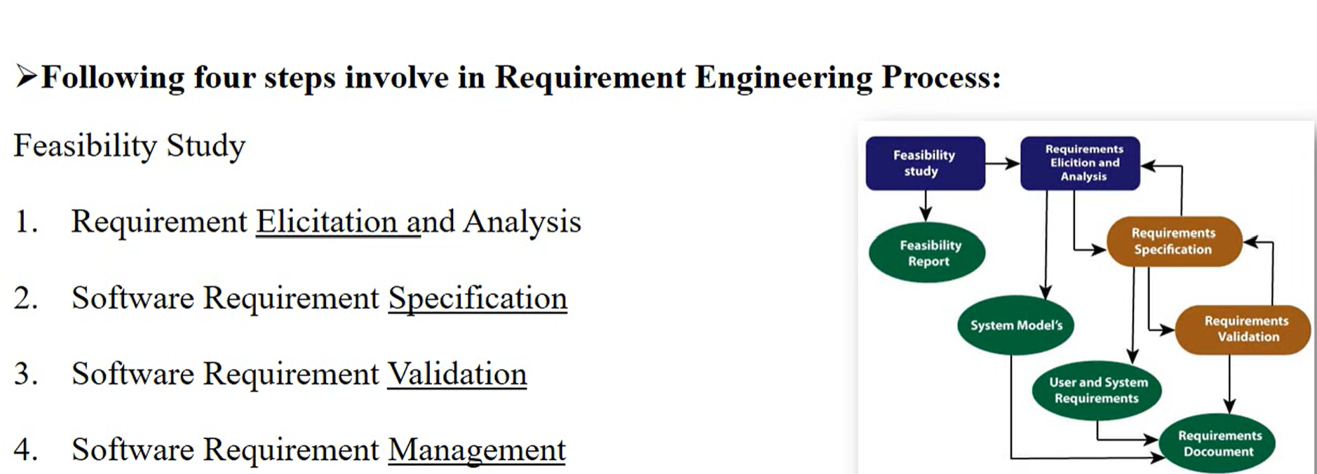
Requirement Engineering Process

Slide 16
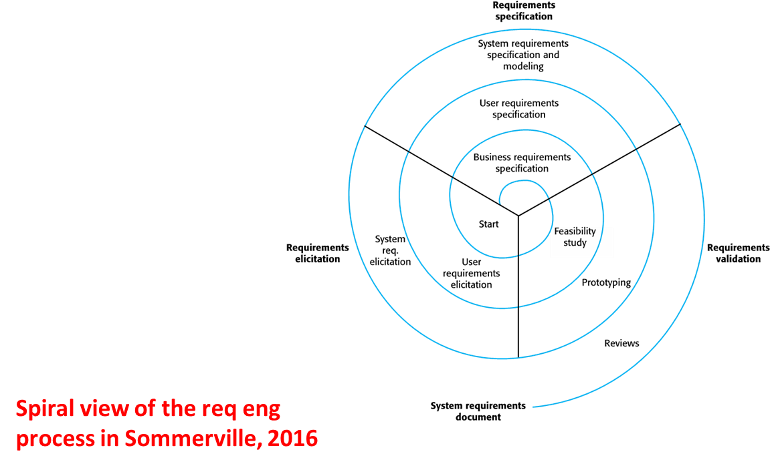
Requirements engineering processes

Slide 17
Step 1: Requirements elicitation & Analysis
Requirements elicitation is the process of gathering actual requirements about the needs and expectations of stakeholders for a software system.
To understand customers, business manuals, the existing software of same type, standards and other stakeholders of the project.
Techniques of Requirements Elicitation:
1. Interviews: One-on-one conversations with stakeholders to gather information about their needs and expectations.
2. Surveys: These are questionnaires that are distributed to stakeholders to gather information.
3. Focus Groups: Small groups of stakeholders who are brought together to discuss their needs.
4. Observation: Observing the stakeholders in their work environment to gather information.
5. Prototyping: Creating a working model of the software system, which can be used to gather feedback from stakeholders and to validate requirements.

Slide 18
Challenges of requirements elicitation
  Clients don’t always understand ICT and hence, find it difficult to express what they want the system to do
  Developers don’t always understand implicit knowledge of the business domain
  Stakeholders will have different perspectives on the software.
  Political influence on requirements
  Requirements change during this stage

Slide 19
Step 2: Software Requirements specification
Requirements received from client are written in natural language.
After collecting, System analyst to document the requirements in technical language.
SRS include Data Flow Diagram, Data Dictionary, Entity Relationship diagram.
SRS defines
How the intended software will interact with hardware.
External interface / GUI
Speed of operation, Response time of system
Portability of software across various platforms
Maintainability

Slide 20
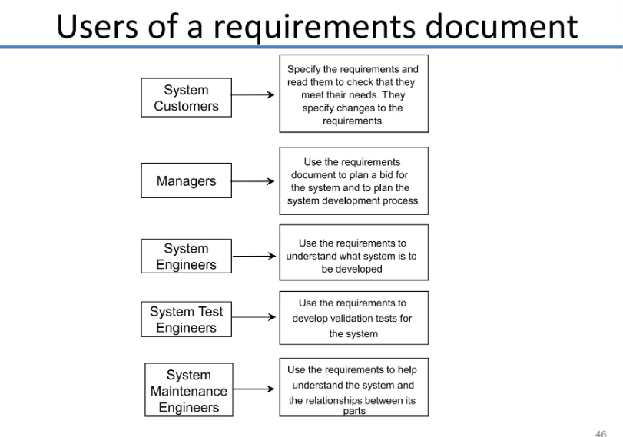
Users of a Requirement document

Slide 21
Step 3: Software Requirements validation
After SRS developed, the requirements discussed in this document are validated or tested.
Requirement validation done through Requirement reviews taken by customers,
After developing prototyping check with customers & Test case generations.
Requirements can be the check against the following conditions:
  If they can practically implement.
  If they are correct and as per the functionality and specially of software.
  If there are any ambiguities.
  If they can describe
  Any changing or additional requirement

Slide 22
Step 4: Software Requirements Management
Requirement management is the process of managing changing requirements during the requirements engineering process.
Activities involved in Requirement Management:
  Tracking & Controlling Changes: Handling changing requirements from customers.
  Version Control: Keeping track of different versions of system.
  Traceability: Trace to software is design, develop or test as per requirements or not.
  Communication: If changing requirements has any issues contact with clients within time.
  Monitoring & Reporting: Monitoring development process & report the status.

