Slide 1
INFORMATION SYSTEMS 3A
SOFTWARE PROCESS

Slide 2

Contents
Software Process
Software process models
  Waterfall model
  Incremental Development
  Integration and configuration
  Process activities

Slide 3
Software Process
A software process is a set of related activities that leads to the production of a software product.
There are many different software processes, but all must include four activities:
  • Software specification: defining what the system should do.
  • Software design and implementation: defining the organization of the system and implementing the system.
  • Software validation: checking that it does what the customer wants.
  • Software evolution: changing the system in response to changing customer needs.

Slide 4
Software processes approach
Software processes are categorized as either plan-driven or agile processes.
Plan-driven processes is a traditional approach where all the process activities of the project are planned upfront and progress is measured against this plan.
Agile processes: is an iterative approach where planning is incremental and it is easier to change the process to reflect changing customer requirements.

Slide 5
Software Process Models
A software process model is a structured framework that describes how the software development process is organized and carried out.
Each process model represents a process from a particular perspective and thus provides a partial information about that process.
Process models covered:
  • The waterfall model
  • Incremental development
  • Reuse-oriented software engineering

Slide 6
The Waterfall Model
The Waterfall model is a plan-driven software process model that organizes development into distinct phases such as requirements, design, implementation, testing, and deployment executed in a strict top-down sequence.
  The following phase should not start until the previous phase has finished.

Slide 7
The Waterfall Model
Benefit:
The process is visible
    Documentation is produced at each phase
Problems:
Inflexible partitioning of the project into distinct stages makes it difficult to respond to changing customer requirements.
    Therefore, this model is only appropriate when the requirements are well-understood and changes will be fairly limited during the design process.
    Few business systems have stable requirements.
The waterfall model is mostly used for large systems engineering projects where a system is developed at several sites.
  In those circumstances, the plan-driven nature of the waterfall model helps coordinate the work.

Slide 8
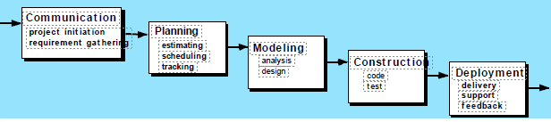
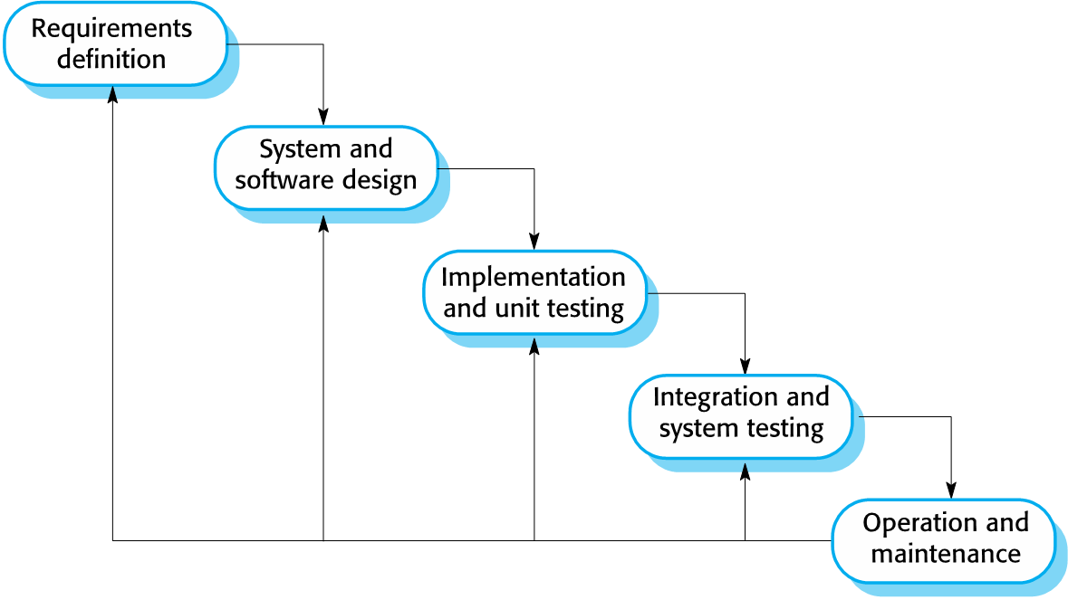
The Waterfall Model

Slide 9
Incremental Development
Incremental development is based on the idea of developing an initial implementation, exposing this to user comment and evolving it through several versions until an adequate (acceptable) system has been developed.
Generally, the early increments of the system include the most important or most urgently required functionality.
Can be either plan-driven, agile, or a mixture of both.

Slide 10
Incremental Development
Benefits:
The cost of accommodating changing customer requirements is reduced
It is easier to get customer feedback on the development work that has been done .
More rapid delivery and deployment of useful software to the customer is possible

Slide 11
Incremental Development
Problems:
The process is not visible
  Managers need regular deliverables to measure progress
System structure tends to degrade as new increments are added
  Unless time and money is spent on refactoring to improve the software, regular change tends to corrupt its structure.

Slide 12
Characteristics of incremental
Most common approach
Used in agile, plan-driven or hybrid
Allows for discovery of functionality

Slide 13
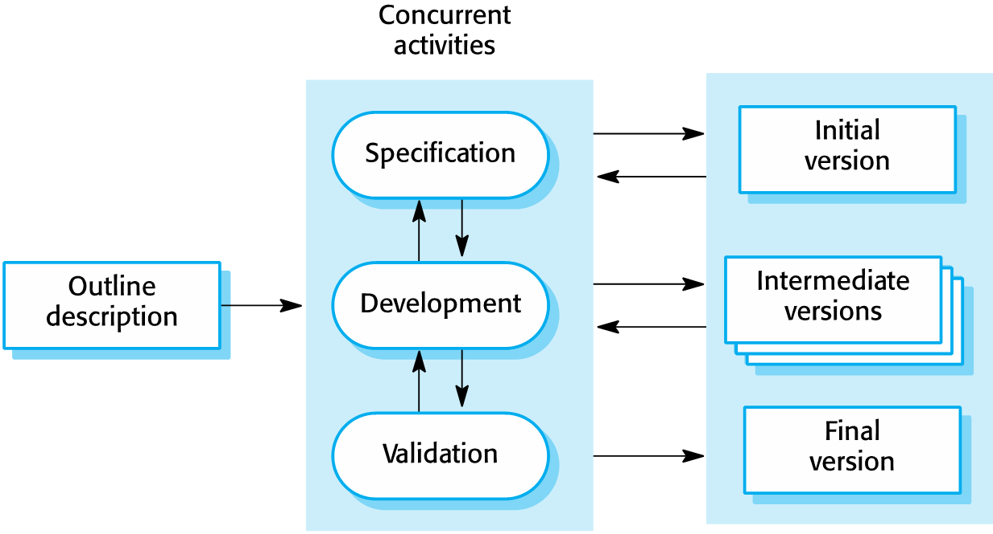
Incremental Development Model

Slide 14
Integration and configuration
Based on software reuse where systems are integrated from existing components or COTS (Commercial-off-the-shelf) systems.
Reused elements may be configured to adapt their behaviour and functionality to a user's requirements
Reuse is now the standard approach for building many types of business system

Slide 15
Types of reusable software
Stand-alone application systems (sometimes called COTS) that are configured for use in a particular environment.
Collections of objects that are developed as a package to be integrated with a component framework such as NET or JEE, OOP.
Web services that are developed according to service standards and which are available for remote invocation.

Slide 16
Integration and configuration Advantages and disadvantages
Advantages
Reduced costs and risks as less software is developed from scratch
Faster delivery and deployment of system
Disadvantages
Requirements compromises are inevitable so system may not meet real needs of users
Loss of control over evolution of reused system elements

Slide 17
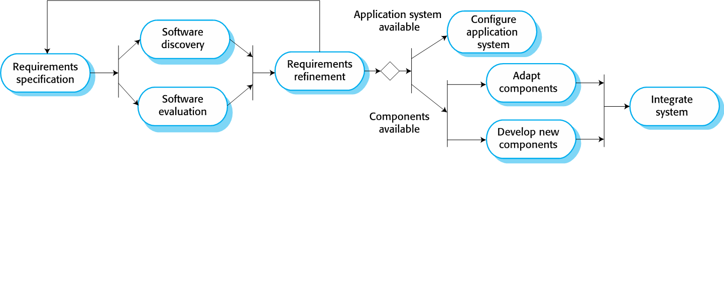
Integration and configuration

Slide 18
Process activities
The four basic process activities specification, development, validation, and evolution are organized differently in different development processes. In the waterfall model, they are organized in sequence, whereas in incremental development they are inter-leaved.

Slide 19
Software Specification
The process of establishing what services are required and the constraints on the system's operation and development.
Requirements engineering process:
  Feasibility study: Is it technically and financially feasible to build the system?
  Requirements elicitation and analysis: what do the system stakeholders require or expect from the system?
  Requirements specification: defining the requirements in detail.
  Requirements validation: checking the validity of the requirements.

Slide 20
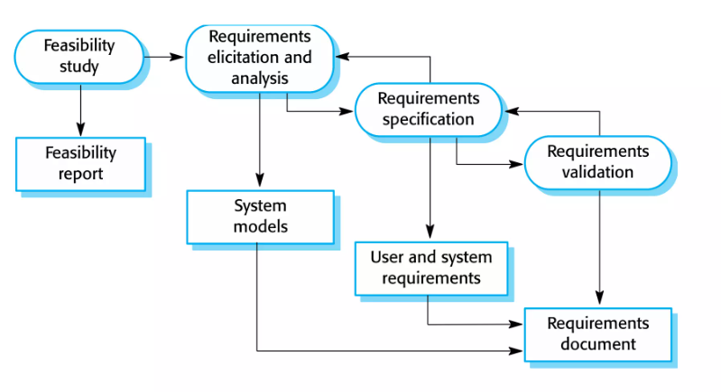
The requirements engineering process

Slide 21
Software design and implementation
The process of converting the system specification into an executable system.
Software design: design a software structure that realizes the specification.
Implementation: translate this structure into an executable program.
The activities of design and implementation are closely related and may be inter-leaved

Slide 22
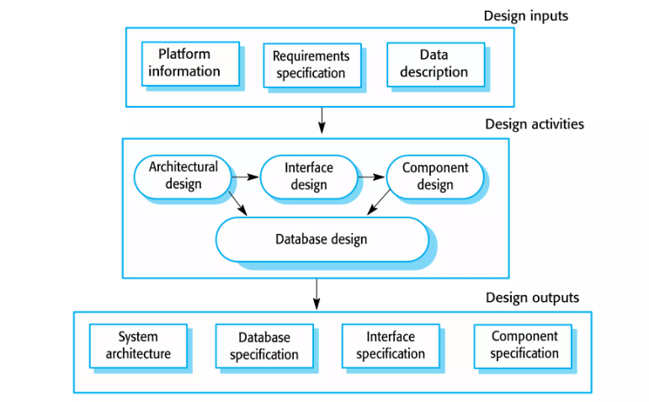
A general model of the design process

Slide 23
Design activities
Component design, where you take each system component and design how it will operate.
Architectural design, where you identify the overall structure of the system, the principal components (sometimes called sub-systems or modules), their relationships, and how they are distributed.
Interface design, where you define the interfaces between system components.
Database design, where you design the system data structures and how these are to be represented in a database.

Slide 24
Software validation
Software Validation is a process of evaluating software product so as to ensure that the software meets the pre defined and specified business requirements as well as the end users/customers' demands and expectations.
Verification and validation (V & V) is intended to show that a system conforms to its specification and meets the requirements of the system customer.
Involves checking and review processes and system testing.
Testing is the most commonly used V & V activity.

Slide 25
Software validation Activities (Testing stages)
Development or component testing
  Individual components are tested independently
  Components may be functions or objects or coherent groupings of these entities.
System testing
  Testing of the system as a whole. Testing of emergent properties is particularly important.
Acceptance testing
  Testing with customer data to check that the system meets the customer's needs.

Slide 26
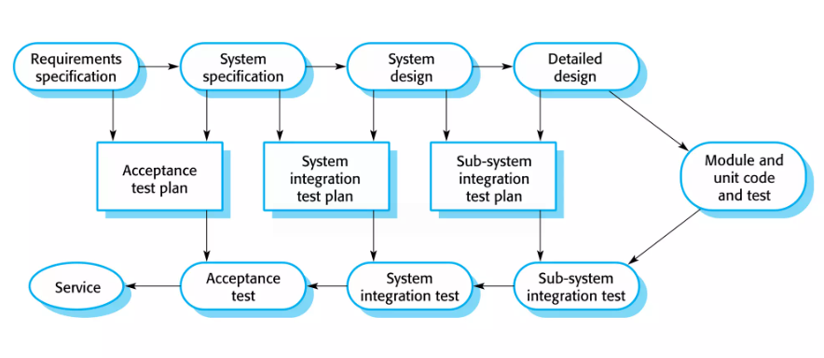
Testing phases in plan driven software process

Slide 27
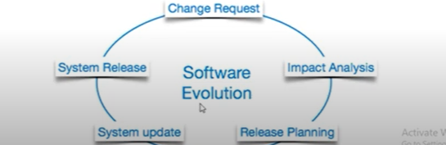
Software evolution
The software is modified to adapt it to changing customer and market requirement
As requirements change through changing business circumstances, the software that supports the business must also evolve and change.

Slide 28
Coping with change
Change is inevitable in all large software projects.
  Business changes lead to new and changed system requirements.
  New technologies open up new possibilities for improving implementations.
  Changing platforms require application changes.
Two related approaches may be used to reduce the costs of rework:
Change anticipation: where the software process includes activities that can anticipate possible changes before significant rework is required.
Change tolerance : where the process is designed so that changes can be accommodated at relatively low cost.
Coping with changing requirements:
System prototyping
Incremental delivery

Slide 29
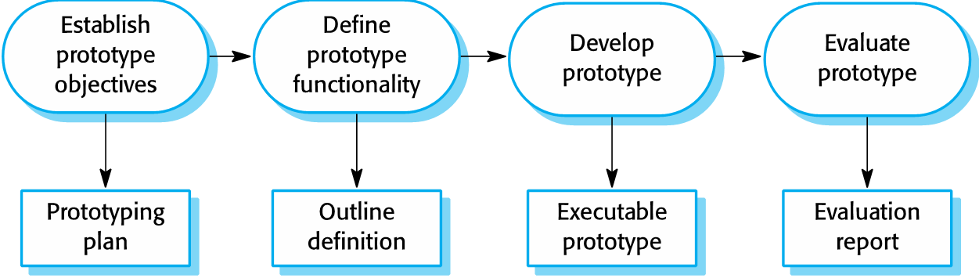
Prototyping

Slide 30
Benefits of prototyping
Improved system usability.
A closer match to users’ real needs.
Improved design quality.
Improved maintainability.
Reduced development effort.

Slide 31
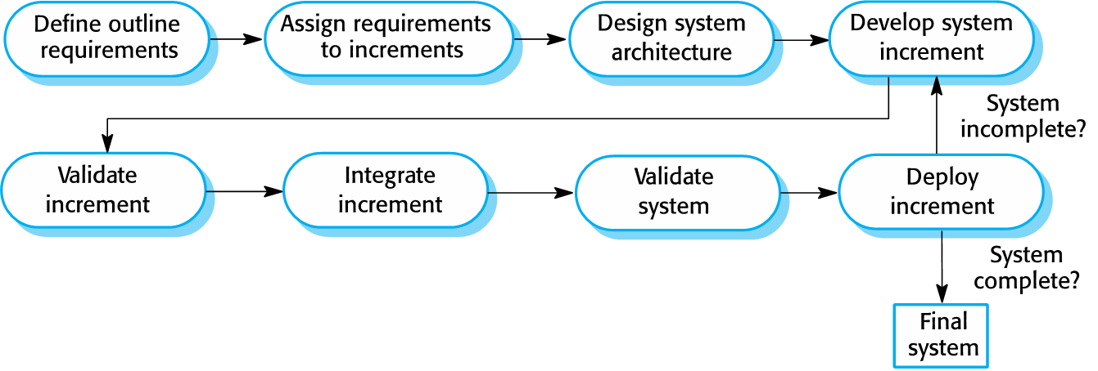
Incremental delivery

Slide 32
Incremental development and delivery
Incremental development
  Develop the system in increments and evaluate each increment before proceeding to the development of the next increment;
  Normal approach used in agile methods;
  Evaluation done by user/customer proxy.
Incremental delivery
  Deploy an increment for use by end-users;
  More realistic evaluation about practical use of software;
  Difficult to implement for replacement systems as increments have less functionality than the system being replaced.

