Slide 1
INFORMATION SYSTEMS 3A
Agile Software Development

Slide 2

Contents
Agile methods
Agile development techniques
Agile project management
Scaling agile methods

Slide 3
Plan-driven and agile development
Plan-driven development
A plan-driven approach to software engineering is based around separate development stages with the outputs to be produced at each of these stages planned in advance.
Agile development
Specification, design, implementation and testing are interleaved and the outputs from the development process are decided through a process of negotiation during the software development process

Slide 4
Agile software development
The agile software development methodology has recently become one of the most used software development techniques. Rather than the long-drawn-out release cycles in the previously popular waterfall methodology, the agile technique suggests regular short sprint release cycles.
This allows the customers and stakeholders to have more involvement within the software development process. This helps promote a higher quality final product because it combats the difficult task of a customer fully understanding and identifying all requirements in the software project planning phase. This also allows for the stakeholders to adjust the priorities of remaining tasks easily throughout the entire software development process.

Slide 5
Agile software development
Dissatisfaction with the overheads involved in software design methods of the 1980s and 1990s led to the creation of agile methods. These methods:
  Focus on the code rather than the design
  Are based on an iterative approach to software development
  Are intended to deliver working software quickly and evolve this rapidly to meet changing requirements
The aim of agile methods is to reduce overheads in the software process (e.g., by limiting documentation) and to be able to respond quickly to changing requirements without excessive rework

Slide 6
Agile software development
Program specification, design and implementation are inter-leaved.
The system is developed as a series of versions or increments with stakeholders involved in version specification and evaluation.
Frequent delivery of new versions for evaluation.
Extensive tool support (e.g. automated testing tools) used to support development.
Minimal documentation – focus on working code.

Slide 7
Plan-driven and agile development

Slide 8
Key characteristics of agile process models
Stronger focus on specification, design and implementation
Do enough documentation to move on
Incremental delivery
Client involvement
Dependency on automated tool support
Ability to respond to project change
Effective communication among all stakeholders
Drawing the customer into the team
Organizing a team so that it is in control of the work performed

Slide 9
Agile manifesto core values
We are uncovering better ways of developing software by doing it and helping others do it. Through this work we have come to value:
Individuals and interactions over processes and tools
Working software over comprehensive documentation
Customer collaboration over contract negotiation
Responding to change over following a plan

Slide 10
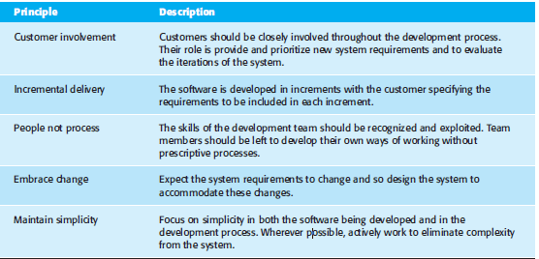
The principles of Agile Methods

Slide 11
Agile method applicability
Product development where a software company is developing a small or medium-sized product for sale.
Custom system development within an organization, where there is a clear commitment from the customer to become involved in the development process and where there are few external rules and regulations that affect the software.

Slide 12
Agile development methods techniques
Extreme Programming (XP)
Scrum
Kanban

Slide 13
Extreme programming (XP)
A very influential agile method, developed in the late 1990s, that introduced a range of agile development techniques.
Extreme Programming (XP) takes an ‘extreme’ approach to iterative development.
  New versions may be built several times per day;
  Increments are delivered to customers every 2 weeks;
  All tests must be run for every build and the build is only accepted if tests run successfully.

Slide 14
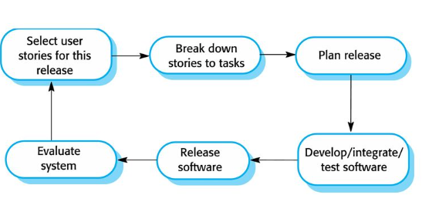
Extreme programming release cycle

Slide 15
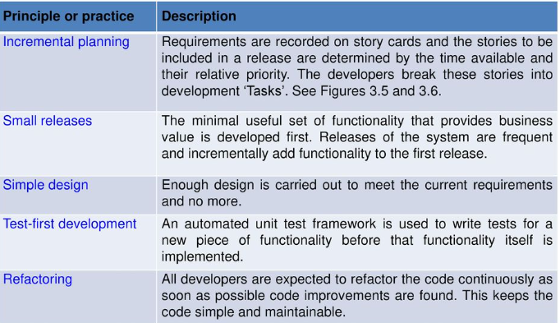
Extreme programming practices (a)

Slide 16
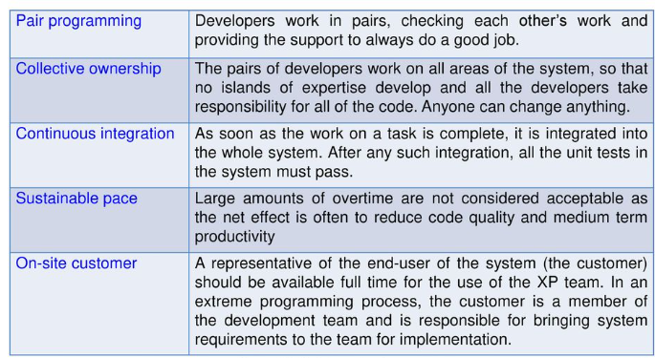
Extreme programming practices (b)

Slide 17
Influential XP practices
Extreme programming has a technical focus and is not easy to integrate with management practice in most organizations
Consequently, while agile development uses practices from XP, the method as originally defined is not widely used
Key practices
  User stories for specification
  Refactoring
  Test-first development
  Pair programming

Slide 18
  User stories for specification
In XP, a customer or user is part of the XP team and is responsible for making decisions on requirements.
User requirements are expressed as scenarios or user stories.
These are written on cards and the development team break them down into implementation tasks. These tasks are the basis of schedule and cost estimates.
The customer chooses the stories for inclusion in the next release based on their priorities and the schedule estimates.

Slide 19
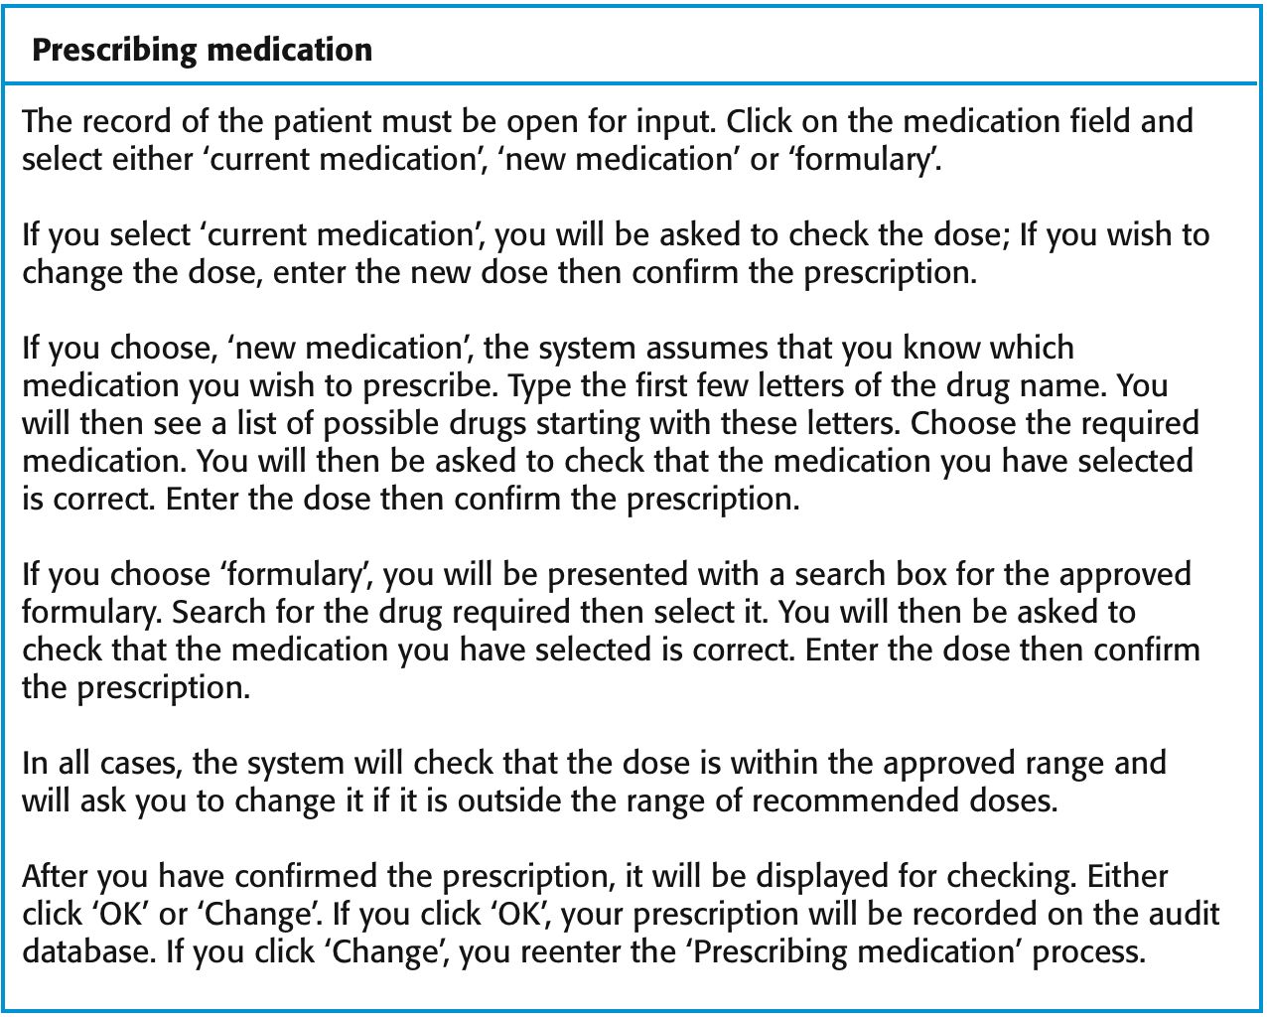
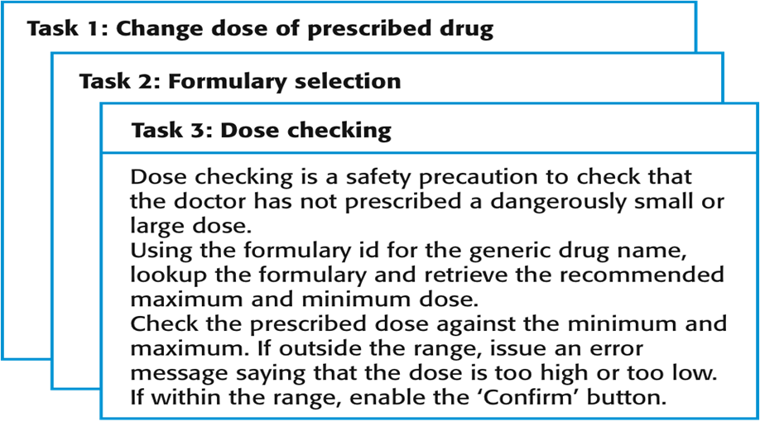
A ‘prescribing medication’ story

Slide 20
Refactoring (Cleaning up the code)
In Extreme Programming (XP), refactoring is the practice of continuously improving code without changing its external behavior. It helps keep the code clean, simple, and maintainable.
More efficient
Helps in finding the Bugs
Remove duplicates
Replacement of similar code sections
Makes software easier to understand
Improves the design of software
Also helps in executing the program faster

Slide 21
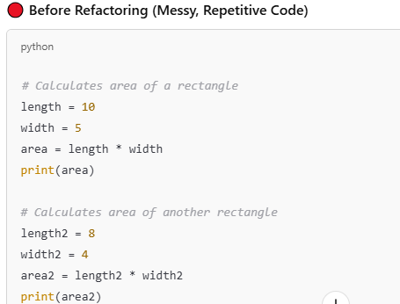
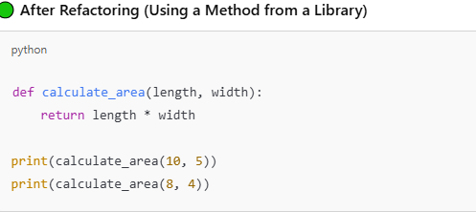
Examples of refactoring
Re-organization of a class hierarchy to remove duplicate code
Tidying up and renaming attributes and methods to make them easier to understand
The replacement of inline code with calls to methods that have been included in a program library

Slide 22
Test-first development
Writing tests before code clarifies the requirements to be implemented
Tests are written as programs rather than data so that they can be executed automatically. The test includes a check that it has executed correctly.
  Usually relies on a testing framework such as Junit
All previous and new tests are run automatically when new functionality is added, thus checking that the new functionality has not introduced errors
XP testing features:
  Test-first development
  Incremental test development from scenarios
  User involvement in test development and validation
  Automated test harnesses are used to run all component tests each time that a new release is built.

Slide 23
Pair programming
In XP, programmers work in pairs, sitting together to develop code.
This helps develop common ownership of code and spreads knowledge across the team.
It serves as an informal review process as each line of code is looked at by more than one person.
It encourages refactoring as the whole team can benefit from this.
In pair programming, programmers sit together at the same computer to develop the software.
Pairs are created dynamically so that all team members work with each other during the development process.

Slide 24
Scrum
The Scrum approach is a general agile method, but its focus is on managing iterative development rather than specific agile practices
There are three phases in Scrum:
  The initial phase is an outline planning phase where you establish the general objectives for the project and design the software architecture
  This is followed by a series of sprint cycles, where each cycle develops an increment of the system
  The project closure phase wraps up the project, completes required documentation such as system help frames and user manuals and assesses the lessons learned from the project

Slide 25
Roles in Scrum
There are three different roles needed in doing the scrum method, namely:
Scrum Master : Scrum master is like a team coach who helps everyone follow the Scrum process smoothly. They don’t manage the team but make sure work happens without problems.
Product Owner: Product Owner is the decision-maker in a Scrum team. They make sure the team is building the right product by setting priorities and defining features.The product owner can be a customer but might also be a product manager in a software company or other stakeholder representative.
Scrum Team: Scrum team is a small, self-organizing group of people who work together to complete a project using the Scrum framework. It includes a mix of roles, with everyone working collaboratively to deliver value in short cycles (sprints).

Slide 26
The scrum sprint cycle
Sprints are fixed length, normally 2–4 weeks.
The starting point for planning is the product backlog, which is the list of work to be done on the project
The selection phase involves all of the project team who work with the customer to select the features and functionality to be developed during the sprint

Slide 27
Teamwork in Scrum
The Scrum master is a facilitator who arranges daily meetings, tracks the backlog of work to be done, records decisions, measures progress against the backlog and communicates with customers and management outside of the team
The whole team attends short daily meetings which are referred as daily stand-up meeting where all team members share information, describe their progress since the last meeting, problems that have arisen and what is planned for the following day
  This means that everyone on the team knows what is going on and, if problems arise, can re-plan short-term work to cope with them

Slide 28
Scrum benefits
The product is broken down into a set of manageable and understandable chunks
The whole team have visibility of everything and consequently team communication is improved
Customers see on-time delivery of increments and gain feedback on how the product works
Trust between customers and developers is established and a positive culture is created in which everyone expects the project to succeed

Slide 29
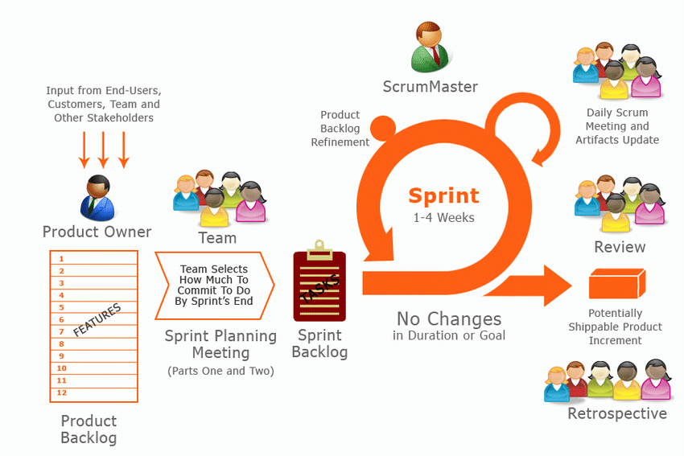
Scrum

Slide 30
Kanban
Kanban is an Agile framework that emphasizes visualization, workflow management, and continuous improvement.
It involves creating a visual board that represents the work that needs to be done, the work that is in progress, and the work that has been completed.
It is designed to help teams manage their work more efficiently by visualizing the workflow, limiting work in progress (WIP), and optimizing the flow of tasks or work items from start to finish.
Kanban uses a kanban board to represent work items as cards that move through different stages of a workflow.

Slide 31
What is the difference between a Kanban board and a Kanban card?
A Kanban card represents an individual task within a workflow.
  Kanban cards include detailed information about each task, including its status, owner, and priority.
A Kanban board is a visual tool that displays an entire workflow.
  The Kanban board brings the Kanban cards together to give the team an overall view of a project.

Slide 32
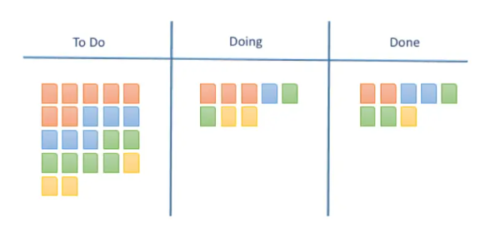
Kanban Methodology

Slide 33
Four core principles make up the Kanban framework
Start with what you know
Pursue incremental change
Respect the current process
Encourage leadership at all levels

Slide 34
Kanban Key practices
Visualize the workflow: Make the process transparent and easy to understand.
Limit work-in-progress (WIP): Reduce bottlenecks and improve flow by limiting the number of tasks in each stage.
Focus on flow: Prioritize the continuous movement of work through the system.
Make explicit policies for the workflow: Establish clear rules and procedures for how work moves through the process.
Implement feedback loops: Continuously monitor and improve the process based on real-time data

Slide 35
Benefits of the Kanban method
The Kanban method offers a range of advantages that streamline project management and enhance team performance, including:
Improved workflow: By visualizing tasks on a Kanban board, teams can identify bottlenecks and optimize workflows.
Increased efficiency: Limiting WIP ensures that team members focus on completing tasks instead of feeling overwhelmed with multitasking.
Enhanced collaboration: The visual nature of Kanban boards fosters a collaborative environment, as everyone is aware of their responsibilities and the status of each task.

Slide 36
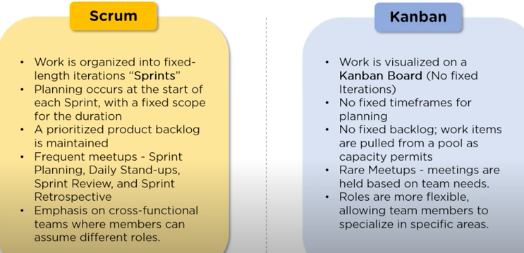
Scrum Vs Kanban

Slide 37
Scaling agile methods
Agile methods have proved to be successful for small and medium sized projects that can be developed by a small co-located team
It is sometimes argued that the success of these methods comes because of improved communications which is possible when everyone is working together
Scaling up agile methods involves changing these to cope with larger, longer projects where there are multiple development teams, perhaps working in different locations

Slide 38
Scaling out and scaling up
'Scaling up' is concerned with using agile methods for developing large software systems that cannot be developed by a small team
'Scaling out' is concerned with how agile methods can be introduced across a large organization with many years of software development experience
When scaling agile methods, it is important to maintain agile fundamentals:
  Flexible planning, frequent system releases, continuous integration, test-driven development, and good team communication

Slide 39
Agile across organizations
Some barriers to agile adoption:
Project managers are largely inexperienced with agile
Bureaucratic procedures that are necessary for quality
Needs highly and multi-skilled team members
Well ingrained plan-driven processes

Slide 40
Agile maintenance
Key problems are:
Lack of product documentation
Keeping customers involved in the development process
Maintaining the continuity of the development team

Slide 41
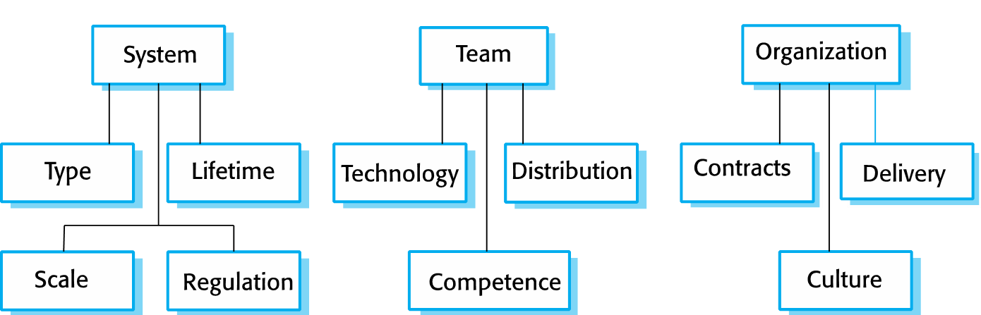
Agile or Plan Driven(How to decide?)
What factors should the team consider before choosing?

Slide 42
Agile methods across organizations
Project managers who do not have experience of agile methods may be reluctant to accept the risk of a new approach.
Large organizations often have quality procedures and standards that all projects are expected to follow, and, because of their bureaucratic nature, these are likely to be incompatible with agile methods.
Agile methods seem to work best when team members have a relatively high skill level. However, within large organizations, there are likely to be a wide range of skills and abilities.
There may be cultural resistance to agile methods, especially in those organizations that have a long history of using conventional systems engineering processes.

