Slide 1
INFORMATION SYSTEMS 3A
INTRODUCTION TO SOFTWARE ENGINEERING

Slide 2
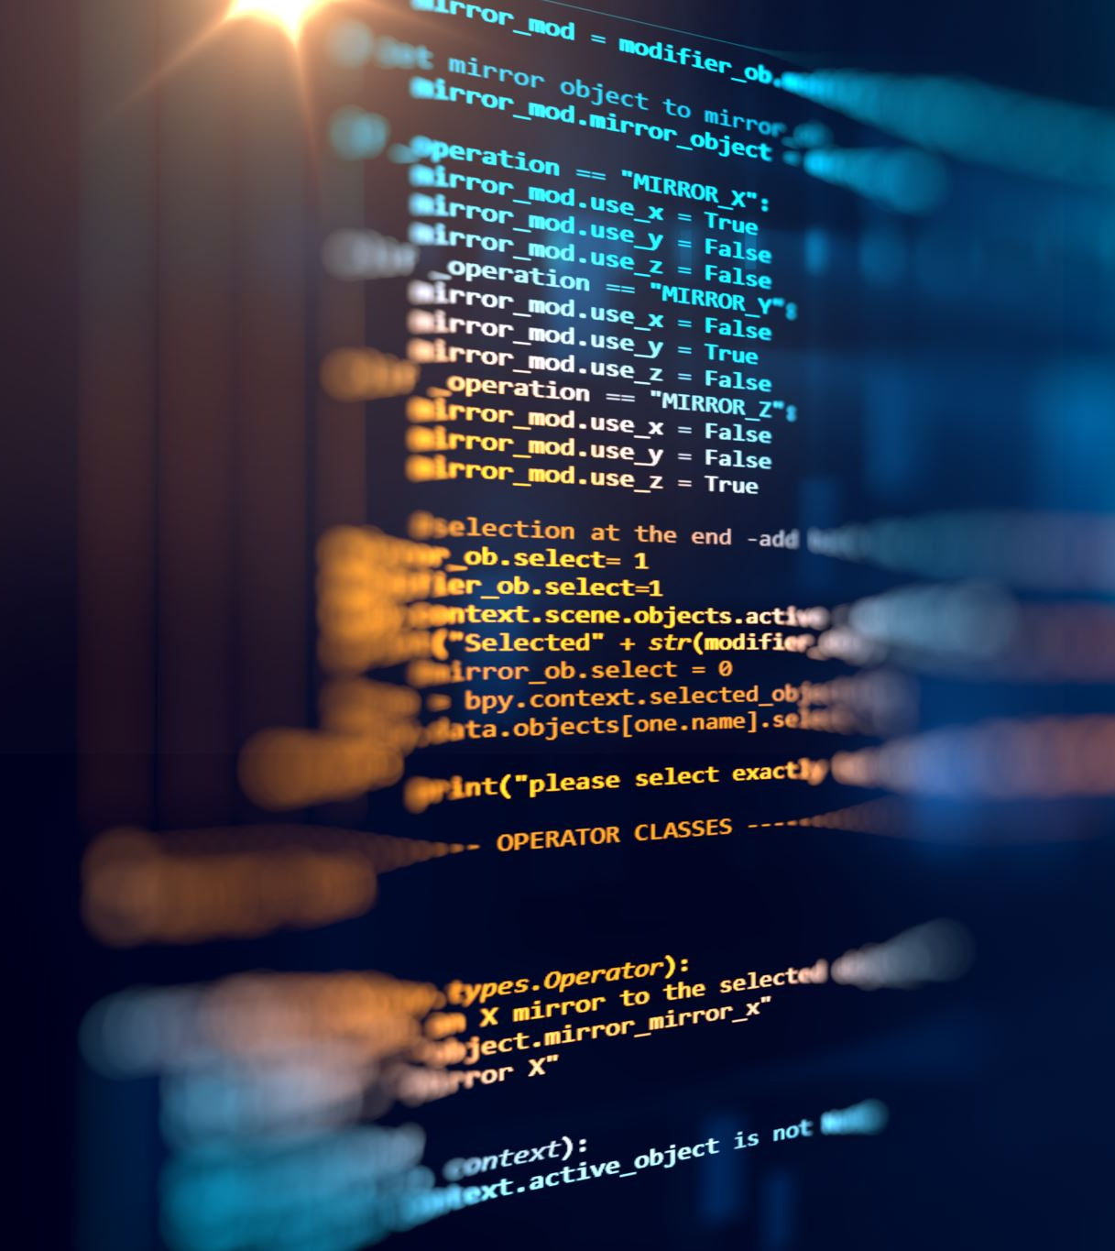
Contents
Introduction of Software Engineering
Need of Software Engineering
Characteristics of Good Software
General issues that affect software
Nature of Software Engineering
Software engineering fundamentals
Changing Nature of Software
Software Process Activities
SDLC Models
Software engineering ethics

Slide 3
What Is Software?
The software is collection of Integrated programs
Software consists of carefully organized instructions and code written by programmers in any of various special computer languages.
Computer programs and associated documentation such as requirements, design models and user manuals.

Slide 4
What Is Engineering?
Engineering is the application of scientific and practical knowledge in order to invent, design, build, maintain, and improve systems, processes, etc.

Slide 5
What is software Engineering?
Software engineering is an engineering discipline that is concerned with all aspects of software production.
According to IEEE's definition software engineering can be defined as the application of a systematic, disciplined, quantifiable approach to the development, operation, and maintenance of software, and the study of these approaches; that is, the application of engineering to software.

Slide 6
Need of Software Engineering
Handling Big Projects: Corporation must use SE to handle large projects without any issues.
To manage the cost: Software engineering programmers plan everything and reduce all those things that are not required.
To decrease time: It will save a lot of time if you are developing software using a software engineering technique.
Reliable software: It is the company's responsibility to deliver software products on schedule and to address any defects that may exist.
Effectiveness: Effectiveness results from things being created in accordance with the software standards.

Slide 7
Software products
Generic products
  Stand-alone systems that are marketed and sold to any customer who wishes to buy them.
  Examples – PC software such as graphics programs, project management tools; CAD software; software for specific markets such as appointments systems for dentists.
Customized products
  Software that is commissioned by a specific customer to meet their own needs.
  Examples – embedded control systems, air traffic control software, traffic monitoring systems.

Slide 8
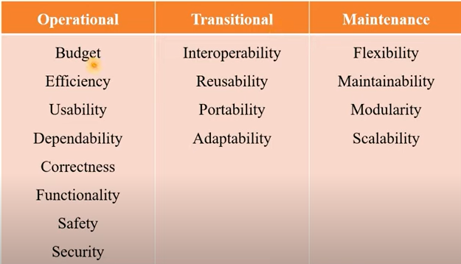
Characteristics of Good Software

Slide 9
General issues that affect software
Heterogeneity
Business and social change
Security and trust
Scale

Slide 10
Nature of Software
System Software: System software is software designed to provide a platform for other software’s.
  • It is a interaction between hardware & application software.
  • Examples: Operating Systems like macOS, Linux, Android and Microsoft Windows.
Application Software: Application Software is a computer program designed to carry out a specific task as per user & business need.
  • Examples: Social medias apps, Gaming apps, Word processing apps, Multimedia apps, Banking apps, Shopping apps, Booking apps etc

Slide 11
Nature of Software
3. Engineering and Scientific Software: This software is used to facilitate the engineering function and task take real time.
  • It has very high accuracy, complex formula evolution & data analysis.
  • Examples: Weather prediction apps, Stock Market apps, Stress Analysis, Body measurement apps
4. Embedded Software: Embedded software resides within the system or product and is used to implement and control feature and function for the end-user and for the system itself.
  • Example: Switches, Routers, Digital camera, Washing machine functionalities, Traffic control

Slide 12
Nature of Software
5. Web Applications: It is a client-server computer program which the client runs on the web browser.
  • Web apps can be little more than a set of linked hypertext files that present information using text and limited graphics.
  • Examples: Online forms, Shopping carts, Gmail, Yahoo, Photo editing, File conversion etc.
6. Artificial Intelligence Software: It makes use of a nonnumerical algorithm to solve a complex problem.
  • Application within this area includes robotics, expert system, pattern recognition, artificial neural network, theorem proving and game playing.
  • Examples: Google Cloud, Azure studio, Tensor Flow, Salesforce etc.

Slide 13
Software engineering fundamentals
Planed and managed development process
Software must behave as expected, always available and work without failure (dependable).
Efficient use of resources (performance).
Manage stakeholder expectations (requirements)
Manage software reuse

Slide 14
Changing Nature of Software
WebApps
Semantic web technologies(Web3.0)
Semantic databases; web linking; flexible data representation; and application programmer interfaces(API’s)
Mobile Apps
Can gain direct access to the hardware found on the device to provide local processing and storage capabilities
Cloud Computing
Cloud computing provides distributed data storage and processing resources to networked computing devices

Slide 15
Changing Nature of Software
Product Line Software
A software product line shares a set of assets that include requirements, architecture, design patterns, reusable components, test cases and other work products
Service orientated software
Software system is composed of standalone web-services
Rich internet interfaces
AJAX and HTML5

Slide 16
Software Process Activities
A software process is the set of activities and associated outcome that produce a software product.
Software engineers mostly carry out these activities.
1. Software Specifications: The functionality of the software and constraints on its operation must be defined
2. Software Development: The software to meet the requirement must be produced.
3. Software Validation: The software must be validated to ensure that it does what the customer wants.
4. Software Evolution: The software must evolve to meet changing client needs.

Slide 17
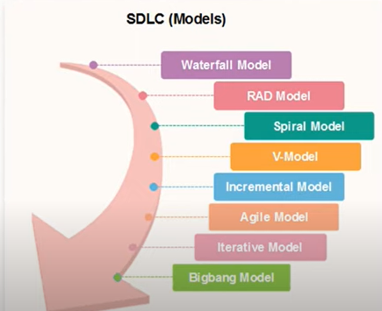
SDLC Models

Slide 18
Software engineering ethics
Software engineers must behave in an honest and ethically
Be respected as professionals
Ethical behavior is more than simply upholding the law
involves following a set of principles that are morally correct.
Respect Confidentiality of employers and clients
Not accept work outside your Competence
Protect the intellectual property of employers and clients
Not use technical skills to misuse other people’s computers
ACM/IEEE maintain code of ethics and processional practice
https://www.youtube.com/watch?v=d91MTV9AlNg

