Slide 1
INFORMATION SYSTEMS 3A
Software Quality Management

Slide 2

Contents
Software Quality
Principles concerns of software quality
Quality Plans
Non-functional requirements to assess the quality of software
Factors Affecting Software Quality
Software Quality Metrics
Software Quality Management
How to Achieve Software Quality?
Quality Assurance Vs Quality Control

Slide 3
Software Quality
• The quality of software can be defined as the ability of the software to function as per user requirements.
• When it comes to software products, they must satisfy all the functionalities written down in the SRS document.
Software Quality includes:
-Good Design: Good visualization design to attract users.
-Durability: The software works without any issue for a long period of time.
-Consistency: Software performs consistently on different platforms and other devices.
-Maintainability: Capture and fix bugs quickly. New features are added easily.
-Value for money: Customers & companies who make this app should feel that the money spent on this app was not wasted.

Slide 4
Three principles concerns(Levels) of software quality
  Organizational Level: Quality management is concerned with establishing a framework of organizational processes and standards that will lead to high-quality software.
  Project Level: Quality management involves the application of specific quality processes, checking that these planned processes have been followed, and establishing a quality plan. The quality plan sets out the quality goals for the project and defines the processes and standards to be used.
  Product Level: Quality management is concerned with ensuring that the final software product meets required quality standards, such as reliability, usability, performance, and security.

Slide 5
Quality plans
A quality plan is a document that outlines the strategy, scope, processes, resources, and goals for ensuring that software products meet the required quality standards. It acts as a roadmap for the entire software development and testing process to ensure that the software delivered to customers meets both functional and non-functional requirements, is reliable and secure, and performs as expected.
Quality plan structure
  Product introduction
  Product plans
  Process descriptions
  Quality goals
  Risks and risk management
Quality plans should be short, succinct(Compact and Precise) documents
  If they are too long, no one will read them.

Slide 6
Product introduction
This section provides an overview of the product or service being developed or delivered.
It typically includes the product’s purpose, key features, specifications, and target market.
The introduction sets the context for the quality management process, emphasizing how quality is essential to meeting the product's objectives and customer expectations.

Slide 7
Product plans
Product plans outline the roadmap for the development, testing, and delivery of the product.
It includes detailed timelines, milestones, and the resources required for successful product realization.
This section focuses on defining the stages of product development, such as design, prototype, production, and launch, while ensuring quality is integrated at every stage

Slide 8
Process descriptions
This section provides detailed descriptions of the processes involved in product development and production.
It typically includes process flows, standard operating procedures (SOPs), and instructions for how tasks should be performed.
The goal is to ensure that the processes are clearly defined, repeatable, and efficient, with a focus on consistent quality control throughout.

Slide 9
Quality goals
Quality goals are the measurable objectives that the organization aims to achieve during the product's lifecycle.
These goals could be related to product performance, customer satisfaction, defect rates, compliance, or other relevant metrics. The quality goals should be aligned with both the organization’s strategic objectives and customer requirements.
They act as benchmarks for measuring and driving quality improvements.

Slide 10
Risks and risk management
This section identifies potential risks that could impact product quality, timelines, or customer satisfaction.
Risks can be related to technical challenges, resource limitations, market fluctuations, or regulatory compliance.
The risk management plan outlines how each risk will be assessed, prioritized, and mitigated.
This includes specifying risk owners, defining mitigation strategies, and monitoring risks throughout the product development lifecycle to ensure that quality standards are maintained.

Slide 11
Non-functional requirements to assess quality of software
Maintainability: The ease with which software can be modified (adding features, enhancing features, fixing bugs, etc.)
Portability: The ability of software to be transferred easily from one location to another.
Functionality: The ability of software to carry out the functions as specified or desired.
Performance: The speed at which software performs under a particular load.
Compatibility: The suitability of software for use in different environments like different devices, operating systems, and browsers.
Usability: The degree of software's ease of use.
Reliability: The ability of software to perform a required function under stated conditions without any errors.
Security: The extent of protection of software against unauthorized access, invasion of privacy, theft. loss of data etc. Ex. OTP

Slide 12
Software Quality Management
Software Quality Management (SQM) refers to the complete process that ensures a software product is developed as per national and international standards like ANSI, IEEE, and ISO.
Need for Software Quality Management:
1. Deliver high-quality products on time.
2. Increases stakeholder faith in product & company.
3. High-quality products always ensure customer satisfaction.

Slide 13
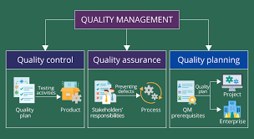
Activities of Software Quality Management

Slide 14
How to Achieve Software Quality?
Quality Planning:
• Select applicable procedures and standards for a particular project and modify them as required to develop a quality plan.
Quality Assurance:
• It assures that the system meets specified requirements and customer expectations.
• It defines standards and methodologies for a successful development process.
• It assures Correctness, Efficiency, Flexibility, Maintainability, Portability, Usability, etc.
Quality Control:
• It focuses on achieving & fulfilling quality parameters or quality goals as per customer requirements.
• It focuses on delivering products on time with accurate cost.

Slide 15
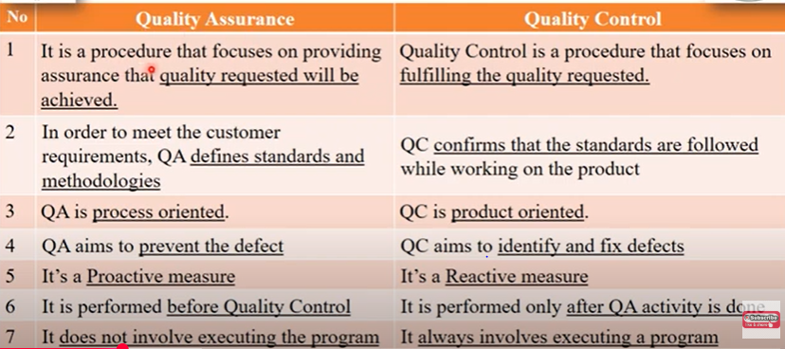
Quality Assurance Vs Quality Control

Slide 16
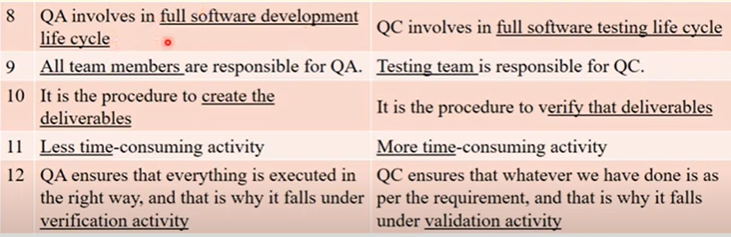
Quality Assurance Vs Quality Control

Slide 17
Software Quality Metrics
Software Quality Management makes sure that the software is high-quality and follows proper rules and standards. To check how good the software is, we use different types of metrics (measurements):
Customer Problem Metrics:
• Measure the problems encountered by the customers while using the product.
• Problems per User Month = (Total Number of Problem Reports) / (Total Number of Users * Number of Months)
For example, if you have 10 problem reports, 100 users, and you're tracking data for 1 month, the problems per user month would be 10 / (100 * 1) = 0.1.
Customer Satisfaction Metrics:
• It deals with the overall quality of the product & how much a customer is satisfied with that product.
• It is measured by Very Satisfied, Satisfied, Neutral, Dissatisfied, and Very Dissatisfied.
Software Maintenance Metrics:
• After completion of Development & Testing product release in the market.
• During this interval. How many defect arrived at customer environment?

Slide 18
Reviews and inspections
A group examines part or all of a process or system and its documentation to find potential problems.
Software or documents may be 'signed off' at a review, which signifies that progress to the next development stage has been approved by management.
There are different types of reviews with different objectives
  Quality reviews
  Inspections for defect removal
  Reviews for progress assessment

Slide 19
Quality reviews
A group of people carefully examines part or all of a software system and its associated documentation.
Code, designs, specifications, test plans, standards, etc., can all be reviewed.
Software or documents may be 'signed off' at a review, which signifies that progress to the next development stage has been approved by management.

Slide 20
Phases in the review process
Pre-review activities
  Pre-review activities are concerned with review planning and review preparation
The review meeting
  During the review meeting, an author of the document or program being reviewed should ‘walk through’ the document with the review team.
Post-review activities
  These address the problems and issues that have been raised during the review meeting.

Slide 21
Program inspections
These are peer reviews where engineers examine the source of a system with the aim of discovering anomalies and defects.
Inspections do not require execution of a system so may be used before implementation.
They may be applied to any representation of the system (requirements, design, configuration data, test data, etc.).
They have been shown to be an effective technique for discovering program errors.

Slide 22
Inspection checklists
Checklist of common errors should be used to drive the inspection.
Error checklists are programming language dependent and reflect the characteristic errors that are likely to arise in the language.
In general, the 'weaker' the type checking, the larger the checklist.
Examples: Initialisation, Constant naming, loop
termination, array bounds, etc.

Slide 23
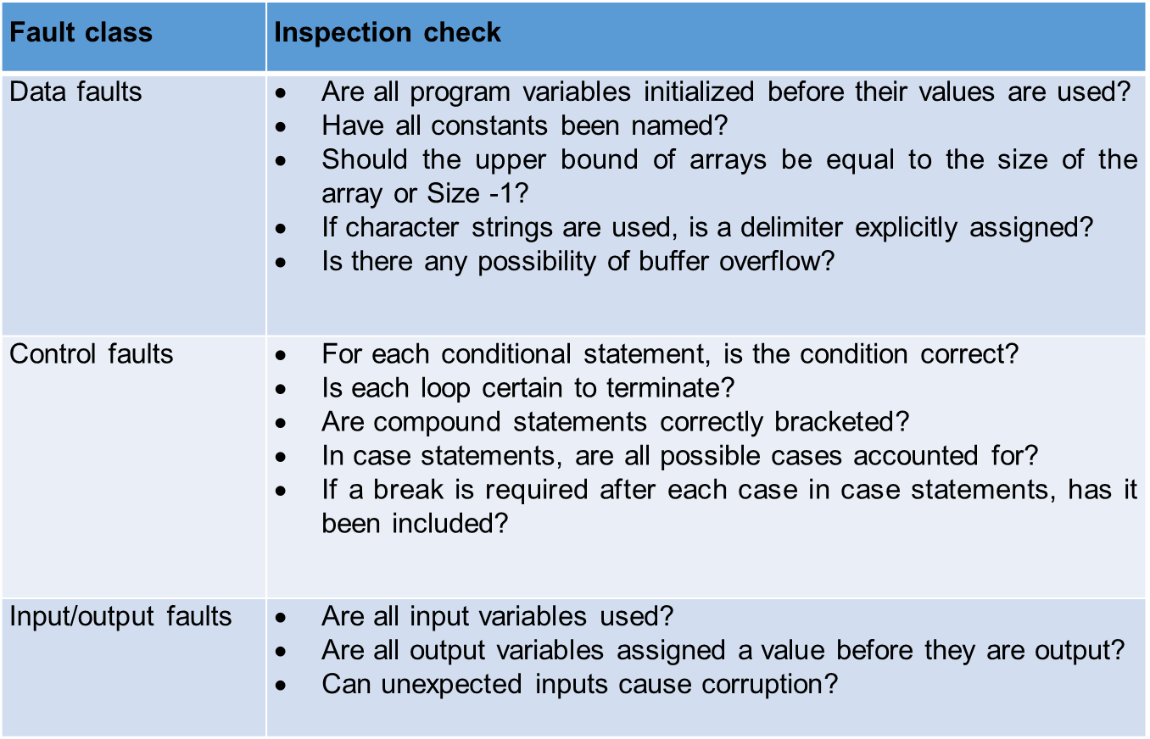
An inspection checklist (a)

Slide 24
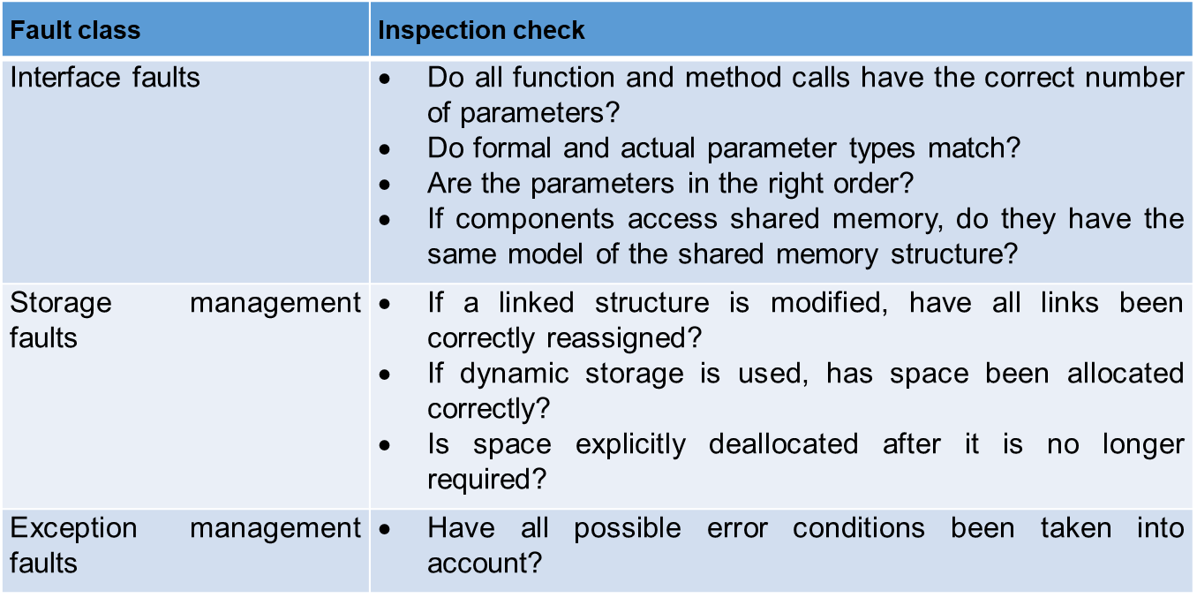
An inspection checklist (b)

