Slide 1
INFORMATION SYSTEMS 3A
Current Trends in System Development

Slide 2

Contents
Trends in System Development Methodologies
Trends in Technology Infrastructure
Trends in Application Software Availability
The Web as an Application Platform

Slide 3
Three Current Methodologies
There are many specific system development methodologies used in practice, and this chapter covers three influential ones
  The Unified Process (UP)
  Extreme Programming (XP)
  Scrum
These methodologies all use an iterative SDLC
The Unified Process uses UML
Extreme Programming and Scrum are based on agile principles, but the Unified Process can also be used in an agile fashion
Many organizations mix and match features of each of these when creating their own methodology

Slide 4
The Unified Process (UP)
Originally developed by Booch, Rumbaugh, and Jacobson, who previously developed UML at Rational Software (now part of IBM)
The UP is now widely recognized as a highly influential innovation in software development methodologies for object-oriented development using an adaptive approach
The original version of UP defined an elaborate set of activities and deliverables for every step of the development process
More recent versions are streamlined, with fewer activities and deliverables, simplifying the methodology
Much of the book’s methodology is loosely based on the Unified Process (in an agile form)

Slide 5
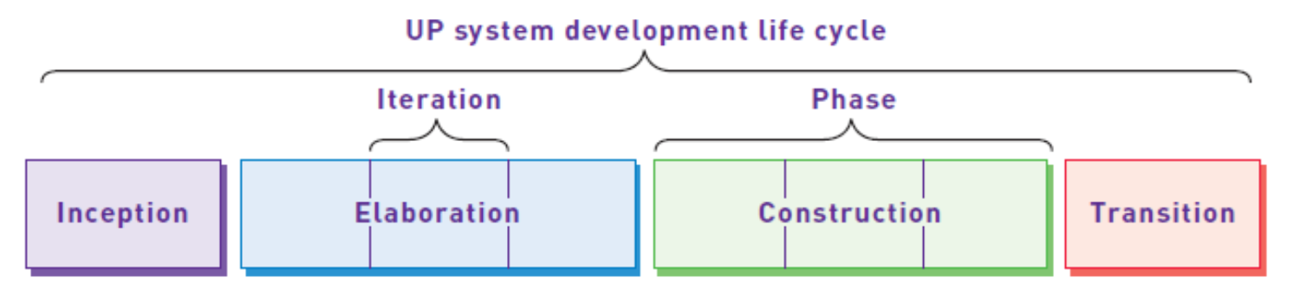
The Unified Process
Life Cycle
The Unified Process Life Cycle model includes iterations and phases (the SDLC in this text is very similar, but left out the UP phases for simplicity)
Each UP phase is made up of iterations. The phases are Inception, Elaboration, Construction, and Transition

Slide 6
The Unified Process
Disciplines
UP Disciplines – a set of functionally related activities that combine to enable the development process in a UP project (each like a core development process):
  Business modeling
  Requirements
  Design
  Implementation
  Testing
  Deployment
  Configuration and change management
  Project management
  Environment

Slide 7
The Unified Process
Disciplines in Each Iteration

Slide 8
The Unified Process
Complete UP SDLC Model

Slide 9
The Unified Process
Philosophies/Practices
Focuses early and often on users
Use case driven
Model driven – uses UML exclusively
Iterative, but provides management structure by defining phases
Focuses on defining an architecture
Adaptable to needs of a specific project
Can be made highly agile, but originally had heavy ceremony

Slide 10
Extreme Programming (XP)
One of the original agile development methodologies (perhaps a reaction to the original UP) from Kent Beck
“Extreme” often thought to be radical, but really just focuses intently on industry best practices and combines best practices in new ways
XP is based on core values
  Communication
  Simplicity
  Feedback
  Courage
XP also defines a set of XP practices

Slide 11
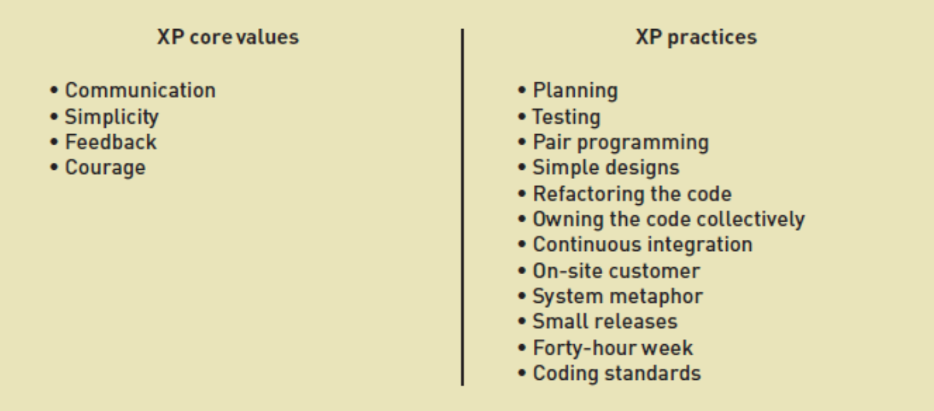
Extreme Programming (XP)
Core Values and Practices

Slide 12
Extreme Programming (XP)
Core Values
Communication—one of the major causes of project failure is a lack of open communication among the right players at the right time and at the right level
Simplicity—XP includes techniques to reinforce keeping things simple to make it a standard way of developing systems
Feedback—as with simplicity, getting frequent, meaningful feedback is recognized as a best practice of software development
Courage—developers always need courage to face the harsh choice of doing things right or throwing away bad code and starting over

Slide 13
Extreme Programming (XP)
XP Practices
Planning—XP planning focuses on making a rough plan quickly and then refining it as things become clearer. This reflects the Agile development philosophical dictum that change is more important than detailed plans
Testing—XP intensifies testing by requiring that the tests for each use case (story) be written first—before the solution is programmed
Pair Programming—XP practice in which two programmers work together on designing, coding, and testing software
Simple Designs—XP conforms to the principles of Agile Modeling. It accomplishes the desired result with as few classes and methods as possible and that doesn’t duplicate code

Slide 14
Extreme Programming (XP)
XP Practices (continued)
Refactoring the Code— refactoring is the technique of improving the code without changing what it does. XP programmers continually refactor their code to achieve a simpler design
Owning the Code Collectively —in XP, everyone is responsible for the code. Collective ownership allows anyone to modify any piece of code.
Continuous Integration —this practice embodies XP’s idea of “growing” the software. Small pieces of code—which have passed the unit tests—are integrated into the system daily or even more often
On-Site Customer —as with all adaptive approaches, XP projects require continual involvement of users who can make business decisions about functionality and scope

Slide 15
Extreme Programming (XP)
XP Practices (continued)
System Metaphor —a system metaphor should be easily understood and well known to the members of the development team. It can guide members toward a vision and help them understand the system
Small Releases —consistent with the entire philosophy of growing the software, small and frequent releases provide upgraded solutions to the users and keep them involved in the project
Forty-Hour Week — the exact number of hours a developer works isn’t the issue. The issue is that the project shouldn’t be a death march that burns out every member of the team
Coding Standards —developers should follow standards for coding and documentation

Slide 16
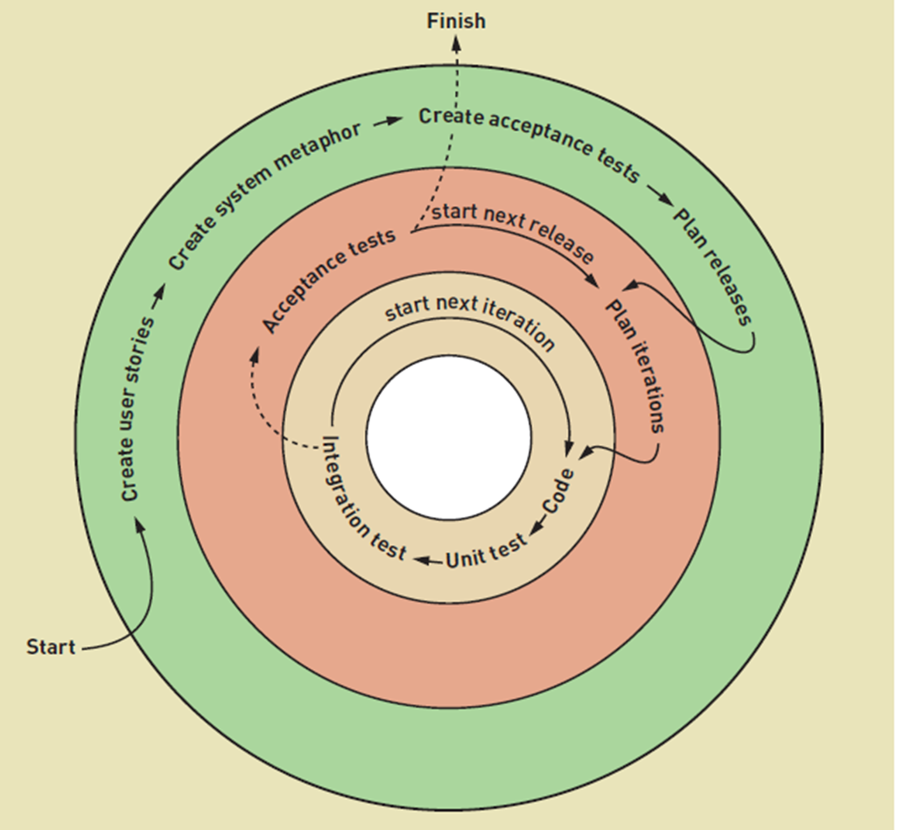
XP Activities
Project Activities
Release Activities
Iteration Activities

Slide 17
Scrum
Another influential agile, iterative development methodology based on ideas from Rugby
A Scrum is used to get a ball back into play after a penalty--it begins quickly, is a very intense effort, involves the entire team, and usually only lasts for a short duration
Scrum philosophy is the complete control a team exerts over its own organization and its work processes. Software is developed incrementally, and controls are imposed empirically—by focusing on things that can be accomplished.

Slide 18
Scrum Organization
Product backlog – a prioritized list of user requirements used to choose work to be done in a Scrum project
  Only a few of the high-priority items are worked on at a time
Product owner – the client stakeholder for whom the system is being built
  Responsible for project backlog and priorities
Scrum master – the person in charge of a Scrum project—similar to a project manager
Scrum team is usually 5 to 9 people
Scrum team sets own goals, organizes self, makes decisions

Slide 19
Scrum Practices
Sprint – a time-controlled mini-project that implements a specific portion of a system
  Firm 30 day time box with specific goal or deliverable
  The scope of that sprint is then frozen, and no one can change it—neither the product owner nor any other users
    Sprint backlog defines the scope
Daily Scrum – a daily meeting of all members of the team to report progress (15 minutes max)
Sprint final half-day review meeting – scheduled to review and identify changes needed for the following sprints

Slide 20
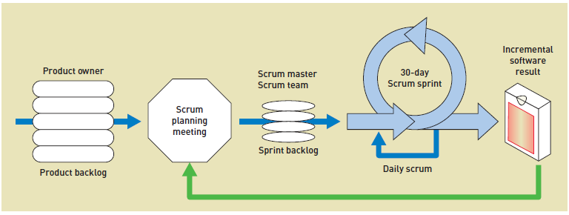
Scrum Development Process

Slide 21
Trends in Technology
Infrastructure
New Client Computing Devices and Applications –Small, mobile, connected
  Device-top application – a computer application that is built to execute on a local device without requiring a client/server connection
  Free-standing Internet application –a client/server application that is self-contained and doesn’t require the use of a Web browser
  Browser-based application –a client/server application that executes locally within the control of a Web browser

Slide 22
Trends in Technology
Infrastructure
Internet and Telephone Communications
  Internet, the telephone, and television are merging
  Long-distance telephone communication and long-distance Internet communication have very similar requirements and capability
  Internet backbone – the primary data routes between large, strategically interconnected networks and routers on the Internet
  Last mile – the final leg that delivers connectivity from the Internet network to the customer

Slide 23
Trends in Technology
Infrastructure
Back-End Computing –the server computers that provide the content—dynamic and static—for all applications that access servers through the Internet
  As more and more client computers try to access a particular application, the workloads on the servers becomes incredibly heavy
  Several factors are driving the need for large back-end computing services
    Trend toward continuous connectivity to the Internet
    Massive amount of data stored—many applications in the world of commerce keep a history of all the transactions that occur
    The consolidation of processing in central locations

Slide 24

Data and programs are off the PC and back in massive data centers

Slide 25
Trends in Application Software
Availability
Software as a service (SAAS) – a software delivery model similar to a utility, in which the application and its associated data are accessed via the Internet without locally installed programs
Open-source software – a method of developing, delivering, and licensing software that makes the application source code freely available to any interested developer or client

Slide 26
Owning Software vs. SAAS

Slide 27
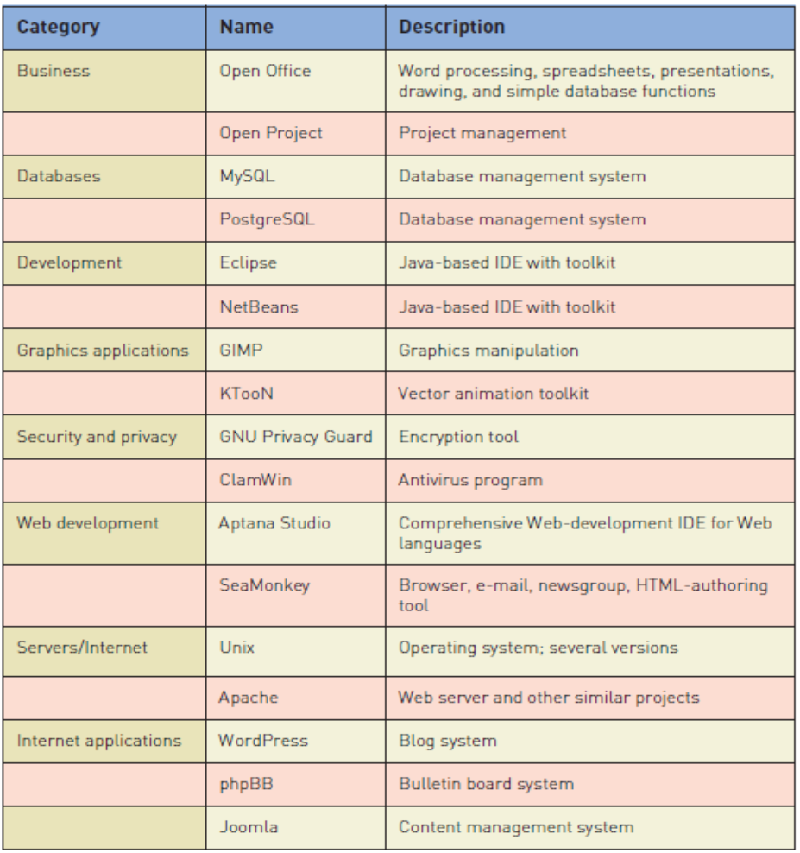
Open Source Software Applications

Slide 28
The Web as an Application Platform – The Evolution

Slide 29
The Web as an Application Platform
Web 2.0 – a loosely defined, nonstandard term used to refer to Web sites that permit user-generated content and user interaction, such as social networking sites
Plug-ins – a software component that adds specific capabilities to a larger software application
Widget – a type of plug-in that focuses on enhancing the user interface with additional capability (also called gadget)
Theme – a type of add-on to an application that allows the look and feel, such as colors and layout, to be changed

Slide 30
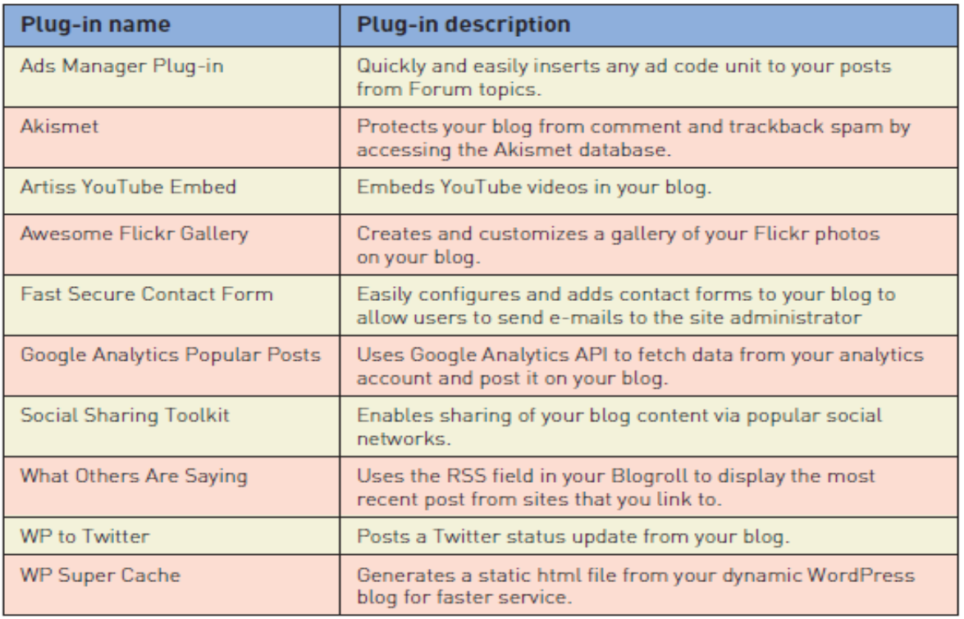
Sample Plug-ins for WordPress Blog

Slide 31
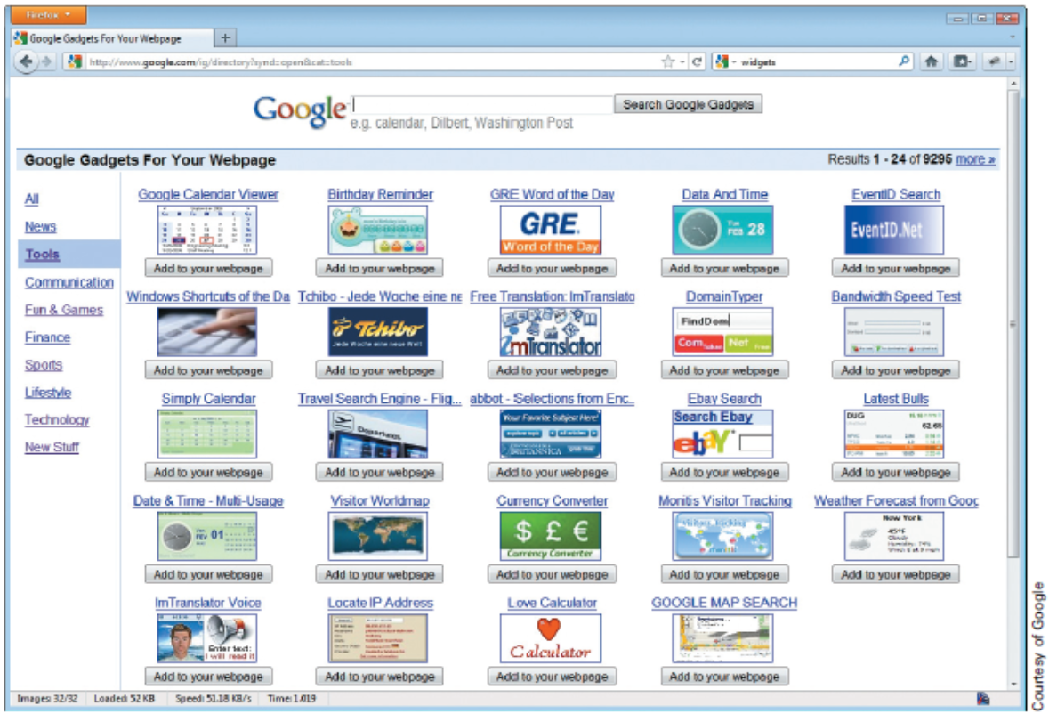
Sample Google Web Page Gadgets

Slide 32
The Web as an Application Platform (continued)
Toolbar – a type of add-on usually comprised of iconic menu items that access the capabilities of the application or plug-ins in a user-friendly fashion
Web mini-app – a software application that provides a complete set of functions but that must be executed within the confines of another application
Mashup – a type of Web site that combines the functionality of several other Web sites through the use of predefined APIs
Rich Internet Applications (RIAs) –a type of Web site that provides active user interaction as well as delivers rich multimedia

Slide 33
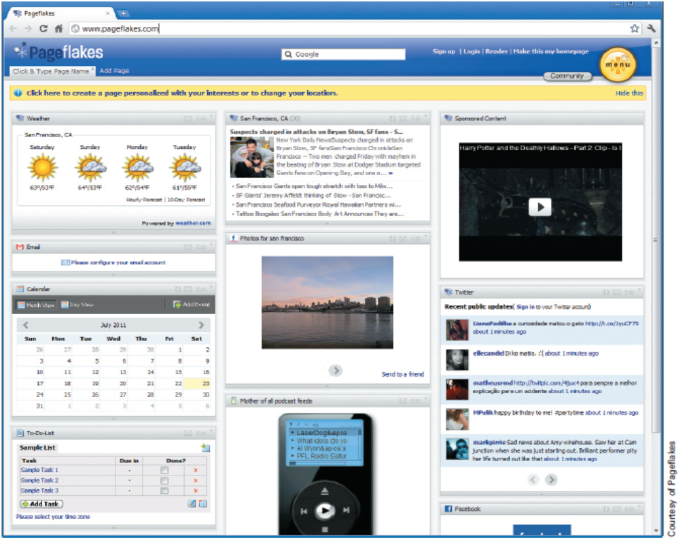
Mashup of Several APIs to Create a Dashboard Page

Slide 34
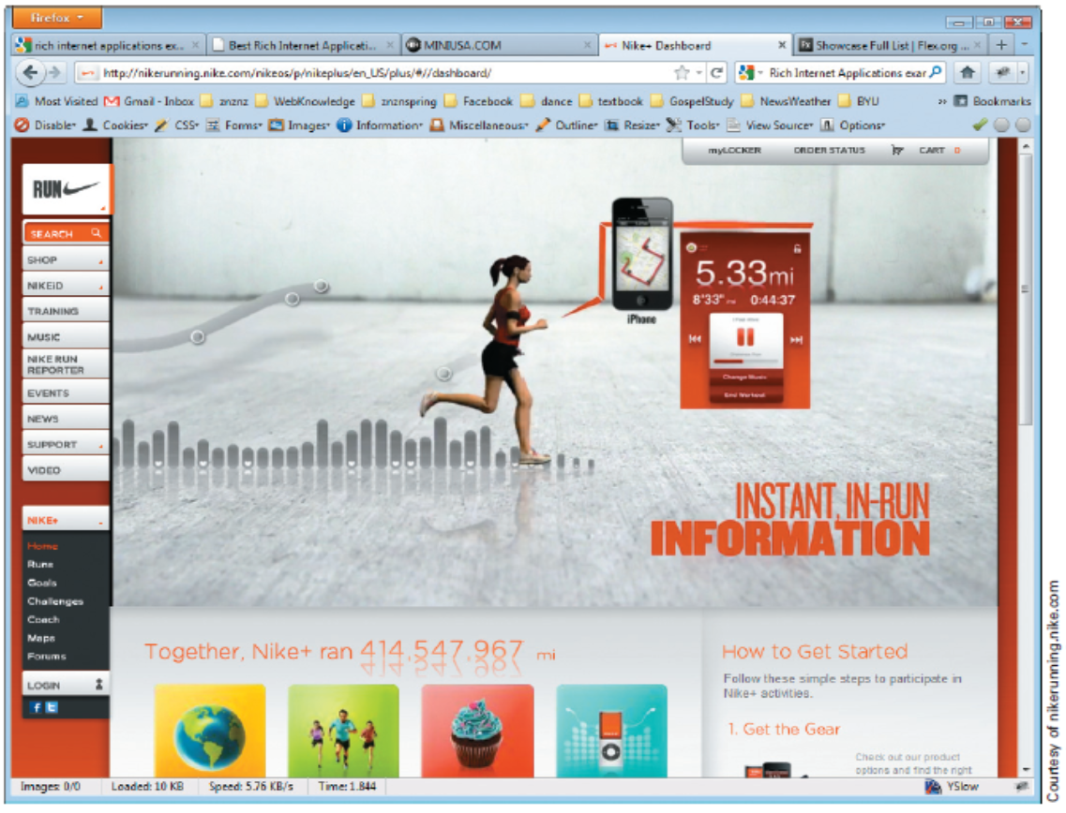
Rich Internet Application (RIA)

Slide 35
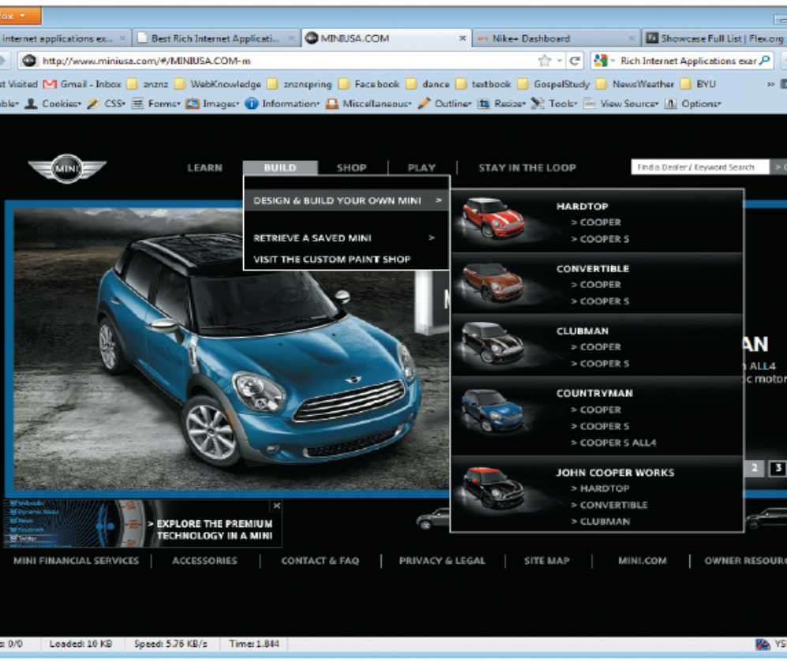
Rich Internet Application (RIA)

Slide 36
Rich Internet Applications (RIAs)
JavaScript and Ajax Libraries
  De facto standard for adding desktop-like computing within browsers
ICEFaces and JavaFX
  Open-source framework that provides Java language APIs to build and deploy server-based RIAs
Adobe Flash Platform
  Best known as a multimedia platform for animation and interactivity
Microsoft Silverlight
  Microsoft’s Windows Communication Foundation (WCF) .NET RIA Services to support the development and deployment of RIAs
HTML5
  New HTML specification that standardizes RIA specifications for built-in browser delivery

