Slide 1
From Requirements to System Design
Subject Name: Applications Development Project Subject Code: APDP201
Lecturer Name : Freedom Khubisa
Department : Information Technology

Slide 2
Objectives
Distinguish between functional and non-functional requirements.
Explain the importance of system design in the software development lifecycle
Describe various components of high-level and low-level design and Create basic architectural diagrams from a given set of requirements.
Demonstrate traceability between requirements and system architecture
Lesson Outline

Slide 3
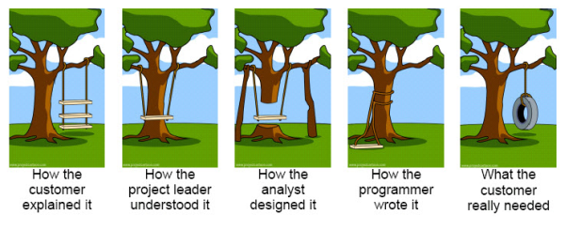
introduction
You’ve gathered the requirements — now what?
“A good design begins with good understanding”

Slide 4
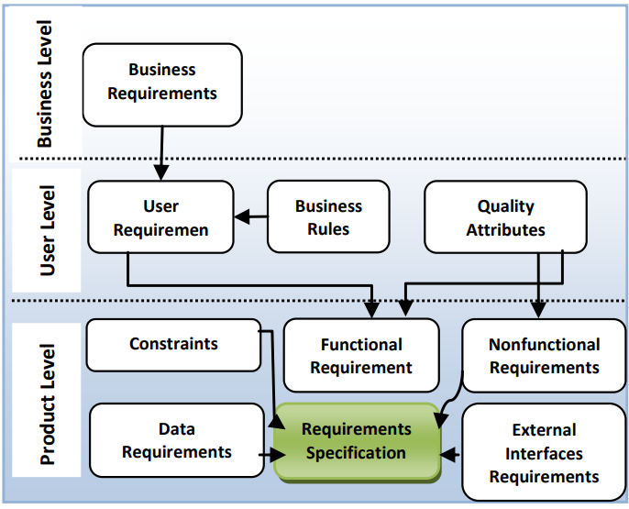
Business Requirements: High-level goals from stakeholders (e.g., increase efficiency, improve user access).
User Requirements: Describe what the users need the system to do. These are derived from the business goals.
Business Rules: Define policies, regulations, or conditions that constrain or guide system behavior (e.g., a customer can't place an order without an account).
Quality Attributes: Also known as non-functional aspects like usability, reliability, security, etc.
Constraints: Limitations like platform restrictions, compliance standard, etc.
Data Requirements: Define what data is needed, formats, integrity rules, etc.

Slide 5

User story example
As a registered user, I want to be able to reset my password so that I can regain access to my account if I forget it.
Functional Requirements
The system shall provide a "Forgot Password" link on the login page.
The system shall validate the email address against registered users.
The system shall generate a secure, time-limited password reset token.
The system shall send a password reset link to the user's email address.
The system shall enforce password complexity rules when creating the new password.
The system shall notify the user once their password has been successfully reset.

Slide 6
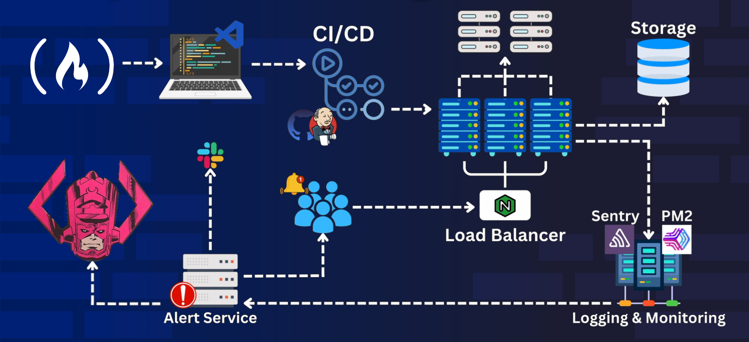
Why system design is needed
Purpose of Design:
  Translate requirements into a blueprint
  Handle complexity
  Plan for implementation and scaling
Without design:
Risk of misunderstandings
Poor performance or fragile systems
Harder to debug or scale

Slide 7
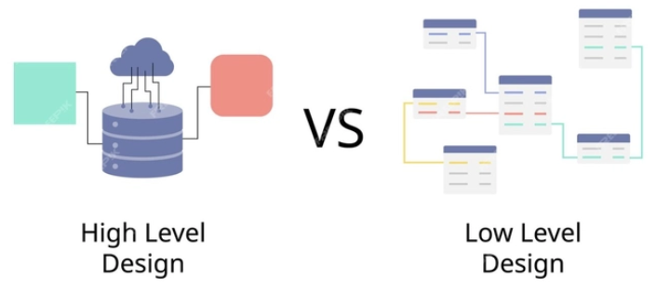
system design concepts
The process of planning the structure of a software system before development. It ensures that the system meets requirements in an efficient, scalable, and maintainable way.

Slide 8
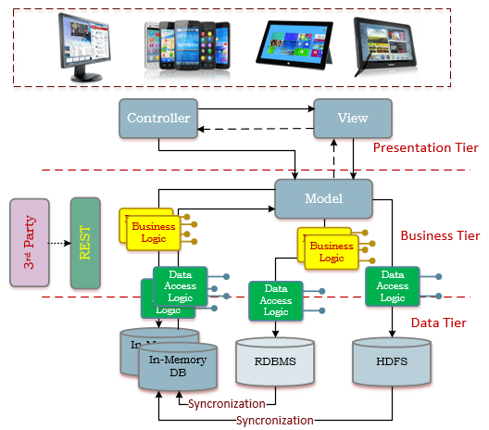
High level design
To provide an overall view of the system's structure, its components, and how they interact. It defines the system architecture, communication between subsystems, and data flow.
Key Features:
Describes major components or modules
Identifies the relationships and interactions between them
Focuses on what each component does, not how
Type of Diagrams
  Component Diagrams
  Data Flow Diagrams
  System Context Diagram

Slide 9
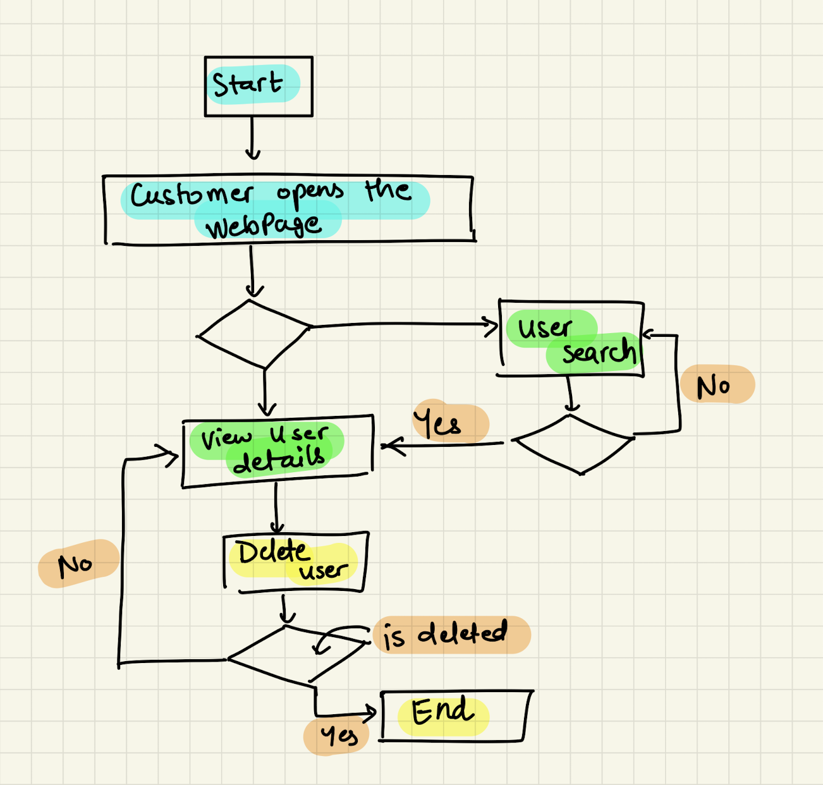
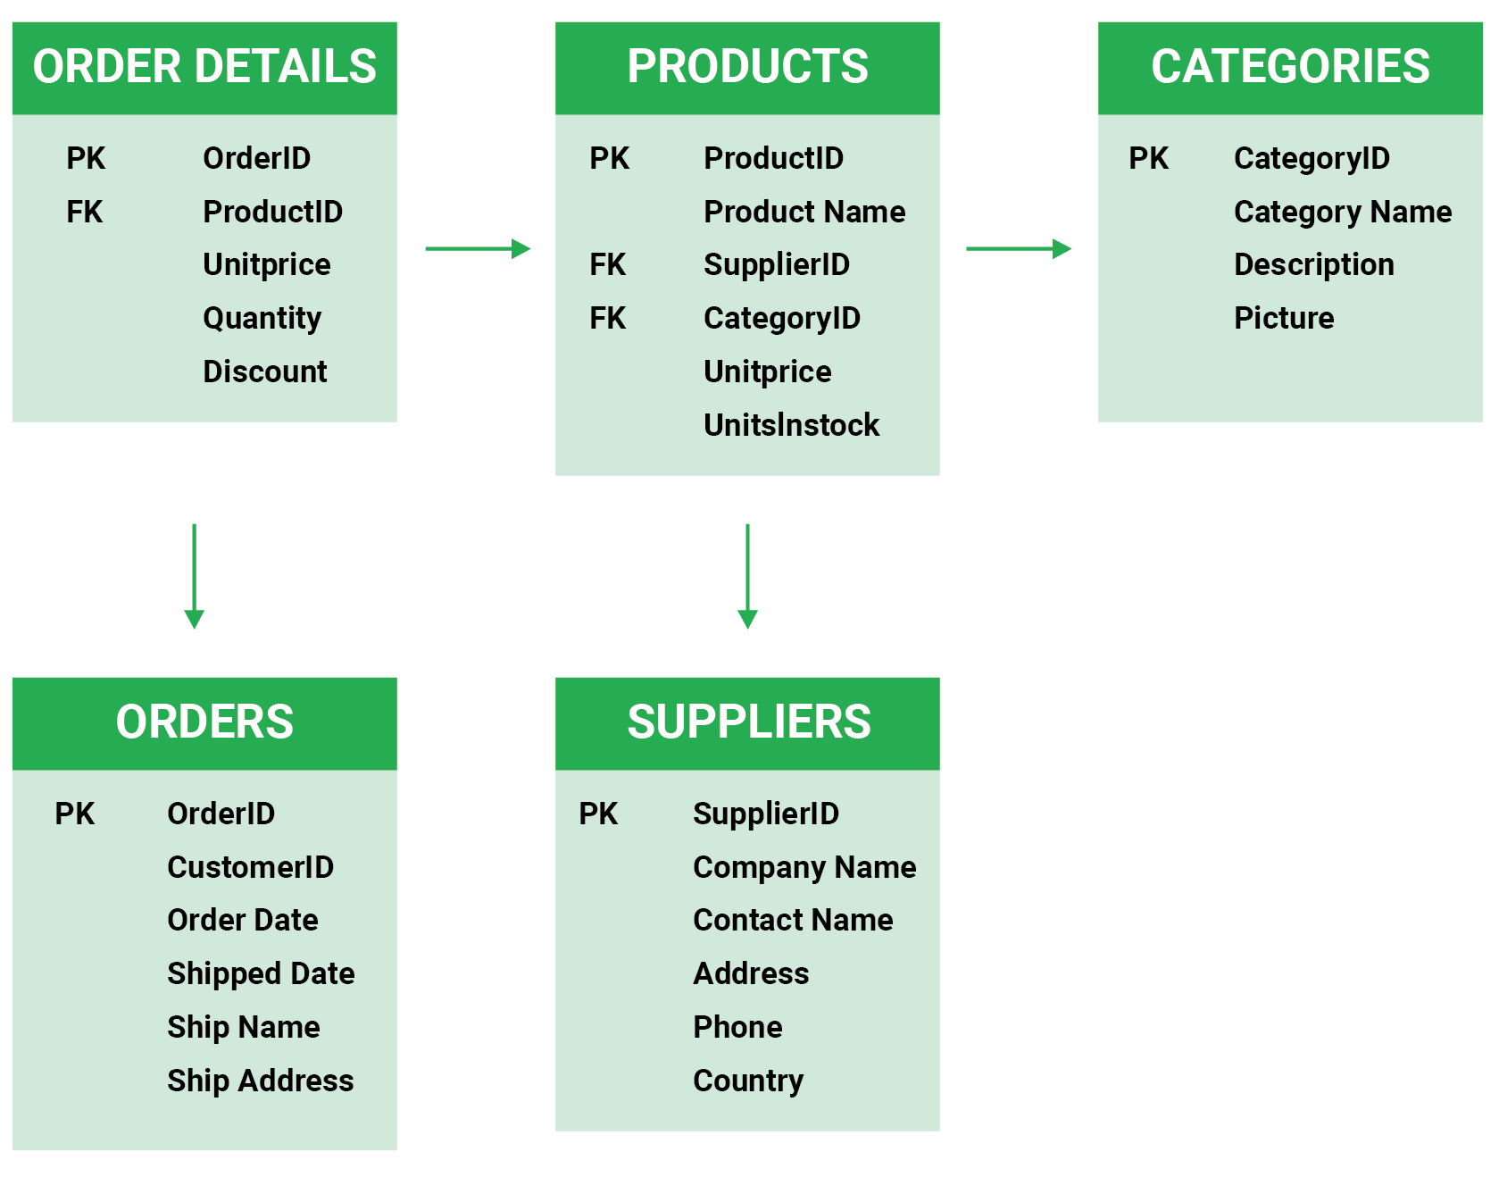
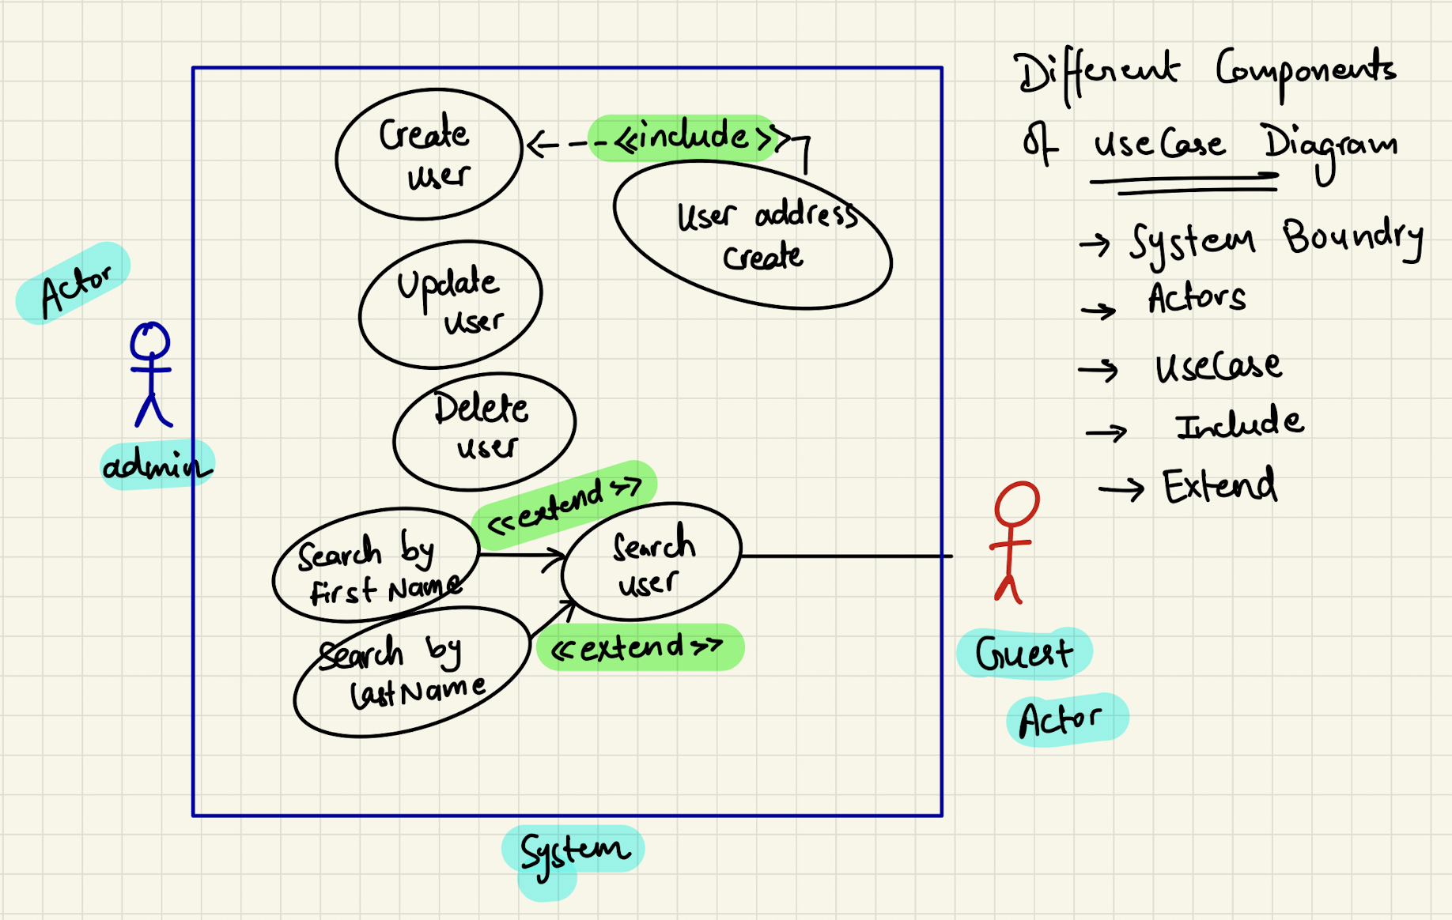
LOw level design
To detail the internal logic, class structures, methods, algorithms, and data handling of each component identified in HLD.
Key Features:
Defines classes, interfaces, attributes, and methods
Specifies database schema and table relationships
Details business logic and algorithmic flow
Type of Diagrams
  Class Diagram
  Sequence Diagram
  ERD (Entity Relationship Diagram)
  Pseudocode or flowcharts

Slide 10
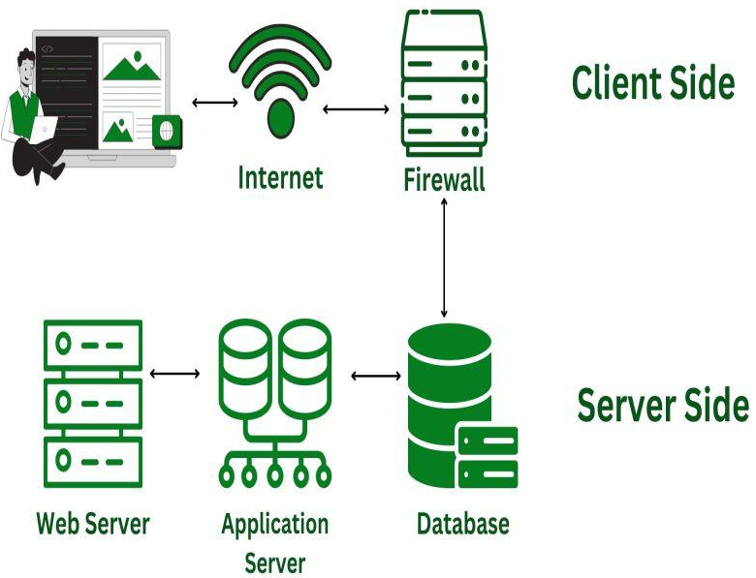
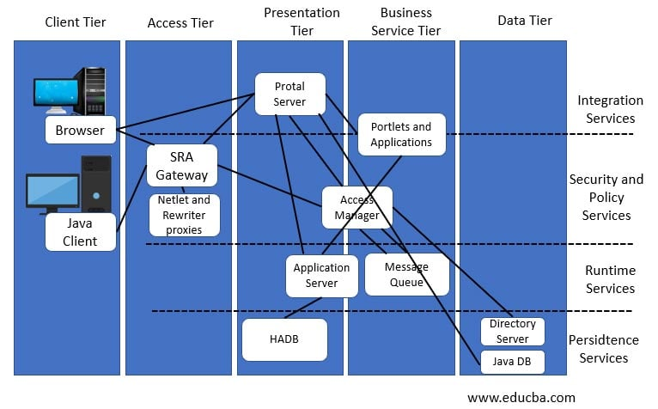
System architecture
System architecture is the structural design of the entire software system from a technical viewpoint
Architecture ensures the system is organized, scalable, and resilient.
It serves as the foundation for developers, DevOps engineers, and testers

Slide 11

Summary
Good design starts with clear requirements
Design links user needs to system structure
Use both logical and physical views
Visualize your system before coding!
Explore tools such as Lucidchart, draw.io, StarUML
Homework
  Redesign a basic system (e.g., attendance tracker) with requirements, HLD and LLD (2 diagrams)

