Slide 1
Recording periodic Fluid Intake and Output for Critically ill patients in the ICU and create a graph for the clinical observation.

Slide 2
Dependencies/Resources used in the project
HTML
CSS
JavaScript:
Chart.JS (To generate graphs)
Google Firebase(To store data and authenticate users)

Slide 3
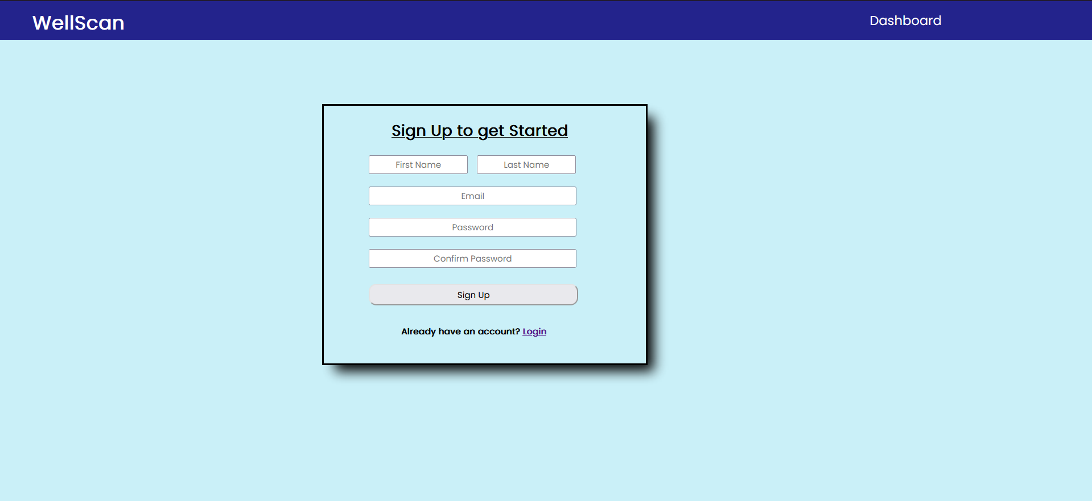
Sign-Up Page
----------------------------------------------------
When we open the site, we are welcomed by the sign up page. A doctor using this would enter the his details such as his first and last name, his email and the password he wants to set.
If the entered email is invalid or the password is weak, less than 6 characters long, the Google Firebase SDK throws an error. Hence, we have setup a .catch() error handler.
If an error is received, we execute the in-built alert function with an appropriate message.
If the user already has an account, they can click on the “Login” text on the bottom of the form which redirects the user the login page.

Slide 4
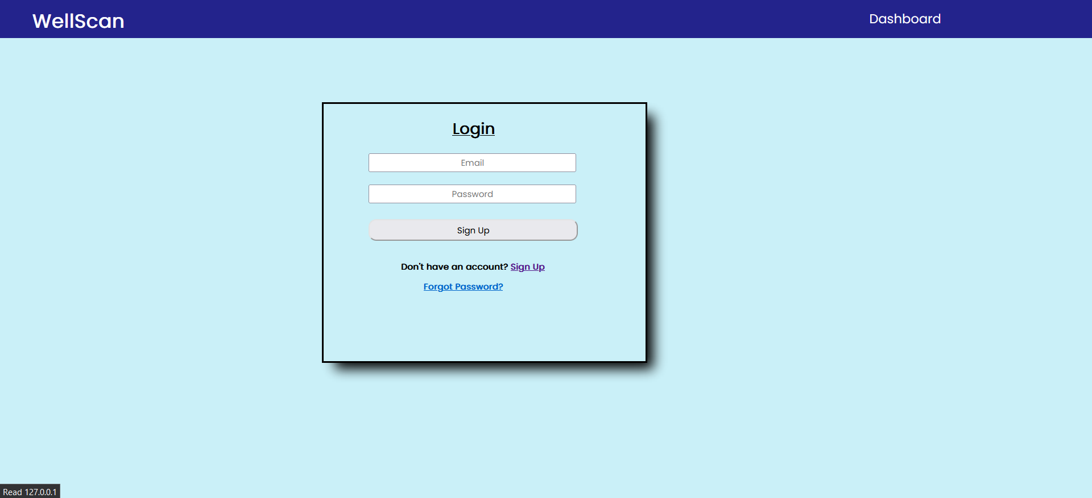
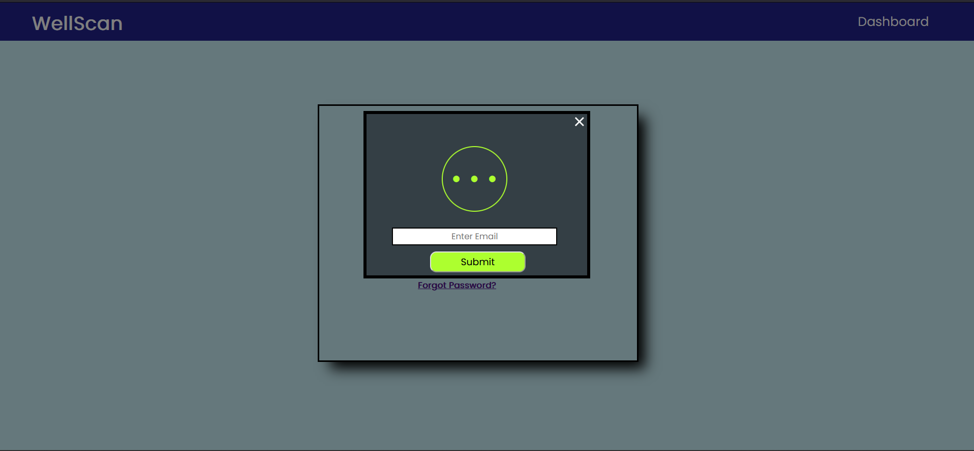
Login Page
----------------------------------------------------
Here, a doctor who already has an account would log into his/her account by entering the email he/she used while registering his account and the password
If the doctor does not have an account, he can click on the “Sign Up” text which will redirect him/her to the sign up page.
If the doctor has forgotten his/her password, he/she can set it again by clicking on the “Forgot Password” text where they have to input the email they are registered with and set another password.
If the doctor tries and enter invalid data, incorrect email or/and password, or tries logging in without having an account, the Google Firebase SDK would throw an error. Hence, we have setup a .catch() error handler.
If an error is caught, we display an appropriate error message to the user through the built-in ‘alert’ function.
If the doctor has forgotten their password, they can reset their password by clicking on the “Forget password” text. They will be required to enter an email and then they will receive an email with a link to change their password. This is done by calling Firebase Authentication’s sendPasswordResetEmail function.

Slide 5
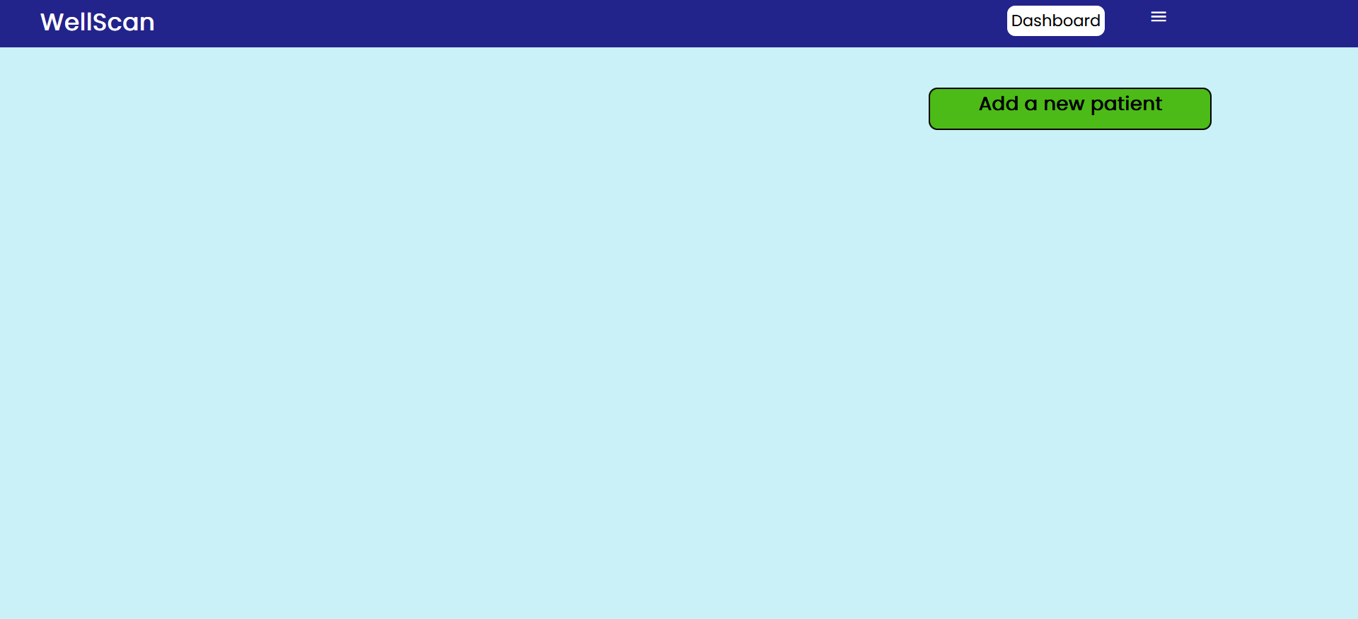
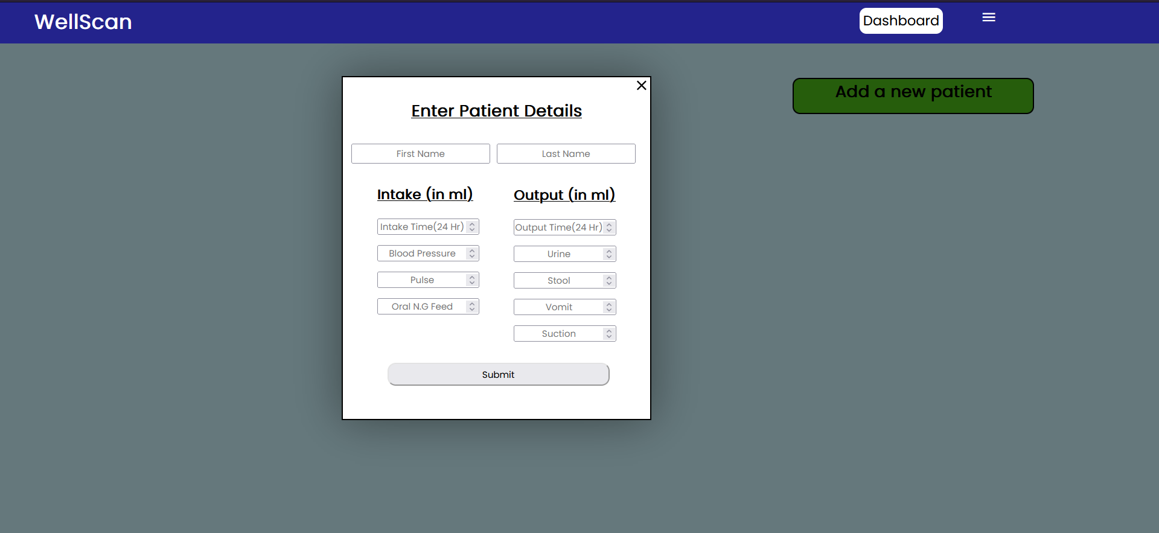
Main Dashboard Page Pt. 1
-----------------------------------------------------------------
After the doctor has successfully logged in/signed up, they are redirected to the main dashboard.
There is a Navigation Bar on the top of the screen with two elements. One is ‘Dashboard’, which redirects to the dashboard, and the other one is a menu icon. Upon being clicked, it reveals a dropdown menu with an element, ‘Sign out’, if the doctor wishes to sign out, they would click this and be redirected to the login page.
Underneath the bar, there is a button labelled “Add a new patient”. When the doctor clicks this, they are prompted with a form as you can see. They have to fill out the form with the corresponding fields.
If a patient is created successfully, a pop up is displayed to inform the doctor that the process was successful. If it was not, an error pop up is displayed.
After a patient is created, the form closes and we can see the name of a patient in the form of a clickable button below the ‘Add new Patient’ button. If the doctor decides to add more patients, their names will be displayed below one another in a list so that the doctor has no difficulty in selecting patients.
If a new patient is added such that the patient’s first and last name matches exactly with a pre-existing patient, a new patient is not created but the display an error that says “Patient already exists”.

Slide 6
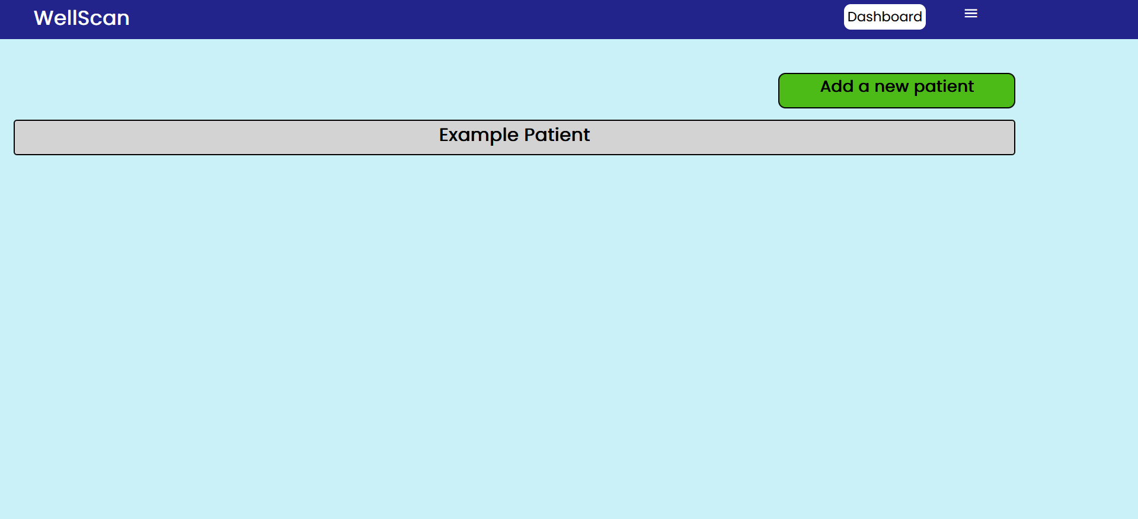
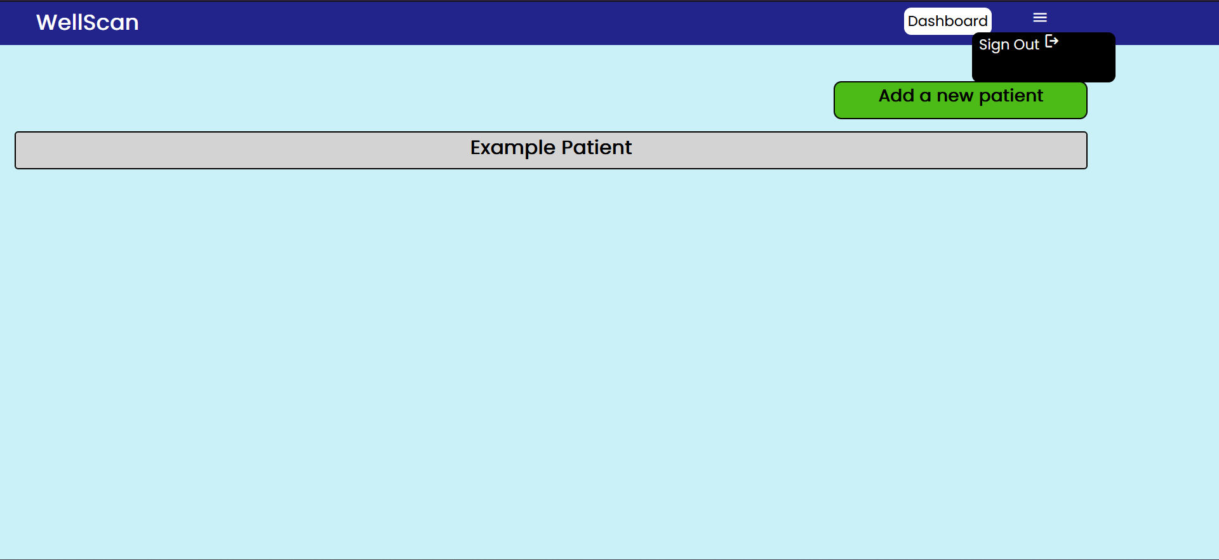
Main Dashboard Page Pt.2
------------------------------------------------------------------------------------
In this slide, the process of the patient being created, being displayed and stored will be explained.
We have setup an event listener for the ‘Sign out’ button on the dropdown menu. After the button is clicked, we use the Firebase’s authentication module’s sign out function to sign out. The doctor is then redirected to the login page
Firstly, after the user clicks the ‘Submit’ button of the form, we fetch all of the information provided into separate variables. We store these valuables in collections in the Firebase’s Firestore database. We create/access separate collections for each of the patients by naming the patient “patients” followed by the user id of the doctor, a user id of the doctor is generated by Firebase on default whenever an account is created.
Along with a collection for the patients, we create a collection called “innerhtml” followed by the doctor’s user id. Here we store a collection which is named the first name and the last name of the patient. In this collection, two documents are stored, one containing the h1 html tag and another one containing the first and last name of the patient. This is so that when we want to display all the patients, we iterate over all the collections. We create an element and display the full name of the patient as a button on that element.
In the patient’s collection, we store a collection with the name of the patient. Inside this collection, we store several documents such as blood pressure, pulse, oral N.G feed, etc. These documents store the values entered by the doctor. We also store arrays of the said values. We store arrays as well as the values as it will be of use later when we have to display the graphs

Slide 7
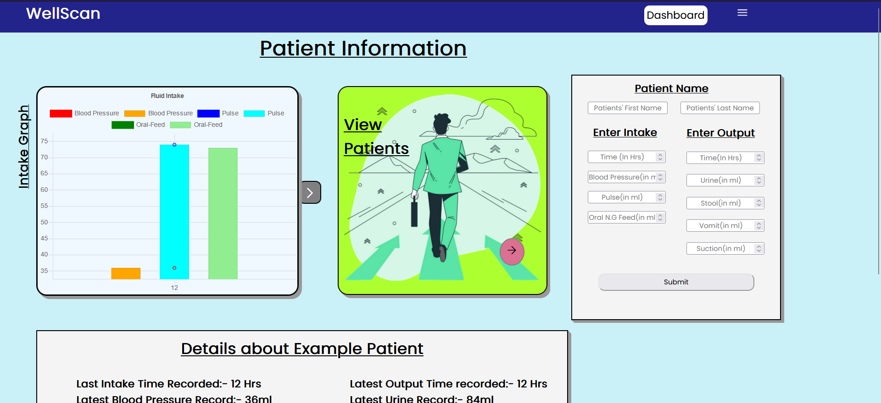
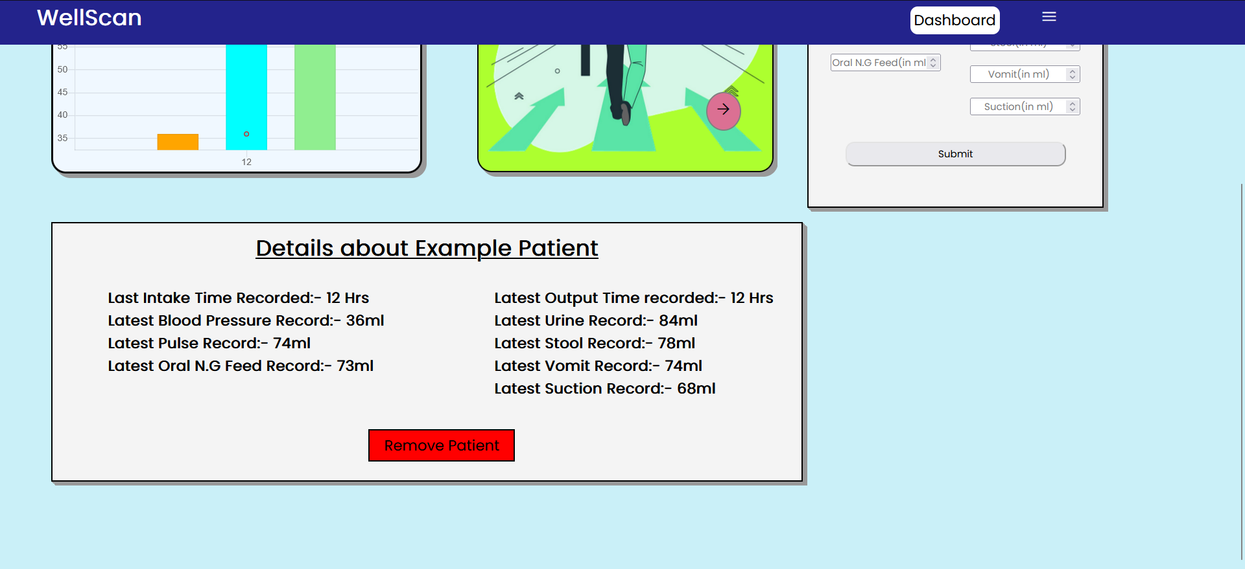
Graph Page Pt. 1
-------------------------------------------------------
In the dashboard page, after the doctor successfully creates a patient and clicks on the patient’s button, he is redirected to the graph page
Here, the doctor can view not only two graphs of the fluid intake/outtake by clicking on the arrow icon of the patient but also view the name of the patient, add more details of the patients, view the latest details inputted and remove the patient altogether.
If the doctor decides to update the details for the patient, he can fill out the form on the right-hand side. After clicking on the submit button, the page is reloaded in order for the graph’s change to take effect
There is a button in between of the graph and the form where the doctor can click in order to go back to the dashboard page if they wish to create a new patient.

Slide 8
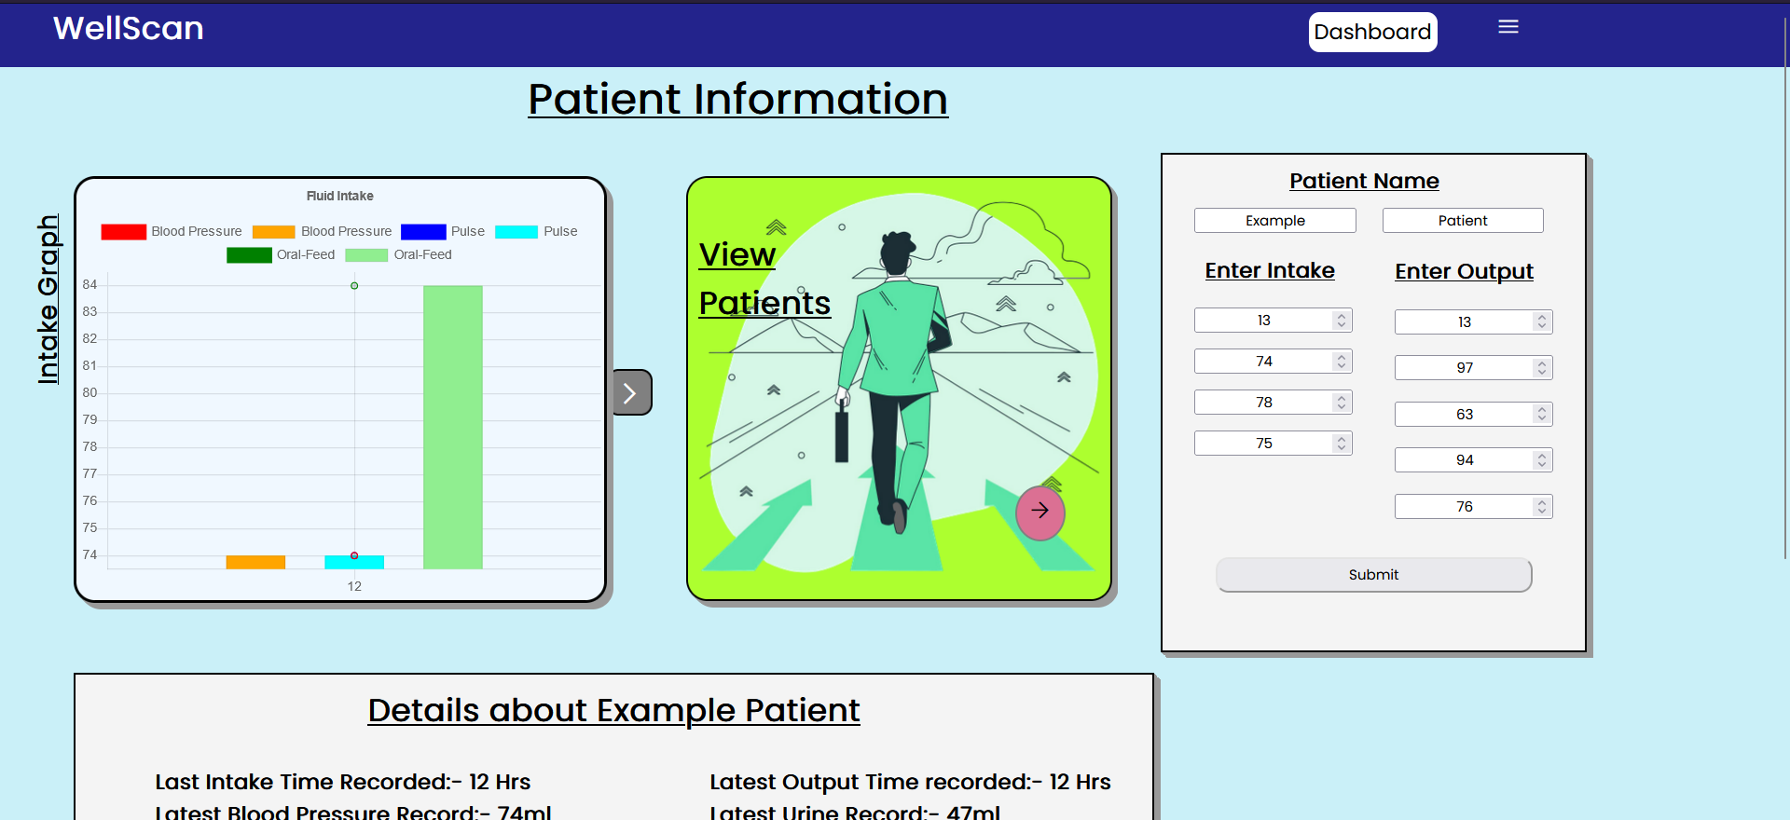
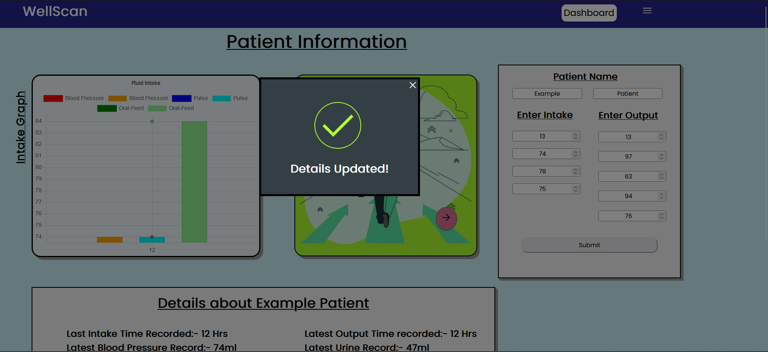
Graph Page Pt. 2
------------------------------------------------------------------
In this slide, the process of getting the data which was previously stored and generating a graph will be explained
Firstly, there are a canvas tag on the left side of the screen where the intake/output graph would be generated.
We first access the collection in which the patient was stored by finding a collection whose name is “patients” followed by the doctors user id
We store the arrays into separate variables by iterating over the collection
The arrays which store the intake time and output time are passed through a function where it is sorted. As we know, the doctor has to input the time in 24 hour format. If the doctor inputs 12 twice, we are faced with an error. 12 only appears once in the 24 hour format so the second 12 must be that of the next day. So we add 24 to the second appearance.
Also suppose, the array has two elements 12 and 10 in order. This is illogical as the doctor cannot input the readings he took at 12 before the ones he took at 10. So the 10 represents the 10 am of the next day, So we must add 24 to it as well.
In the function, we create a separate array with its first element the same as the first element of the inputted array. We iterate over the inputted array from its 2nd index. We check if its previous index is greater than or equal to its current one. We run a while loop based on this condition which will add 24 to the current index until the condition of the loop is false. Then, we push the current index to the new array. After the array is fully sorted, we return the separate array.

Slide 9
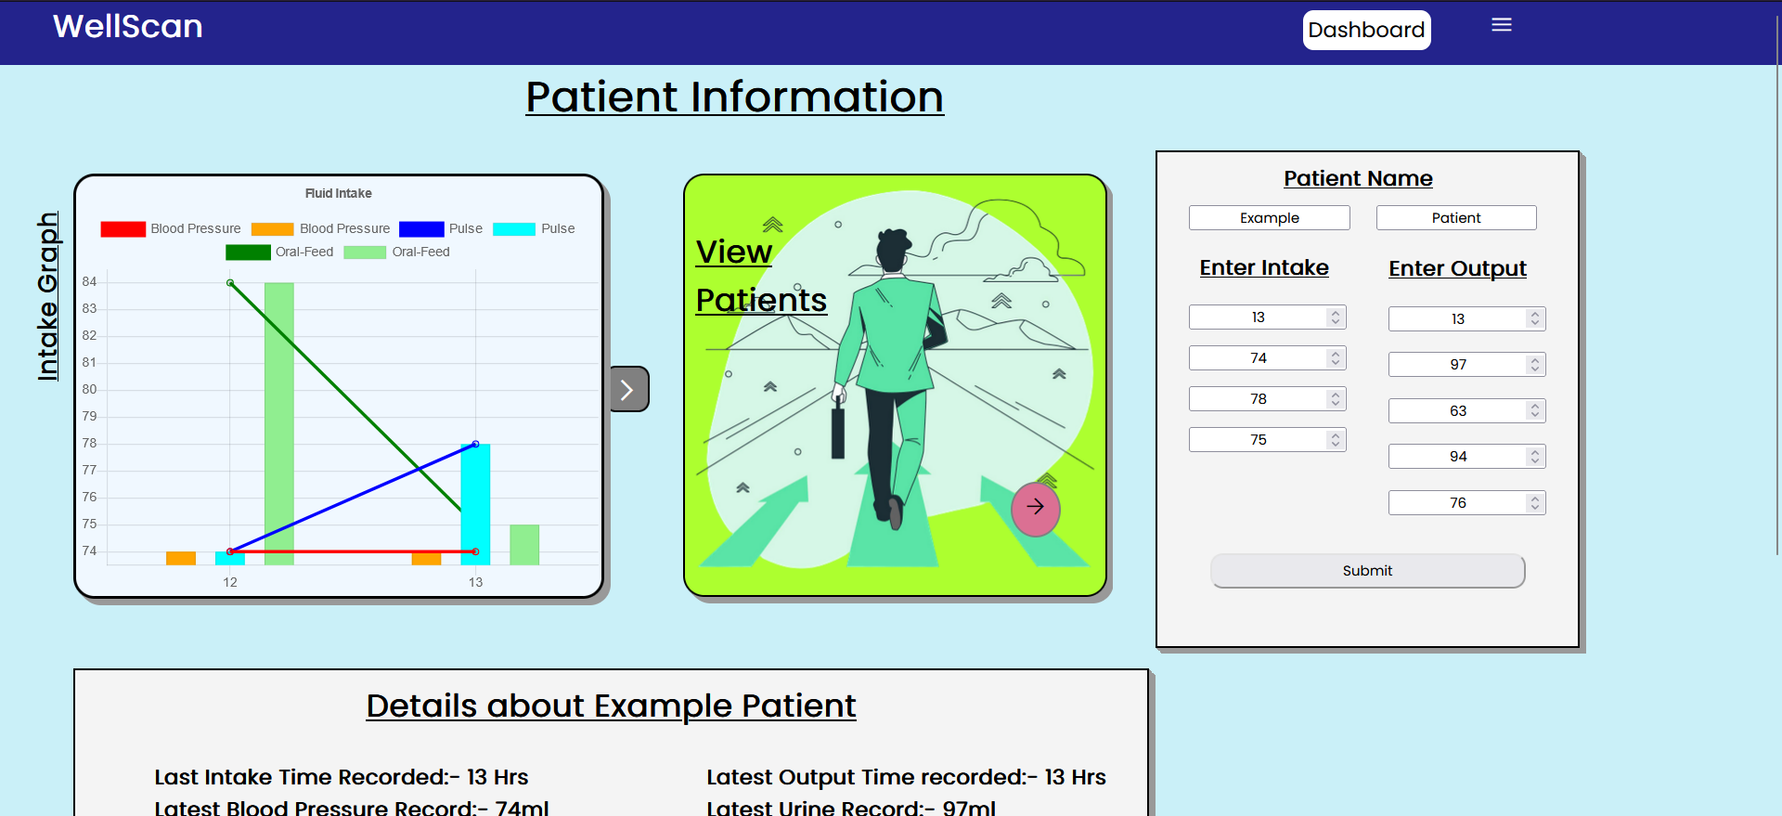
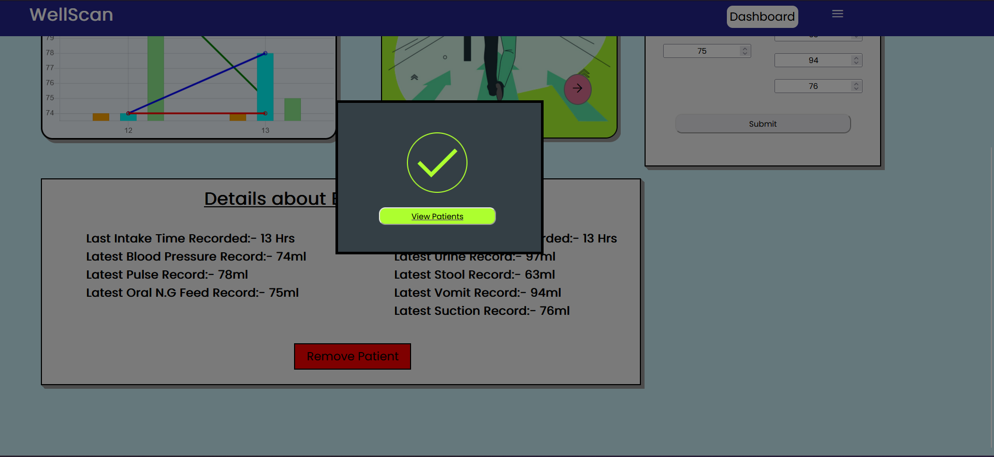
Graph Page Pt. 3
-------------------------------------------------------------------------------
After the both arrays are sorted, we create the graphs using Chart.JS
In the canvas tag, we create combo graphs of the inputted details over the time inputted. A combo graph is a bar graph and a line graph.
Firstly we create a new Chart object using the Chart.JS module. In the object, we first specify the default type as line so that a line graph is generated. Then we provide the data which is the time, blood pressure, pulse and oral N.G. After creating the line graphs, we create bar graphs by overriding the default type by explicitly declaring the type to be bar. We pass in the same data as the line graph.
After providing all details, we change the height, width, padding and the left margin of the graph. Finally, we call the update function of the Chart object so that the chart can be seen/updated
For the output graph, we follow the same steps but simply provide different data which is urine, stool, vomit and suction. Then we change the height, width, padding and the left margin of the graph and update the chart.
Both graphs cannot be viewed together. By default, the intake graph is showed. However, if the doctor clicks on the arrow button beside the graph, he can change the graph to the output graph and vice versa
On the bottom of the page, the doctors can view the last recorded details. We get the information by iterating through the documents and displaying the information directly.
There is also a ‘Remove Patient’ button which the doctor can use to delete the patient. We have setup an event listener for the button which, on being clicked, iterates through the collection. When a collection is found in which the documents containing the first and last name of the patient are equal to the first and last name of the current patient, we delete the collection from “patients” as well as from the “innerhtml” collection

Slide 10
Made by:
Garvit Maheshwari (Team Leader)
Jagrit Parakh

