Slide 1
Ordinal Measures for Texture
Ganiyu Ibraheem & Philipp Seybold
Advanced Computer Vision
Group A3

Slide 2
Overview
Introduction
Demonstration
Definition
Methods overview
…

Slide 3
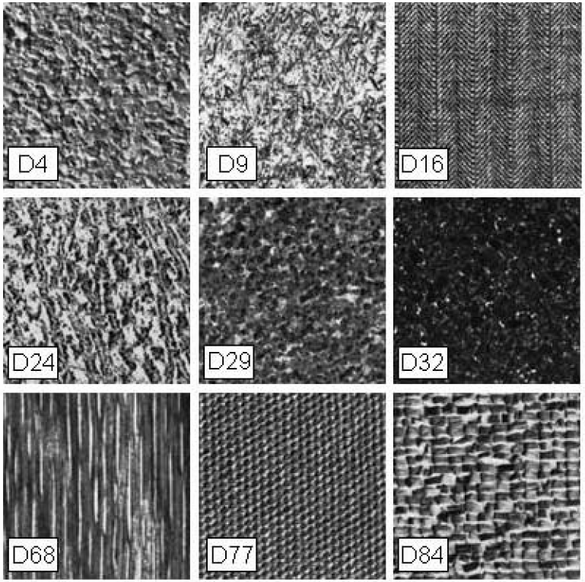
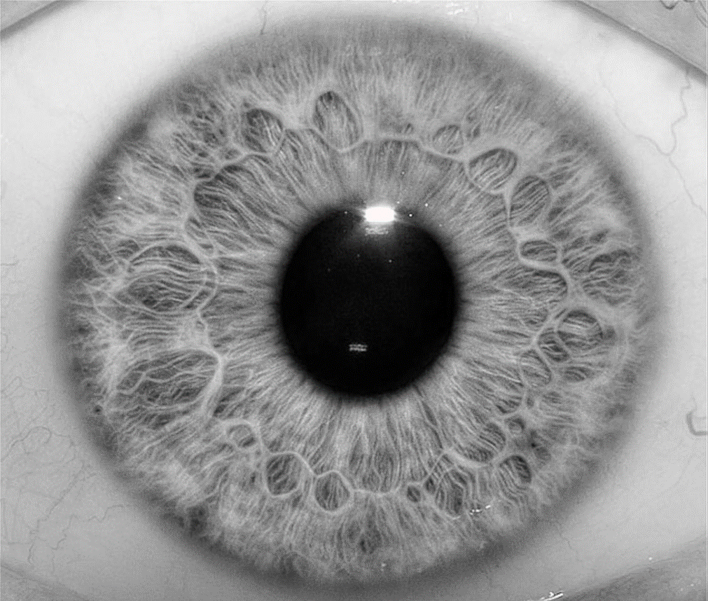
Introduction
Texture as descriptor
Notes:
Firstly introduced by Xiaofeng Ren and Jitendra Malik in their paper (but superpixel-like segmentation was applied already before): Learning a Classification Model for Segmentation
Goal: Classification model for Segmentation accuracy
Drew attention through good results and holding its promises
First algorithms around 2009

Slide 4
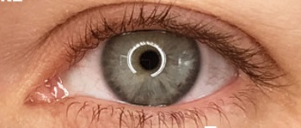
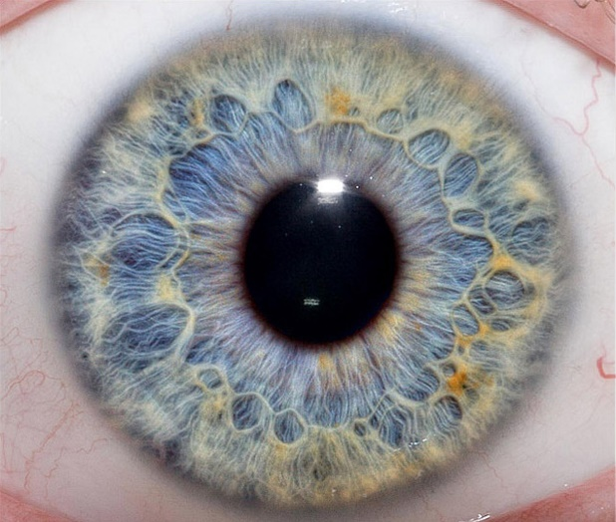
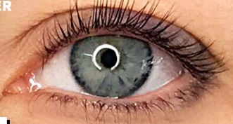
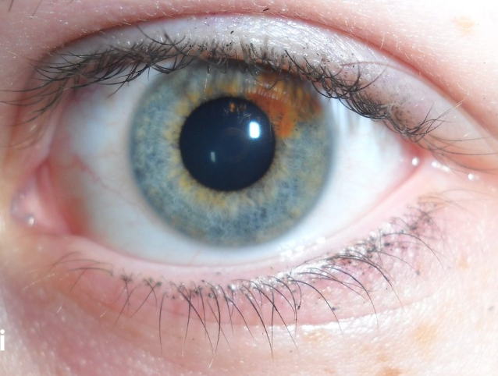
Demonstration
Ordinal measures for iris biometrics
Same eye

Slide 5


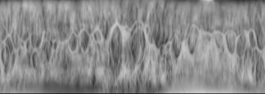
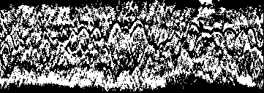
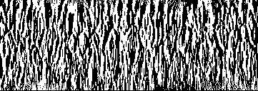
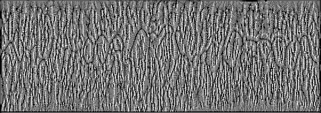
Demonstration (Ordinal measures for iris biometrics)

Slide 6

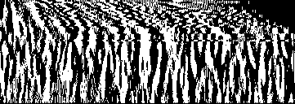
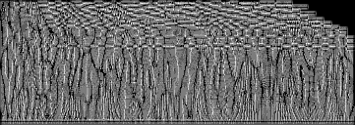

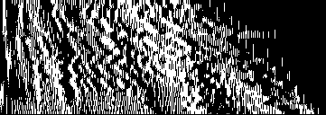
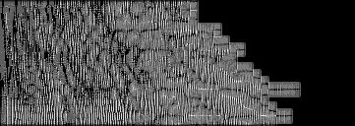
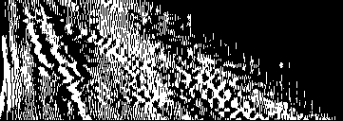
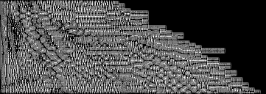
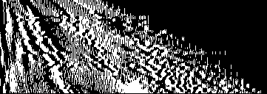
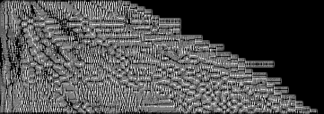
Demonstration (Ordinal measures for iris biometrics)
Vertical regions & binary
LBP

Slide 7
Demonstration (Ordinal measures for iris biometrics)
Vertical regions & binary
LBP

Slide 8

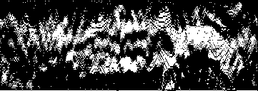
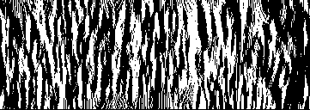
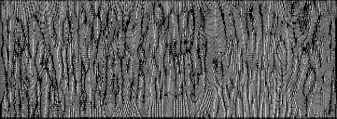
Demonstration (Ordinal measures for iris biometrics)
Horizontal
Vertical
LBP

Slide 9
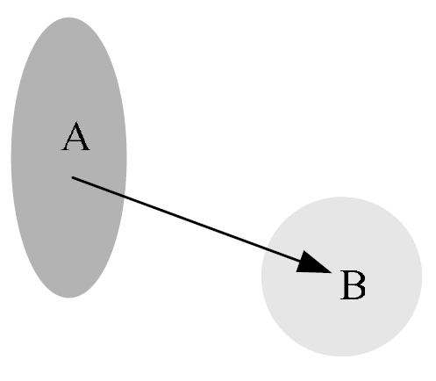
Definition
Ordinal Measures (OM)
Relative ordering of variables
For intensity or feature level (Gabor features)
Advantages in computer vision:
Invariance to monotonic illumination changes
Robustness against noise
Useful for recognition tasks
Notes:
Ordinal measure (OM) is defined as the relative ordering information of multiple variables
For Intensity: qualitative relationship between the average intensity values of two image regions
ordinal measure is “A>B” and we can use one bit feature code “1”
For Feature: qualitative information computed on the image features, e.g. Gabor features

Slide 10
Overview
LBP (Local binary patterns)
LOCP (Local ordinal contrast pattern)
GOM (Gabor ordinal measure)
Non-Neighbour methods
Notes:
LBP suggests that the ordinal relationship between a single reference pixel and its neighbourhood contains texture information
LOCP on the contrary, suggests a new paradigm where texture is represented by pairwise ordinal relationships of the entire neighbourhood.
GOM ???

Slide 11
Sources
[1] | Z. Chai, Z. Sun, H. Méndez-Vázquez, R. He and T. Tan, "Gabor Ordinal Measures for Face Recognition," in IEEE Transactions on Information Forensics and Security, vol. 9, no. 1, pp. 14-26, Jan. 2014.
[2] | C. H. Chan, B. Goswami, J. Kittler and W. Christmas, "Local Ordinal Contrast Pattern Histograms for Spatiotemporal, Lip-Based Speaker Authentication," in IEEE Transactions on Information Forensics and Security, vol. 7, no. 2, pp. 602-612, April 2012.
[3] | Z. Sun and T. Tan, "Ordinal Measures for Iris Recognition," in IEEE Transactions on Pattern Analysis and Machine Intelligence, vol. 31, no. 12, pp. 2211-2226, Dec. 2009.
[4] | M. Partio, B. Cramariuc and M. Gabbouj, "Texture retrieval using ordinal co-occurrence features," Proceedings of the 6th Nordic Signal Processing Symposium, 2004. NORSIG 2004., Espoo, Finland, 2004, pp. 308-311

Slide 12
Work distribution
Equal workload for both group members in every part of the project with different focusses for the presentation:
Ganiyu | tbd
Philipp | Worked on ordinal measures for texture in general and methods; Implementation of the iris extraction and ordinal measure representation for biometrics

Slide 13

Discussion
Any Questions?

