Slide 1
Ordinal Measures for Texture
Ganiyu Ibraheem & Philipp Seybold
Advanced Computer Vision
Group A3

Slide 2
Overview
Introduction
Applications in Biometrics
Demonstration
Definition
Methods overview
Ordinal Measures
Mathematical background

Slide 3
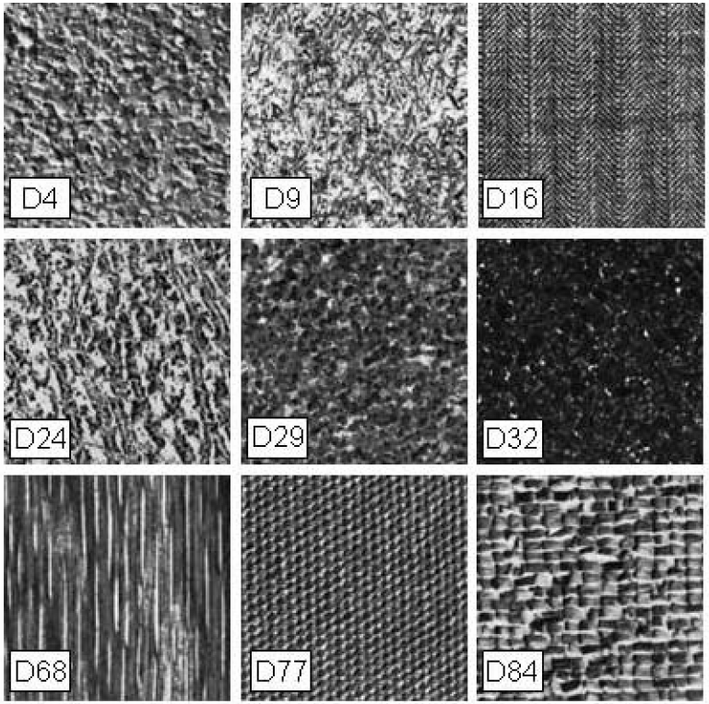
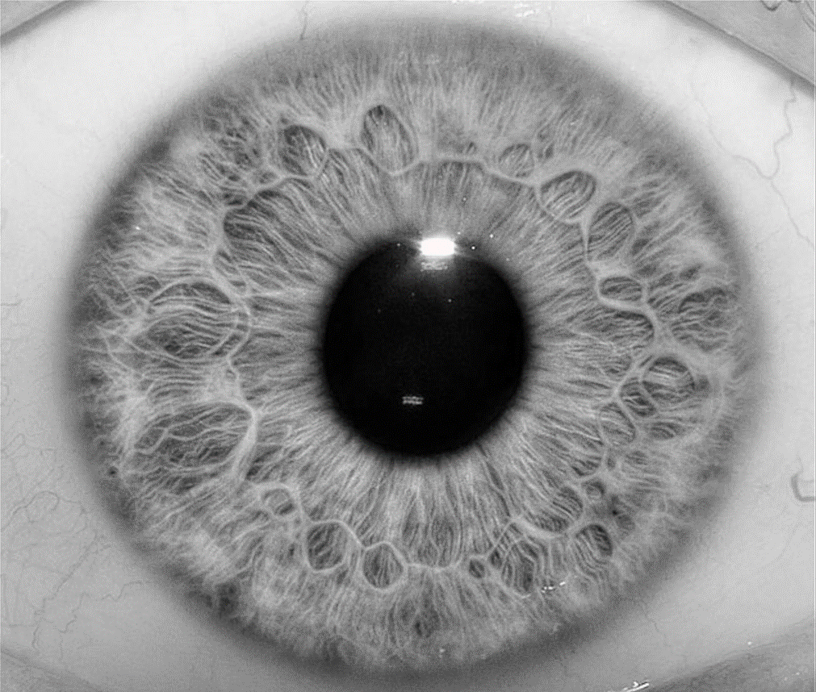
Introduction
Texture as descriptor
Notes:
Firstly introduced by Xiaofeng Ren and Jitendra Malik in their paper (but superpixel-like segmentation was applied already before): Learning a Classification Model for Segmentation
Goal: Classification model for Segmentation accuracy
Drew attention through good results and holding its promises
First algorithms around 2009

Slide 4
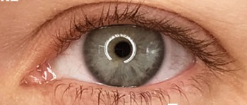
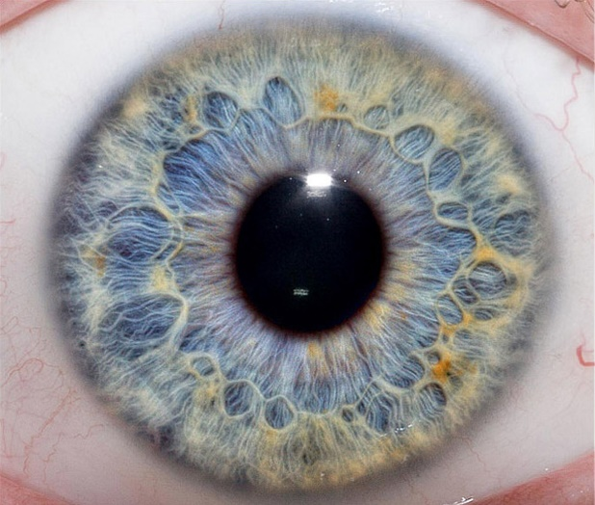
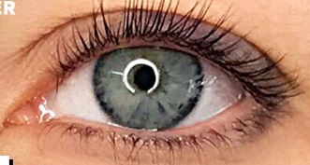
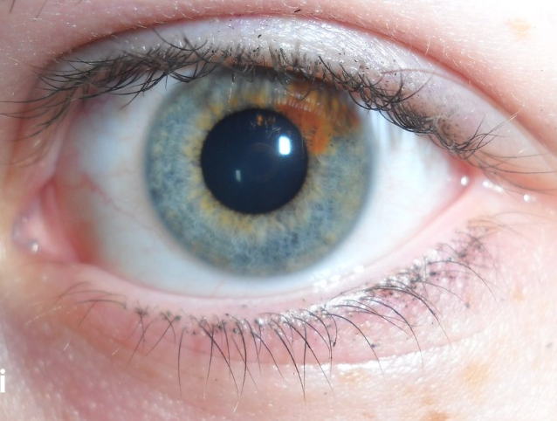
Demonstration
Ordinal measures for iris biometrics
Same eye

Slide 5


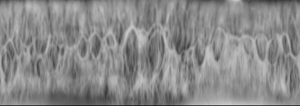
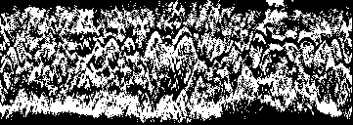
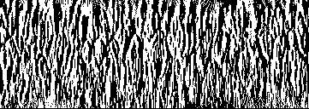
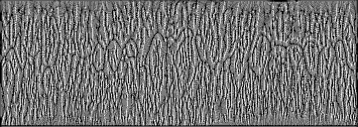
Demonstration (Ordinal measures for iris biometrics)

Slide 6

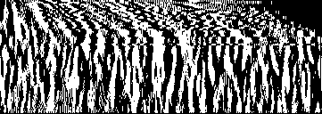
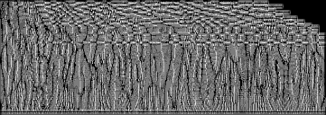

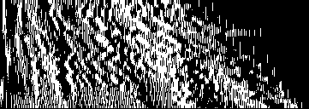
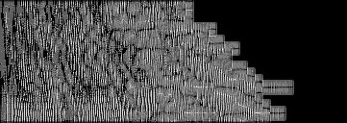
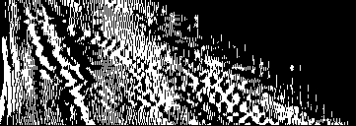
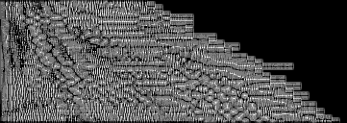
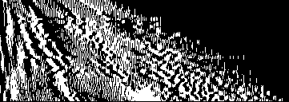
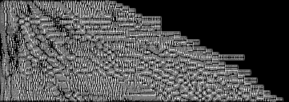
Demonstration (Ordinal measures for iris biometrics)
Vertical regions & binary
LBP

Slide 7
Demonstration (Ordinal measures for iris biometrics)
Vertical regions & binary
LBP

Slide 8

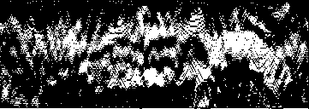
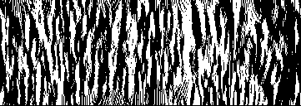
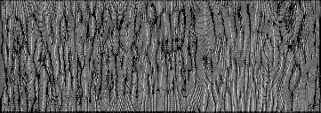
Demonstration (Ordinal measures for iris biometrics)
Horizontal
Vertical
LBP

Slide 9
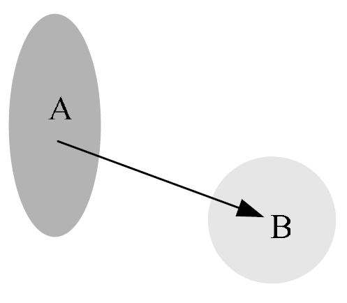
Definition
Ordinal Measures (OM)
Relative ordering of variables
For intensity or feature level (Gabor features)
Advantages in computer vision:
Invariance to monotonic illumination changes
Robustness against noise
Useful for recognition tasks
Notes:
Ordinal measure (OM) is defined as the relative ordering information of multiple variables
For Intensity: qualitative relationship between the average intensity values of two image regions
ordinal measure is “A>B” and we can use one bit feature code “1”
For Feature: qualitative information computed on the image features, e.g. Gabor features

Slide 10
Overview
LBP (Local binary patterns)
LOCP (Local ordinal contrast pattern)
GOM (Gabor ordinal measure)
Non-Neighbour methods
Notes:
LBP suggests that the ordinal relationship between a single reference pixel and its neighbourhood contains texture information
LOCP on the contrary, suggests a new paradigm where texture is represented by pairwise ordinal relationships of the entire neighbourhood.
GOM ???

Slide 11
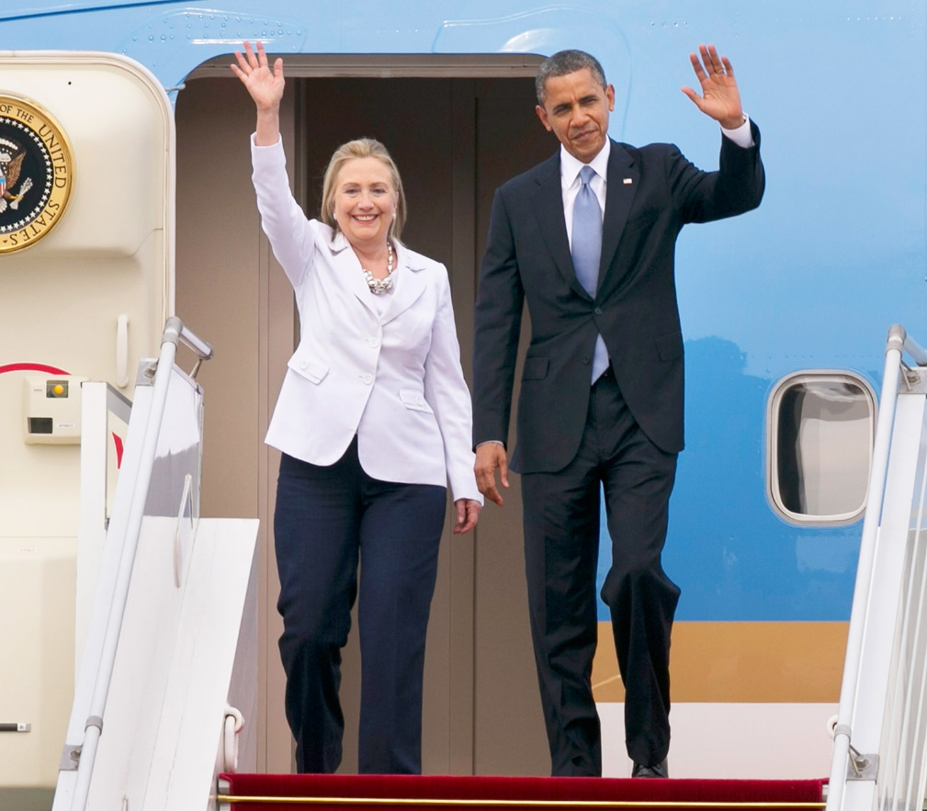
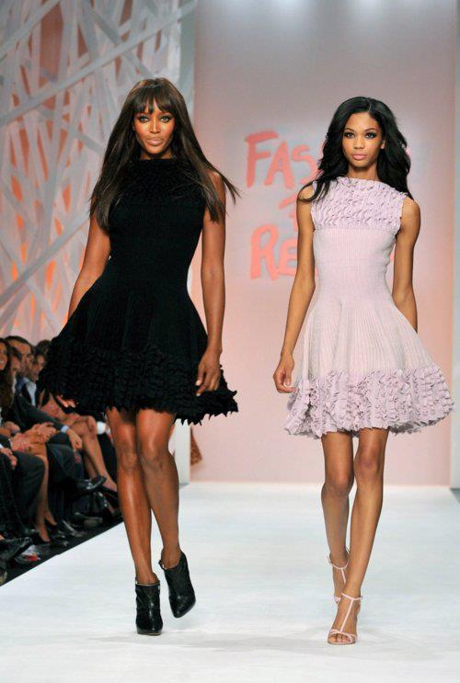
Ordinal Measures
Who is taller between them?
How many inches of height difference do they have between them?

Slide 12
Ordinal Measures
Ordinal measures are a form of qualitative measurement related to the relative ordering of several quantities
5 shades of grey
>
>
>
>

Slide 13
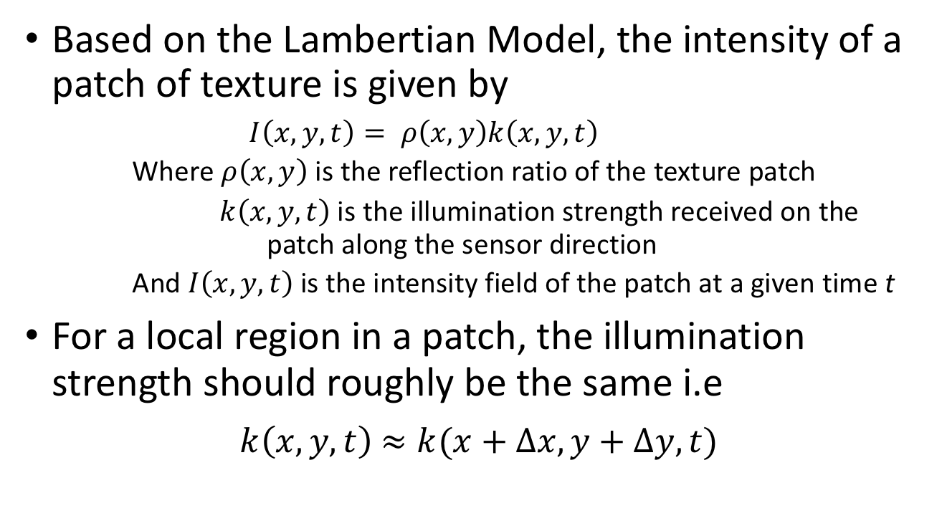
Mathematical Basis
Based on the Lambertian Model, the intensity of a patch of texture is given by
$$I\left(x,y,t\right)= ρ\left(x,y\right)k\left(x,y,t\right)$$
Where $ρ\left(x,y\right)$ is the reflection ratio of the texture patch
$k\left(x,y,t\right)$ is the illumination strength received on the patch along the sensor direction
And $I\left(x,y,t\right)$ is the intensity field of the patch at a given time t
For a local region in a patch, the illumination strength should roughly be the same i.e
$k\left(x,y,t\right)$ $≈k(x+∆x, y+∆y,t)$

Slide 14
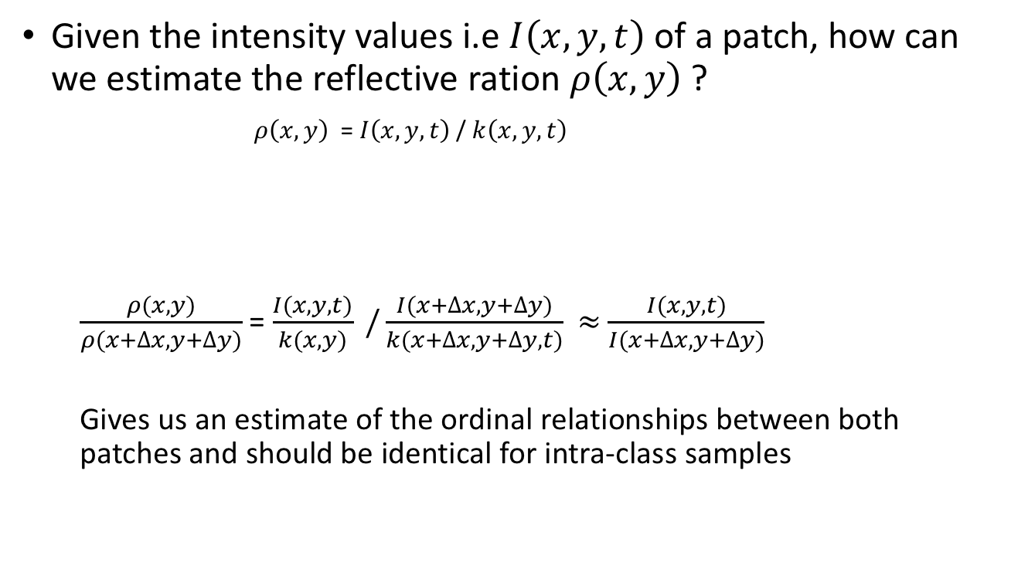
Mathematical Basis
Given the intensity values i.e $I\left(x,y,t\right)$of a patch, how can we estimate the reflective ration $ρ\left(x,y\right)$ ?
$ρ\left(x,y\right)$ = $I\left(x,y,t\right)$ / $k\left(x,y,t\right)$
$\frac{ρ(x,y)}{ρ(x+∆x,y+∆y)}$ = $\frac{I(x,y,t)}{k(x,y)} /\frac{I(x+∆x, y+∆y)}{k(x+∆x,y+∆y,t)}$ $≈$ $\frac{I(x,y,t)}{I(x+∆x, y+∆y)}$
Gives us an estimate of the ordinal relationships between both patches and should be identical for intra-class samples

Slide 15
Application in Biometrics
Problem? The performance of a biometric system relies greatly on its feature representation
A common practice is to encode the input biometric signal into compact features so as to maximize intra-class similarity and inter-class dissimilarity

Slide 16
Application in Biometrics
Pipeline

Slide 17
Sources
[1] | Z. Chai, Z. Sun, H. Méndez-Vázquez, R. He and T. Tan, "Gabor Ordinal Measures for Face Recognition," in IEEE Transactions on Information Forensics and Security, vol. 9, no. 1, pp. 14-26, Jan. 2014.
[2] | C. H. Chan, B. Goswami, J. Kittler and W. Christmas, "Local Ordinal Contrast Pattern Histograms for Spatiotemporal, Lip-Based Speaker Authentication," in IEEE Transactions on Information Forensics and Security, vol. 7, no. 2, pp. 602-612, April 2012.
[3] | Z. Sun and T. Tan, "Ordinal Measures for Iris Recognition," in IEEE Transactions on Pattern Analysis and Machine Intelligence, vol. 31, no. 12, pp. 2211-2226, Dec. 2009.
[4] | M. Partio, B. Cramariuc and M. Gabbouj, "Texture retrieval using ordinal co-occurrence features," Proceedings of the 6th Nordic Signal Processing Symposium, 2004. NORSIG 2004., Espoo, Finland, 2004, pp. 308-311

Slide 18
Work distribution
Equal workload for both group members in every part of the project with different focusses for the presentation:
Ganiyu | tbd
Philipp | Worked on ordinal measures for texture in general and methods; Implementation of the iris extraction and ordinal measure representation for biometrics

Slide 19

Discussion
Any Questions?

