Slide 1
Software Engineering
The ATM Project
By Group7

Slide 2
ABOUT US Group7
Team members in presentation order and our work focus
Chen Hao
Li Wei Peng
Zeng Xian Tao
Chen Hao Yuan
2017052533
2017052544
2017052543
2017053995
Design
Design
Design
Design
Coding
Coding
Coding
Coding
Writing
Writing
Writing
Writing
Testing
Testing
Testing
Testing

Slide 3
Main Part
The ATM Project
Basic Functions - Deposit and withdraw money , show balance
User Management - User registration , login , logout , change password
System Maintenance - Data , hardware and software maintaince
1
2
3

Slide 4
Added Features
New users can register an account and set a password , also his phone number
If the users input a wrong password , the system will display a warning
In the above case , the users are allowed to input the password again
If the users input a wrong password more than 5 times , his account will be frozen
1
2
3
4
In the above case , a staff is needed to unblock the account and change the password
If the users insert a wrong card or in a wrong way , then it will be rejected by system
In the above case , the users are allowed to insert his card again
There are several staffs to maintain the ATM machine after users’ operating
5
6
7
8

Slide 5
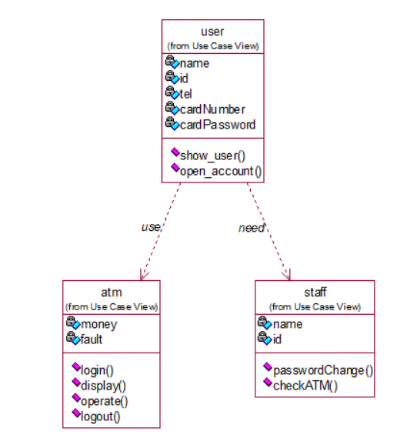
Class Diagram

Slide 6
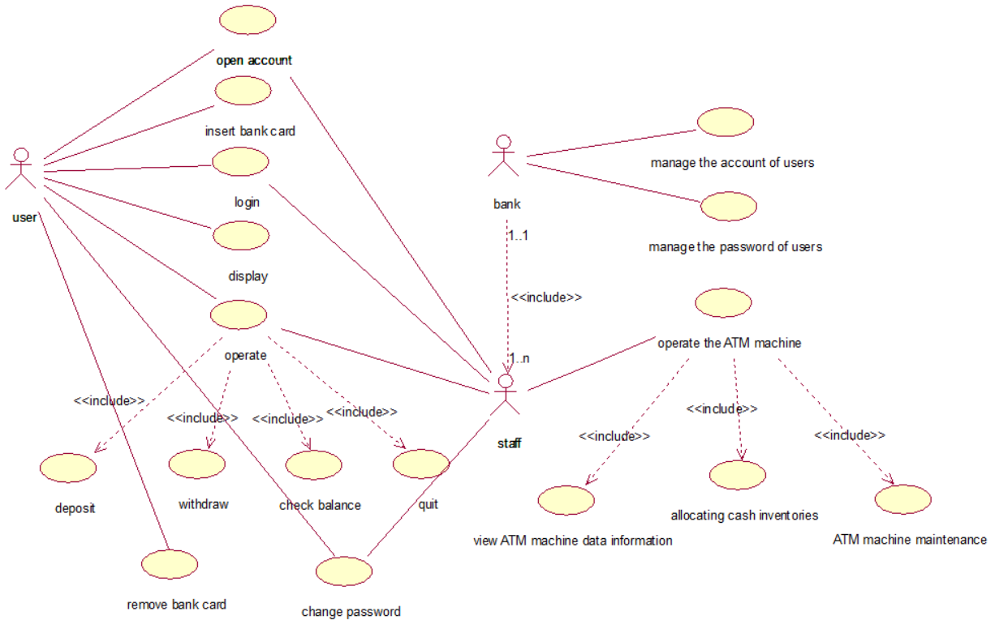
Use-case Diagram

Slide 7
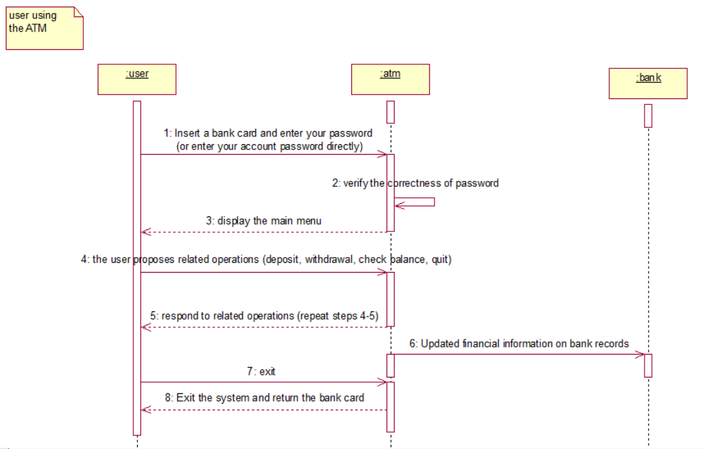
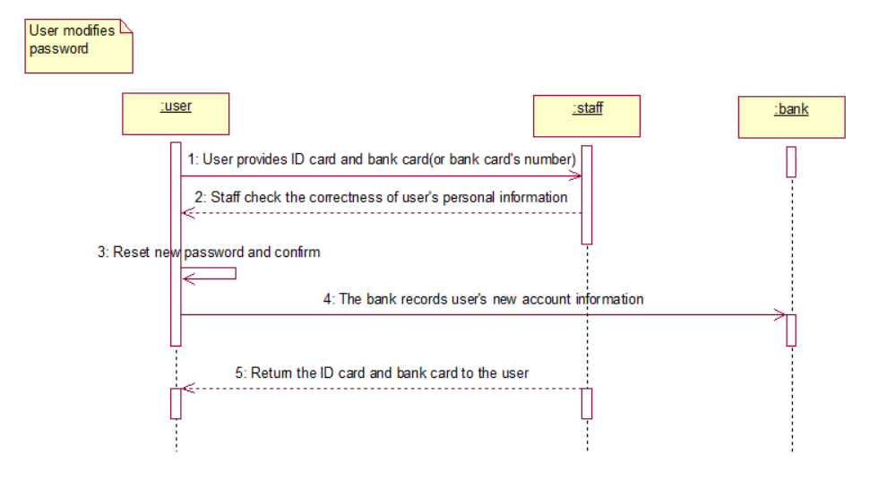
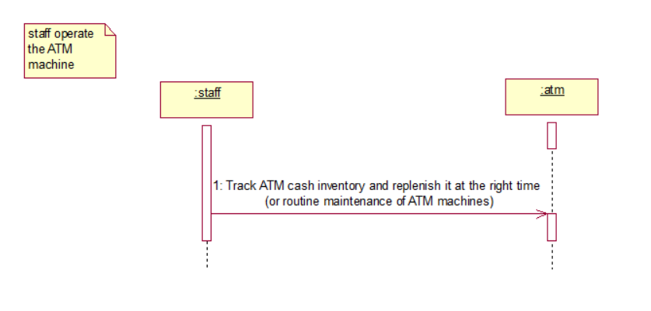
Sequence Diagram

Slide 8
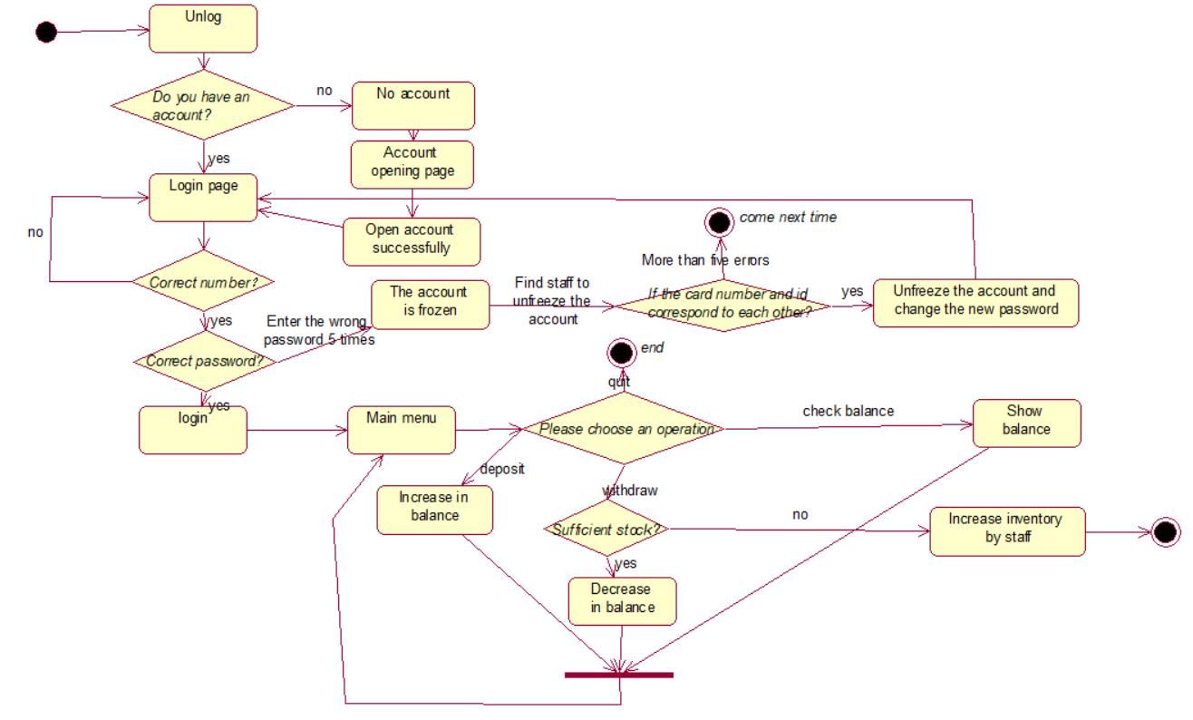
Statechart Diagram

Slide 9
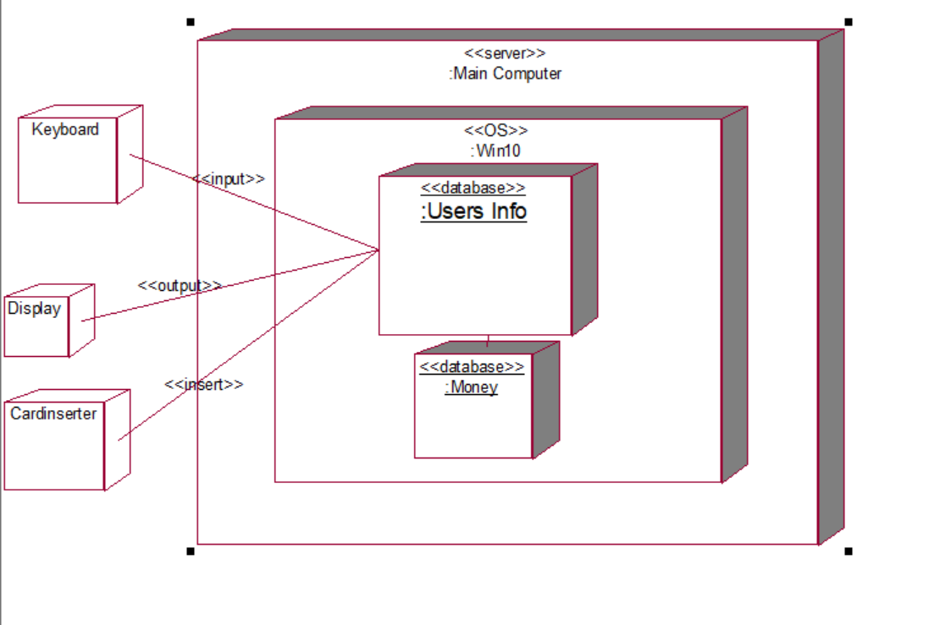
Deployment Diagram

Slide 10
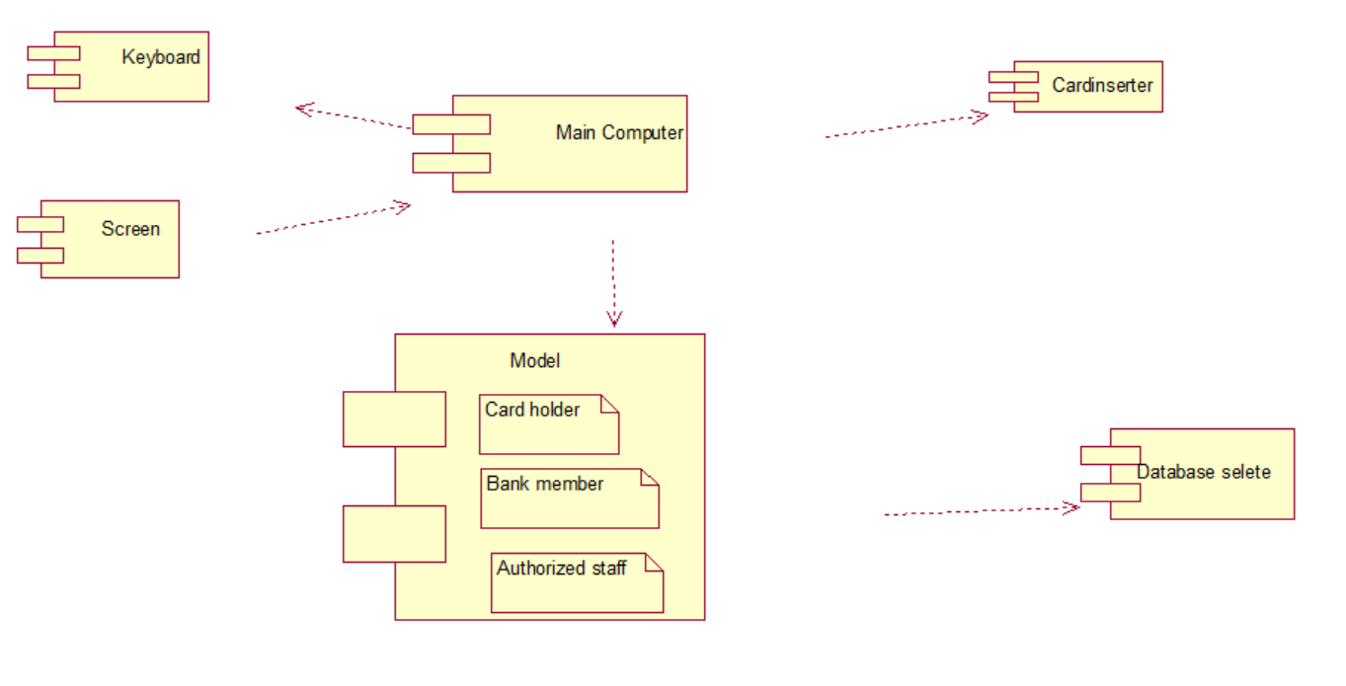
Component Diagram

Slide 11
int main()
{
cout << "Do you have an account?" << endl;
cout << "1. Yes 2. No" << endl;
while (1)
{
int yesOrNo;
cin >> yesOrNo;
if (yesOrNo == 1)
{
break;
}
else if (yesOrNo == 2)
{
user u1;
u1.Open_account();
break;
}
else
{
cout << endl << "Please enter the correct option(1 or 2)!" << endl;
}
}
ATM a1, a2, a3, a4, a5;
vector<ATM> atms = { a1, a2, a3, a4, a5 }; //Five ATM are initialized by default
srand((int)time(NULL));
int randIndex = rand() % 5;
string number = atms[randIndex].login();
atms[randIndex].display();
atms[randIndex].operate(number);
atms[randIndex].logout();
cout << endl << endl << "staff[" << staffs[rand() % 10].id << "]: " << endl;
staffs[rand() % 10].checkATM(atms[randIndex]);
system("pause");
return 0;
}
Main Function

Slide 12
THANKS
!
Proudly Presented By Group7

