Slide 1
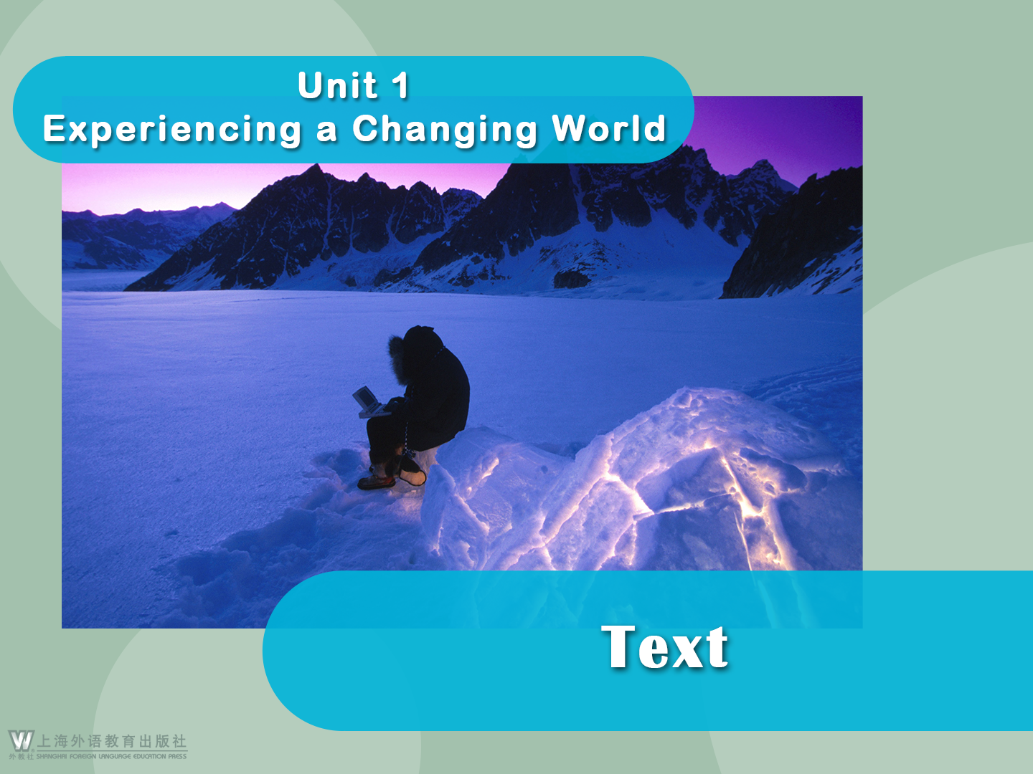

Slide 2






Can’t Get Away from It All?
Can’t Get Away from It All?
Mat Honan
On a connected planet, you can’t run away from technology — you have to manage it.

Slide 3

Can’t Get Away from It All?
1 A few years ago, my wife and I spent three weeks hiking the backcountry of California. We walked more than 200 miles without crossing a road — and even better, without fielding any calls, emails, tweets, or other day-to-day Internet channel. It was heavenly. But at trail’s end, as we stood atop Mount Whitney, looking over the unfolding American West, I was appalled to see smartphones everywhere.

Slide 4

Can’t Get Away from It All?
People were snapping photos and sending texts; one woman was even making calls. We sniffed at the jibber-jabberers, walked down to the trailhead, and hitchhiked back into Yosemite, where our car was parked, feeling pretty smug.

Slide 5

Can’t Get Away from It All?
2 As I began telling my story to a colleague, he stopped me cold: “Did you bring GPS?” I said that I had. “Well, that’s not really being out in the wilderness,” he replied. And he kind of had a point.
3 Everyone has a different definition of getting away from it all. By some definitions, my clean break wasn’t so clean. Even during my most remote moments in the backcountry, satellite signals bounced down to tell me exactly where I was.

Slide 6

Can’t Get Away from It All?
4 The practice of taking an intentional break from technology and civilization is probably as old as technology and civilization. But it seems increasingly urgent now, in an era when the Internet — and thus most of the planet — is as close as an iPhone. We go to seek waldeinsamkeit, as the poet Ralph Waldo Emerson described it — the feeling of being alone in the woods.

Slide 7

Can’t Get Away from It All?
5 This feeling is prominent in our written history. In Heart of Darkness, the protagonist, Charles Marlow, is driven by his desire to visit the few remaining blank spaces on the map. That is, more or less, how many of us plan our vacations today. Of course, the rivers and valleys and borders were long ago mapped; our blank spaces are the few remaining holes in the global communications network.

Slide 8

Can’t Get Away from It All?
We go where it’s impossible to connect, no matter what. But quite soon those gaps will all be filled. Before much longer, the entire planet will be smothered in signals, and we won’t be able to find places that are off the grid.

Slide 9

Can’t Get Away from It All?
6 We’re already nearly there. Take a look at the National Telecommunications and Information Administration’s broadband coverage maps for the US online and you’ll see a nation that is painted almost solid blue, save for some very high mountains and sparsely populated deserts. Internationally, even formerly isolated countries like Laos and Bhutan are becoming smartphone-friendly as Internet access becomes more and more widespread.

Slide 10

Can’t Get Away from It All?
And if telecom towers can’t do it, satellites, Google balloons, and Mark Zuckerberg are all working to bring the global cacophony to even the loneliest outposts.

Slide 11

Can’t Get Away from It All?
7 Which means we’re now seeing some pretty bizarre attempts to get away from it all. Technology critic Evgeny Morozov famously puts his router and phone in a safe with a timer lock when he needs to be free of distractions. Techno-isolation is one of Burning Man’s many appeals (though citizens of the playa are increasingly willing and able to Instagram or tweet their escapades in the desert).

Slide 12

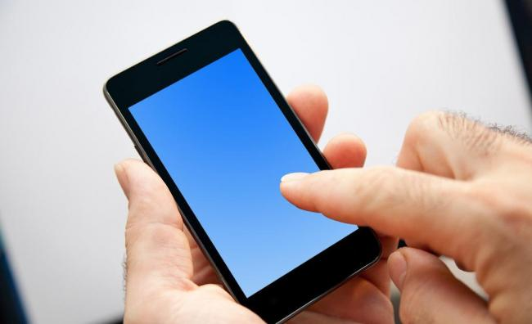
Can’t Get Away from It All?
There are now multiple high-end summer camps for adults, and part of what you pay for is having counselors enforce strict no-phone, no-camera policies.

Slide 13

Can’t Get Away from It All?
8 Those may be silly examples, but they’re worth thinking about. We’re living in a remarkable time, when it will soon be impossible to be truly alone. Waldeinsamkeit becomes more and more endangered with every cell tower. And if you’re the kind of person who can only leave email behind when you go off the grid, that means you’re going to need a new plan. Our streets are already filled with people staring into their hands.

Slide 14

Can’t Get Away from It All?
So are our dinner tables and cafés, even our living rooms and bedrooms. Rather than focusing on taking temporary breaks from technology, we need the discipline to live with it at all times. We can’t rely on a mountain or a remote wasteland to create waldeinsamkeit; we have to create it ourselves.

Slide 15

Can’t Get Away from It All?
9 Getting away from technology by leaving it behind becomes a pointless exercise in competitive reductionism. Where do you draw the line? Your smartphone? Your GPS? Your compass? Your tent? Fire?
10 Here’s a better idea: Shut up and bring your iPhone into the backcountry, but resist the urge to open the email app. If you can’t manage that, delete or turn off the account. Don’t worry, it’ll come back.

Slide 16

Can’t Get Away from It All?
11 Meanwhile, technology can enhance your wilderness experience. The Night Sky mobile app on iOS, for example, can tell you exactly which constellations you’re observing, and it serves up thousands of years of human history. There are other apps that have transformed birding; they can identify species, forecast migrations, even alert you to rare birds in your area. And by tracking your location from your pocket, your phone lets you spend less time squinting at a map and more time looking at the world.

Slide 17

Can’t Get Away from It All?
12 The phone isn’t the problem. The problem is us — our inability to step away from email and games and inessential data, our inability to look up, be it at an alpine lake or at family members. We won’t be able to get away from it all for very much longer. So it’s vitally important that each of us learns how to live with a persistent connection, everywhere we go, whether it’s in the wilderness or at a dinner party.

Slide 18

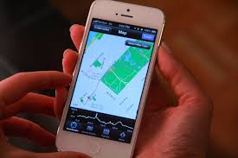
Can’t Get Away from It All?
13 I still love the wilderness, and I can’t wait for my next trip to the backcountry — to walk for miles without crossing a road, without fielding a call or an email or a tweet. To once again drink deeply from a mountain stream. And to stretch out under the open sky at night, gaze up at the stars, and use my phone to name each and every one.

Slide 19

Language Points
1. get away from it all (Title): to go somewhere completely different from what is usual
Many young couples seeking to get away from it all might choose a tent on a campsite — but not Prince William and his bride. Instead they got a small island to themselves.
许多想要避开干扰的年轻夫妇会选择有帐篷的野营地，但是威廉王子和他的新娘可不这样想，而是给自己找了个小岛。

Slide 20
Language Points
1. get away from it all (Title): to go somewhere completely different from what is usual
我希望的是在希腊呆上两周，让我摆脱一切烦恼。
What I’d like is a fortnight in Greece where I can get away from it all.

Slide 21
Language Points
2. We walked more than 200 miles without crossing a road — and even better, without fielding any calls, emails, tweets, or other day-to-day Internet channel. (Para. 1)
[Paraphrase]:
During the 200-mile hike, we didn’t cross any road. What made it even better was that we didn’t make any phone calls, receive or send any emails, tweet or use any other Internet connections.

Slide 22
Language Points
2. We walked more than 200 miles without crossing a road — and even better, without fielding any calls, emails, tweets, or other day-to-day Internet channel. (Para. 1)
[Analysis]:
The author uses parallel structures following “without” to reflect the feeling of relief and satisfaction in being able to get away from technology.

Slide 23
Language Points
2. We walked more than 200 miles without crossing a road — and even better, without fielding any calls, emails, tweets, or other day-to-day Internet channel. (Para. 1)
[Translation]:
我们走了200多英里却没有踏足任何公路；更爽的是，这期间我们没有回复任何电话、电子邮件、推特或其他日常网络通信。

Slide 24
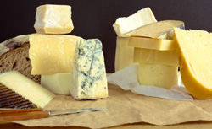
Language Points
3. appall (Para. 1): v. to cause to have strong feelings of shock
The Chinese dislike the cheeses enjoyed by Europeans, but they themselves adore some stinky foods that would appall many foreigners.
中国人厌恶欧洲人喜欢的奶酪，但他们自己却推崇一些臭到让外国人感到惊骇的食物。

Slide 25
Language Points
3. appall (Para. 1): v. to cause to have strong feelings of shock
让他震惊的是，造假者为了盈利正在危及疗效最好的抗疟药品。
He is appalled that counterfeiters are now threatening the most effective anti-malarial drugs for profit.

Slide 26
Language Points
4. We sniffed at the jibber-jabberers, walked down to the trailhead, and hitchhiked back into Yosemite, where our car was parked, feeling pretty smug. (Para. 1)
[Paraphrase]:
We had a contempt for what we saw, then we walked down to the beginning of the trail and hitchhiked back into Yosemite to take our car. We felt extremely pleased and satisfied with ourselves.

Slide 27
Language Points
4. We sniffed at the jibber-jabberers, walked down to the trailhead, and hitchhiked back into Yosemite, where our car was parked, feeling pretty smug. (Para. 1)
[Analysis]:
A parallel structure of three verb phrases is used in this sentence. The attributive clause and the
-ing structure provide additional information.

Slide 28
Language Points
4. We sniffed at the jibber-jabberers, walked down to the trailhead, and hitchhiked back into Yosemite, where our car was parked, feeling pretty smug. (Para. 1)
[Translation]:
我们鄙视了一把这群叽叽喳喳的人，继续走到小路的起点，然后搭便车回到我们停车的约塞米蒂国家公园，心中颇为自得。

Slide 29
Language Points
5. sniff at (Para. 1): to express contempt or dislike for
It’s really not advisable for you to sniff at such a constructive and sensible proposal.
对如此建设性的、明智的建议嗤之以鼻，你这样做真不应该。
千万不要嘲笑任何有雄心抱负的年轻人，他有可能在世界之巅占有一席之地。
Never sniff at any ambitious and aspiring young man, who is likely to seize his position on top of the world.

Slide 30
Language Points
6. have a point (Para. 2): to make sense
Critics have a point that too hasty social progress may result in irreversible loss, even harm.
太仓促的社会进步可能会导致不可逆转的损失，甚至伤害，在这个认识上评论家们是正确的。
仔细一想，你父母不赞成你和那个狡猾男人结婚的想法也许是对的。
On second thoughts, maybe your parents have a point when they disagree with your intention to marry that slippery guy.

Slide 31
Language Points
7. Everyone has a different definition of getting away from it all. By some definitions, my clean break wasn’t so clean. (Para. 3)
[Paraphrase]:
Different people may have different understandings of getting away from technology. To some people, I was not so completely away from technology as I had thought.

Slide 32
Language Points
7. Everyone has a different definition of getting away from it all. By some definitions, my clean break wasn’t so clean. (Para. 3)
[Analysis]:
The word “clean” is used repeatedly to strengthen the tone and emphasize the difficulty in remaining completely undisturbed by technology.

Slide 33
Language Points
7. Everyone has a different definition of getting away from it all. By some definitions, my clean break wasn’t so clean. (Para. 3)
[Translation]:
每个人对何为彻底逃离（科技）都有自己的定义。在某些人看来，我的所谓彻底逃离其实并不彻底。

Slide 34
Language Points
8. The practice of taking an intentional break from technology and civilization is probably as old as technology and civilization. But it seems increasingly urgent now, in an era when the Internet — and thus most of the planet — is as close as an iPhone. (Para. 4)

Slide 35
Language Points
[Paraphrase]:
The long tradition for people to temporally break away intentionally from technology and civilization started with the day technology and civilization came into being. This intentional practice is becoming even more necessary today because the Internet has made the whole world within the same easy access just as iPhones are (so that we are overwhelmed by technology and the whole world).

Slide 36
Language Points
[Translation]:
人类有意逃离科技和文明的传统由来已久，可以说是与科技和文明相伴相随。但在当今，将世界上绝大多数地方连接起来的互联网就像苹果手机一样近在身边，这种逃离便显得愈发紧迫。

Slide 37
Language Points
9. prominent (Para. 5): adj. noticeable; easily seen
Science education and research has taken a prominent role in the recent history of Maldives.
科学教育与研究在马尔代夫近期的历史上占有突出地位。

Slide 38
Language Points
9. prominent (Para. 5): adj. noticeable; easily seen
在她进驻音乐行业的第一个十年，她成为了主流通俗音乐和流行文化的杰出人物。
During her first decade in the music industry, she became a prominent figure in mainstream popular music and popular culture.

Slide 39
Language Points
prominence: n. the state of being prominent
During the past decade, public health has achieved unprecedented prominence as a key drive of socioeconomic progress.
过去十年中，公共卫生作为社会经济进步的重要推动因素，受到了前所未有的重视。

Slide 40
Language Points
prominently: adv. in a prominent way
This news of his resignation was prominently featured in all the papers.
各报均以显著的位置刊载了这条他辞职的消息。

Slide 41
Language Points
10. blank (Para. 5): adj. without writing or print;
unmarked
You may be astonished to find that almost all the blank places in her textbook have been filled with notes.
也许你会很惊讶地发现她教科书的所有空白处几乎都写满了笔记。

Slide 42
Language Points
10. blank (Para. 5): adj. without writing or print;
unmarked
你的履历档案一片空白，你凭什么认为自己能得到这份新工作呢？
By what reasons do you think that you get this new career when your resume is blank?

Slide 43
Language Points
Cf.: blank empty vacant hollow
这四个词都有“空的”之意，有时可以交换使用，如a(n) hollow/empty promise, blank/empty eyes, a(n) vacant/empty mind, a blank/vacant expression，但各有侧重。
blank means “having nothing on …”, e.g. a blank page
empty means “holding or containing nothing”, e.g. an empty bottle

Slide 44
Language Points
Cf.: blank empty vacant hollow
这四个词都有“空的”之意，有时可以交换使用，如a(n) hollow/empty promise, blank/empty eyes, a(n) vacant/empty mind, a blank/vacant expression，但各有侧重。
vacant means “not being used by anyone”, e.g. a vacant seat
hollow means “having a space or gap in …”, e.g. a hollow tree

Slide 45
Language Points
11. We go where it’s impossible to connect, no matter what. (Para. 5)
[Paraphrase]:
We choose to go to places with no connections available, no matter what kinds of places they are.
[Analysis]:
The author uses “no matter what” to show people’s determination to go to places without disturbance.

Slide 46
Language Points
11. We go where it’s impossible to connect, no matter what. (Para. 5)
[Translation]:
我们要去的是外界无法联络到的地方，无论什么地方都行。

Slide 47
Language Points
12. smother (Para. 5): v. to cover sth./sb. thickly or with too much of sth.
News stories about the huge rise in skin cancer have made many women afraid to go out in the sun or, if they do, they smother themselves head-to-toe in sunblock.
皮肤癌大幅上升的说法使得女人们不敢外出走在日光下。如果外出，她们把自己从头到脚都涂抹上防晒乳。

Slide 48
Language Points
12. smother (Para. 5): v. to cover sth./sb. thickly or with too much of sth.
事实上，那个时候的学校教育只会抑制人们的创造力。
As a matter of fact, the school education at that time could do nothing but smother creativity of the human.
As a matter of fact, what the school education at that time could do was to smother creativity of the human.

Slide 49
Language Points
13. We’re already nearly there. (Para. 6)
[Paraphrase]:
We have almost entered the era when it’s impossible to live a life without disturbance of technology.
[Translation]:
现在的情形已基本如此了。

Slide 50
Language Points
14. save for (Para. 6): except for; not including
He kept his helmet on save for a brief phone conversation with his wife.
他总是戴着他的头盔，除了接听了妻子一个简短的电话。
她既没有化妆，又没有戴首饰，除了在海蓝色上衣上别了个校徽。
She wore no makeup or jewelry, save for a school badge pinned to her navy blazer.

Slide 51
Language Points
15. populate (Para. 6): v. (often passive) to live in an area and form its population
Birds, like any other living thing, populate an area and compete with one another for food.
鸟类，像任何其他生物一样，栖息在一处地方，互相竞争，获取食物。
她惊讶地发现这个城市现在已经人口稠密了。
It surprised her that this city was densely populated now.

Slide 52
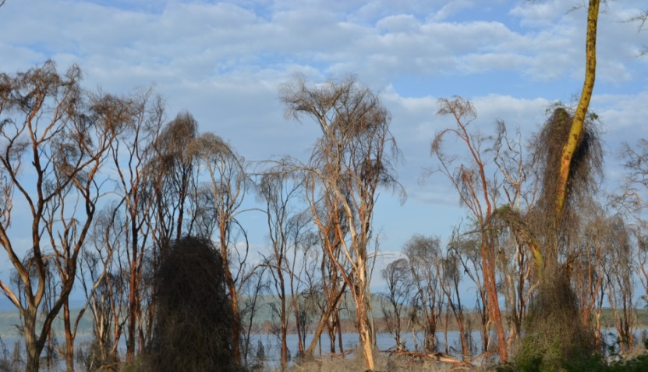
Language Points
16. formerly (Para. 6): adv. at a previous time
Formerly he often lingered about the woods, doing nothing.
过去，他经常在林中流连，什么也不做。

Slide 53
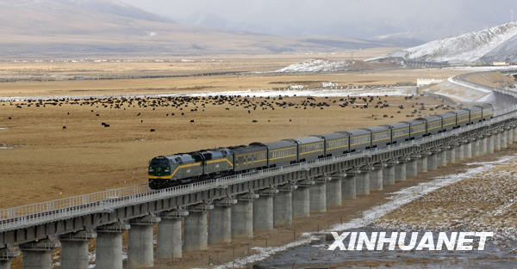
Language Points
16. formerly (Para. 6): adv. at a previous time
这个曾经偏远难及的地方现在已经通上公路和铁路了。
This formerly inaccessible place can now be reached by road and rail.

Slide 54
Language Points
17. And if telecom towers can’t do it, satellites, Google balloons, and Mark Zuckerberg are all working to bring the global cacophony to even the loneliest outposts. (Para. 6)
[Paraphrase]:
Even in the most remote and isolated places where telecom towers cannot provide Internet access, satellites, Google balloons and Facebook are working together to expose them to the noisy babble of the Internet.

Slide 55
Language Points
17. And if telecom towers can’t do it, satellites, Google balloons, and Mark Zuckerberg are all working to bring the global cacophony to even the loneliest outposts. (Para. 6)
[Analysis]:
Sarcasm is used here to indicate that even the most remote places cannot be free of the disturbance of modern technology.

Slide 56
Language Points
17. And if telecom towers can’t do it, satellites, Google balloons, and Mark Zuckerberg are all working to bring the global cacophony to even the loneliest outposts. (Para. 6)
[Translation]:
如果电信发射塔的信号覆盖不了，还有卫星、谷歌气球和马克•扎克伯格的脸谱公司联合行动，将刺耳的网络信号传遍全球，哪怕是最偏僻的村落。

Slide 57

Language Points
18. bizarre (Para. 7): adj. very strange or unusual
However, the bizarre Loch Ness monster is largely anecdotal as several scientific investigations have failed to find any evidence that it exists.
然而，离奇的尼斯湖水怪在很大程度上是个传闻而已，因为数次科学考察都没能找到它存在的证据。

Slide 58
Language Points
18. bizarre (Para. 7): adj. very strange or unusual
这建筑构造奇异。
The building was of bizarre construction.

Slide 59
Language Points
19. Techno-isolation is one of Burning Man’s many appeals (though citizens of the playa are increasingly willing and able to Instagram or tweet their escapades in the desert). (Para. 7)
[Paraphrase]:
Isolation from technology is one of the attractions of Burning Man, yet citizens of the playa are more willing to upload their adventures in the desert through Instagram or Twitter, and they are more capable of doing that as a result of technological development.

Slide 60
Language Points
19. Techno-isolation is one of Burning Man’s many appeals (though citizens of the playa are increasingly willing and able to Instagram or tweet their escapades in the desert). (Para. 7)
[Analysis]:
Sarcasm is used here to indicate the contradictory and ridiculous behavior of those claiming to break away from technology.

Slide 61
Language Points
19. Techno-isolation is one of Burning Man’s many appeals (though citizens of the playa are increasingly willing and able to Instagram or tweet their escapades in the desert). (Para. 7)
[Translation]:
远离科技也是“火人”反传统狂欢节的众多亮点之一（虽然这些来到这片干涸湖床的狂欢者们越来越喜欢也越来越做得到将他们在沙漠中的刺激冒险在Instagram或推特上共享）。

Slide 62
Language Points
20. enforce (Para. 7): v. to cause a rule or law to be carried out effectively
Gossip — or the fear of gossip — may serve to enforce the social norms that are necessary for any group to exist.
八卦——或者害怕八卦——也许有助于实施社会规范，社会规范对任何群体的存在都是必需的。

Slide 63
Language Points
20. enforce (Para. 7): v. to cause a rule or law to be carried out effectively
值得赞扬的是，中国政府已经采取措施以更好地实施知识产权。
The Chinese government has, to its credit, taken steps to better enforce intellectual property rights.

Slide 64
Language Points
en- is a prefix added to adjectives or nouns to form transitive verbs, meaning “to make, to put, to give, etc.”, or added to verbs to form new verbs, meaning “in, into, on” or as an intensifier. Such as:
entrap = to put into a trap
endanger = to put in danger
empower = to give power to
entitle = to give title to

Slide 65
Language Points
en- is a prefix added to adjectives or nouns to form transitive verbs, meaning “to make, to put, to give, etc.”, or added to verbs to form new verbs, meaning “in, into, on” or as an intensifier. Such as:
ennoble = to make noble or nobler
enlarge = to make large or larger
enclose = to close in
enfold = en-(intensifier) + fold

Slide 66
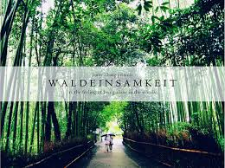
Language Points
21. Waldeinsamkeit becomes more and more endangered with every cell tower. (Para. 8)
[Paraphrase]:
With more and more cell towers being built, it becomes more and more difficult to enjoy the quiet and pleasant experiences like being alone in the woods.
[Translation]:
每一座基站的建立都只会让林中独处的机会愈加渺茫。

Slide 67
Language Points
22. endanger (Para. 8): v. to put sb./sth. in a situation
in which they could be harmed or damaged
Such offences as his profoundly endanger public security.
他这样的犯罪行为极度地危害了公共安全。
为了保护濒危物种，人们已经付出了极大的努力。
Major efforts are being made to protect the endangered species.

Slide 68
Language Points
23. draw the line (Para. 9): to decide firmly the limit of what one will tolerate or participate in
Helping these folks can be very rewarding, but you have to be careful about where to draw the line.
帮助这些人可能非常值得，但你要小心地划定帮助的界限。
你们认为天才与疯狂的界限在哪里呢？
Where do you draw the line between genius and madness?

Slide 69
Language Points
24. urge (Para. 10): n. a strong desire to do sth.
Once you have a little bit of success, you get the urge for more.
一旦你有了些许成功，你就想要更多。
打破规章的强烈欲望终究取决于制定规章的强烈要求。
The urge to break rules, after all, depends on the urge to make rules.

Slide 70
Language Points
25. delete (Para. 10): v. to remove sth. that has been written or printed, or that has been stored on a computer
He had to search wikiHow, a how-to site, to figure out how to delete his Facebook account permanently.
他得搜索wikiHow，一个指南网站，来解决如何永久删除他的脸谱网账号的问题。

Slide 71
Language Points
25. delete (Para. 10): v. to remove sth. that has been written or printed, or that has been stored on a computer
由于遭受网络攻击，她删除了博客里所有相关文章与图片。
Due to the online assault, she deleted all the concerned articles and pictures from her blog.

Slide 72
Language Points
26. forecast (Para. 11): v. to say in advance what is likely to happen
He confidently forecast a big increase in sales, and he turned out to be right.
他信心满满地预言了销售额的大幅增长，结果证明他是对的。
专家指明很难准确预测这次地震带来的最终损失。
Experts said it was difficult to forecast accurately the final bill from the earthquake.

Slide 73
Language Points
fore- = before
1. forearm
2. forefather
3. forerun
4. foresee
5. foreshadow
前臂
祖先
先驱
预见
预示

Slide 74
Language Points
fore- = before
6. foretaste
7. foretell
8. forethought
9. forewarn
10. foreword
预尝
预言
预谋
预警
前言

Slide 75
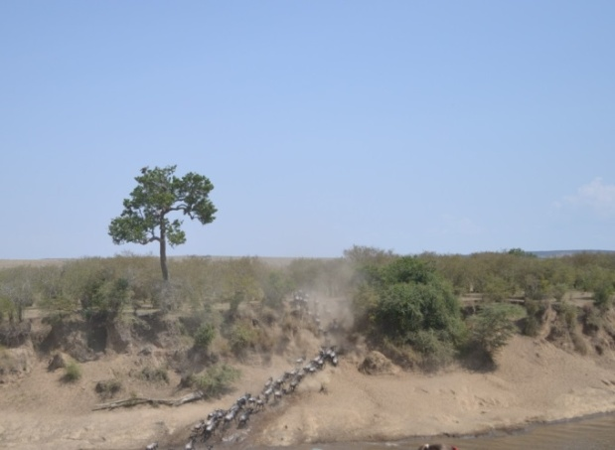
Language Points
27. migration (Para. 11): n. the movement of large numbers of people, birds or animals from one place to another
They visited Kenya in the last summer, when the wildebeest migration was in full swing.
他们去年夏天去了肯尼亚，正是角马大规模迁徙的季节。

Slide 76
Language Points
27. migration (Para. 11): n. the movement of large numbers of people, birds or animals from one place to another
气候变化肯定对于迁徙产生了强烈影响。
Change of climate must have had a powerful influence on migration.

Slide 77
Language Points
migrate: v. (of a person or an animal) move from one place to another
As autumn arrives, the wild geese migrate south.
migrant: n. a person or an animal that migrates
移民；迁徙动物
Migrants make up about half of the workers in the United States with science or engineering qualifications.

Slide 78
Language Points
migrant: adj. tending to migrate or having migrated 迁徙的
The visitors were appalled by the conditions of the migrant schools.
migratory: adj. migrant
migratory birds/fish
migratory habits/patterns

Slide 79
Language Points
28. alert (Para. 11): v. to make sb. aware of sth.
A telephone call alerting them briefly to the problem followed up by a letter is usually the most effective approach.
先打一个电话简单警告他们这个问题，跟着寄一封信给他们，这样做通常是最有效的办法。
你应该事先警告孩子们他们这些行为的后果。
You should alert the children in advance to the consequences of their actions.

Slide 80
Language Points
29. And by tracking your location from your pocket, your phone lets you spend less time squinting at a map and more time looking at the world. (Para. 11)
[Paraphrase]:
The phone in your pocket can tell where you are, therefore you don’t have to waste time studying the map painfully. It saves time for you to better observe and enjoy the world.

Slide 81
Language Points
29. And by tracking your location from your pocket, your phone lets you spend less time squinting at a map and more time looking at the world. (Para. 11)
[Analysis]:
Contrast is made between “squinting at a map” and “looking at the world” to indicate the benefits brought by technology.

Slide 82
Language Points
29. And by tracking your location from your pocket, your phone lets you spend less time squinting at a map and more time looking at the world. (Para. 11)
[Translation]:
你口袋里的手机还能追踪你的所在地，节省眯眼查找地图的时间，增加放眼看世界的机会。

Slide 83
Language Points
30. The phone isn’t the problem. The problem is us — our inability to step away from email and games and inessential data, our inability to look up, be it at an alpine lake or at family members. (Para. 12)
[Paraphrase]:
The problem lies not with the phone, but with ourselves who are so much addicted to email, games or unimportant information on the phone that we are not willing to raise our eyes to look at beautiful scenery like an alpine lake or at our family members.

Slide 84
Language Points
30. The phone isn’t the problem. The problem is us — our inability to step away from email and games and inessential data, our inability to look up, be it at an alpine lake or at family members. (Para. 12)
[Analysis]:
The parallel structures following “our inability to” and the subjunctive mood “be it at an alpine lake or at family members” are used to illustrate how addicted we are to technology.

Slide 85
Language Points
30. The phone isn’t the problem. The problem is us — our inability to step away from email and games and inessential data, our inability to look up, be it at an alpine lake or at family members. (Para. 12)
[Translation]:
手机不是症结所在，我们才是——是我们自己离不开邮件、游戏和那些实际上无关紧要的数据，是我们自己不能抬起头来看看周围的世界，无论是湖光山色，还是家人亲友。

Slide 86
Language Points
31. persistent (Para. 12): adj. continuing for a long period of time without interruption, or repeated frequently, especially in a way that is annoying and cannot be stopped
How do you deal with persistent salesmen who won’t take “no” for an answer?
你如何应对不愿接受“不”字的固执的推销员？
这样的寒流是受到来自俄罗斯的持续东风的影响。
Such cold spells are caused by persistent easterly winds blowing from Russia.

Slide 87
Language Points
persist: v. continue in an opinion or course of action in spite of difficulty or opposition
If you persist in doing that you will end up in trouble.
persistence: n. the fact of continuing in an opinion or course of action in spite of difficulty or opposition
Skill comes only with practice, patience, and persistence.

Slide 88
Language Points
persistently: adv. in a persistent manner; continuously
The famous singer flew into a rage when being persistently questioned about his divorce and ex-wife.

Slide 89
Language Points
Cf.: persistent insistent consistent
三词分别派生于persist，insist，consist，可以从内涵以及搭配上辨析三词。
He is persistent.
强调他坚持自己的做法或想法，可能别人都不赞同
He is insistent.
强调他坚持自己的要求，不容拒绝
He is consistent.
强调他始终如一，很稳定

Slide 90
Language Points
Cf.: persistent insistent consistent
consistent
1) Creating a __________ brand that resonates (共鸣) with a particular audience has become more important than ever.
persistent
2) This __________ stress can lead to health problems, such as headaches and insomnia.
insistent
3) She was very _________ that I call her.

