Slide 1
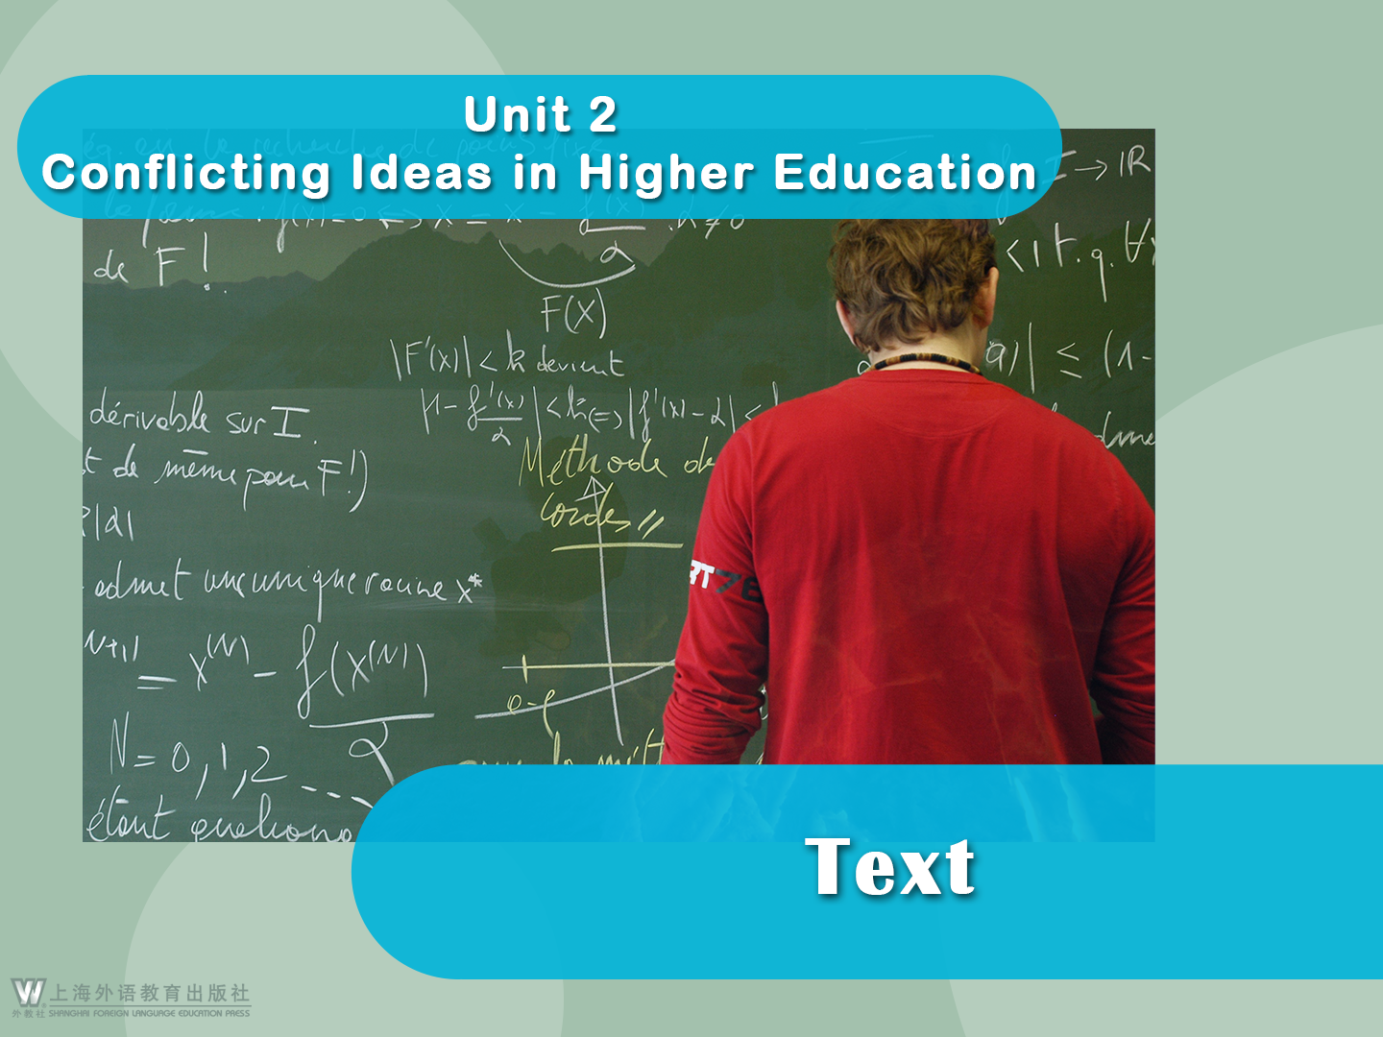

Slide 2





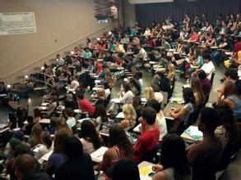
Get the Most Out of College
Get the Most Out of College
Ken Bain
1 On a hot September afternoon, four hundred students crashed into a small classroom, looking for seats on the long rows that curved around like
giant horseshoes. As the room filled with chattering voices, each one grew louder to compete with the clamor around them.

Slide 3

Get the Most Out of College
2 After a few minutes, a tall, thin man wearing white running shoes, brown trousers, and a blue shirt entered and stood at a podium in the front of the room. From their seats, most of the students could look down at the top of his head. He clipped on a lavaliere microphone and cleared his throat.

Slide 4

Get the Most Out of College
3 “I know it’s hot in here,” he said, almost shouting over the chatter. “But we’ve got work to do.” As the students stopped talking, he continued. “This is History 112, and I suppose most of you are here because you think you’re required to take this class. Well, you are not,” he said as he moved from behind the podium and looked toward the back row.

Slide 5

Get the Most Out of College
4 A soft murmur rippled across the room as students turned from side to side and whispered expressions of disbelief. “But wait,” he quickly added, thrusting his hands in the air as if to stop an oncoming locomotive. “This course is by definition a part of getting a liberal education at this institution, but nobody in the world is requiring you to pursue such broad learning. You will not be whipped in the public square if you don’t. No one will imprison or fine you. You are in charge of your own education.”

Slide 6

Get the Most Out of College
5 As students listened, he continued. “I want you to think about whether you really want to get this kind of education. I want you to understand both its beauty and utility, then you can decide if it is for you.” The room grew still now, and a soft breeze floated around the space as the air conditioning finally kicked in.

Slide 7


Get the Most Out of College
6 Within a few minutes, he had unfurled a brief history of liberal education, and told them that “liberal” came from the Latin for “free”, and it was the kind of schooling that free children (as opposite to slaves) received in the ancient world. In the modern version, students explored a host of disciplines from the sciences to the humanities,
taking a deep approach to important issues that those disciplines could help them address.

Slide 8

Get the Most Out of College
7 When the professor finished, he asked the students to do something rather strange. “This evening, when you go home or to your dorm room,” he said, “I want you to decide whether you really want to pursue such an education. Run everybody out of the room, sit in the dark for at least thirty minutes, and ask yourself, ‘do I really want to get a liberal education?’ If you do,” he concluded, “come back on Wednesday, and prepare for the ride of a lifetime. But if you don’t, you also know what to do. You don’t really attend this college. You should pursue something else.” No one dropped the course.

Slide 9

Get the Most Out of College
8 Many students would now reject that appeal. They believe that if you want to do well in an increasingly specialized world, you must concentrate on a single area and become an expert in that field, forsaking all other subjects. Students study to become doctors, plumbers, business executives, law specialists, account managers, computer technicians, and other professionals.

Slide 10


Get the Most Out of College
They often see no reason for the large number of “general education” requirements they face in most traditional college and universities, and “liberal arts” sounds to them like something you pursue if you don’t have a real major. They speak of courses one must “get out of the way”, and their advisors help them “check off” those requirements. In the most extreme version of this thinking, students believe
that schools exist merely to get you the right certificate or degree, not to help you develop as a creative, critically intelligent, compassionate, and concerned human being.

Slide 11

Get the Most Out of College
9 Sadly, many professors and deans also don’t understand and appreciate why anyone would need to take all those general education requirements. They have few notions of what the whole tradition of liberal education entails, except for some vague sense that it’s “good for students to be well-rounded”.

Slide 12

Get the Most Out of College
10 I met recently with a group of influential policy-makers in Washington, D.C., and they too had difficulty understanding anything of value about education other than preparation for a job. They dismiss as meaningless anything about higher learning that doesn’t center on training someone to do a task that would make them money.

Slide 13

Get the Most Out of College
11 In our research into what the best students end up doing in life, however, we found that those who turned out to be the most creative and productive bucked the trend. They found great value in general and liberal education, yet they didn’t become jacks of all trades and masters of none. If we are to understand what our subjects did that enabled them to fashion such highly productive and creative lives, we must appreciate why they valued a broad education before specializing in one or two fields.

Slide 14

Get the Most Out of College
12 An important part of the creative process is the ability to recognize good ideas when you encounter them. The implications of that notion are profound. To grow on the ideas and creations of others, we must encounter them, and to do so, we must explore the great works of the mind found in the arts, sciences, mathematics, philosophies, and historical perspectives. We have to get excited about probing a vast array of subjects and disciplines.

Slide 15

Get the Most Out of College
The world of ideas and scholarship becomes our oyster, and the possibilities become almost unlimited, at least as large as all of human endeavor and achievement throughout history.

Slide 16

Get the Most Out of College
13 The most creative students used their college experience to engage and stimulate their minds, feeling both the freedom to do as they pleased and the responsibility to be organized. They understood education as a developmental process in which they sought to grow the power of their minds, and that too influenced the kind of learning they attempted.

Slide 17

Get the Most Out of College
14 When the decision came to specialize it didn’t mean turning off all their other interests. Rather it meant using everything they had learned to create in one or two primary areas. Most important, they didn’t define themselves in terms of the profession they pursued, or the contraption they invented, but instead as compassionate, concerned, and caring human beings, citizens of the world.

Slide 18

Language Points
1. curve (Para. 1): v. to form a line or surface that bends gradually
Overlooking the harbor, the Opera House is a freestanding sculpture of spherical roofs and curved shapes.
他迅速弯着头，对着喷出来的水大口畅饮。
He quickly curved his head over the spouting water and began to gulp.

Slide 19
Language Points
2. chatter (Para. 1): v. to talk quickly and continuously, usually about things which are not important
While the kids chattered and the man drove, the woman sat smiling, surrounded by her flowers, a faraway look in her eyes.
我获得了允许，和那些老人闲聊起在芒什省（Le Manche）的美好时光。
I was allowed to chatter with the older men about the good old days in Le Manche.

Slide 20
Language Points
3. A soft murmur rippled across the room as students turned from side to side and whispered expressions of disbelief. (Para. 4)
[Paraphrase]:
The whole class did not believe what the teacher said, and the students kept turning to each other and began to talk in a low voice, speaking out their disbelief.

Slide 21
Language Points
4. murmur (Para. 4): n. a softly spoken word or words; a continuous low sound, like the noise of a river or of voices far away
The shout died into a murmur, as one portion of the crowd obtained a glimpse of the impatient boss.

Slide 22
Language Points
My songs are one with my love, like the murmur of a stream, that sings with all its waves and currents. (Tagore: “Lover’s Gift”)
我的歌充满着我的爱，若夏日的小溪低声悄语，以它的波和浪卷起欢歌。

Slide 23
Language Points
5. ripple (Para. 4): v. (of a sound or feeling) to spread through a group of people like a wave
The case has rippled across the global offshore banking industry because it marks the biggest legal challenge ever to Switzerland’s bank secrecy.
这家跨国公司破产的消息不仅在国内传开，还传到了国外。
The bankruptcy of this multi-national company has rippled not only at home but also overseas.

Slide 24

Language Points
6. thrust (Para. 4): v. to push sth./sb. suddenly or violently in a particular direction
Expanding the availability of air travel thrust America into the new age of civil aviation.
一缕阳光透过云层照射下来。
A ray of sunlight thrust out through the clouds.

Slide 25
Language Points
Cf.: propel push shove thrust
这些动词均有“推、推动”之意。
push: most generally used word expressing “to move with force” 普通用词，最广泛使用。
propel: to cause to move forward with force 有表驱动之意。
shove: to push roughly 粗鲁地推。
thrust: to push forcefully and suddenly 指迅猛地一推或突然有力地推进，侧重速度。

Slide 26
Language Points
1) She ______ her way into the crowd to chase the thief.
thrust
2) He dragged her out of the door and ______ her into the street.
shoved
propel
3) They use paddles to ______ canoes.
4) The motorcycle is too heavy for the boy to _____.
push

Slide 27
Language Points
7. oncoming (Para. 4): adj. coming towards one; approaching
Still, he chose to sail into the oncoming tsunami, sacrificing his own life so others could live.
乌云聚集，预示着风暴即将到来。
Gathering clouds announced an oncoming storm.

Slide 28
Language Points
8. utility (Para. 5): n. the quality of being useful
Analysts say such technology is feasible in the foreseeable future, but some question its utility.
很多人认为这种书没用。
Many people believe that such books are of no utility.

Slide 29
Language Points
utilize: v. use
We must utilize all available resources.
utilization: n. the act of using
Social networks are a legitimate journalistic tool, but its utilization must be regulated.
Tip:
Some verbs have two forms of nouns, one expressing the quality or characteristic, while the other expressing the act or movement, as in utilize-utility-utilization.

Slide 30
Language Points
More examples:
Verb | Noun (quality) | Noun (action)
extend | extent | extension
tolerate | tolerance | toleration
purify | purity | purification
clarify | clarity | clarification
identify | identity | identification
civilize | civility | civilization
modernize | modernity | modernization
symbolize | symbol | symbolization

Slide 31

Language Points
9. still (Para. 5): adj. not moving, showing no sign of activity
It was the still afternoon of a weekday, and we had the world to ourselves.
静水流深。
Still waters run deep.

Slide 32
Language Points
10. unfurl (Para. 6): v. to unroll, unfold or spread out
You can fly if you unfurl your wings to face the sun!
学生们展开旗子，让它飘扬在风中。
The students unfurled the flag and let it flutter in the wind.

Slide 33
Language Points
11. a host of (Para. 6): a large number of, a crowd of
Among a host of reasons for this, the best accepted one is that by this age, women tend to have a greater sense of security.
大量的冲突、争论和灾难充斥着2014年。
The year 2014 featured a host of conflicts, controversies and disasters.

Slide 34
Language Points
12. take an approach (to) (Para. 6): to adopt a way of dealing with a situation or problem
The new companies that are generating high profit, growing fast and appealing to consumers generally have taken an open-minded approach.
他们的研究结果显示，和更会展示女性特征的女人相比，争强好胜的女人往往不太可能获得成功。
Their studies show that women who take an aggressive approach are often less likely to get ahead than those who exhibit more feminine traits.

Slide 35

Language Points
13. address (Para. 6): v. to think about a problem or a situation and decide how you are going to deal with it
How we address these issues will shape the lives of the next generation of children with disabilities.
对于无法远程解决的问题，应该派技术员去处理。
Technicians must be dispatched to address problems that cannot be handled remotely.

Slide 36
Language Points
14. You don’t really attend this college. (Para. 7)
[Paraphrase]:
Though you take courses in this college, you do not really understand what education the college provides for its students.

Slide 37
Language Points
15. reject (Para. 8): v. to refuse to accept or consider sth.
They lead him on, tease him, and then reject him, leaving him frustrated and angry.
他们反对消费提议，断然拒绝为此而增税。
They object to spending proposals and flatly reject raising taxes to pay for them.

Slide 38
Language Points
Cf.: refuse decline reject 三词都有拒绝之意。
refuse: not to accept sth. offered 最普通的用词，一般指直接地拒绝，语气不那么委婉。
He firmly refused the bribery. 他坚决拒绝贿赂。
decline: to refuse politely 谢绝，语气较委婉。
He declined my invitation because of a previous appointment.
因另有约会在先，他谢绝了我的邀请。

Slide 39
Language Points
Cf.: refuse decline reject 三词都有拒绝之意。
reject: to refuse firmly 语气强烈，用于正式场合，如外交和商业条款之类，表示当面明确地拒绝。
They rejected his application for membership. 他们拒绝考虑他的成员资格申请。

Slide 40
Language Points
16. specialized (Para. 8): adj. requiring or involving detailed and specific knowledge or training
He entered a specialized high school and wanted to work as a mechanic after graduation.
那位病人需要专业化的治疗。
That patient needed specialized treatment.

Slide 41
Language Points
Language Points
specialize: v. to become an expert in a particular area of work, study or business 专门研究
We specialize in offering reliable same day messenger service in Boston and surrounding metros.

Slide 42
Language Points
Language Points
specialty: n. the special line of work you have adopted as your career 专业
His specialty is international economic law.

Slide 43
Language Points
specialization: n. the act of specializing 专门化
In classic economics, a marriage is, at least in part, an exercise in labor specialization.

Slide 44
Language Points
17. forsake (Para. 8): v. to give up (especially sth. valued or pleasant)
If my wisdom should someday forsake me, my days would turn out to be a hell.
总有些什么在诱惑人们为了即时满足而放弃未来。
There will always be temptations to forsake the future for immediate gratification.

Slide 45
Language Points
18. They speak of courses one must “get out of the way”, and their advisors help them “check off” those requirements. (Para. 8)
[Paraphrase]:
They often discuss which liberal education courses they can drop, and their advisors try to help them tick off the requirements.

Slide 46
Language Points
19. get out of the way (Para. 8): to make sth./sb.
no longer an obstacle or hindrance to one’s
plans
She felt better as she had got the big problem out of the way.
通常领导们不会信任那些遇到麻烦或危险就避让的人。
Usually leaders would not trust those who get out of the way when confronted with troubles or dangers.

Slide 47
Language Points
20. check off (Para. 8): to mark things on a list to
show that you have dealt with them or that
they are correct; tick off
Check off items as you complete them to give yourself a sense of accomplishment.
老师点名以核对学生姓名。
The teacher checked off the students’ names during the roll call.

Slide 48
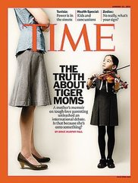
Language Points
21. compassionate (Para. 8): adj. feeling or showing sympathy for people who are suffering
She was not just responding to the Tiger Mother, she was speaking in defense of all sensible, rational, compassionate Chinese mothers.
她用让他感兴趣的问题和富有同情心的回应向他展示她的爱。
She shows her love for him with interesting questions and compassionate responses.

Slide 49
Language Points
22. They dismiss as meaningless anything about higher learning that doesn’t center on training someone to do a task that would make them money. (Para. 10)
[Paraphrase]:
They think that any college learning that does not focus on training students to make money is meaningless.

Slide 50
Language Points
23. dismiss as (Para. 10): to treat as unworthy of
serious consideration
Don’t be discouraged if what you produce initially is something other people dismiss as a toy.
这些症状太普通模糊了，很多女人和医生都认为不用在意。
These symptoms are so common and vague that many women and doctors often dismiss them as unimportant.

Slide 51
Language Points
24. buck the trend (Para. 11): to be noticeably different from the way that a situation is developing generally
We wanted to buck the trend and go beyond what’s expected by today’s business standards.
一两家公司在经济衰退中成功逆袭。
One or two companies have managed to buck the trend of the recession.

Slide 52
Language Points
25. If we are to understand what our subjects did that enabled them to fashion such highly productive and creative lives, we must appreciate why they valued a broad education before specializing in one or two fields. (Para. 11)
[Paraphrase]:
If we want to know how our courses helped our subjects (students) become so productive and creative in their life, we must first understand why they wished to pursue a liberal education before narrowing their focus to their specific fields.

Slide 53
Language Points
26. To grow on the ideas and creations of others, we must encounter them, and to do so, we must explore the great works of the mind found in the arts, sciences, mathematics, philosophies, and historical perspectives. (Para. 12)
[Paraphrase]:
To take full advantage of the ideas and creations of others, we must first meet them, and in order to meet them, we must first read great works in such fields as arts, sciences, mathematics, philosophies, and history.

Slide 54
Language Points
27. The world of ideas and scholarship becomes our oyster, and the possibilities become almost unlimited, at least as large as all of human endeavor and achievement throughout history. (Para. 12)
[Paraphrase]:
We come to feel at home with the great ideas and creations of the world, which give us freedom to roam in a nearly unlimited range of fields or areas, to the extent that humans have ever explored throughout history.

Slide 55
Language Points
28. endeavor (Para. 12): n. earnest and industrial effort
We cannot succeed in this endeavor alone, but we can play a leading role.
人类的努力有没有可能阻挡命运的潮流呢？
Is human endeavor likely to turn back the tides of fate?

Slide 56

Language Points
29. stimulate (Para. 13): v. to make sth. develop or become more active; to encourage sth.
Governments are being urged to take “coordinated action” to stimulate their economies by boosting spending.
你的鼓励将激励我继续努力。
Your encouragement will stimulate me to further efforts.

Slide 57
Language Points
stimulus: n. sth. that encourages an activity 刺激
Light is a stimulus to growth in plants. 光可刺激植物生长。
stimulating: adj. rousing or quickening activity or the senses 刺激的
The positive side of this pressure is that it can be highly stimulating.
这种压力值得肯定的一面在于它可以非常有激励作用。

Slide 58
Language Points
stimulant: n. a drug that makes your body work faster, often increasing your heart rate and making you less likely to sleep 兴奋剂
Sharapova is the most prominent tennis player to test positive for a banned stimulant in recent years.
莎拉波娃是近年来接受违禁兴奋剂检测呈阳性的网球运动员中最出色的一位。
stimulant: adj. stimulating
Musk is used in medicine for its stimulant quality.
麝香由于有兴奋剂的特性而被应用于医学。

Slide 59
Language Points
30. in terms of (Para. 14): with regard to; with reference to
After all, our privacy and security on these sites — in terms of how much we share with others and what we consume — is ultimately up to each of us.
不要从做什么的角度，而是要从什么时候做的角度来考虑你的重点。
Think of your priorities not in terms of what activities you do, but when you do them.

