Slide 1
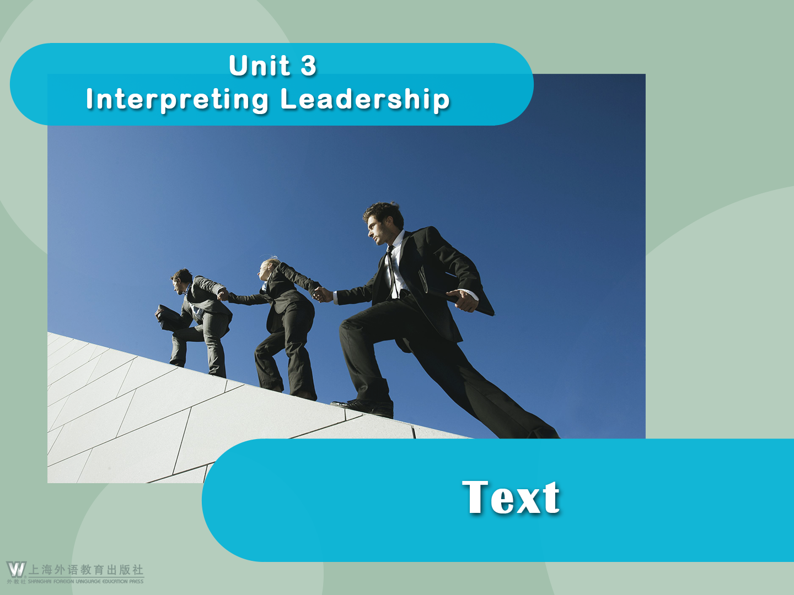

Slide 2





Leadership and the Art of Struggle
Leadership and the Art of Struggle
Steven Snyder
1 The Steve Jobs who emerged two decades later to deliver the 2005 Stanford University commencement address was a very different person. He had confronted his struggles, personal and professional, and had navigated through a number of challenges. He was on his way to becoming one of the most influential leaders of our time. Even though he died tragically young in 2011, his life is a testament to personal growth, leadership development, and human potential.

Slide 3

Leadership and the Art of Struggle
Not only did Jobs push the boundaries of what was considered possible, he radically changed our thinking about leadership and innovation.
He maximized his own contribution, left us wondering what more might have followed, and inspired us to see the benefits of shifting our perspective and thinking in new ways. Through his struggles Jobs had redefined his purpose in life and transformed his leadership energies in service to this core purpose.

Slide 4

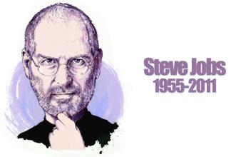
Leadership and the Art of Struggle
2 Steve Jobs was not a perfect man or a perfect leader. He was a leader who struggled, like all of us, and whose life and leadership illustrated the developmental metamorphosis that is available to us all.

Slide 5

Leadership and the Art of Struggle
3 Leadership is often a struggle. Yet societal taboos often prevent leaders from talking openly and honestly about their struggles for fear of being perceived as ineffective and inadequate. Social mores reinforce the myth that leaders are supposed to be perfect and that struggle is a sign of weakness and a source of shame. It is hard to keep these societal views in perspective, especially when facing significant challenges. This cultural programming, learned over many years, becomes ingrained, causing some leaders to lose their confidence and doubt their abilities, thinking something is wrong with them.

Slide 6

Leadership and the Art of Struggle
4 The best leaders learn to sidestep these unrealistic expectations by accepting themselves for who they are today while continually striving to be better tomorrow. These individuals come to understand that struggle is a natural part of leadership and that it is often the struggle itself that unlocks the potential for the greatest growth. Instead of denying the struggle or feeling diminished by it,
they learn to embrace it as an art to be mastered. Consequently, they develop skills, capabilities, and practices that help them cope with challenge and adversity.

Slide 7

Leadership and the Art of Struggle
5 Everyone is at their own unique stage in the leadership continuum and in their mastery of the art of struggle. Some leaders, especially those who are just starting out, may not be aware that their behavior is counterproductive. They have no self-regulatory mechanism, no brakes. Some are so oblivious that they just plunge ahead until they run into a brick wall. They have no awareness of how their own choices and blind spots get them into trouble, and they blame others for their misfortune.

Slide 8

Leadership and the Art of Struggle
6 Some continue to repeat the same mistakes over and over. They go from one job to another, acting out the same patterns, reenacting the same scripts. As these scripts play out, they produce the same predictable, unsatisfactory results. Yet they lack the insight to connect the dots between their own unenlightened behavior and the unfavorable outcomes they grumble about.

Slide 9

Leadership and the Art of Struggle
7 Great leaders use failure as a wake-up call. Instead of blaming others, they seek out the counsel of a mentor and/or turn their attention inward for reflection and introspection. They become aware of how their own behavior and practices contribute to undesirable outcomes and resolve to break from past habits, to begin anew. The next time they encounter the same constellation of circumstances, they try a different approach. Choosing a new script frees them from the prison of stale thinking and unproductive behavior and leads to an understanding of how they can work with others to achieve some larger purpose or mission.

Slide 10

Leadership and the Art of Struggle
8 As these awakened individuals advance on their leadership journey, they gradually view themselves and their role as leaders in fundamentally different ways than they did earlier in their careers. They reach a place where they view leadership as an enriching, deeply human experience. They derive happiness and fulfillment from not only their successes but also the intrinsic nature of the journey itself.

Slide 11

Leadership and the Art of Struggle
9 Fulfilling your potential as a leader requires that you think differently about leadership. You must recast your struggles as positive learning experiences and view them as necessary steps in your development as a leader. You must look at struggles through an entirely different lens. This is the Struggle Lens View.

Slide 12

Leadership and the Art of Struggle
10 Although the Struggle Lens was initially focused on fictional characters, its power can be fully leveraged by using it to probe real stories of actual leaders. To that end I asked numerous corporate, nonprofit, and government leaders to recall and describe a time of great struggle in their professional careers. Rather than predefine for them what struggle was, I allowed their unique narratives to guide my inquiry.

Slide 13

Leadership and the Art of Struggle
11 From 151 struggle examples covering a variety of challenging situations, a distinct pattern emerged. I saw that three fundamental conditions, or defining elements, were at the heart of every episode:
● Change plays a prominent role in leadership struggle.
● This change creates a natural set of tensions.
● The tensions throw the leader off balance.

Slide 14

Leadership and the Art of Struggle
12 Many of these real-world struggle stories turned out well. Some did not. Outcomes were influenced largely by how effectively leaders channeled their energies to accept and embrace change and adaptively engage in the struggle. Even in the stories that ended badly, there was much learning to be gained; failures often proved to be catalysts for future growth.

Slide 15

Language Points
1. confront (Para. 1): v. to deal with a problem or difficult situation
What is required now for this country is to be united, confront boldly the challenges, and take responsibility for our future once more.
我们太害怕了而不愿面对这样的事实。因为这样做就意味着会面临这种危险，即我们所一直相信的有可能是错的。
We are too frightened to confront the facts, for doing so means confronting the danger that what we have long believed might be wrong.

Slide 16
Language Points
confrontation: n. ~ (with sb.) ~ (between A and B)
a situation in which there is an angry disagreement between people or groups who have different opinions 对抗；对峙；冲突
The Western and Oriental values are found to be in confrontation in learning English.
分析人士说这种举措存在着与朝鲜发生直接冲突的风险。
Analysts say the move runs the risk of a direct confrontation with North Korea.

Slide 17
Language Points
2. navigate (Para. 1): v. to find the right way to deal with a difficult or complicated situation
Institutions that succeeded in helping students navigate the difficult job market improved their standings the most.
要想在人生的长河中顺利航行，一种方法就是拥有开阔的心胸。
Having an open mind is one way to navigate successfully through the long days in one’s life.

Slide 18
Language Points
3. Not only did Jobs push the boundaries of what was considered possible, he radically changed our thinking about leadership and innovation. (Para. 1)
[Paraphrase]:
Jobs has not only broadened our idea of what can be achieved, but also completely changed our way of looking at leadership and innovation.

Slide 19
Language Points
3. Not only did Jobs push the boundaries of what was considered possible, he radically changed our thinking about leadership and innovation. (Para. 1)
[Analysis]:
The inversion led by “not only” is used in this sentence to emphasize the contribution of Jobs.
[Translation]:
乔布斯不仅将可以做的事情推向了新的高度，还彻底改变了我们对于领导力和创新精神的看法。

Slide 20
Language Points
4. He maximized his own contribution, left us wondering what more might have followed, and inspired us to see the benefits of shifting our perspective and thinking in new ways. (Para. 1)
[Paraphrase]:
His contribution was so great that we were left speculating about what more could be achieved. His great achievement also made us understand the benefits of looking at things in new or different ways.

Slide 21
Language Points
4. He maximized his own contribution, left us wondering what more might have followed, and inspired us to see the benefits of shifting our perspective and thinking in new ways. (Para. 1)
[Analysis]:
A parallel structure is used in this sentence to emphasize influences of Jobs’ contribution.

Slide 22
Language Points
4. He maximized his own contribution, left us wondering what more might have followed, and inspired us to see the benefits of shifting our perspective and thinking in new ways. (Para. 1)
[Translation]:
他的个人贡献已达极限，我们几乎不知道在他之后还能再做些什么，这也激发我们明白了转变观念、创新思维带来的各种裨益。

Slide 23
Language Points
5. maximize (Para. 1): v. to increase sth. as much as possible
So when you take responsibility for your life, you give yourself the opportunity to maximize your potential.
当他了解这些优势及劣势后，他就能想办法将优势最大化而把劣势降到最低。
When he knows those positives and negatives he can find a way to maximize the positives and minimize the negatives.

Slide 24
Language Points
maximum:
adj. as large, fast, etc. as is possible, or the most that is possible or allowed
n. the greatest amount, size, speed, etc. that is possible, recorded or allowed
The main governing body is the Board consisting of a maximum of eight members who are elected by the General Assembly.
A third offense would be charged by a maximum $1,000 fine and a year’s jail time.

Slide 25
Language Points
Antonyms:
minimize: v. to reduce sth., especially sth. bad, to the lowest possible level
minimum: n. adj. the smallest that is possible or allowed; extremely small
People who are really efficient seem to do things easily, with a minimum of effort. In so doing they release maximum power.

Slide 26
Language Points
The company is trying to minimize the cost of production.
本公司保证员工的月工资将不低于当地政府规定的最低工资。
Our company will ensure that the monthly salary of the employee is not less than the minimum pay standard set by the local government.

Slide 27
Language Points
6. shift (Para. 1): v. to change your opinion of or attitude towards sth., or change the way that you do sth.
This change was to try to shift more value back to the market.
要让人们转变对这件事情的看法，可能需要十年，甚至更长的时间。
It would take a decade, maybe longer, to be able to shift people’s thoughts on this issue.

Slide 28
Language Points
7. illustrate (Para. 2): v. to make the meaning of sth. clearer by using examples, pictures, etc.
The best speeches include a clear, relevant message and a few great stories to illustrate it.
医学上最新的重大突破也许能解释这个观点。
The latest major breakthrough in medicine may be able to illustrate this point of view.

Slide 29

Language Points
illustration: n. the process of illustrating sth.; a story, an event or an example that clearly shows the truth about sth.
Despite the detailed illustration of this point, many students failed to comprehend it.
这是蝴蝶效应的一个实例。
This was an illustration of the butterfly effect.

Slide 30
Language Points
8. available (Para. 2): adj. (of things) that you can
get, buy or find
When you do go out, look for available deals and discounts.
这些病例并不总能通过外科手术治愈，当前还没有相应的医学治疗方法。
These cases are not always treatable with surgery and there is currently no medical treatment available.

Slide 31
Language Points
9. perceive (Para. 3): v. to understand or think of sb./sth. in a particular way
Some shoppers are not accustomed to what they perceive as additional costs in online shopping.
在我认为是消极的思想，可能在其他人看来是很自然的。
What I perceive as a negative thought may be something natural for somebody else.

Slide 32
Language Points
10. Social mores reinforce the myth that leaders are supposed to be perfect and that struggle is a sign of weakness and a source of shame. (Para. 3)
[Paraphrase]:
Social conventions make people even more mistakenly think that leaders should be faultless and that engaging in struggles is weak and shameful.

Slide 33
Language Points
10. Social mores reinforce the myth that leaders are supposed to be perfect and that struggle is a sign of weakness and a source of shame. (Para. 3)
[Analysis]:
Two appositive clauses modifying the word “myth” help to clarify what has been generally claimed about leaders.
[Translation]:
社会习俗更是强化了这种误解，人们认为领导者应该是完美的，挣扎是软弱的标志，是耻辱的根源。

Slide 34
Language Points
11. reinforce (Para. 3): v. to make a feeling, an idea, etc. stronger
This activity was made to reinforce the concept that the company owns you and your time.
如果我们加强交通安全教育，更多的人能遵守交通规则，我相信交通意外总有一天能得到避免。
If we reinforce the traffic security education and more people comply with traffic regulations, I believe one day traffic accidents can be avoided.

Slide 35
Language Points
Differences among:
aggravate reinforce increase strengthen intensify
aggravate: to make an illness or a bad or unpleasant situation worse
reinforce: to make a feeling, an idea, etc. stronger
increase: to become or to make sth. greater in amount, number, value, etc.
strengthen: to become stronger; to make sb./sth. stronger
intensify: to increase or make sth. increase in degree or strength; to become more intense or intensive

Slide 36
Language Points
Complete the following sentences with one of the above five expressions.
aggravated
1) I hurt my foot, then __________ it by trying to walk too soon.
strengthens
2) Competition, they believe, ___________ the national character rather than corrupt it.
intensify
3) The wind seemed to ________ the freezing cold in winter.
reinforce
4) Newspapers like this tend to _________ people’s prejudices.
increased
5) The number of people has been __________.

Slide 37
Language Points
12. This cultural programming, learned over many years, becomes ingrained, causing some leaders to lose their confidence and doubt their abilities, thinking something is wrong with them. (Para. 3)
[Paraphrase]:
As a result of so many years’ accumulation, this cultural misconception becomes deep-rooted. Therefore, some leaders become discouraged and question their own abilities, believing there is something wrong with themselves.

Slide 38
Language Points
12. This cultural programming, learned over many years, becomes ingrained, causing some leaders to lose their confidence and doubt their abilities, thinking something is wrong with them. (Para. 3)
[Analysis]:
The past participle phrase “learned ...” serves as an adverbial indicating cause; the present participle phrase “causing ...” functions as an adverbial indicating result of the fact; the other present participle phrase “thinking ...” is a further explanation of some leaders.

Slide 39
Language Points
12. This cultural programming, learned over many years, becomes ingrained, causing some leaders to lose their confidence and doubt their abilities, thinking something is wrong with them. (Para. 3)
[Translation]:
这些文化定势日积月累，已经变得根深蒂固，致使一些领导者丧失自信，怀疑自己的能力，觉得自身存在缺陷。

Slide 40

Language Points
13. sidestep (Para. 4): v. to avoid answering a question or dealing with a problem
The G20 appeared to offer room for countries to sidestep criticism.
夫妻间只要不打开潘多拉盒子，就能更容易避免一场大的争吵。
It’s easier for a couple to sidestep a huge argument by not opening that Pandora’s box.

Slide 41
Language Points
14. diminish (Para. 4): v. to make sb./sth. seem
less important than they really are
His constant attempts to diminish his colleagues’ achievements eventually led to his dismissal.
随着大金融机构的出现，小机构则变得越来越无足轻重了。
With the appearance of bigger financial institutions, the role of smaller institutions will diminish.

Slide 42
Language Points
15. adversity (Para. 4): n. a difficult or unpleasant
situation
Growth, honor, and the ability to overcome adversity are important factors in our life.
在顺境中朋友结识了我们，在逆境中我们了解了朋友。
In prosperity our friends know us; in adversity we know our friends.

Slide 43
Language Points
adverse: adj. negative and unpleasant; not likely to produce a good result
Financial crisis and measures to combat its adverse effects were an important topic during the meeting.
植入体内的任何东西总有产生不良反应的可能性。
There’s always the possibility of an adverse reaction to anything placed inside the body.

Slide 44
Language Points
16. act out (Para. 6): to act a part in a real situation
All his life he is devoted to acting out his beliefs.
政府决定将这一政策实施下去。
The government has decided to act out this policy.

Slide 45
Language Points
17. play out (Para. 6): to act the whole of a drama; to enact a scene or role
As I see it, there are four ways the European crisis could play out (and it may play out differently in different countries).
即使当事件如预期上演时，市场的反应并不像很多人预期的那样。
Even when events play out as predicted, the markets haven’t responded the way many had expected.

Slide 46
Language Points
18. Yet they lack the insight to connect the dots between their own unenlightened behavior and the unfavorable outcomes they grumble about. (Para. 6)
[Paraphrase]:
But they are not wise enough to see the internal relationship between their own unwise behavior and the unfavorable outcomes they complain about.
[Translation]:
然而他们缺乏见识，无法洞察其愚昧无知的行为与不尽人意的结果之间的内在联系，却还对结果抱怨不休。

Slide 47
Language Points
19. insight (Para. 6): n. the power of using one’s mind to see or understand the true nature of a situation
The book gives an insight into how women from different parts of the world see things.
你所需要的就是洞悉人物，去倾听他的声音。
All you needed was an insight into character and an ear for the character’s speech.
insightful: adj. showing a clear understanding of a person or situation
Some questions are pointless and groundless while some are worth analyzing or really insightful.

Slide 48

Language Points
20. grumble (Para. 6): v. to complain about sb./sth. in a bad-tempered way
For myself I do not grumble, for I am one of the lucky ones.
即使那些抱怨社交网站的人也承认，他们的生活已经离不开这些网站。
Even some of those who grumble about social websites admit they could never live without them.

Slide 49
Language Points
21. seek out (Para. 7): to look for and find sb./sth., especially when this means using a lot of effort
You should seek out those things you can get passionate about and use them to create excellence in your life.
投资者们努力寻找有创新精神的公司，能在全球化竞争中创造和获得价值。
Investors seek out innovative companies that can create and capture value in the face of global competition.

Slide 50
Language Points
22. contribute to (Para. 7): to be one of the causes of sth.
It’s important to understand what businesses will contribute to the future growth of the company.
他们也能促进不同文化间的对话，由此推进和平和持续发展。
They can also contribute to dialogue among cultures, thereby promoting peace as well as sustainable development.
contribution: n. an action or a service that helps to cause or increase sth.
make contribution to:
Despite being the captain, he didn’t make much contribution to the team.

Slide 51
Language Points
23. Choosing a new script frees them from the prison of stale thinking and unproductive behavior and leads to an understanding of how they can work with others to achieve some larger purpose or mission. (Para. 7)
[Paraphrase]:
Taking a new approach helps them to break away from the old-fashioned way of thinking and fruitless behavior. They can then figure out how they can cooperate with others to reach larger goals and accomplish more.
[Translation]:
选择全新的剧本使他们获得解脱，不再受到陈腐思想和徒劳行为的束缚，并让他们认识到怎样与他人共事才能达成更大的目的，或完成更大的使命。

Slide 52
Language Points
24. They derive happiness and fulfillment from not only their successes but also the intrinsic nature of the journey itself. (Para. 8)
[Paraphrase]:
Their happiness and sense of achievement come not only from their successes but also from the process of striving for them.
[Translation]:
他们的幸福感和成就感不仅来自于成功，更来自于这个过程的内在特征。

Slide 53
Language Points
25. fulfillment (Para. 8): n. the achievement of sth. desired; happiness or satisfaction as a result of fully developing one’s potential
Visiting that palace was the fulfillment of his dream.
他们最珍惜的不是金钱，而是成就感。
It is not the money but the fulfillment that they cherish most.

Slide 54
Language Points
26. recast (Para. 9): v. to change sth. by organizing or presenting it in a different way
In the last decade, Brazil has recast itself as a global brand and a global power.
但过去几十年印度和中国的崛起已重新改写这场争论。
But the rise of India and China over the last few decades has recast this debate.

Slide 55
Language Points
27. to that end (Para. 10): in order to achieve this
Students are seeking new marketable job skills and community colleges offer a viable means to that end.
为实现这一目标，星期四晚上，奥巴马总统公布了刺激美国经济的方案。
To that end, on Thursday night, President Barack Obama unveiled his plan to stimulate the US economy.

Slide 56
Language Points
28. Rather than predefine for them what struggle was, I allowed their unique narratives to guide my inquiry. (Para. 10)
[Paraphrase]:
I didn’t define the term “struggle” in advance; rather, I let them describe their own unique understandings and experiences of struggle. And my investigation just followed their description.

Slide 57
Language Points
28. Rather than predefine for them what struggle was, I allowed their unique narratives to guide my inquiry. (Para. 10)
[Analysis]:
The expression “allowed … to guide my inquiry” is used here to indicate that the author gave the initiative to the narrators in defining the term “struggle”.

Slide 58
Language Points
28. Rather than predefine for them what struggle was, I allowed their unique narratives to guide my inquiry. (Para. 10)
[Translation]:
我没有预先定义“抗争”，而是任由他们各自的叙述来引导我的调查。

Slide 59
Language Points
29. inquiry (Para. 10): n. a process to find out the cause of sth. or information about sth.
Soon after, I made a confidential inquiry as to how and when this accident happened.
道森相信，她与这个调查领域的个人联系给了她独特的洞察力。
Dawson believes her personal connection to this field of inquiry gives her unique insights.

Slide 60
Language Points
30. distinct (Para. 11): adj. easily or clearly heard,
seen, felt, etc.
He noticed the distinct note of annoyance in her words.
房间里尼古丁的气味随处可闻。
There was a distinct smell of nicotine in the room.
distinctive: adj. having a quality or characteristic that makes sth. different and easily noticed
One of the most distinctive human characteristics is the ability to understand and use symbols.

Slide 61
Language Points
31. Outcomes were influenced largely by how effectively leaders channeled their energies to accept and embrace change and adaptively engage in the struggle. (Para. 12)
[Paraphrase]:
The way leaders managed to willingly accept change and actively participate in the struggle would, to a large extent, shape the outcomes.
[Translation]:
影响结局的因素主要是领导者如何有效地引导自己花精力来接受改变，抱着努力适应的态度投入抗争。

